Slide 1
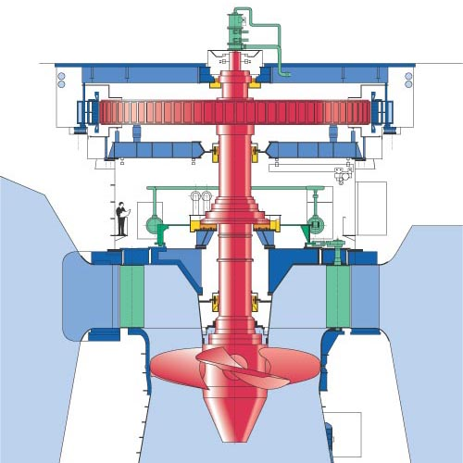
Kaplan Turbine
P M V Subbarao
Professor
Mechanical Engineering Department
Pure Axial Flow with Aerofoil Theory….

Slide 2
The Fast Machine for A Low Head
U_{b}
V_{wi}
V_{ri}
V_{fi}
V_{ai}
U_{b}
Vwi
V_{fi}
V_{ai}
V_{ri}

Slide 3
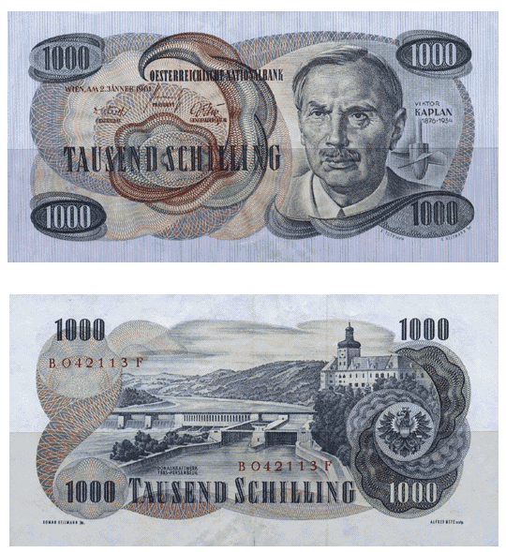

Slide 4
Kaplan Turbine
The kaplan turbine is a great development of early 20th century.
Invented by Prof. Viktor Kaplan of Austria during 1913 – 1922.
The Kaplan is of the propeller type, similar to an airplane propeller.
The difference between the Propeller and Kaplan turbines is that the Propeller turbine has fixed runner blades while the Kaplan turbine has adjustable runner blades.
It is a pure axial flow turbine uses basic aerofoil theory.
The kaplan's blades are adjustable for pitch and will handle a great variation of flow very efficiently.
They are 90% or better in efficiency and are used in place some of the old (but great) Francis types in a good many of installations.
They are very expensive.
The kaplan turbine, unlike all other turbines, the runner's blades are movable.
The application of Kaplan turbines are from a head of 2m to 40m.

Slide 5
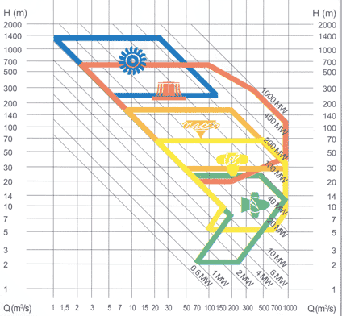
Francis to Kaplan

Slide 6
Major Kaplan Plants in Karnataka, India
S.No. | Station | No. Units × unit Size, MW | Design Head | Speed rpm | Design Discharge, Cumecs
1 | LPH | 2 × 27.5 | 29.5 | 200 | 101
2 | Kadra | 3 × 50 | 32.0 | 142.86 | 175.5
3 | Kodasalli | 3 × 40 | 37.0 | 166.67 | 123
4. | Almatti | 1 × 15 5 × 55 | 24.09 | 187.50 | 26.69 115.4

Slide 7
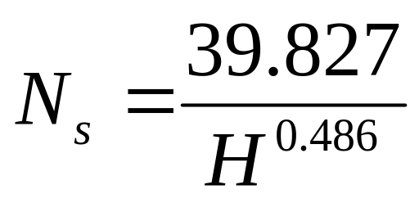
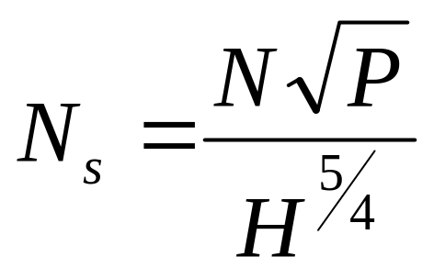
Specific Speed of Kaplan Turbine
Using statistical studies of schemes, F. Schweiger and J. Gregory established the following correlation between the specific speed and the net head for Kaplan turbines:
P in watts.

Slide 8
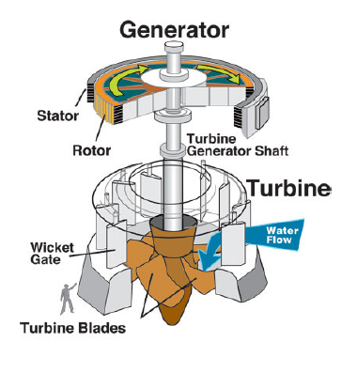
The Schematic of Kaplan Turbine

Slide 9
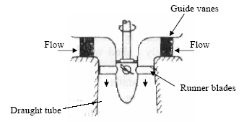

Major Parts of A Kaplan Turbine

Slide 10
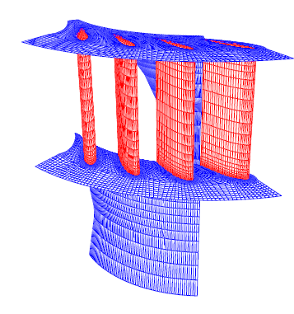
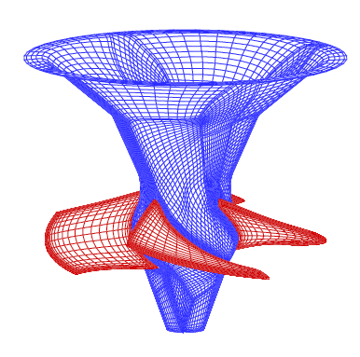
Superior Hydrodynamic Features
Essential for High Efficiency at low Heads
Section of Guide Wheel
Runner

Slide 11
Classification of Kaplan Turbines
The Kaplan turbine can be divided in double and single regulated turbines.
A Kaplan turbine with adjustable runner blades and adjustable guide vanes is double regulated while one with only adjustable runner blades is single regulated.
The advantage of the double regulated turbines is that they can be used in a wider field.
The double regulated Kaplan turbines can work between 15% and 100% of the maximum design discharge;
the single regulated turbines can only work between 30% and 100% of the maximum design discharge.

Slide 12
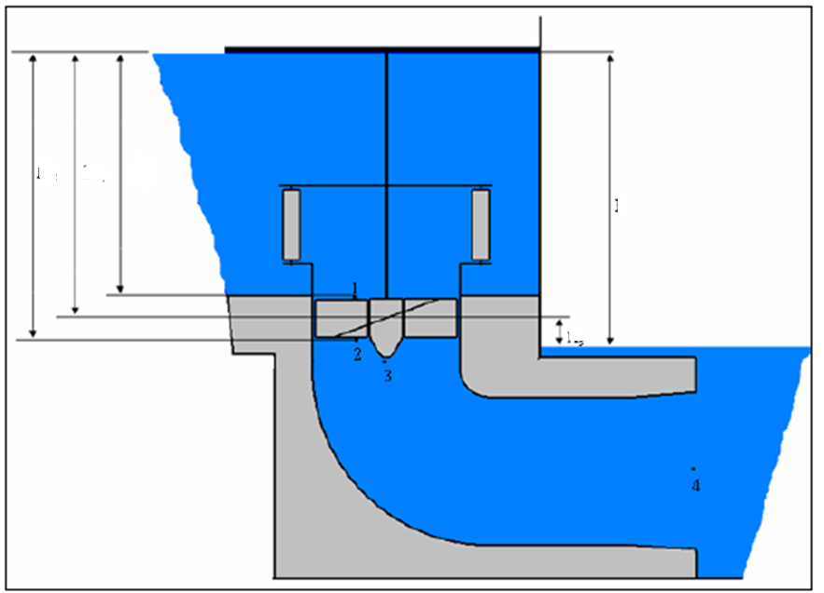
Hydraulic Energy Diagram
H_{m}
H_{ri}
H_{re}
H_{total}
H_{s}

Slide 13
CAVITATION
Cavitation occurs especially at spots where the pressure is low.
In the case of a Kaplan turbine, the inlet of the runner is quite susceptible to it.
At parts with a high water flow velocity cavitation might also arise.
The major design criteria for blades is : Avoid Cavitation.
First it decreases the efficiency and causes crackling noises.
The main problem is the wear or rather the damage of the turbine’s parts such as the blades.
Cavitation does not just destroy the parts, chemical properties are also lost.

Slide 14
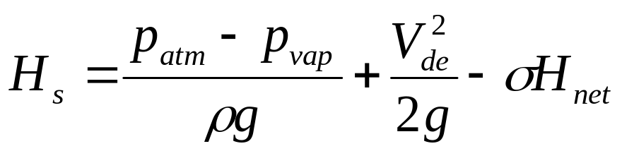
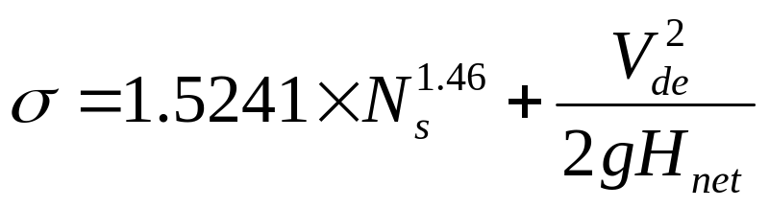
The suction head
The suction head H_{s} is the head where the turbine is installed;
if the suction head is positive, the mean line of turbine is located above the trail water;
if it is negative, the mean line of turbine is located under the trail water.
To avoid cavitation, the range of the suction head is limited.
The maximum allowed suction head can be calculated using the following equation:

Slide 15
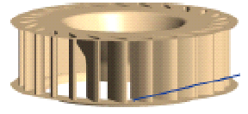
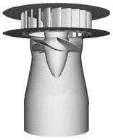
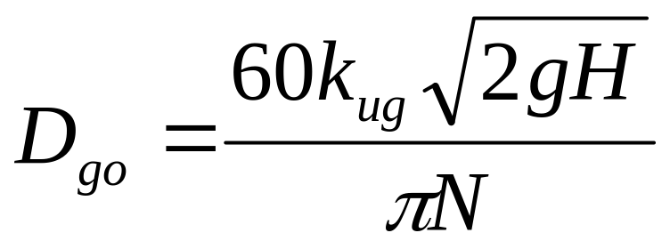
Design of Guide Wheel
D_{go}
k_{ug} 1.3 to 2.25 : Higher values for high specific speeds
Number of guide vanes : 8 to 24 : Higher number of vanes for large diameter of guide wheel.

Slide 16
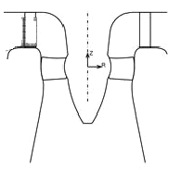
Outlines of Kaplan Runner
a
b
Guide Vanes
Whirl Chamber
The space between guide wheel outlet and kaplan runner is known as Whirl Chamber.
a=0.13 D_{runner} & b=0.16 to 0.2 D_{runner}.

Slide 17
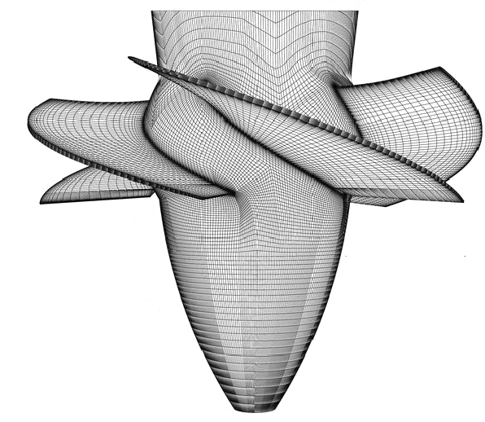
Design of Kaplan Runner
D_{runner}
D_{hub}

Slide 18
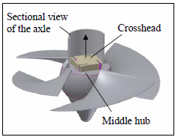
The Kaplan Runner

Slide 19
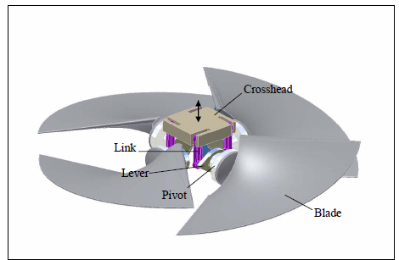
Adaptation Mechanism inside the Hub

Slide 20
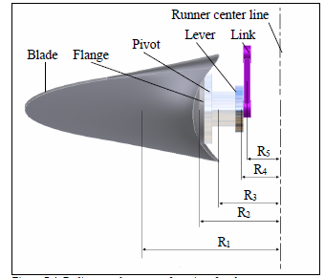
Inside the Hub

Slide 21
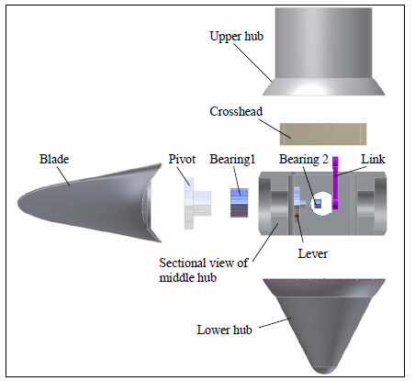
Parts of Runner

Slide 22
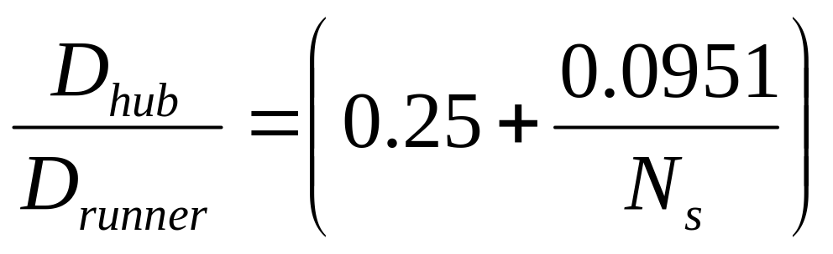
Hub diameter
The hub diameter D_{i} can be calculated with the following equation:

Slide 23
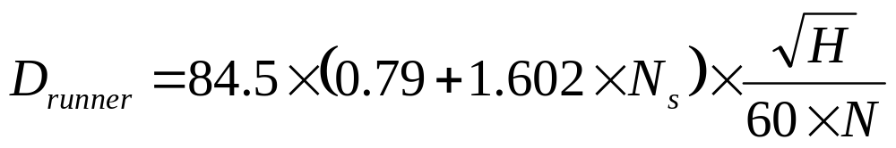
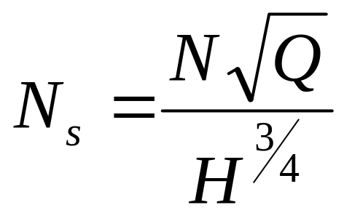
Runner diameter section
The runner diameter can be calculated by the following equation:

Slide 24
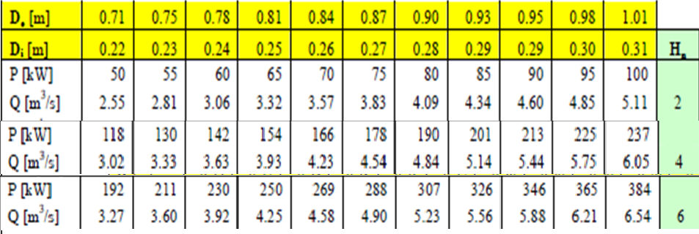
Generic Designs for Micro Hydel Plants

Slide 25
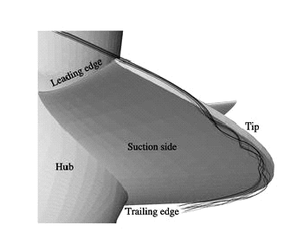
Hydrodynamics of Kaplan Blade

Slide 26
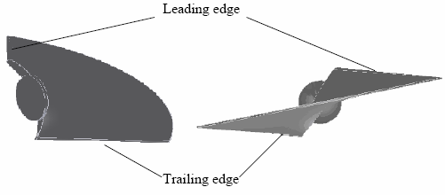
DESIGN OF THE BLADE
Two different views of a blade

