Slide 1
Final Project PPT
By Dhruv Khanna

Slide 2

Dataset Overview
The dataset comprises 700 rows and 16 columns, detailing sales and financial performance across various segments, countries, and products.
Key metrics include Units Sold, Sales, Profit, and Discounts, alongside categorical variables like Segment, Country, and Discount Band.
However, critical numeric columns, such as Sales and Profit, have significant missing data, which may limit insights.
The dataset provides a foundation for analyzing trends, profitability, and regional performance, but addressing missing data will be crucial for meaningful analysis. This data can help identify high-performing segments and inform strategic decisions.

Slide 3
Target Attribute: Profit
The target attribute "Profit" is a critical financial metric that measures the net financial gain for the company. Below are its key characteristics:
Definition: Profit is calculated as the difference between Sales (revenue after discounts) and COGS (Cost of Goods Sold). Profit=Sales−COGS\text{Profit} = \text{Sales} - \text{COGS}Profit=Sales−COGS
Nature: It is a continuous numeric variable representing monetary value (e.g., dollars).
Dependencies:
Influenced by Sales, which depends on factors like pricing and discount policies.
Directly impacted by COGS, reflecting production or procurement costs.
Indirectly affected by the Discount Band, as higher discounts can reduce profit margins.
Business Insights:
A positive profit indicates efficient cost and sales management.
Negative or low profits may highlight areas for improvement, such as pricing, discounts, or cost optimization.
Challenges: The Profit column has many complete missing values, making data imputation or alternative strategies essential for analysis.
Understanding and optimizing profit is vital for driving strategic decisions and improving overall business performance.

Slide 4
Problems in the Data
There are 66 outliers in the Profit column, which need to be addressed to ensure accurate analysis.
The Discounts column is stored as strings, like $-, making it unusable for calculations without cleaning.
I noticed redundancy in the Date, Month Number, and Month Name columns, which need validation for consistency.
There are potential outliers in Profit and Sales, which need further investigation to prevent skewed results.

Slide 5
Data Cleaning

Slide 6
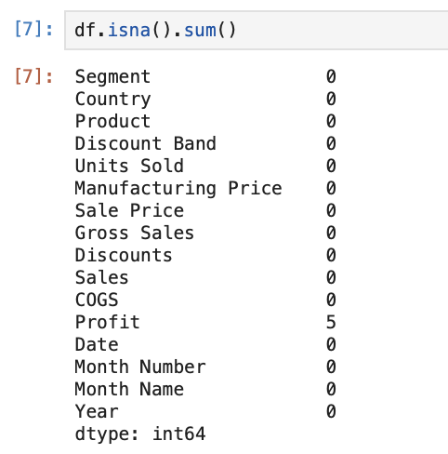
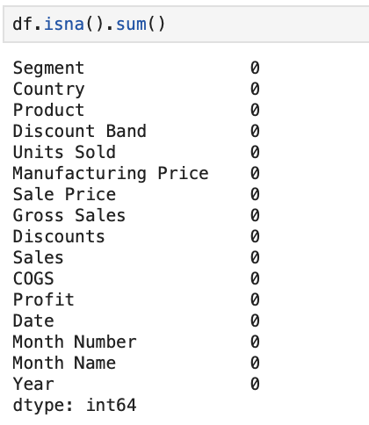

Missing Values
Before:
Code used
After:

Slide 7
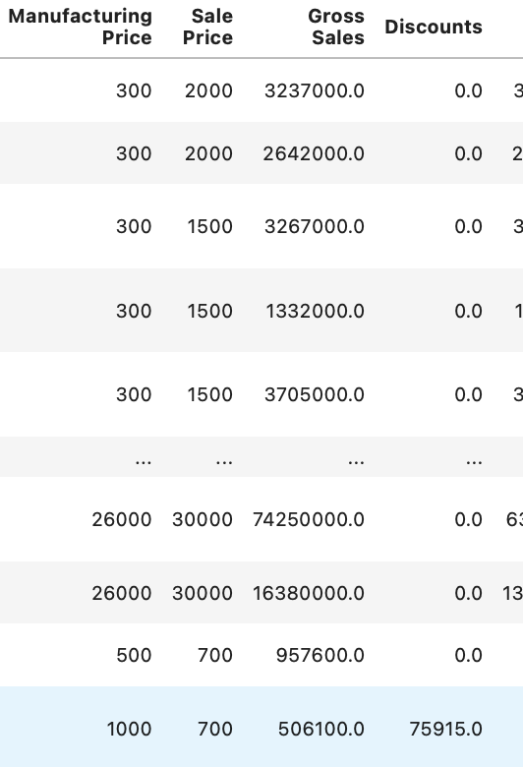
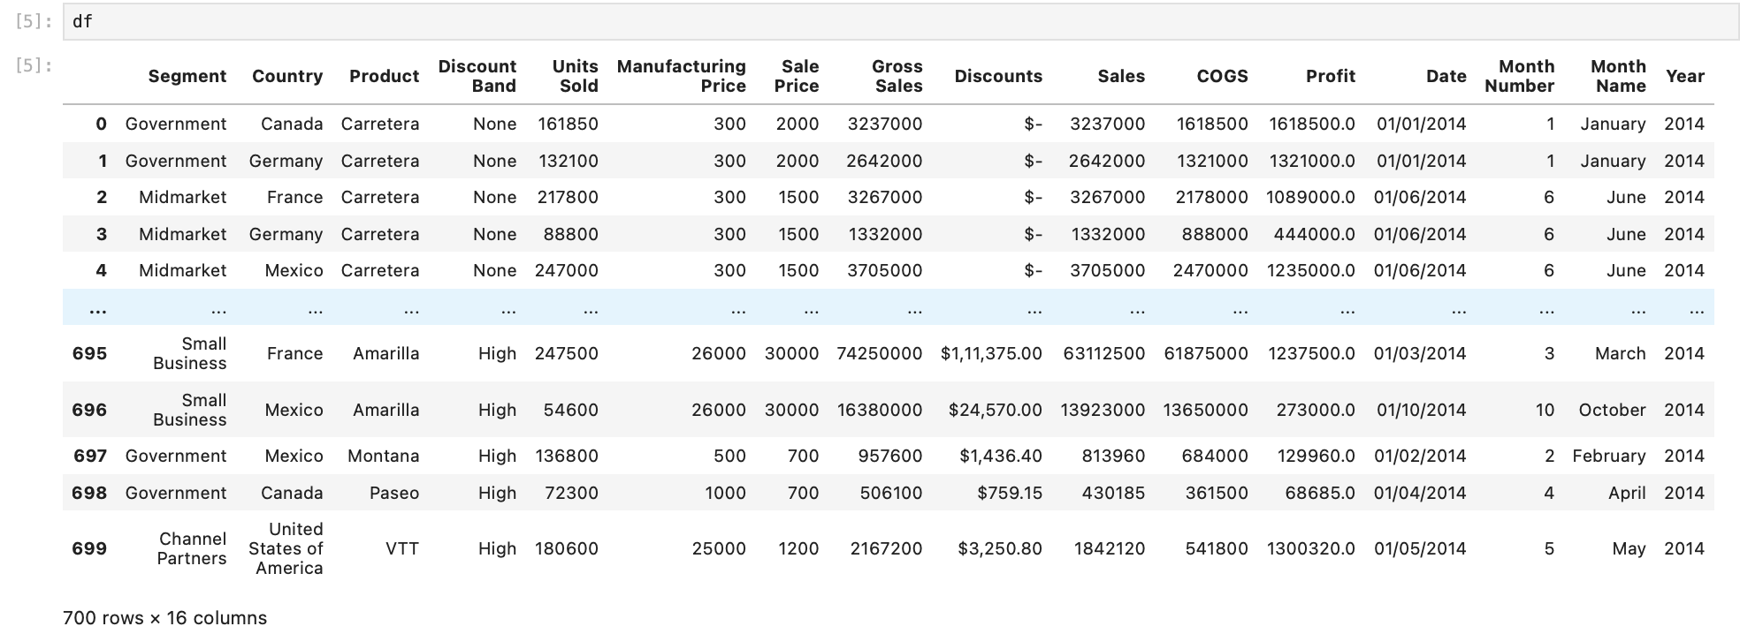
Data Mutation(Discount)
Discount has ‘$-’ df['Discounts']=df['Discounts'].str.replace('$','',regex=False)
This code was used to clean the data and
df.fillna(0, inplace=True) this code was used to fill the missing values
the output is on the right side

Slide 8
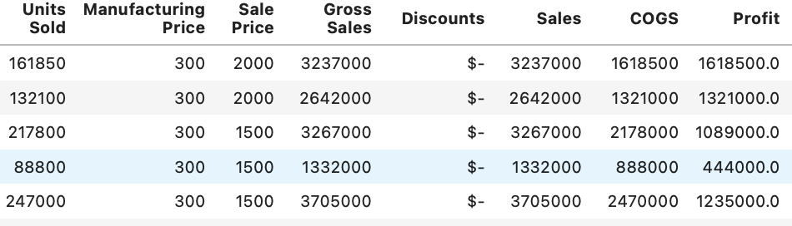
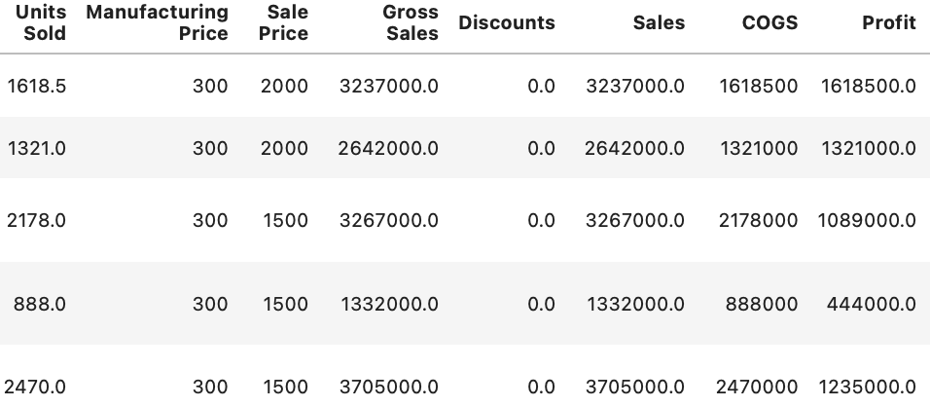
Data Mutation ( Decimal points)
Units sold, and discount are very odd figurers
and the numbers don’t make sense
For Correcting the decimal points this code was used
df['Discounts'] = df['Discounts'] * 100
df['Units Sold'] = df['Units Sold'] / 100
The output shows the data with correct numeric values
The units sold and sales now add up and make sense

Slide 9
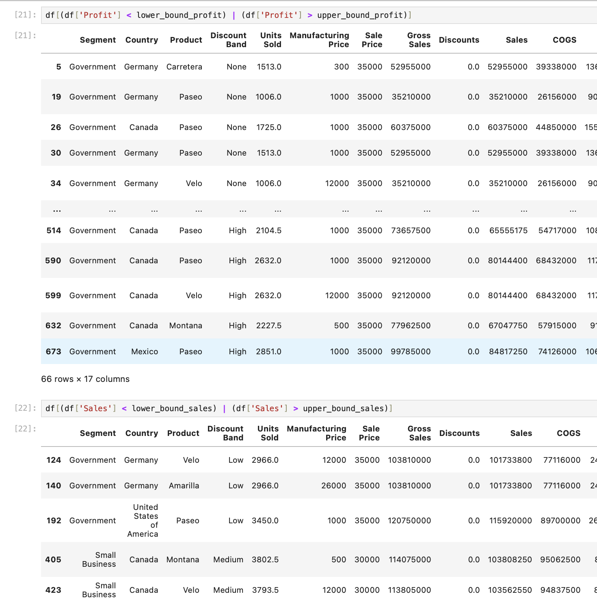
Handling Outliers
There were 2 main variables that had outliers
Profit with 66 outliers
Sales with 5 outliers
This code was used:
# Replace extreme outliers in Profit with the median
median_profit = df['Profit'].median()
df['Profit'] = np.where((df['Profit'] < lower_bound_profit) |
(df['Profit'] > upper_bound_profit),
median_profit,
df['Profit'])
# Replace extreme outliers in Sales with the median
median_sales = df['Sales'].median()
df['Sales'] = np.where((df['Sales'] < lower_bound_sales) |
(df['Sales'] > upper_bound_sales),
median_sales,
df['Sales'])
These were removed by using the IQR method

Slide 10

EXPLORATORY DATA ANALYSIS

Slide 11
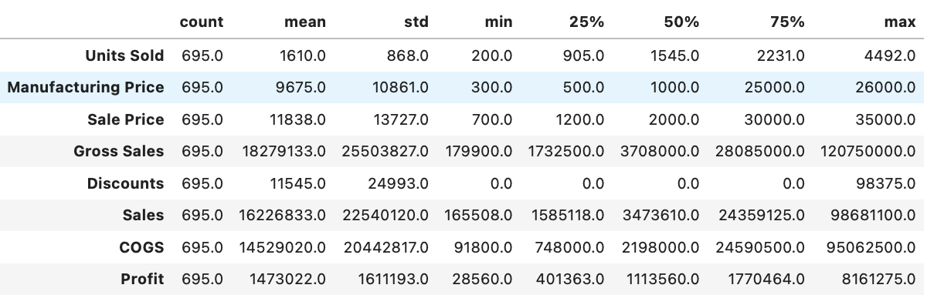
Descriptive Stats
Profit ranges from 28,560 to 8,161,275
Sale Price and Gross Sales exhibit high variability, with maximum values significantly exceeding the 75th percentile.
The Discounts column has a median and 25th percentile of zero, suggesting that most transactions had no discounts, but the maximum value reaches 98,375.
Manufacturing Price varies between 300 and 26,000, highlighting significant differences across products.
The count confirms 695 non-null entries for all variables, leaving 5 missing values in some columns.
This analysis reveals variability and potential outliers, emphasizing the need for careful handling during analysis.

Slide 12
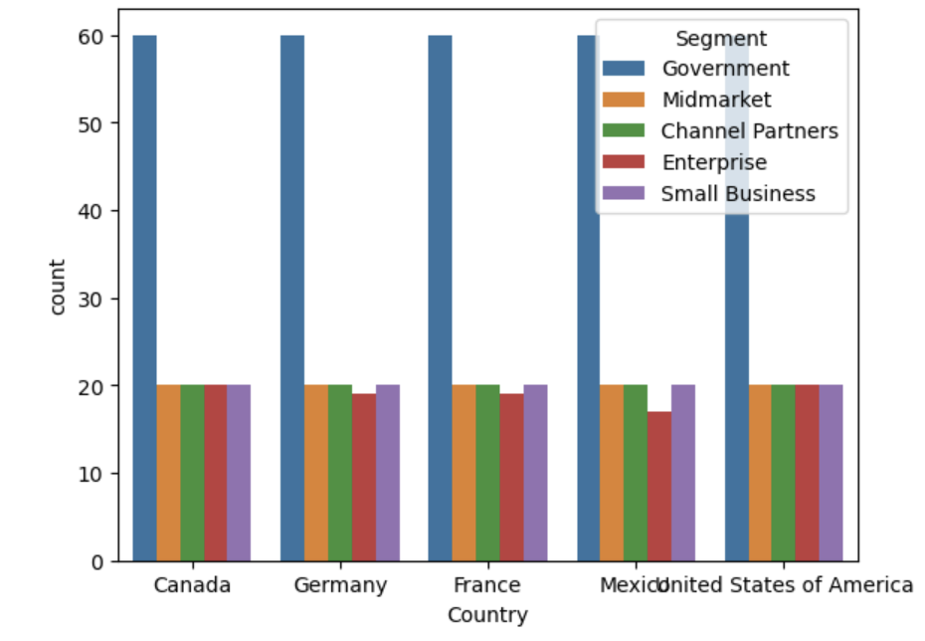
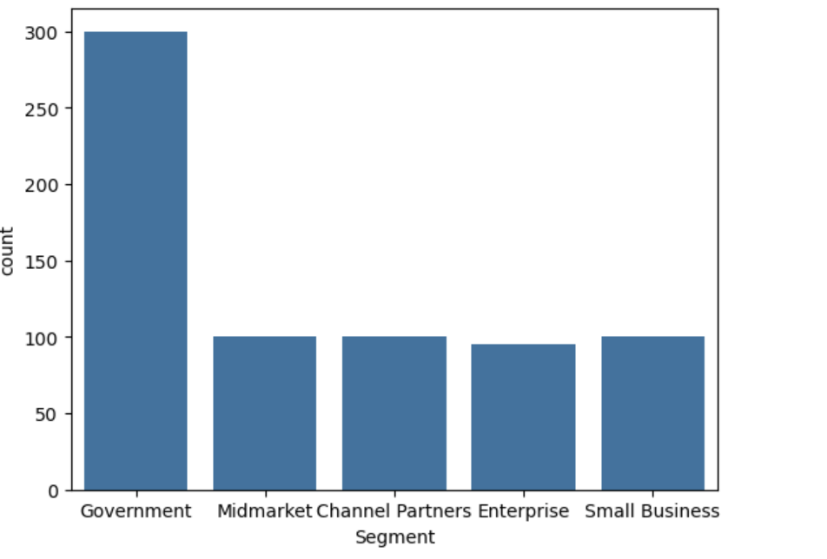
Categorical Varibales
Segment Distribution
The bar chart indicates that the Government segment dominates the dataset, accounting for nearly 300 entries.
Other segments, such as Midmarket, Channel Partners, Enterprise, and Small Business, are evenly distributed, with approximately 100 entries each.
The grouped bar chart compares segment distributions across countries.

Slide 13
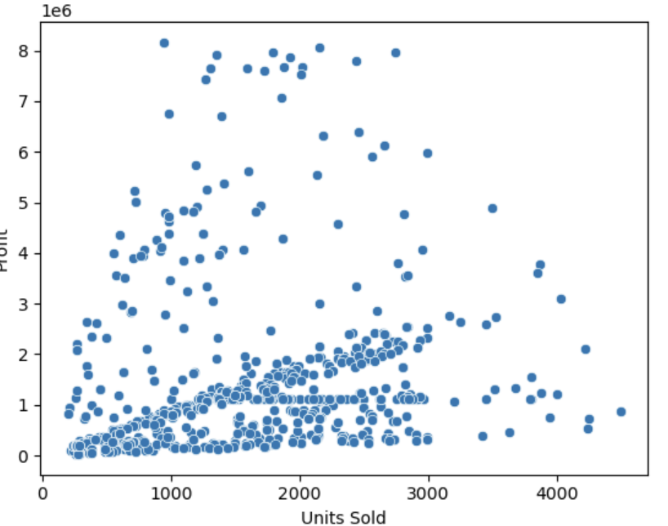
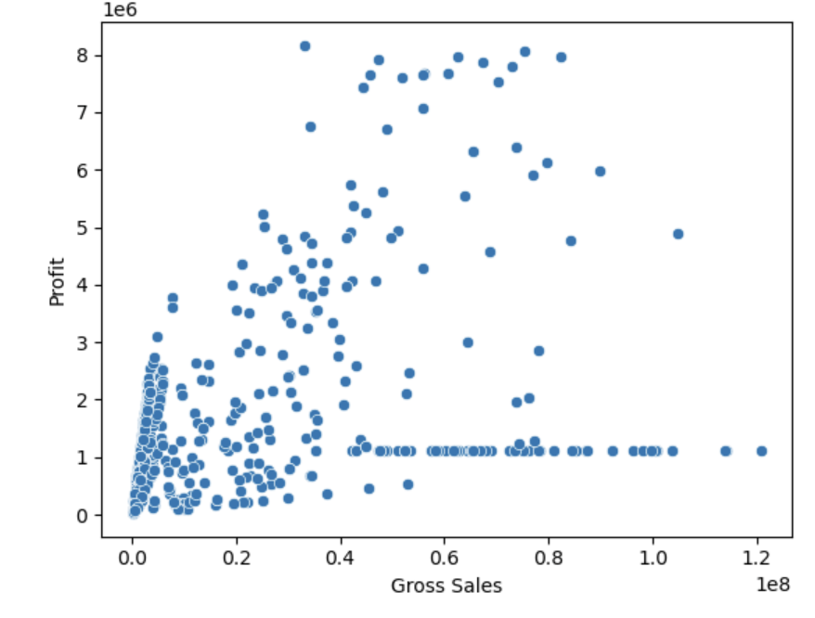
Profit v/s Units sold & Gorss Sales
Scatterplot: Profit vs. Units Sold
A positive relationship exists; higher units sold generally lead to higher profits.
Most data points are below 2,000 units sold and $2,000,000 in profit.
Outliers show high profits (up to $8,000,000) with relatively fewer units sold.
Variability suggests other factors like pricing or costs impact profit.
Scatterplot: Profit vs. Gross Sales
The plot shows a positive trend, where higher gross sales generally lead to higher profits.
Most data points are clustered below $20,000,000 in gross sales and $2,000,000 in profit.
Outliers are visible with profits exceeding $7,000,000, even at moderate gross sales.
The flat clusters suggest potential pricing or cost patterns influencing profitability independently of sales volume.

Slide 14
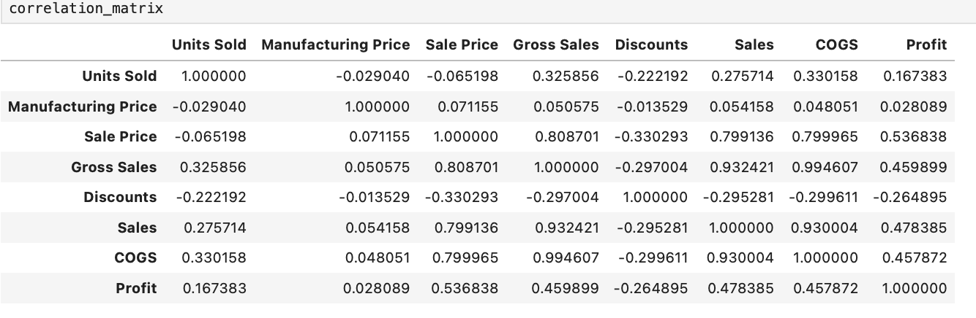
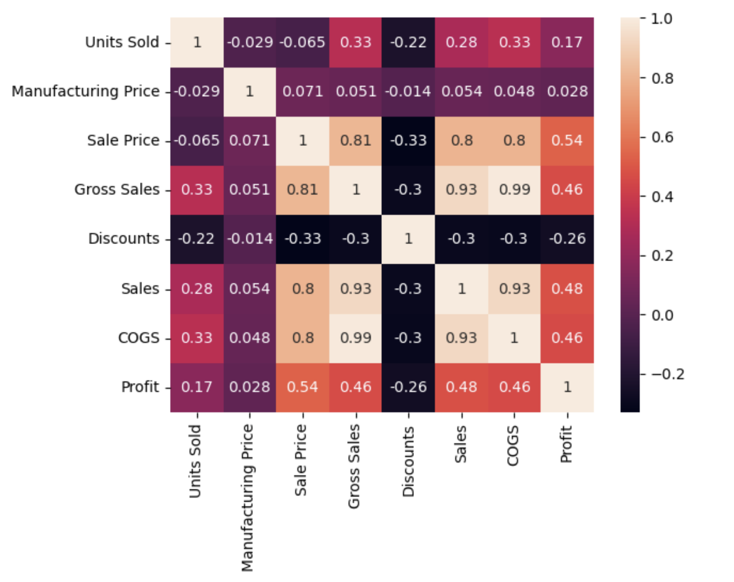
Correlations
Profit Drivers:
Positively correlated with:
Sale Price (0.54)
Gross Sales (0.46)
Sales (0.48)
Weak correlation with Units Sold (0.17).
Negatively correlated with Discounts (-0.26).
Revenue Relationships:
Gross Sales strongly correlated with:
COGS (0.99)
Sales (0.93).
Discount Impact:
Discounts negatively affect:
Sale Price (-0.33)
Profit (-0.26).
These correlations highlight the importance of pricing strategies and controlling discounts to maximize profitability.

Slide 15
Predictive modeling

Slide 16
Linear Regression
How it works: This model assumes a straight-line relationship between features (like Units Sold and Sale Price) and Profit.
Performance: Struggles to accurately predict Profit due to the complexity of interactions between features.
Example: For a sale with high Units Sold but a low Sale Price, it might overestimate Profit.
Result: Largest errors ($1.6M), showing it’s unable to capture non-linear patterns in the data.

Slide 17
Decision Tree Regression
How it works: Splits data into segments (e.g., high Sale Price vs. low Sale Price) and makes predictions based on group averages.
Performance: Best model with an average error of $921K.
Captures complex patterns, such as how high Sale Price with low COGS leads to better profits.
Result: Handles variations in the data well, such as profit differences across products or countries.

Slide 18
Hyperparameter tuned DTR
Objective: Optimize the performance of a Decision Tree Regressor for better predictions.
Method:
Defined hyperparameter grid:
max_depth: [8, 9]
min_samples_leaf: [2, 5, 10, 20, 25]
Used GridSearchCV to test combinations.
Results:
Best Parameters:
max_depth: [Best Value Found]
min_samples_leaf: [Best Value Found]
Improved Accuracy: [Insert Metrics]
Key Takeaway: Hyperparameter tuning reduces overfitting and enhances model stability.

Slide 19
K-Nearest Neighbors
How it works: Predicts Profit by averaging the profits of similar past sales (e.g., items with similar Units Sold and Sale Price).
Performance: Moderately accurate with errors around $1M.
Works well in cases with consistent data but struggles with outliers or unusual combinations.
Result: Slightly less accurate than Decision Tree but still a reasonable predictor.

Slide 20

Profit Predictions: What the Models Tell Us
Profit Drivers:
Sale Price: The higher the Sale Price, the more likely profits increase. For example:
A $500 increase in Sale Price might result in a $250,000 boost in Profit.
Units Sold: Larger sales volumes significantly impact Profit, but only when costs are managed.
Selling an extra 10,000 units can add $1M to profits under the right conditions.
Cost of Goods Sold (COGS): Reducing costs directly improves profits.
Cutting COGS by $100 per unit could save $1M for large sales volumes.
Challenges in Predicting Profit:
The relationship between features is non-linear (e.g., a small change in Sale Price has a big impact on high sales volumes but little on low volumes).
Outliers like exceptionally high or low profits skew simpler models (like Linear Regression).

Slide 21
Conclusion
Best Performing Model:
Hyper-Tuned Decision Tree Regressor,
Reason for Best Performance:
Achieved the highest accuracy
Lowest error metrics
Balanced bias-variance tradeoff effectively.
Key Insights:
Hyperparameter tuning significantly improved model performance.

Slide 22
Thank you

