Slide 1






QuickPrint
TEAM NAME : CODETECH

Slide 2
PROBLEM STATEMENT
Local print shops struggle to attract customers beyond walk-ins because most lack an online presence, instant price quoting, or order tracking.
Customers, on the other hand, face inconvenience — they have to physically visit multiple shops, compare prices manually, and often wait without knowing the order status.
There is no single platform that connects customers to multiple verified local print shops, offers instant service discovery, and provides a transparent, hassle-free ordering experience.

Slide 3
We are building a multi-vendor online printing marketplace — a one-stop platform where customers can find, compare, and order from multiple
PROPOSED SOLUTION
For Customers 🛒 | For Vendors 🏪
🔍 Find & compare verified print shops | 📋 Manage orders via vendor dashboard
📂 Browse services & upload files | ⚙ Update status & set pricing easily
💰 Get instant automated pricing | 🖥 No technical skills required
📦 Track orders in real time | 📢 Increase visibility with premium listings
💳 Pay directly to the shop | 📊 Access analytics & subscription perks

Slide 4
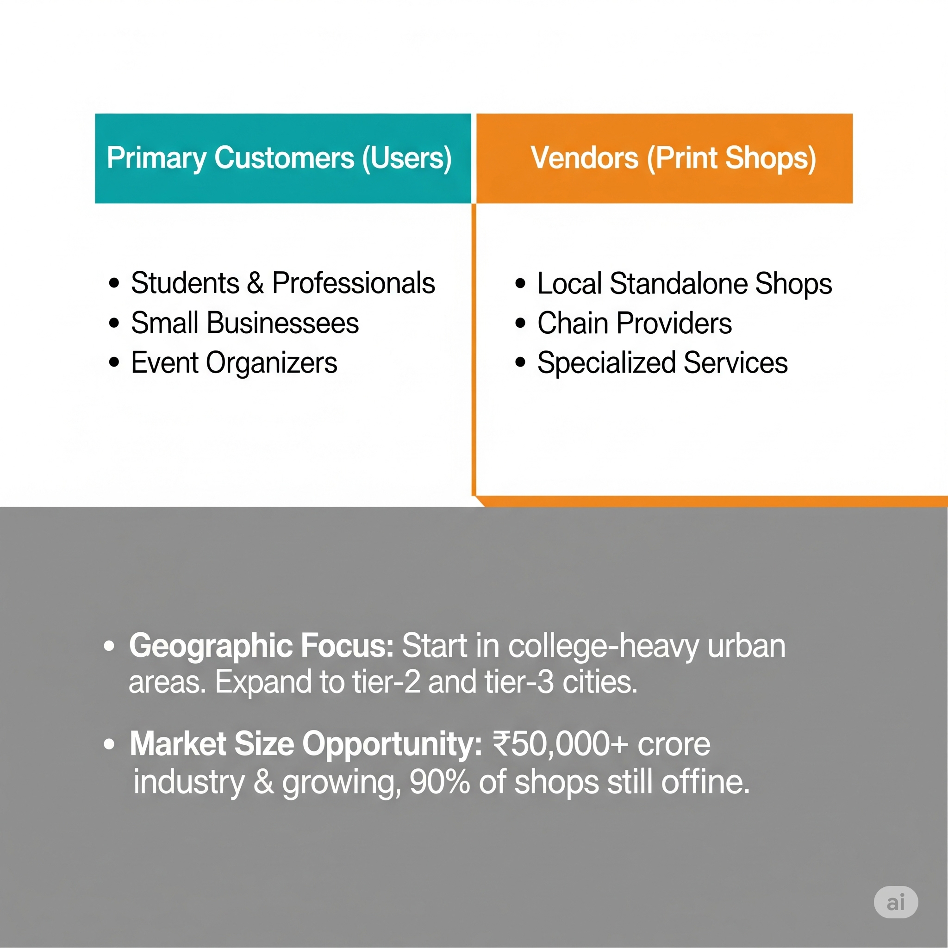



TARGET MARKET

Slide 5
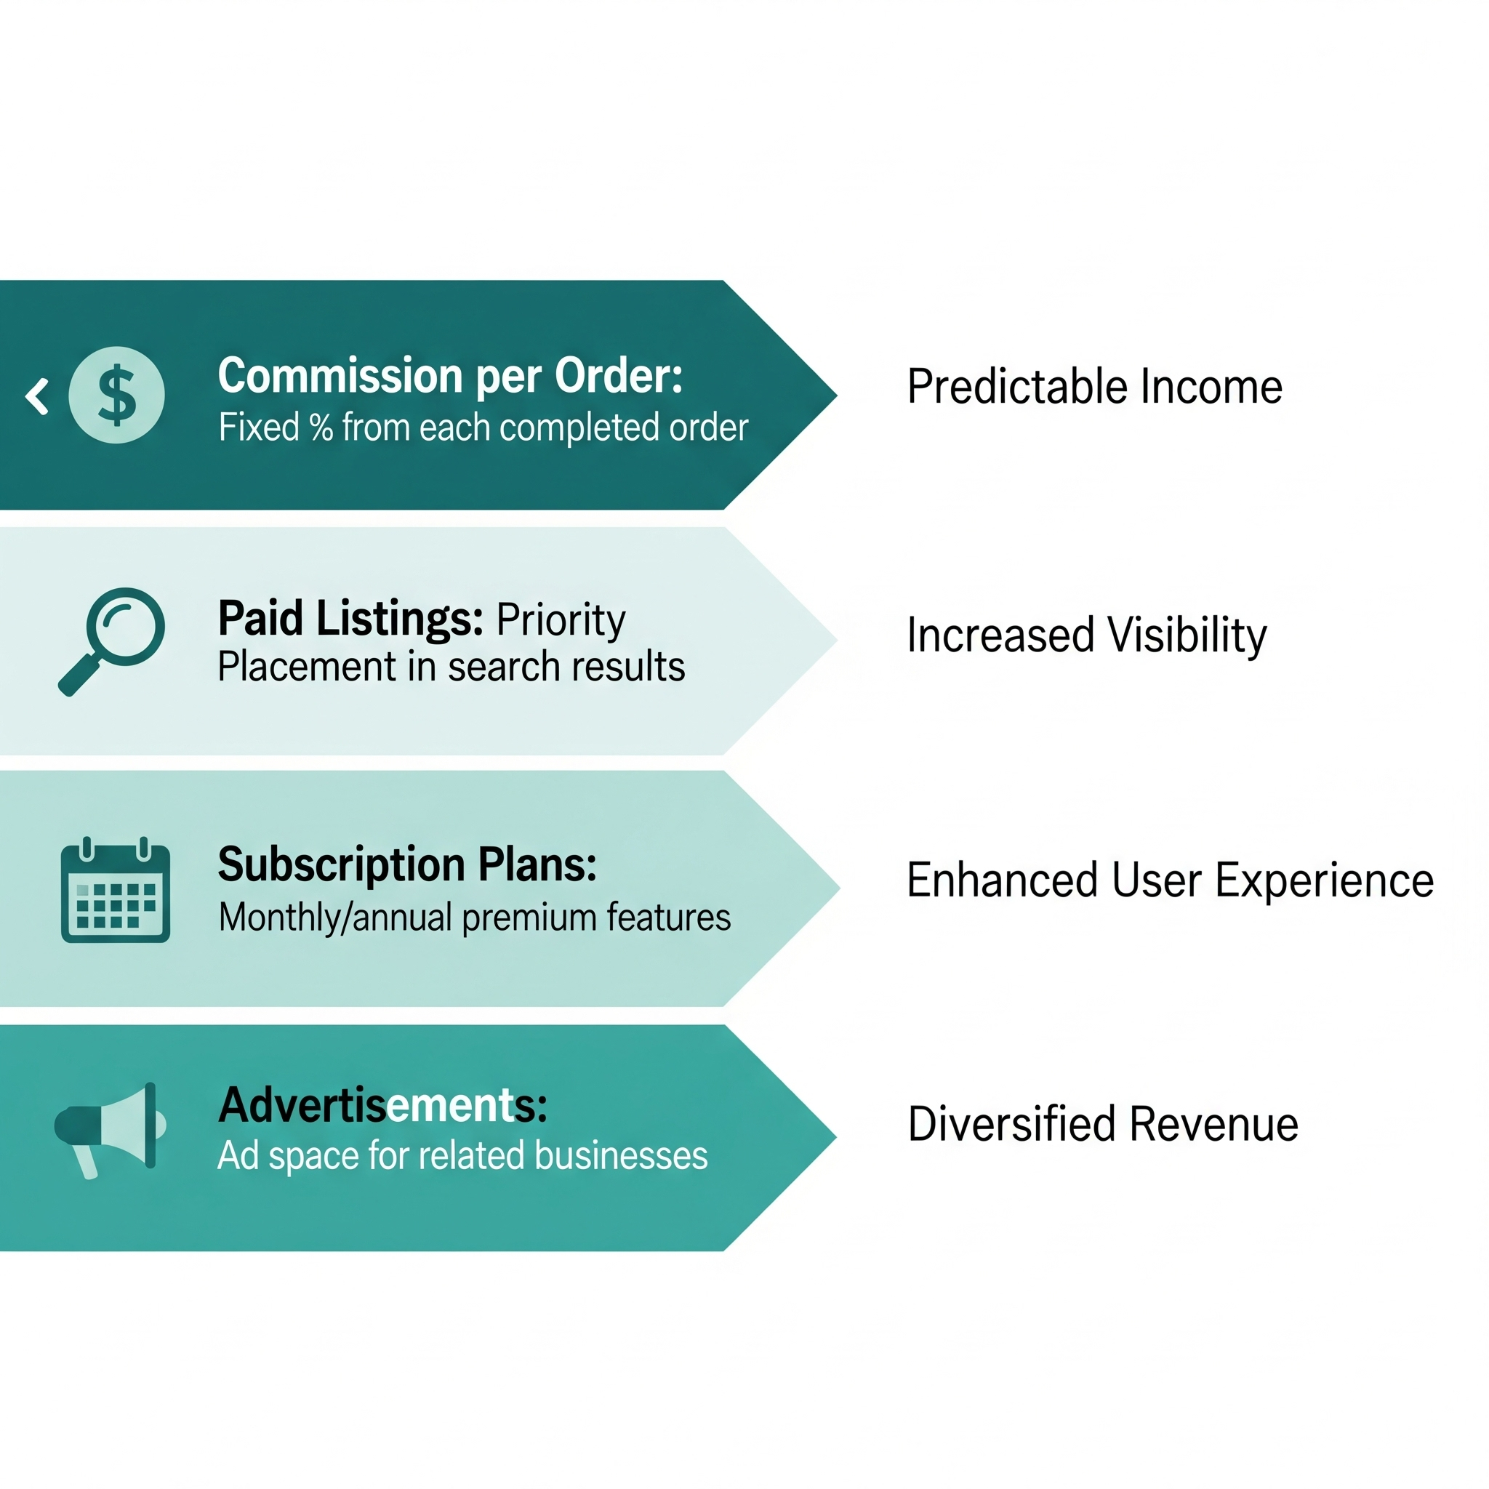
BUSINESS MODEL

Slide 6
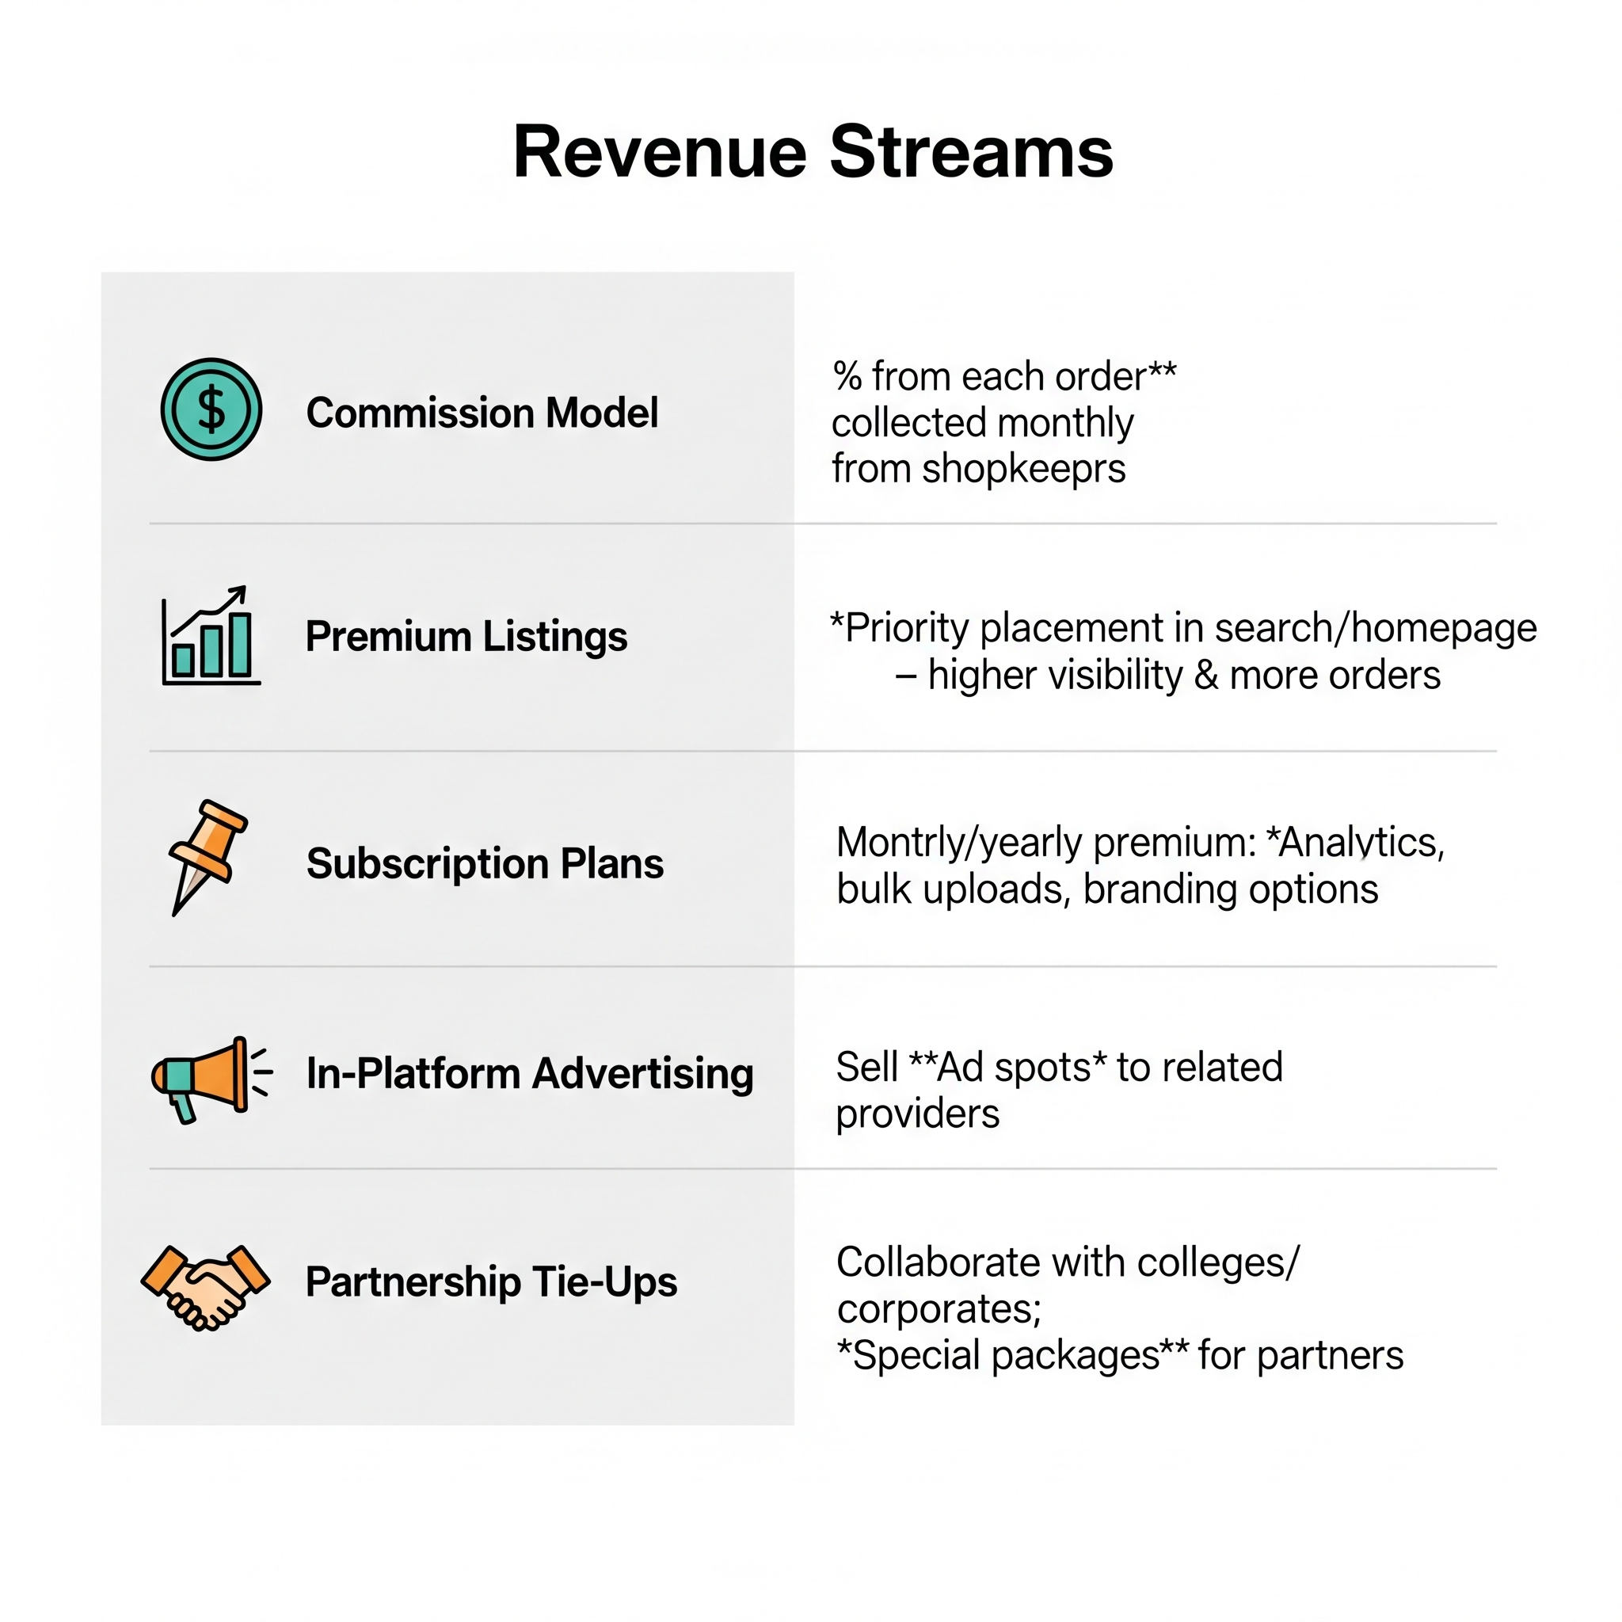
REVENUE STRATEGY

Slide 7
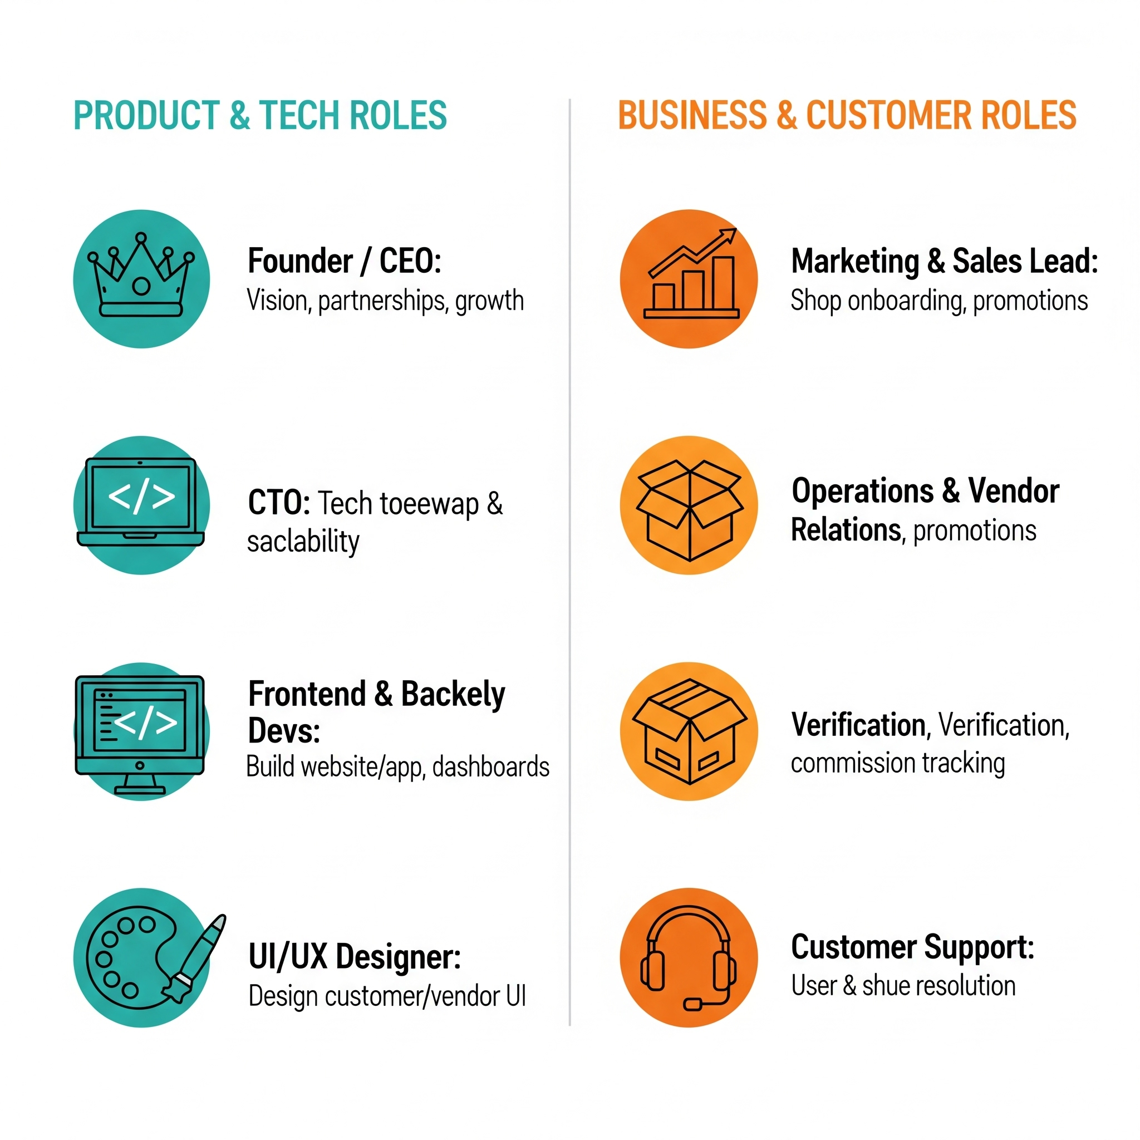
TEAM STRUCTURE

Slide 8
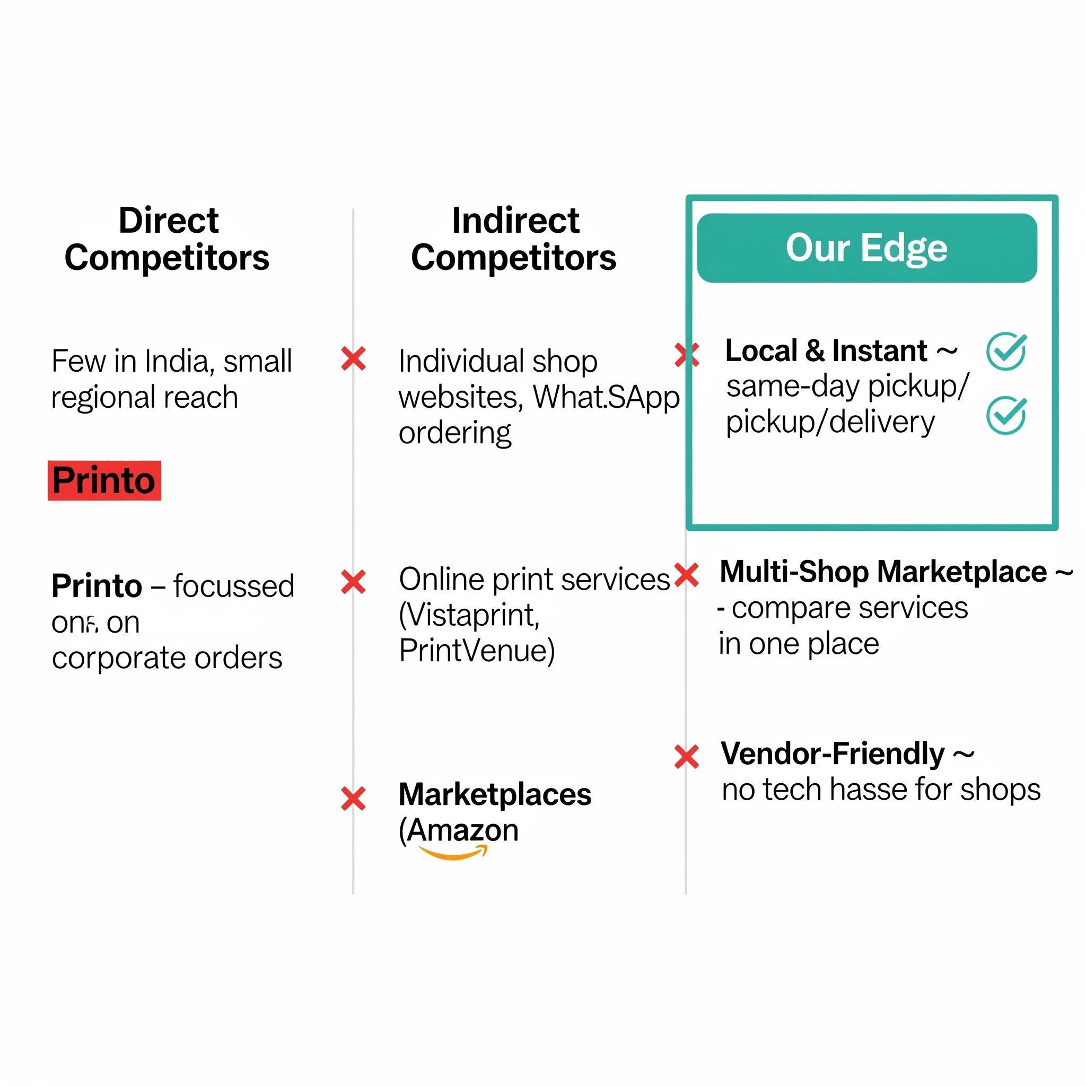
COMPETITION IF ANY

Slide 9
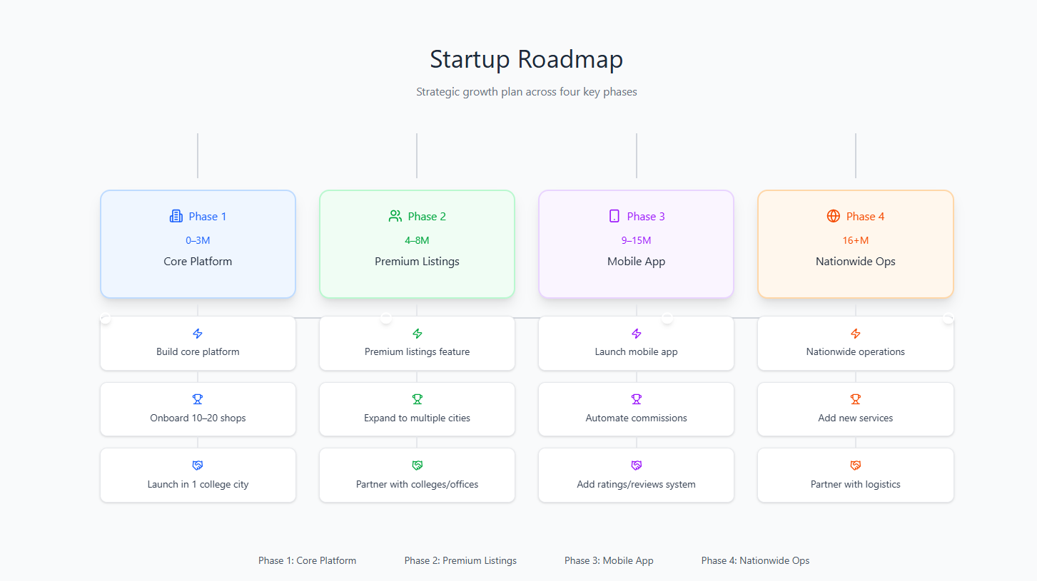
ROADMAP

Slide 10
Thank You !

