Slide 1

SQL Project:
RCB - IPL Strategy
DHRUV KR. KESHRI

Slide 2

PROBLEM STATEMENT
You have been appointed as a sports data analyst for RCB, tasked with identifying top-performing and cost-effective players ahead of the 2017 mega auction.
Your objective is to develop data-driven strategies and actionable insights that will help the franchise build a competitive and well-balanced squad.

Slide 3
DATA OVERVIEW
Core Entities:
  Player: Details about players (ID, name, role).
  Match: Information on matches (ID, date, winner, venue).
  Team: Teams participating in the IPL (ID, name).
  Venue: Locations of matches (ID, name, city, country).
Performance Tracking:
  Ball by Ball: Events for each ball (runs, wickets, player involvement).
  Wickets Taken: Dismissals (bowler, fielder, player out).
  Extra Runs: Extra runs conceded (wides, no-balls).
Match Outcomes:
  Outcome: Match results (winning team, outcome type).
  Win By: Method and margin of victory.
Player Awards:
  Season: Season details and awards (Man of the Series, Orange Cap, Purple Cap).
  Rolee: Player roles and skills.
Supporting Entities:
  City & Country: Geographical context for venues.
  Umpire: Details about match officials.
  Toss Decision: Outcome of the toss.

Slide 4
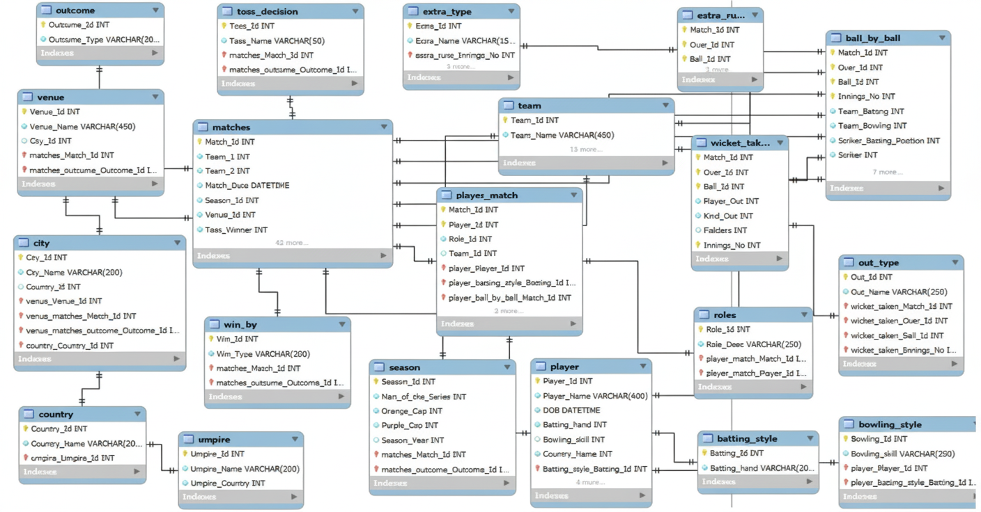
DATABASE SCHEMA

Slide 5
METHODOLOGY
Data Understanding & Cleaning: Explored and cleaned data, handling missing values and standardizing team names.
Data Extraction: Retrieved match, player, and venue data using SQL joins and CTEs.
KPI Definition: Defined metrics like win %, strike rate, runs, wickets, and economy rate.
Analysis & Visualization: Studied performance trends and compared seasons, players, and venues using Excel and Power BI.
Insights Generation: Identified patterns, strengths, and improvement areas for RCB.
Tools: SQL, Excel, Power BI

Slide 6
RCB Performance Analysis: 2013–2016
RCB showed moments of strength but struggled with consistency
from 2013 to 2016, with performance rising after a mid-period dip.
Strong performance in 2013 with a 56.3% win rate.
Major drop in 2014, the weakest season.
Solid recovery in 2015 with improved wins.
2016 matches the best performance, returning to a 56.3% win rate.
Overall trend shows a dip in 2014 followed by steady improvement

Slide 7
Top Batters By Average Runs Per Match
To assess RCB’s batting strength, I analyzed total runs, average runs per match, strike rate, and venue-wise performance to identify players who are both consistent and adaptable. Focusing on average runs per match across IPL seasons highlights batsmen who score reliably and anchor innings,
making them key candidates for retention and future strategic planning.
Simmons leads, followed by Kohli, DA warner and de Villiers.
RCB depends on Kohli and de Villiers for stability and scoring.
Big gap exists between top batsmen and the rest of the lineup.

Slide 8
Wicket-Taking Bowling Champions
I analyzed Total Wickets and season-wise consistency to identify bowlers who consistently make an impact. For RCB, these insights highlight reliable, pressure-ready bowlers who add stability to the attack. Targeting such performers in future auctions will help build a stronger, balanced bowling unit.
DJ Bravo leads as the most consistent wicket-taker.
MM Sharma, and B Kumar show strong, steady impact.
Chart highlights clear top-tier bowlers who perform under pressure.
These consistent wicket-takers are key targets for strengthening RCB’s attack.

Slide 9
All-Rounder Performers
All-rounders who excel with both bat and ball bring vital balance and adaptability to any team. RCB, investing in such all-rounders brings depth and stability, helping turn close matches into winning moments.
Watson & Jadeja are the strongest dual-impact all-rounders.
Pollard & Smith contribute mainly with the bat.
Russell & Henriques offer balanced mid-level support.
These players boost balance and adaptability across situations.
Ideal targets for RCB to add depth, stability, and flexibility.

Slide 10
Batting Champions By Strike Rate
To assess RCB’s batting strength, I analyzed Total Runs, Strike Rate, and venue-wise performance to identify players who are both consistent and adaptable. Strike Rate trends across seasons highlighted batsmen who score reliably under different conditions. These dependable performers anchor the innings while delivering impactful runs, making them valuable choices for retention and future auction strategies.
AB de Villiers offers maximum impact with the best strike rate.
Kohli and Warner deliver consistent high-volume scoring.
Gayle and Raina add aggressive momentum.
Rahane and Gambhir provide stability but slower scoring.
Overall, a mix of high-impact hitters and steady accumulators is key for effective team strategy.

Slide 11
Impact Of Toss Decision On Match Results Across Venues
A good way to study match dynamics is to see how the toss affects results. The analysis shows that winning the toss often helps teams choose the better option for the conditions .The data shows that the impact of winning the toss changes from venue to venue. Some stadiums offer a clear advantage after the toss, while others show little to no benefit. This means the toss only helps when local pitch and weather conditions strongly influence the game.
Toss advantage varies widely across venues.
Some grounds strongly favor teams winning the toss.
In many venues, the toss has minimal impact.
Bat/field decisions work best when based on venue-specific conditions.
Teams should plan toss strategies differently for each stadium.

Slide 12
Win Margin And High-scoring Match Insights
The data reveals that RCB leads with the highest average win margin, indicating strong dominance across their matches. CSK and MI also show solid consistency, while mid-tier teams like KXIP, RR, and SRH display competitive but less commanding performances. Teams with lower margins, such as DD and GL, struggle to secure convincing wins, highlighting clear performance gaps across teams.
High win margins reflect strong batting–bowling balance.
RCB, CSK, and MI set benchmarks for dominant team performance.
Mid-tier teams show potential but lack consistent finishing strength.
Low-margin teams may need strategic changes in squad composition.
Win-margin patterns help guide planning and performance benchmarking.

Slide 13
KEY INSIGHTS
Team Performance
RCB showed fluctuating results across seasons.
Best performances came in 2013 and 2016.
Batting Insights
Kohli and AB de Villiers are the main scoring pillars.
High strike-rate hitters like ABD and Pandya stand out.
Bowling Insights
Bravo leads in consistent wicket-taking.
MM Sharma and B Kumar provide strong bowling impact.
All-Rounder Impact
Watson and Jadeja deliver strong dual contributions.
All-rounders add balance and match-winning flexibility.
Toss Decision Insights
Toss advantage varies significantly by venue.
Effective only when conditions strongly affect gameplay.

Slide 14
STRATEGIC RECOMMENDATION
Player Recruitment: Sign players with steady, proven batting and bowling performance.
Venue Strategies: Shape match plans using past venue-specific results.
Toss Optimization: Let historical data guide whether to bat or bowl first.
Diverse Skill Sets: Build a balanced team with varied batting and bowling strengths.
Team Morale: Maintain a positive, unified team environment.
Performance Monitoring: Track key metrics regularly to adjust strategies.
High-Scoring Insights: Apply lessons from high-scoring games to future tactics.

Slide 15
CONCLUSION
The analysis shows which players perform well regularly and which new talents are growing.
Choosing players who can adapt to different match conditions will help the team.
Mixing experienced players with young talent makes the team stronger.
Overall, using this information will help RCB make better choices and improve their chances of doing well in 2017 and in the future.

