Slide 1

SRM INSTITUTE OF SCIENCE AND TECHNOLOGY
SCHOOL OF COMPUTING
DEPARTMENT OF COMPUTING TECHNOLOGIES MAJOR PROJECT
Identifying Suicidal Ideation -
A Detection & Prevention System
Batch ID: B111
Date: 17/05/2023
Student 1 Reg. No: RA1911003010550
Student 1 Name: Dhruv Kant Ladia
Student 2 Reg. No: RA1911003010520
Student 2 Name: Saatvik Shukla
Corresponding Author: Dr. C. Pretty Diana Cyril
Designation: Assistant Professor Department: Computing Technologies

Slide 2
ABSTRACT
Social Networking sites and online networks have recently become very famous. These sites empower their users with an excellent forum for sharing their feelings and views.
Reddit is one of the main social media platforms. Social media is recognised as a crucial medium of expression and provides a method where its users can be observed extensively, and their likings and disliking can be recorded.
We are trying to investigate suicidal ideation behavioural patterns that are the major concerns for our society by using various Machine Learning Models and further developing a prevention system to avoid any such mishaps.
Index Terms- Depression Detection, Machine Learning Algorithms, Suicidal Ideation, Suicide Prevention

Slide 3
INTRODUCTION
Suicidal ideation is a sign of some mental illnesses but it can even occur without the presence of a mental disease as a result of a personal tragedy.
The difference between active and passive ideation is almost non-existent. Even while not everyone who considers suicide actually dies, it might be regarded as a risk factor.
According to psychology studies, there is a direct correlation between a person's mental health and speech usage.

Slide 4
LITERATURE REVIEW
Social networking and online platforms are commonly used for self-expression.
Suicides constitute a significant concern, with individuals expressing suicidal thoughts on social media.
A study in 2022 found that around 300 million people worldwide experience depression.
Advanced technologies of Machine Learning can be used to investigate patterns of suicidal ideation and develop prevention systems.
Chatbots are programs that use AI, machine learning, and neural capabilities to communicate with humans.

Slide 5
LITERATURE REVIEW
Chatbots are being used by startups and companies to improve customer service in various industries.
AI/ML is easy to use and learn, making it suitable for chatbots.
Chatbots have user-friendly interfaces, conversational systems, and the ability to operate in multiple languages.
Organizations use chatbots to respond quickly and productively to customer inquiries.
Chatbots are being used in diverse industries such as e-commerce, insurance, banking, healthcare, and more.

Slide 6
OBJECTIVE
Suicides and even its attempt leaves a ripple on everyone. But suicides are preventable. This project will help identify people with suicidal tendencies through their posts on social media and help prevent it.
It is crucial for the close ones of the suffering person to know the condition. Hence, this project aims to notify the person’s close family and person.
In a state of depression, it is imperative to consult a professional. Therefore, in extreme cases, help resources and professional help will be provided
This project primarily focuses on identifying any ideas of suicide in a Reddit post to train on a dataset which contains suicidal intent worth content.
As a prevention system, we are deploying a chatbot that will communicate with the user and assist them in need.

Slide 7
INNOVATION IDEA OF THE PROJECT
A recent study showed that 300 million people worldwide were affected by depression and about 800 thousand people committed suicide in 2022.
We are trying to investigate suicidal ideation behavioural patterns that are the major concerns for our society by using various NLP and Machine Learning Models and further develop a prevention system with high accuracy to avoid any such mishaps.
There are 3 major phases of this project:
Dataset Collection & Pre-processing
Detection of the proposed problem along with model selection
Prevention of the proposed problem using a chatbot

Slide 8

Challenges in the existing system
S.No | Title of the paper | Author, Journal Name, Year of the paper | Concepts Proposed/Novelty of the proposed Approach | Challenges in the existing system /Inference
1 | The Development of a chatbot using Convolutional Neural Networks | Giorgos Tsakiris, Christos Papadopoulos, Giannis Patrikalos, Konstantinos-Filippos Kollias1, Nikolaos Asimopoulos and George F. Fragulis, SHS Web of Conferences 139, 03009 (2022) | CNN model was used to be trained and used on a chatbot to help generate near accurate reponses | Lacks intervention of human-like responses CNN models generally have a lesser F1 score than the new Transformer model(s).
2 | Intelligent Chatbot Adapted from Question and Answer System Using RNN-LSTM Model | Prasnurzaki Anki, A Bustamam, Herley Shaori Al-Ash, Devvi Sarwinda, Journal of Physics Conference 1844(1):012001, 2021 | RNN-LSTM model ran through a dataset to train it to develop a chatbot to assist the elderly | Accuracy resulted to be 70.9% in which case our ELECTRA model is significantly more efficient.

Slide 9
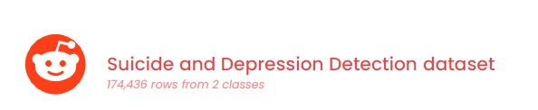
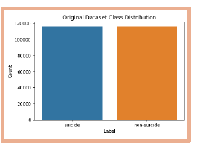
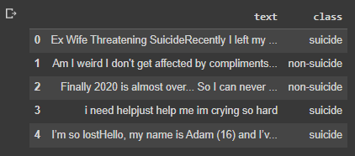
Data Collection
Fig. Data displayed in a table format
Fig. Dataset class distribution

Slide 10
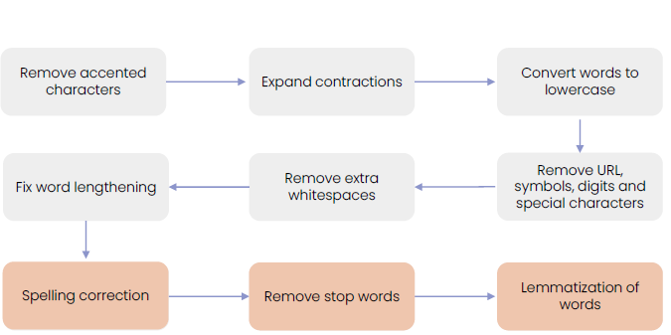
Text Pre-processing
Fig. Stages of text pre-processing to clean the dataset

Slide 11
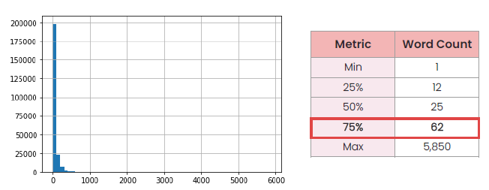
Data Cleaning
Remove irrelevant words:
An anonymous word ‘filler’ was found in the top 30 frequently occurring words
The word ‘filler’ was filtered out as it does not contain any significant meaning
Remove empty rows:
Rows without any dataset were found during pre-processing
The said rows were dropped due to a lack of content
Remove outliers in a word count:
Fig. No. of Reddit posts versus their Word Count

Slide 12
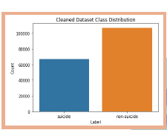
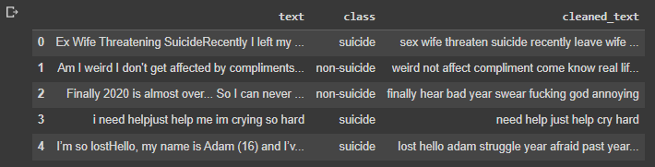
Final Dataset
Fig. Final cleaned dataset displayed in a table
Fig. Class Distribution of Data

Slide 13
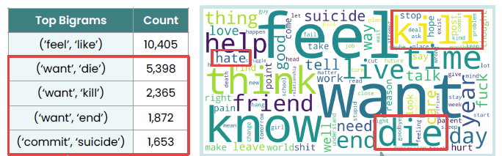
Data Exploration
Suicidal
Fig. Negative Words and their Count

Slide 14
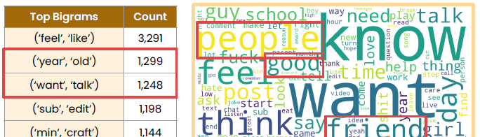
Data Exploration
Non-Suicidal
Fig. Neutral & Positive Words and their Count

Slide 15
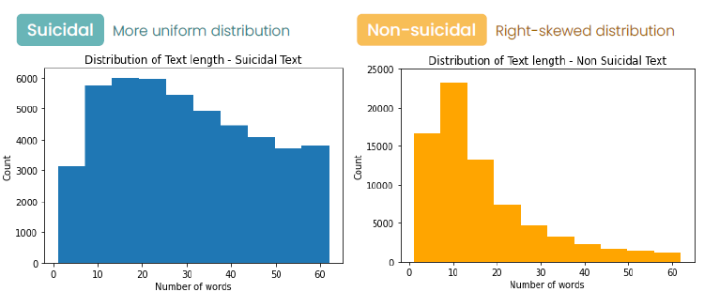
Average Text Length

Slide 16
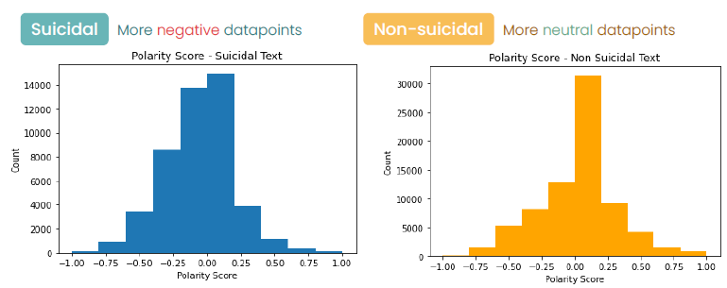
Polarity Score

Slide 17
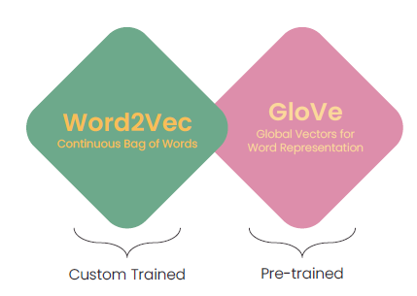
Representation Learning
Word2vec Embeddings:
Estimates the meaning of a word through
grouping of similar words
Prediction model built on neural networks
Vocabulary size: ~20,400
Training Data Points: ~1,39,500
Dimensions: 300
GloVe:
Count based log bilinear model which incorporates both
global and local context
Vocabulary Size: ~12,00,000
Training Data Points: ~127,00,00,000
Dimensions: 200

Slide 18
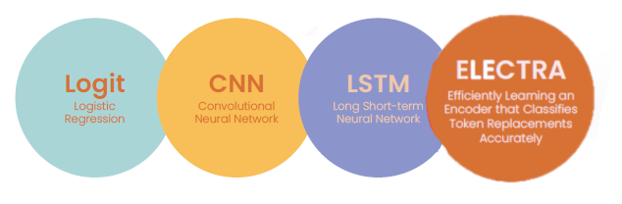
Model Building & Evaluation
Models Implemented:
Machine & Deep Learning
Transformers

Slide 19
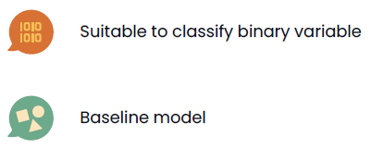
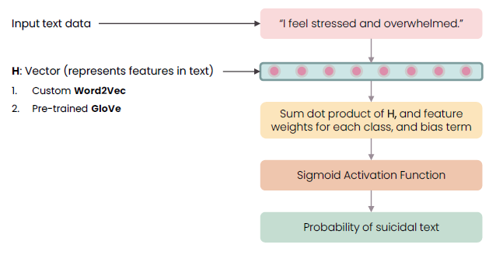
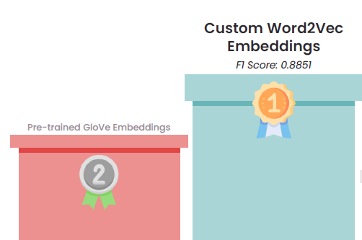
Logistic Regression (Logit) Evaluation:

Slide 20
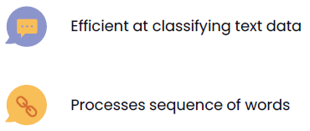
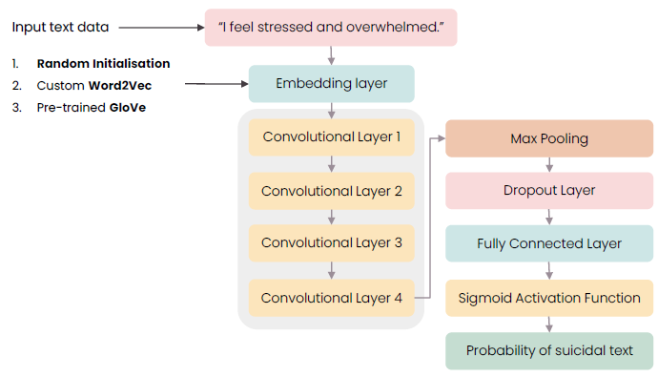
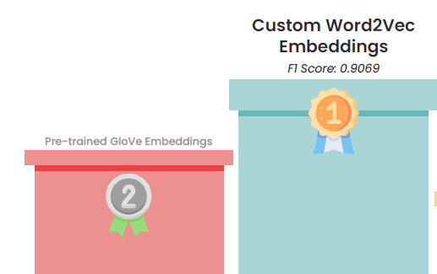
Convolutional Neural Network (CNN) Evaluation:

Slide 21
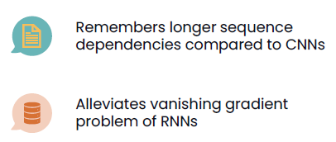
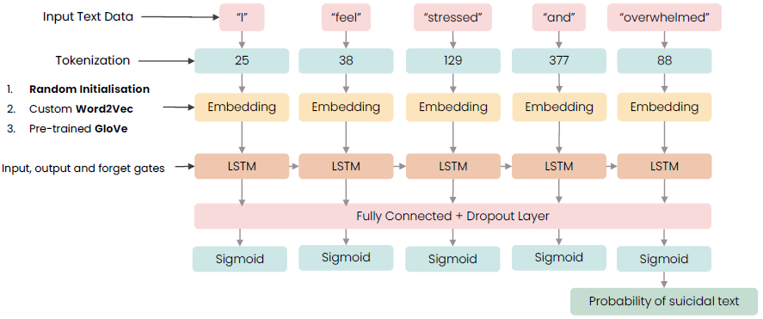
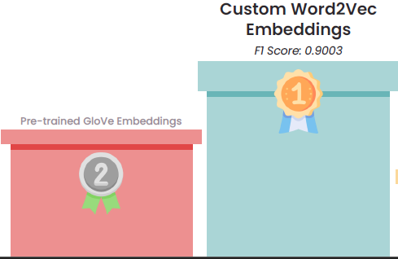
Long Short Term Memory (LSTM) Evaluation:

Slide 22
Transformers Evaluation (ELECTRA):
Attention-based Encoder Decoder
Achieved state-of-the-art performance
Handles long-range interactions
Parallelisation of tasks
Transfer Learning
Fine-tuning feature trains the entire pre-trained architecture
ELECTRA:
Latest transformer model
Achieved current state-of-the-art performance
Implemented using base model
Replaced Token Detection(RTD) efficiently analyses the final dataset

Slide 23
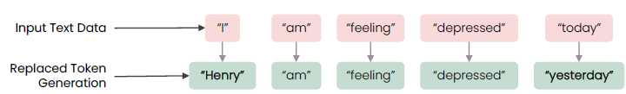
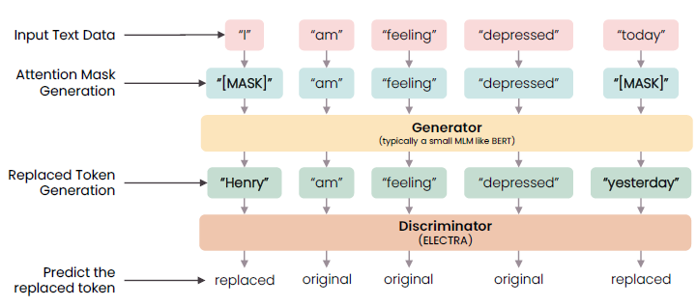
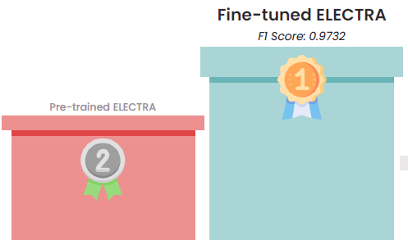
Fig. Replaced Token Detection Implementation
Fig. Replaced Token Detection capturing token-level information
Fig: ELECTRA Evaluation

Slide 24
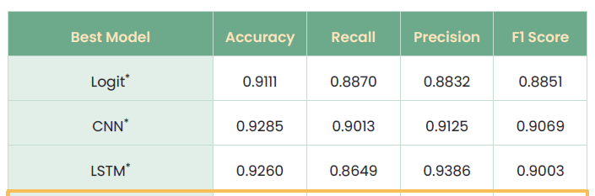
Model Selection by Evaluation Metrics
Fig. Model Performance

Slide 25

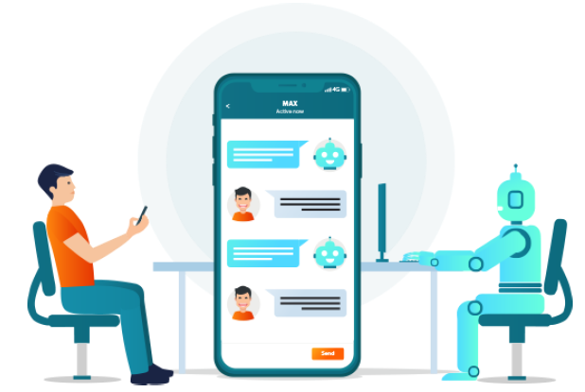
Chatbot Integration

Slide 26
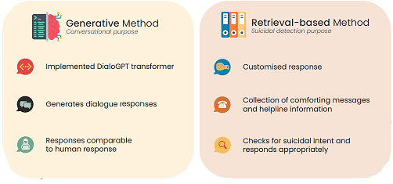
Chatbot Architecture

Slide 27
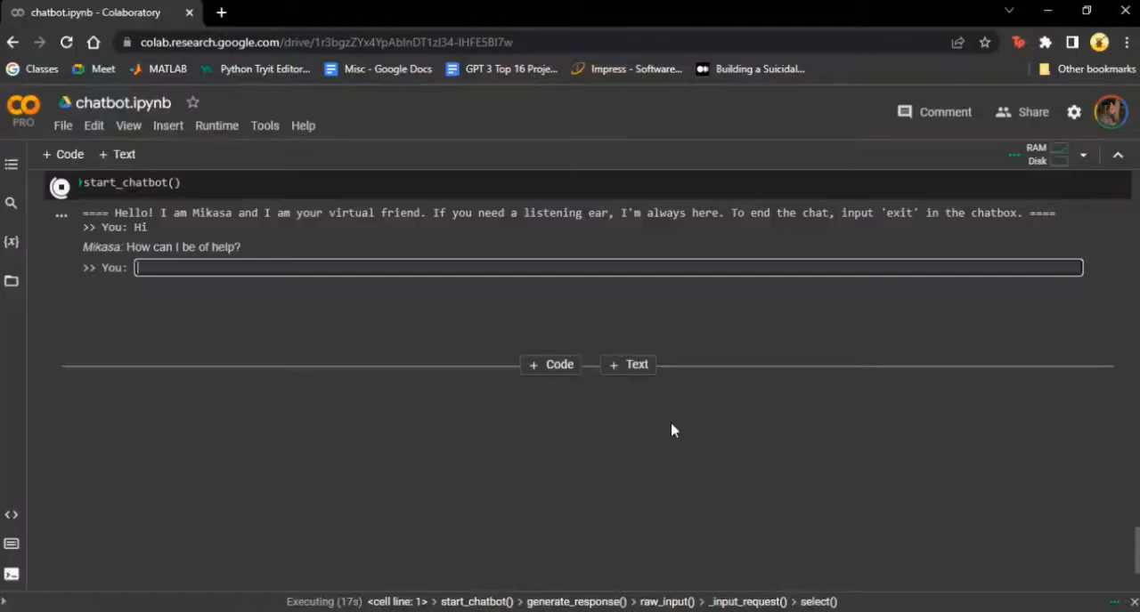
Chatbot Demo

Slide 28
References
1. Arya, Vanshika & Khan, Rukhsar & Aggarwal, Prof. (2022). A Chatbot Application by using Natural Language Processing and Artificial Intelligence Markup Language. International Journal of Soft Computing and Engineering. 12. 1-7. 10.35940/ijsce.C3566.0712322.
2. Tirumala, Kushal & Markosyan, Aram & Zettlemoyer, Luke & Aghajanyan, Armen. (2022). Memorization Without Overfitting: Analyzing the Training Dynamics of Large Language Models. 10.48550/arXiv.2205.10770.
3. Zhang, Xiaopeng & Qin, Liangxi. (2022). An Improved Extreme Learning Machine for Imbalanced Data Classification. IEEE Access. PP. 1-1. 10.1109/ACCESS.2022.3142724.
4. Rahali, Abir & Akhloufi, Moulay. (2023). End-to-End Transformer-Based Models in Textual-Based NLP. AI. 4. 54-110. 10.3390/ai4010004.
5. Gabín, Jorge & Ares, M. & Parapar, Javier. (2023). Keyword Embeddings for Query Suggestion. 10.48550/arXiv.2301.08006.
6. Bao, Han-Wu-Shuang & Wang, Zi-Xi & Cheng, Xi & Su, Zhan & Yang, Ying & Zhang, Guang-Yao & Wang, Bo & Cai, Huajian. (2023). Using word embeddings to investigate human psychology: Methods and applications. 31. 887. 10.3724/SP.J.1042.2023.00887.
7. Ricciardelli, Elena & Biswas, Debmalya. (2019). Self-improving Chatbots based on Reinforcement Learning.
8. Cameron, Gillian & Cameron, David & Megaw, Gavin & Bond, Raymond & Mulvenna, Maurice & O ' Neill, Siobhan & Armour, Cherie & Mctear, Michael. (2019). Assessing the Usability of a Chatbot for Mental Health Care. 10.1007/978-3-030-17705-8_11.

Slide 29
Proof of Conference

Slide 30
Thank You
For Your Time!

