Slide 1
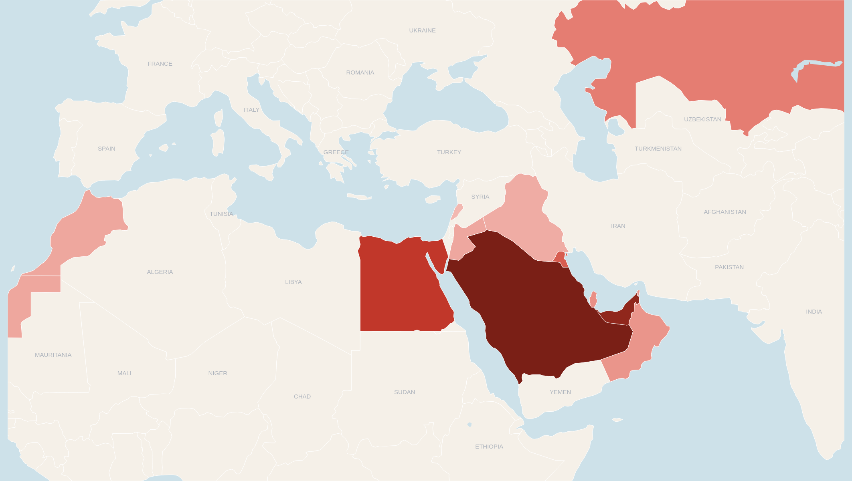
12 countries · 2,746 restaurants (2Q26) — top 4 = 78% of base
Kuwait
274 stores · ~$365m
Iraq
44 stores · ~$35m
Lebanon
17 stores · ~$30m
Kazakhstan
149 stores · ~$135m
Jordan
55 stores · ~$45m
Bahrain
73 stores · ~$70m
Qatar
110 stores · ~$115m
UAE
664 stores · ~$880m
Morocco
56 stores · ~$50m
Egypt
447 stores · ~$180m
Saudi Arabia
761 stores · ~$660m
Oman
96 stores · ~$85m
STORE COUNT
12 countries · 2,746 restaurants · $2.7bn LTM revenue · ~39k employees
Fewer (17)
More (761)
Stores by region (2Q26): KSA 761 · UAE 664 (incl. 7 MAT) · Kuwait 274 · Egypt 447 — top 4 markets = 78% of footprint.
Store counts: Americana H1 26 investor pack (30-Jun-2026) · Revenue by country: Bernstein estimates (LTM Jun-26) · All labels editable
7

