Slide 1
Same dish, same restaurant: Toing is 14–61% cheaper than Swiggy on four of five dishes; on Swiggy's '50% off' hero dish both apps charge ₹149
EXHIBIT 1
Toing selling price vs Swiggy
Dish | Gap | Toing's 'Other apps' claim
Lemon Rice | –61% | ₹229–239
Thai Green Curry | –45% | ₹379–399
Veg Manchurian | –38% | ₹289–299
Kadhi Chawal | –14% | ₹279–289
Drunken Chicken* | 0% | ₹359–379
Toing's 'Other apps' price is Swiggy's own menu price: the low end of the range matches Swiggy's listed price for every dish we checked — Toing is benchmarking itself against its parent.
Most of the gap is an on-app offer, not a lower menu: Toing's struck-through menu sits only 3–13% below Swiggy (Lemon Rice: 39%).
* Drunken Chicken: Swiggy menu ₹359, shown at ₹149 under Swiggy's 'Minimum 50% off' deal. Gap = Toing selling price vs Swiggy price shown.
Source: Toing and Swiggy iOS apps; The Bowl Company, Koramangala (Bengaluru); screenshots taken 13 Nov 2026, ~11:40 IST; Bernstein analysis

Slide 2
At checkout the gap is in the fees: at the same ₹89 dish price Swiggy's order is 27% dearer, and on a two-item cart 60% dearer
EXHIBIT 2
+27%
₹248
Cart A: Swiggy ₹154 vs Toing ₹121. Food is ₹89 on both (Swiggy via the DELULU4FOOD ₹140 coupon); ₹57 of packaging + platform fee does the damage.
+60%
₹154
₹155
₹121
Cart B: Swiggy ₹248 vs Toing ₹155. Swiggy's coupon is roughly a fixed ₹140, so it dilutes as the basket grows; Toing's per-item prices do not.
Swiggy figures already include Swiggy One free delivery (₹45 waived). A non-member would pay ₹199 / ₹293. Toing charges ₹0 packaging and ₹0 platform fee, and ₹26 delivery only below ₹99.
Cart A: Classic Lemon Rice
Cart B: Lemon Rice + Gulab Jamun
Delivery promise: Toing Basic 25–35 min vs Swiggy Standard 20–25 min
Source: Toing and Swiggy iOS apps; The Bowl Company, Koramangala (Bengaluru); screenshots taken 13 Nov 2026, ~11:40 IST; Bernstein analysis

Slide 3
Bridging the two-item cart: of the ₹93 Swiggy premium, ₹57 is packaging and platform fee — fees Toing has removed — and only ₹30 is a higher food price
EXHIBIT 3
+₹6
₹248
₹57 of ₹93 (61%)
comes from packaging and platform fees — the two lines Toing advertises as ₹0 ('No unnecessary fees. Ever!')
+₹18
+₹39
+₹30
₹155
Toing
to pay
Higher food price
(after offers)
Restaurant
packaging
Platform fee
Higher
GST
Swiggy
to pay
Swiggy price after DELULU4FOOD coupon (–₹140) and Swiggy One free delivery; Toing price after 'Items starting ₹59' offer and free delivery above ₹99.
Source: Toing and Swiggy iOS apps; The Bowl Company, Koramangala (Bengaluru); screenshots taken 13 Nov 2026, ~11:40 IST; Bernstein analysis

Slide 4
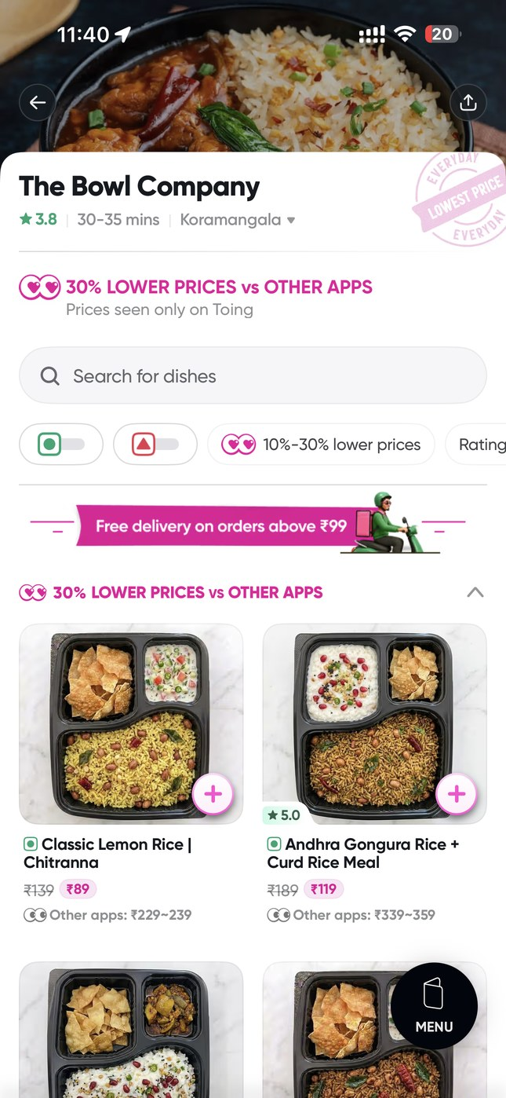
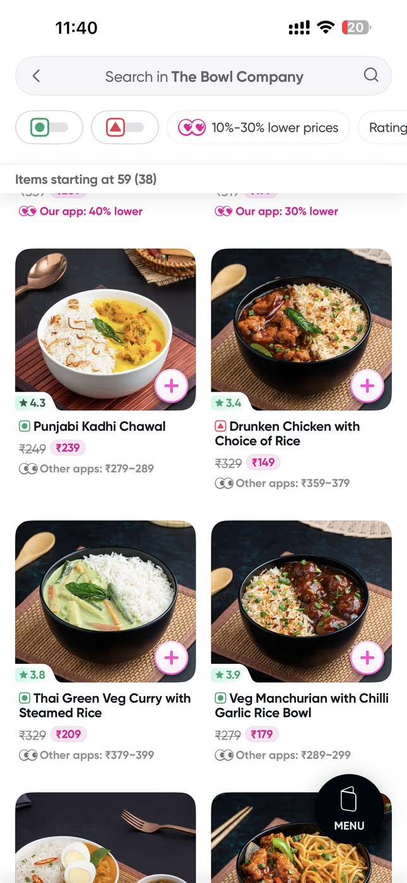
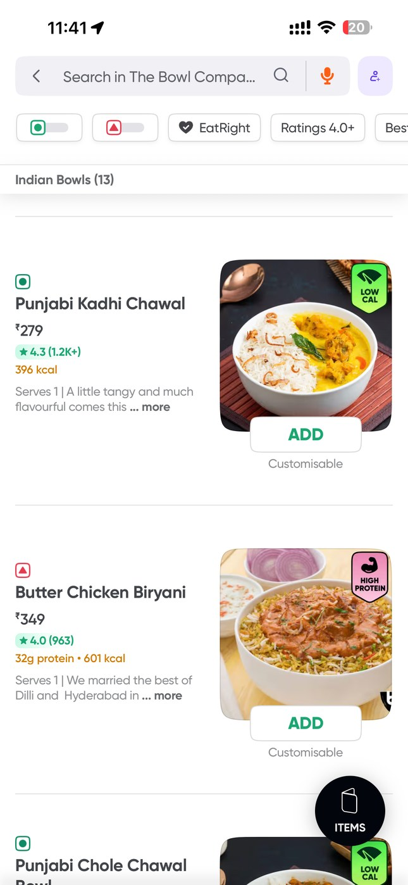
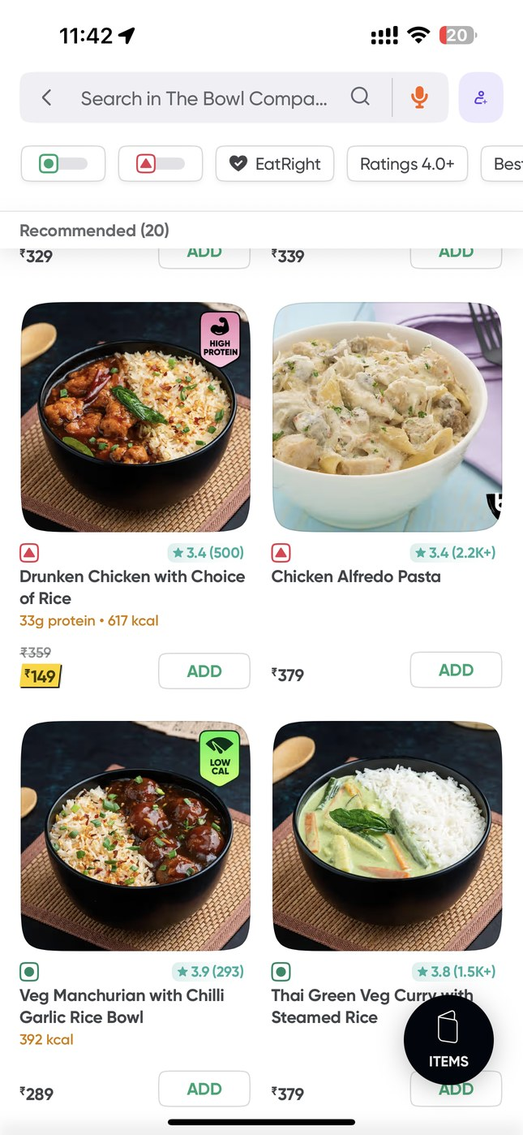
Toing prints the 'Other apps' price next to its own — ₹89 vs ₹229–239 for Lemon Rice — and Swiggy's menu matches that 'other apps' price
EXHIBIT 4
TOING
SWIGGY
Lemon Rice ₹89 (other apps ₹229–239)
Kadhi Chawal ₹239, Thai Curry ₹209
Kadhi Chawal ₹279
Thai Curry ₹379, Manchurian ₹289
Source: Toing and Swiggy iOS apps; The Bowl Company, Koramangala (Bengaluru); screenshots taken 13 Nov 2026, ~11:40 IST; Bernstein analysis

Slide 5
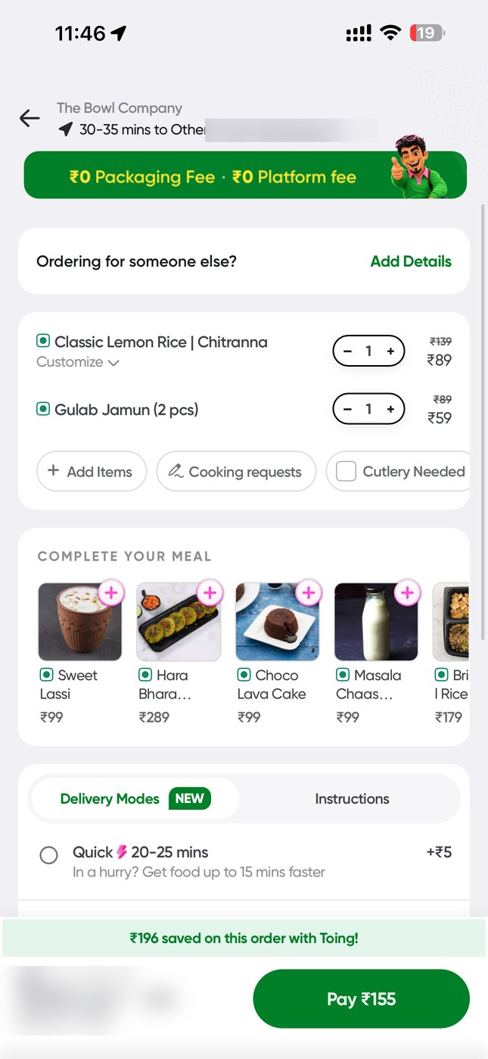
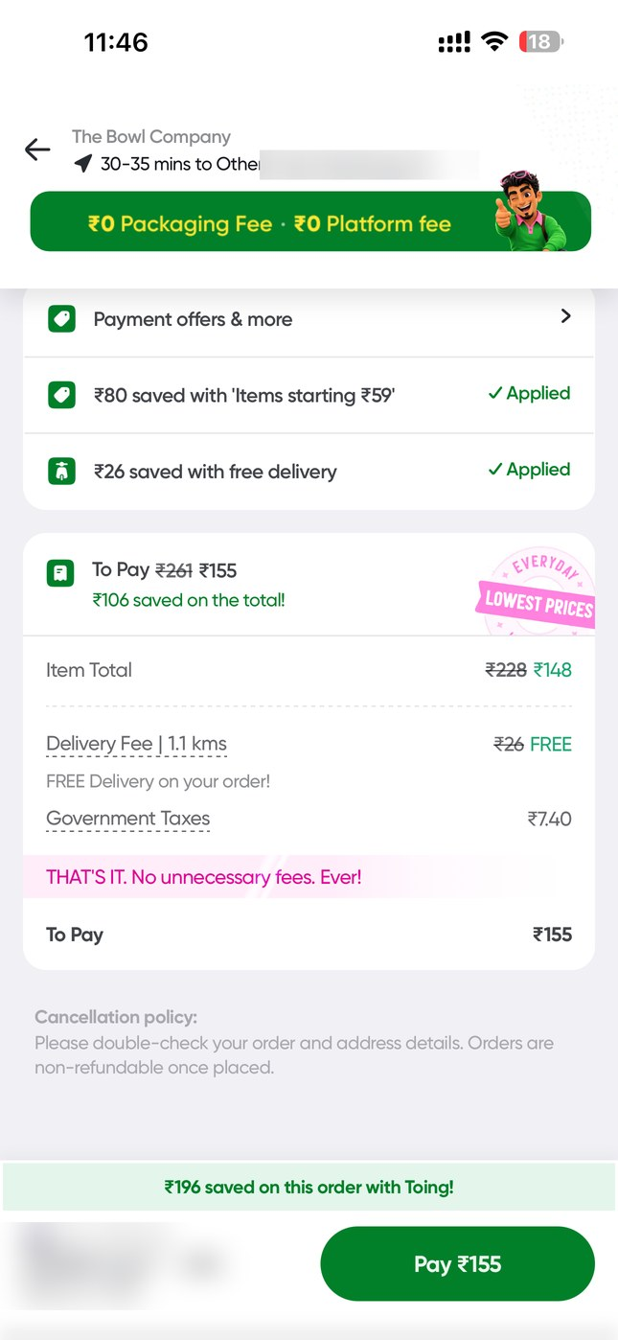
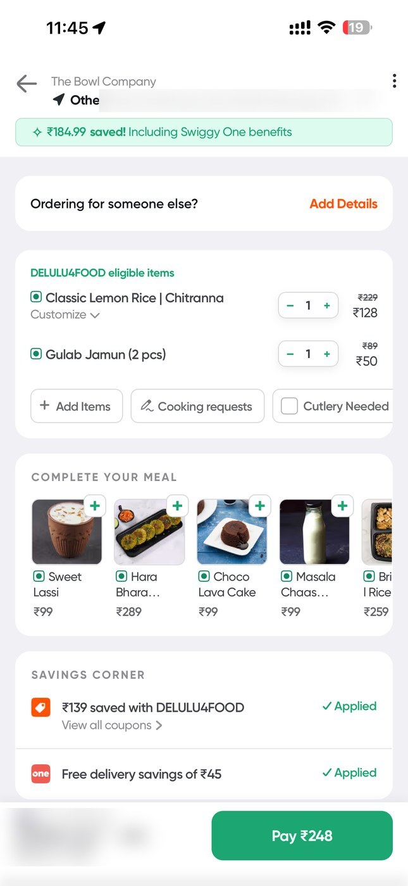
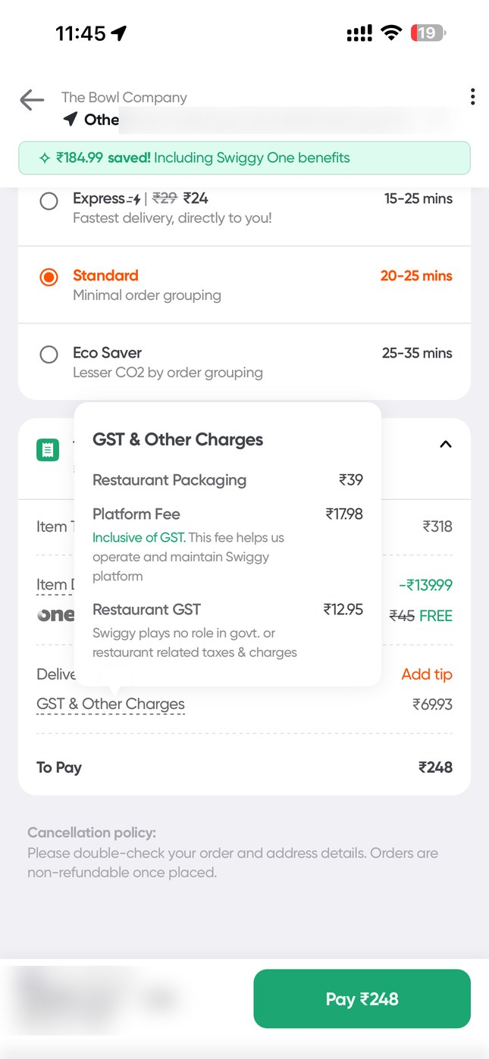
Same two-item order, same restaurant: ₹155 on Toing vs ₹248 on Swiggy — even after a ₹140 Swiggy coupon and Swiggy One free delivery
EXHIBIT 5
TOING
SWIGGY
Lemon Rice ₹89 + Gulab Jamun ₹59
₹0 packaging, ₹0 platform: ₹155
₹128 + ₹50 after DELULU4FOOD
+₹39 packaging, +₹18 platform: ₹248
Source: Toing and Swiggy iOS apps; The Bowl Company, Koramangala (Bengaluru); screenshots taken 13 Nov 2026, ~11:40 IST; Bernstein analysis. Address and payment details blurred.

Slide 6
Bill-level detail: Toing's bill is food, delivery and tax; Swiggy adds packaging and platform fee on top of a coupon-dependent food price
EXHIBIT 6
 | Cart A – Toing | Cart A – Swiggy | Cart B – Toing | Cart B – Swiggy
Items at menu price | ₹139 | ₹229 | ₹228 | ₹318
Offer / coupon | –₹50 ('Items at ₹89') | –₹140 (DELULU4FOOD) | –₹80 ('Items from ₹59') | –₹140 (DELULU4FOOD)
Food after offers | ₹89 | ₹89 | ₹148 | ₹178
Restaurant packaging | ₹0 | ₹39 | ₹0 | ₹39
Platform fee | ₹0 | ₹18 | ₹0 | ₹18
Delivery fee | ₹26 (order < ₹99) | ₹0 (₹45 waived, One) | ₹0 (₹26 waived) | ₹0 (₹45 waived, One)
Taxes / GST | ₹5.75 | ₹8.50 | ₹7.40 | ₹12.95
To pay | ₹121 | ₹154 | ₹155 | ₹248
Swiggy premium vs Toing |  | +₹33 (+27%) |  | +₹93 (+60%)
Swiggy, if not a One member |  | ₹199 (+65%) |  | ₹293 (+89%)
Swiggy coupon is user-specific; rounding as shown in each app. Screenshots: Toing IMG_8202–03, 8208, 8213–15; Swiggy IMG_8204–07, 8209–12.
Source: Toing and Swiggy iOS apps; The Bowl Company, Koramangala (Bengaluru); screenshots taken 13 Nov 2026, ~11:40 IST; Bernstein analysis

