Slide 1

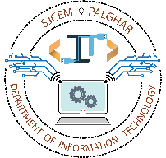
SQL Injection Detection
Aldel Education Trust’s
St. John College of Engineering and Management, Palghar
NAAC Accredited with Grade A+
Department of Information Technology
Manaswa Machhi [EU1214001]
Yash Pashte [EU1214029]
Hardik Mandale [EU1214050]
Gaurang Kapse [EU1214053]
Ms. Shraddha More | Project Guide
April 26, 2024
1

Slide 2
Contents
Abstract
Introduction
Motivation
Problem Statement
Objectives
Scope
Review of Existing Literature
Proposed System
Block Diagram of Proposed System
Implementation
Algorithm/Flowchart
Screenshots of the Output
Technologies Used
Results and Discussion
Conclusion and Future Work
References
2

Slide 3
Abstract
The prevalence of SQL injection attacks poses a significant threat to the security of web applications, enabling malicious actors to exploit vulnerabilities in database systems. These attacks involve the insertion of malicious SQL code into input fields, potentially compromising sensitive data and undermining the integrity of the affected systems. To address this threat, our project focuses on developing an effective SQL injection detection system. Through the implementation of machine learning algorithms, we aim to identify and mitigate SQL injection attacks in real time. By analyzing query patterns and characteristics, our system can distinguish between legitimate and malicious SQL queries, thereby enhancing the overall security posture of web applications. Through proactive detection and prevention measures, we strive to safeguard against the potential risks posed by SQL injection vulnerabilities, ultimately bolstering the resilience of online systems against cyber threats.
3

Slide 4
Introduction
Motivation:
Security Vulnerabilities: The pervasive threat of SQL injection attacks poses a substantial risk to web applications, necessitating robust detection mechanisms.
Data Breach Risks: Exploitation of SQL injection vulnerabilities can lead to unauthorized access to sensitive data, compromising user privacy and system integrity.
Need for Proactive Measures: Existing security measures may be insufficient to mitigate the evolving tactics of attackers, highlighting the urgency for advanced detection systems.
4

Slide 5
Introduction
Problem Statement:
SQL injection attacks present a pervasive threat to the security of web applications, allowing malicious actors to exploit vulnerabilities in database systems. Without robust detection mechanisms, these attacks can lead to unauthorized access to sensitive data and compromise the integrity of affected systems. Addressing this issue requires the development of efficient detection systems capable of identifying and mitigating SQL injection vulnerabilities in real-time, thereby enhancing the overall security posture of web applications.
5

Slide 6
Introduction
Objectives:
Algorithm Evaluation: Assess the performance of multiple machine learning algorithms for SQL injection detection, focusing on metrics such as accuracy, precision, recall, and F1-score.
Model Selection: Identify the most accurate and reliable algorithm for integrating into the SQL injection detection system, considering factors such as computational efficiency and real-world applicability.
Integration Readiness: Prepare the selected algorithm for seamless integration into existing web application environments, ensuring compatibility and interoperability with relevant frameworks and technologies.
6

Slide 7
Introduction
Scope:
The scope of the project entails the creation of an efficient SQL injection detection system tailored for web applications. This system will focus on accurately identifying and mitigating SQL injection vulnerabilities in real time, thereby enhancing the security posture of targeted web applications. The project will involve the development and implementation of machine learning algorithms for robust detection capabilities.
7

Slide 8
Literature Review
Year | Paper Title | Methodology | Results | Future Scope
2022 | Detection and prevention of SQLI attacks and developing compressive framework using machine learning and hybrid techniques | Naïve Bayes, Decision Tree, SVM, Random Forest | Random Forest machine learning model provides results with an accuracy of 96.64%. | Maximizing the dataset and running with different techniques in a real-world environment.
2022 | Detection of SQL Injection using Machine Learning: A Survey | Naïve Bayes, Gradient Boosting Machine | Naïve Bayes classifier machine learning model provides results with an accuracy of 92.8%. | Implementation of other machine learning algorithms to get better accuracy.
8

Slide 9
Literature Review
Year | Paper Title | Methodology | Results | Future Scope
2019 | SQL Injection Detection Using Machine Learning | Naïve Bayes, Gradient Boosting Machine | Naïve Bayes classifier machine learning model provides results with an accuracy of 92.8%. | Implementation of other machine learning algorithms to get better accuracy.
2018 | SQL Injection Detection Using Machine Learning and Multiple Data Sources | Random Forest, SVM, ANN | Random Forest algorithm shown 96.525% accuracy. | Collection of larger dataset and analysis of additional machine learning techniques for both accuracy and performance.
9

Slide 10
Proposed System
The proposed system is a robust SQL injection detection solution that leverages machine learning algorithms to identify and mitigate potential security threats in web applications. Through extensive training and evaluation, the system has been equipped with multiple algorithms, including Logistic Regression, Naive Bayes, Random Forest, and Support Vector Machine, to accurately detect SQL injection attacks. While the primary focus has been on algorithm selection and model training, the next phase of development will involve integrating the detection system seamlessly into existing web application frameworks. This integration will enable developers and administrators to deploy the solution effortlessly, bolstering the security posture of their applications. Additionally, ongoing performance optimization efforts will ensure that the system remains effective and efficient in identifying and mitigating SQL injection vulnerabilities.
10

Slide 11
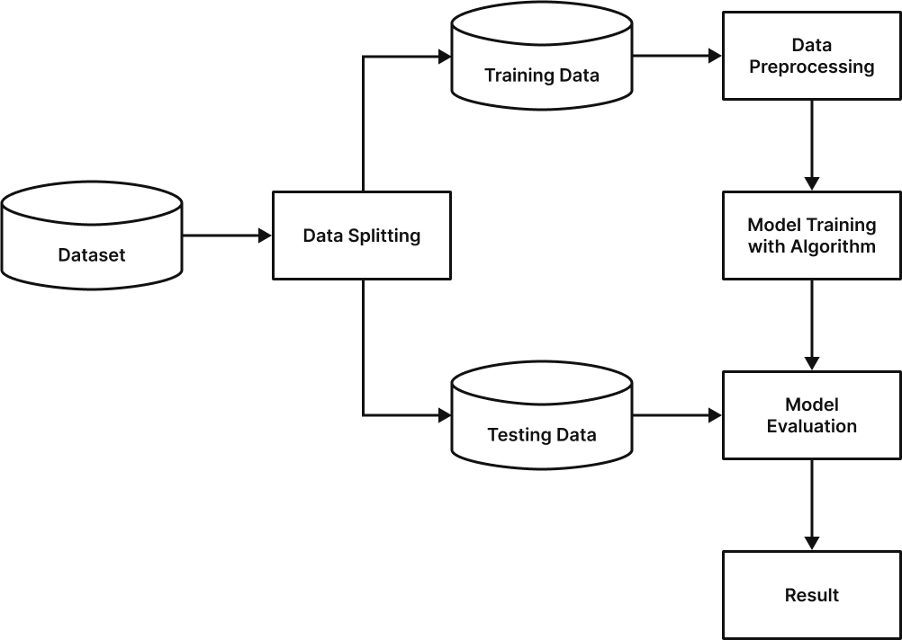
Proposed System
Fig. 1: Block Diagram
11

Slide 12
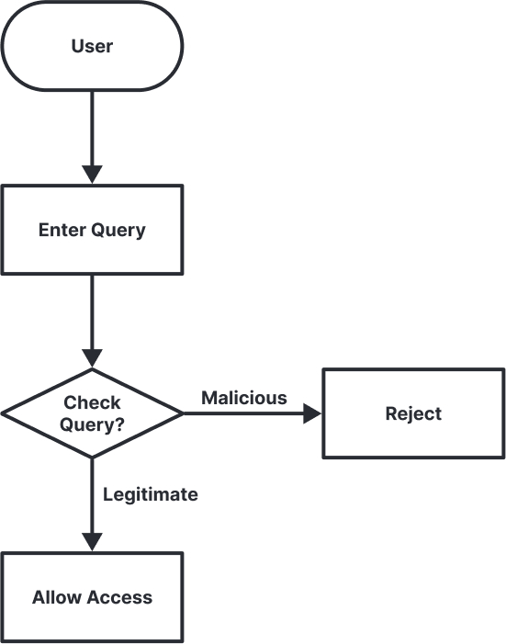
Implementation
Fig. 2: Flowchart
12

Slide 13
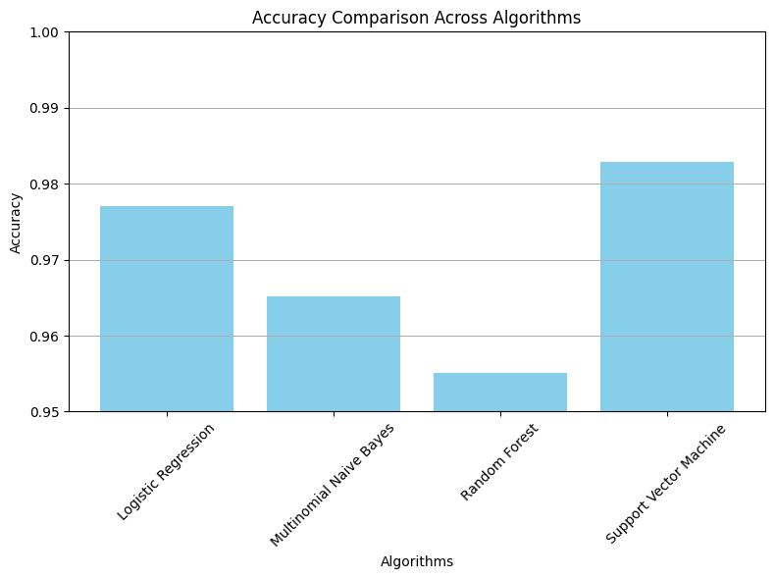
Implementation
Fig. 3: Bar plot comparing the accuracy of different algorithms
13

Slide 14
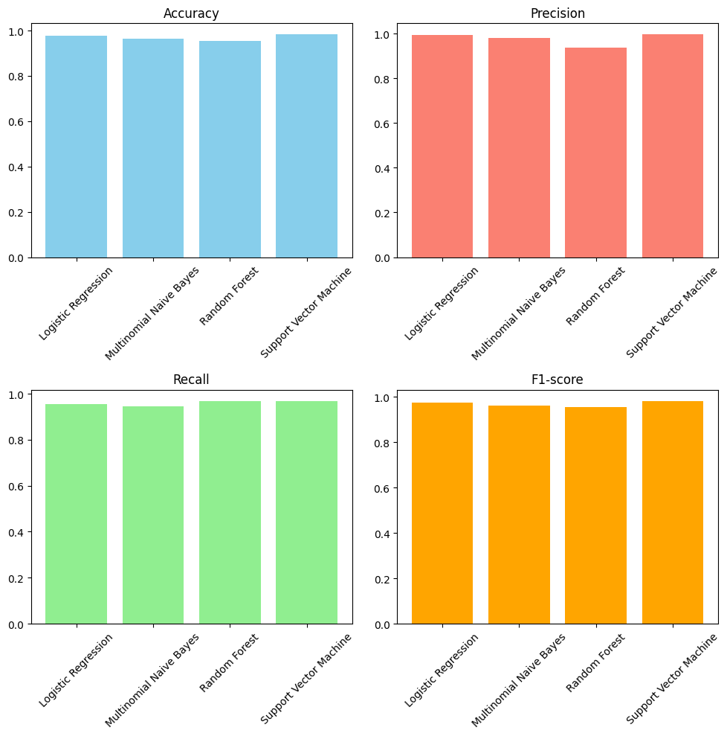
Implementation
Fig. 4: Bar Plot representing the value of each metric of a specific algorithm
14

Slide 15
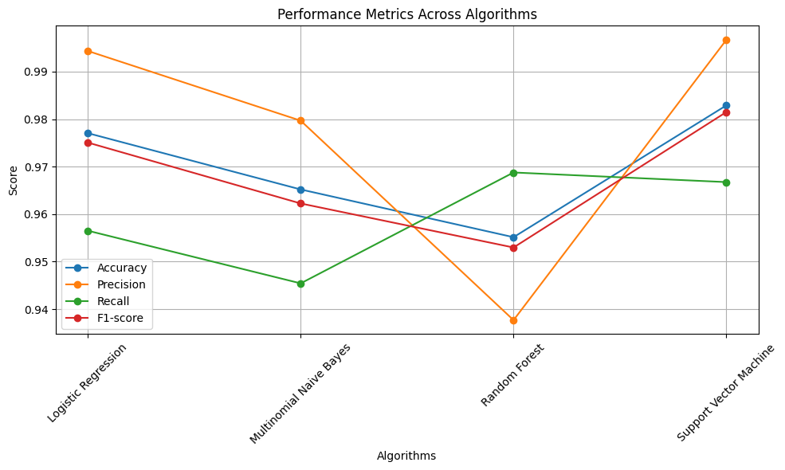
Implementation
Fig. 5: Line plot showing the performance metrics across different algorithms
15

Slide 16
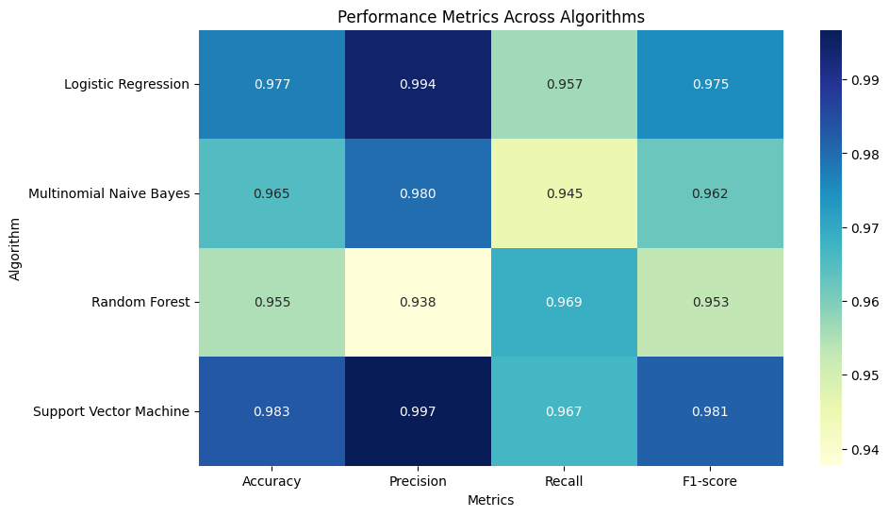
Implementation
Fig. 6: Performance Metrics Heatmap Across Algorithms
16

Slide 17
Technologies Used
Hardware Requirements:
Hard Disk – 500 GB (minimum)
RAM required – 8GB (minimum)
Processor – Intel Core i5 8th Gen
Software Requirements:
Python (for machine learning model development)
Google Colab (for code development and analysis)
Visual Studio Code (for code development)
17

Slide 18
Results and Discussion
The project evaluated multiple machine learning algorithms to identify the most effective approach for SQL injection detection. Each algorithm was trained and evaluated based on metrics such as accuracy, precision, recall, and F1 score. Notably, the Support Vector Machine (SVM) algorithm exhibited the highest accuracy of 98.29%, showcasing its effectiveness in detecting SQL injection vulnerabilities.
Conversely, other algorithms such as Logistic Regression, Multinomial Naive Bayes, and Random Forest yielded slightly lower accuracy rates, ranging from 95% to 97%. While these algorithms provided respectable performance, their precision and recall scores varied, indicating potential limitations in accurately detecting SQL injection attacks compared to SVM.
Overall, the results highlight the critical role of selecting an appropriate machine-learning algorithm for SQL injection detection. The superior performance of SVM underscores its suitability for real-world applications where precision and accuracy are paramount. Future efforts may involve fine-tuning model hyperparameters and exploring ensemble methods to further enhance detection accuracy and robustness.
18

Slide 19
Conclusion and Future Work
Conclusion:
In conclusion, the "SQL Injection Detection" project has made significant strides in enhancing the security of database systems against SQL injection attacks. By leveraging machine learning algorithms, particularly Support Vector Machine (SVM), the project has demonstrated the ability to accurately detect and mitigate SQL injection vulnerabilities. The development of a robust detection system contributes to bolstering cybersecurity measures for organizations and individuals relying on database technologies. safeguarding critical data assets and fortifying defenses against malicious attacks.
19

Slide 20
Conclusion and Future Work
Future Work:
System Integration: Integrate the SQL injection detection system seamlessly into web application frameworks and platforms, ensuring compatibility and ease of deployment for developers and administrators.
Performance Optimization: Continuously optimize the detection system for enhanced efficiency and accuracy, leveraging advancements in machine learning algorithms and cybersecurity techniques.
20

Slide 21
References
[1] Wubetu Barud Demilie and Fitsum Gizachew Deriba, “Detection and prevention of SQLI attacks
and developing compressive framework using machine learning and hybrid techniques” (2022).
[2] Maha Alghawazi, Daniyal Alghazzawi and Suaad Alarifi, “Detection of SQL Injection using Machine Learning: A Survey” (2022).
[3] Sonali Mishra, “SQL Injection Detection Using Machine Learning” (2019).
[4] Kevin Ross, “SQL Injection Detection Using Machine Learning and Multiple Data Sources” (2018).
[5] Akhtar, C. G., Reddy, M. H., Keerthana, P., Likitha, P., & Nithya Sri, S., “SQL Injection Detection Using Machine Learning Techniques”, Journal of Critical Reviews, vol. 21, no. 6, pp. 686-728 (2018).
21

Slide 22
Thank You !!!
22

Slide 23
Q & A
23

