Slide 1

Faculty of Engineering and Tech , Jamia Millia Islamia
Team Rule_Followers:- Dhruv Malik and Abhishek Barnwal
#HumseFarakPadtaHai www.road-safety.co.in

Slide 2
Scope of our Application
Reduce Driver Distraction and Their Credibility
Each Yr , around “1.5 lakh in india alone”are killed worldwide by road accidents
(i) majority reason (85%) is due to distracted driver and in-ability of driver to take correct decision in crucial time (2 sec)
(ii) also significant number of accidents are caused by the people who have been on substance abuse (like on alcohol,drugs) , they regularly break laws and due to laxity , they again get driving jobs and thus become frequent offenders
#HumseFarakPadtaHai www.road-safety.co.in

Slide 3
Possible Solution
Making an app which will indicate driver about the impeding dangers using front camera while at the same time observe the behaviour driver and measure Cognitive Load (Wether the driver is about to snooze or not , less
Making an immutable ledger of the Statistics of the Driver (number of miles traveled , no of accidents / traffic based violations. This will be helping not only law enforcement agencies but also the insurance industries , cab services can benifit the most to get experienced drivers with clean record.
Also when there is incoming call/message , we can use NLP bots like allo/alexa to tell the user about the contents and asks action to be taken so that we can minimise the distraction from smartphone while using its basic functions
#HumseFarakPadtaHai www.road-safety.co.in

Slide 4

Our Alternative:- Drive Safe
Uses state of the art machine learning models to process the video feeds(as a background process) and then warn user about distractive behaviour or of tailgating/other obstacles
Keeps the stats of driver and all the violations done by him (accidents , overspeeding etc) to make reporting and mitigation of judicial process easier. Also it profiles the persons driving skills which can then be used to get good insurance schemes.
#HumseFarakPadtaHai www.road-safety.co.in

Slide 5
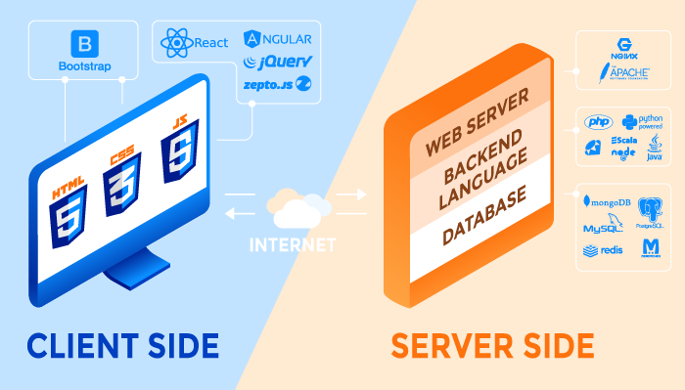
Tech stack used:-
Programming Language (Python ,Java)
Video processing libraries like OpenCV
Deep learning and machine learning frameworks like Tensorflow , Sklearn ,
#HumseFarakPadtaHai www.road-safety.co.in

Slide 6
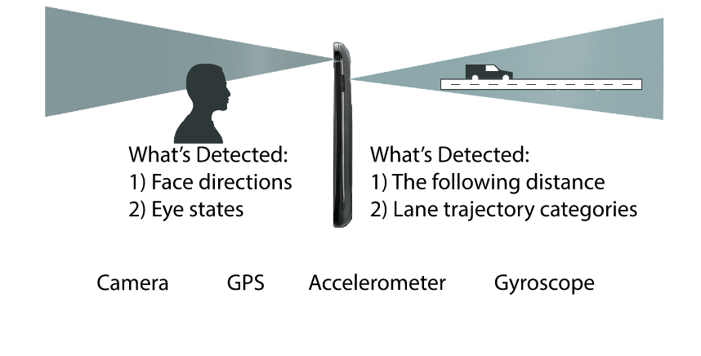
General architecture
#HumseFarakPadtaHai www.road-safety.co.in

Slide 7
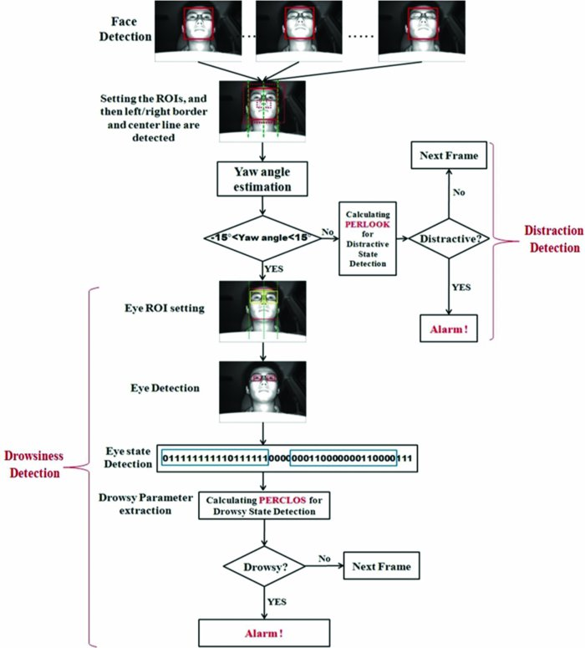
Application architecture for face detection
#HumseFarakPadtaHai www.road-safety.co.in

Slide 8
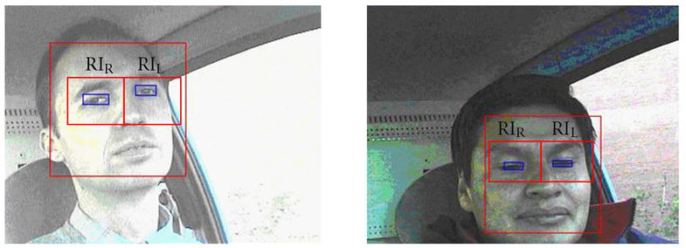
Examples
#HumseFarakPadtaHai www.road-safety.co.in

Slide 9
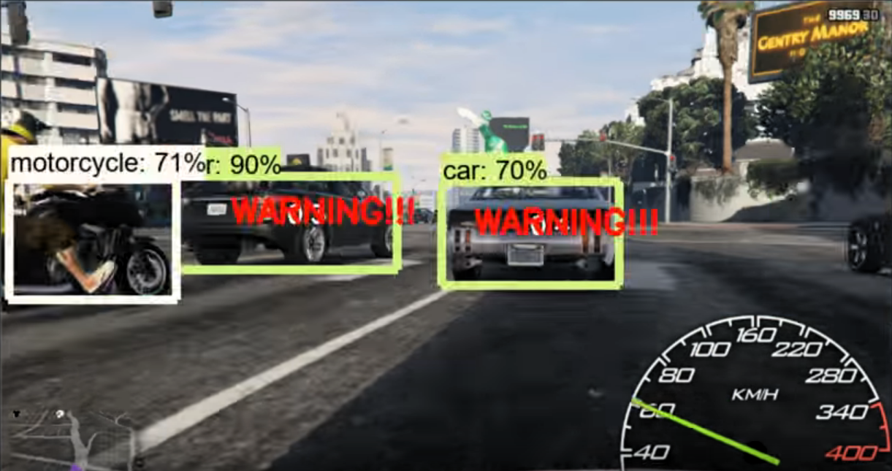
Use of back Camera :- Making a collison Detection System using OpenCV and Tensorflow

Slide 10
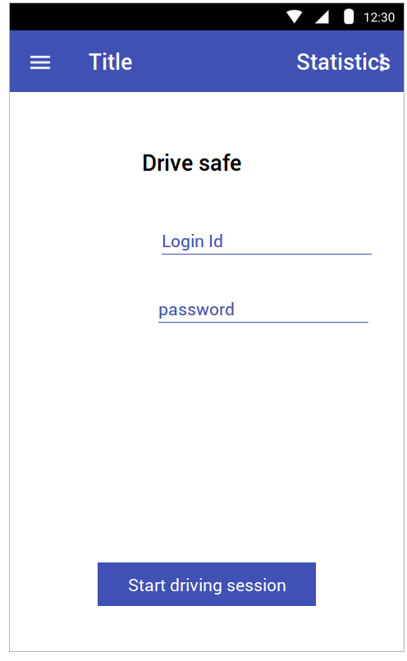
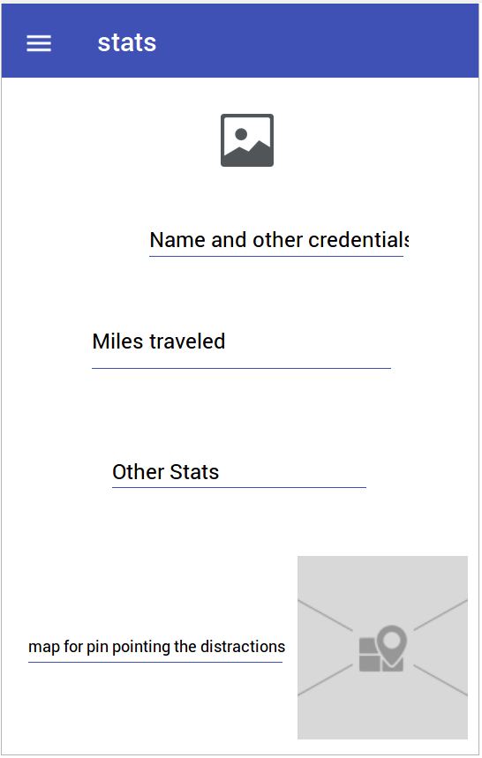
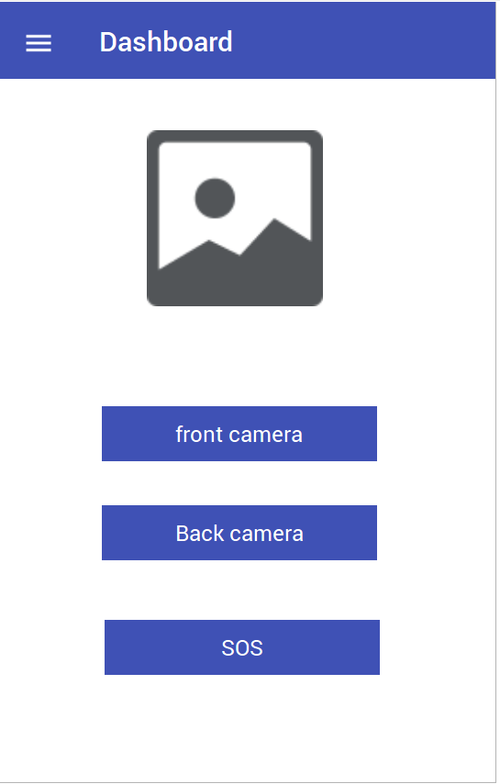
User Interface

Slide 11
Future Roadmap
Optimizing the models
Optimize the battery and memory usage
Working on other aspects of the architecture

Slide 12
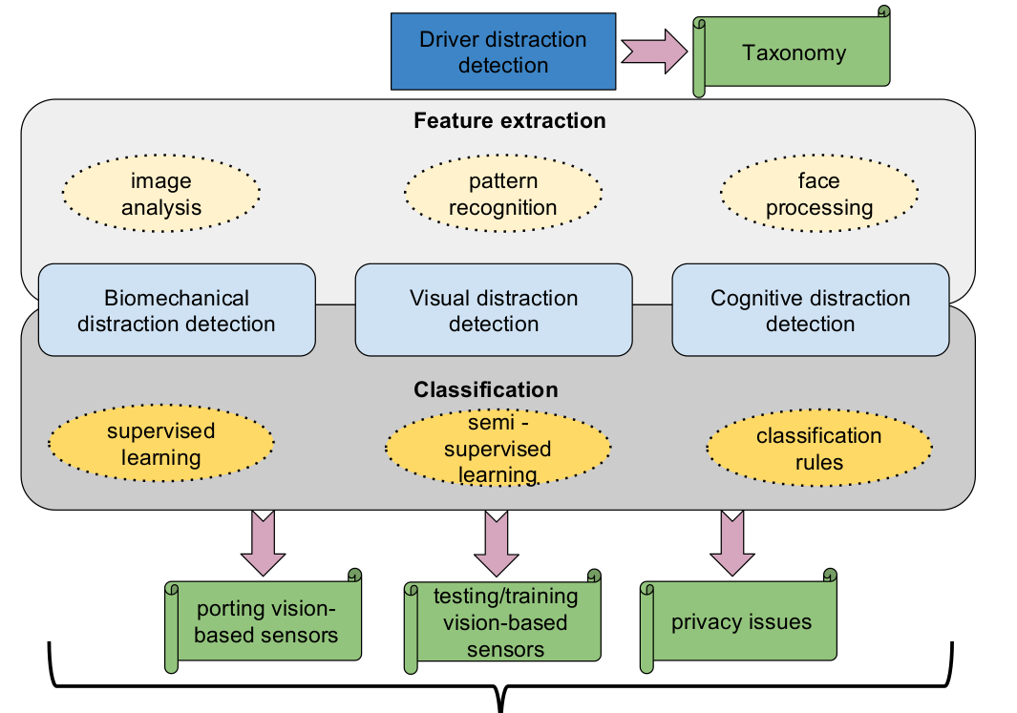
Complete architecture

Slide 13
Any Questions?

Slide 14
THANK
YOU

