Slide 1
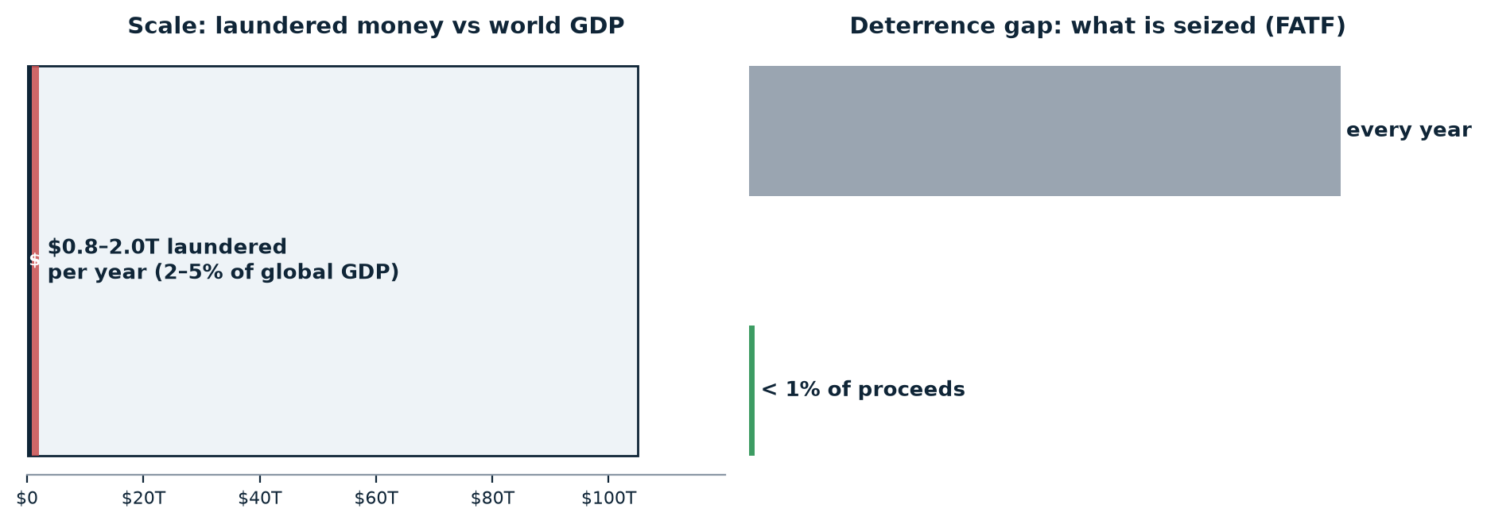
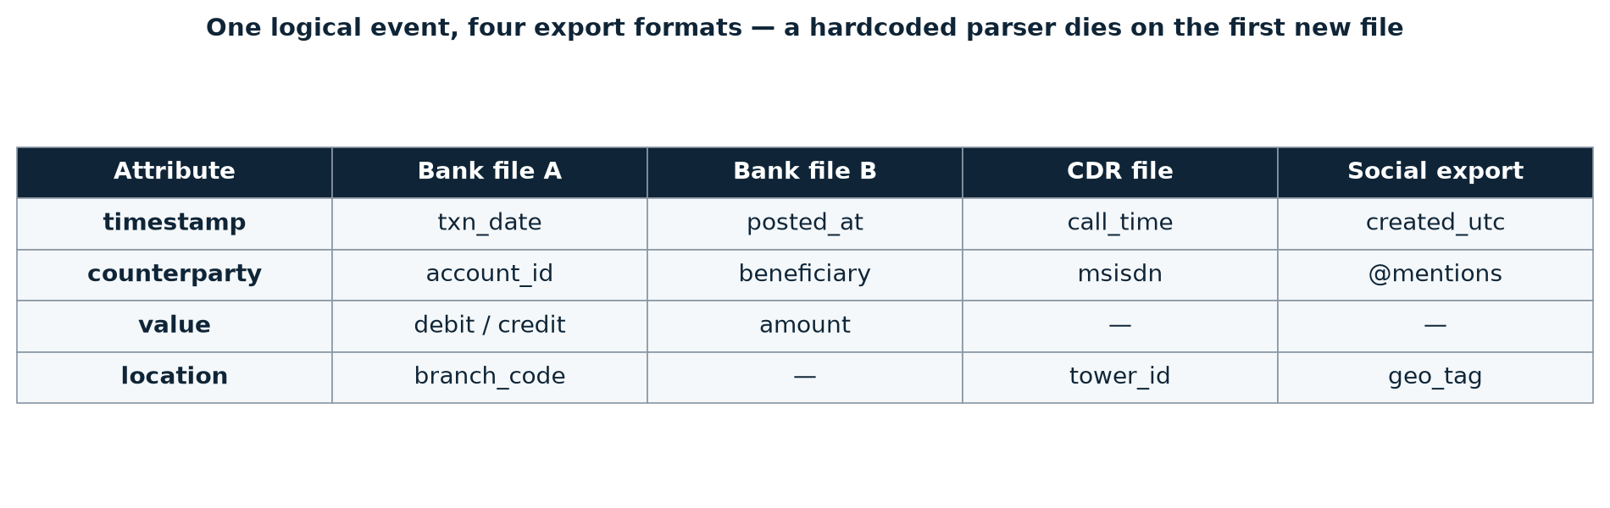
1 · Problem Statement
Financial crime is hidden across channels — single-source monitors can't see it
Cross-source blindness
A call 19 minutes before a transfer is invisible to a bank-only monitor. The link between sources IS the crime signal.
Schema fragility
txn_date vs posted_at vs call_time — a hardcoded parser dies on the first new export format.
Coverage dishonesty
Systems silently run with missing attributes — no “insufficient data” story, no analyst trust, no accountability.
Consequence: no fixed parser can work. The pipeline must detect schema at runtime — and say exactly when a model cannot be supported.
Multi-Model Anomaly Detection Engine · CDR · Bank · Social
1 / 4

Slide 2
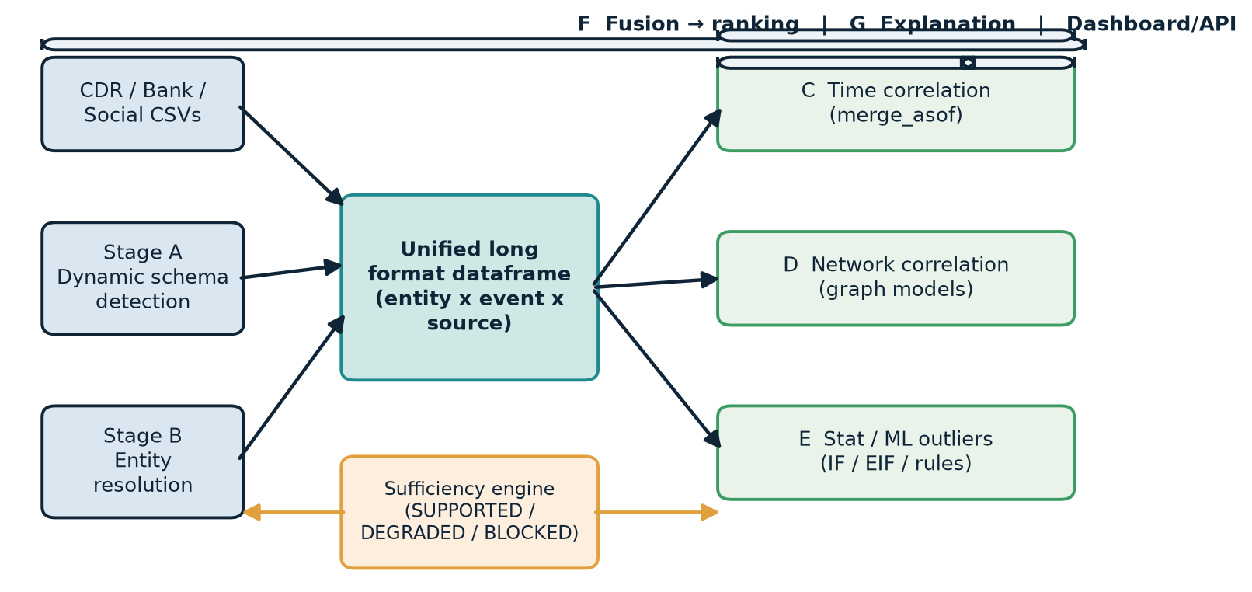
2 · Proposed Solution
One source-agnostic pipeline — only the models the data can support run
The five-step pipeline
1. Dynamic schema detection
fuzzy header match + content probes; source type falls out of resolved fields
2. Entity resolution
ties one person across bank, call & social records without a shared ID
3. Unified long-format frame
entity × event × source × amount × counterparty
4. Three analysis families in parallel
time · network · statistical/ML outliers
5. Fusion → explanation → dashboard
which models fired, the evidence, the score
Every model reads the same unified long-format frame
Data-sufficiency engine — verdict per model, per source combination:
entity_id | event_type | timestamp | source | amount | counterparty
E014 | call | 09:12 | cdr | — | E027
E014 | transaction | 09:24 | bank | 48,000 | E027
E047 | post | 09:27 | social | — | —
SUPPORTED → run
DEGRADED → run + warn
BLOCKED → say why
“Network-correlation model skipped: no counterparty/edge dimension resolved. Add a CDR (phone) or bank (account) file to enable it.”
Multi-Model Anomaly Detection Engine · CDR · Bank · Social
2 / 4

Slide 3
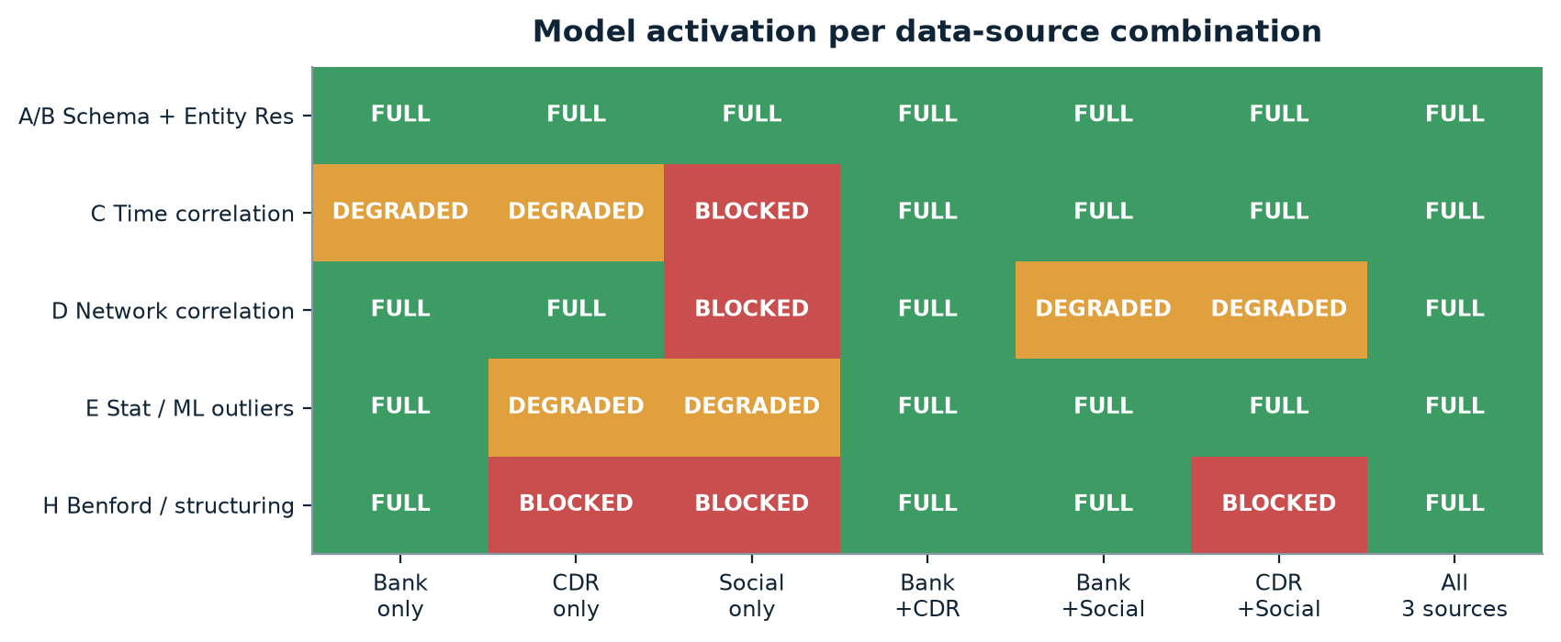
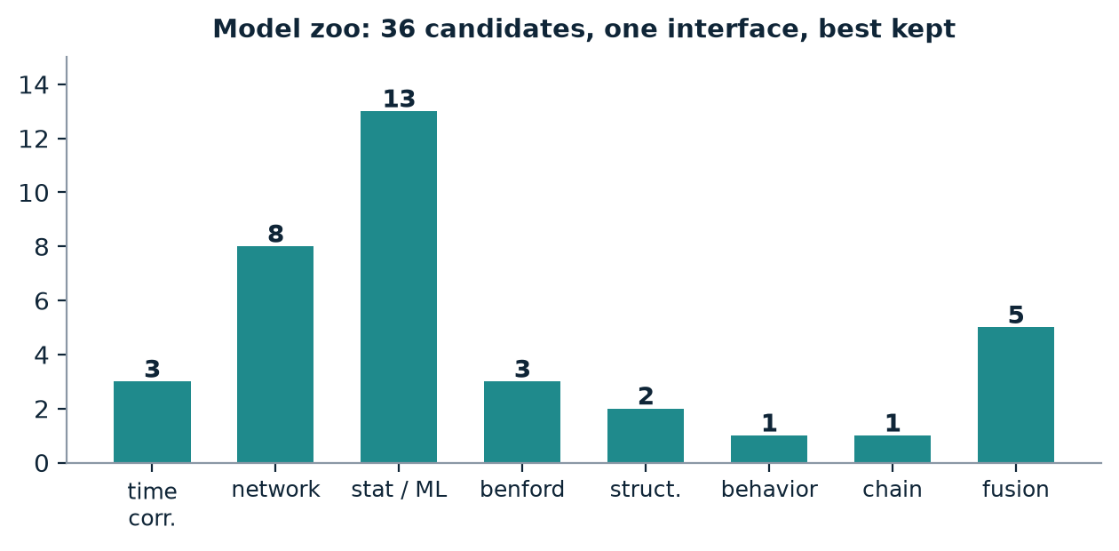
3 · Key Features
Six capabilities make the ensemble honest, explainable and provable
1
Dynamic schema detection
Fuzzy header match + content inference; handles renamed, unlabeled and mixed-format columns
2
Entity resolution
Blocking + weighted fuzzy linkage resolves one person across sources with no shared ID
3
Multi-model ensemble
Time · network · stat-ML · Benford · structuring · behavioral · chain fused into one ranking
4
Data-sufficiency engine
Per-model SUPPORTED / DEGRADED / BLOCKED verdicts with human-readable reasons — never silent failure
5
Explainable insights
Plain-language narration per flagged entity: which models fired, the evidence, the combined score
6
One-command evaluation
Recall/precision@k, per-type ablation, H1 check and surprise hold-out from a single command
Multi-Model Anomaly Detection Engine · CDR · Bank · Social
3 / 4

Slide 4
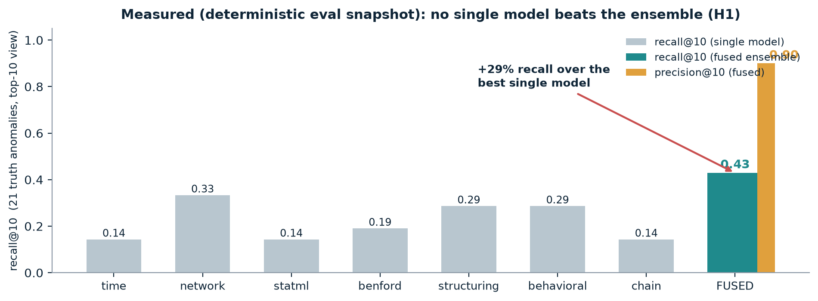
4 · Deliverables / Proposed Outcome
Working today — every claim is harness-measured, not illustrative
What we ship — working today
✓ Auto-adaptive ingestion + schema detection
dirty-data audit 14/14
✓ Capability registry + sufficiency engine
SUPPORTED / DEGRADED / BLOCKED
✓ 7 model families, ~36 candidates
one shared dataframe
✓ Fusion ranking + explanation generator
Borda + learned meta-learner
✓ GUI dashboard
drag & drop, history, JSON/CSV/prose reports
✓ Synthetic generator + surprise answer key
write-only, leak-proof
✓ One-command eval harness
92 pytest green
Proposed outcome — targets vs measured (deterministic eval snapshot)
Metric | Measured | Target
recall@10 · predefined storylines | 0.43 baseline | ≥ 0.95*
precision@10 · false-alert control | 0.90 | ≥ 0.60
fusion vs best single model | +29% relative | +15%*
schema stress · renamed / unlabeled files | 14 / 14 | 100%
surprise hold-out · write-only key | 12 / 12 mapped | ≥ 0.80 recall*
regression suite | 92 pytest | stay green
*Targets are reached by threshold tuning only — models and features are frozen after the demo.
Multi-Model Anomaly Detection Engine · CDR · Bank · Social
4 / 4

