Slide 1
AI-POWERED HEALTHCARE PLATFORM
ArogyaAI
From patient symptoms to doctor-ready clinical briefs —
in any language, before the consultation begins.
Hack Nova • AI Nexus 2026
Presented By- 1) Dhruv Nayak 2) Ankita Sangwikar
Notes:
Say the name clearly. Pause. Deliver the subtitle. 10 seconds — set the tone that this is a serious healthcare project.

Slide 2
THE PROBLEM
Meet Ramesh
"Ramesh is 58. He carried a folder of lab reports to a government hospital.
He waited
3 hours. His consultation lasted 90 seconds.
The doctor never opened his folder. Ramesh has undiagnosed diabetes."
1:1,457
Doctor-patient ratio
WHO recommends 1:1,000
This isn't rare. This is the norm.
⏱️
Under 2 minutes — average consultation time in India [Irving et al., BMJ Open 2017]
~63%
📄
Paper reports ignored — doctors have no time to read unstructured documents
Out-of-pocket
health spending
🗣️
Language barrier — most Indians don't speak English, yet health AI is English-only
22
Official languages
Health AI speaks 1
Notes:
Tell Ramesh's story. Don't read bullets — narrate. Pause. Let it land. Then move forward.

Slide 3
OUR SOLUTION
ArogyaAI — Making Every 2 Minutes Count
An end-to-end AI platform that speaks the patient's language, understands their documents, and prepares the doctor — before the consultation begins.
🗣️
🧠
👨‍⚕️
Speak Your Language
AI Understands Reports
Doctor Gets a Brief
Voice input in Hindi, Marathi, English — even mixed Hinglish
Lab values extracted with AI reliability indicators you can verify
Structured clinical copilot with urgency, conditions, and focus areas
💡 Key: These aren't separate apps. It's one integrated pipeline — symptoms → documents → booking → AI copilot brief → doctor.
Notes:
Transition: 'What if Ramesh could describe his symptoms in Hindi? What if the AI could read his lab report AND tell the doctor what's wrong — before Ramesh walks in?'

Slide 4
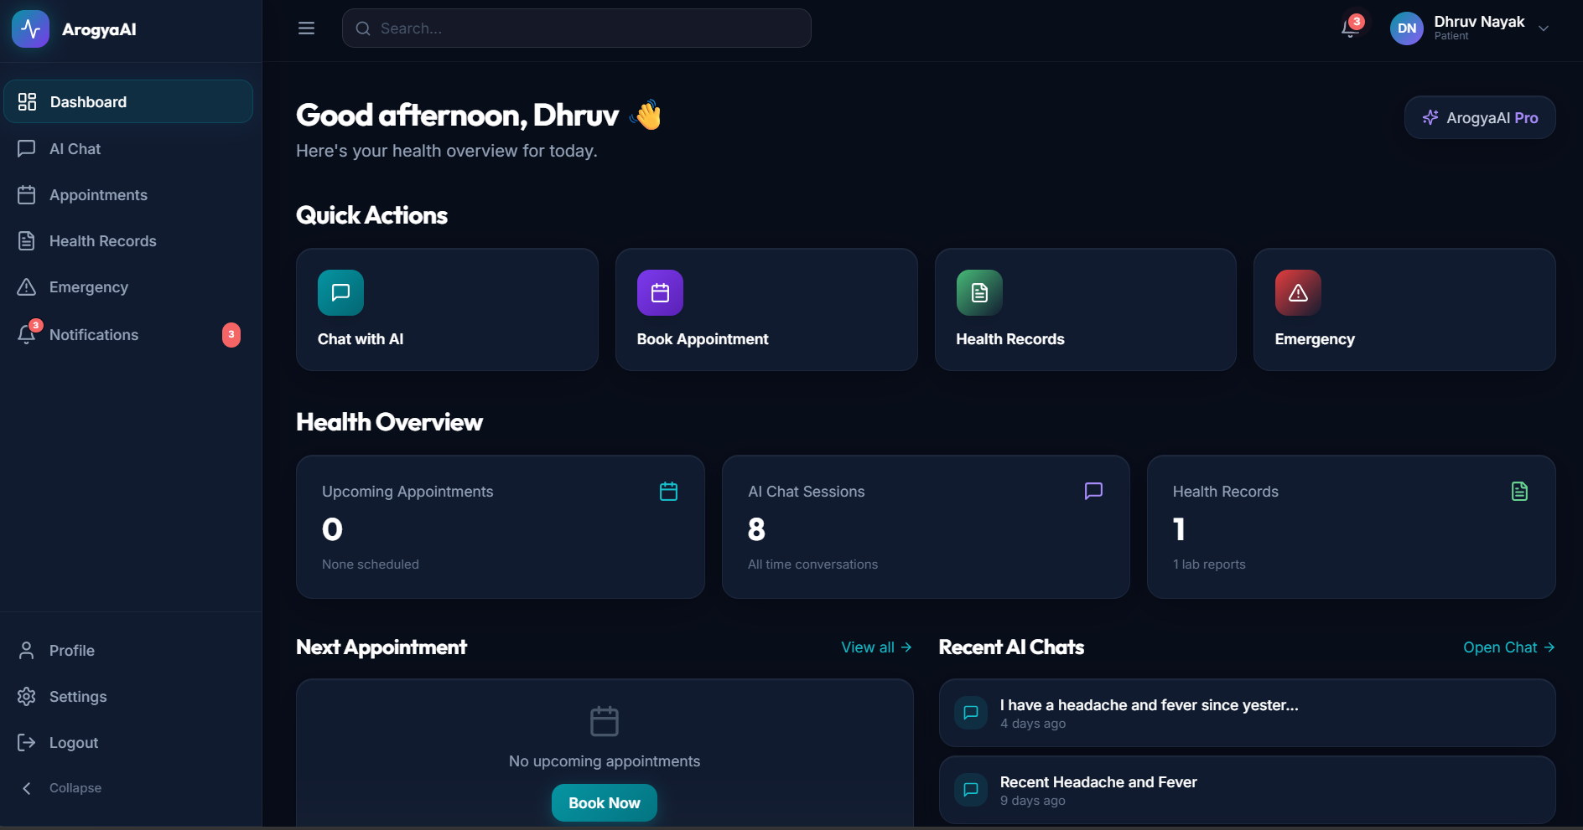
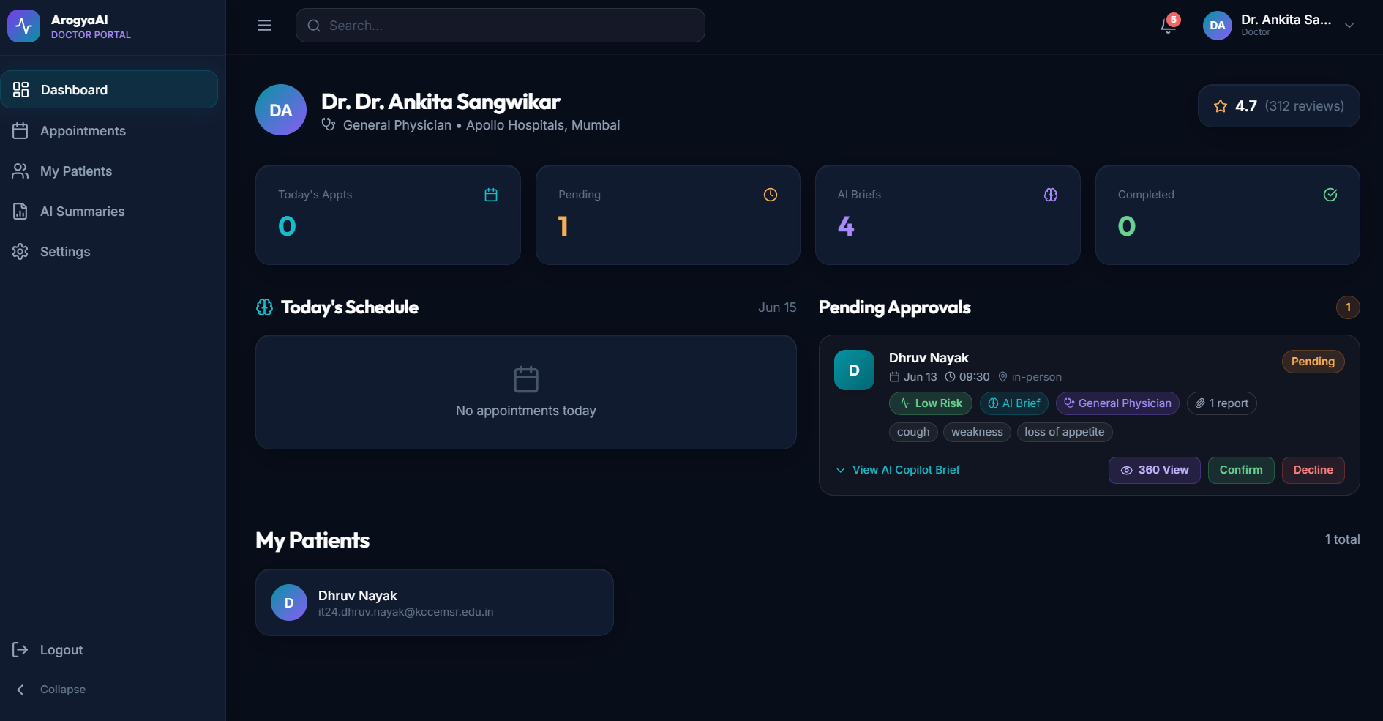
HOW IT WORKS
The Patient Journey — End to End
🗣️
📄
🤖
✅
👨‍⚕️
Describe
Symptoms
→
Upload
Reports
→
AI
Analyzes
→
Patient
Verifies
→
Doctor Gets
Brief
Voice or text
Hindi / Marathi / EN
PDF / image
Lab reports
OCR + Gemini
Quality indicators
Review & correct
Human-in-the-loop
AI Copilot output
Urgency + conditions
📱 Screenshot: Patient Dashboard
Capture from /dashboard
👨‍⚕️ Screenshot: Doctor Dashboard
Capture from /doctor/dashboard
Notes:
Walk through each step. Emphasize that every stage feeds the next. Key line: 'The doctor never starts a consultation cold.'

Slide 5
⭐ KEY INNOVATION #1
AI Pre-Consultation Copilot
Before the appointment, AI synthesizes symptoms + reports into a structured clinical brief the doctor reviews before the patient walks in.
{
"summaryText": "Patient reports fever and
headache for 3 days. Lab reports
indicate low hemoglobin.",
"symptoms": ["fever", "headache", "fatigue"],
"symptomTimeline": "3 days",
"urgencyLevel": "MEDIUM",
"conditions": ["Anemia", "Viral fever"],
"suggestedFocusAreas": [
"Complete blood count",
"Iron studies"
],
"abnormalValues": [{
"parameter": "Hemoglobin",
"value": "8.2 g/dL",
"normalRange": "12.0–17.5 g/dL"
}],
"analysisReliability": "HIGH",
"recommendedSpecialty": "General Physician"
}
🗣️ Accepts symptoms in Hindi, Marathi, English
📊 Correlates with uploaded report data
🚨 Assigns urgency: LOW → CRITICAL
🎯 Suggests focus areas + recommended specialty
🔬 Flags abnormal lab values with normal ranges
📈 Analysis reliability indicator (HIGH / MEDIUM / LOW)
⚠️ Advisory output only — not a clinical diagnosis. Always reviewed by the consulting physician.
Notes:
THIS IS YOUR STAR SLIDE. Spend 60+ seconds here. Point to the JSON. Read key fields aloud. Pause. Then: 'No consumer health app does this today.'

Slide 6
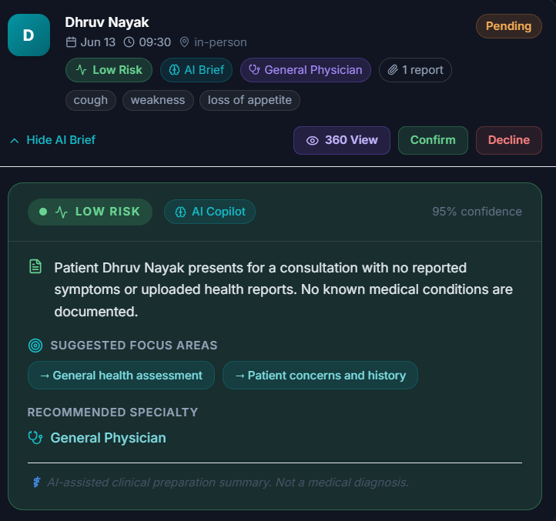
⭐ KEY INNOVATION #2
Medical Document Intelligence
📄
📝
🧠
✅
👨‍⚕️
Upload
→
Extract
→
AI Analysis
→
Verify
→
Doctor Summary
PDF / Image
pdf-parse →
Gemini Vision
Structured JSON +
quality indicators
🟢🟡🔴 cues
Edit & correct
Auto-generated
clinical summary
🟢 HIGH — AI Self-Assessment
🟡 MEDIUM — Verify Recommended
🔴 LOW — Manual Check Needed
Score ≥ 0.8 — AI reports high extraction certainty
Score 0.5–0.8 — patient should double-check this value
Score < 0.5 — patient should enter correct value
Notes:
Walk through the pipeline. Say 'AI self-assessment indicators' NOT 'confidence scores.' Green = confident, Amber = double-check, Red = verify manually. Do NOT say RLHF.

Slide 7
⭐ KEY INNOVATION #3
Multilingual Voice-First Input
Patients describe symptoms by speaking naturally — in their own language.
🇬🇧 English
🇮🇳 हिंदी
🇮🇳 मराठी
🎤
🎤 Real-time live transcription (browser-native speech recognition)
Voice Input (Hindi):
🔄 AI mirrors input language in responses
"मुझे 3 दिन से बुखार और सिरदर्द है,
और सीने में दर्द हो रहा है"
⚠️ Urgency keywords (chest pain, breathlessness) trigger instant alerts
🏷️ Quick-pick symptom tags for common conditions
🌐 Hinglish (mixed Hindi-English) handled naturally
⚠️ Urgent symptom detected: chest pain — call 112
AI normalizes for doctor's brief:
→ fever, headache, chest pain (3-day duration)
Notes:
Demo moment. Speak in Hindi live if mic works. If not, point to the card. The Hindi → urgency detection → clinical English normalization is visceral.

Slide 8
THE DOCTOR'S VIEW
AI-Powered Patient 360°
When the doctor opens a patient profile, they see an AI Command Center — not a blank chart.
🧠
AI Patient Snapshot
🎯
Consultation Prep Panel
Risk badge (LOW→CRITICAL), current symptoms, conditions, allergies — one hero view
AI-suggested focus areas, new symptoms since last visit, recent abnormal findings
📈
Health Trends
📋
Health Timeline
Biomarker trend charts (hemoglobin, glucose, cholesterol) with SVG line charts
Chronological patient history — appointments, reports, risk levels
📄
Reports Viewer
🚨
Emergency Triage
View PDFs and images inline. See AI analysis severity and extraction data.
4-level AI severity classification (CRITICAL/HIGH/MODERATE/LOW) and 112 quick-dial
Notes:
Show the doctor's side. 'This closes the loop — patient speaks, AI analyzes, doctor sees everything BEFORE the patient walks in.'

Slide 9
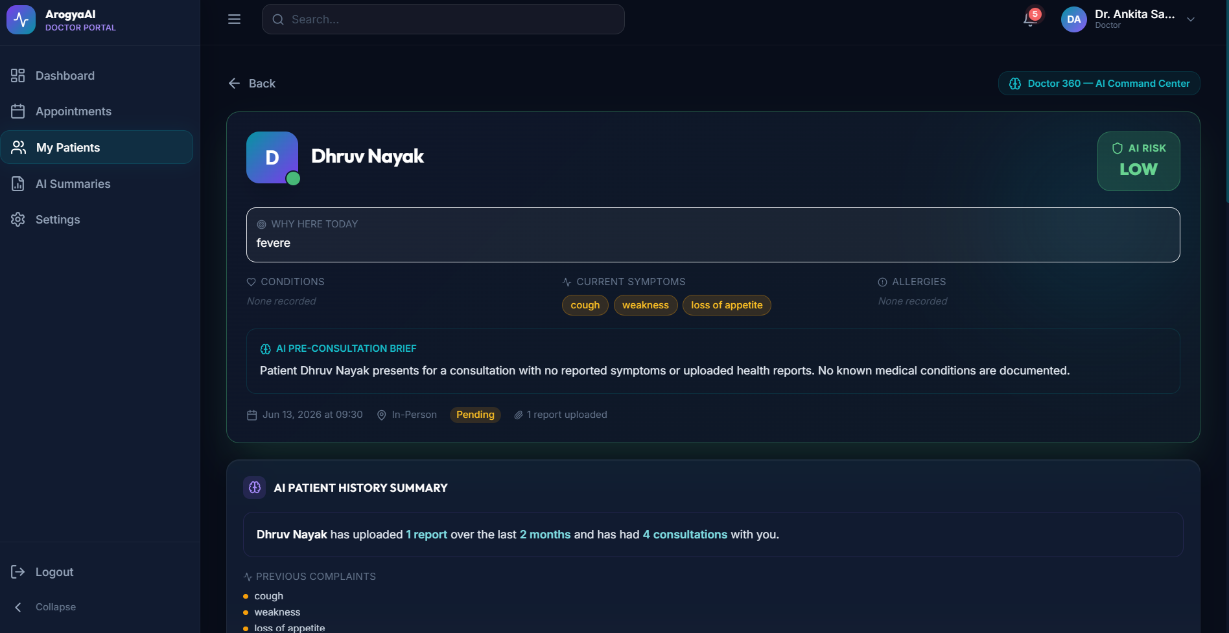
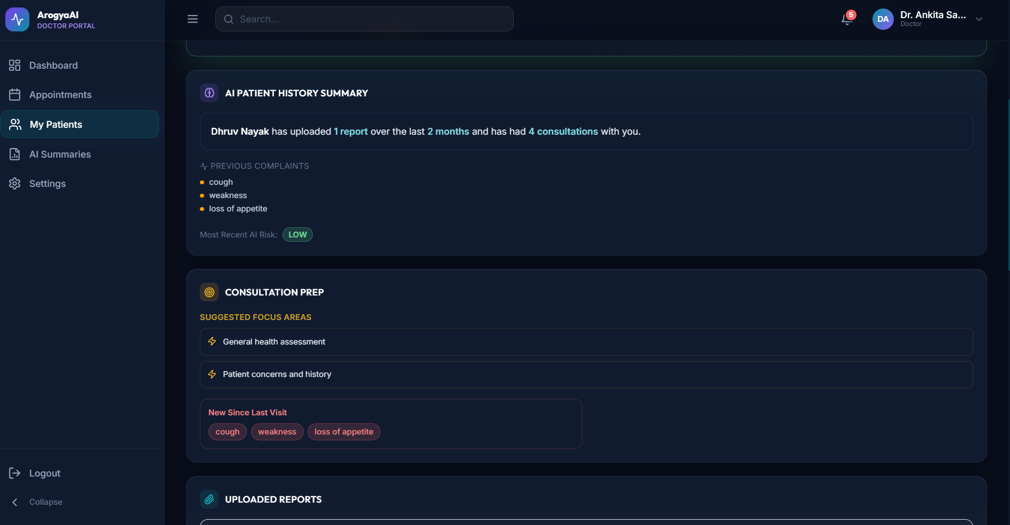
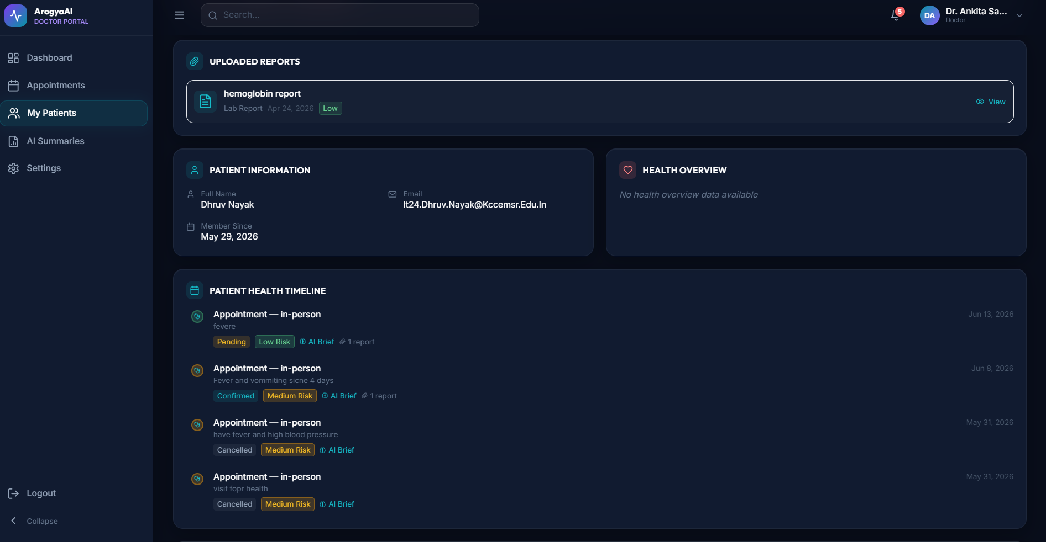
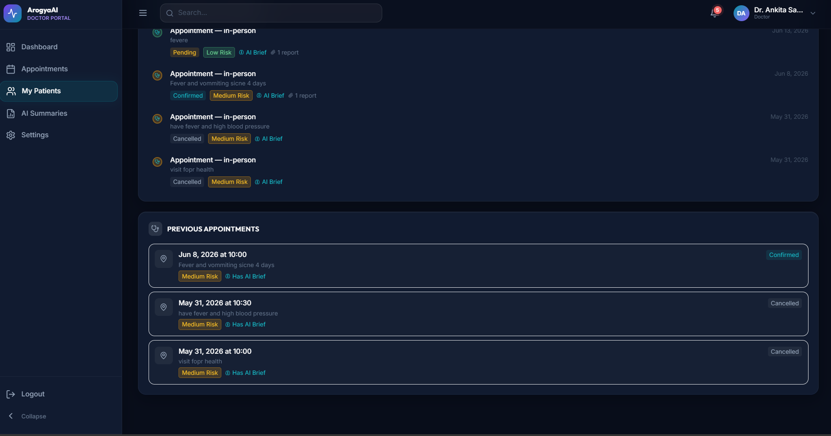

Slide 10
UNDER THE HOOD
Technical Foundation
Frontend
Backend
AI & Data
React 18 + Vite
Tailwind CSS + Framer Motion
Zustand state management
Browser-native voice API
Lazy-loaded routes
Node.js + Express.js
Modular service layer
JWT + OTP authentication
Cron-based reminders
Role-based access
Google Gemini API
4-model fallback chain
MongoDB Atlas
Cloudinary CDN
Nodemailer
🔄 AI Resilience
🛡️ Security
4-tier model fallback: gemini-flash-latest → 2.0-flash-lite → 2.0-flash → 2.5-flash. Daily quota exhaustion cached. Safety blocks throw immediately.
Helmet.js headers, MongoDB injection sanitization, CORS whitelist, role-based rate limiting (auth: 20/15min, AI: 20/15min, uploads: 10/15min), medical disclaimers.
Notes:
25 seconds max. Quick trust-building slide. Don't linger on npm packages. Say 'deployment-ready architecture' not 'production-grade.'

Slide 11
MARKET POSITION
Competitive Landscape
AI Capability
Practo
Ada Health
Nuance DAX
ArogyaAI
Appointment Booking
✅
—
—
✅
AI Symptom Chat
—
✅
—
✅
Medical Document AI
—
—
—
✅
AI Quality Indicators
—
—
—
✅
Human-in-the-Loop
—
—
—
✅
Pre-Consultation Copilot
—
—
Post-visit
✅
Multilingual Voice
—
—
EN only
✅
AI Emergency Triage
—
✅
—
✅
Total AI Features
1/8
2/8
1/8
8/8
⚡ Honest note: This comparison focuses on AI capabilities. Practo has millions of users, real payments, and verified doctors — operational capabilities we haven't built yet. Our advantage is in AI intelligence, not operational scale.
Notes:
Be honest about Practo's advantages. This honesty INCREASES your score with judges who know the market.

Slide 12
IMPACT & POSITIONING
Who Benefits — And Why We Can Win
👤 For Patients
👨‍⚕️ For Doctors
🛡️ Responsible AI
🗣️ Accessibility: Speak symptoms in your language
📋 Pre-read Brief: AI copilot before consultation
⚕️ Advisory only — not a diagnosis
📊 Transparency: See AI extractions, correct mistakes
⏱️ Time Efficiency: 1 min saved × 40+ patients
✅ Human verification for extracted data
📁 Continuity: Health records organized
🔬 Structured Data: Abnormal values flagged
👨‍⚕️ Doctors remain final decision makers
🚨 Safety: Emergency triage when seconds matter
📱 Automation: Cron reminders reduce no-shows
⚠️ Medical disclaimers on every AI output
✅ Working Prototype
🧠 5 AI Capabilities
🌐 3 Languages
⚙️ Deployment-Ready
❤️ 1.4B People
Running code, not slides
Chat, OCR, copilot, triage, summary
Hindi, Marathi, English
Fallback chain, auth, rate limiting
Solving a real problem at scale
Notes:
Three sections: Patients, Doctors, Responsible AI. Then the 5 reasons. Deliver with conviction.

Slide 13
VISION
Future Scope & Validation Roadmap
Future Development Phases
Validation & Ethics Roadmap
PHASE 1
NOT YET IMPLEMENTED
🏥 Clinical validation with practicing doctors
Verified doctor onboarding · Razorpay payments · Video consultations
🧪 Real-world pilot testing in healthcare facilities
PHASE 2
NOT YET IMPLEMENTED
ABDM / ABHA integration · Digital prescriptions · Unified health records
📊 Accuracy benchmarking against ground truth data
PHASE 3
NOT YET IMPLEMENTED
🔍 Explainability improvements for AI decisions
Chronic disease prediction · Longitudinal monitoring · AI visit summaries
⚖️ Bias and safety evaluation across demographics
PHASE 4
NOT YET IMPLEMENTED
📋 Regulatory readiness assessment (DISHA, CDSCO)
Android & iOS apps · Tamil, Telugu, Bengali, Kannada
PHASE 5
NOT YET IMPLEMENTED
⚠️ All validation items are future work. We know the path from prototype to product — and we've designed the architecture to support it.
Wearable integrations · Remote patient monitoring
Notes:
Run through 5 phases quickly. Then point to validation: 'We know the path from prototype to product.' Every item is future work.

Slide 14
Thank You
In India, a doctor sees 40 patients a day. Each consultation lasts 2 minutes. We can't add more minutes. But we can make every minute count.
Notes:
Deliver with conviction. Pause. 'We can't add more minutes. But we can make every minute count. That is ArogyaAI.' Smile.

