Slide 1

Enhancing Northwind Operations through Data Analytics
GROUP-8
Dhruv Patel | NF1000200
Jay Solanki | NF1019757
Krishmaben Patel | NF1017024
Professor: Omid Isfahanialamdari
Date: March 24, 2025

Slide 2
Problem Definition
Challenge: Northwind needs to understand customer behavior, sales trends, and product performance to stay competitive.
Goal: Use the database to identify patterns in customer behavior and product sales to make data-driven marketing decisions.
Research Questions
What are the purchasing patterns of Northwind's customers? How do customer segments impact marketing?
Which products generate the highest revenue? How do seasonal trends affect product demand?
How do operational factors like delivery affect repeat purchases?

Slide 3
Hypothesis
RQ1) Customer Segment
Null: Customers with higher order frequency do not significantly contribute
Alternative: Customers with higher order frequency contribute significantly more
RQ2) Product Performance
Null: Uniform distribution across categories
Alternative: Significant variations exist between categories
RQ3) Predictive Capability
Null: Random purchasing patterns
Alternative: Predictable patterns based on historical data

Slide 4
Data Collection
SELECT c.CustomerID, COUNT(o.OrderID) AS OrderFrequency, SUM(od.UnitPrice * od.Quantity * (1 - od.Discount)) AS TotalRevenue FROM northwindfull.Customers c LEFT JOIN northwindfull.Orders o ON c.CustomerID = o.CustomerID LEFT JOIN northwindfull.OrderDetails od ON o.OrderID = od.OrderID GROUP BY c.CustomerID ORDER BY OrderFrequency DESC, TotalRevenue DESC; | SELECT c.Country, c.CustomerID, c.City, COUNT(DISTINCT o.OrderID) AS TotalOrders, SUM(od.UnitPrice * od.Quantity * (1 - od.Discount)) AS TotalSales, AVG(od.UnitPrice * od.Quantity * (1 - od.Discount)) AS AvgOrderValue FROM northwindfull.Customers c JOIN northwindfull.Orders o ON c.CustomerID = o.CustomerID JOIN northwindfull.orderdetails od ON o.OrderID = od.OrderID GROUP BY c.Country, c.City, c.CustomerID ORDER BY TotalSales DESC LIMIT 25;

Slide 5
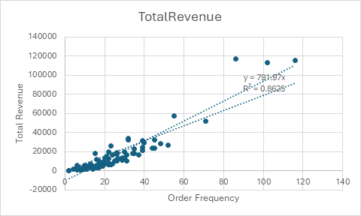
Data Analysis Results
Scatter Plot
Most points lie between 10–60 orders and $0–50,000 revenue.
A couple of points appears between 50-70 orders which generated $50,000–60,000 revenue.
Outliers include points near 120 orders and $120,000 revenue.
Bar Graph
Top 3 buyers by Total Sales are as follows:
Quick, Ernsh, and Sayea ~ $100,000
RaTc, Hung, and KoNe ~ $50,000 - 80,000
Hilaa, Bonap, and Botmi ~ $20,000 – 30,000

Slide 6
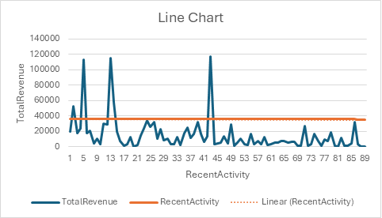
Data Analysis Results
Line Chart
Total Revenue (blue line) fluctuates particularly around RecentActivity values 5, 9, 41, and 45, indicating high revenue at these activity levels.
Recent Activity (orange line) shows a relatively constant trend.
Bar Graph
Top 5 frequent buyers by Order Frequency are as follows:
Beverages & Condiments leads with $200,000-$250,000 sales.
Confection & Meat/Poultry producing $150,000-$250,000 sales.
Seafood & Grains/Cereals with lowest Sale value of around $100,000.

Slide 7
Model Development
 | OrderFrequency | TotalRevenue
OrderFrequency | 1
TotalRevenue | 0.937104431 | 1
Correlation and T-test
The correlation between OrderFrequency and TotalRevenue is 0.9371, indicating a strong positive relationship.
The t-test results with extremely low p-values (2.04E-10 for one-tail, 4.09E-10 for two-tail) suggest that the means of the two variables are significantly different, confirming the importance of OrderFrequency in predicting TotalRevenue.
 | TotalRevenue | OrderFrequency
Mean | 14222.3937 | 24.21348315
Variance | 408841047.6 | 391.7834525
Observations | 89 | 89
Pooled Variance | 204420719.7
Hypothesized Mean Difference | 0
df | 176
t Stat | 6.624456207
P(T<=t) one-tail | 2.04E-10
t Critical one-tail | 1.653557435
P(T<=t) two-tail | 4.09E-10
t Critical two-tail | 1.973534388

Slide 8
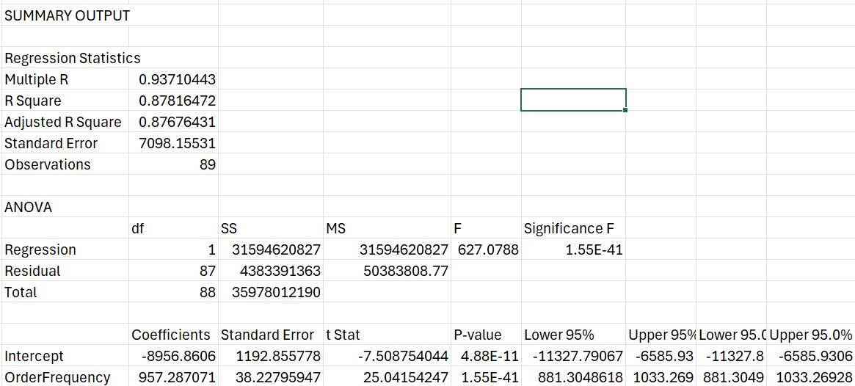
Model Development
Model Fit: The R² value of 0.0878indicates the model explains only 8.7% of the variation, with a Standard Error of 7098.16 , reflecting moderate prediction accuracy.
Significance: The F-statistic of 627.07 and a p-value of 1.55 confirm the model’s statistical significance at the 1% level. The p-values for AvgDeliveryTime (0.0354) and DeliveryConsistency (0.0066) indicate that these factors significantly influence RepeatOrderCount.

Slide 9
Conclusion
Key Findings | Business Aspects | Hypothesis
Returning customers significantly contribute more to revenue than one-time buyers. Beverages consistently generate the highest revenue. Total revenue strongly influences quarterly sales with an R-squared value of 0.5345. Timely deliveries can influence customer loyalty. | Focus on improving customer loyalty programs and strategies for retaining existing customers. Strengthen marketing and promotional efforts for Beverages to maximize revenue generation. Prioritize strategies that drive total revenue to enhance overall business performance. Optimize operational efficiency and delivery systems to ensure high customer satisfaction and repeat business. | H1: Customers with higher order frequency contribute significantly more. H2: Significant variations exist between categories. H3: Predictable patterns based on historical data.

Slide 10
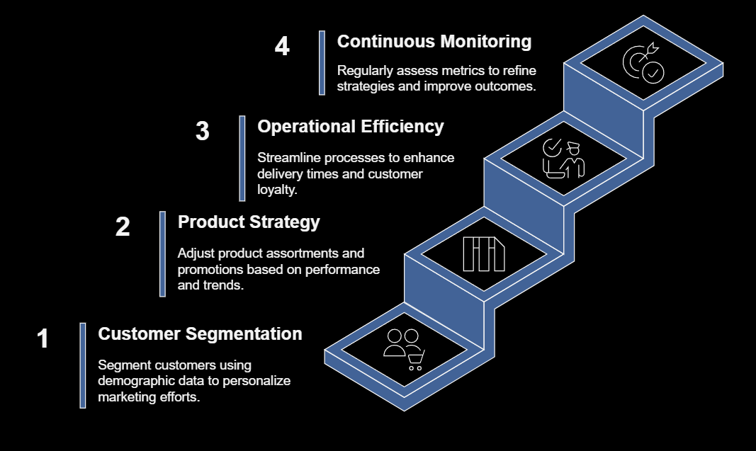
Recommendations

Slide 11
Thank You

