Slide 1



SMART INDIA HACKATHON 2026
IDEA SUBMISSION
VALIDRA
Evidence-first AI compliance engine for packaged commodities
Problem Statement ID | 26034
Problem Statement Title | Software System to check compliance of Packaged Commodities under Legal Metrology (Packaged Commodities) Rules, 2011 by scanning products, images and labels
Theme | Miscellaneous
PS Category | Software
Team Name | VisionMinds

Slide 2



IDEA / PROPOSED SOLUTION
VisionMinds
THE PROBLEM
Mandatory declarations are critical: Packaged commodities must display MRP, net quantity, manufacturer/packer details, dates and consumer-care information.
Manual inspection does not scale: Checking millions of packaged products across retail and e-commerce is time-consuming and difficult to perform consistently.
Violations are easy to miss: Missing declarations, incorrect MRP format, undersized text and improper placement require detailed visual verification.
No evidence-linked workflow: Traditional inspection often separates the observed label evidence from the rule/provision used to justify the finding.
OUR SOLUTION - VALIDRA
AI extracts → Rule Engine validates → Evidence-backed report
UNIQUENESS & INNOVATION
Evidence-first compliance — Every decision is linked to the extracted value, image evidence and applicable rule.
Rule-based validation — A dedicated rule engine checks presence, correctness, format, placement and font-size requirements instead of relying on an LLM for compliance decisions.
Confidence-aware pipeline — Confidence is carried from OCR → extraction → validation; uncertain cases are automatically marked NEEDS REVIEW.
Multi-parameter checking: checks declarations across value, format, placement, readability and font size, not just text presence.
Evidence-grade audit trail — Original images, bounding boxes, extracted values, validation results and inspection records are preserved for traceability and review..
COMPLIANCE CHECKS PERFORMED
1
SCAN: Upload or capture product label images for inspection.
EXTRACT: Image preprocessing + OCR identify required declarations and their location.
VALIDATE: A versioned rule engine checks presence, value, format, placement and font-size requirements against the applicable Legal Metrology rules.
CLASSIFY: Each declaration is classified as COMPLIANT, NON-COMPLIANT or NEEDS REVIEW based on validation and confidence.
REPORT: Generate a compliance report containing detected values, evidence crops, violations, confidence and applicable rule references.
REVIEW: Officers can review flagged cases and access searchable inspection history..
MRP Net Quantity Manufacturer / Packer
Mfg & Expiry Dates Consumer Care
Country of Origin Font Size (mm)
Placement Unit Sale Price Readability
2
3
4
5
6
AI-ASSISTED
RULE-DRIVEN
EVIDENCE-BACKED
OFFICER-READY
Automated label extraction with OCR + computer vision
Compliance decisions based on predefined Legal Metrology rules
Every finding includes extracted values and visual evidence
Clear compliance status, flagged issues and downloadable reports

Slide 3
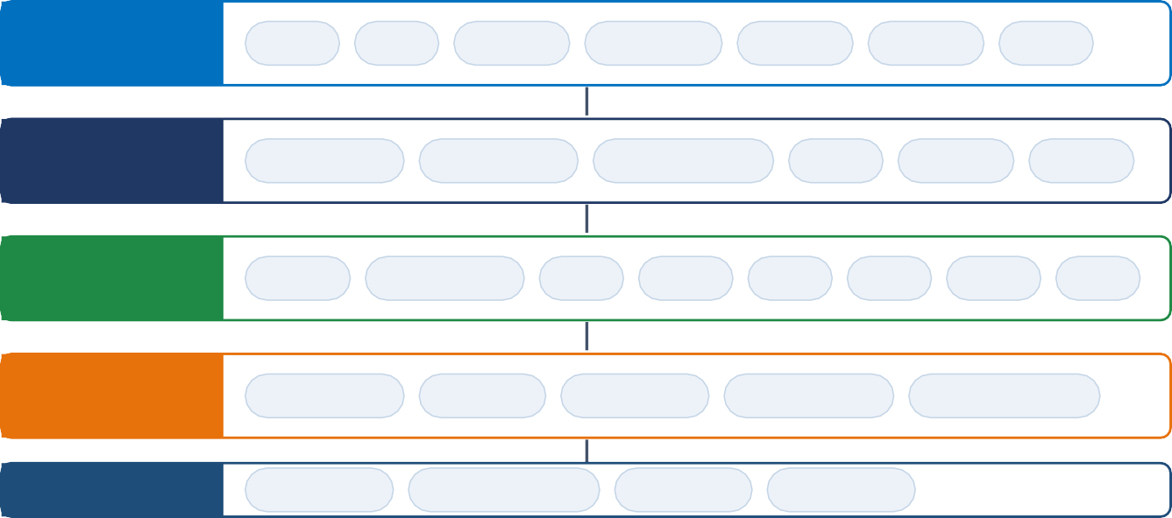
TECHNICAL APPROACH
VisionMinds
PROCESSING PIPELINE
COMPLIANT
COMPLIANT
Product Image
Preprocessing
OCR + CV
Extraction
Rule Engine
Decision
Evidence · Report · Dashboard
Product Image
Preprocessing
OCR + CV
Extraction
NON-COMPLIANT
NON-COMPLIANT
Decision
NEEDS REVIEW
ARCHITECTURE OVERVIEW
TECHNOLOGY STACK
Frontend Next.js · TypeScript · Tailwind · shadcn/ui
Backend FastAPI · Python · REST API Computer Vision OpenCV
OCR EasyOCR
Field Extraction Regex
Compliance Engine Python
Database PostgreSQL, Prisma, SQLAlchemy 2.0
Reports ReportLab
Security JWT · Next Auth.js
FRONTEND
Next.js
Login
Scan
Results
Dashboard
History
Reports
Admin
REST / JSON
BACKEND
FastAPI
Auth / RBAC
API Gateway
Orchestration
Files
Reports
DB Ops
AI LAYER CV + NLP
OpenCV
Image Preprocessing
Upscale
OCR
MRP
Qty
Dates
Care
COMPLIANCE
Rules Engine
Declaration Checks
Confidence
Rule Engine
Confidence Scoring
Severity Classification
DATA
PostgreSQL
Inspection Records
Object Storage
Audit Logs
IMPLEMENTATION METHODOLOGY - 6 PHASES
01
Foundation
02
06
0
2
AI EXTRACTION PIPELINE
0
3
COMPLIANCE ENGINE
0
4
0
5
PRODUCTIZATION
0
6
1
03
04
EVIDENCE & REPORTING
05
VALIDATION
Repo, Next.js + FastAPI skeleton, PostgreSQL schema, auth & API contracts
Image upload, OpenCV preprocessing, OCR, bounding boxes and required field extraction.
Rule repository, declaration checks, violation classification, severity and confidence handling.
Store original images and extracted evidence, generate compliance results and PDF reports.
Dashboard, inspection history, report management, RBAC and audit logging.
Accuracy testing, edge-case testing, end-to-end testing, security checks.

Slide 4
FEASIBILITY AND VIABILITY
VisionMinds
FEASIBILITY OF THE IDEA
CHALLENGES & MITIGATION STRATEGIES
TECHNICAL FEASIBILITY
Built using mature technologies: Next.js, FastAPI, OpenCV, EasyOCR and PostgreSQL.
No custom AI model training is required; the core approach combines OCR/CV extraction with deterministic rule-based validation.
Required declarations can be detected and validated using text, bounding boxes and measurable visual properties.
!
OCR errors on real-world packaging
RISK - Glare, curved surfaces, low contrast and complex layouts can reduce OCR accuracy.
MITIGATION — OpenCV preprocessing, perspective correction and OCR confidence scoring; low-confidence extraction is routed to NEEDS REVIEW.
OPERATIONAL FEASIBILITY
!
Font-size measurement from images
Follows a simple officer workflow: Scan → Extract → Validate → Review → Report.
Web-based interface supports product image capture/upload and centralized inspection management.
NEEDS REVIEW cases allow officers to manually verify uncertain or borderline results.
RISK — Legal requirements specify physical font sizes, while images provide measurements in pixels.
MITIGATION — Use image calibration/reference measurements to estimate physical size and flag borderline measurements for manual review.
Uses widely available open-source technologies, reducing software licensing dependency.
Can support centralized deployment without requiring specialized field hardware.
Final compliance action remains with the authorized officer, while VALIDRA provides evidence and validation results.
Inspection records, original images and generated reports provide traceability and accountability.
!
Different product categories & rule conditions
ECONOMIC & LEGAL FEASIBILITY
RISK — Compliance requirements can vary by product category and declaration type.
MITIGATION — Organize compliance checks as configurable rules mapped to the relevant product category and declaration.
!
Incorrect or incomplete AI extraction
RISK — OCR may extract incorrect values or miss required declarations.
MITIGATION — Combine OCR confidence + field validation + rule checks and use NEEDS REVIEW when confidence is insufficient.

Slide 5
IMPACT AND BENEFITS
VisionMinds
TARGET AUDIENCE & IMPACT
BENEFIT ANALYSIS
LEGAL METROLOGY INSPECTORS
SOCIAL BENEFITS
Faster inspection — Scan a product and automatically extract required declarations.
Easy compliance checking — Rule engine checks MRP, quantity, dates, manufacturer details, font size and placement.
Evidence-based reporting — Get clear COMPLIANT / NON-COMPLIANT / NEEDS REVIEW results with supporting image evidence.
Better consumer information — Accurate and readable MRP, quantity and product declarations.
Greater consumer confidence — Consistent compliance checks support trustworthy packaged products.
Stronger consumer protection — Faster identification of incorrect or missing declarations
CONSUMERS
ECONOMIC BENEFITS
better product information — Clear and correct MRP, quantity, dates and other declarations help consumers make informed purchases.
Greater product confidence — Regular compliance checks encourage accurate and readable information on packaged goods.
Better protection — Faster detection of packaging violations helps reduce misleading or incorrect declarations.
Less inspection effort — Automates routine label checking and reduces manual work for officers.
Higher inspection capacity — Officers can review more products in the same working time.
Reduced rework — Early identification of packaging errors helps businesses correct issues before release.
INDUSTRY & E-COMMERCE
ENVIRONMENTAL & SYSTEMIC BENEFITS
Early compliance checks — Manufacturers can identify label issues before products reach the market.
Better production quality — Clear compliance requirements encourage manufacturers to maintain accurate packaging and product information.
Fewer compliance issues — Early detection can help reduce rework, rejected packaging and regulatory violations.
Paperless inspections — Digital evidence and reports reduce dependence on physical records.
Fewer unnecessary reprints — Early detection helps avoid printing packaging with compliance errors.
Better compliance insights — Digital inspection data can reveal recurring violations and common problem areas.
EXPECTED IMPACT INDICATORS
FASTER
Reduced manual label-checking effort
MORE COVERAGE
More products inspected per officer
CONSISTENT
Same rule-based checks across inspections
TRACEABLE
Digital evidence preserved with every inspection
ACTIONABLE
Clear COMPLIANT / NON-COMPLIANT / NEEDS REVIEW results

Slide 6
RESEARCH AND REFERENCES
VisionMinds
STATUTE & OFFICIAL SOURCES
OCR & IMAGE PROCESSING
Legal Metrology Act, 2009 — Department of Consumer Affairs
Legal Metrology (Packaged Commodities) Rules, 2011 — as amended
Department of Consumer Affairs — Legal Metrology guidelines, notifications & amendments
SIH 2026 — Problem Statement 26034
OCR.space API — image-to-text extraction and OCR result overlays
OpenCV — image preprocessing, resizing and perspective correction
OCR confidence and extracted text used as inputs for downstream validation
AI / COMPLIANCE PROCESSING
PROJECT REPOSITORY & DOCUMENTATION
Groq API — fast LLM inference for structured AI processing
Rule-based validation — deterministic checks for mandatory declarations
Confidence-aware validation — uncertain extraction/validation routed to NEEDS REVIEW
AI output is treated as decision support, not an independent legal verdict
VALIDRA — source code, architecture and technical documentation (github.com/dhruvpatel16120/Validra)
Next.js — frontend framework
FastAPI — backend API framework
PostgreSQL — inspection and compliance data
ReportLab — compliance report generation
KEY RESEARCH TAKEAWAYS
VALIDATION & BENCHMARKING
COMPLIANCE PRACTICE
OCR enables automated extraction of mandatory declarations from product-label images.
Visual information matters — Text location and bounding boxes help validate placement and other visual requirements.
Confidence-based review is essential — Uncertain OCR or extraction results should be flagged for human verification.
Rule-based validation improves consistency — Compliance checks can be applied systematically across product inspections.
Curated product-label images across selected categories
Ground-truth annotations for MRP, net quantity, dates, manufacturer/packer and consumer-care fields
Metrics: extraction accuracy, rule-validation accuracy and processing time
Edge cases: glare, low contrast, curved surfaces and complex layouts
Mandatory declarations defined under the Packaged Commodities Rules
Validation of presence, value, format and applicable visual requirements
Evidence preservation through original images and extracted data
RBAC and audit logs for inspection traceability

