Slide 1

No Cat Left Behind
By Dhruv

Slide 2
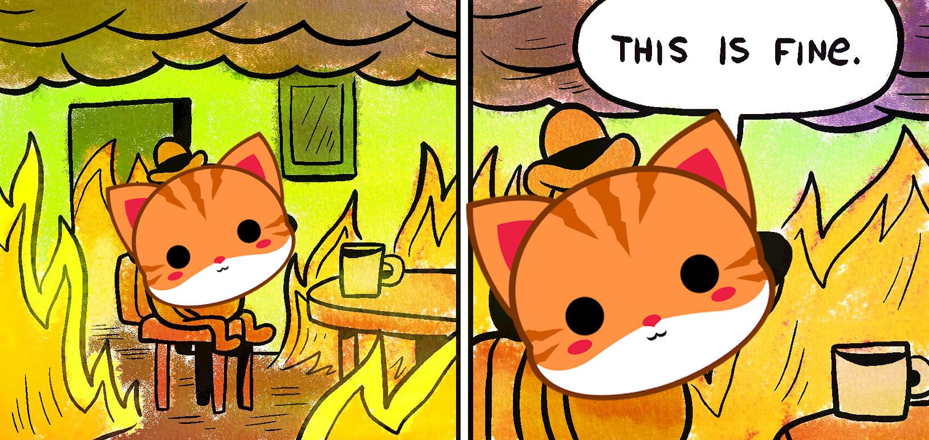

Slide 3


Pyra
Grey (50 Shades)
Ghost(?) Cat
The protagonist
Heat resistance +
Loyal
Cute
Weak in high temperature situations
There’s a lot of them
Cute
Not sure if hallucination from the heat or real
Still cute
No cat left behind!

Slide 4

Black Smoke
Does not care about Pyra’s heat resistance
Thankfully stationary

Slide 5

Big Hot Fire
Hot
Heat Resistance != Fire Resistance
Moves

Slide 6
How to play the game ?
Move the savior cat
Avoid fire
Collect rewards
Notes:
How to play the game? There are 3 things you always need to do. Move the savior cat, avoid fire and collect rewards.Move the savior cat
Avoid fire
Collect reward

Slide 7
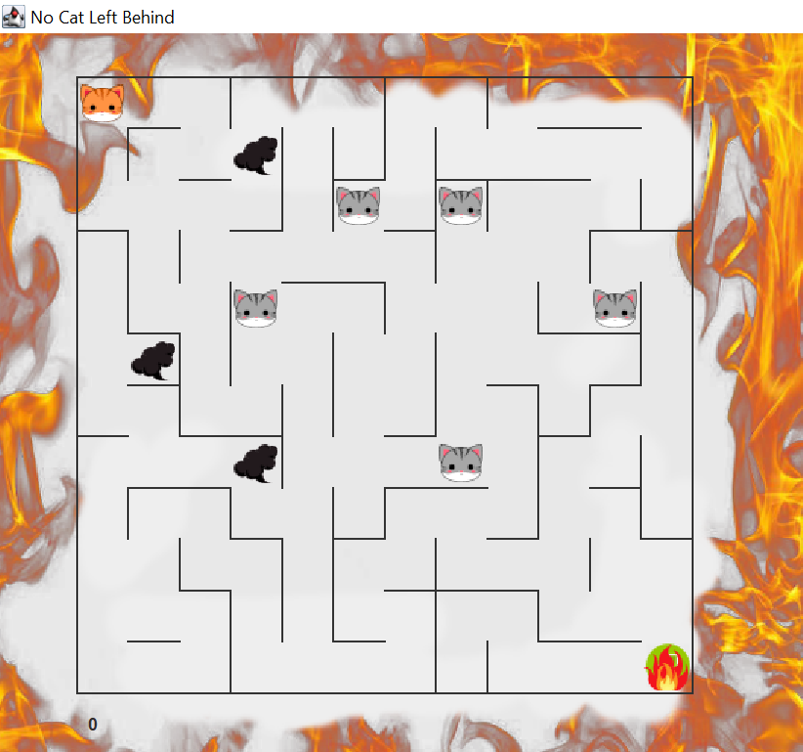
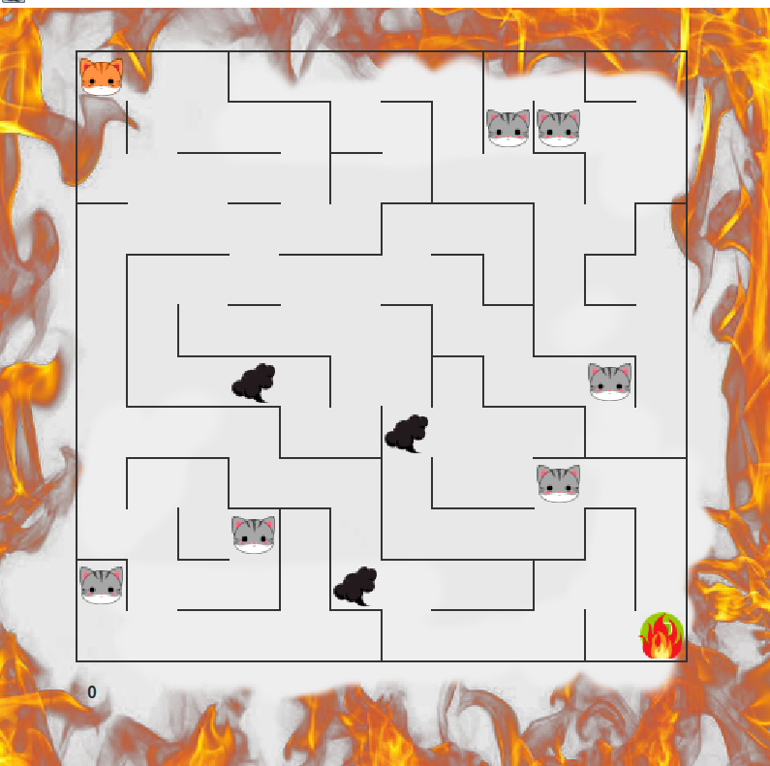
Maze Starting
Notes:
At the begin of your game, the player’s character that is savior cat always stays on the top left corner and the enemy that is a moving fire stays on the bottom right corner. There are also regular rewards represented by grey cats and stationary enemies represented by black smoke in the maze.

Slide 8
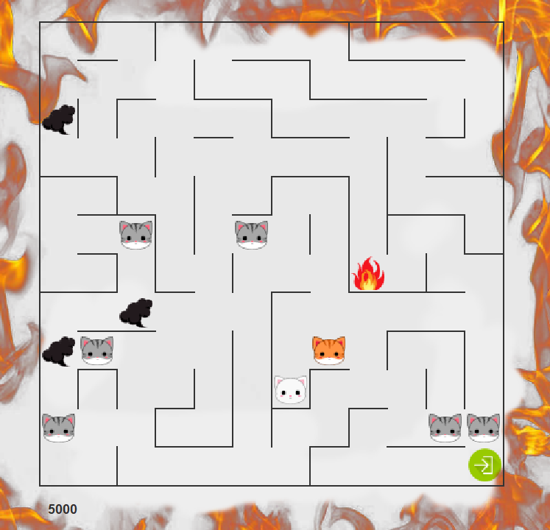
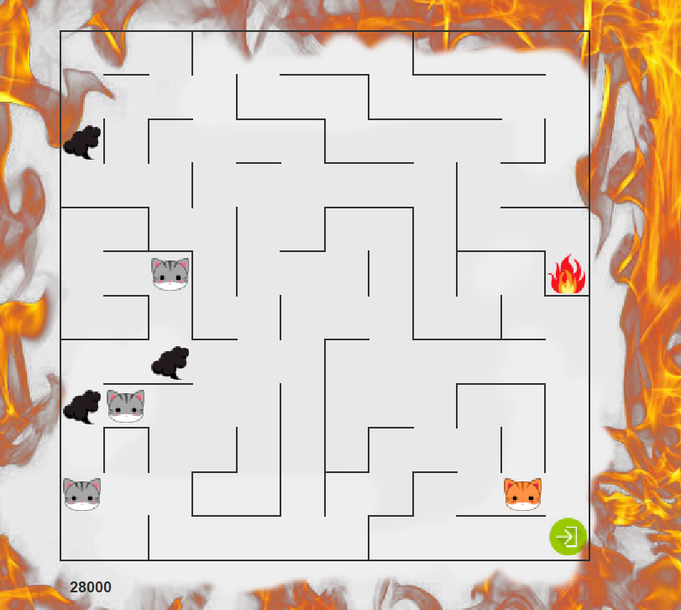
Game operating
Notes:
When you play the game, you use keyboard to control the savior cat. When your cat moves, the fire moves towards you. You must avoid being caught. You need to rescue all the grey cats and reach the escape location where on the bottom left to win the game. With time passing, bonus rewards represented by white cats appear in the maze randomly. When your rescues them, you will get much scores. Your current score is shown in the bottom left.

Slide 9
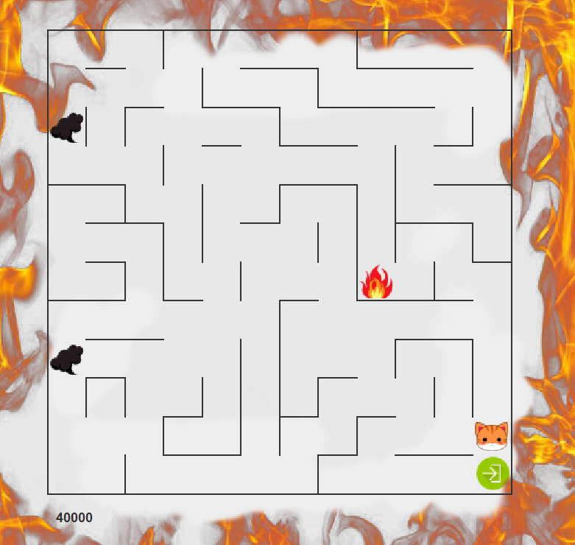
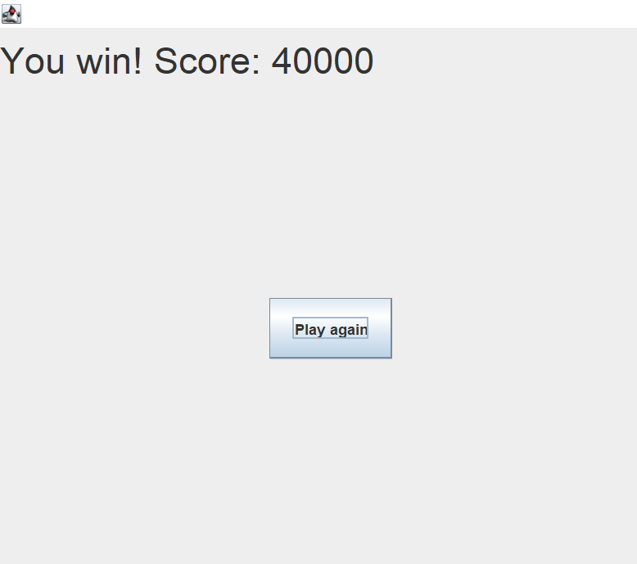
Win The Game
Rescue all grey cats
Escape
Notes:
There are two conditions you must get to win a game. Rescue all grey cats and get the escape location. After that, the maze window will be closed and a new window will be created which shows victory message and your score.

Slide 10
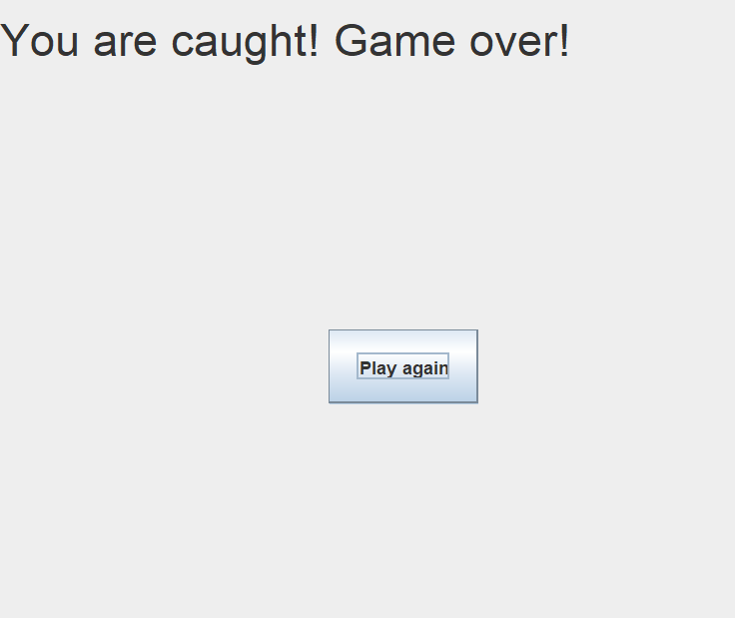
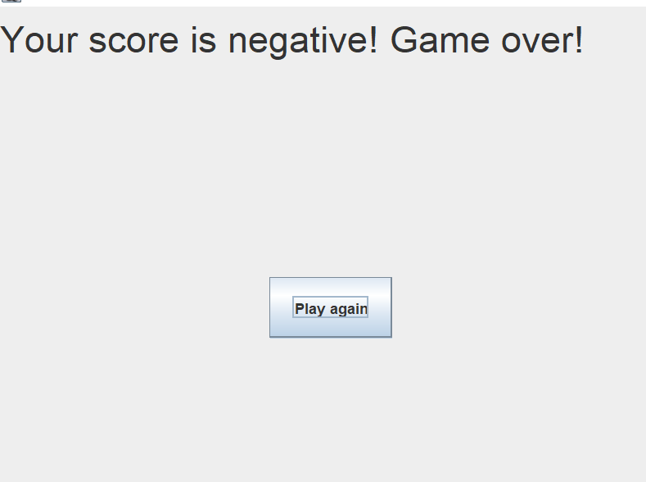
Lose the Game
Case1
Case2
Notes:
There are two cases that you will lose the game. The first case is your cat is caught by the fire that is the case your cat is in the same location with the fire. The second case is your current score is too low and you move in a place where there is a black smoke. These two case cause the game terminated.

Slide 11
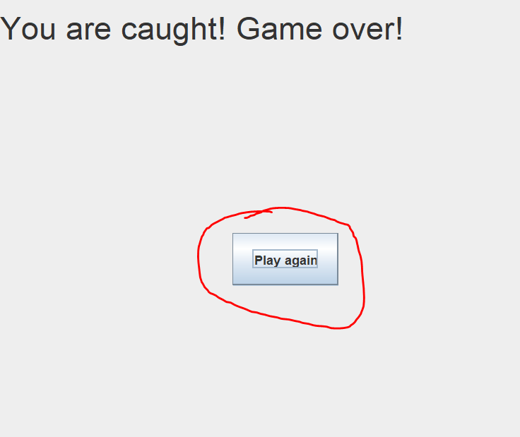
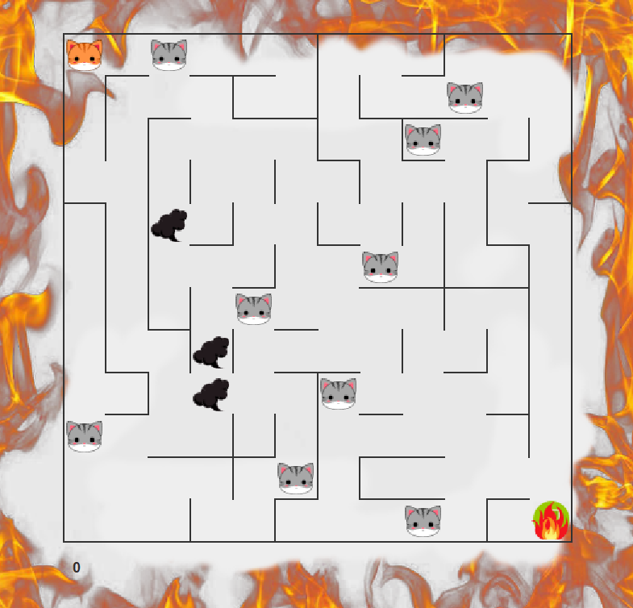
Restart
1.After winning
2.After losing
Notes:
After winning or losing a game, a new window will appear. It not only gives you the message, but also has a button. When you hit the button you can have a new game.

Slide 12
What did we use to code on?
-> We coded on intellij using java.swing for the GUI
As it was easier to use.
We were all familiar with intellij so it made us comfortable using it.

Slide 13
Unique features for our game
Every time you play, you will have a unique maze, so you won’t get bored playing the game.
The game is challenging everytime you play

Slide 14
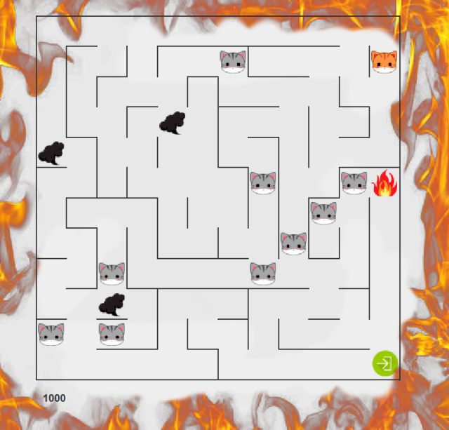
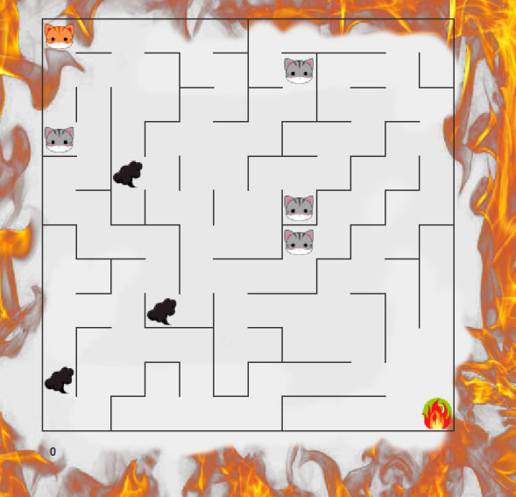
An example of a harder level of the game
An example of an easier level of the game

Slide 15
Thank you for listening.

