Slide 1



Phishing Awareness Training: Safeguarding Your Digital Life
Welcome to this essential training on Phishing Awareness. In today's interconnected world, understanding and recognizing phishing attempts is crucial for protecting your personal and professional information. This presentation will equip you with the knowledge and tools to identify, avoid, and report these deceptive cyber threats, ensuring a safer digital experience for everyone.
by Parmar Dhruvrajsinh

Slide 2



Understanding Phishing: The Digital Deception
Email Phishing
The most common form, where attackers send fraudulent emails impersonating legitimate organizations to trick recipients into revealing sensitive information like login credentials or financial details.
Spear Phishing
A highly targeted attack, often personalized for a specific individual or organization, using information gathered about the target to increase the credibility of the fraudulent message.
Smishing (SMS Phishing)
Phishing attacks conducted via SMS messages. These texts often contain malicious links or requests for personal information, leveraging urgency or tempting offers.
Vishing (Voice Phishing)
Deceptive phone calls where attackers pose as legitimate entities to trick victims into divulging sensitive information or performing actions that compromise security.

Slide 3
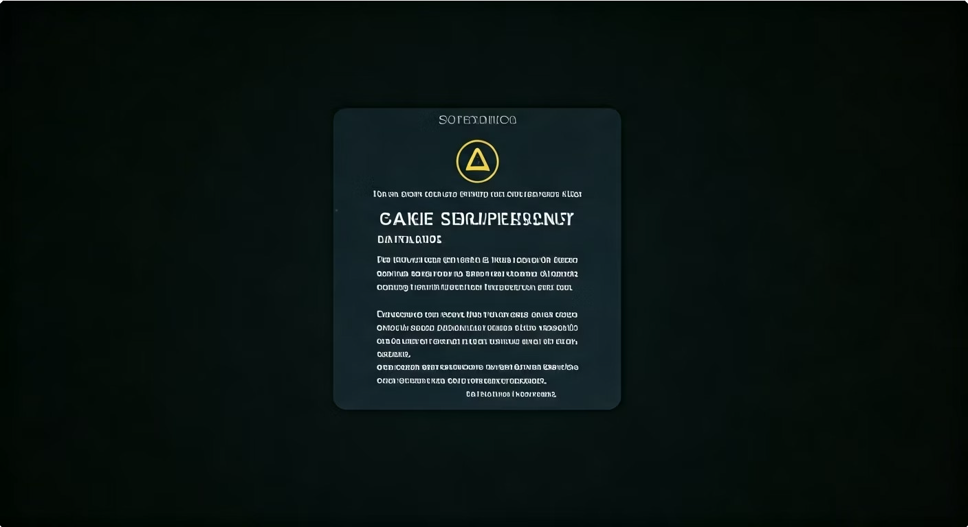
Spotting the Red Flags: Recognizing Phishing Attempts
Phishing attempts often contain tell-tale signs. Always be wary of emails or messages that demand immediate action or create a sense of panic.
Suspicious Links
Hover over links without clicking to reveal the actual URL. Look for inconsistencies between the displayed text and the link's destination.
Poor Grammar & Spelling
Legitimate organizations rarely send communications with numerous typographical errors or awkward phrasing.
Fake Sender Names
Check the sender's email address carefully. Attackers often use addresses that are similar to legitimate ones but have subtle differences.
Unusual Requests
Be suspicious of requests for personal information, especially passwords or financial details, that seem out of place.

Slide 4

Social Engineering: Playing on Human Emotions
Attackers often leverage social engineering tactics to manipulate victims into complying with their requests. These tactics exploit human psychology and can be very effective if you're not aware of them.
Fear & Urgency
Messages threatening account suspension or legal action if immediate action isn't
taken.
Fake Authority
Impersonating IT support, executives, or government officials to command compliance.
Temptation
Offering enticing but fake prizes, discounts,
or job opportunities.
Emotional Manipulation
Appealing to empathy or curiosity, such as fake charity requests or sensational news.

Slide 5

Quiz Time: Test Your Phishing Knowledge!
Let's test your understanding of what we've covered so far. Choose the best answer for each question.
Which of these is a common red flag in a phishing email?
What should you do if you receive a suspicious email asking for your password?
A personalized greeting with your correct name.
A link that takes you to a well-known, legitimate website.
Poor grammar, spelling mistakes, and generic greetings.
Reply immediately asking for clarification.
Click the link to see where it takes you.
Delete the email and report it to your IT/security team.
Answer: C - Legitimate organizations maintain high standards for communication.
Answer: C - Never provide sensitive information via email and always report suspicious activity.

Slide 6
Real-World Impact: The Google & Facebook Phishing Scam
Even tech giants can fall victim to sophisticated phishing schemes. From 2013 to 2015, a Lithuanian man, Evaldas Rimasauskas, orchestrated an elaborate phishing scam that defrauded Google and Facebook of over $100 million. He impersonated an Asian manufacturer that both companies regularly did business with.
Rimasauskas sent phishing emails to employees of Google and Facebook, faking invoices, contracts, and letters that appeared to be from the legitimate vendor. He set up fake company websites and bank accounts in various countries to receive the fraudulent payments.
This case highlights the importance of rigorous vendor verification processes and internal controls. It demonstrates that even large, sophisticated organizations can be susceptible to well-executed social engineering and phishing attacks, underscoring the need for constant vigilance and robust security training for all employees.

Slide 7
Quiz Time: More Phishing Scenarios!
One more set of questions to reinforce your learning. Your vigilance is your first line of defense.
You receive an SMS from an unknown number with a link, stating you've won a prize. What should you do?
An email from your "CEO" asks you to immediately transfer funds to a new vendor. The email address looks slightly off. What is your best course of action?
Click the link to claim your prize.
Reply to the sender asking for more details.
Delete the message and block the number.
Proceed with the transfer as instructed to avoid delays.
Reply to the email asking for confirmation from the CEO.
Verify the request through an alternative, trusted channel (e.g., call the CEO directly or check company policy).
Answer: C - This is a classic smishing attempt designed to trick you into clicking a malicious link.
Answer: C - Always verify unusual or high-stakes requests through a secondary, secure method.

Slide 8
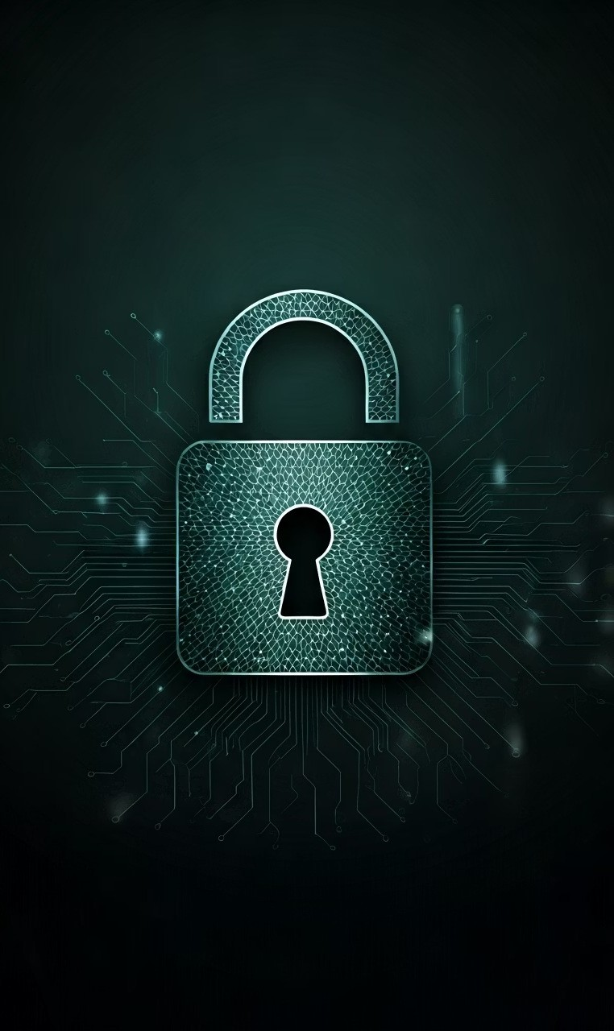
Key Takeaways & Next Steps: Be Our Human Firewall
Your awareness is the most critical defense against phishing attacks. By following these best practices, you become an essential part of our organization's cybersecurity defense.
1
Verify URLs Before Clicking
Always hover over links to check the actual destination. If it looks suspicious, don't click.
2
Enable Two-Factor Authentication (2FA)
Add an extra layer of security to your accounts whenever possible, requiring a second form of verification.
3
Report Suspicious Activity
If you suspect a phishing attempt, report it immediately to the IT/security team using the official reporting channels.
4
Stay Informed
Phishing tactics evolve. Continuously educate yourself on new threats and best practices.

