Slide 1
MOVIE TICKET
BOOKING SYSTEM
Student Name: Sisodiya Dhruvrajsinh (12502080601024)
Jaimish Kachhiya (12502080601041)
Amar Verma (12502080601005)
Department : Information Technology
SEM-3 IT-1

Slide 2
1. Project Overview
A small database project focused on three core functions.
• Manage movie show dates, times, screens and ticket prices.
• Track seats reserved for each show and record booking status.
• Calculate revenue from confirmed bookings only.
• Implemented through SQL commands in MariaDB command line.
2

Slide 3
2. Problem Statement & Objectives
• Manual show schedules and seat records can be difficult to maintain.
• Duplicate seat reservations must be prevented.
• Revenue totals should be calculated accurately from confirmed bookings.
• Objective: store related data in tables and retrieve it using SQL queries.
3

Slide 4
3. Project Scope
SHOW TIME MANAGEMENT
RESERVED SEAT TRACKING
BOOKING REVENUE
Movie title • Date • Time • Screen • Ticket price
Show ID • Seat number • Booking status
Confirmed bookings • Tickets sold • Revenue totals
Out of scope: online payment gateway, user login, and graphical website/app.
4

Slide 5
4. System Requirements
• Software: MariaDB / MySQL-compatible command-line client.
• Database: college_db.
• Tables used: Movies, Screens, Shows and Bookings.
• Basic SQL: CREATE TABLE, INSERT, SELECT, JOIN, GROUP BY, UPDATE.
5

Slide 6
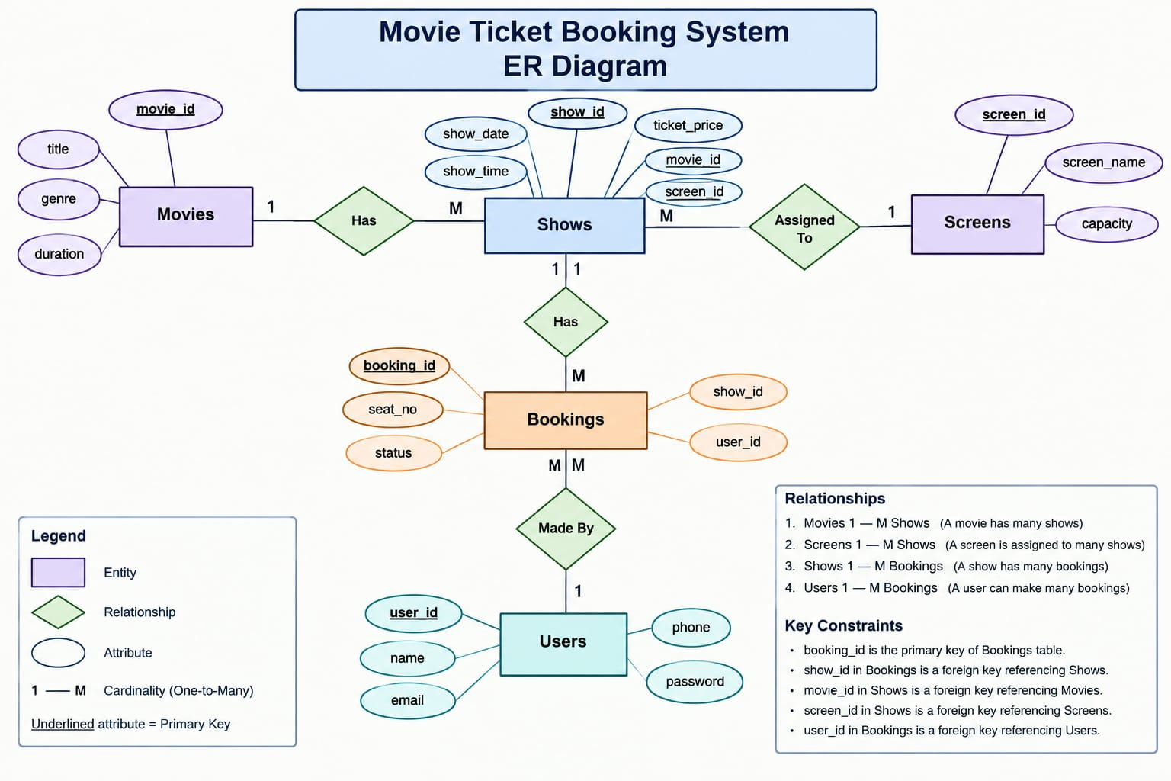
5. ER Diagram & Relationships
6

Slide 7
6. Relational Schema
• Movies(movie_id PK, title, genre, duration, ...)
• Screens(screen_id PK, screen_name, capacity, ...)
• Shows(show_id PK, movie_id FK, screen_id FK, show_date, show_time, ticket_price)
• Bookings(booking_id PK, show_id FK, seat_no, status)
• A unique constraint on (show_id, seat_no) prevents duplicate seat rows for the same show.
7

Slide 8
7. Normalization
• 1NF: Each column stores a single value; each record is identifiable by a key.
• 2NF: Non-key attributes depend on the complete primary key.
• 3NF: Movie, screen, show and booking details are stored in separate related tables.
• Benefits: less repeated data, easier updates, and improved consistency.
8

Slide 9
8. Implementation: Show Time Management
This query lists each scheduled show with movie title, date, time and ticket price.
SELECT s.show_id, m.title, s.show_date,
s.show_time, s.ticket_price
FROM Shows s
JOIN Movies m ON s.movie_id = m.movie_id
ORDER BY s.show_date, s.show_time;
9

Slide 10
9. Implementation: Reserved Seat Tracking
Only confirmed reservations are shown as currently booked.
SELECT show_id, seat_no
FROM Bookings
WHERE status = 'CONFIRMED'
ORDER BY show_id, seat_no;
10

Slide 11
10. Implementation: Revenue Calculation
Revenue is calculated from confirmed bookings and the ticket price for each show.
SELECT COALESCE(SUM(s.ticket_price), 0) AS total_revenue
FROM Shows s
JOIN Bookings b ON s.show_id = b.show_id
WHERE b.status = 'CONFIRMED';
11

Slide 12
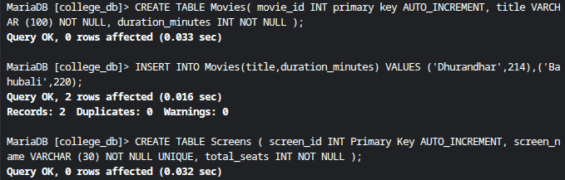
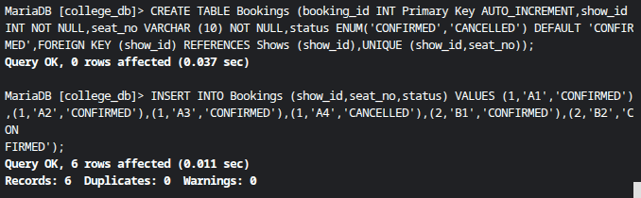
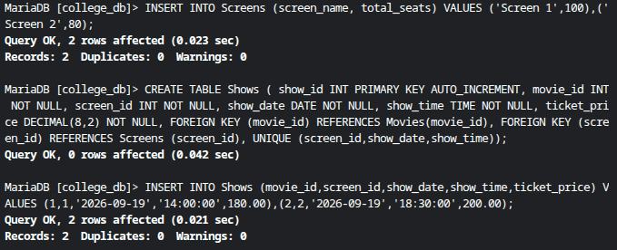
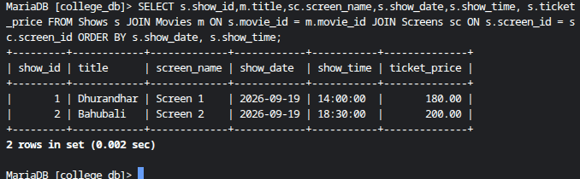
OUTPUT

Slide 13
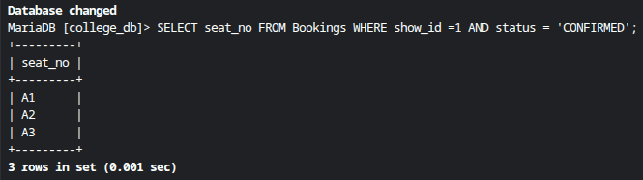
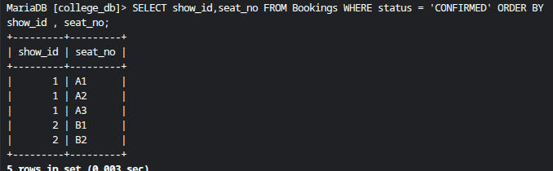
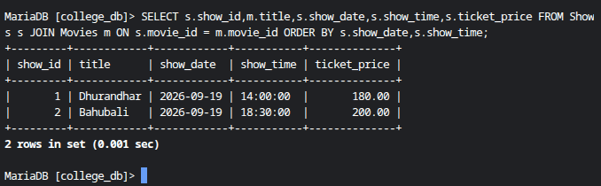
OUTPUT

Slide 14
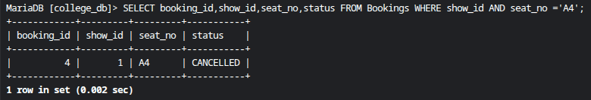
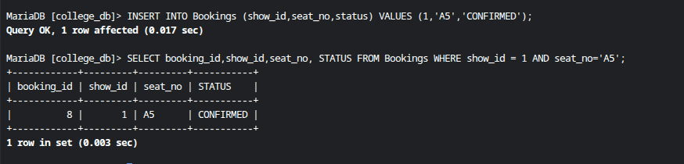
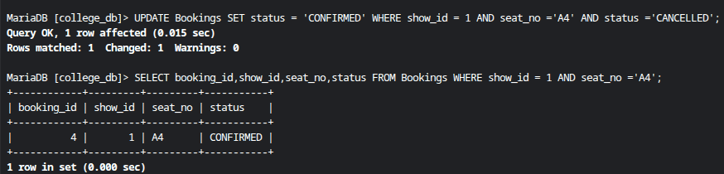
OUTPUT

Slide 15
11. Testing, Conclusion & Future Scope
• Test 1: Display scheduled shows with movie details.
• Test 2: Display confirmed seats and verify seat status.
• Test 3: Insert or update a booking and verify the result.
• Test 4: Calculate revenue while excluding cancelled bookings.
• Conclusion: The database supports the three project requirements.
• Future scope: customer records, payment gateway, online interface and reports.
12

Slide 16
THANK YOU

