Slide 1
AI Agent for Digital Financial Literacy using RAG ON IBM CLOUD
CAPSTONE PROJECT
Presented By:
1. Dhruv Singh Rawat-Graphic Era Deemed to be University-BTECH CSE Core

Slide 2
OUTLINE
Problem Statement
Proposed System/Solution
System Development Approach
Algorithm & Deployment
Result
Conclusion
Future Scope
References

Slide 3
Problem Statement
With the increasing shift to digital finance, many individuals—especially from rural or less tech-savvy backgrounds—struggle to understand essential financial tools and avoid digital fraud. There's a critical need for an AI-based system that makes digital financial literacy accessible, reliable, multilingual, and culturally inclusive.

Slide 4
Proposed Solution
The proposed system is an AI-powered assistant integrated with RAG (Retrieval-Augmented Generation) architecture, hosted on IBM Cloud. It retrieves reliable and up-to-date information from trusted sources to help users improve their digital financial literacy in their preferred language.Data Collection:
Crawl and index content from trusted sources such as RBI, NPCI, banking portals, and financial literacy platforms.Ensure coverage of topics like UPI usage, online scam prevention, interest rates, and budgeting tips . Support multilingual data for wider accessibility. Data Preprocessing:
Clean and preprocess the collected data to handle missing values, outliers, and inconsistencies.
Feature engineering to extract relevant features from the data that might impact bike demand.
Machine Learning Algorithm:
Use Retrieval-Augmented Generation (RAG) pipeline
The Model suggested is Granite-3.3-8B-Instruct because of it’s capabilities like Thinking, Summarization, Text classification, Text extraction, Question-answering, Retrieval Augmented Generation (RAG) and many more.
Deployment:
Develop a user-friendly interface, question-answer type interface of an AI agent that guides the users regarding their financial doubts and queries.
Deploy the solution on a scalable and reliable platform, considering factors like server infrastructure, response time, and user accessibility . The appropriate platform for this is IBM cloud.
Evaluation:
Assess the model's performance using appropriate metrics such as Mean Absolute Error (MAE), Root Mean Squared Error (RMSE), or other relevant metrics.
Fine-tune the model based on feedback and continuous monitoring of prediction accuracy.
Result: A user friendly, context aware, multilingual and intelligent AI agent that answers the queries of the users related to digital finance tools like UPI, online safety, interest rates, budgeting, and personal finance—quickly and clearly

Slide 5
System Approach
FRAMEWORK-LANG GRAPH
ARCHITECTURE-ReAct
Tools for searching used by the agent-
Google search
DuckDuckGo search
Webcrawler
MODEL- Granite-3.3-8B-Instruct
DEPLOYMENT PALTFORM-IBM CLOUD

Slide 6
Algorithm & Deployment
Algorithm Selection:
The chosen model for this AI agent is Granite-3.3-8B-Instruct, an 8-billion parameter large language model developed by IBM and trained using the ReAct architecture and LangGraph framework. It is specifically fine-tuned for instruction-following, multilingual dialogue, reasoning, and Retrieval-Augmented Generation (RAG) tasks.
Training Process:
Training Data: Overall, our training data is largely comprised of two key sources: (1) publicly available datasets with permissive license, (2) internal synthetically generated data targeted to enhance reasoning capabilites. We train Granite-3.3-8B-Instruct using IBM's super computing cluster, Blue Vela, which is outfitted with NVIDIA H100 GPUs. This cluster provides a scalable and efficient infrastructure for training our models over thousands of GPUs.
Prediction Process:
The AI agent performs web search relevant to the user’s query using the tools specified by the creator of the agent and then responds in a simple step by step guidance manner.

Slide 7
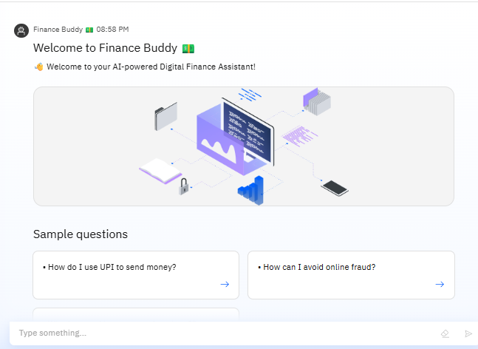
Result
OUTPUT AI AGENT INTERFACE ALONG WITH INITIAL BUTTON-TYPE SAMPLE QUESTIONS

Slide 8
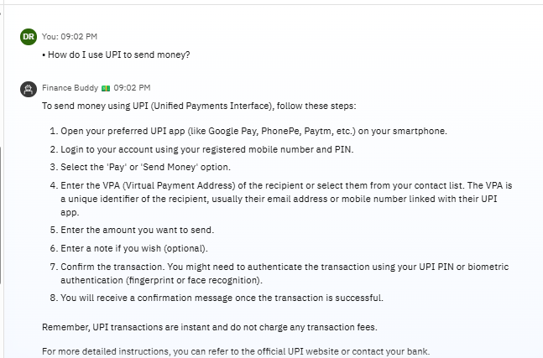
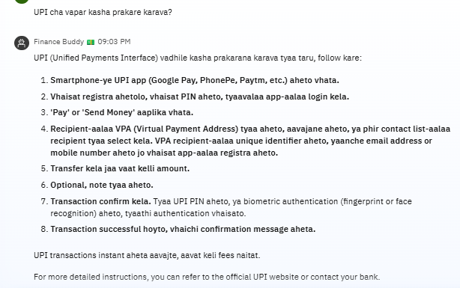
Result
AGENT REPLYING IN MARATHI(MULTILINGUAL FUNCTIONALITY)
NORMAL REPLY OF THE AGENT TO A SAMPLE QUESTION

Slide 9
Conclusion
In conclusion, the AI-powered digital finance assistant provides accessible, multilingual support to improve financial literacy across diverse user groups. By leveraging Retrieval-Augmented Generation and IBM Cloud services, it delivers accurate, trustworthy, and user-friendly responses. This solution empowers users to navigate digital finance with confidence, reducing risks of fraud and misinformation.

Slide 10
Future scope
Voice-based Interaction: Integrate speech-to-text and text-to-speech systems for hands-free usage, especially beneficial for users with low literacy or visual impairments.
Support for More Regional Languages: Expand multilingual capabilities to include Indian dialects and lesser-known regional languages for wider inclusivity.
Offline Accessibility: Develop a lightweight mobile version with offline access to preloaded financial literacy content for users in low-connectivity areas.
Integration with Financial Institutions: Collaborate with banks and government platforms to offer real-time support for digital services like UPI, KYC, or loan queries.
AI-Driven Personal Finance Coaching: Evolve the assistant into a personalized advisor that can track user goals, spending patterns, and suggest budgeting tips or financial products.

Slide 11
References
IBM GRANITE- https://www.ibm.com/granite/docs/
Agent Creation- https://dataplatform.cloud.ibm.com/docs/content/wsj/analyze-data/fm-agent-lab.html?context=wx&audience=wdp
RAG Pipeline- https://docs.langchain.com
IBM Cloud Documentation- https://cloud.ibm.com/docs

Slide 12
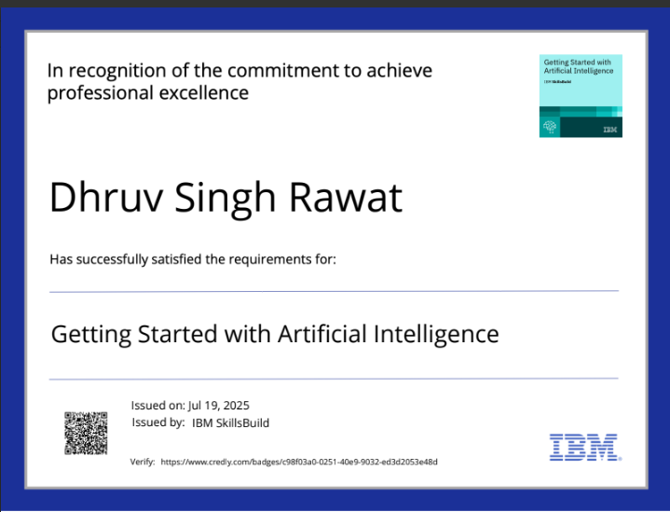
IBM Certifications
Screenshot/ credly certificate( getting started with AI)

Slide 13
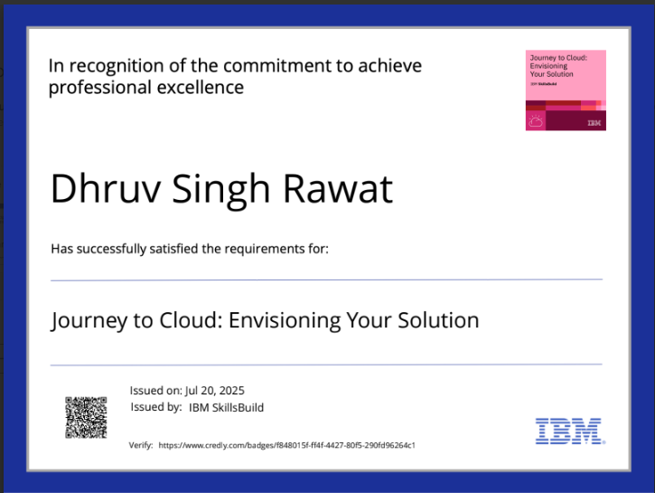
IBM Certifications
Screenshot/ credly certificate( Journey to Cloud)

Slide 14
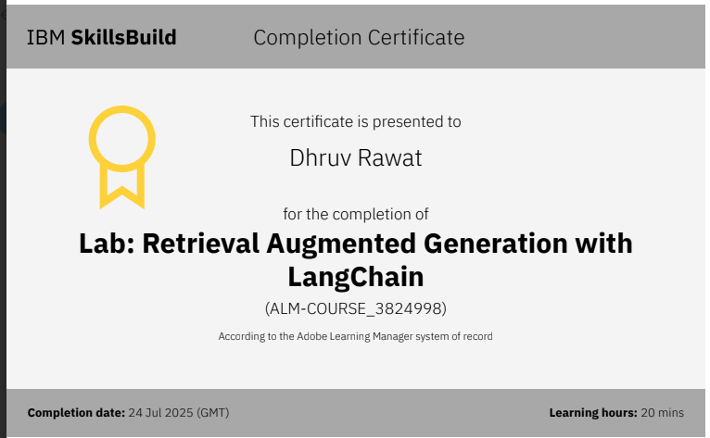
IBM Certifications
Screenshot/ credly certificate( RAG Lab)

Slide 15
THANK YOU

