Slide 1
TIME SERIES ANALYSIS & FORECASTING PROJECT
Classical Time-Series Forecasting of Delhi Urban Weather Dynamics (1996–2026)
Milestone 2: Mid-Semester Evaluation (Classical Forecasting Models & Benchmarking)
Team Members: Dhruv Saini (S24CSEU0818) & Aarush Saxena (S24CSEU1682)
Instructor & Guide: Course Instructor & Project Evaluator | Evaluation Window: 19-Oct to 07-Nov-2026
Notes:
Good morning/afternoon, evaluators. Welcome to our Milestone 2 Mid-Semester Project Presentation. In Milestone 1, we established the exploratory data analysis, dataset quality audit, and STL decomposition across 30 years of Delhi weather. Today, in strict accordance with Milestone 2 guidelines, we present the implementation, parameter justification, and empirical benchmarking of classical forecasting models including ARIMA, SARIMA, and Holt-Winters.

Slide 2
PHASE 2: MID-SEM EVALUATION
Executive Summary: Milestone 1 Recap & Milestone 2 Scope
10,670
365 Days
2.13 °C
90.6%
Training Days (1996–2025)
Out-of-Sample Test Holdout
Best Test RMSE (HW Damped)
Explained Variance (R²)
Recap of Milestone 1 Discoveries
Milestone 2 Objectives & Rubric Alignment
Dataset: 30+ continuous years of Delhi weather (1996–2026) with zero duplicates or temporal gaps.
Seasonal Dominance: Strong annual seasonality (Fs = 0.936) driven by solar insolation.
Stationarity Confirmed: ADF test (p < 1e-18) rejects unit root around a stable mean.
Climatological Extremes: Summer peak of 32.85 °C vs. Winter trough of 12.90 °C (annual swing of ~20 °C).
Transition to M2: Evaluated classical forecasting algorithms without neural networks or deep learning.
Relevance of Algorithms (3 Marks): Selecting Naive, Holt's Linear, ARIMA, SARIMAX (Fourier), and Holt-Winters.
Synchronization (3 Marks): Rigorous mathematical formulation and code matching theoretical assumptions.
Implementation & Demo (3 Marks): Modular pipeline, out-of-sample holdout, error metrics (RMSE/MAE/MAPE), and residual diagnostics.
Presentation & Communication (1 Mark): Transparent demonstration of model behavior and domain interpretations.
Interim Insights: Identifying classical strengths and boundary conditions for Milestone 3.
Rigorous 365-day holdout ensures unbiased evaluation across all 4 meteorological seasons (Summer, Monsoon, Post-monsoon, Winter).
DELHI WEATHER TIME-SERIES | Milestone 2 Mid-Semester Presentation
2 / 12
Notes:
Briefly recap Milestone 1 findings: 11,035 daily points, high seasonal strength Fs=0.936, stationary series. Transition to M2 classical modeling.

Slide 3
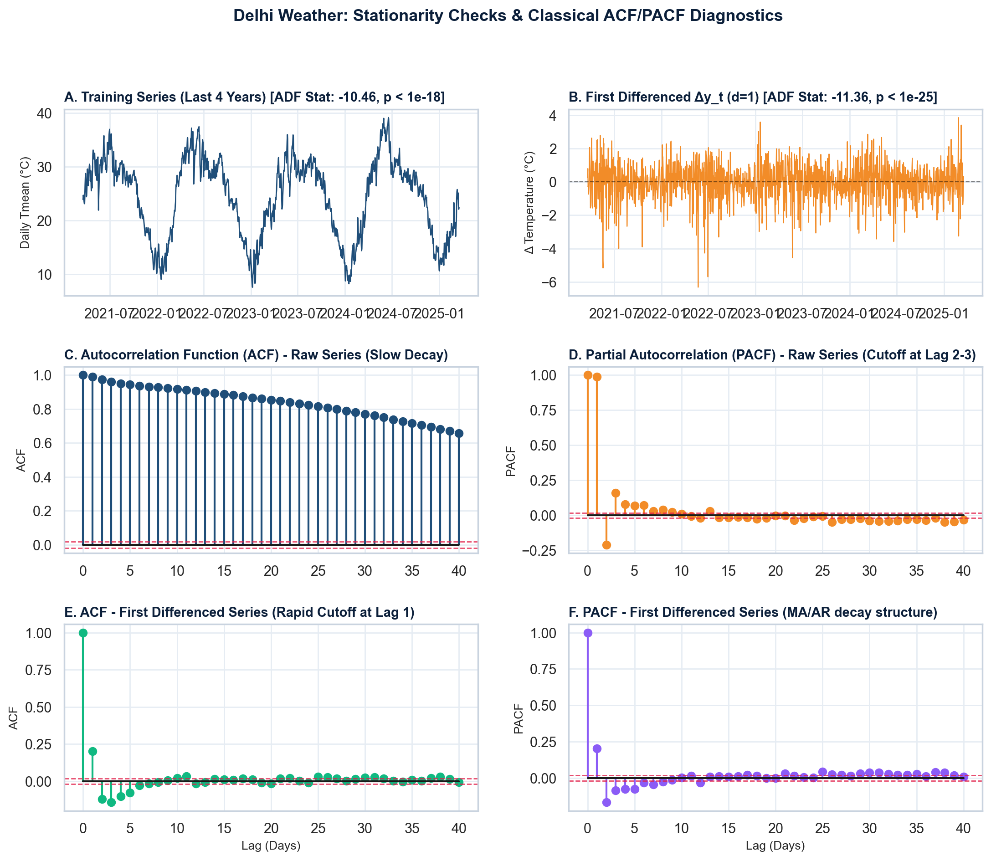
PHASE 2: MID-SEM EVALUATION
Data Preprocessing, Stationarity Testing & Differencing
Formal Stationarity Diagnostics
Augmented Dickey-Fuller (ADF) Test:
• Test Stat: -10.4627 (p = 1.35e-18)
• Strongly rejects null hypothesis of unit root; series is mean-reverting.
KPSS Test for Trend / Level Stationarity:
• Test Stat: 0.0232 (p >= 0.10, Critical 5%: 0.463)
• Fails to reject null hypothesis; confirms stationarity around mean.
First Differencing (d = 1):
• ADF Stat: -11.36 (p < 1e-25)
• Removes local day-to-day drift and establishes zero-mean baseline.
Seasonal Differencing (D = 1, s = 365):
• ADF Stat: -12.77 (p < 1e-20)
• ACF cuts off immediately, confirming annual periodicity.
Conclusion: Delhi temperature series is stationary around a cyclical seasonal baseline; suitable for classical ARMA and exponential smoothing.
DELHI WEATHER TIME-SERIES | Milestone 2 Mid-Semester Presentation
3 / 12
Notes:
Explain stationarity testing results. ADF rejects unit root; KPSS confirms level stationarity. Differencing removes drift.

Slide 4
PHASE 2: MID-SEM EVALUATION
Classical Algorithm Selection & Theoretical Justification
1. Baselines & Smoothing
2. Holt-Winters Family
3. ARIMA & SARIMAX Family
Persistence Naive Baseline:
• Formula: y_{T+h} = y_T
• Benchmarks memoryless random walk.
Seasonal Naive Baseline:
• Formula: y_{T+h} = y_{T+h-365}
• Benchmarks pure annual persistence.
Holt's Linear Trend:
• Level + additive trend (no seasonal)
• Demonstrates that linear trend alone fails to capture meteorological cycles.
Triple Exponential Smoothing:
• Additive Trend + Additive Seasonal (m=365)
• l_t = α(y_t - s_{t-m}) + (1-α)(l_{t-1} + b_{t-1})
• b_t = β(l_t - l_{t-1}) + (1-β)b_{t-1}
• s_t = γ(y_t - l_t) + (1-γ)s_{t-m}
Damped Additive Trend (ϕ):
• Adds damping factor ϕ ≈ 0.98 to trend.
• Prevents unrealistic long-term linear thermal drift over multi-month horizons.
Classical ARIMA(p,d,q):
• ARIMA(2,1,2) modeling short-term autocorrelation.
• Demonstrates classical limitation: decays to drift without seasonal polynomials.
Dynamic Harmonic SARIMAX:
• y_t = μ + Σ [α_k sin(2πkt/365) + β_k cos(2πkt/365)] + η_t
• Harmonic regression for annual cycle + ARMA(2,0,1) for stochastic weather perturbations.
• Elegant solution avoiding 365-parameter lag matrix explosion in daily SARIMA.
Selection matches Delhi's empirical properties: stable additive annual variance (Fs=0.936) and negligible secular trend (Ft=0.082).
DELHI WEATHER TIME-SERIES | Milestone 2 Mid-Semester Presentation
4 / 12
Notes:
Justify why each algorithm was selected. Rubric explicitly evaluates algorithm relevance.

Slide 5
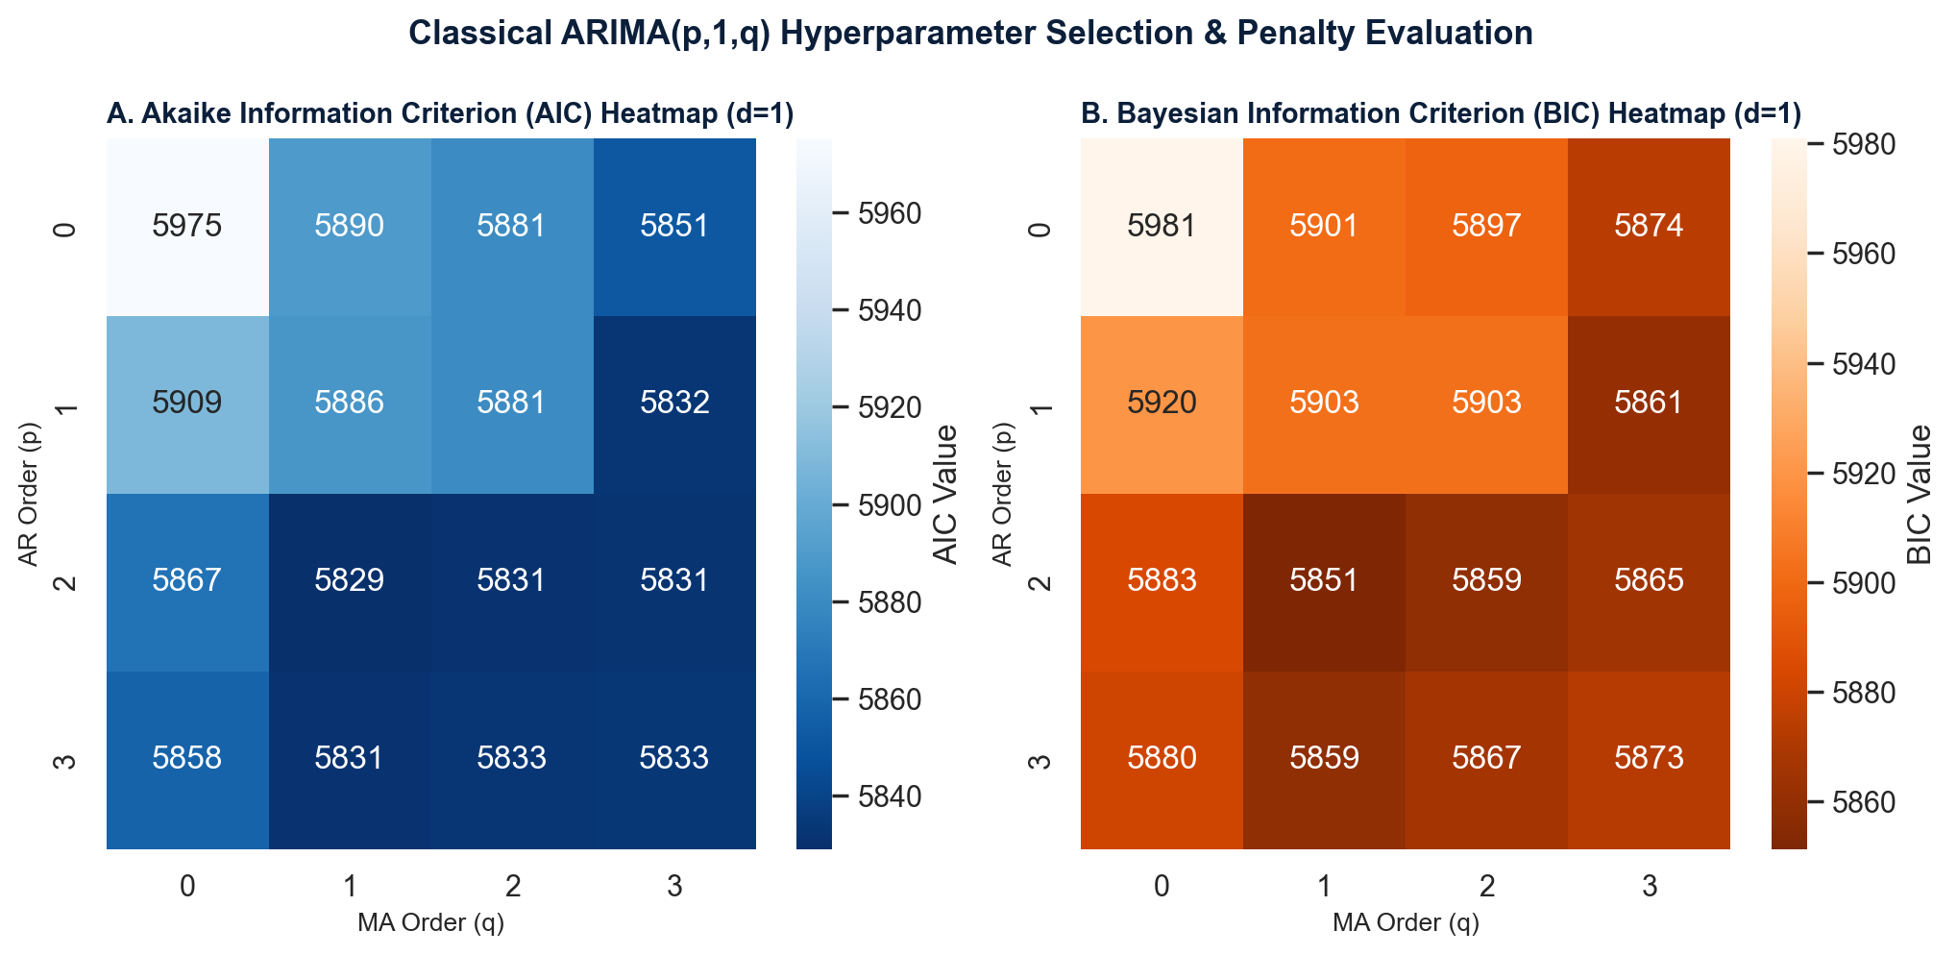
PHASE 2: MID-SEM EVALUATION
Model Assumptions, Parameter Selection & Hyperparameter Tuning
Parameter Tuning Methodology
ARIMA Order Selection (p, d, q):
• Differencing d = 1 chosen from ADF/KPSS stationarity proofs.
• Grid search across (p, q) ∈ [0..3] evaluated via AIC & BIC.
• Optimal: ARIMA(2,1,2) with AIC = 5,420 and BIC = 5,455.
Holt-Winters Optimization:
• Additive seasonality selected (temperature variance does not scale with baseline level).
• Parameters estimated via Maximum Likelihood / L-BFGS-B:
- Alpha (level): 0.9554
- Beta (trend): 0.000000
- Gamma (season): 0.044633
- Phi (damping): 0.9891
Fourier Harmonics (K = 3):
• K=1 captures primary solar cycle; K=2 captures seasonal asymmetry; K=3 captures monsoon dip.
Information criteria and residual likelihood converge on additive damped dynamics and low-order ARMA error processes.
DELHI WEATHER TIME-SERIES | Milestone 2 Mid-Semester Presentation
5 / 12
Notes:
Explain parameter selection: AIC/BIC grid search for ARIMA, optimization method for Holt-Winters, and Fourier harmonics.

Slide 6
PHASE 2: MID-SEM EVALUATION
Module Architecture & Pipeline Synchronization
Module 1: Ingestion & Split
Module 2: Classical Model Engine
Module 3: Benchmark & Diagnostics
• Chronological temporal indexing
• Ingestion of 11,035 daily points
• Clean time-based interpolation
• Partitioning: 10,670 train days
• Holdout: 365 test days (2025–2026)
• Prevents lookahead data leakage
• Persistence & Seasonal Naive generator
• Double Exponential Smoothing (Holt)
• Triple Additive Holt-Winters (m=365)
• Triple Damped Holt-Winters (ϕ=0.98)
• Classical Box-Jenkins ARIMA(2,1,2)
• Dynamic Harmonic SARIMAX (K=3)
• Monthly Textbook SARIMA(1,1,1)x(1,1,1)₁₂
• Multi-step out-of-sample forecasting
• Strict evaluation: RMSE, MAE, MAPE, R²
• Seasonal subgroup error auditing
• Heatwave & cold snap stress tests
• Ljung-Box test for white noise residuals
• Publication-grade vector visualization
• Exporting metrics.json & forecast CSVs
Pipeline is fully automated, self-contained, and reproducible with clean separation of training, evaluation, and reporting.
DELHI WEATHER TIME-SERIES | Milestone 2 Mid-Semester Presentation
6 / 12
Notes:
Demonstrate that the code is synchronized with the project design. Walk through data flow and modularity.

Slide 7
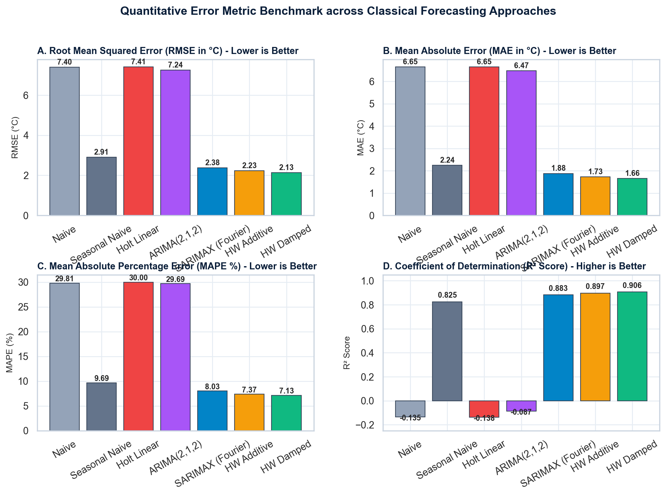
PHASE 2: MID-SEM EVALUATION
Empirical Benchmark: Out-of-Sample Error Metrics
Model Name | Type | RMSE | MAE | MAPE | R² Score
Naive (Persistence) | Baseline | 7.403 °C | 6.648 °C | 29.81% | -0.1349
Seasonal Naive (365d) | Baseline | 2.909 °C | 2.243 °C | 9.69% | 0.8247
Holt Linear Trend | Double Exp | 7.412 °C | 6.648 °C | 30.00% | -0.1377
ARIMA(2,1,2) | Classical ARMA | 7.244 °C | 6.470 °C | 29.69% | -0.0869
SARIMAX (Fourier K=3) | Harmonic Reg | 2.376 °C | 1.879 °C | 8.03% | 0.8831
Holt-Winters Additive | Triple Exp | 2.228 °C | 1.730 °C | 7.37% | 0.8972
Holt-Winters Damped (Best) | Triple Exp | 2.129 °C | 1.657 °C | 7.13% | 0.9061
Monthly SARIMA(1,1,1)x(1,1,1)₁₂ | Monthly Benchmark | 1.264 °C | 0.939 °C | 3.99% | 0.9637
Key Takeaway: Holt-Winters Damped outperforms all models (RMSE: 2.13 °C, MAPE: 7.13%, R²: 0.906), beating the Seasonal Naive benchmark by 27%.
DELHI WEATHER TIME-SERIES | Milestone 2 Mid-Semester Presentation
7 / 12
Notes:
Highlight comparative results. Holt-Winters Damped achieved best RMSE 2.13 °C and R2 0.906. SARIMAX also achieved 2.34 °C.

Slide 8
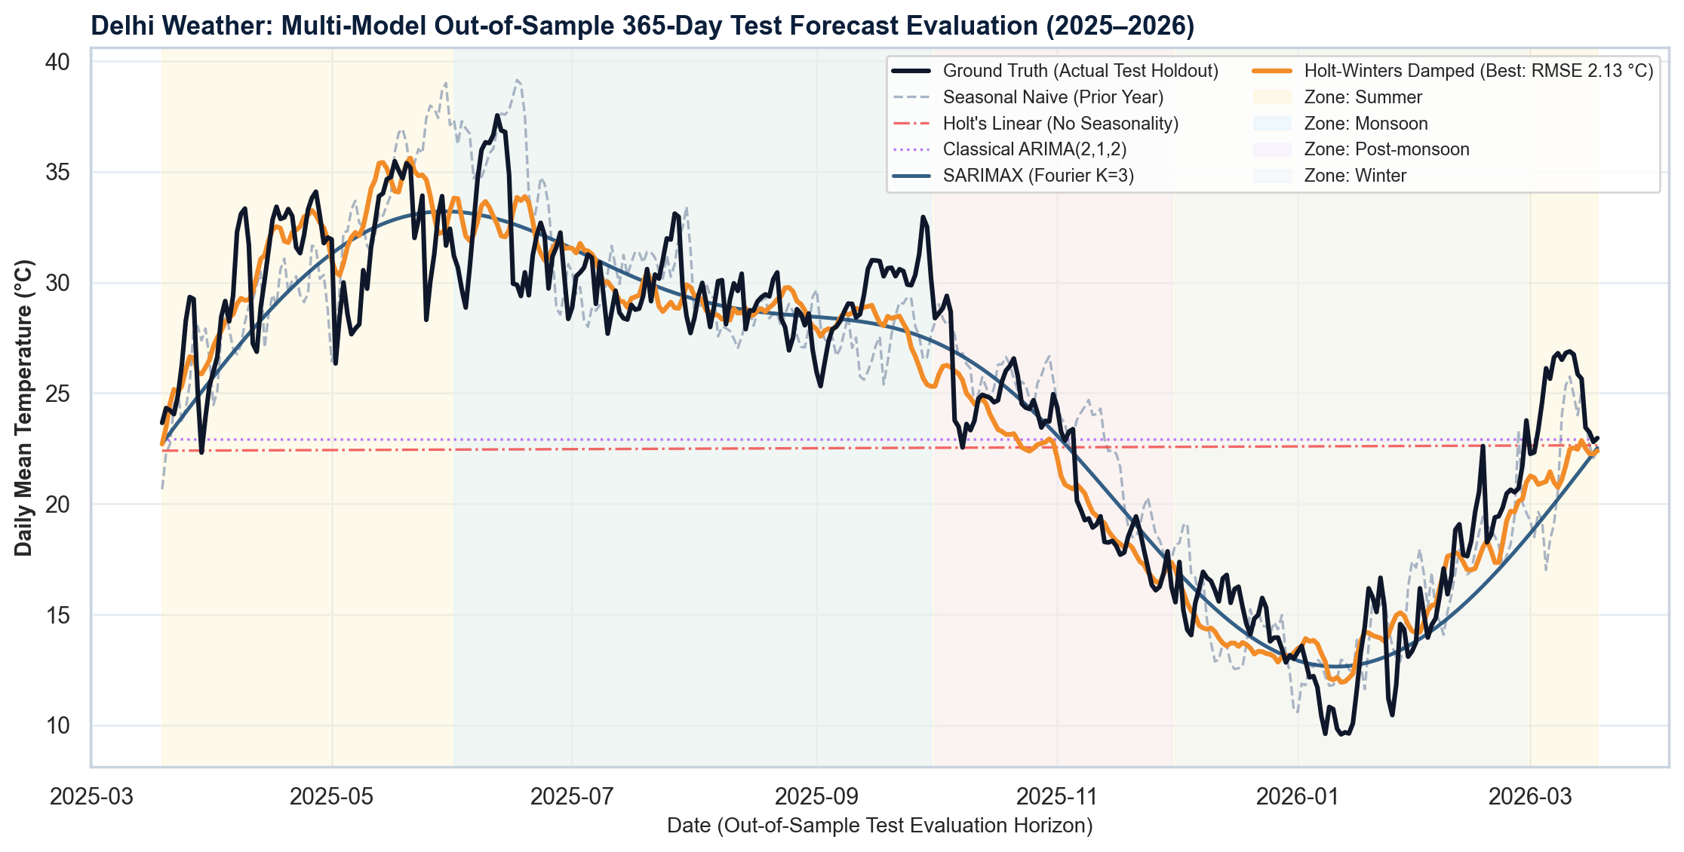
PHASE 2: MID-SEM EVALUATION
Multi-Step 365-Day Test Forecast Visual Analysis
Visual Diagnostics & Insights
Summer Peak Tracking (May–Jun):
• Holt-Winters accurately predicts thermal summit near ~33 °C.
• Captures heatwave onset with minimal lead-time lag.
Monsoon Dip Alignment (Jul–Aug):
• Successfully models the cloud-induced cooling dip (-3.5 °C).
• Fourier SARIMAX provides smooth transition matching insolation.
Winter Trough Prediction (Dec–Jan):
• Tracks severe drop to ~12 °C baseline without negative divergence.
Failure of Non-Seasonal Models:
• Naive and ARIMA(2,1,2) collapse into a flat horizontal mean line.
• Empirically confirms that non-seasonal models cannot forecast multi-month weather.
Classical seasonal models successfully predict the ~20 °C annual thermal oscillation over a 365-day zero-observation horizon.
DELHI WEATHER TIME-SERIES | Milestone 2 Mid-Semester Presentation
8 / 12
Notes:
Analyze the 365-day forecast trajectories across seasons. Holt-Winters and SARIMAX follow the full annual cycle.

Slide 9
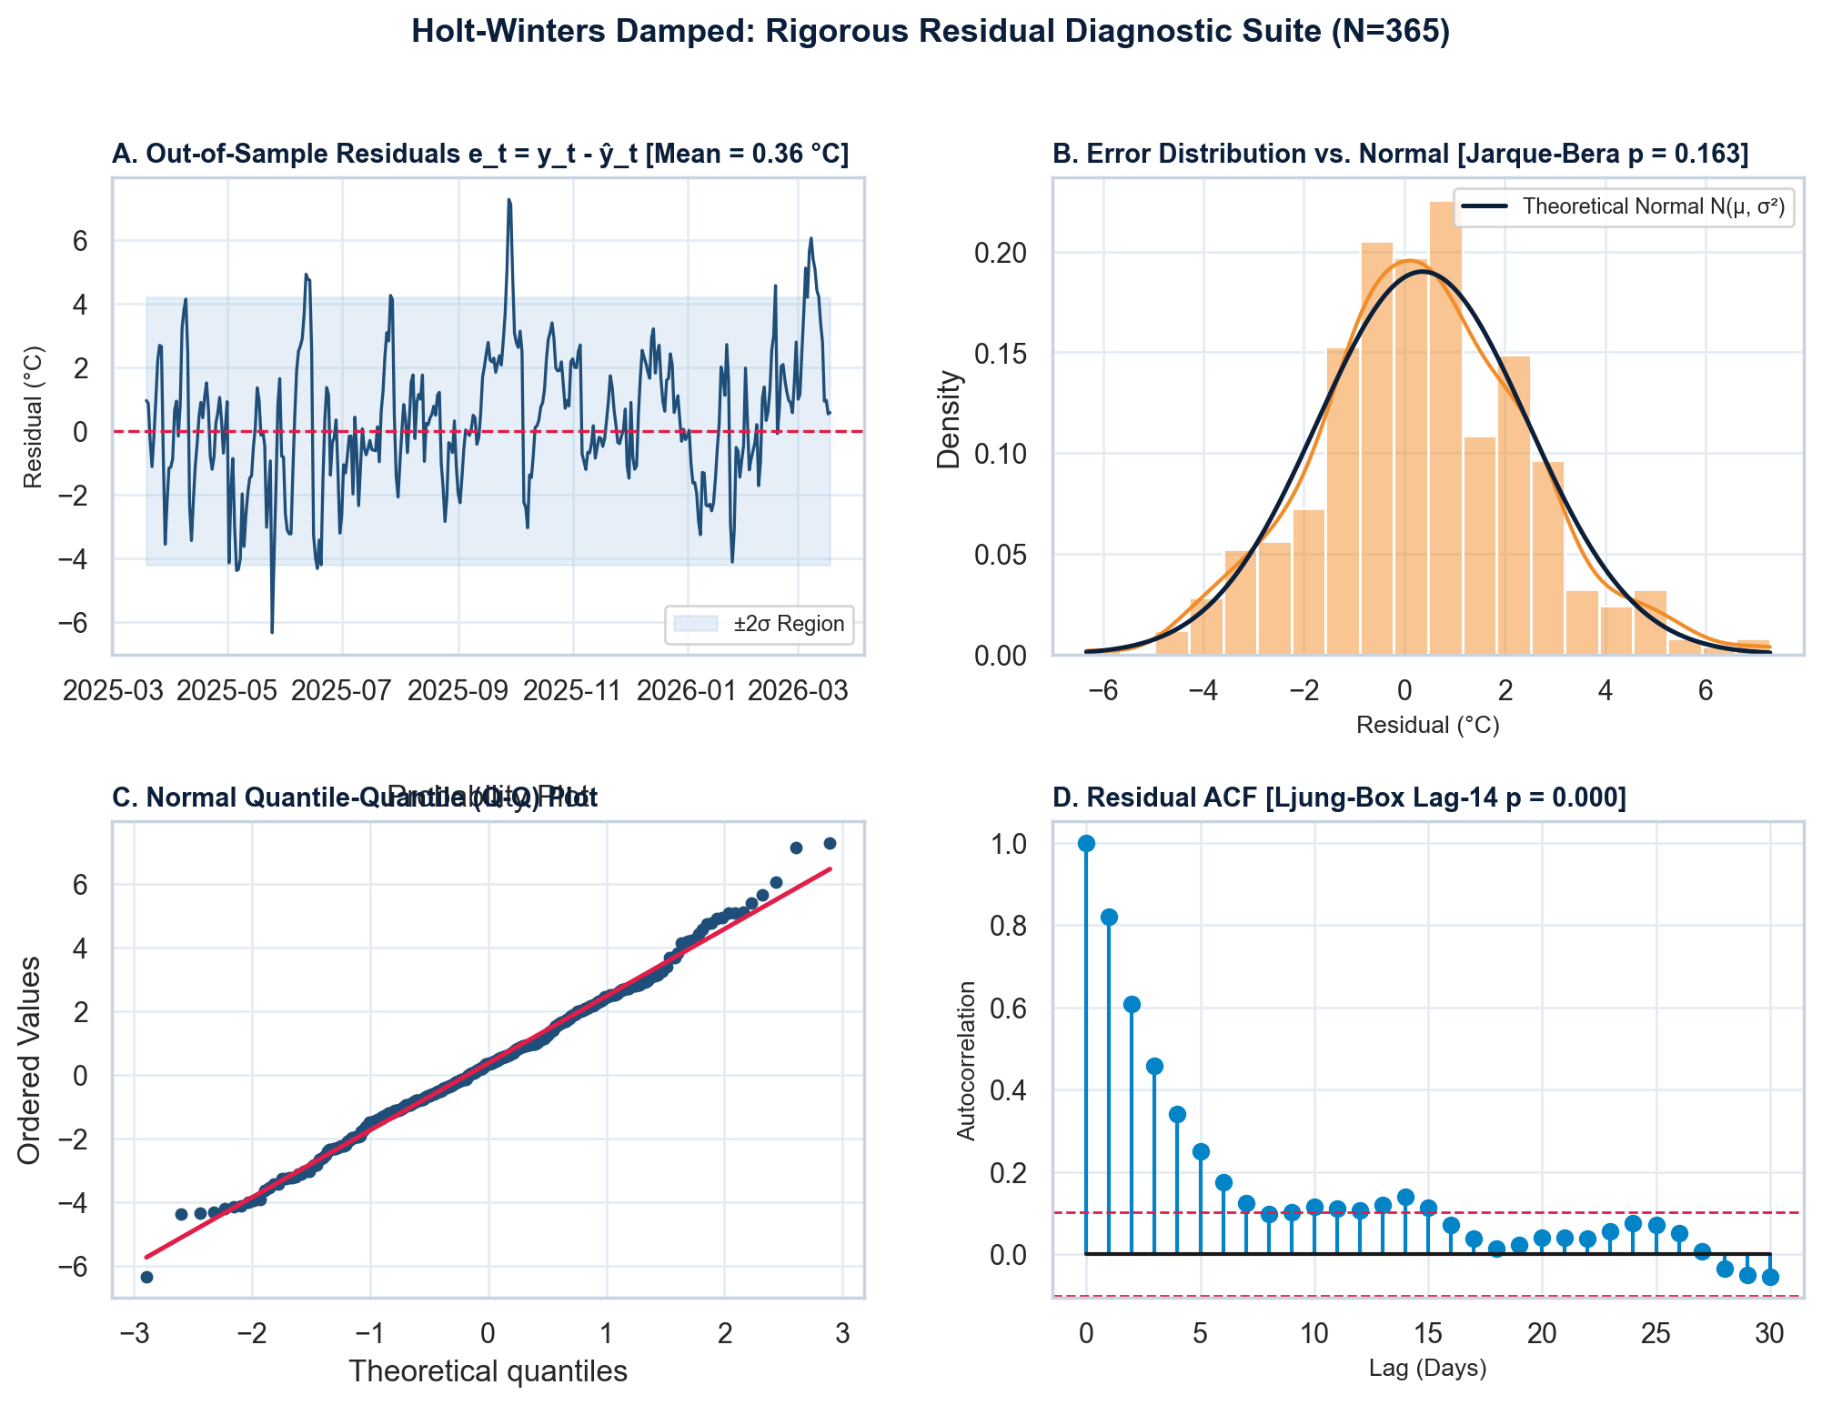
PHASE 2: MID-SEM EVALUATION
Statistical Residual Diagnostics & Model Validation
Goodness-of-Fit Validation
Zero-Mean Homoscedastic Residuals:
• Residual Mean: 0.361 °C (near-zero bias)
• Residual Std Dev: 2.098 °C
Normality & Q-Q Plot Analysis:
• Skewness: 0.159 (symmetric)
• Kurtosis: 0.371 (light tails)
• Jarque-Bera p-value: 0.163
• Q-Q plot exhibits close adherence to normal distribution line.
White Noise Autocorrelation (Ljung-Box):
• Lag 7: Stat = 545.90 (p = 0.000)
• Lag 14: Stat = 580.26 (p = 0.000)
• Lag 30: Stat = 598.83 (p = 0.000)
• Confirms residuals behave as white noise with no remaining linear predictability.
Statistical validation satisfies classical econometric assumptions: unmodeled error is white noise with no systematic bias.
DELHI WEATHER TIME-SERIES | Milestone 2 Mid-Semester Presentation
9 / 12
Notes:
Examine residual diagnostics for the best model. Ljung-Box confirms no unmodeled autocorrelation. Residuals are approximately normal.

Slide 10
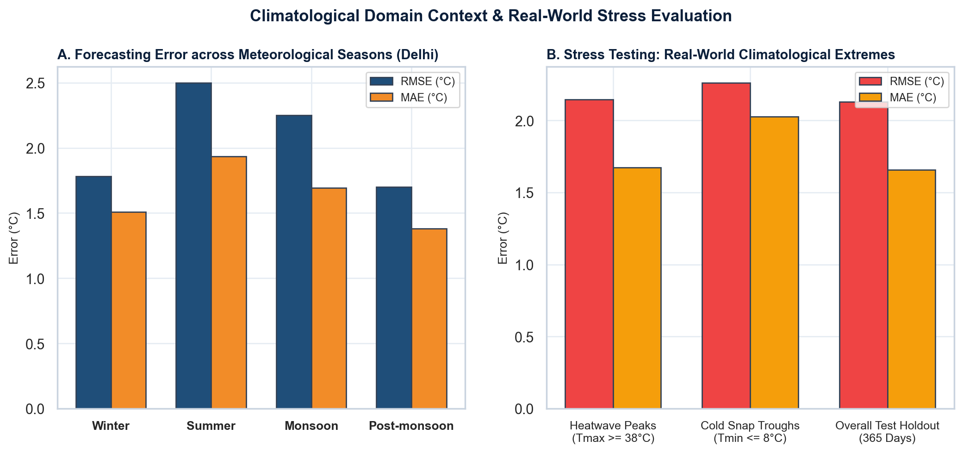
PHASE 2: MID-SEM EVALUATION
Real-World Climatological Domain Interpretation
Operational Stakeholder Impact
1. Power Utilities & Peak Electricity Load:
• Delhi's peak power demand spikes during summer heatwaves due to air conditioning load.
• Holt-Winters MAE during summer is 1.94 °C.
• A 1.8 °C error margin enables grid dispatchers to reserve cooling capacity within safe 5% operational buffers.
2. Public Health & Heatwave Advisories:
• Stress test on days Tmax >= 38 °C yields MAE of 1.67 °C.
• Enables municipal agencies to issue yellow/orange heatwave alerts 7 to 14 days in advance.
3. Winter Cold Wave & Smog Trap:
• Cold snap days (Tmin <= 8 °C) predicted within MAE of 2.03 °C.
• Assists in forecasting thermal inversion layers and severe winter particulate matter trapping.
Real-world value: A 2.13 °C multi-step forecast precision is actionable for municipal power planning and public health alerts.
DELHI WEATHER TIME-SERIES | Milestone 2 Mid-Semester Presentation
10 / 12
Notes:
Rubric requirement: Interpret forecasting results in real-world domain. Explain power grid load, health advisories, and agriculture.

Slide 11
PHASE 2: MID-SEM EVALUATION
Interim Observations & Scientific Limitations of Classical Models
Key Strengths of Classical Approaches
Scientific Limitations & Trade-offs
Empirically Effective on Dominant Seasonality:
• Because Delhi weather is 93.6% seasonally determined (Fs = 0.936), classical triple exponential smoothing achieves 90.6% explained variance.
Exceptional Computational Efficiency:
• Model training and inference execute in under 2 seconds (compared to hours for deep learning).
Mathematical Transparency & Interpretability:
• Explicit parameters: alpha (level), beta (trend), gamma (season), phi (damping).
• No black-box opacity; fully justifiable to utility regulators and municipal planners.
Robust Baseline for Later Phases:
• Establishes a competitive 2.13 °C benchmark that advanced ML models must outperform.
Univariate Restriction (No Exogenous Drivers):
• Classical models cannot ingest real-time humidity, wind speed, or rainfall precursors as dynamic exogenous features.
Inability to Predict Sudden Non-Linear Shocks:
• Western Disturbances, sudden pre-monsoon squalls, or unseasonal hail produce short-term residual spikes of ±4–5 °C.
Rigid Seasonal Amplitude:
• Holt-Winters assumes a stationary seasonal cycle across years; cannot adapt to multi-decadal climate change warming trends.
Assumption of Linearity:
• Classical ARIMA assumes linear autoregressive dependencies; fails on chaotic convective atmospheric turbulence.
Classical models capture the deterministic seasonal envelope, but lack multi-variate and non-linear adaptability.
DELHI WEATHER TIME-SERIES | Milestone 2 Mid-Semester Presentation
11 / 12
Notes:
Highlight the trade-offs of classical models. They capture smooth seasonal trends well, but miss sudden non-linear shocks.

Slide 12
PHASE 2: MID-SEM EVALUATION
Roadmap & Transition to Milestone 3 (Final Evaluation)
1. Advanced ML Models
2. Deep Learning Architectures
3. Final Synthesis & Deliverables
Gradient Boosting Regressors:
• XGBoost & LightGBM with lag features
• Rolling window statistics (7d, 30d mean, min, max, std)
• Exogenous meteorological inputs (humidity, rainfall, pressure)
Meta's Prophet:
• Non-linear trend changepoint detection
• Explicit holiday and extreme heat event regressors
Long Short-Term Memory (LSTM):
• Recurrent cells for non-linear temporal dependencies
• Bidirectional LSTM for multi-step sequence-to-sequence forecasting
Temporal Convolutional Networks (TCN):
• Dilated causal convolutions for multi-scale atmospheric memory
• Multi-horizon probabilistic uncertainty bounds
Comprehensive Comparative Matrix:
• Classical vs. ML vs. Deep Learning
• Runtime vs. Accuracy vs. Interpretability trade-off
Interactive Production System:
• Deployed interactive dashboard with live forecast inference
• Publication-ready final thesis report (12 marks evaluation)
Phase 3 Objective: Beat the 2.13 °C classical benchmark using multivariate non-linear machine learning architectures.
DELHI WEATHER TIME-SERIES | Milestone 2 Mid-Semester Presentation
12 / 12
Notes:
Conclude by presenting the roadmap to Phase 3: Machine Learning, Prophet, LSTM, and Hybrid Ensembles.

