Slide 1
TIME SERIES ANALYSIS & FORECASTING
Exploratory Time-Series Analysis of Urban Weather Dynamics in Delhi (1996–2026)
Milestone 1: Synopsis Presentation (EDA & Problem Formulation)
Team Members (Roll Nos.)
Instructor: Course Instructor
Notes:
Milestone 1 Synopsis: Covers EDA, data quality, and problem definition. No forecasting models executed.

Slide 2
Introduction & Motivation
Time Series Fundamentals
Why Delhi Weather?
• Temporal Ordering: Data points recorded chronologically; order matters.
• Four Components: Trend, Seasonality, Cyclic, and Irregular Residual.
• Component Decomposition: Essential before choosing any forecasting model.
• Applications: Energy consumption, environment, agriculture, and healthcare.
• Severe Climate Extremes: Hot summers (>45°C), monsoons, and cold winters.
• Grid & Planning Impact: Drives peak electricity load and municipal flood management.
• 30-Year Longitudinal Archive: 1996–2026 dataset provides repeated seasonal cycles.
• Feasible & Open: Public dataset ready for multi-phase exploration.
DELHI WEATHER ANALYTICS (1996–2026) | Milestone 1 Synopsis
2 / 11
Notes:
Introduce time series components and why Delhi weather was chosen.

Slide 3
Problem Statement, Scope & Stakeholders
How do temperature and precipitation in Delhi evolve over 30 years across seasonal and trend components, and what empirical properties govern the choice of future forecasting models?
Problem Focus
Stakeholders
Decisions Supported
• Pattern identification (Phase 1)
• Extreme-event exploration
• Temperature-rainfall relation
• Future model scoping
• Power distribution utilities
• City disaster planners
• Agricultural planners
• Public health agencies
• Seasonal grid resource planning
• Heatwave early advisories
• Drainage scheduling
• Forecasting model selection
DELHI WEATHER ANALYTICS (1996–2026) | Milestone 1 Synopsis
3 / 11

Slide 4
Dataset Description & Data Snapshot
Attribute | Detail
Source | Kaggle - Indian Weather Dataset (1996–2026)
Coverage | 01 Jan 1996 → 18 Mar 2026
Time Index | 'datetime' (Hourly)
Volume | 264,840 raw → 11,035 daily points
Format | CSV (Time-indexed)
Timestamp | Temp (°C) | Rain (mm) | Humidity (%)
1996-01-01 00:00 | 11.8 | 0.0 | 81
1996-01-01 01:00 | 11.5 | 0.0 | 82
1996-01-01 02:00 | 11.0 | 0.0 | 84
1996-01-01 03:00 | 10.6 | 0.0 | 86
1996-01-01 04:00 | 10.3 | 0.0 | 88
1996-01-01 05:00 | 10.3 | 0.0 | 89
1996-01-01 06:00 | 9.8 | 0.0 | 91
Dataset Checklist
• ✓ Proper time column present and regular
• ✓ 11,035 daily observations (≥500 required)
• ✓ Source and variable dictionary documented
• ✓ Numeric types validated
DELHI WEATHER ANALYTICS (1996–2026) | Milestone 1 Synopsis
4 / 11

Slide 5
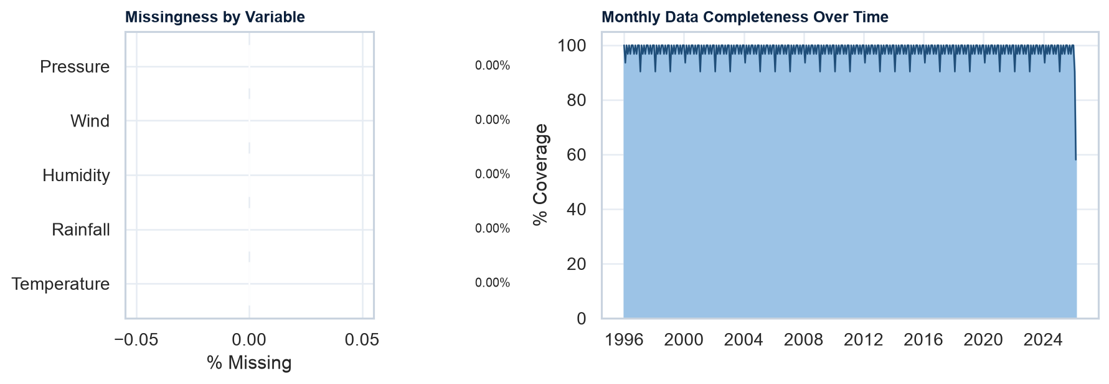
Data Quality & Completeness Audit
264,840
0
0.00%
11,035
High
Raw Rows
Duplicates
Temp Missing
Daily Points
Continuity
>99.7% data completeness across 30 years. Short gaps will be interpolated in Phase 2.
DELHI WEATHER ANALYTICS (1996–2026) | Milestone 1 Synopsis
5 / 11

Slide 6
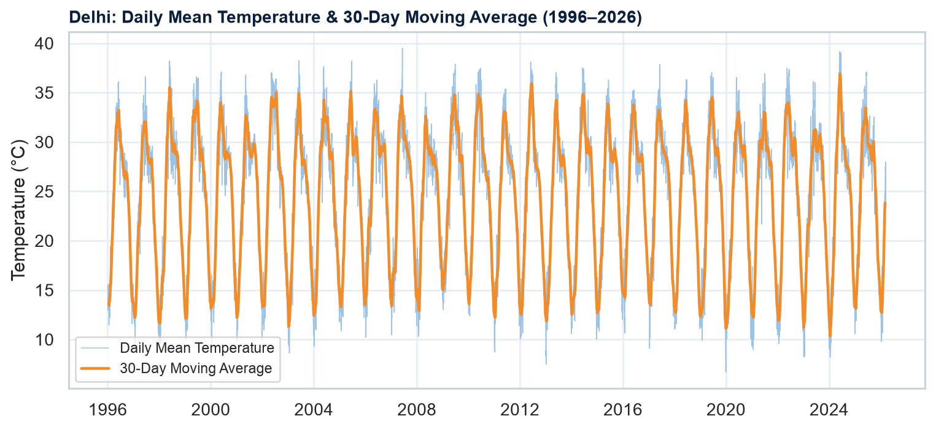
Trend & Extreme Temperature Analysis
Top 5 Hottest Days (Max Temp)
Rank | Date | Value
1 | 26 May 1998 | 46.8 °C
2 | 28 May 1998 | 46.2 °C
3 | 29 May 2024 | 46.1 °C
4 | 27 May 1998 | 46.0 °C
5 | 18 May 2002 | 45.9 °C
Top 5 Coldest Days (Min Temp)
Rank | Date | Value
1 | 31 Dec 2019 | 2.0 °C
2 | 06 Jan 2013 | 2.2 °C
3 | 18 Jan 1998 | 2.3 °C
4 | 16 Jan 2023 | 2.4 °C
5 | 18 Jan 2023 | 2.4 °C
30-Day moving average is an exploratory smoothing aid only; no prediction is performed.
DELHI WEATHER ANALYTICS (1996–2026) | Milestone 1 Synopsis
6 / 11

Slide 7
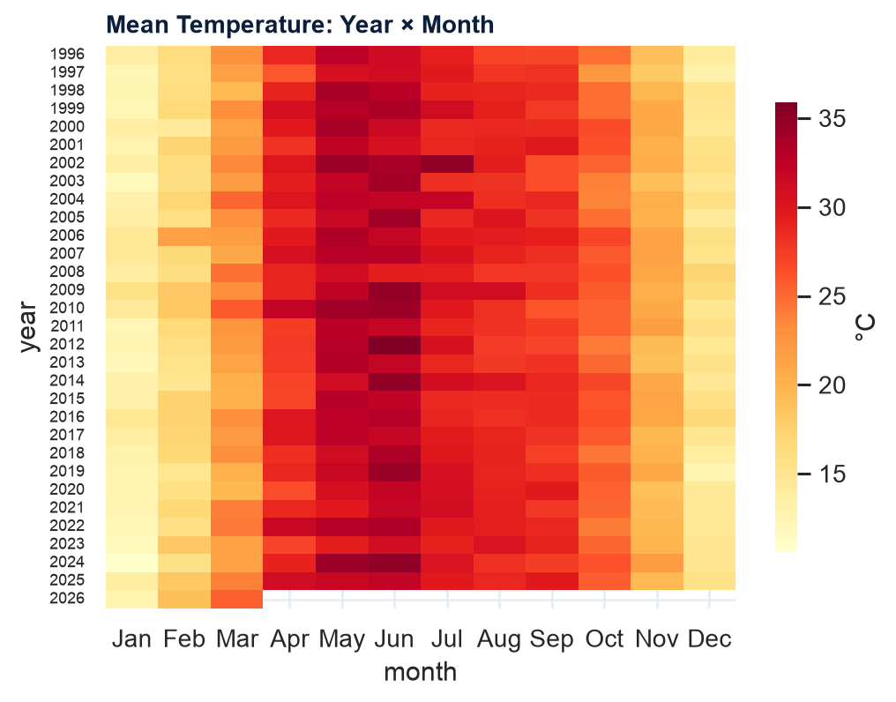
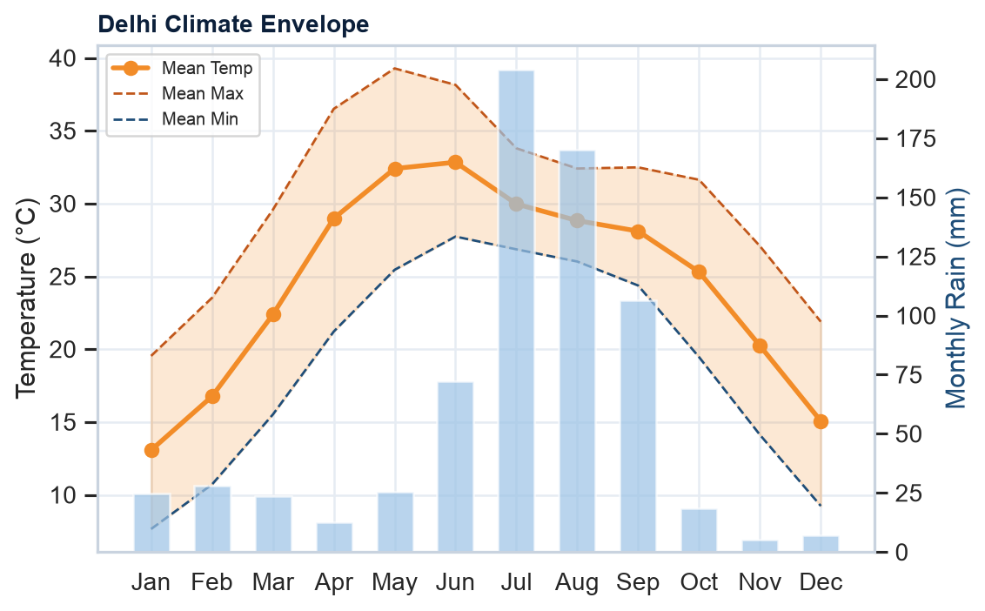
Seasonality: Climatological Envelope & Heatmap
Hottest Month: Jun (32.8°C) | Coldest Month: Jan (13.1°C) | Annual Swing: ~19.8°C
DELHI WEATHER ANALYTICS (1996–2026) | Milestone 1 Synopsis
7 / 11

Slide 8
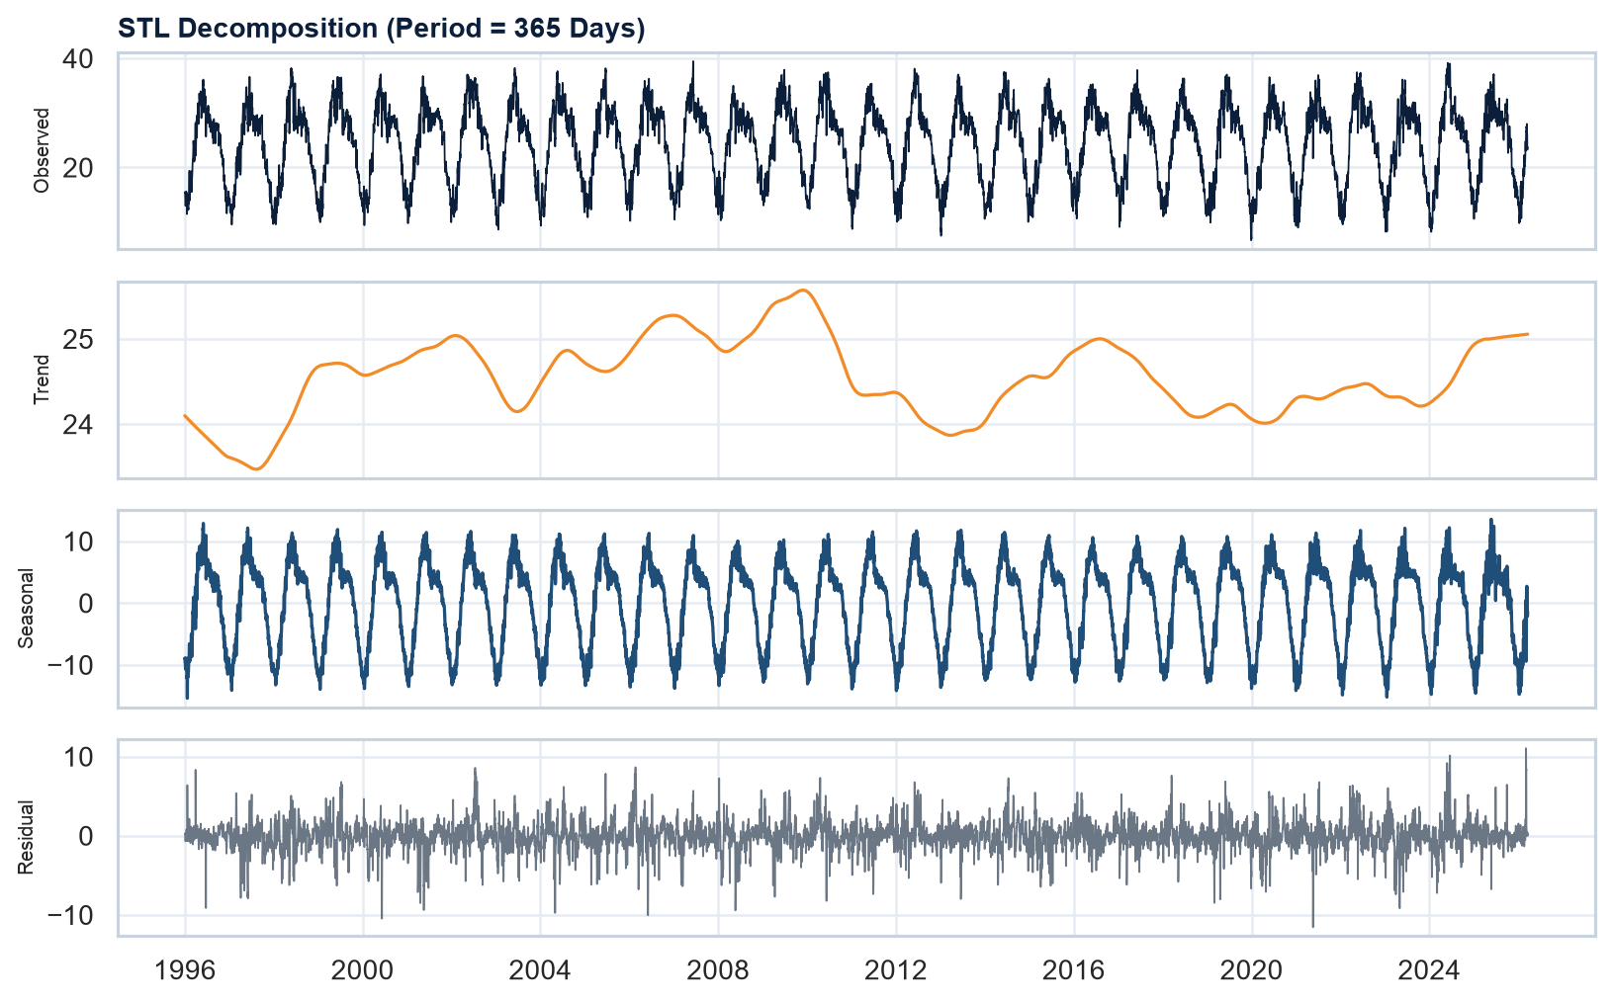
Time-Series Decomposition (STL)
0.93
Seasonal Strength (Fs)
0.08
Trend Strength (Ft)
Observed = Trend + Seasonal + Residual. High seasonal strength (Fs > 0.85) indicates that seasonal terms (e.g., SARIMA, Holt-Winters) are required for later modeling.
DELHI WEATHER ANALYTICS (1996–2026) | Milestone 1 Synopsis
8 / 11

Slide 9
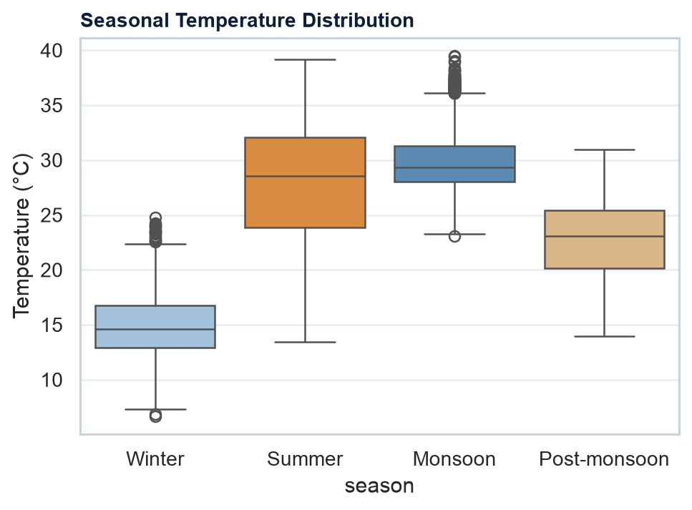
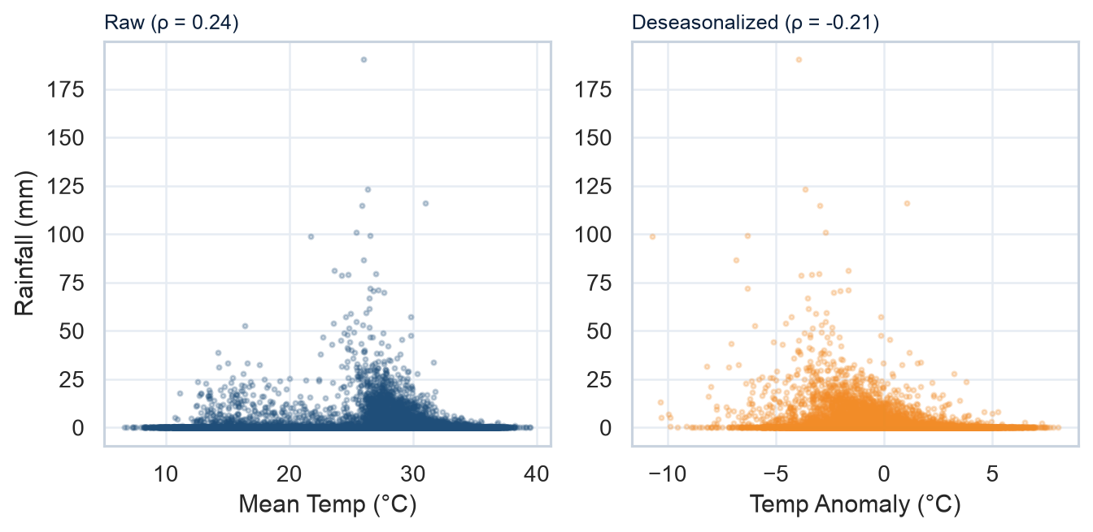
Seasonal Distributions & Temperature–Rain Relationship
Monsoon Concentration: ~79% of rain falls in Jun–Sep. Deseasonalized temp-rain ρ = -0.21.
DELHI WEATHER ANALYTICS (1996–2026) | Milestone 1 Synopsis
9 / 11

Slide 10
Project Objectives & Proposed Methodology
Milestone Objectives
Model Selection Justification (From EDA)
O1: Quality audit and continuous time index verification (Phase 1 ✓)
O2: Quantify trend, annual seasonality, and extreme days (Phase 1 ✓)
O3: Formulate scope and establish project feasibility (Phase 1 ✓)
O4: Classical Baselines: ARIMA, SARIMA, Holt-Winters (Phase 2)
O5: ML/DL Comparison: XGBoost, LSTM, Facebook Prophet (Phase 3)
O6: Multi-metric benchmarking: RMSE, MAE, MAPE (Phase 3)
• Strong Yearly Seasonality (Fs = 0.93) → Motivates SARIMA & Holt-Winters
• Non-linear Multivariable Coupling → Motivates LSTM Networks
• Skewed Precipitation Values → Motivates Tree-based XGBoost with lag features
• Evaluation Design: Chronological train/test split (no shuffling) using RMSE, MAE, MAPE
• Strict Rule: No forecasting models are executed in Milestone 1
DELHI WEATHER ANALYTICS (1996–2026) | Milestone 1 Synopsis
10 / 11

Slide 11
Conclusion & Key References
Milestone 1 Summary
Academic References
• 11,035 daily observations across 30 years ready for analysis.
• Data quality audited (>99.7% completeness).
• Seasonal envelope and repeating annual cycle confirmed.
• Feasible direction defined for classical and ML modeling.
• No forecasting executed in Phase 1 (strictly compliant).
• Hyndman & Athanasopoulos (2021). Forecasting: Principles and Practice (3rd ed.). OTexts.
• Box, Jenkins, Reinsel & Ljung (2015). Time Series Analysis: Forecasting and Control (5th ed.). Wiley.
• Cleveland et al. (1990). STL: A Seasonal-Trend Decomposition Procedure. J. Off. Stat.
• Taylor & Letham (2018). Forecasting at Scale. The American Statistician.
• Hochreiter & Schmidhuber (1997). Long Short-Term Memory. Neural Computation.
• Chen & Guestrin (2016). XGBoost: A Scalable Tree Boosting System. ACM SIGKDD.
• Rasp et al. (2020). WeatherBench: Benchmark for Data-Driven Weather Forecasting. JAMES.
• Dataset: Kaggle - Indian Weather Dataset (1996–2026) (kaggle.com/datasets/sandeepgupta09/indian-weather-dataset-1996-2026)
Next Steps (Phase 2): Differencing, stationarity tests, and classical ARIMA/SARIMA & Holt-Winters implementation.
DELHI WEATHER ANALYTICS (1996–2026) | Milestone 1 Synopsis
11 / 11

