Slide 1

$ML
Dhruv Sakalley

Slide 2
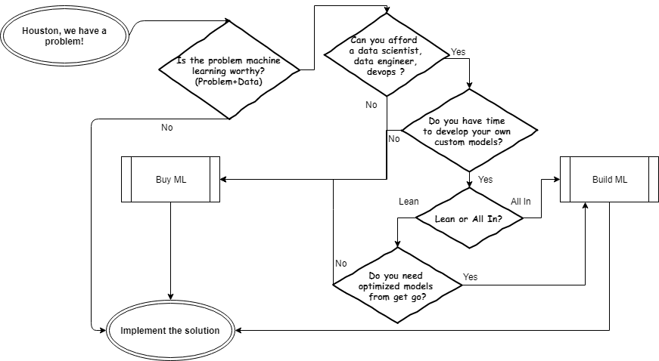
Why $Buy

Slide 3
Some of the major Players
Microsoft Cognitive Services
Amazon & Amazon Marketplace
IBM
Google
…

Slide 4

Typical Choice
Do-It-Yourself
Hosted Custom Clusters
Hosted machines
Hosted Cloud Studios
RESTful APIs
In-app integrations

Slide 5
Typical Choice
Do-It-Yourself
Hosted Custom Clusters
Hosted machines
Hosted Cloud Studios
RESTful APIs
In-app integrations

Slide 6

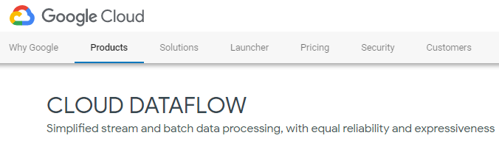
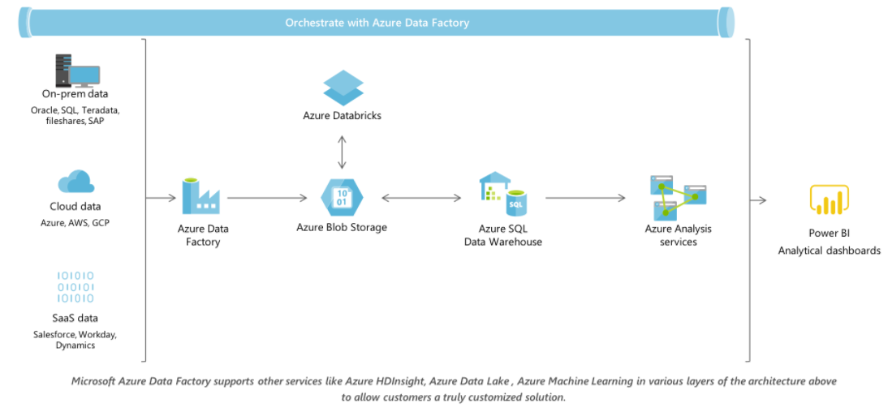
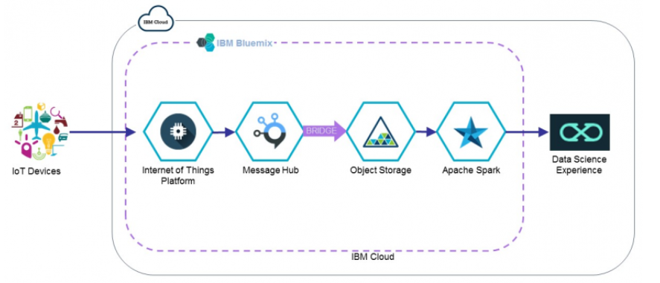
Orchestration and Data Pipelines

Slide 7
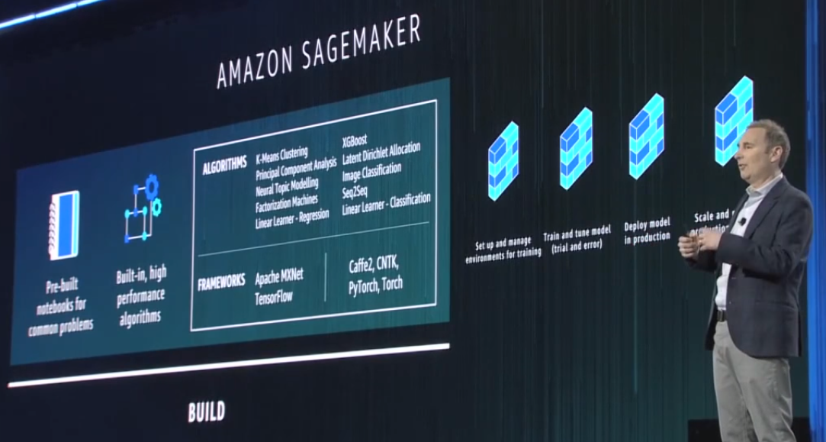

Slide 8
Amazon Offerings
https://aws.amazon.com/sagemaker/ (Studio)
https://aws.amazon.com/rekognition/ (Deep learning-based image and video analysis)
https://aws.amazon.com/lex/ (Bot)
https://aws.amazon.com/comprehend/ (Topic Modeling)
https://aws.amazon.com/translate/
https://aws.amazon.com/transcribe

Slide 9
Google Offerings
https://cloud.google.com/products/machine-learning/
https://cloud.google.com/job-discovery/

Slide 10
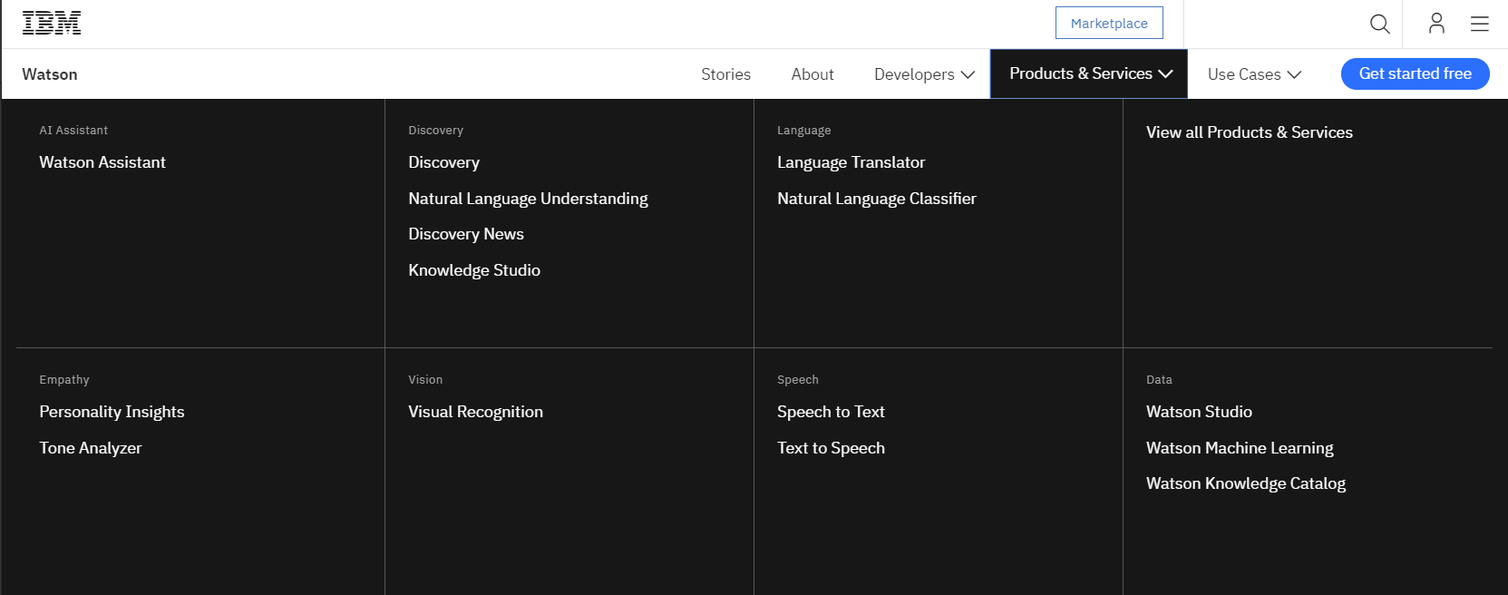
IBM Offerings

Slide 11
Microsoft Offerings
https://aka.ms/AzureMLStudio
https://aka.ms/ExcelML - https://docs.microsoft.com/en-us/azure/machine-learning/studio/excel-add-in-for-web-services
https://aka.ms/CognitiveServices

Slide 12
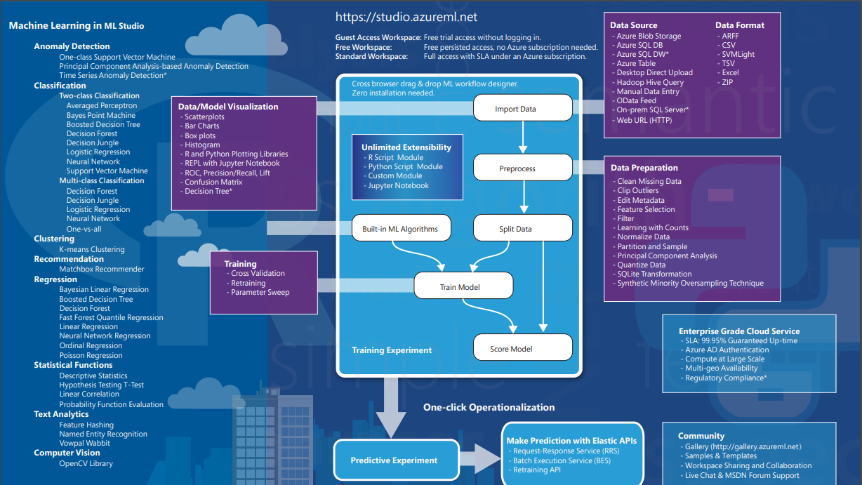

Slide 13
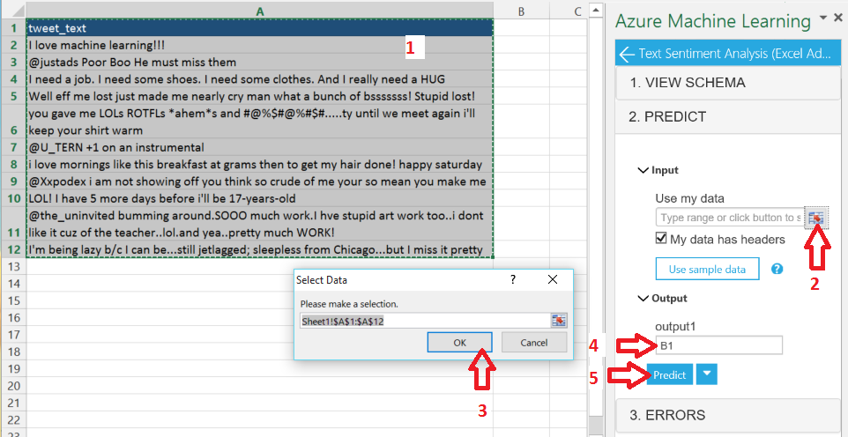
Excel ML Add-in

Slide 14
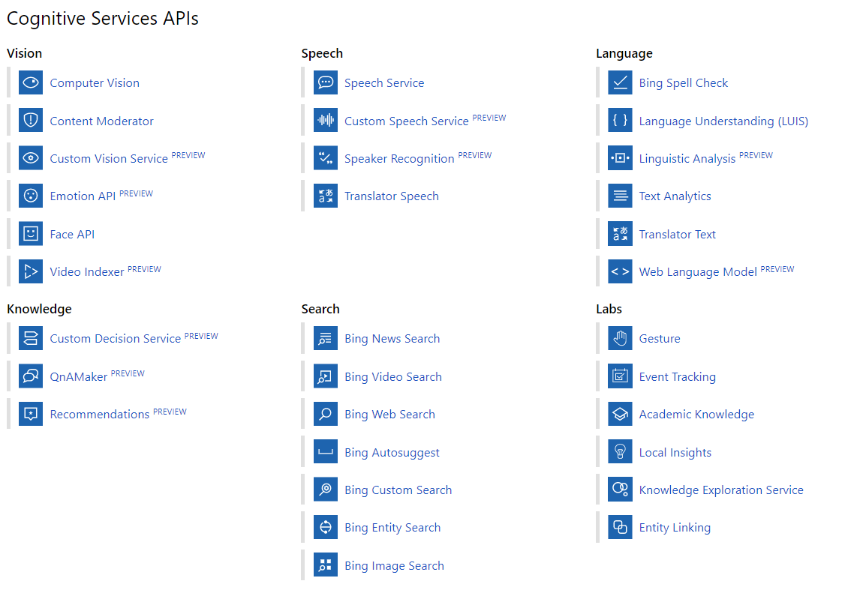
https://docs.microsoft.com/en-us/azure/cognitive-services/

Slide 15

Microsoft Examples
Vision API
Tag images based on content.
Categorize images.
Identify the type and quality of images.
Detect human faces and return their coordinates.
Recognize domain-specific content.
Generate descriptions of the content.
Use optical character recognition to identify printed text found in images.
Recognize handwritten text.
Distinguish color schemes.
Flag adult content.
Crop photos to be used as thumbnails.

Slide 16
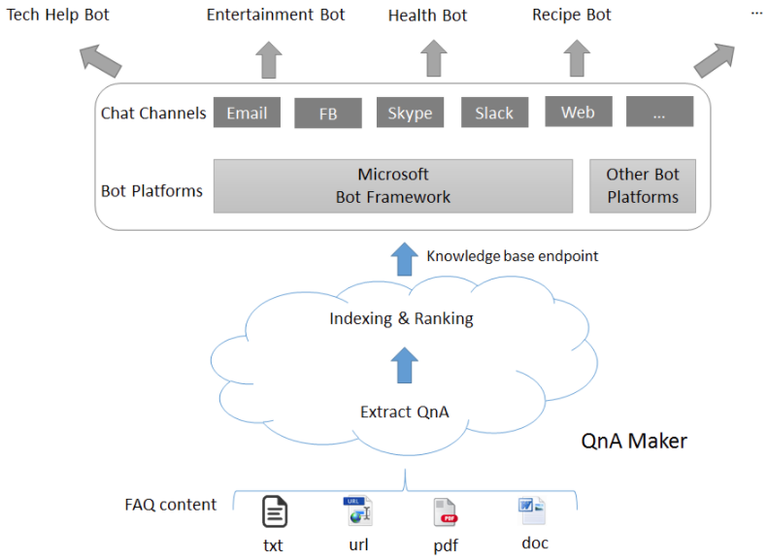
Microsoft Examples
Speech API & Microsoft QnA Maker
Speech to Text API converts human speech to text that can be used as input or commands to control your application.
Text to Speech API converts text to audio streams that can be played back to the user of your application.

Slide 17

Challenge
Complete the vision API Notebook
Choose your adventure
Write a note, take a picture and speak it out to us with a notebook in another language
A picture is worth a thousand words… make someone see a picture through AI- eyes
Identify the person in a business card, if a linkedin link is missing look up the linkedin account for the person to make them into a possible lead.

Slide 18

Helpful Links
https://help.parsehub.com/hc/en-us/articles/219619888-Analyzing-JSON-With-Python
http://www.pythonforbeginners.com/dictionary/how-to-use-dictionaries-in-python
http://www.pythonforbeginners.com/requests/using-requests-in-python
https://docs.microsoft.com/en-us/azure/machine-learning/studio/walkthrough-5-publish-web-service
https://www.anaconda.com/download
https://github.com/Microsoft/Cognitive-Vision-Python/tree/master/Jupyter%20Notebook

Slide 19

Thank you!

