Slide 1
Install and Configure CLion
EE 312 – Software Design I

Slide 2
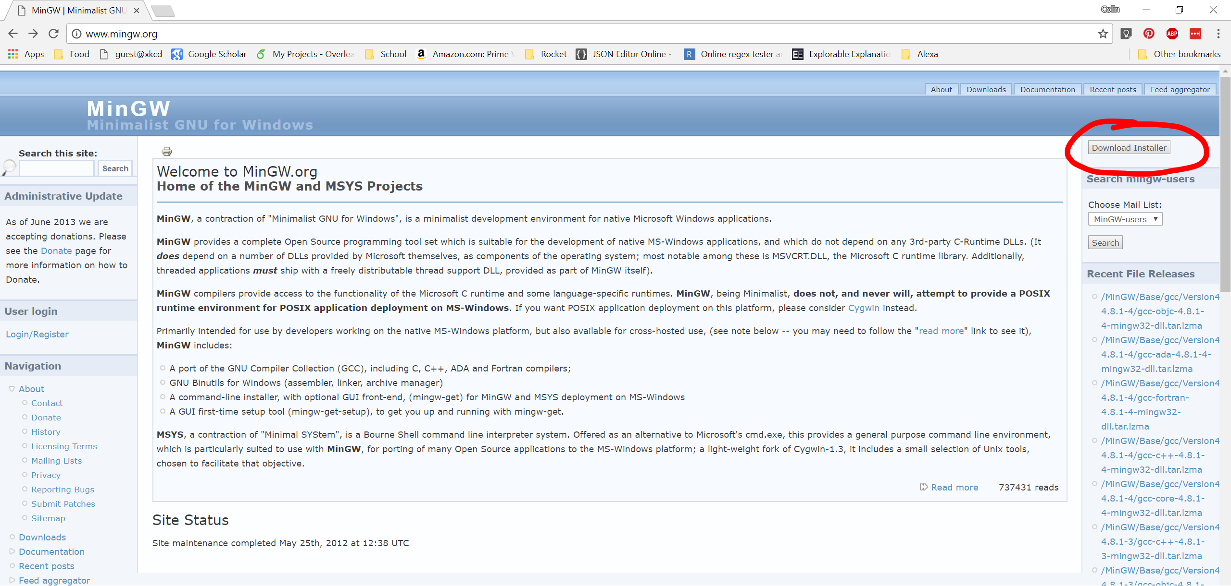
Download MinGW
Go to www.mingw.org
On the right of the page click “Download Installer

Slide 3
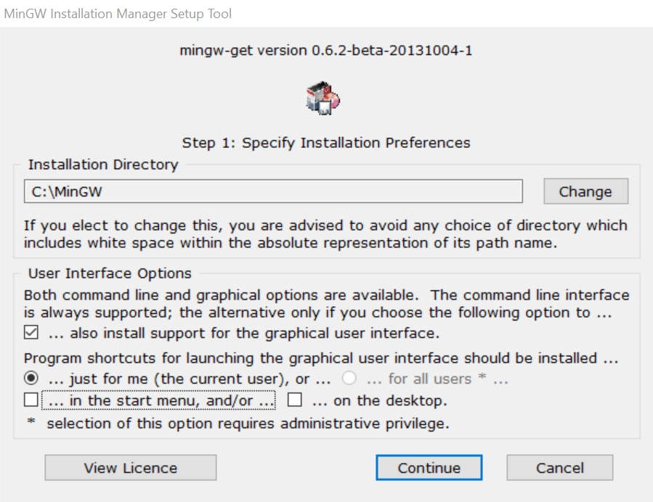
Install MinGW
Go to your downloads folder or click the file in your browser once it has finished downloading to begin the installation process (should be called “mingw-get-setup”)
Click “Install” and then it will take you to “Step 1”. Here you can leave the defaults unless you don’t want shortcuts (the below picture is if you don’t want any shortcuts created). Then click “Continue” and it will begin a download.

Slide 4
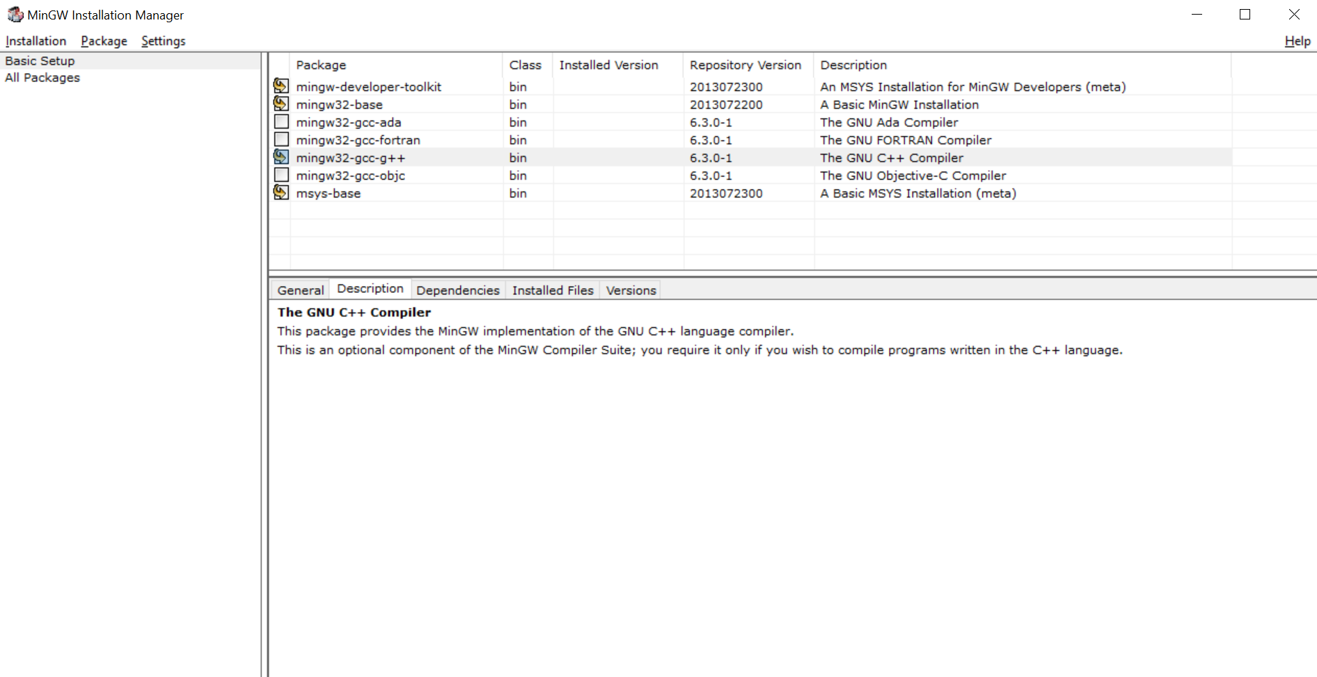
Install MinGW
Once the download finishes click “Continue” and the installation will move to a new menu with a few packages to choose.
Select “mingw-developer-toolkit”, “mingw32-base”, “mingw32-gcc-g++”, “msys-base” and select “Mark for Installation” for each of them (it should look like below)
Next, click “Installation” in the top left, then “Apply Changes” and a new popup will appear, click “Apply” to start the download. Once the download is finished, close the dialog and then the installer.

Slide 5
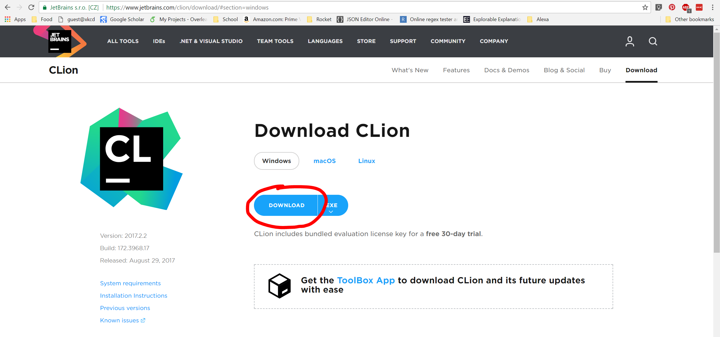
Download CLion
Go to https://www.jetbrains.com/clion/download
It should show a Windows button highlighted and have a “Download” button. Go ahead and click the “Download” button.

Slide 6
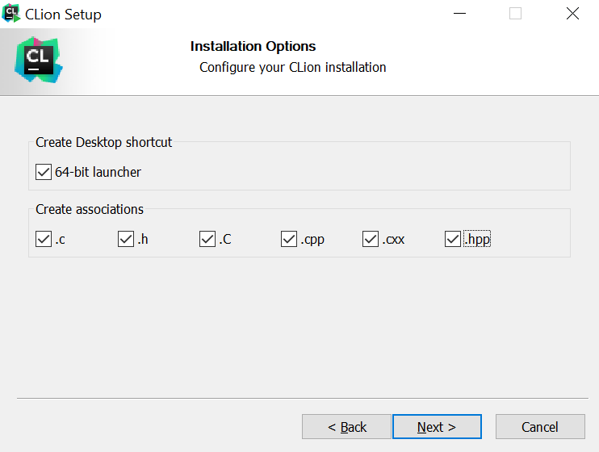
Install CLion
Go to your downloads folder or click the downloaded file in your browser to begin the installation process
At the beginning just click “Next” and then “Next” again. At the next window choose to make a Desktop Launcher and then also create all of the file associations (like below) and then click “Next”. Finally click “Install”.
Once the installation finishes, select “Run CLion“ and then click “Finish”

Slide 7
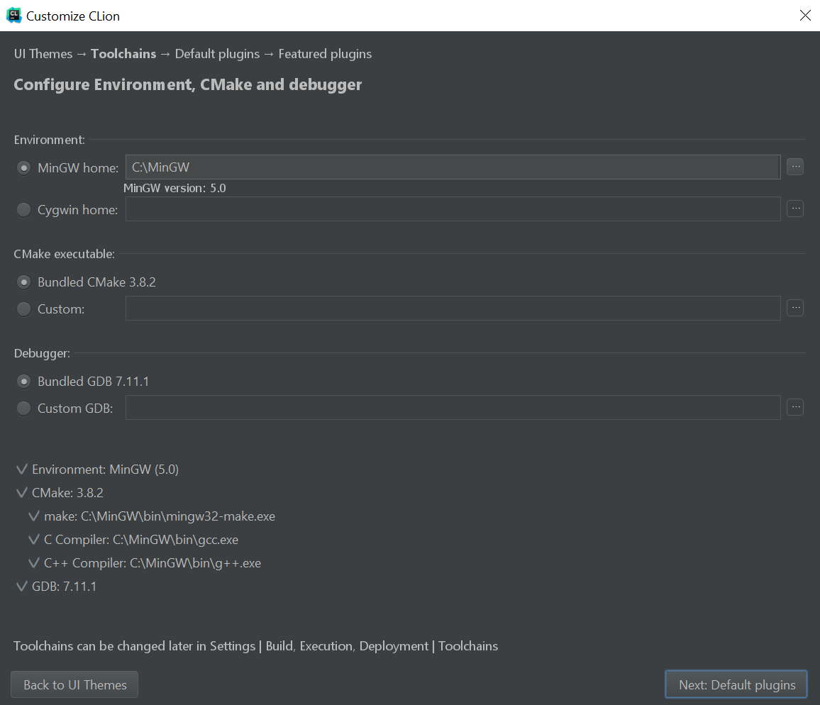
Configure CLion
Once you start CLion the first time, leave the default “Do not import settings” and click “Ok”
On the next menu select your preferred color scheme (this can be changed later) and click “Next: Toolchains”
If you finished installing MinGW it should find that directory (if not simply click the ellipsis at the top right and find where you installed MinGW). Leave the selected options “Bundled CMake” and “Bundled GDB” like the picture and click “Next: Default plugins”

Slide 8
Configure CLion
All of the “Default plugins” are okay to install (they are pretty small) so just click “Next: Featured plugins”
You don’t need any of the “Featured plugins” so just click “Start using CLion“ and CLion should start up and be ready to go!

Slide 9
Configure Educational License
CLion comes with a 30-day free license but since you are a student you can create an educational license for free.
Go to https://www.jetbrains.com/student and click the blue “Apply Now” button
Fill out the form using your @utexas.edu email address and click “Apply for Free Products”
Once you have your account created go ahead and open CLion

Slide 10
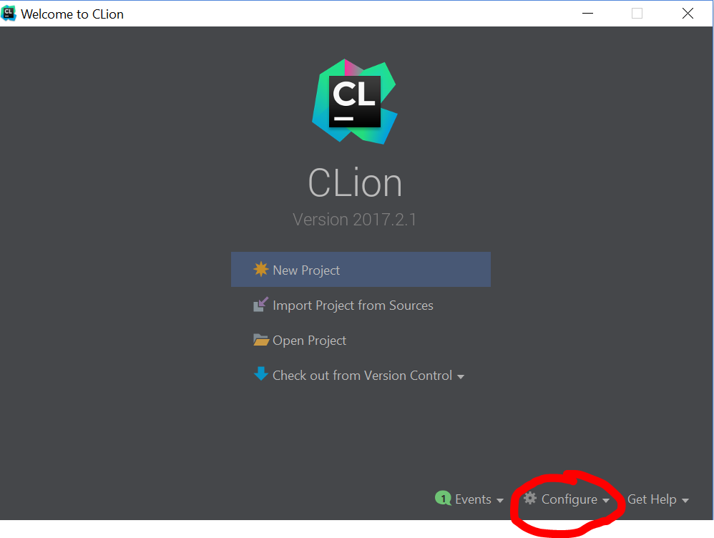
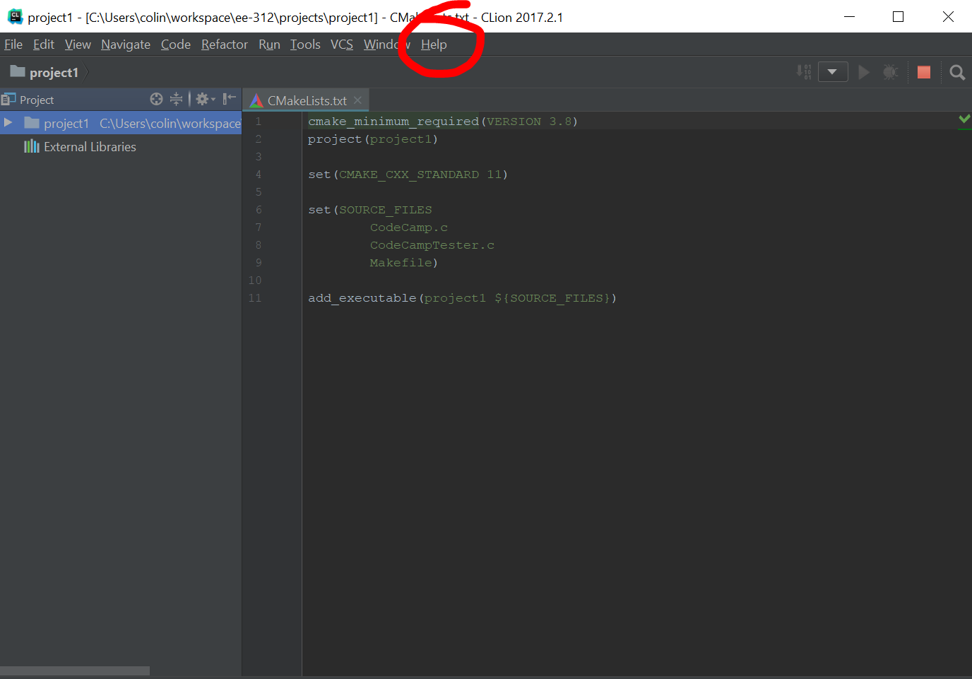
Configure Educational License
If you are at the startup window to create a new project click “Configure” and then “Manage License” from that submenu
If you have a project open already click “Help” and then “Register”
A popup will appear where you can enter your Jetbrains account information and click “Activate”

