Slide 1
Software Tools Recitation 1
ECE Linux accounts
Introduction to Linux
CLion
Text editor + gcc

Slide 2
ECE Linux Accounts

Slide 3
ECE Linux Account
Enable your account
We will grade your projects on the 64-bit ECE Linux machines
Test your project on those machines (e.g., kamek) before you submit for grading
Using Windows? Connect with Putty
Use ssh to log in to Linux machine
Using Mac OS (10.7 and above)? You'll need XQuartz
Try it: ssh –X username@kamek.ece.utexas.edu
You will be prompted for your password

Slide 4
CLion IDE: Getting Started

Slide 5
CLion: Integrated Development Environment C and C++
Recommended IDE for EE 312
Apply for an academic license
Download and installation
Quick Start
system requirements
Creating a project
Notes:
TAs: We should ask them to download and install before class if possible. Then you can work through basics of how to use CLion in recitation.

Slide 6
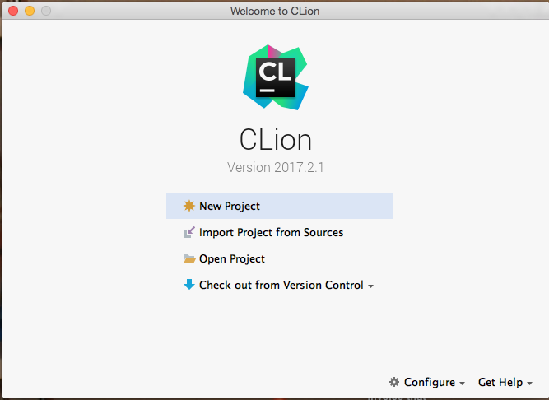
CLion
Create a new project, open an existing project, or check out from version control (e.g., git)

Slide 7
CLion: creating a new C project
Menu File|New Project|C Executable
Enter a name for your project (default is untitled)
Choose language standard: C11
Project initially contains only file main.c
Change file name using menu Refactor|move
Add new files (.c or .h) to project:
Menu View|Tool Windows|Project
In Project window, right-click directory for new file
Select New from menu
Select C/C++ Source File (.c) or C/C++ Header File (.h)
Add new file to SOURCE_FILES in CMakeLists.txt
Notes:
TAs: Demonstrate using CLion to create the standard "hello world" program (store in file hello.c). Compile and run.
hello.c:
#include<stdio.h>
int main() {
puts("hello world");
}

Slide 8
CLion Exercise
Create a new project called Recitation1
In this project, create a new .c file called stuff.c
Edit stuff.c so that when you select "build all", it prints the message, "My name is Inigo Montoya, you killed my father, prepare to die!" (without the quotes)
Run it!

Slide 9
Text Editor + gcc + gdb

Slide 10
Text Editor: emacs
You can use emacs on your Mac or Windows machine
From linux prompt on kamek (or yoshi, mario, ...):
% emacs &
C-x C-f: create a new file called helloWorld.c
Enter your program
C-x C-s: saves your file
C-x C-c: exit emacs
% gcc –o helloWorld helloWorld.c
% ./helloWorld
Emacs tutorial: C-h t

Slide 11
Debugging with gdb
Download this program, arrayMax.c
Compile with the –g option to embed debugging info: gcc –std=c99 –g –o arrayMax arrayMax.c
Execute: ./arrayMax
Oops! Seg fault (core dumped)
Start gdb on the executable file: gdb arrayMax
List your program with l or list:
(gdb) l
Set some breakpoints (b linenumber or
b functionName) and step through until you identify the problem.
List of gdb commands on next slide...
Notes:
This program assumes C99 or C11.

Slide 12
gdb: command line debugger
Useful commands
break linenumber ← create breakpoint at specified line
run ← run program
c ← continue execution
step ← execute next line or step into function
quit ← quit gdb
print expression ← print current value of expression
l ← list program
Notes:
Can also abbreviate: b for break, r for run, p for print
To debug a program with gdb, it must be compiled by gcc with option -g

Slide 13
"UNIX is basically a simple operating system, but you have to be a genius to understand the simplicity." -- Dennis Ritchie, creator of C programming language
Introduction to Linux

Slide 14

Some History
Tux, the Linux mascot
1969: Unix operating system, Ken Thompson and Dennis Ritchie
Unix widely adopted
1977: Berkeley Software Distribution (BSD) by UC Berkeley
1983: GNU project by Richard Stallman – free Unix-like OS (GPL).
1991: Undergrad Linus Torvalds' fun project that became Linux kernel
Image: lewing@isc.tamu.edu Larry Ewing and The GIMP
Notes:
kernel – computer program which is core of computer's OS – has complete control over everything in system. First program loaded on start up.

Slide 15
Linux Operating System
Open source
Built-in networking
Rich software development environment
Powerful, flexible command-line interface (CLI)

Slide 16
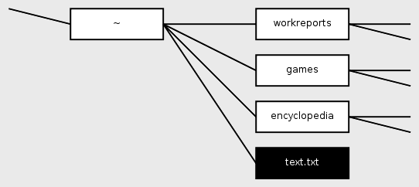
Unix/Linux
shell – program that takes Unix commands from keyboard and executes them
sh: Bourne shell
bash: Bourne Again shell
csh: C-shell
Hierarchical File system
home directory: where you are in your file system when you log in
contains all your files
directories contain subdirectories & files
file system looks like a tree of directories & files
We are using this
https://commons.wikimedia.org/w/index.php?title=File:Chdir_example.png&oldid=141616172
Notes:
How does shell know where to find executable? PATH variable – list of directories to use when looking up commands specified without path names

Slide 17
Linux Commands

Slide 18
cd: change directory
cd subDirName: move to a subdirectory of your current directory
Example: I'm currently in my home directory (denoted ~). To move into ee312 subdirectory:
% cd ee312
To move to this directory from any directory:
% cd ~/ee312
To move to parent directory, one level up in the directory tree:
% cd ..
parent directory referred to as ..

Slide 19
mkdir: create directory
To create a subdirectory called ee312 in current directory:
% mkdir ee312
To move into the ee312 directory and create a project1 directory:
%cd ee312
%mkdir project1

Slide 20
pwd: where am I?
To see the directory you are currently in:
% pwd
/Users/eberlein/EE312

Slide 21
Exercise
Connect to one of the ECE linux machines
Use pwd to display your current directory (which is your home directory)
Create an EE312 directory in home directory
Create a project1 subdirectory in your EE312 directory

Slide 22
list, remove and copy files
ls: list files in current directory
rm fileName: remove specified file
cp file1 file2: Make a copy of file1 named file2
Example:
% pwd
/Users/eberlein/Documents/EE312
% ls
lab1 lab2
project1 lab2
topic1.pptx lab1Notes.txt
% rm topic1.pptx
% cp lab1Notes.txt lab1NotesCopy.txt
% ls
lab1 lab2
project1 lab2
lab1Notes.txt lab1NotesCopy.txt

Slide 23
mv:renaming files
mv file1 file2: move file1 to file2 (file1 is renamed file2)
mv file1 dir: move file1 to directory dir
Example: Move lab1Notes.txt to parent directory
% mv lab1Notes.txt ..

Slide 24
more: display contents of file
more file1.txt: displays contents of file1.txt, one screen at a time
hit space bar to see next screen of contents
Pipe the output of one command as input to another command using |
To list files in directory, one screen at a time:
% ls|more

Slide 25
Output Redirection
> file
append to command that writes to standard output
output of command written to file
Example:
who: Unix command displays list of users who are currently logged on to computer
Try this:
% who
% who > peeps
% more peeps
more: displays file contents

Slide 26
Input Redirection
< file
Append to command that takes input from standard input
Input taken from file instead
Example:
Use a text editor to create a program that reads two integers from standard input and prints their sum (store program in sum.c)
Create text file input.txt containing:
2 3
Try this:
% gcc –o hello hello.c
% ./hello < input.txt
Sum is 5
#include<stdio.h>
int main() {
int value1, value2;
int sum;
scanf(" %d %d", &value1, &value2);
sum = value1 + value2;
printf("Sum is %d\n", sum);
}

Slide 27
Exercise
Using the executable hello from the previous example, run the program
read input from input.txt
write output to a new file output.txt

Slide 28
man: Online Help
man command: see the manual page, which provides online info on any Unix command
Example: Get a description of the ls command
bash$ man ls

Slide 29
Unix/Linux Tutorials
ECE tutorial
Unix tutorial from the Berkeley I-School

