Slide 1
EE 312 Course Introduction
"Computers are good at following instructions, but not at reading your mind."
-Donald Knuth
"The only way to learn a new programming language is by writing programs in it."
-B. Kernighan and D. Ritchie
Instructor: Dr. Mary Eberlein
eberlein @utexas.edu
www.ece.utexas.edu/~meberlein/ee312

Slide 2
Plan of the Day
Introductions
Communication
How to Succeed
Course Topics
Prerequisites
Syllabus Review
Start C Basics

Slide 3




Who Am I?
Lecturer in ECE
Taught CS: Tennessee Tech, St. Ed's, UTCS (15 years)
Scientist and product workshop instructor, Software Engineering Technologies
Education
Math: BS, MS
Computer Science: PhD (UT-Knoxville)

Slide 4
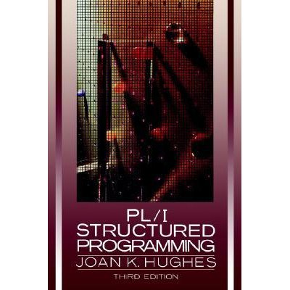
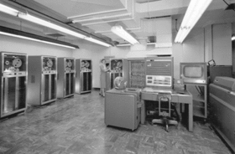
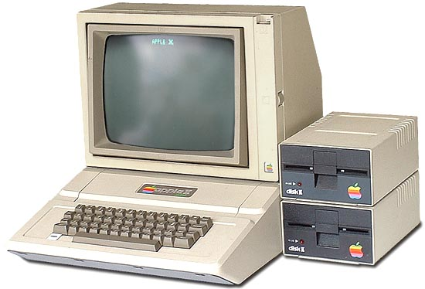
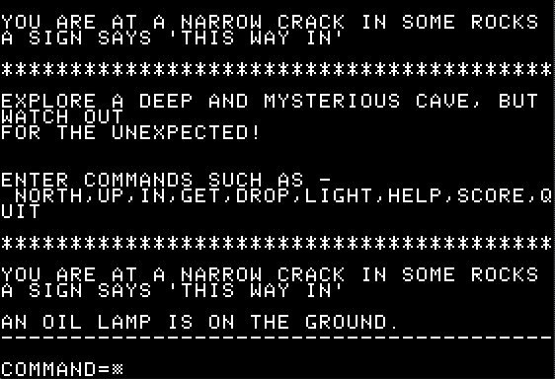
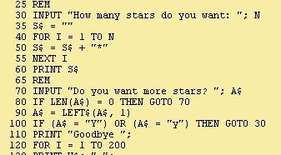
My Path to CS...

Slide 5
Teaching Team
Huy Doan (huydoan @utexas.edu)
Scott Fennell (spfennell @gmail.com)
Colin Maxfield (colinmaxfield @gmail.com)
Shyam Sabhaya (shyam.sabhaya @utexas.edu)
Miguel Salinas (MiguelASalinasS @utexas.edu)
Bobby Streit (rpstreit @utexas.edu)

Slide 6
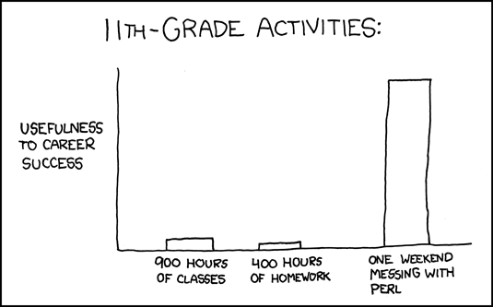

Who Are You?
Freshman? Sophomore? Junior? Senior?
Prior programming experience:
EE319k: C programming (C program structure, numeric types, numeric operations, I/O...)
Java?
C++?
Python?
Notes:
Who are your classmates? Introduce yourself to someone sitting near you that you do not already know. Learn their name. Ask them to tell you one interesting thing about themselves and tell them one about yourself.

Slide 7
Communication
Piazza
Use first for non-personal communication
Use informative subject lines
Email: TAs, me (eberlein @ utexas.edu)
Subject: EE312: + <topic of message>
Sign message (complete name)
Office hours

Slide 8
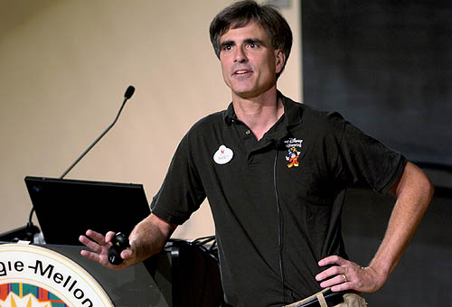
Succeeding in the Course
Randy Pausch, CS Professor at CMU said:
"When I got tenure a year early at Virginia, other Assistant Professors would come up to me and say, 'You got tenure early!?!?! What's your secret?!?!?' and I would tell them, 'Call me in my office at 10pm on Friday night and I'll tell you.' "
“A lot of people want a shortcut. I find the best shortcut is the long way, which is basically two words: work hard.”

Slide 9
How to Succeed in 312
"I would like to offer some advice about how you can best learn [this subject]. You will learn the most by actively working exercises. I suggest that you solve as many as you possibly can. After working the exercises your instructor has assigned, I encourage you to solve additional exercises..."
-- Kenneth H. Rosen, in foreword of his textbook Discrete Mathematics and Its Applications
"The key question to keep asking is,
Are you spending your time on the right things? Because time is all you have."
-- Randy Pausch, The Last Lecture
Course is cumulative – material builds on earlier concepts
Learn by doing
Write lots of code
Do the readings
Ask for help: instructor, TAs, tutoring
Run the code examples yourself
Experiment. Change things. Break the code!
Attend lecture and discussion sections. Pay attention. Participate.
Start programming assignments early
Get to know your classmates. Form exam study groups.
Attend office hours
Notes:
Cannot succeed via memorization. Things I expect you to do are not rote. Learn by doing.

Slide 10
Software Design & Implementation I
Writing algorithms to solve problems
Problem decomposition
Structured programming in C and C++
Introduction to software design principles
Introduction to SWE tools (version control, makefiles, debuggers, etc.)
Elementary data structures
Analysis of algorithm efficiency
Builds on EE306, EE319k
have clear idea of processor-memory interaction, basic instructions, ALU, RAM, etc.
Foundation for EE422C, all other SWE classes
many non-SWE classes as well, e.g., Computer Architecture
Prereqs:
BME 303 or EE 306
EE 319k

Slide 11
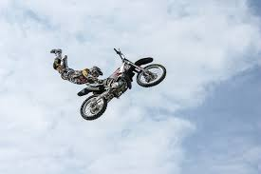
Startup
www.ece.utexas.edu/~meberlein/ee312
Read the syllabus & look over schedule
Explore class webpage & Canvas
Sign up for class discussion group on Piazza
Let the adventure begin...
Notes:
Note the m

Slide 12
Grading
Recitation section assignments – go to your section
Quizzes (announced or unannounced) – go to your lecture and recitation section
Programming projects
Must work on the ECE 64-bit Linux machines
Code that does not compile will get a 0
Two midterms
7-9 pm: 10/12, 11/16 (subject to change)
conflict? email me ASAP
Final exam – unified with my other 312 class
Grades posted on Canvas
maintained by the TA who leads your recitation section

Slide 13
Programming Projects
Start out easy but get much, much harder
Individual unless otherwise specified – do your own work
usually ok to share tests you write (Piazza)
Programs checked automatically with plagiarism detection software
Cheating → F in the class & referral to Dean of Students
Turn in the right thing – correct file name, correct format – or you will lose points
Slip days
6 for term, maximum 2 per assignment
don't use frivolously

Slide 14
Quizzes & Recitation Assignments
10 minute quizzes in lecture or recitation
Announced or unannounced
Assignments to complete before or in recitation
Won't always be graded
Notes:
Warning: For me, the following are treated as synonyms: recitation, discussion, lab

