Slide 1
Classes and Objects
"A class is where we teach an object how to behave."
--Rich Pattis

Slide 2
C++ Classes
Classes are programmer-defined types
Classes help us manage complexity, since they:
tie together related data and operations
decompose an application into objects and their interactions
can be re-used in different applications
Example: string class
data: sequences of characters
operations: length(), append(), insert(), etc.
general description or blueprint of a collection of objects, such as "Charlie", and operations that I can invoke on those objects
string myDogsName = "Charlie"; // a string object, a instance of string class
Call string functions on the object:
myDogsName.append(" Boy");

Slide 3
Calendar Program
Want to write program that manipulates dates
Calendar application, program that stores birthdays, etc.
No C++ type that represents dates
What is today's date? 10 30
What is your birthday: 11 3
It is 4 days until your next birthday.
So: write a Date class so that each object represents a date like October 30.
What data and operations should a Date object have?

Slide 4
Date – client code
#include<iostream>
#include "Date.h"
int main() {
Date today(10, 30);
Date halloween(10, 31);
cout << "Today is: " << today.toString()
<< ", the month is: " << today.getMonth() << endl;
}

Slide 5
Classes and Objects
class: a blueprint or template for a new type of objects
object: an entity in your program that combines state and behavior
object-oriented programming (OOP): programs that perform their behavior as interactions between objects

Slide 6
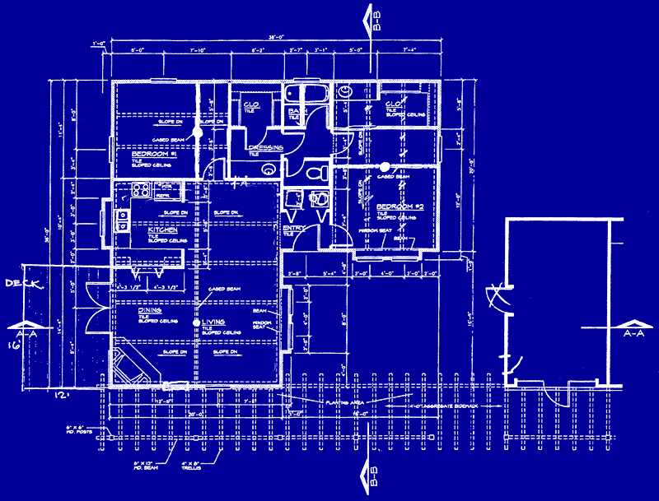
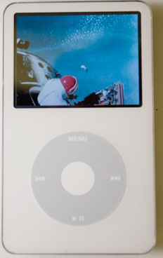
Blueprint analogy
iPod blueprint
state: current song volume battery life
behavior: power on/off change station/song change volume choose random song
creates
iPod #1
state: song = "1,000,000 Miles" volume = 17 battery life = 2.5 hrs
behavior: power on/off change station/song change volume choose random song
iPod #2
state: song = "Letting You" volume = 9 battery life = 3.41 hrs
behavior: power on/off change station/song change volume choose random song
iPod #3
state: song = "Discipline" volume = 24 battery life = 1.8 hrs
behavior: power on/off change station/song change volume choose random song

Slide 7
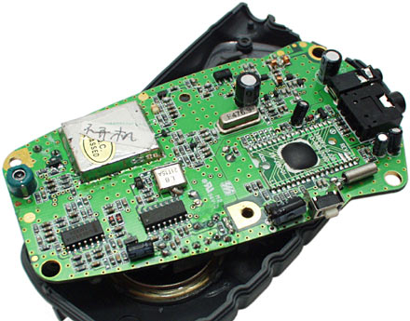
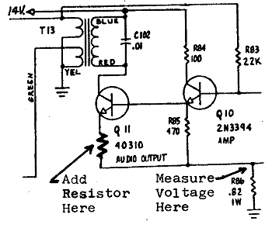
Abstraction
abstraction: A distancing between ideas and details.
We can use objects without knowing how they work.
Objects provide abstraction in programming.
abstraction in an iPod:
You understand its external behavior (buttons, screen).
You don't understand its inner details, and you don't need to, in order to use an iPod.

Slide 8
Class Design
We will implement a Date class, i.e., a type of objects named Date
Each Date object will contain month, day variables called fields or member variables
Each Date object will contain behavior called member functions or methods
Client programs will use the Date objects.
To create a new class, think about the objects that will be created of this new class type:
what information to store about the object
what behavior the object has

Slide 9
Client, Class and Object
Use class to construct
new objects
Client Program
int main() {...
- uses class and objects
Class
- defines data in each object
-how to construct new objects
send/receive messages to/from objects by calling member functions
constructs
Object
-member functions (behavior)
fun1()
fun2()
-member variables (data)
object
object

Slide 10
C++ Date Class
#include "Date.h"
Date::Date(int m, int d) {
month = m;
day = d;
}
int Date::getMonth() const {
return month;
}
int Date::getDay() const {
return day;
}
int Date::daysInMonth() const {
if(month == 4 || month == 9
|| month == 6 || month == 11){
return 30;
}
else if(month == 2) return 28;
else return 31;
}
void Date::nextDay() {
day++;
if(day > daysInMonth()) {
day = 1;
month++;
if(month > 12) month = 1;
}
}

Slide 11
Interface and Implementation
C++ classes:
interface: declaration of functions, classes, members, etc.
implementation: definitions – how the things in interface are implemented
Separated into two types of files
header .h file contains the interface
source .cpp file contains definitions
For class Date, write Date.h and Date.cpp
In Date.cpp: #include "Date.h"

Slide 12
.h File
// yourClass.h
#ifndef _classname_h
#define _classname_h
class declaration
#endif
Possibly multiple .cpp files will include the header file. This prevents the contents getting declared twice.

Slide 13
Class Declaration
class ClassName {
public:
ClassName(parameter-list); // constructor
type name1(parameter-list); // member functions
type name2(parameter-list);
private:
type name; // member variables
type name;
};

Slide 14
Date.h
#ifndef _date_h
#define _date_h
class Date {
public:
Date(int m, int d);
int daysInMonth();
int getMonth();
int getDay();
void nextDay();
string toString();
private:
int month;
int day;
};
#endif

Slide 15
Encapsulation
encapsulation: hiding implementation details of class from clients
protects data from manipulation by client
Ex: client cannot change month field in Date object to 20
Class data fields should be declared private
access permitted only through member functions
code outside class cannot access them
private:
type fieldName;

Slide 16
Member Definitions (.cpp file)
ClassName.cpp: contains function definitions for member functions that were declared in header file
#include "ClassName.h"
type ClassName::functionName(parameter-list) {
// function stuff
};
Not any old function – part of my class

Slide 17
Implementation
#include "Date.h"
Date::Date(int m, int d) {
month = m;
day = d;
}
// write getMonth() function here...
...

Slide 18
Date
int Date::getMonth() { // in Date.cpp
return month;
}
// client code
Date today;
Date halloween;
...
int mo = today.getMonth();
halloween.getMonth();
today
month day
int Date::getMonth() {
return month;
}
10
30
halloween
month day
int Date::getMonth() {
return month;
}
10
31

Slide 19
Client Code
#include<iostream>
#include "Date.h"
using namespace std;
int main() {
Date date1(10, 30);
Date date2(10, 31);
Date examDate(12, 15);
cout << "date1 is: " << date1.getMonth() << "\" <<
date1.getDay() << endl;
}
Notes:
const – doesn't change the date (state of date) – ie, doesn't change fields day, month
Promise that calling function doesn't modify the date fields

Slide 20
Operator Overloading
Overload the behavior of operators in C++
+ - ++ * & ! % >
Don't overuse – can produce confusing code
Declare operator in .h file, implement in .cpp
return operator op(parameter-list); // .h
return operator or(parameter-list) { // .cpp
statements;
}

Slide 21
Operator Overloading
In Date.cpp
bool operator ==(const Date& d1, const Date& d2) {
return d1.getMonth() == d2.getMonth() && d1.getDay() ==
d2.getDay());
}
Exercise: Overload < for Dates: if a Date comes earlier in the year, it's less than another Date

