Slide 1
Storing, Sending, and Tracking Files Recitation 2
Zip
SCP
Git

Slide 2
Zip in the Terminal

Slide 3
Zip
Within a Linux terminal, “zip” can be a very powerful tool
From a Linux terminal:
% zip
This will show you all of the options that can be used by zip
% zip a1.zip * (zip all files in current directory to out.zip)
% zip -j a1.zip * (zip all files in current directory without tree structure)
% zip -r a1.zip . (zip all files in current and all subdirectories)
% zip -f -r a1.zip . (update files stored in the zip with new revisions)
% zip a1.zip -d “CodeCamp” (delete the given file from the zip file)
% unzip -l a1.zip (List all files stored in a1.zip)

Slide 4
Transfer Files with SCP

Slide 5
SCP
SCP (secure copy) allows us to copy files to or from a remote computer
Basic scp syntax is the same as the Linux cp command:
% scp [[user@]host1:]file1 [[user@]host2:]file2
Can be used to send files:
% scp CodeCamp.c cmaxfield@mario.ece.utexas.edu:~/ee-312/projects/project1/CodeCamp.c
Or to download files:
% scp cmaxfield@mario.ece.utexas.edu:~/ee-312/projects/project1/CodeCamp.c CodeCamp.c
You can even send full directories:
% scp -r project1 cmaxfield@mario.ece.utexas.edu:~/ee-312/

Slide 6
Version Control with Git

Slide 7
Version Control
Managing changes to documents, programs, web sites, and really any information
Version control is already a part of applications like Word, Google Sheets, Wikipedia, etc.
Changes are associated with timestamps and some sort of ”revision number”

Slide 8
SCM
SCM or Source Code Management describes a system of version control used to manage…source code!
Lots of different forms of SCM over the years including: CVS, SVN, Mercurial, and Git

Slide 9
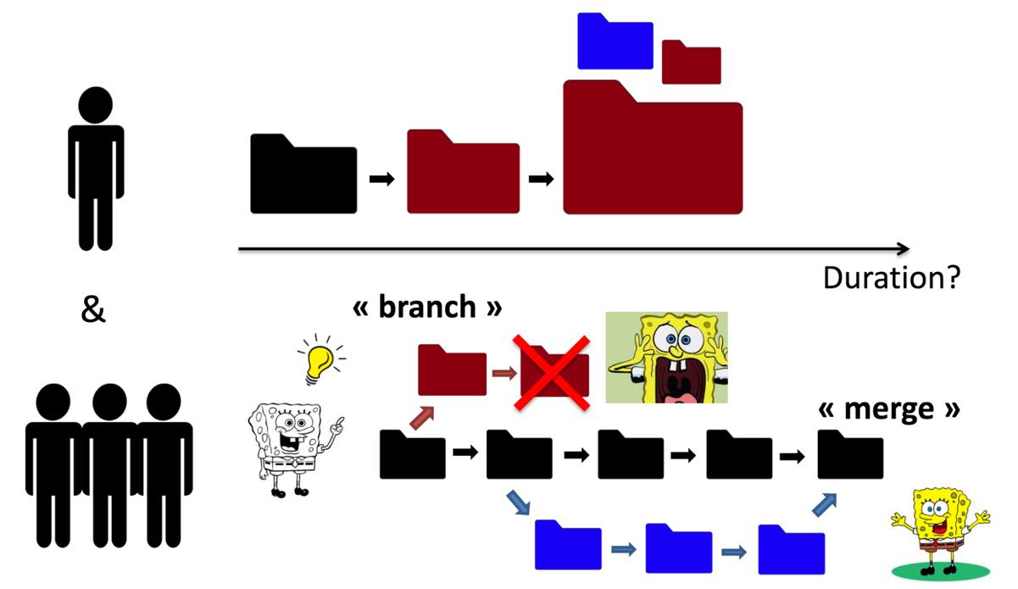
SCM
Image provided by Sébastien Dawans: https://github.com/sdawans/git-slides

Slide 10
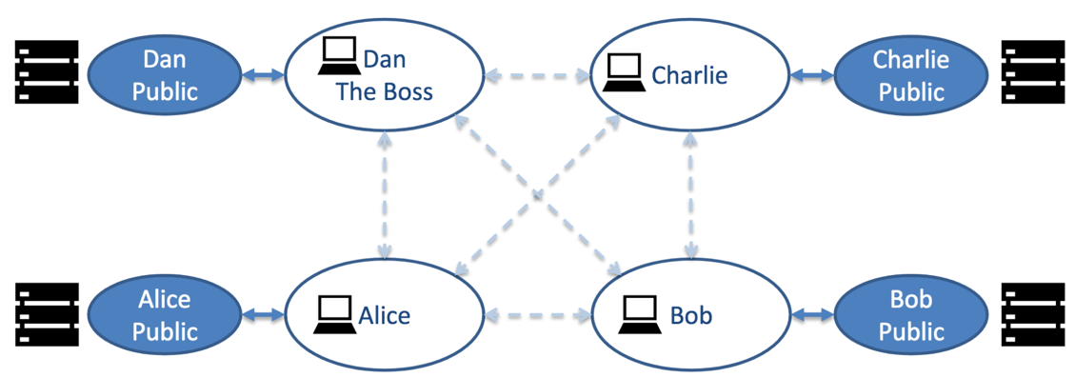
Git
Git was created in 2005 by the creator of Linux, Linus Torvalds, and is now maintained by Junio Hamano.
Git is a distributed SCM system which allows it to be fast and reliable
Git works by tracking changes to individual lines as ”deltas” so you can add, change, or remove lines
Image provided by Sébastien Dawans: https://github.com/sdawans/git-slides

Slide 11
Hosting
Since Git is distributed we need somewhere to host our own repositories so that they are available to others at all times.
Hosting platforms provide different levels of control and availability. They have different interfaces but each of them uses the same technology and commands from the command line.

Slide 12
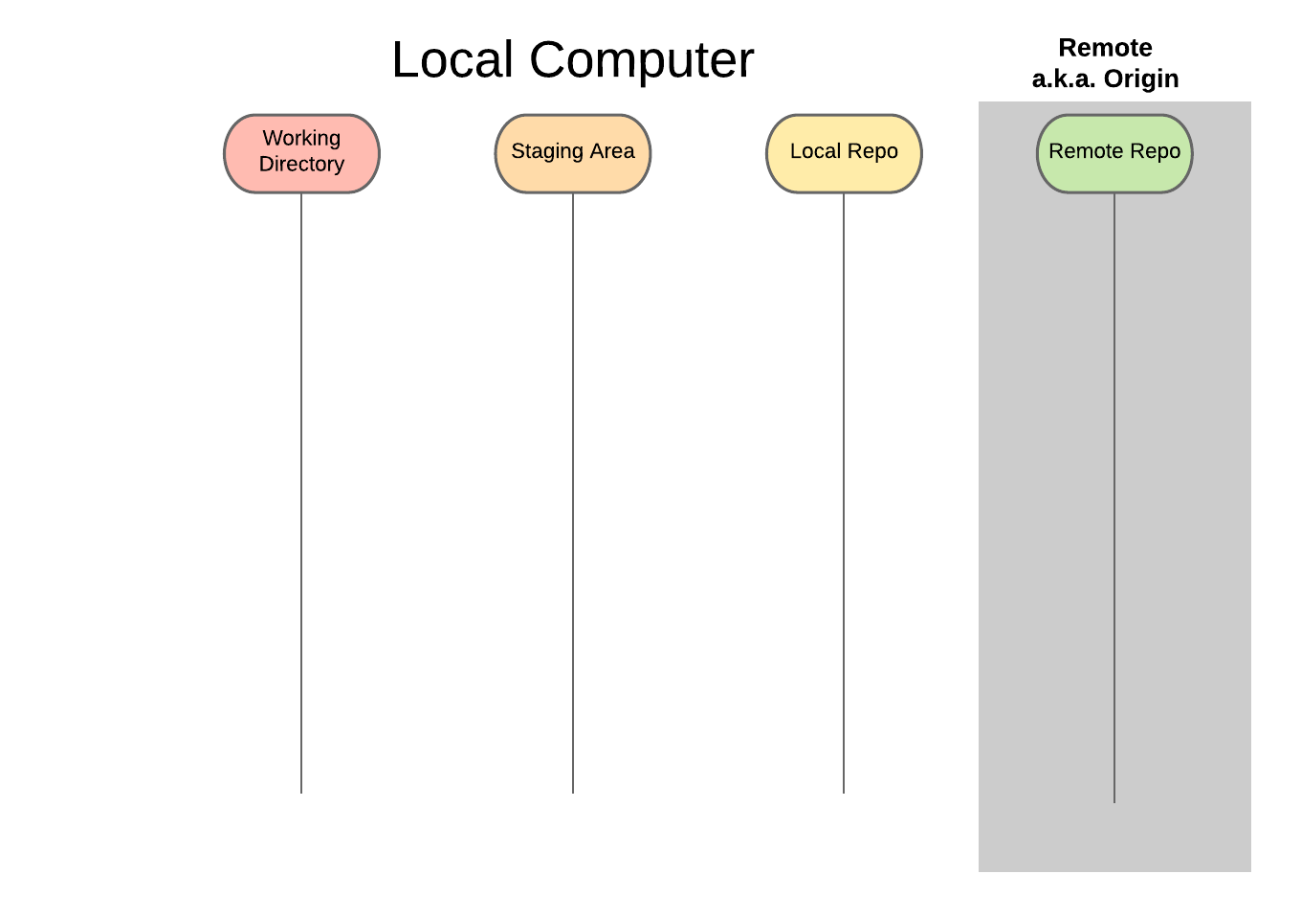
Notes:
Mention that you have a local repository and a remote repo and that the local is broken into different sections. Different commands take changes from different sections

Slide 13
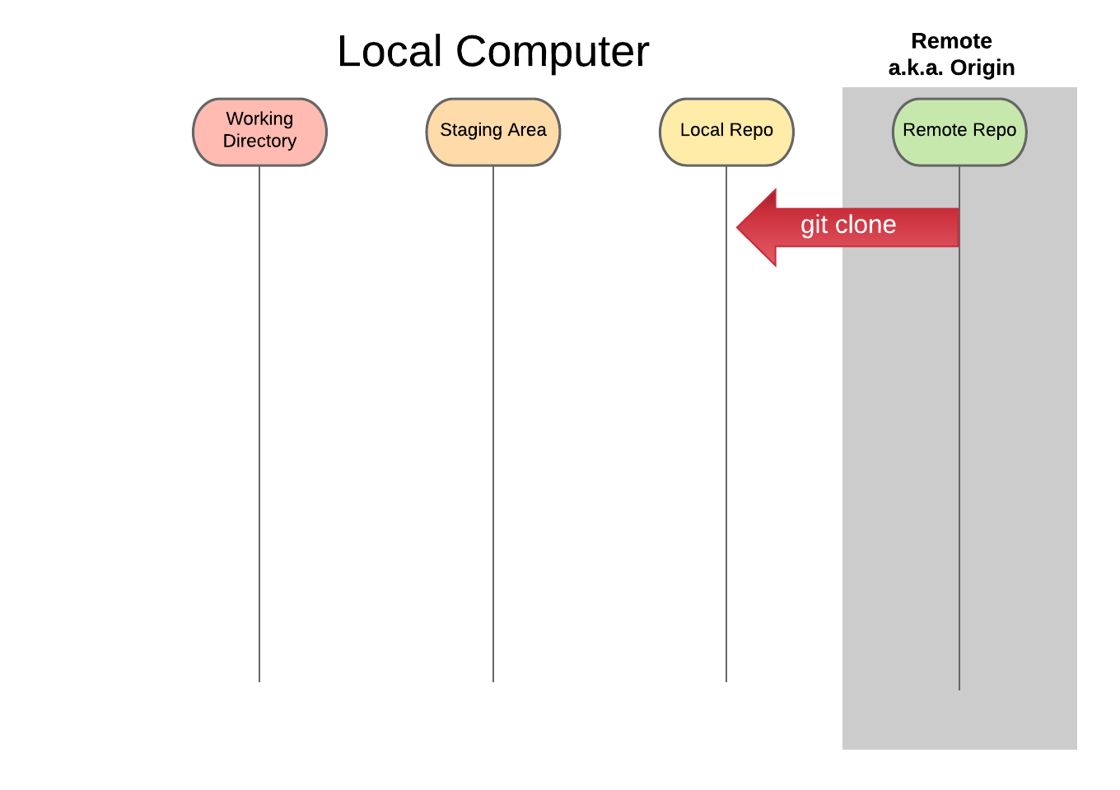
Notes:
Clone is used to make a full copy of another repository, often used to clone a repo from GitHub or GitLab

Slide 14
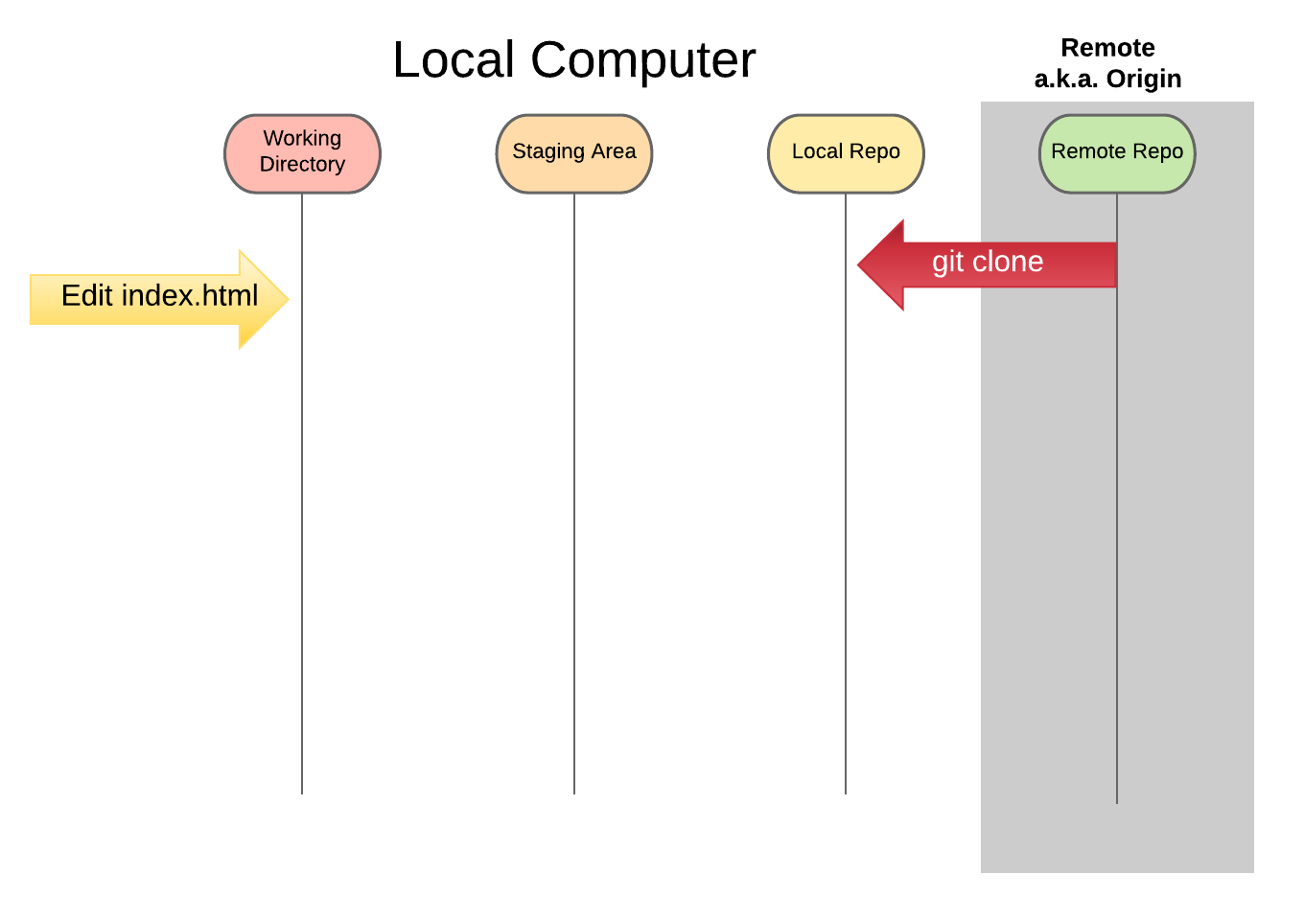
Notes:
Files that you edit are changed in your working directory, these can be seen by git status

Slide 15
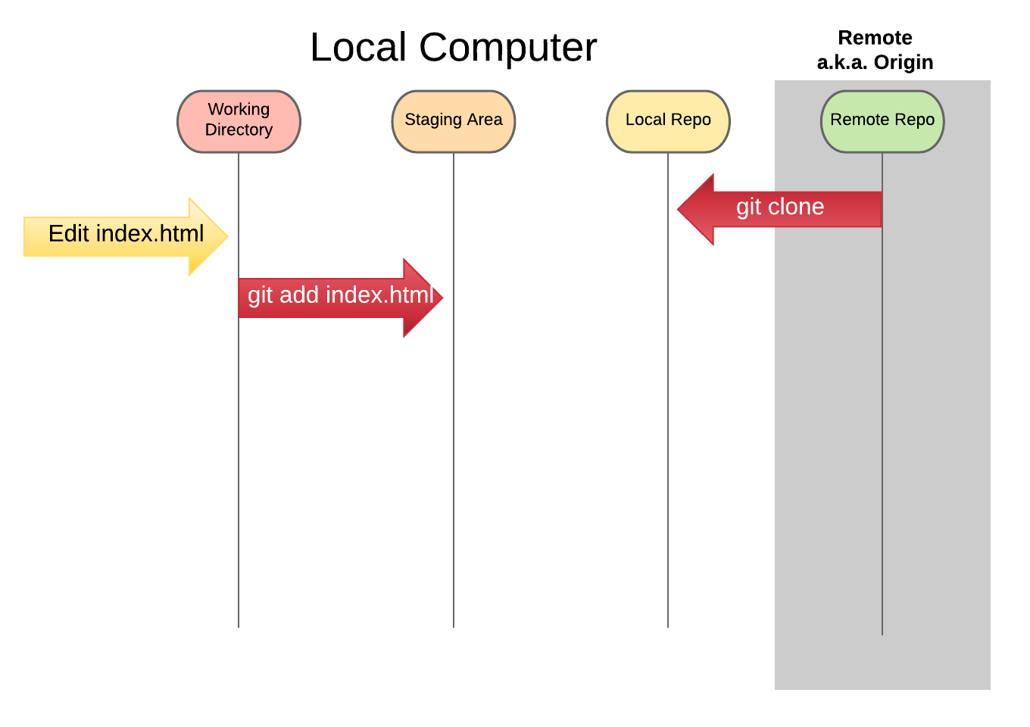
Notes:
When you add a file it moves it into your staging area, this can be seen in git status

Slide 16
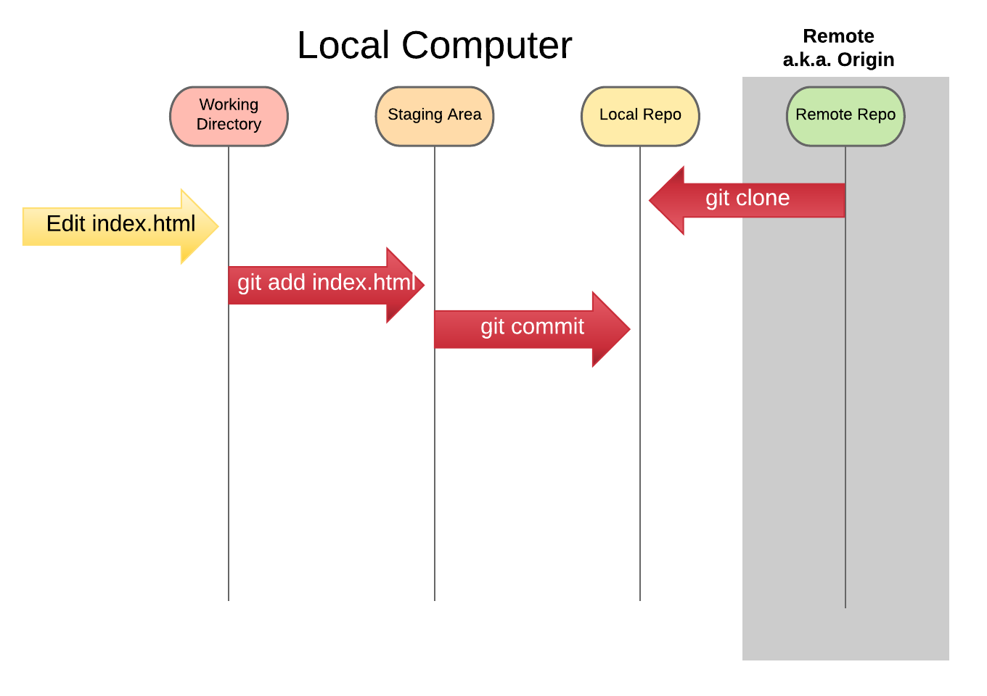
Notes:
Committing a file gives it a message and an identifier and puts it in your local repository

Slide 17
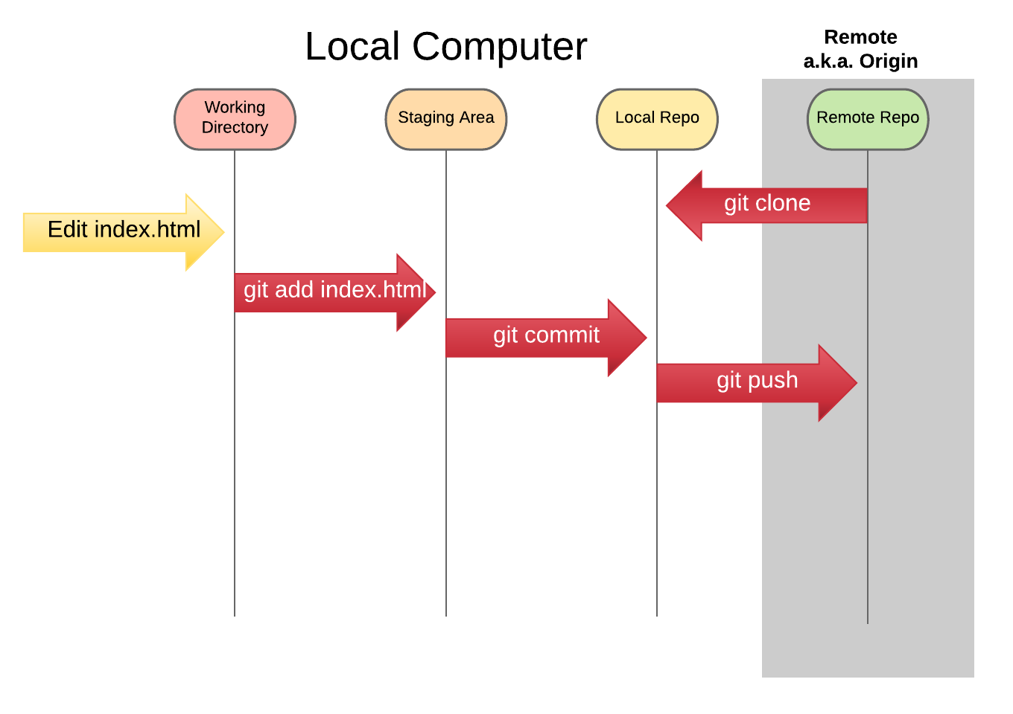
Notes:
Push allows you to push any changes that exist in your local repo to a remote repo

Slide 18
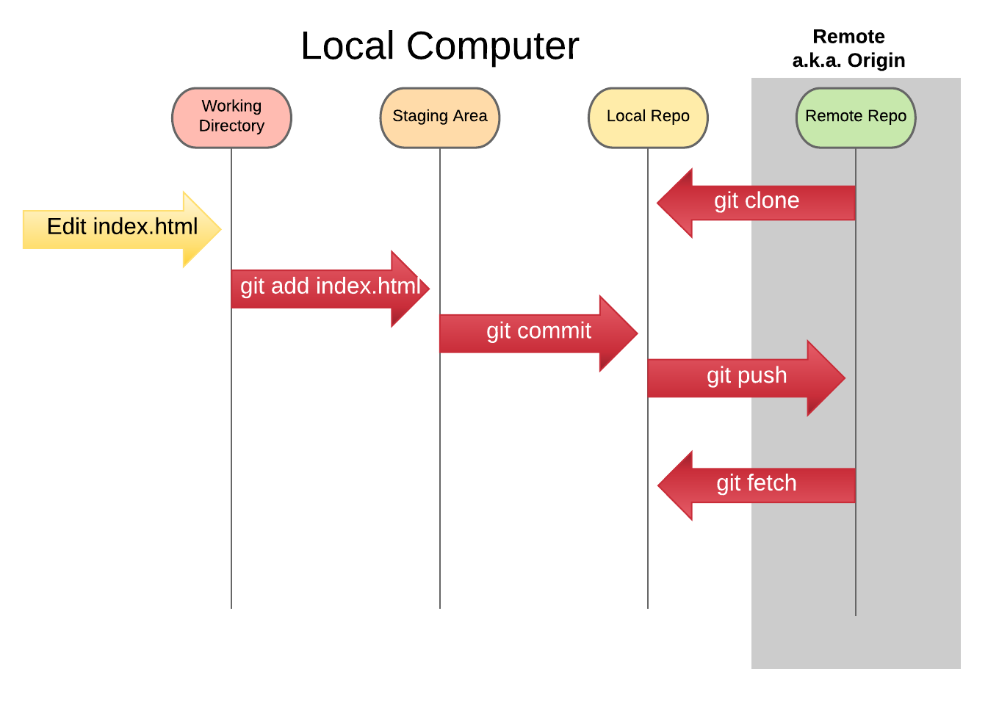
Notes:
Fetch updates your local repo with changes from the remote without changing your working directory

Slide 19
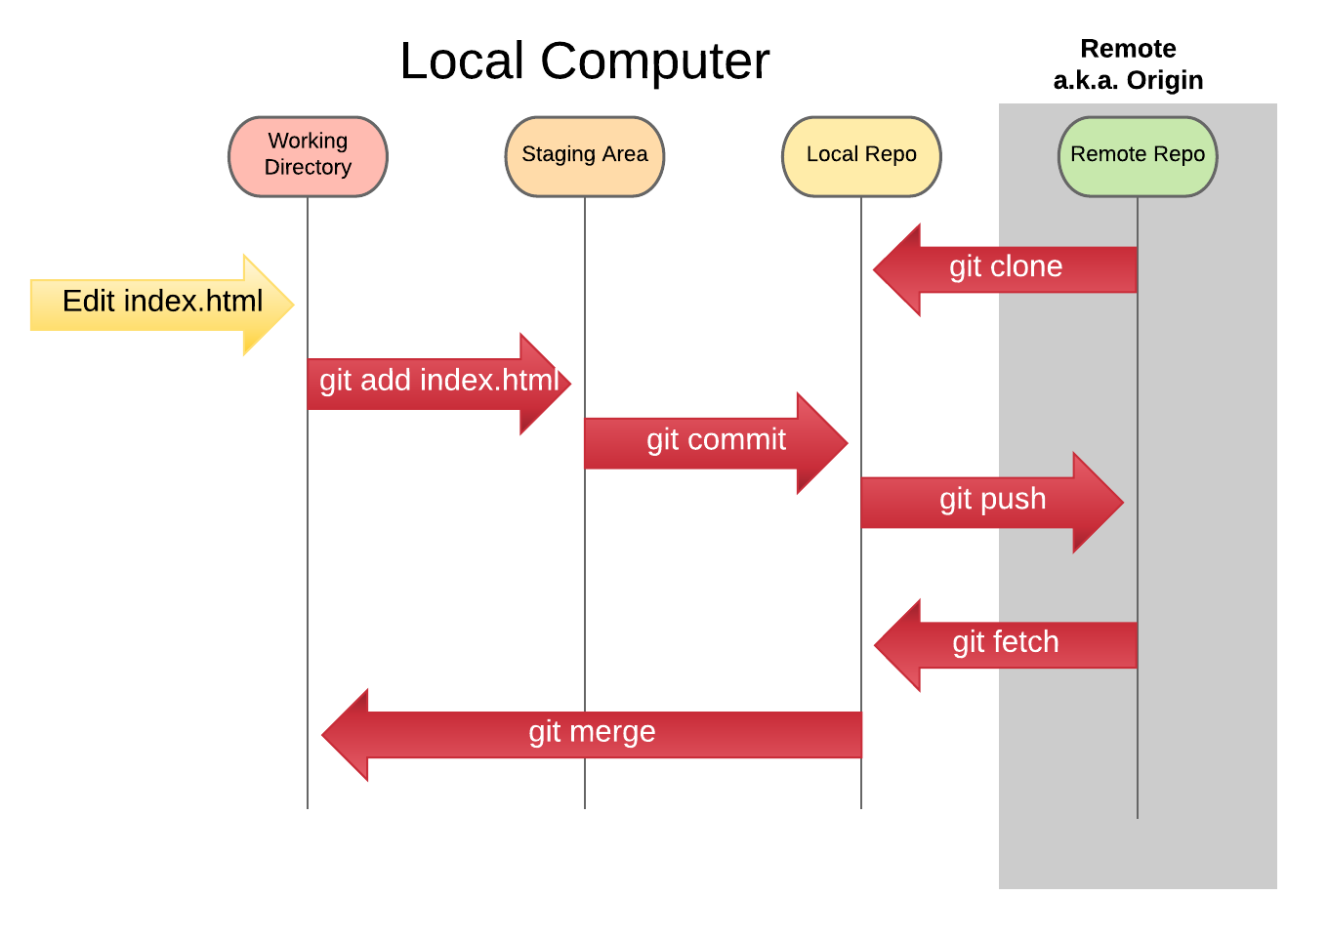
Notes:
Merge allows you to combine any new code with your working directory or with another branch

Slide 20
Using Git with LRC

Slide 21
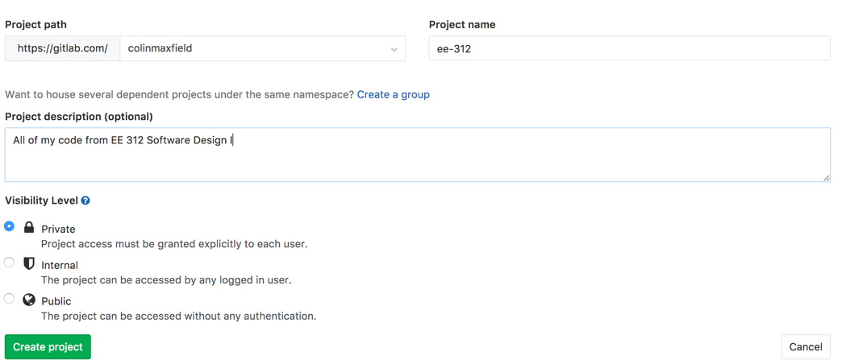
GitLab
GitLab provides unlimited private repositories for free meaning you can keep all of your code secret forever!
Create an account to get started
Once you have an account created you can create your own repositories and make them private

Slide 22
SSH Keys
Git supports both HTTPS and SSH urls to clone your projects
By adding an SSH key to your GitLab account you can clone without needing a password
Log into your LRC machine and generate a new SSH key:
% ssh-keygen -t rsa -C “{your_email}”
Don’t change the default filename (just hit enter) and enter a password for your key if you would like. Print the key and copy it
% cat ~/.ssh/id_rsa.pub
Go back to GitLab and click on your user dropdown and click ”Settings”
From there click “SSH Keys” and paste in your new key, give it a name like “UT LRC Machine” and click “Add key”

Slide 23
Cloning
Now that you have a SSH key added to your account you can go back to the LRC machine and clone your repository
% git clone git@gitlab.com:{username}/ee-312.git
Once your repo is cloned all you need to do is pull down the new changes anytime you would like
% git pull

Slide 24
Git Tutorials
Git Guide
GitHub Try Git

