Slide 1
Structured Programming + Algorithms
“Think twice, code once.”
-- Anonymous
“Weeks of programming can save you hours of planning.”
-- Anonymous
Plan for Today
More Simple C Programs
Comments in C
Algorithms
Problem Decomposition
Very loosely based on slides by Reges and Stepp at buildingjavaprograms.com

Slide 2
Comments
comment: A note written in source code by the programmer to describe the code and make it easier to understand.
Comments are not executed when your program runs.
Syntax:
// comment text, on one line or, /* comment text; may span multiple lines */
Examples:
// This is a one-line comment.
/* This is a very long
multi-line comment. */

Slide 3
Using comments
Where to place comments:
at the top of each file (a "comment header") - identifies the author and describes what the program does
at the start of every function - describes the function’s behavior
to explain complex pieces of code inside function
Comments are useful for:
Understanding larger, more complex programs.
Multiple programmers working together, who must understand each other's code.

Slide 4
Comments example
#include<stdio.h>
/* Suzy Student, EE 312, Fall 2099
This program prints the Powerpuff Girls theme song. */
int main(void) {
// first verse
printf(”Blossom, she is commander and leader,\n");
printf(”Bubbles, she is a joy and a laughter,\n");
printf(“Buttercup, she’s the toughest fighter\n”);
printf(“Powerpuffs save the day.\n”);
printf("\n");
//second verse
printf(”Fighting crime,trying to save the world\n");
printf(”Here they come just in time, the Powerpuff Girls\n");
}

Slide 5
Program Hygiene - a.k.a. Style
Structure your code properly
Eliminate redundant code
Use spaces judiciously and consistently
Indent properly
Follow the naming conventions
Use comments to describe code behavior
Follow a brace style
Good software follows style guides
See links on assignment page

Slide 6
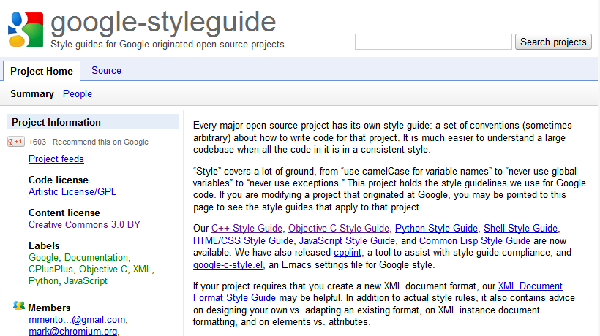
Google C++ Style Guide
http://code.google.com/p/google-styleguide/

Slide 7
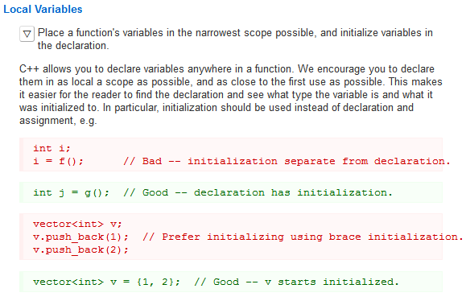
Google C++ Style Guide

Slide 8
Why Worry About Program Hygiene ?
Programmers build on top of other’s code all the time.
Software developers spend as much time maintaining code as they do creating new code
You shouldn’t waste time deciphering what a function does.
You should spend time on thinking and coding. You should NOT be wasting time looking for that missing closing brace.
So code with style!

Slide 9
Algorithms
How to structure the solution to your problem to:
Manage complexity
Increase reuse and reduce redundancy

Slide 10
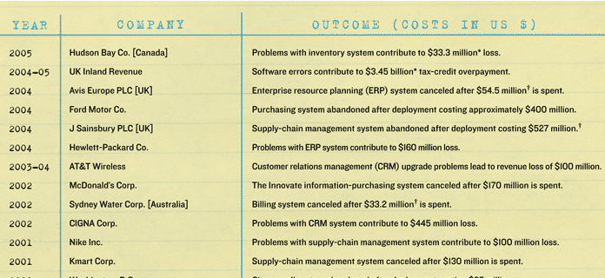
Managing Complexity
Building complex systems is hard
Some of the most complex systems are software systems
http://spectrum.ieee.org/computing/software/why-software-fails
http://spectrum.ieee.org/computing/software/why-software-fails

Slide 11
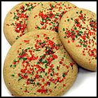
Algorithms
algorithm: A list of steps for solving a problem.
Example algorithm: "Bake sugar cookies"
Mix the dry ingredients.
Cream the butter and sugar.
Beat in the eggs.
Stir in the dry ingredients.
Set the oven temperature.
Set the timer.
Place the cookies into the oven.
Allow the cookies to bake.
Spread frosting and sprinkles onto the cookies.
...
Notes:
A lot of little steps – chunk the tasks into meaningful sub-tasks

Slide 12
Problems with algorithms
lack of structure: Many tiny steps; tough to remember.
redundancy: Consider making a double batch...
Mix the dry ingredients.
Cream the butter and sugar.
Beat in the eggs.
Stir in the dry ingredients.
Set the oven temperature.
Set the timer.
Place the first batch of cookies into the oven.
Allow the cookies to bake.
Set the timer.
Place the second batch of cookies into the oven.
Allow the cookies to bake.
Mix ingredients for frosting.
...

Slide 13
Structured algorithms
structured algorithm: Split solution into coherent tasks.
1 Make the cookie batter.
Mix the dry ingredients.
Cream the butter and sugar.
Beat in the eggs.
Stir in the dry ingredients.
2 Bake the cookies.
Set the oven temperature.
Set the timer.
Place the cookies into the oven.
Allow the cookies to bake.
3 Add frosting and sprinkles.
Mix the ingredients for the frosting.
Spread frosting and sprinkles onto the cookies.
...

Slide 14
Removing redundancy
A well-structured algorithm can describe repeated tasks with less redundancy.
1 Make the cookie batter.
Mix the dry ingredients.
...
2a Bake the cookies (first batch).
Set the oven temperature.
Set the timer.
...
2b Bake the cookies (second batch).
3 Decorate the cookies.
...

Slide 15
A program with redundancy
// This program displays a delicious recipe for baking cookies.
int main(void) {
printf("Mix the dry ingredients.\n");
printf("Cream the butter and sugar.\n");
printf("Beat in the eggs.\n");
printf("Stir in the dry ingredients.\n");
printf("Set the oven temperature.\n");
printf("Set the timer.\n");
printf("Place a batch of cookies into the oven.\n");
printf("Allow the cookies to bake.\n");
printf("Set the oven temperature.\n");
printf("Set the timer.\n");
printf("Place a batch of cookies into the oven.\n");
printf("Allow the cookies to bake.\n");
printf("Mix ingredients for frosting.\n");
printf("Spread frosting and sprinkles.\n");
}

Slide 16
Problem Decomposition
function: A named group of statements.
denotes the structure of a program
eliminates redundancy by code reuse
procedural decomposition: dividing a problem into functions
Writing a function is like adding a new command to C.
your program
function A
statement
statement
statement
function B
statement
statement
function C
statement
statement
statement

Slide 17
Using Functions for Procedural Decomposition
1. Design the algorithm.
Look at the structure, and which commands are repeated.
Decide what are the important overall tasks.
2. Declare (write down) the functions.
Arrange statements into groups and give each group a name.
3. Call (run) the functions.
The program's main function executes the other functions to perform the overall task.

Slide 18
Design of an algorithm
// This program displays a delicious recipe for baking cookies.
int main(void) {
// Step 1: Make the cake batter.
printf("Mix the dry ingredients.");
printf("Cream the butter and sugar.");
printf("Beat in the eggs.");
printf("Stir in the dry ingredients.");
// Step 2a: Bake cookies (first batch).
printf("Set the oven temperature.");
printf("Set the timer.");
printf("Place a batch of cookies into the oven.");
printf("Allow the cookies to bake.");
// Step 2b: Bake cookies (second batch).
printf("Set the oven temperature.");
printf("Set the timer.");
printf("Place a batch of cookies into the oven.");
printf("Allow the cookies to bake.");
// Step 3: Decorate the cookies.
printf("Mix ingredients for frosting.");
printf("Spread frosting and sprinkles.");
}

Slide 19
Problem Decomposition
function: a set of statements which is given a name, so it can be executed in a program.
Functions simplify our programs by eliminating redundancy and breaking our program into manageable, cohesive pieces.
Breaking a problem down into functions is called procedural decomposition.
Using a function requires:
Write the function - write down a set of statements and give them a name. This is like writing down the recipe.
Call the function - execute the statements in our function. This is like using the recipe to bake cookies.

Slide 20
Defining a Function
Gives your function a name so it can be executed
void <Function Name>(void) { statement; statement; ... statement;
}
Example: void printWarning() { printf("This product causes cancer\n"); printf("in lab rats and humans.\n"); }

Slide 21
Calling a function
Calling function = executing method’s code
Syntax:
<Function aNme>();
You can call the same function as many times as you like.
Example:
printWarning();
printf("\n");
printWarning();
Output:
This product causes cancer
in lab rats and humans.
This product causes cancer
in lab rats and humans.

Slide 22
Repetitive Code → Function
int main(void) {
rap(); // Calling (running) the rap method
printf("\n");
rap(); // Calling the rap method again
}
// This method prints the lyrics to my favorite song.
void rap() {
printf("Now this is the story all about how\n");
printf("My life got flipped turned upside-down\n");
}
Output:
Now this is the story all about how
My life got flipped turned upside-down
Now this is the story all about how
My life got flipped turned upside-down

Slide 23
Final cookie program
// This program displays a delicious recipe for baking cookies.
int main(void) {
makeBatter();
bake(); // 1st batch
bake(); // 2nd batch
decorate();
}
// Step 1: Make the cake batter.
void makeBatter() {
printf("Mix the dry ingredients.\n");
printf("Cream the butter and sugar.\n");
printf("Beat in the eggs.\n");
printf("Stir in the dry ingredients.\n");
}
// Step 2: Bake a batch of cookies.
void bake() {
printf("Set the oven temperature.\n");
printf("Set the timer.\n");
printf("Place a batch of cookies into the oven.\n");
printf("Allow the cookies to bake.\n");
}
// Step 3: Decorate the cookies.
void decorate() {
printf("Mix ingredients for frosting.\n");
printf("Spread frosting and sprinkles.\n");
}

Slide 24
Summary: Why Decompose?
Makes code easier to read by capturing the structure of the program
main should be a good summary of the program
int main(void) {
}
Note: Longer code doesn’t
necessarily mean worse code!!!
int main(void) {
}
void ... (...) {
}
void ... (...) {
}
Notes:
Longer code does not mean worse code.

Slide 25
Summary: Why decompose?
Eliminate redundancy
int main(void) {
}
int main(void) {
}
void ... (...) {
}

Slide 26
Functions calling other functions
int main(void) {
message1();
message2();
printf("Done with main.\n");
}
void message1() {
printf("This is message 1.");
}
void message2() {
printf("This is message 2.\n");
message1();
printf("Done with message 2.");
}
}
Output:
This is message 1.
This is message 2.
This is message 1.
Done with message 2.
Done with main.

Slide 27
Control flow
When a function is called, the program's execution...
"jumps" into that function, executing its statements, then
"jumps" back to the point where the function was called.
int main(void) {
message1();
message2();
printf("Done with main.");
}
...
void message1() {
printf("This is message1.\n");
}
void message2() {
printf("This is message2.\n");
message1();
printf("Done with message2.\n");
}
void message1() {
printf("This is message1.\n");
}

Slide 28
When to use a new function
Place statements into a function if:
The statements are related structurally, and/or
The statements are repeated.
You should not create functions for:
An individual printf statement.
Only blank lines. (Put these printfs in main.)
Unrelated or weakly related statements. (Consider splitting them into two smaller functions.)

Slide 29
Output structure
Write a program to print these figures using functions.
______
/ \
/ \
\ /
\______/
\ /
\______/
+--------+
______
/ \
/ \
| STOP |
\ /
\______/
______
/ \
/ \
+--------+

Slide 30
Development strategy
______
/ \
/ \
\ /
\______/
\ /
\______/
+--------+
______
/ \
/ \
| STOP |
\ /
\______/
______
/ \
/ \
+--------+
First version (unstructured):
Create an empty program and main.
Copy the expected output into it, surrounding each line with printf syntax.
Run it to verify the output.

Slide 31
Program version 1 - anything wrong with this?
int main(void) {
printf(" ______");
printf(" / \\");
printf("/ \\");
printf("\\ /");
printf(" \\______/");
printf("\n");
printf("\\ /");
printf(" \\______/");
printf("+--------+");
printf("\n");
printf(" ______");
printf(" / \\");
printf("/ \\");
printf("| STOP |");
printf("\\ /");
printf(" \\______/");
printf();
printf(" ______");
printf(" / \\");
printf("/ \\");
printf("+--------+");
}
Add \n to end of string arguments. Omitted for readability.

Slide 32
Development strategy 2
______
/ \
/ \
\ /
\______/
\ /
\______/
+--------+
______
/ \
/ \
| STOP |
\ /
\______/
______
/ \
/ \
+--------+
Second version (structured, with redundancy):
Identify the structure of the output.
Divide the main function into functions based on this structure.

Slide 33
Output structure
______
/ \
/ \
\ /
\______/
\ /
\______/
+--------+
______
/ \
/ \
| STOP |
\ /
\______/
______
/ \
/ \
+--------+
The structure of the output:
initial "egg" figure
second "teacup" figure
third "stop sign" figure
fourth "hat" figure
This structure can be represented by functions:
egg
teaCup
stopSign
hat

Slide 34
Program version 2
int main() {
egg();
teaCup();
stopSign();
hat();
}
void egg() {
printf(" ______");
printf(" / \\");
printf("/ \\");
printf("\\ /");
printf(" \\______/");
printf("\n");
}
void teaCup() {
printf("\\ /");
printf(" \\______/");
printf("+--------+");
printf("\n");
}
...

Slide 35
Program version 2, cont'd.
...
void stopSign() {
printf(" ______");
printf(" / \\");
printf("/ \\");
printf("| STOP |");
printf("\\ /");
printf(" \\______/");
printf("\n");
}
void hat() {
printf(" ______");
printf(" / \\");
printf("/ \\");
printf("+--------+");
}

Slide 36
Development strategy 3
______
/ \
/ \
\ /
\______/
\ /
\______/
+--------+
______
/ \
/ \
| STOP |
\ /
\______/
______
/ \
/ \
+--------+
Third version (structured, without redundancy):
Identify redundancy in the output, and create functions to eliminate as much as possible.
Add comments to the program.

Slide 37
Output redundancy
______
/ \
/ \
\ /
\______/
\ /
\______/
+--------+
______
/ \
/ \
| STOP |
\ /
\______/
______
/ \
/ \
+--------+
The redundancy in the output:
egg top: reused on stop sign, hat
egg bottom: reused on teacup, stop sign
divider line: used on teacup, hat
This redundancy can be fixed by methods:
eggTop
eggBottom
line

Slide 38
Program version 3
// Suzy Student, EE 312, Fall 2099
// Prints several figures, with methods for structure and redundancy.
int main(void) {
egg();
teaCup();
stopSign();
hat();
}
// Draws the top half of an an egg figure.
void eggTop() {
printf(" ______");
printf(" / \\");
printf("/ \\");
}
// Draws the bottom half of an egg figure.
void eggBottom() {
printf("\\ /");
printf(" \\______/");
}
// Draws a complete egg figure.
void egg() {
eggTop();
eggBottom();
printf("\n");
}
...

Slide 39
Program version 3, cont'd.
...
// Draws a teacup figure.
void teaCup() {
eggBottom();
line();
printf("\n");
}
// Draws a stop sign figure.
void stopSign() {
eggTop();
printf("| STOP |");
eggBottom();
printf();
}
// Draws a figure that looks sort of like a hat.
void hat() {
eggTop();
line();
}
// Draws a line of dashes.
void line() {
printf("+--------+");
}

Slide 40
Procedural heuristics
Each function should have a clear set of responsibilities.
No function should do too large a share of the overall task.
Minimize coupling and dependencies between functions.
The main function should read as a concise summary of the overall set of tasks performed by the program.
Variables should be declared/used at the lowest level possible.

