Slide 1
Debugging with Clion and GDB
EE312 – Week 03

Slide 2
Necessity of debugging
Codes usually have bugs and it’s hard to get them at the first try
Non-trivial bugs are hard to find by reading code
No need to ask TA “why this weird error happens”

Slide 3
Common Debugging Techniques
Embedded printing statements in the code to examine values and behavior
Not flexible, hard to examine multiple values at the same time
Have to edit and rebuild the project every time to test
Using a debugger
Can go through every single line and examine every value of interest
Faster and more handy with modern debuggers.

Slide 4
Buggy Program
arrayMax.c
Compile the program with –g flag for debug information
gcc –std=c99 –g –o arrayMax arrayMax.c
Execute ./arrayMax
“TA that’s segmentation fault”, “weird error”, “I’m clueless!”
Notes:
http://users.ece.utexas.edu/~meberlein/ee312/CCode/arrayMax.c

Slide 5
GDB – the ultimate debugger
Start gdb on the executable file: gdb arrayMax
List your program: (gdb) list
Set breakpoint: (gdb) break <linenumber>
Set breakpoint: (gdb) break <filename>:<function name>
Run debugger: (gdb) run
Step in: (gdb) step
Step through: (gdb) next
Continue: (gdb) continue
Notes:
GDB commands:
list : list the content of the program. Shortcut: l
list <line>: list lines centered around <line>
list <first>,<last>: list lines from <first> to <last> (first or last can be empty as well)
list +,-: list lines after or before those just listed
break: set breakpoint. Shortcut: b
run: start running debugger with the program. Before run, nothing of the program is executed.
step: step into a function to examine what happens inside. Shortcut: s
next: step over a command/function call. The function call details will be skipped. Shortcut: n
continue: run the program till the next breakpoint. Shortcut: c

Slide 6
GDB – the ultimate debugger
Print value of x: print x
Pause when the value of x changes: watch x
Print an array arr with length len: p *arr@len
Print a char array buffer: x/s buffer
If you ever need help with a command: help [command]

Slide 7
More Buggy Programs
factorial.c
Try using gdb to debug the factorial program
sum.c
Create a new CLion project called sum
Either copy the code from sum.c into main.c or move the file into your project directory and add it to the CMakeLists.txt
Notes:
https://utexas.instructure.com/files/43080319/download?download_frd=1 (factorial.c)
https://utexas.instructure.com/files/43079352/download?download_frd=1 (sum.c)

Slide 8
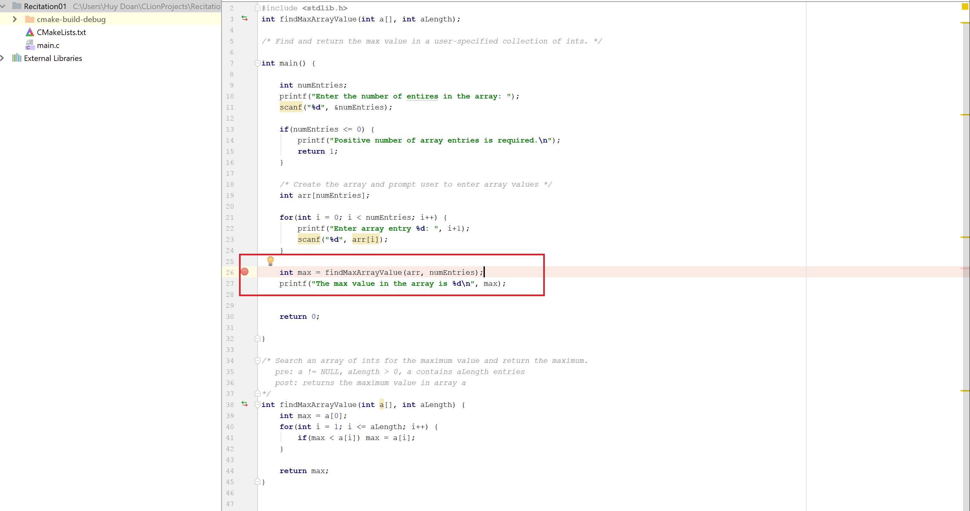
Clion – IDE debugger
Click on line number panel to set breakpoints.
Shortcut (Windows): Ctrl-F8

Slide 9
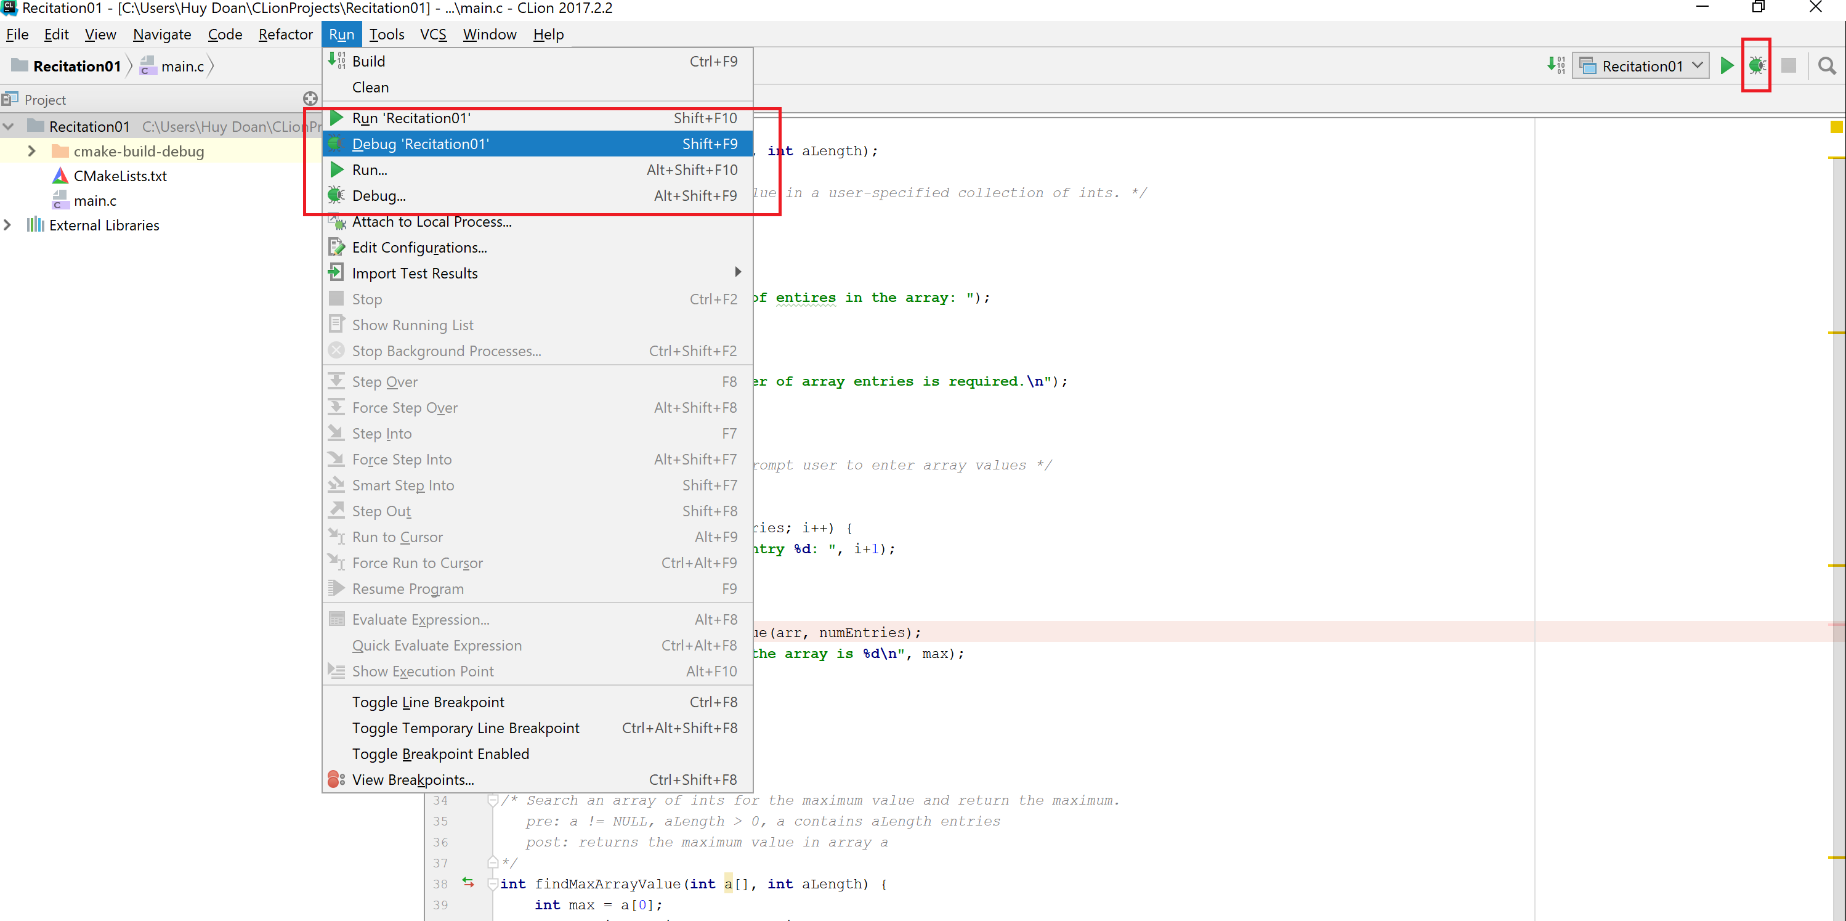
Clion – IDE debugger
Run program in debug mode
Shortcut (Windows): Shift-F9

Slide 10
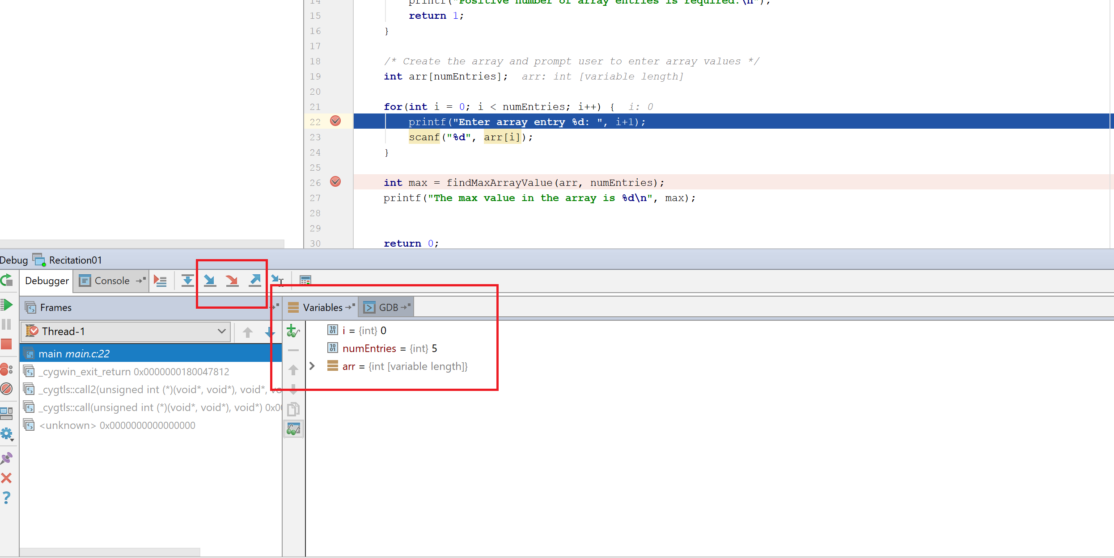

Clion – IDE debugger
Examine variable values in debug mode
Step Over : F8
Step In: F7
Continue: F9
It also has GDB

