Slide 1
Valgrind
Checking Memory Management

Slide 2
Outline
Pointers
Memory Model in C
Multidimensional Arrays
Valgrind

Slide 3
Pointers
Basic Concepts and Operations

Slide 4
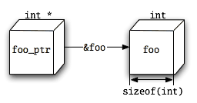
Recap: Concepts
A pointer is a type of variable that contains a memory address
With that memory address you can view/change the data stored there
The type of a pointer is the type of data that is stored at that address
void *ptr is an unspecified type
Pointers can be cast to a different type just like other variables
int *myIntPtr = (int *) floatPtr;

Slide 5
Recap: Operation
There are two main operations that deal with pointers:
Dereference (*ptr): get the value stored at the memory location of the pointer
Address of (&var): get the address of any variable
int *myIntPtr = &myInt;
You can have a pointer to a pointer
char *argv[]; // argv is now a pointer to list of pointers
**argv;

Slide 6

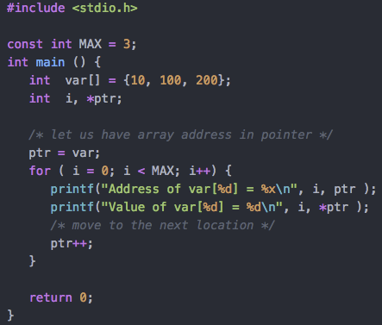

Pointer Arithmetic
Directly manipulate a pointer’s content to access other locations
Memory location is changed by the size of the pointer type
You can also set a value to an offset of a pointer with something like this:
*(ptr + 4) = 28;

Slide 7
Memory Model in C
Stack, Heap, Malloc, and Free

Slide 8
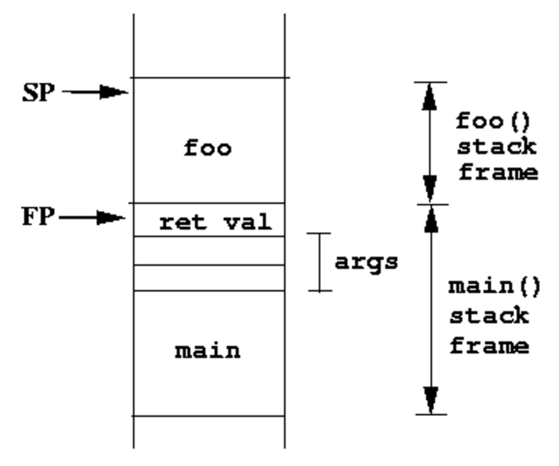
The Stack
The stack is a memory structure managed by the compiler
Each function call made creates a stack frame that is put on the top of the stack
The stack frame contains the collection of data associated with that call (like the return address and the argument variables)
The stack frame is destroyed when returning from a function

Slide 9
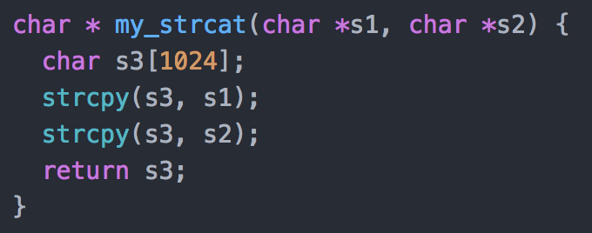
Local Variables
Local variables are stored on the stack
Returning from a function deallocates the memory for those variables
Returning a pointer to a local variable is almost always a bug

Slide 10
What can go wrong?
Run out of stack stack space
Unintentionally change values on the stack
Values in a frame belonging to another function
Accidentally change the return address from a function
Access memory even after the frame is deallocated

Slide 11
The Heap
You can use space in a part of memory separate from the stack known as the heap
Variables or regions that are stored in the heap are not deallocated when a function returns
C never puts variables on the heap automatically, you must request storage space on the heap

Slide 12
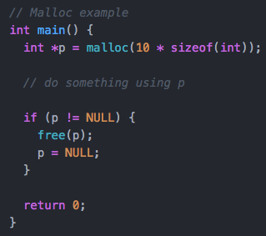
Malloc – Memory allocate
malloc is a library function in stdlib.h
Requests a memory region of a specified size
void *malloc(int size)
Remember that void * is a generic pointer
You must explicitly free memory after using it

Slide 13
What can go wrong?
Run out of heap space (malloc returns a null pointer)
Unintentionally change other heap data just like with the stack
Access memory after you have called free on it
Free the same memory twice

Slide 14
Valgrind
Basic usage and common errors

Slide 15
Basic Usage
Valgrind is a UNIX program that allows you to detect errors in your code that occur from using malloc and free improperly.
These errors can include things like: uninitialized memory, invalid read/write, invalid free, memory leak, etc.
Compilation is done by adding debugging info just like with gdb
$ gcc –g myProgram.c

Slide 16
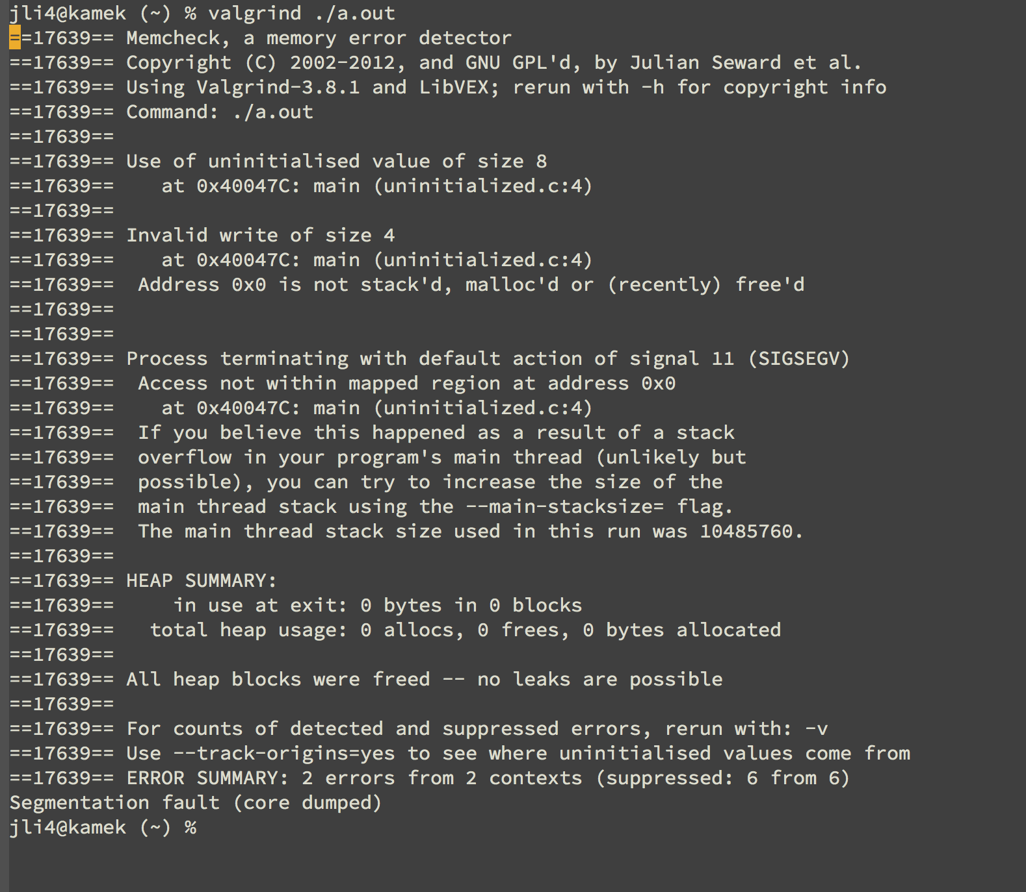
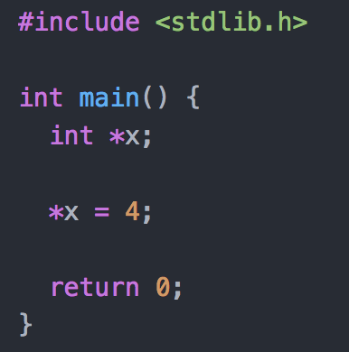
Uninitialized Memory

Slide 17
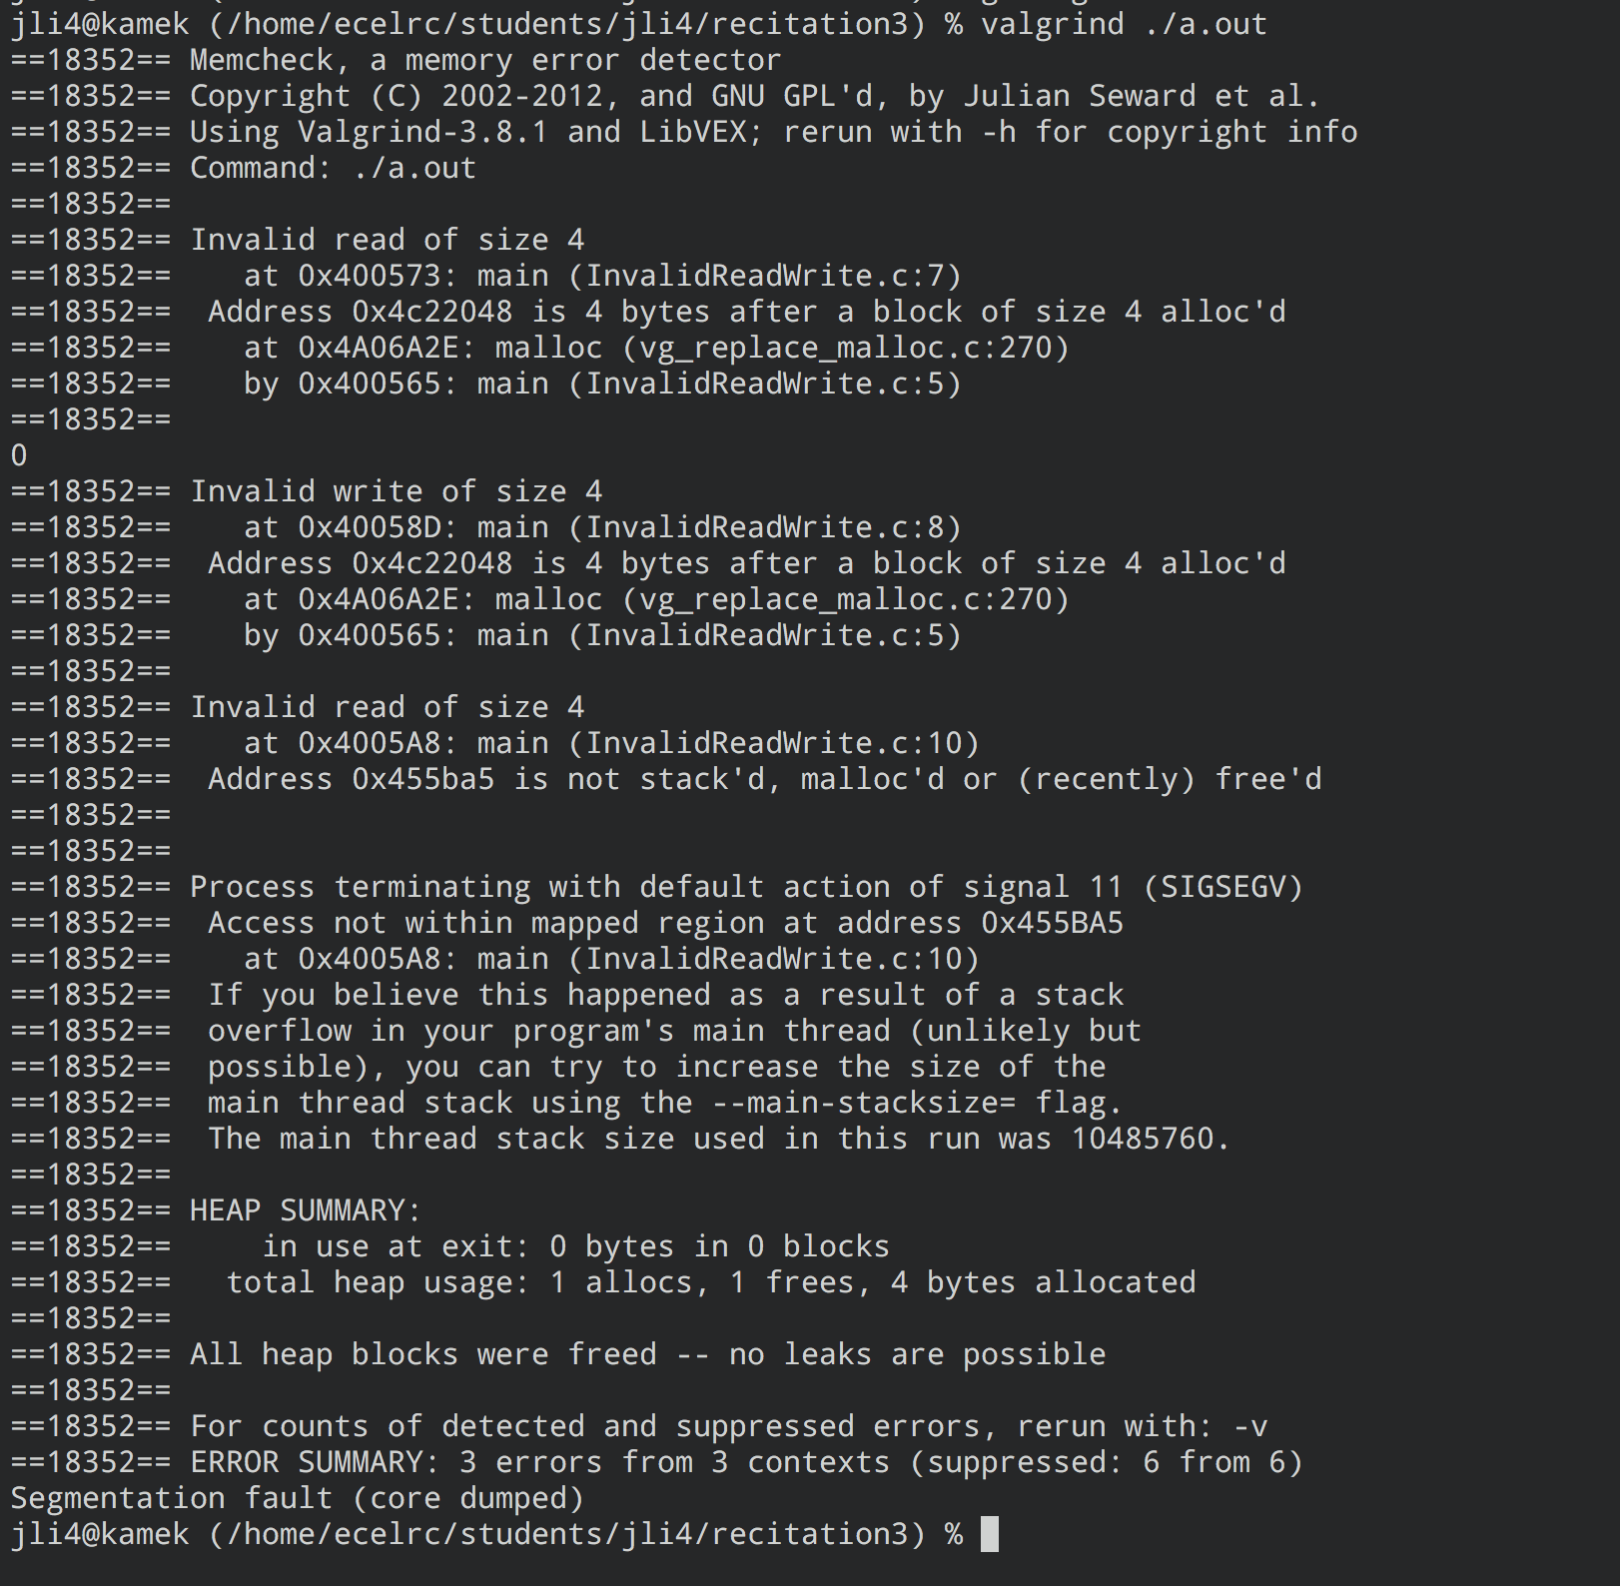
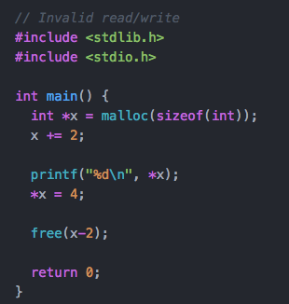
INVALID READ OR WRITE

Slide 18
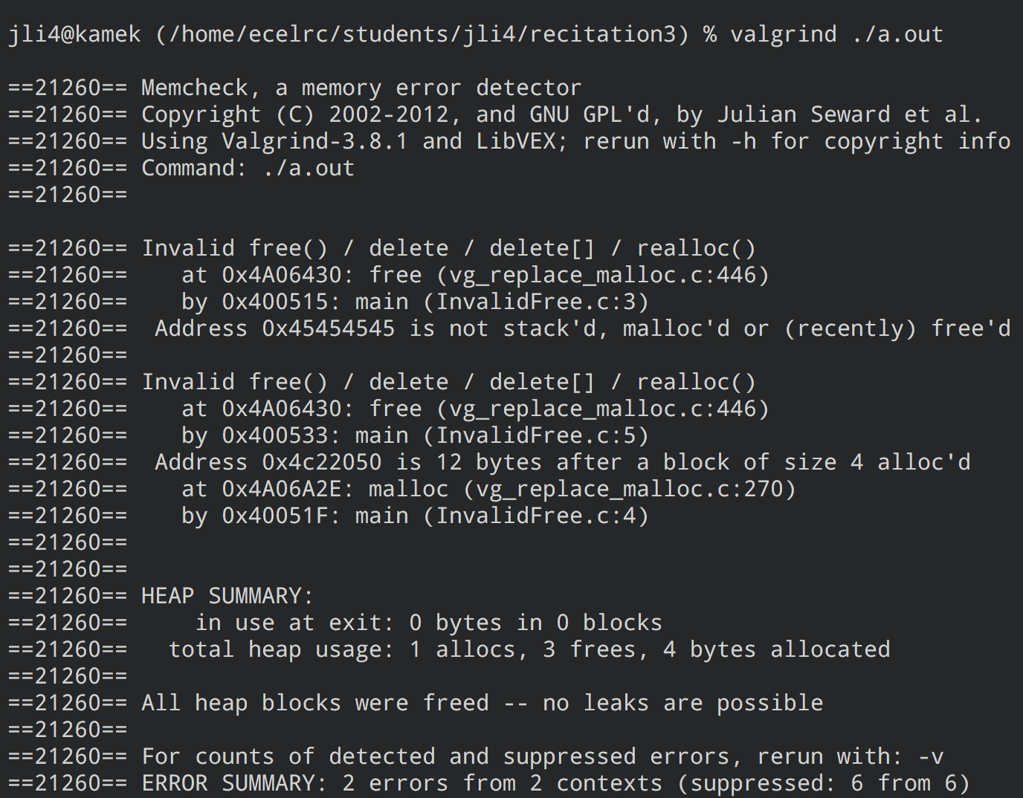
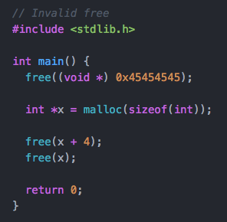
Invalid Free

Slide 19
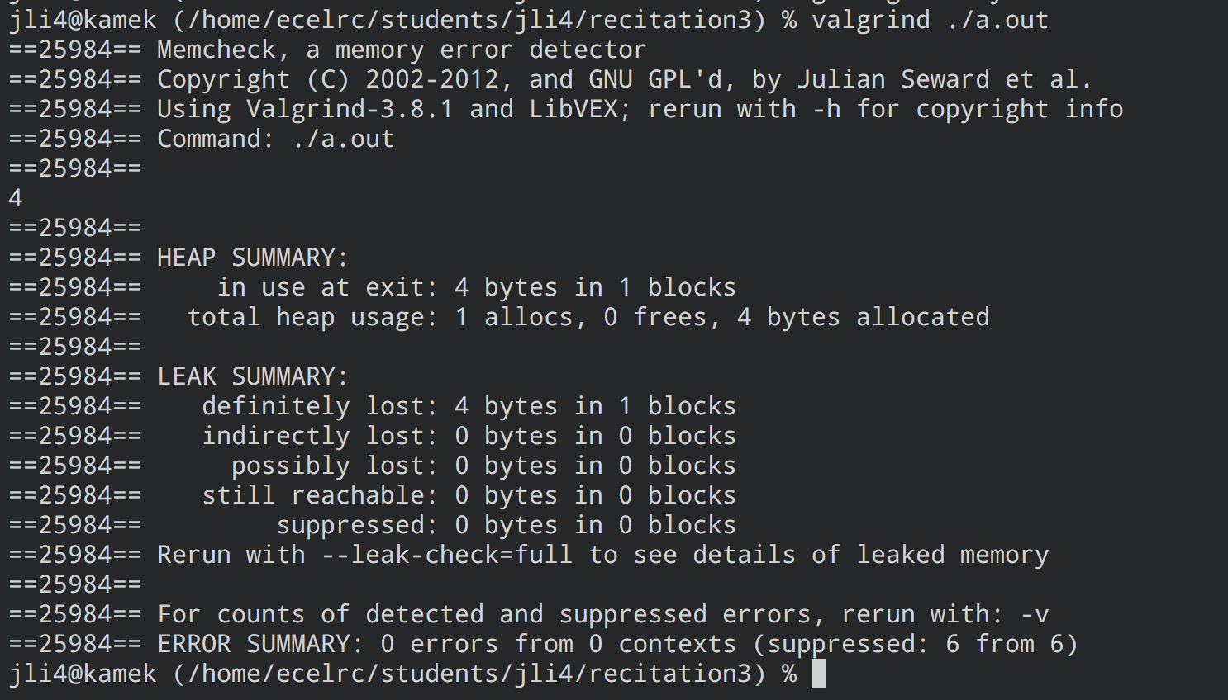
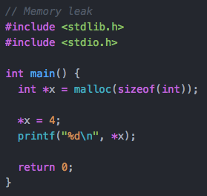
Memory Leak

