Slide 1
Arrays & Dynamic Memory Allocation
2D arrays
malloc, calloc, realloc, and free
Linked Lists
Pointers to pointers

Slide 2
2D Arrays
Used for tables, matrices
Specify number of rows, columns
0-indexing for rows and columns
an array of 1D arrays
Examples:
int matrix[10][5]; // 5 rows, 10 cols
char conversionTable[26][26];
Initializer lists: specify bracketed lists for each row, or omit row brackets – values will fill array row by row
int arr[3][4] = {{0, 1, 2, 3}, {4, 5, 6, 7}, {8, 9, 10, 11}};
int arr[3][4] = {0,1, 2, 3, 4, 5, 6, 7, 8, 9, 10, 11};
Notes:
If initializer list is too short to fill all elements, rest are filled with 0

Slide 3
2D Array Example
int main() {
// 4 rows, 2 columns
int arr[4][2] = {{1, 2}, {3, 4}, {5, 6}, {7, 8}};
// print array
for(int i = 0; i < 4; i++) {
for(int j = 0; j < 2; j++) {
printf("%d\t", arr[i][j]);
}
printf("\n");
}
}
Output:
1 2
3 4
5 6
7 8

Slide 4
2D Array Example
In a 2D array, you can omit the number of rows if the array is completely initialized when declared
If a parameter is a 2D array, the number of rows may be omitted:
int sum2D(int arr[][LEN], int n) {
int sum = 0;
for(int i = 0; i < n; i++) {
for(int j = 0; j < LEN; j++) {
sum += arr[i][j];
}
}
return sum;
}

Slide 5
Variable Length Array Parameter
Starting in C99: specify array dimension with non-constant
int sumArray(int n, int a[n]) {// must put n first ...}
int sum2DArray(int n, int m, int a[n][m]) {
int sum = 0;
for(int i = 0; i < n; i++) {
for(int j = 0; j < m; j++) {
sum += a[i][j];
}
}
return sum;
}
n, m must come before a in parm list

Slide 6
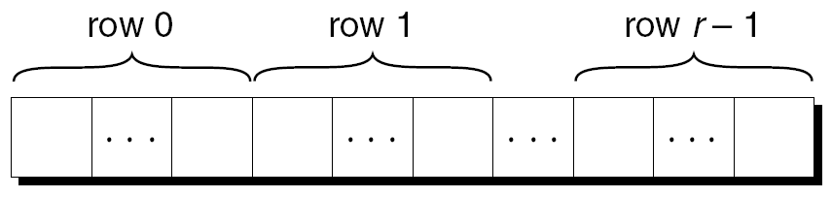
Pointers & 2DArrays
Arrays stored in row-major order
To initialize elements in 2D array:
nested for loops
single loop another option with pointer arithmetic:
int arr[NUM_ROWS][NUM_COLS];
int *p;
for(p = &a[0][0]; p <= &arr[NUM_ROWS-1][NUM_COLS-1]; p++) {
*p = 3;
}
No real advantage of second approach – less readable
Use a pointer to a row to process that row:
p = &arr[i][0]; // for valid row number i.
OR
p = arr[i]; // p points to row i

Slide 7
Example
int arr[][3] = {{1, 2, 3}, {4, 5, 6}, {7, 8, 9}};
int *p;
for(int i = 0; i < 3; i++) {
p = &arr[i][0];
for(int j = 0; j < 3; j++)
printf("%d ", *(p+j));
printf("\n");
}
Output:
1 2 3
4 5 6
7 8 9
for(int i = 0; i < 3; i++) {
p = arr[i];
for(int j = 0; j < 3; j++)
printf("%d ", *(p+j));
printf("\n");
}

Slide 8
Row Processing: 2D Array
So arr[i] is address of row i in 2D array arr
Can pass arr[i] to function that takes 1D array as argument
To set all values of row i to zero:
int arr[NUM_ROWS][NUM_COLS], *p, i;
…
for (p = arr[i]; p < arr[i] + NUM_COLS; p++)
*p = 0;

Slide 9
2D Array Name as Pointer
Any array name can be used as a pointer
arr is a pointer to arr[0]
arr is regarded as a 1D array with elements that are 1D arrays
arr has type int (*) [NUM_COLS]
To set elements in column c to zero:
for(p = arr; p < arr + NUM_ROWS; p++) {
(*p)[c] = 0;
}
Since p points to a row of arr, incrementing p assigns p to point to next row

Slide 10
Dynamic Memory

Slide 11
Dynamic Memory
We can allocate memory on the heap during program execution
Often used for strings, arrays, structs, linked lists, trees
<stdlib.h> declares 3 memory allocation functions:
malloc: allocates an uninitialized block of memory
calloc: allocates a block of memory and initializes to zero
Takes time to zero out memory – don't use unless needed
realloc: resizes allocated block of memory
All three return type void * (a void pointer)
Return null pointer if block of requested size isn't found
NULL represents null pointer

Slide 12
Allocating Memory
prototype: void *malloc(size_t size);
malloc allocates contiguous size bytes and returns pointer to it
size_t: unsigned integer type (defined in <stdlib.h>)
void free(void *ptr); // free memory when done with it
Example: array of n ints
int * a = malloc(n * sizeof(int));// a holds address of first elt
if(a != NULL) { // better: if(a)
for(int i = 0; i < n; i++)
a[i] = i; // Or: *(a+i) = i;
}
Later - free memory: free(a);

Slide 13
Deallocation & Common Mistakes
free(a); // releases allocated block on heap
Free memory which has been dynamically allocated
Calling free() does not change value of pointer variable – reset it to NULL
Common mistakes:
dangling pointer: a pointer that contains the address of dynamic memory which has been freed
Can happen when there are multiple pointers to dynamically allocated memory
memory leak: memory is allocated and not freed up again
system will eventually run out of memory
can occur if memory is malloc'ed in a loop
check return value of malloc/calloc/realloc to ensure it isn't NULL
use valgrind to detect (more on valgrind in recitation)
double deallocation: attempting to deallocate memory pointed to by dangling pointer
uninitialized pointer: an uninitialized pointer contains garbage – trying to access random memory location can cause unpredictable behavior

Slide 14
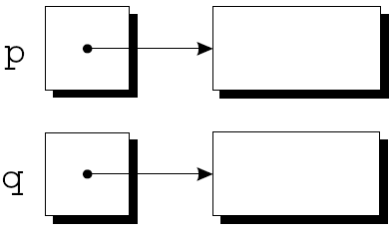
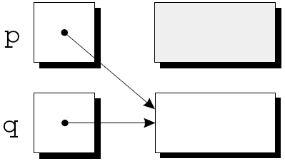
Memory Leak
p = malloc(...);
q = malloc(...);
p = q;
no pointer to 1st block (garbage)
Block cannot be freed
This sort of code leads to memory leaks

Slide 15
Dangling Pointer
char *ptr1 = malloc(10*sizeof(char)); // new string
char *ptr2 = ptr1;
...
free(ptr2);
...
strcpy(ptr1, "hello");
Two dangling pointers – point to same deallocated memory

Slide 16
String Functions
char *myConcat(const char *s1, const char *s2) {
char *result = malloc(strlen(s1) + strlen(s2) + 1);
if(result == NULL) {
printf("Error: malloc failed\n");
exit(EXIT_FAILURE);
}
strcpy(result, s1);
strcat(result, s2);
return result;
}
Function call:
char *p = myConcat("hello ", "world");
process termination: flushes output streams, closes open streams
Type man 3 exit at command prompt for more info
Notes:
version of strcat: takes pointers to two strings, allocates enough memory for both + the null character, allocates memory for concatenated string and copies both strings in

Slide 17
calloc
Prototype: void *calloc(size_t nmemb, size_t size);
Allocates space for nmemb elements, each of size bytes
Initializes memory to 0
Notes:
Performance hit for initialization – don't use unless you really need initialization to 0

Slide 18
Dynamically Allocated Arrays
Particularly useful before C99 standard allowed non-constant array sizes
int numVals = -1;
double *data = NULL;
do {
printf("How many data values do you want to store? ");
scanf("%d", &numVals);
} while (numVals < 1);
data = malloc(numVals * sizeof(double)); // uninitialized
// data = calloc(numValues, sizeof(double)); // cleared to zeros
if(!data) printf("Error – malloc failed\n");

Slide 19
realloc
Resize a dynamically allocated array
Prototype: void *realloc(void *ptr, size_t size);
ptr points to previously allocated memory block
if ptr is NULL, new block allocated and pointer to block returned
size = new size of block in bytes (can be larger or smaller than original size)
if size is 0 and ptr points to existing block, block is deallocated and NULL is returned
Returns pointer to new block or NULL on failure
Attempts to use original block of memory, shrinking or expanding it in place
Notes:
int *temp = realloc(ptr, 1000 * sizeof(int));
if(temp) ptr = temp;
Check for success of realloc call before resetting pointer to data

Slide 20

Linked List
chain of structs (nodes) in which each node contains a pointer to next node
last node contains null pointer
Need pointer to head of list (1st element)
Advantages over array:
easy to increase size of list
easy to insert or delete element at any location
Disadvantages:
Slow access to i^{th} element of list

Slide 21
Define List Node
Nodes contain data and pointer to next node in list
struct node {
int value;
struct node *next;
};
node must be tag, not typedef alias, to allow declaration of type of next pointer

Slide 22
Create Empty List
Sets list pointer to null, creating empty list
struct node *first = NULL;

Slide 23
Exercise
Add first node to list – value for node is 10
allocate memory for new node
initialize node's fields
update list pointer

Slide 24
Exercise
Write code that adds a new element to the beginning of a list. Assume first is a pointer to the beginning of the list, and add 15 to the list.

Slide 25
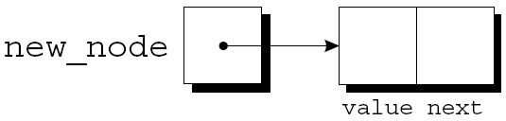
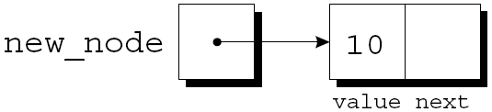
Create List Node
List nodes are typically allocated dynamically and added to list
Allocate memory for node
Store data in node
Insert node into list
Allocating memory:
struct node *new_node = malloc(sizeof(struct node));
Store data in node:
new_node → value = 10;
OR: (*new_node).value = 10;
OR: scanf("%d", &new_node → value);

Slide 26
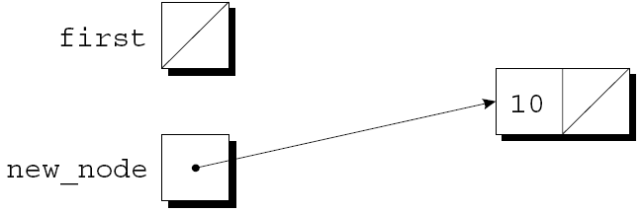
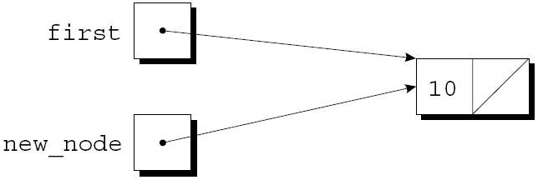
Insert Node at Beginning of List
new_node points to node we are inserting
first always points to first node in list
here list was initially empty
new_node → next = first;
first = new_node;

Slide 27
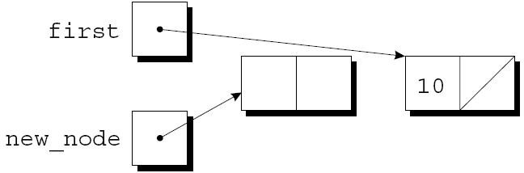
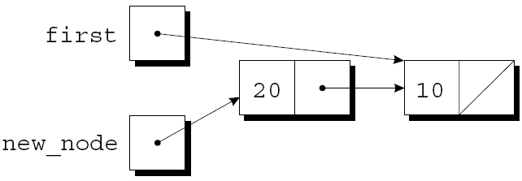
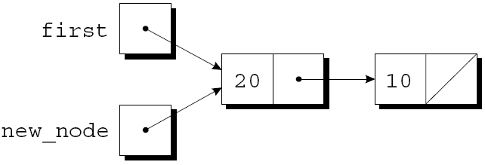
Insert Node at Beginning of List
new_node points to node we are inserting
first points to first node in list
new_node = malloc(sizeof(struct node));
new_node → value = 20;
new_node → next = first;
first = new_node;

Slide 28
Function: Insert Node at Beginning of List
struct node *addToList(struct node *list, int n) {
struct node *newNode = malloc(sizeof(struct node));
if(newNode == NULL) {
printf("Error: malloc failed\n");
exit(EXIT_FAILURE);
}
newNode → value = n;
newNode → next = list;
return newNode;
}
Store return value in first:
first = addToList(first, 10);
first = addToList(first, 20);

Slide 29
Exercise
Write a function that finds integer n in list, and returns a pointer to the node that contains n. The function returns NULL if n is not in the list.
struct node *searchList(struct node *list, int n) {

Slide 30
Search Linked List
Look for node containing value n
struct node *searchList(struct node *list, int n) {
struct node *p;
for(p = list; p != NULL; p = p → next)
if(p → value == n)
return p;
return NULL;
}
Notes:
Could also just use list to iterate, since it's a copy of the original list pointer (we can't change it).
for(; list != NULL; list = list → next) {if(list →value == n) return list; ...

Slide 31
Search Linked List
struct node *searchList(struct node *list, int n) {
for(; list!= NULL && list→value != n; list = list→next) ;
return list;
}
loop body is empty
list is NULL if we reach end of list, so NULL is returned if n not found
more natural to use while loop:
while(list != NULL && list→value != n) list = list→next;
return list;

Slide 32
Deleting Node From Linked List
Easy to delete node from linked list
3 steps:
Locate the node
Maintain pointer to previous node (prev) and pointer to current node (cur)
Initially prev is NULL, cur is first (list pointer)
Update previous node's next pointer to bypass deleted node
Free the deleted node

Slide 33
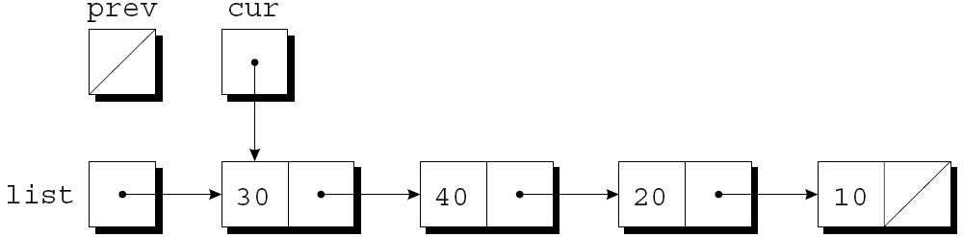
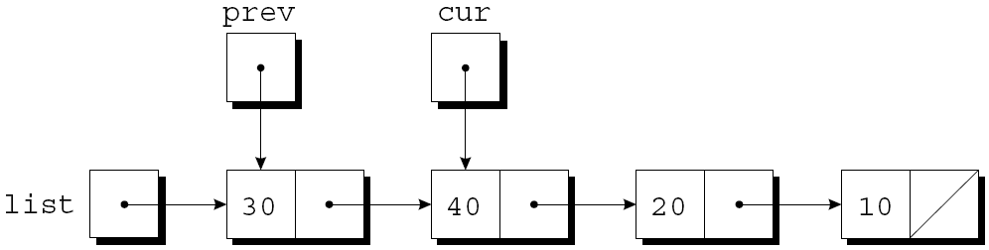
Deleting Node From List
Assume list is as follows, n is 20
cur = list; prev = NULL;
while(cur != NULL && cur→value !=n)
prev = cur; cur = cur → next;

Slide 34
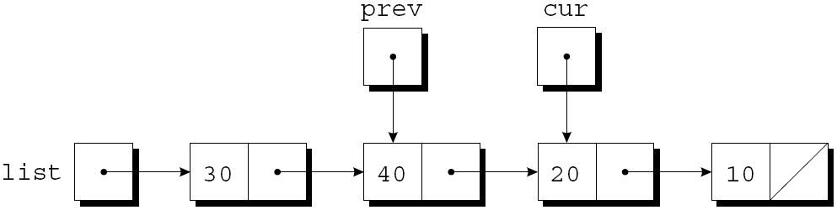
Deleting Node From List
while(cur != NULL && cur→value !=n)
prev = cur; cur = cur → next;
loop terminates since cur→value != n is false

Slide 35
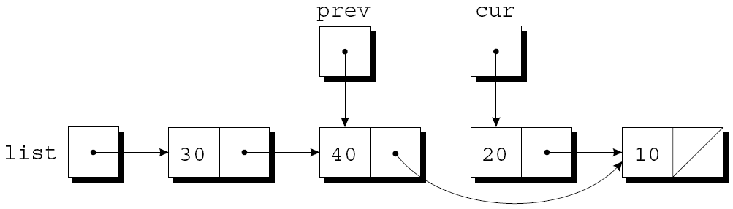
Deleting Node: Steps 2 & 3 Bypass Deleted Node and Free It
prev → next = cur → next;
free(cur);

Slide 36
Deleting Node From Linked List
struct node *deleteNode(struct node *list, int n) {
struct node *cur, *prev;
for(cur = list, prev = NULL; cur != NULL && cur → value != n;
prev = cur, cur = cur → next) ;
if(cur == NULL) return list; // n not found
if(prev == NULL) list = list → next; // n in first node
else prev → next = cur →next; // n in some other node
free(cur);
return list;
}
Notes:
Return list pointer.
Function returns FIRST node containing n.
Deleting 1st node is a special case that requires updating the list pointer.

Slide 37
Exercise
Write a function that returns the length of a linked list:
int linkedLength(struct node *list) {
// Your code here
}

Slide 38
Ordered List
Nodes are maintained in order – decreasing or increasing
Inserting is more difficult than inserting always at the beginning of the list
Exercise: Rewrite addToList assuming that the list of nodes is in increasing order.

Slide 39
Pointers to Pointers
If we want a function to modify a pointer, we must pass a pointer to that pointer
The function addToList adds a new element to beginning of a list, and updates the list pointer, rather than returning the list pointer
void addToList(struct node **listRef, int n) {
struct node *newNode = malloc(sizeof(struct node));
if(newNode == NULL) {
printf("Error: malloc failed\n");
exit(EXIT_FAILURE);
}
// What goes here??
}

Slide 40
Pointers to Pointers: Add to Beginning of List
void add_to_list(struct node **listRef, int n)
{
struct node *new_node;
new_node = malloc(sizeof(struct node));
if (new_node == NULL) {
printf("Error: malloc failed in add_to_list\n");
exit(EXIT_FAILURE);
}
new_node->value = n;
new_node->next = *listRef;
*listRef = new_node;
}
Call: addToList(&first, 10);

Slide 41
Exercise
Write C code that adds a new node (containing your favorite integer) to the end of a linked list. Assume list points at the first element of the list.
struct node *list = ... ;

Slide 42
Exercise
Write a function that moves the last node in a list to the front of the linked list. headRef is a pointer to the list pointer.
void moveLastToFirst(struct node **headRef) { ...

Slide 43
Exercise
Write a function that reverses a linked list. headRef is a pointer to the list pointer.
void reverse(struct node **headRef) {...

