Slide 1

Searching & Sorting
"There's nothing hidden in your head the sorting hat can't see. So try me on and I will tell you where you ought to be."
-The Sorting Hat, Harry Potter and the Sorcerer's Stone

Slide 2
Searching
Given an array of ints, find the index of an int key
For key = 27 and the above array, a search function returns 2
If it's not present, often returns negative value
What if more than one occurrence of the key?
index | 0 | 1 | 2 | 3 | 4 | 5
value | 89 | 0 | 27 | -5 | 42 | 11

Slide 3
Question
Given an array of 1,000,000 distinct elements in random order, how many elements do you expect to look at on average when searching if:
key present key not present
A. 1 1,000,000
B. 500,000 1,000,000
C. 1,000,000 1,000,000
D. 1,000 500,000
E. 20 1,000,000

Slide 4
Linear or Sequential Search
Examine each array value successively, comparing to the key, until the key is found or end of array is reached
int linearSearch(int arr[], int N, int key) {
for(int i = 0; i < N; i++) {
if(arr[i] == key) return i;
}
return -1;
}
Worst case runtime: every array element is compared to the key. O(N)
Average case runtime: N/2 comparisons before key is found. O(N)
Best case runtime: 1 comparison before key is found. O(1)

Slide 5
Searching in a Sorted List
If array elements are sorted (e.g., in increasing order), then we can divide and conquer
Dividing your work in half with each step
a good thing!
Searching is more efficient if the array is sorted

Slide 6
Binary Search
Problem: Searching for a key in an array of N elements
Binary search assumes that the array is sorted (i.e., array elements are in increasing order)
Binary search successively eliminates half of the elements
Algorithm: Examine the middle element of the array
If it's too big: eliminate the right half of the array and repeat
If it's too small: eliminate the left half of the array and repeat
Else it's the key we're searching for of the sub-array size is 0, so stop
Which indices does the algorithm examine to find value 42?
What is the runtime complexity of binary search?
index | 0 | 1 | 2 | 3 | 4 | 5 | 6 | 7 | 8 | 9 | 10 | 11 | 12 | 13 | 14 | 15 | 16
value | -5 | 3 | 8 | 10 | 14 | 20 | 23 | 25 | 32 | 36 | 42 | 51 | 57 | 66 | 84 | 90 | 101
min
mid
max

Slide 7
Binary Search
index | 0 | 1 | 2 | 3 | 4 | 5 | 6 | 7 | 8 | 9 | 10 | 11 | 12 | 13 | 14 | 15 | 16
value | -5 | 3 | 8 | 10 | 14 | 20 | 23 | 25 | 32 | 36 | 42 | 51 | 57 | 66 | 84 | 90 | 101
min
mid
max
index | 0 | 1 | 2 | 3 | 4 | 5 | 6 | 7 | 8 | 9 | 10 | 11 | 12 | 13 | 14 | 15 | 16
value | -5 | 3 | 8 | 10 | 14 | 20 | 23 | 25 | 32 | 36 | 42 | 51 | 57 | 66 | 84 | 90 | 101
min
mid
max
index | 0 | 1 | 2 | 3 | 4 | 5 | 6 | 7 | 8 | 9 | 10 | 11 | 12 | 13 | 14 | 15 | 16
value | -5 | 3 | 8 | 10 | 14 | 20 | 23 | 25 | 32 | 36 | 42 | 51 | 57 | 66 | 84 | 90 | 101
min
mid
max

Slide 8
Binary Search Example
0 | 1 | 2 | 3 | 4 | 5 | 6 | 7 | 8 | 9 | 10 | 11 | 12 | 13 | 14 | 15
2 | 3 | 5 | 7 | 11 | 13 | 17 | 19 | 23 | 29 | 31 | 37 | 41 | 43 | 47 | 53

Slide 9
Binary Search
int binarySearch(int arr[], int N, int key) {
int mid;
int min = arr[0];
int max = arr[N-1];
while(min <= max) {
mid = (start + end)/2;
if(n == arr[mid]) return mid;
else if(n < arr[mid]) max = mid – 1;
else start = mid + 1;
}
return -1;
}

Slide 10
Binary Search Runtime
For an array of size N, binary search eliminates ½ until 1 element remains
N, N/2, N/2², N/2³, ..., 2, 1.
How many divisions are required?
N/2^{k} = 1 → 2^{k} = N → k = log₂N
Binary search is O(logN), i.e., it's in the logarithmic complexity class
Exercise: What is T(N)? Prove that T(N) = O(logN).
Notes:
T(N) = 4 + 5logN
Note that log16 = 4. Let N0 = 2 and c = 9.
Whenever N >= 2, T(N) = 5logN + 4 <= 5logN + 4logN = 9logN.
Therefore, T(N) = O(logN).

Slide 11
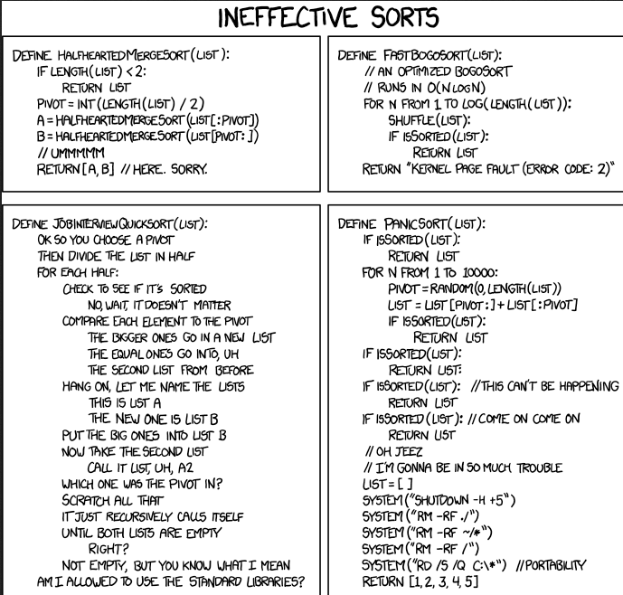
Sorting
XKCD
xkcd.com/1185

Slide 12
Insertion Sort
insertion sort: order a list of values by repetitively inserting a particular value into a sorted subset of the list
To start: consider the first item to be a sorted sublist L[0:0] of length 1
Step 1: Insert second item into sorted sublist, swapping with first item as needed
Now L[0:1] is sorted
Step 2: Insert 3rd item into sorted sublist, swapping to left as needed
Now L[0:2] is sorted
...
Repeat until all values have been sorted into their proper positions
L[0:N-1] is sorted
Notes:
Think of the list as having 2 regions: a region at the beginning of the list that is sorted among itself, and a second region to the right that is not yet sorted.
One at a time, you add elements to the sorted region, until you've added all elements in the array.
Each time you add a new element to the sorted region, it's at the end, and it might not be in the right position among the sorted elements.
Compare it to the element to its left, swapping with that element, until it's in the right place.
Makes N-1 passes over array
At end of pass i, A[0:i] is sorted

Slide 13
Insertion Sort Example
Make N-1 passes over array
After pass i: L[0:i] is sorted
Index Value | 0 15 | 1 2 | 2 1 | 3 17 | 4 10 | 5 12 | 6 5
pass 1 | 2 | 15 | 1 | 17 | 10 | 12 | 5
pass 2 | 1 | 2 | 15 | 17 | 10 | 12 | 5
pass 3 | 1 | 2 | 15 | 17 | 10 | 12 | 5
pass 4 | 1 | 2 | 10 | 15 | 17 | 12 | 5
pass 5 | 1 | 2 | 10 | 12 | 15 | 17 | 5
pass 6 | 1 | 2 | 5 | 10 | 12 | 15 | 17
Notes:
Pass i: Put L[i] in correct position relative to sorted array to its right
What arrangement of data would make it slower: If its backwards! You have to slow every elt all the way over.
If its sorted already, nothing has to be swapped, so it is faster.

Slide 14
Insertion Sort Example
44 68 191 119 37 83 82 191 45 158 130 76 153 39 25
Insertion sort dancing: https://www.youtube.com/watch?v=ROalU379l3U
Insertion sort from Harvard's CS 50: https://www.youtube.com/watch?v=DFG-XuyPYUQ
Notes:
Inserting a sorted element into a sorted chunk over and over again.

Slide 15
Insertion Sort
for i = 1 to N-1
elt = arr[i]
j = i
while(j > 0 and arr[j-1] > elt)
arr[j] = arr[j-1]
j = j – 1
arr[j] = elt
Homework: Implement insertion sort in C
Insert elt = arr[i] into sorted subarray arr[0:i-1]
Keep sliding elt to the left of the array until it's in proper position
Notes:
j is current index for elt as its being moved left in the sorted region of the array
Iterate over sorted portion once we find the right position for elt – shift elements in sorted portion that are less than elt to the rlght

Slide 16
Insertion Sort
void insertionSort(int arr[], int N) {
for(int i = 1; i < N; i++) {
int temp = arr[i];
// slide elements right to make room for arr[i]
int j = i;
while(j >= 1 && arr[j-1] > temp) {
arr[j] = arr[j-1];
j--;
}
arr[j] = temp;
}
}

Slide 17
Insertion Sort Analysis
Worst case: the array is in reverse sorted order, and each element inserted into the sorted subarray must be swapped all the way down to arr[0]
Worst case runtime?
for i = 1 to N-1
elt = arr[i]
j = i
while(j > 0 and arr[j-1] > elt)
arr[j] = arr[j-1]
j = j – 1
arr[j] = elt

Slide 18
Selection Sort
To sort a list into increasing order:
Find the smallest item in the array, and swap it with the first array element
Find the second smallest item in the array, and swap it with the second array element
...
For i = 0 to N-2:
Step i: Find the smallest item in arr[i:N-1] and swap it with arr[i]

