Slide 1


Wavelets: an application of mathematics to
Signal Analysis
Kathy Davis, Anna C. Gilbert
John E. Gilbert
REU: Summer 2006

Slide 2


Motivation:
Wavelets are building blocks that can
quickly decorrelate data
1. what type of data?
2. each signal written as (possibly infinite) sum
3. new coefficients
provide more ‘compact’
representation. Why need?
4. switch representations in time proportional
to size of data

Slide 3
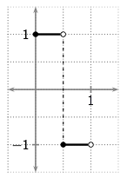
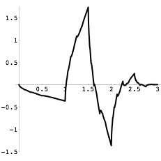
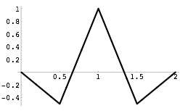

Wavelet = ‘little wave’
Haar
Mexican Hat
Daubechies 4-tap
Wave property:
Support in Interval

Slide 4
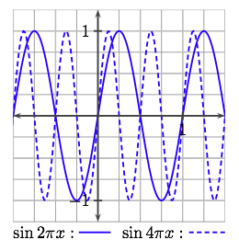
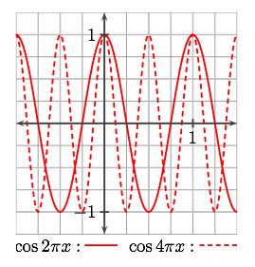


Trig functions = ‘big wave’
Wave property:
Support =

Slide 5
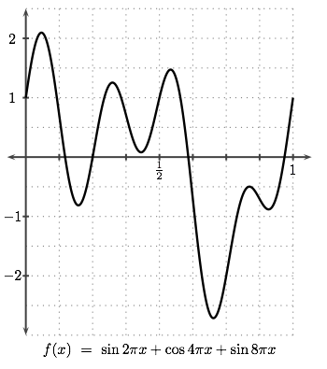

Data = function
finite linear combination
of trig functions on

Slide 6
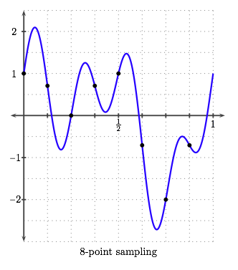



Data = sequence of sample values
Sampling
on a
uniform mesh on
gives a
sequence

Slide 7
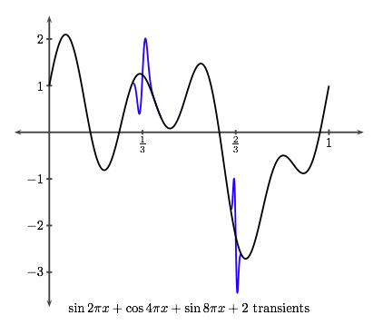
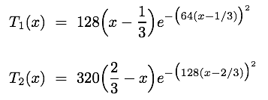
Data = function with transients
oscillate at
different rates
need to sample at higher resolution now!

Slide 8
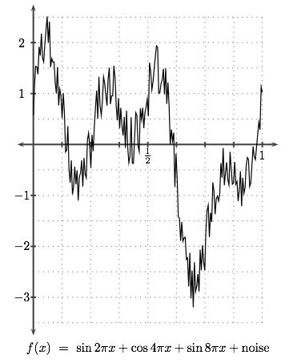
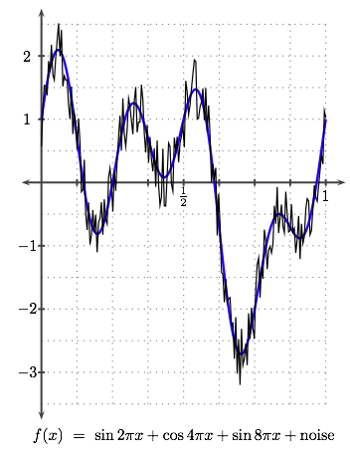
Data = function with noise

Slide 9
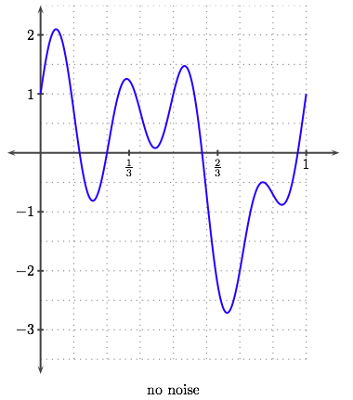
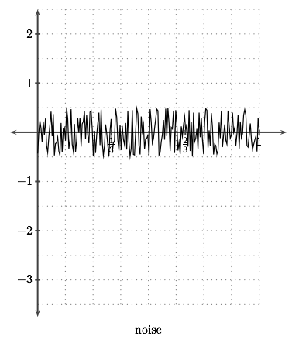
Can we denoise?

Slide 10
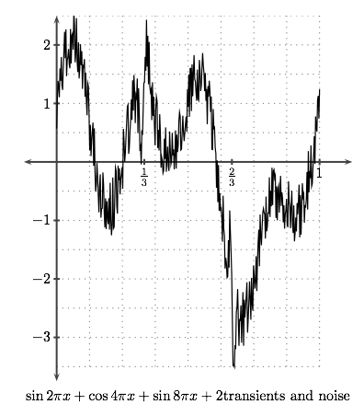
With transients and noise!
Can you locate
the transients
in all this noise?
Not so clear!

Slide 11
Audio files: piano roll
A clip from an old recording of Caruso
Original
Denoised
Noise

Slide 12

Audio files: piano roll
A clip from an old recording of Caruso
Original
Denoised
Noise

Slide 13
Audio files: piano roll
A clip from an old recording of Caruso
Original
Denoised
Noise

Slide 14
Audio files: piano roll
A clip from an old recording of Caruso
Original
Denoised
Noise

Slide 15
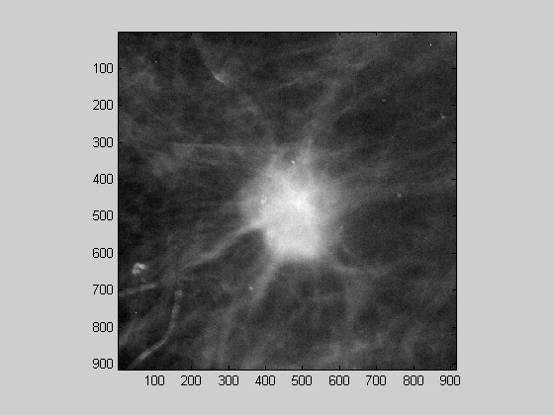
Bio-medical data
diagnostic tool:
locate and determine
malignancy of breast tumors
Detect transients
Spiculated: bad

Slide 16
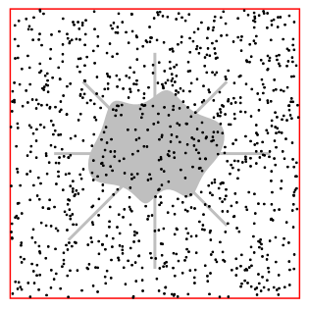

Synthetic data
de-noise
Machine noise affects quality of CAT Scan.
De-noise, then look for transients.

Slide 17
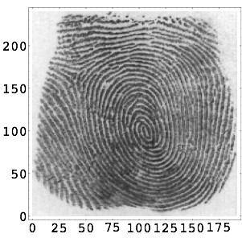

Data = images
real data
contour plot of surface
Compression: allows efficient storage, transmission

Slide 18

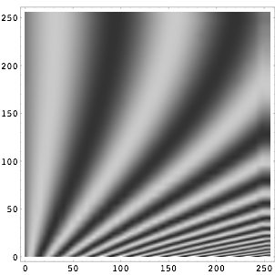
Compression
compress
Right-hand figure uses less than
5% of data in left-hand figure.

