Slide 1


END TERM
Major Project — End-Term Report
NOESIS
An Operating-System-Inspired Kernel for Autonomous Multi-Agent Intelligence
School of Computer Science · UPES Dehradun · Academic Year 2026–2027
Presented by:
500118979 – Dhruv Shah
500123471 – Manan Nasa
Mentored By:
Dr. Archana Kumari
Notes:
Introduce the team and guide. One-line pitch: NOESIS is an operating-system-style kernel for multi-agent AI — it plans goals deterministically, runs twelve typed agents under least-privilege capabilities, and records an audit trail; an LLM is optional.

Slide 2
Content
1
Introduction
Problem · motivation · gap · proposed solution
2
Literature Review
Agent frameworks · OS-for-LLM · capability security · SWOT
3
Objectives
O1–O7 and their status
4
Methodology
Architecture · tech stack · algorithms · process
5
Working Model
Modules · workflow · LLM integration · UI screens
6
Results
Tests · security · determinism · performance · benchmarks
7
Conclusion
Challenges · limitations · future scope
8
References
Key sources
NOESIS · Major Project End-Term Report · Dhruv Shah, Manan Nasa
2
Notes:
Roadmap of the talk, following the UPES end-term template: introduction, literature, objectives, methodology, working model, results, conclusion, references.

Slide 3
Introduction — Problem Statement
Introduction
Agent frameworks wire prompts and tools; the runtime concerns are left to the application
Permission boundaries
Reproducibility
Any agent can usually call any tool; nothing checks a scoped capability before a side effect (prompt-injection risk).
Sampling makes the same goal yield different plans — hard to debug, test or audit.
Memory lifecycle
Operational visibility
Flat vector stores; promotion, retention and provenance are ad hoc.
Health, metrics, per-step audit and an operator console are outside the framework.
Problem: apply OS primitives — least-privilege capabilities, deterministic scheduling, tiered memory with provenance, observable syscalls — to multi-agent LLM workflows, usable on one laptop with or without an LLM.
NOESIS · Major Project End-Term Report · Dhruv Shah, Manan Nasa
3
Notes:
Four system-level gaps: permissions, reproducibility, memory lifecycle, operations. These are exactly what operating systems solved for processes.

Slide 4
Introduction — Motivation
Introduction
Untrusted output
Engineering discipline
Local, free inference
Explainable design
Prompt injection turns fetched text into instructions → side effects need a check the model cannot bypass.
Same input ⇒ same plan enables unit tests, snapshots and exact replay.
Qwen2.5-Coder 7B via Ollama runs on a laptop; the kernel must treat any LLM as optional.
Syscalls, capability tables, schedulers and interrupts make agent systems teachable and testable.
OS analogy: process → agent · syscall → tool/memory/model call · capability list → permission set · scheduler → step order · interrupt → async event
NOESIS · Major Project End-Term Report · Dhruv Shah, Manan Nasa
4
Notes:
Why now: untrusted model output, reproducibility, context limits, cost/privacy of local models, operability.

Slide 5
Literature Review — Existing Gap
Literature
Qualitative comparison of system-level concerns
Concern | Agent frameworks | OS-for-LLM research | NOESIS (as built)
Capability check on tool calls | Application-defined | Proposed (AIOS) | Implemented (registry + kernel)
Spawn-time privilege check | Rare | — | Implemented (AgentRoster)
Reproducible planning | Sampling-dependent | Not a focus | Implemented — 50/50 goals bit-identical
Tiered memory + provenance | Vector stores | Context paging (MemGPT) | 6 tiers + SHA-256 chain (component)
Works without an LLM | No | No | Yes — deterministic agents
Agent task intelligence | LLM-driven | LLM-driven | Rule-based (limitation)
Gap: no self-hostable runtime in the reviewed work combines kernel-mediated capabilities, bit-exact plan replay, provenance-logged memory and an operator console while staying functional without an LLM.
NOESIS · Major Project End-Term Report · Dhruv Shah, Manan Nasa
5
Notes:
ReAct/Reflexion/Toolformer define the agent loop; AutoGen/MetaGPT/CAMEL/CrewAI/LangGraph coordinate agents; MemGPT/AIOS bring OS ideas to LLMs; Dennis–Van Horn, Saltzer–Schroeder and Miller ground capability security.

Slide 6
Literature Review — SWOT Analysis
Literature
Strengths
Weaknesses
• OS-style, test-covered architecture
• Bit-identical planning (~1 ms/plan)
• Works with or without an LLM
• 310 backend tests pass · 70 % coverage
• Agents are rule-based heuristics
• Resource routes unauthenticated
• Simulated ingestion / RAG agent
• 6 dashboard pages show placeholders
Opportunities
Threats
• Wire BM25 + memory bus into runs
• LLM-backed agents with same typed reports
• Functional code benchmarks
• Capability gate on all routes
• Fast-moving frameworks (LangGraph, AutoGen)
• Local 7B ≈ 23 tok/s — slow
• Prompt injection once LLM drives actions
• Over-claiming in docs erodes trust
NOESIS · Major Project End-Term Report · Dhruv Shah, Manan Nasa
6
Notes:
Honest SWOT based on the audit.

Slide 7
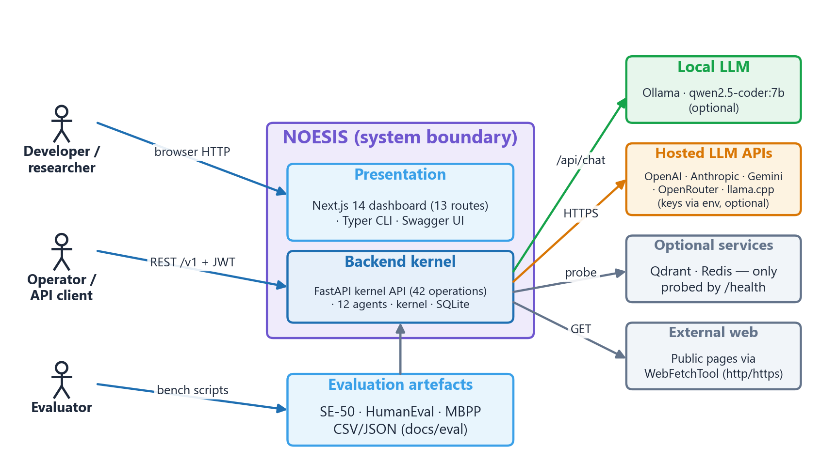
Proposed Solution — NOESIS at a Glance
Introduction
What NOESIS does
Goal → deterministic plan (seeded DAG)
Steps run by 12 typed agents
Each step gets a least-privilege token
Every step audited (rows, messages, spans)
6-tier memory with SHA-256 provenance
LLM optional — adds rationale only
REST API (42 ops) + Next.js dashboard
NOESIS · Major Project End-Term Report · Dhruv Shah, Manan Nasa
7
Notes:
Context diagram: three actors, backend kernel, optional LLMs and stores.

Slide 8
Objectives
Objectives
Main objective: a permission-checked, reproducible, auditable agent kernel usable without paid APIs
O1
Agent microkernel: typed agents, capabilities, syscall tracing
Achieved
O2
Deterministic, reproducible planning
Achieved
O3
Least-privilege enforcement (agents, tools, routes)
Partial — routes open
O4
Tiered memory with verifiable provenance
Component only
O5
Optional LLMs with graceful fallback; characterise local model
Achieved
O6
REST API + dashboard with automated tests
Partial — 6 mock pages
O7
Evaluation harness with statistics
Partial — compile-only
NOESIS · Major Project End-Term Report · Dhruv Shah, Manan Nasa
8
Notes:
Status reflects measured evidence; be explicit about partial ones.

Slide 9
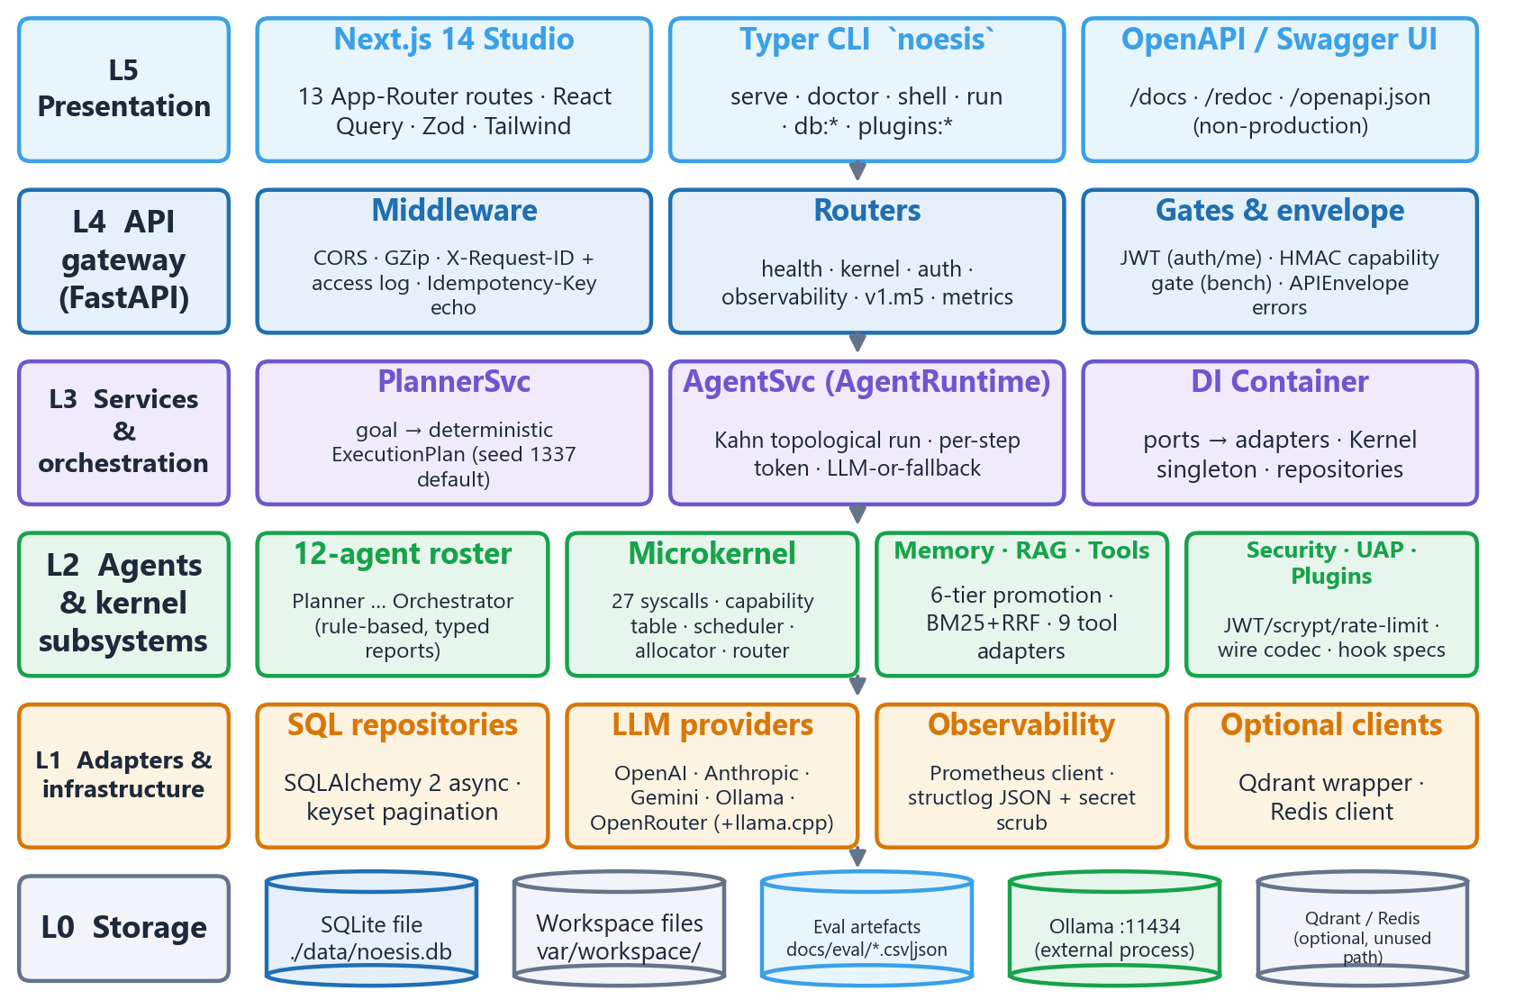
Methodology — System Overview
Methodology
Five layers over storage; dependencies point downwards (ports and adapters)
NOESIS · Major Project End-Term Report · Dhruv Shah, Manan Nasa
9
Notes:
Walk top-down: UI, API gateway, services, agents/kernel, adapters, storage.

Slide 10
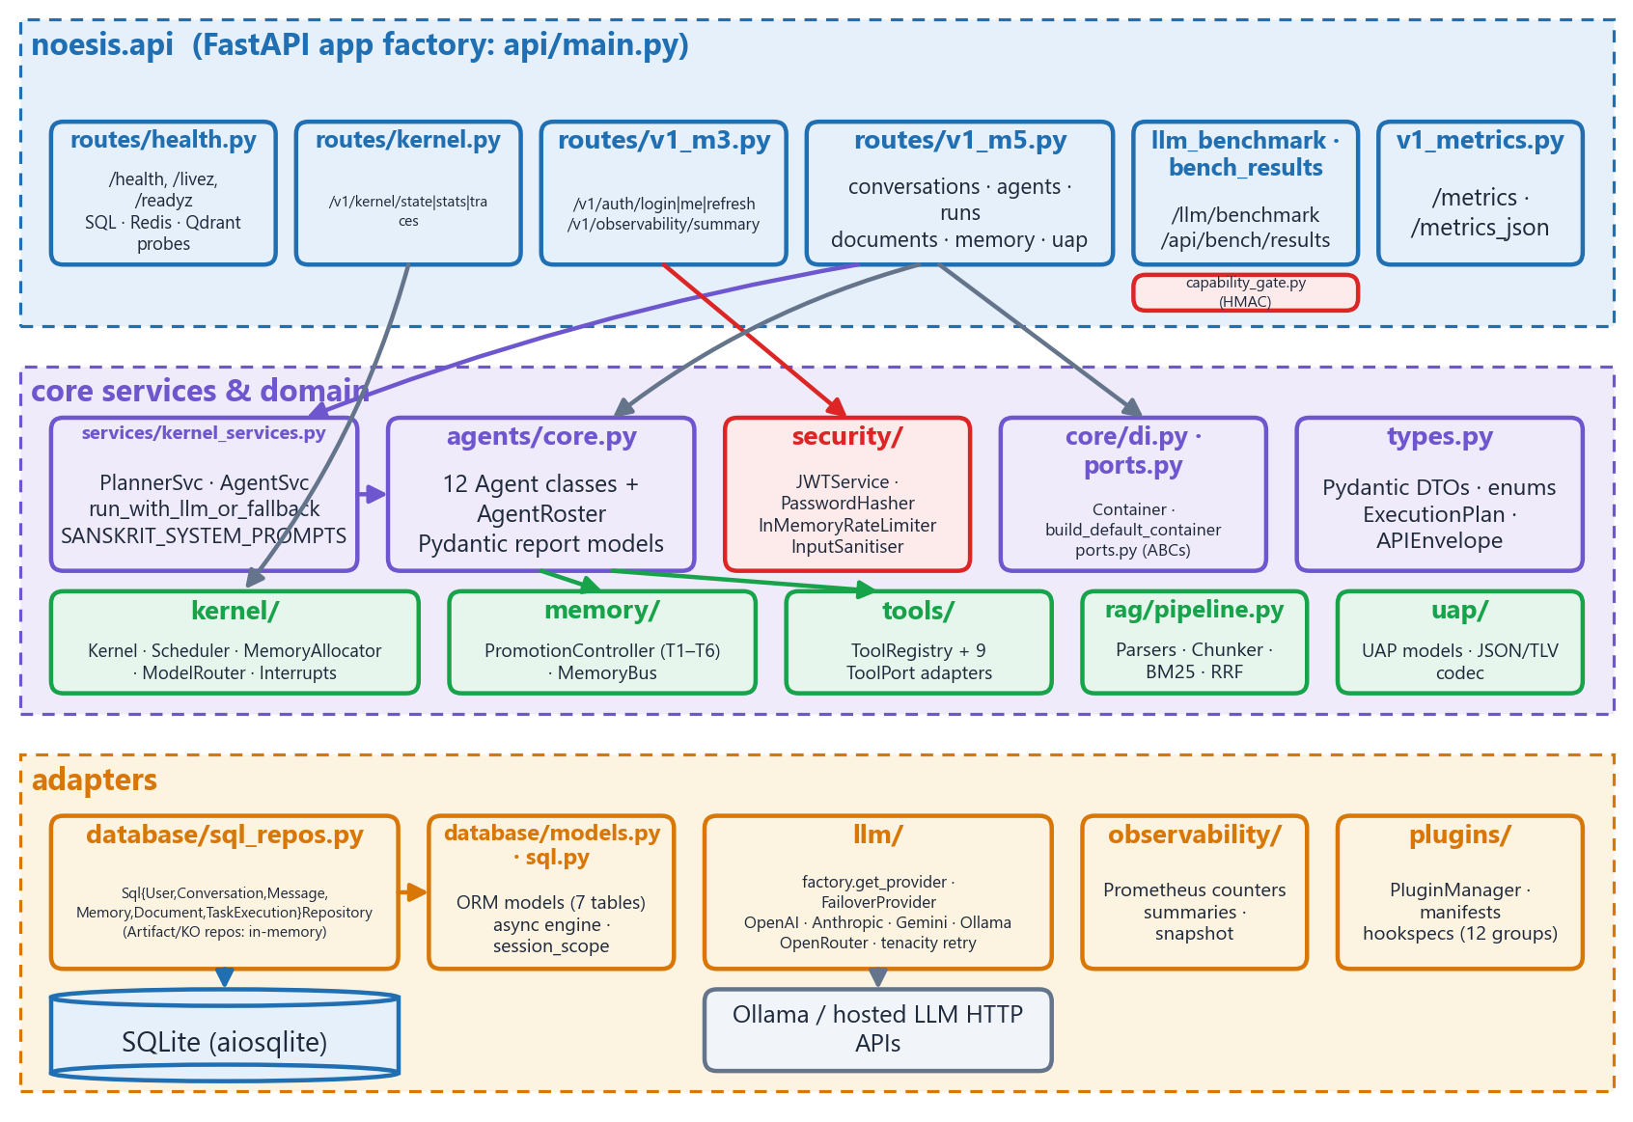
Methodology — Architecture
Methodology
Backend components and dependencies
Key numbers (measured)
17,072 LOC backend (16 packages)
42 HTTP operations
27 syscall ids · 6 handlers
12 agents · 9 tool adapters
5 LLM provider families
7 SQL tables
9,612 lines TS/TSX · 13 routes
NOESIS · Major Project End-Term Report · Dhruv Shah, Manan Nasa
10
Notes:
Routers → services → agents → memory/tools; repositories map DTOs to ORM rows; providers wrap HTTP APIs; capability gate protects bench routes.

Slide 11
Methodology — Technology Stack
Methodology
Layer | Technology | Why
API | FastAPI · Uvicorn · Pydantic v2 | Typed validation, async, OpenAPI
Persistence | SQLAlchemy 2 async · aiosqlite · Alembic | Portable SQL, zero setup
LLM | httpx · tenacity · Ollama (Qwen2.5-Coder 7B) | 5 providers, retries, local inference
Security | HS256 JWT · bcrypt/scrypt · HMAC-SHA256 | Standard primitives, no external IdP
Observability | structlog · prometheus-client | JSON logs, scrapeable metrics
Frontend | Next.js 14 · React 18 · TS · TanStack Query · Zod · Tailwind | Routing, caching, runtime schemas
Quality | pytest · coverage · Vitest · tsc · ESLint · ruff | Automated gates
Ops | Docker Compose · GitHub Actions (defined) | Reproducible deployment target
NOESIS · Major Project End-Term Report · Dhruv Shah, Manan Nasa
11
Notes:
Explain why each choice was made: validation, async, portability, zero-cost local inference.

Slide 12
Methodology — Process & Evaluation Design
Methodology
M0
M2
M3
M5
M7
W7
Foundation: types, settings, ORM, providers, probes
Memory tiers, bus, promotion, RAG library
Tools, research/reflection/coding agents, auth
Planner/Agent services, v1 routes, dashboard parity
Full 12-agent roster
Local-LLM evaluation runs (6 Oct 2026)
Question | Method | Metric
Does it behave as specified? | Run 312 backend + 105 frontend tests (isolated copy) | pass/fail, coverage
Are permissions enforced? | Kernel, roster, tool & HTTP-gate scenarios | expected vs observed
Is planning reproducible? | 50 SE-50 goals × 3 runs; 5 seeds | unique SHA-256
How fast? | TestClient latency; /llm/benchmark with Ollama | p50/p95 ms, tok/s
What do benchmarks show? | Re-analyse W7 artefacts | compile-pass, sign-off
NOESIS · Major Project End-Term Report · Dhruv Shah, Manan Nasa
12
Notes:
Milestones as evidenced in code/changelog; evaluation questions answered with measured evidence on an isolated copy.

Slide 13
Working Model — Key Modules
Working Model
Kernel
Agents (12)
Runtime services
27 syscall ids, capability table with glob targets, span ring buffer (10 k), scheduler, quota allocator, model router, interrupts
Planner, Research, Coding, Memory, RAG, Tool, Reflection, Judge, Critic, Executor, Supervisor, Orchestrator — typed reports
PlannerSvc + AgentSvc: Kahn ordering, per-step token (TTL 900 s), LLM-or-fallback, audit rows
Memory
Tools & sandbox
Security & ops
T1 Indriya → T6 Paalak promotion with SHA-256 chain; memory bus with RRF recall
Shell (dry-run), Python AST sandbox, files (rooted), web fetch (http/https) + 5 more adapters
JWT + bcrypt + rate limit; HMAC capability gate; Prometheus; request ids; secret-scrubbed logs
NOESIS · Major Project End-Term Report · Dhruv Shah, Manan Nasa
13
Notes:
One sentence per module; emphasise capability gating and determinism.

Slide 14
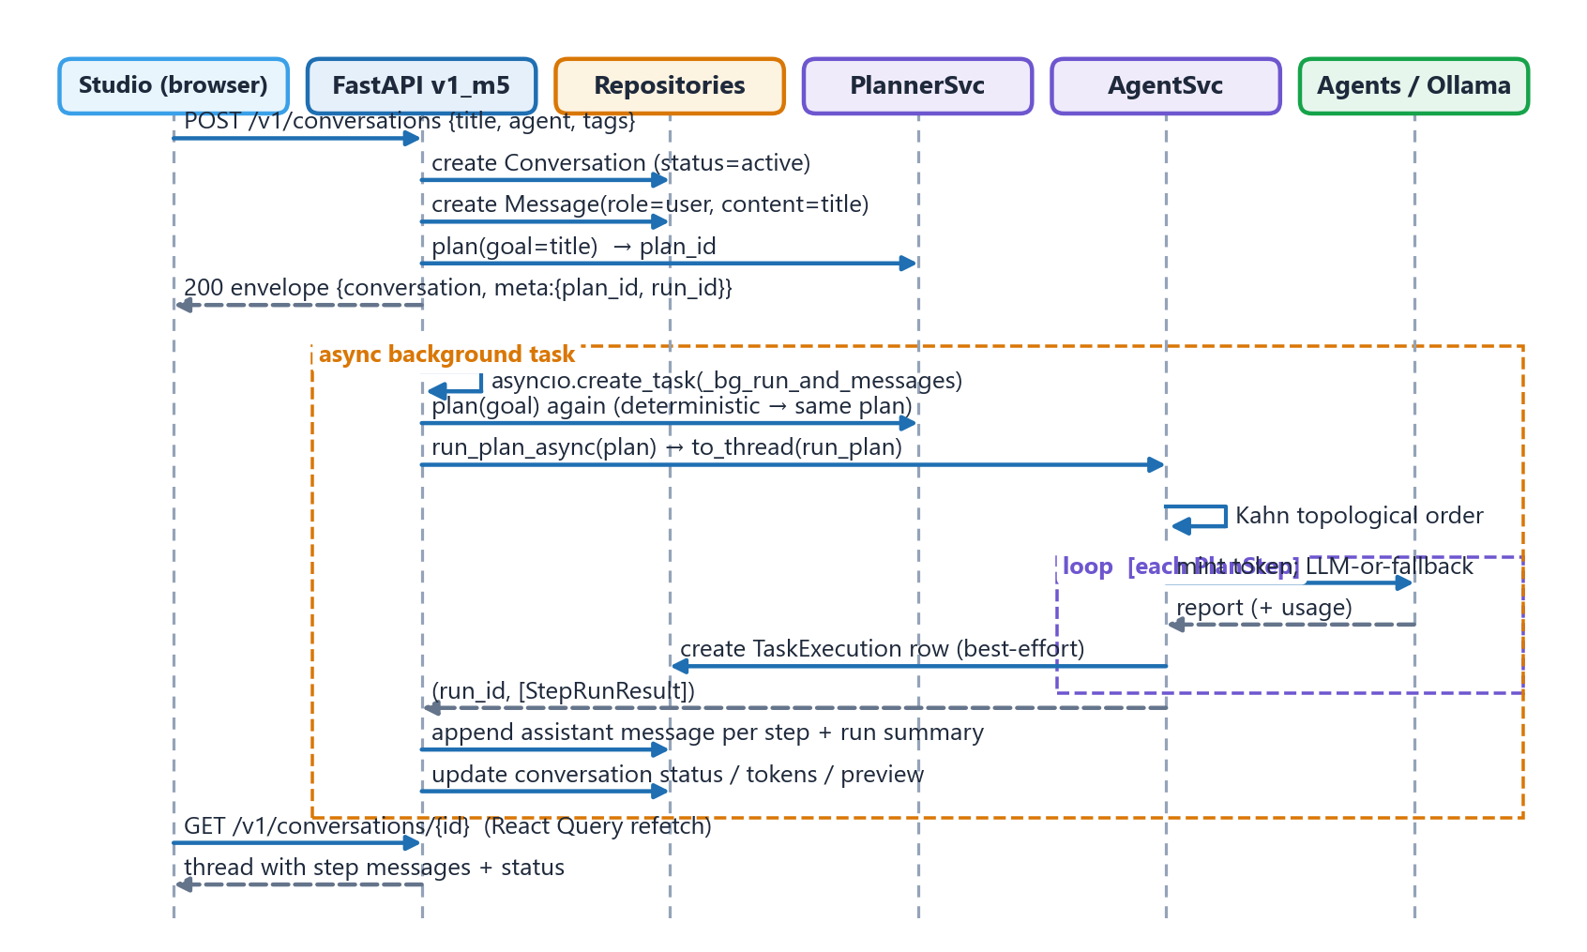
Working Model — End-to-End Workflow
Working Model
Create conversation → plan → background execution → thread updates
NOESIS · Major Project End-Term Report · Dhruv Shah, Manan Nasa
14
Notes:
Request returns in under a second; the run continues in a background task; the dashboard polls the thread.

Slide 15
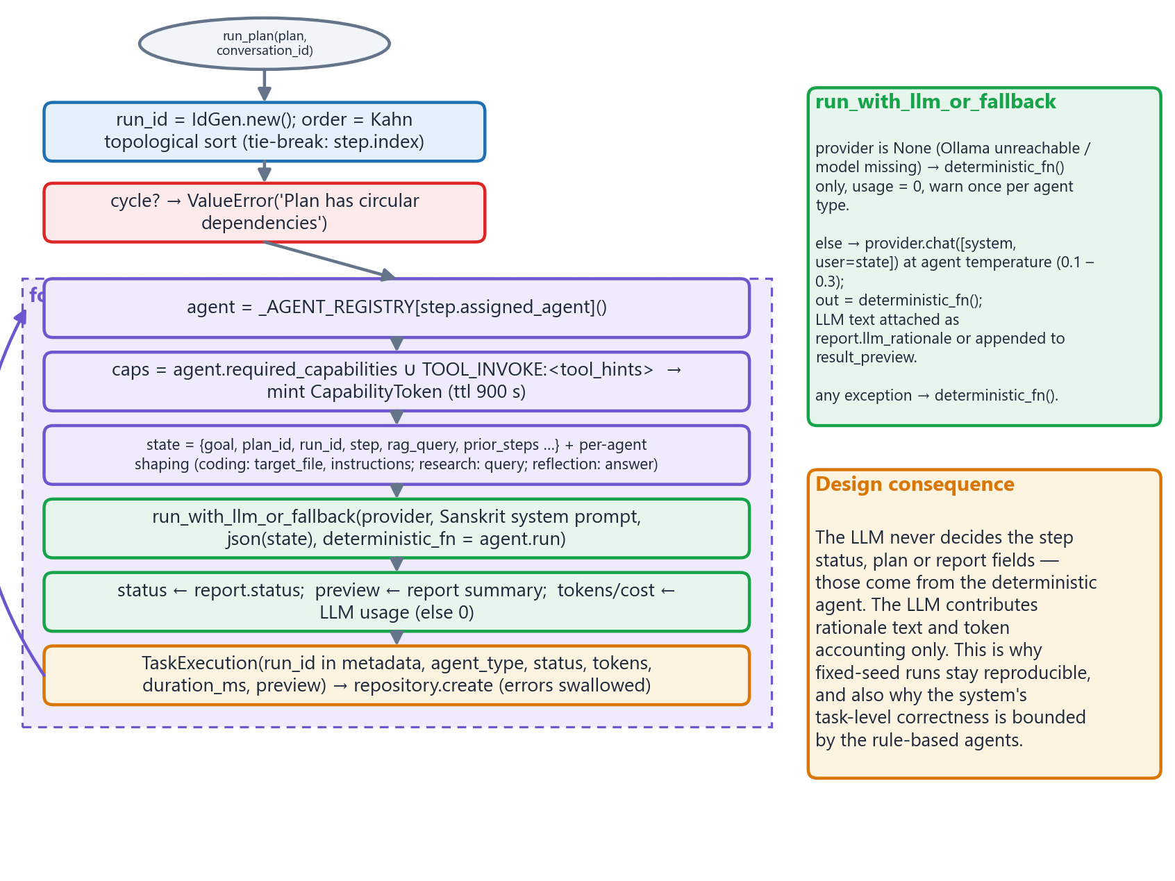
Working Model — AI / LLM Methodology
Working Model
Deterministic agents decide; the LLM (if reachable) contributes rationale and token accounting
Model & settings
Model: qwen2.5-coder:7b-instruct-q4_K_M (7.6 B, 4.68 GB)
Temperatures: planner/coding/judge 0.1 · critic 0.3 · others 0.2
State ≤ 6 000 chars per call
Unreachable → deterministic, 0 tokens
No training, no fine-tuning, no embeddings at run time
NOESIS · Major Project End-Term Report · Dhruv Shah, Manan Nasa
15
Notes:
No model training; Qwen2.5-Coder 7B Q4_K_M via Ollama; per-agent Sanskrit system prompts and temperatures 0.1–0.3; fallback when unavailable.

Slide 16
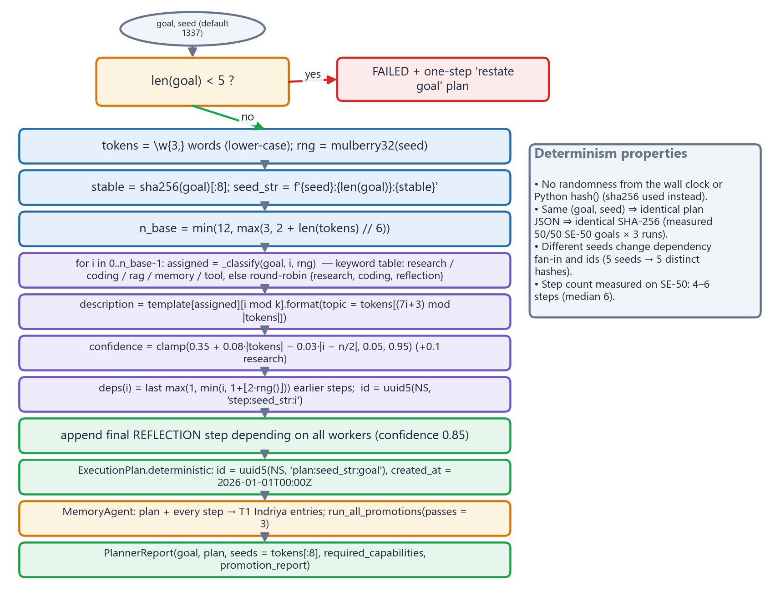
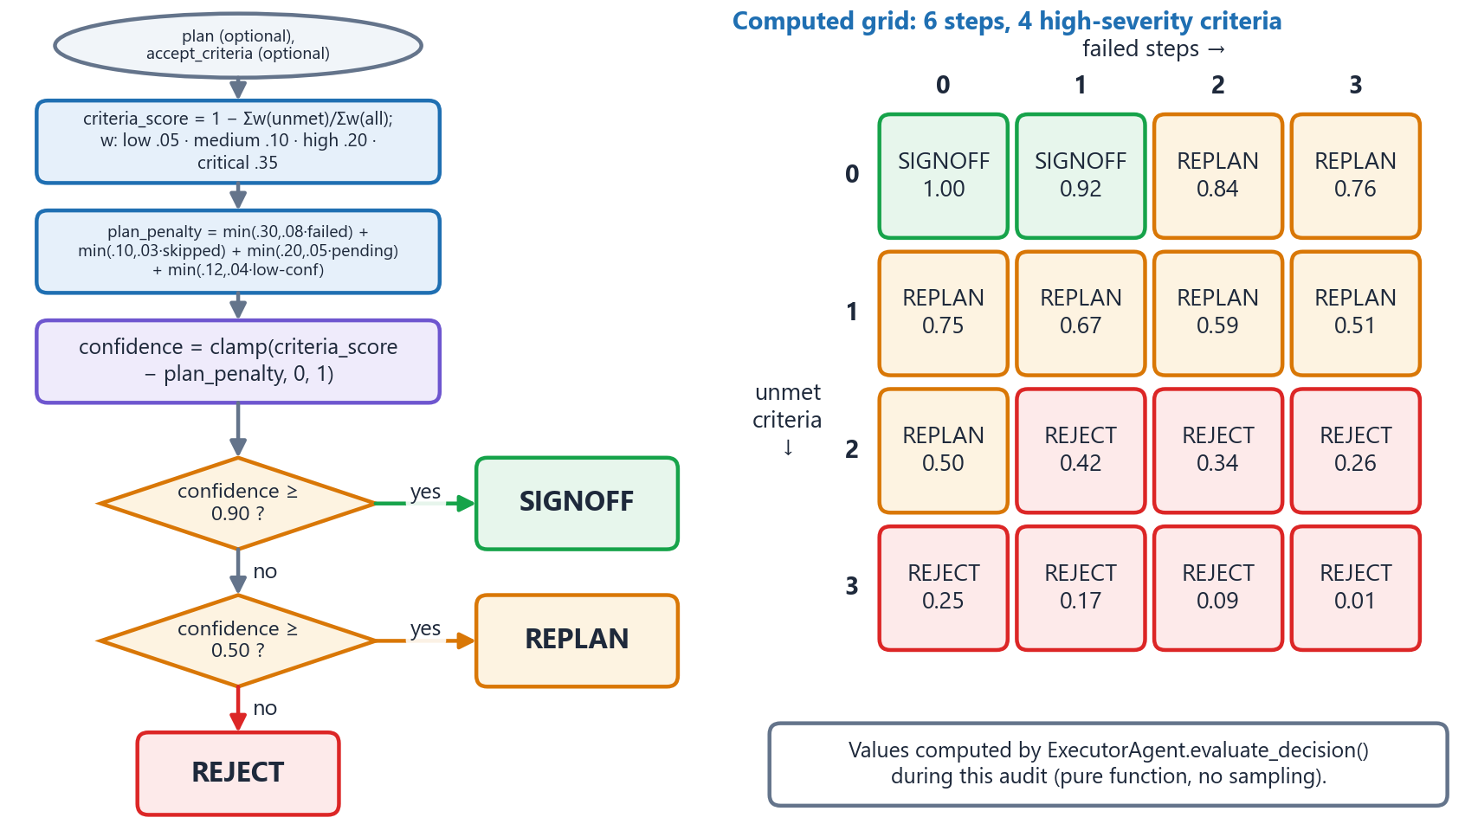
Working Model — Implementation Highlights
Working Model
NOESIS · Major Project End-Term Report · Dhruv Shah, Manan Nasa
16
Notes:
Planner determinism via UUIDv5/sha256/fixed epoch; executor thresholds 0.90/0.50; capability gate 5 checks.

Slide 17
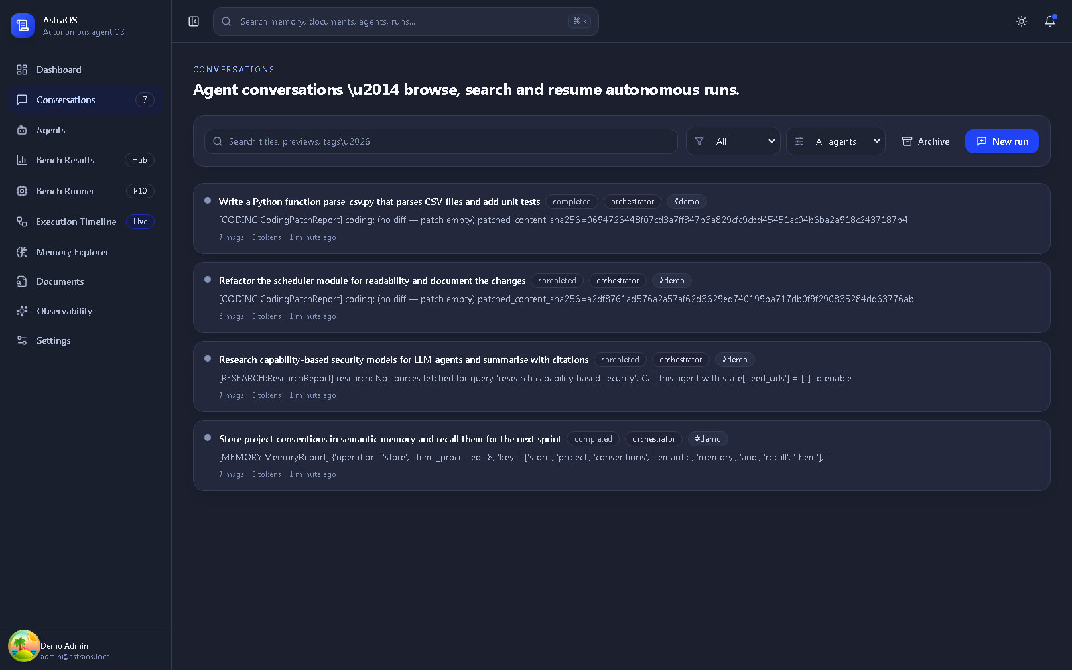
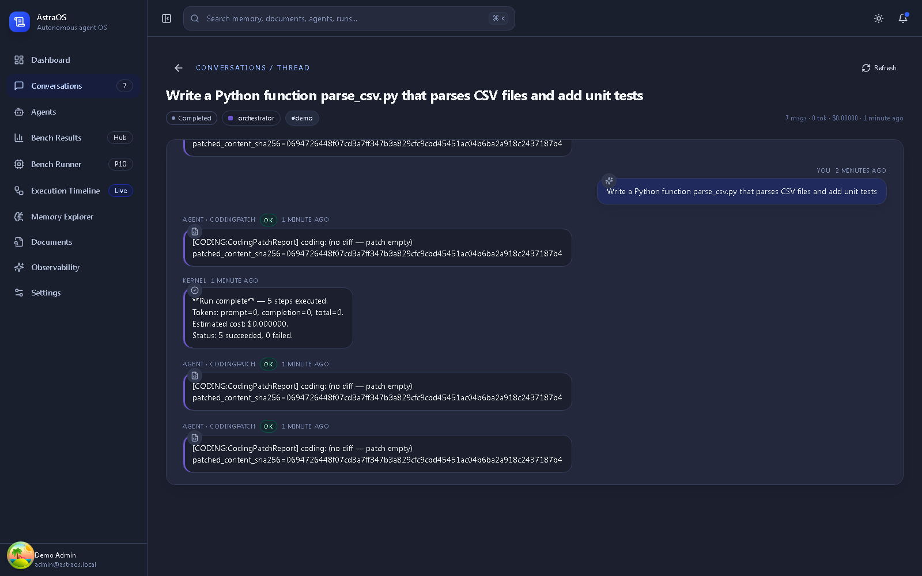
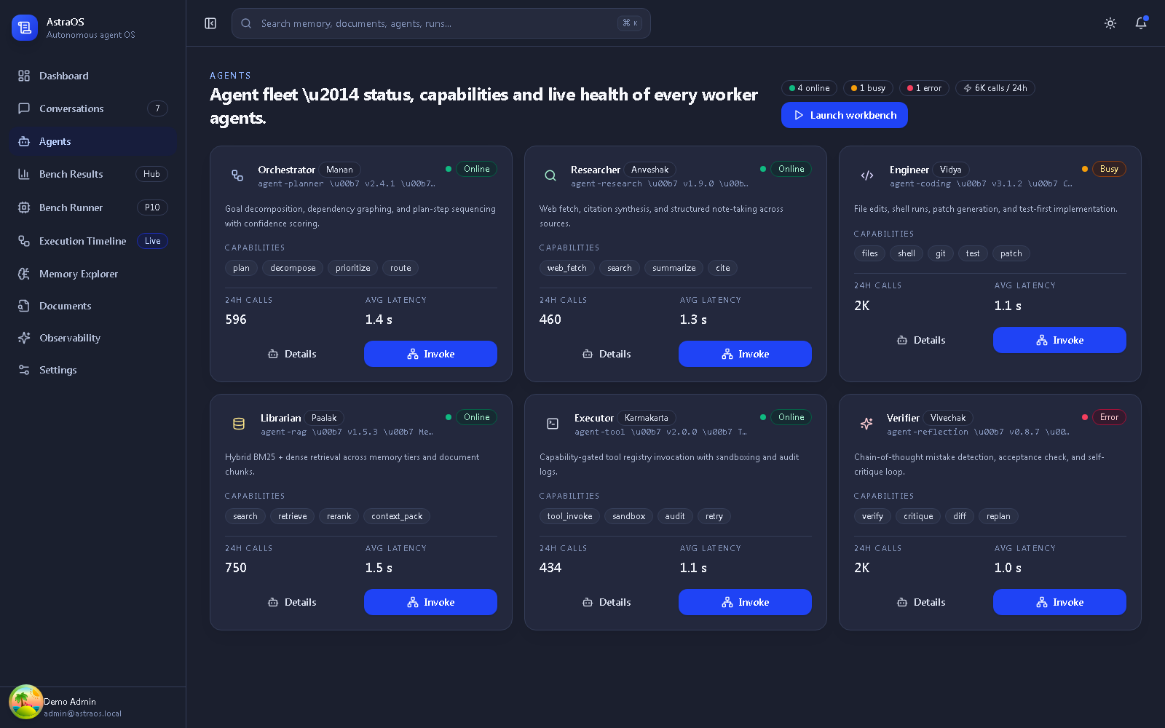
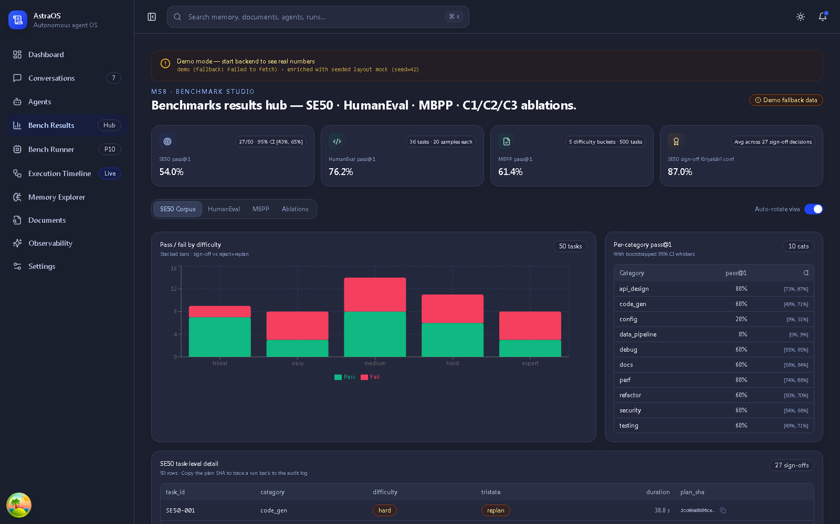
Working Model — Dashboard Screens
Working Model
Screenshots of the running application (scratch backend, 6 Oct 2026)
Conversations — live
Thread — live step reports
Agents — placeholder data
Bench Hub — labelled demo data
NOESIS · Major Project End-Term Report · Dhruv Shah, Manan Nasa
17
Notes:
Conversation pages are live; dashboard/agents/timeline/memory/documents/metrics fall back to placeholder data because list helpers do not unwrap the API envelope.

Slide 18
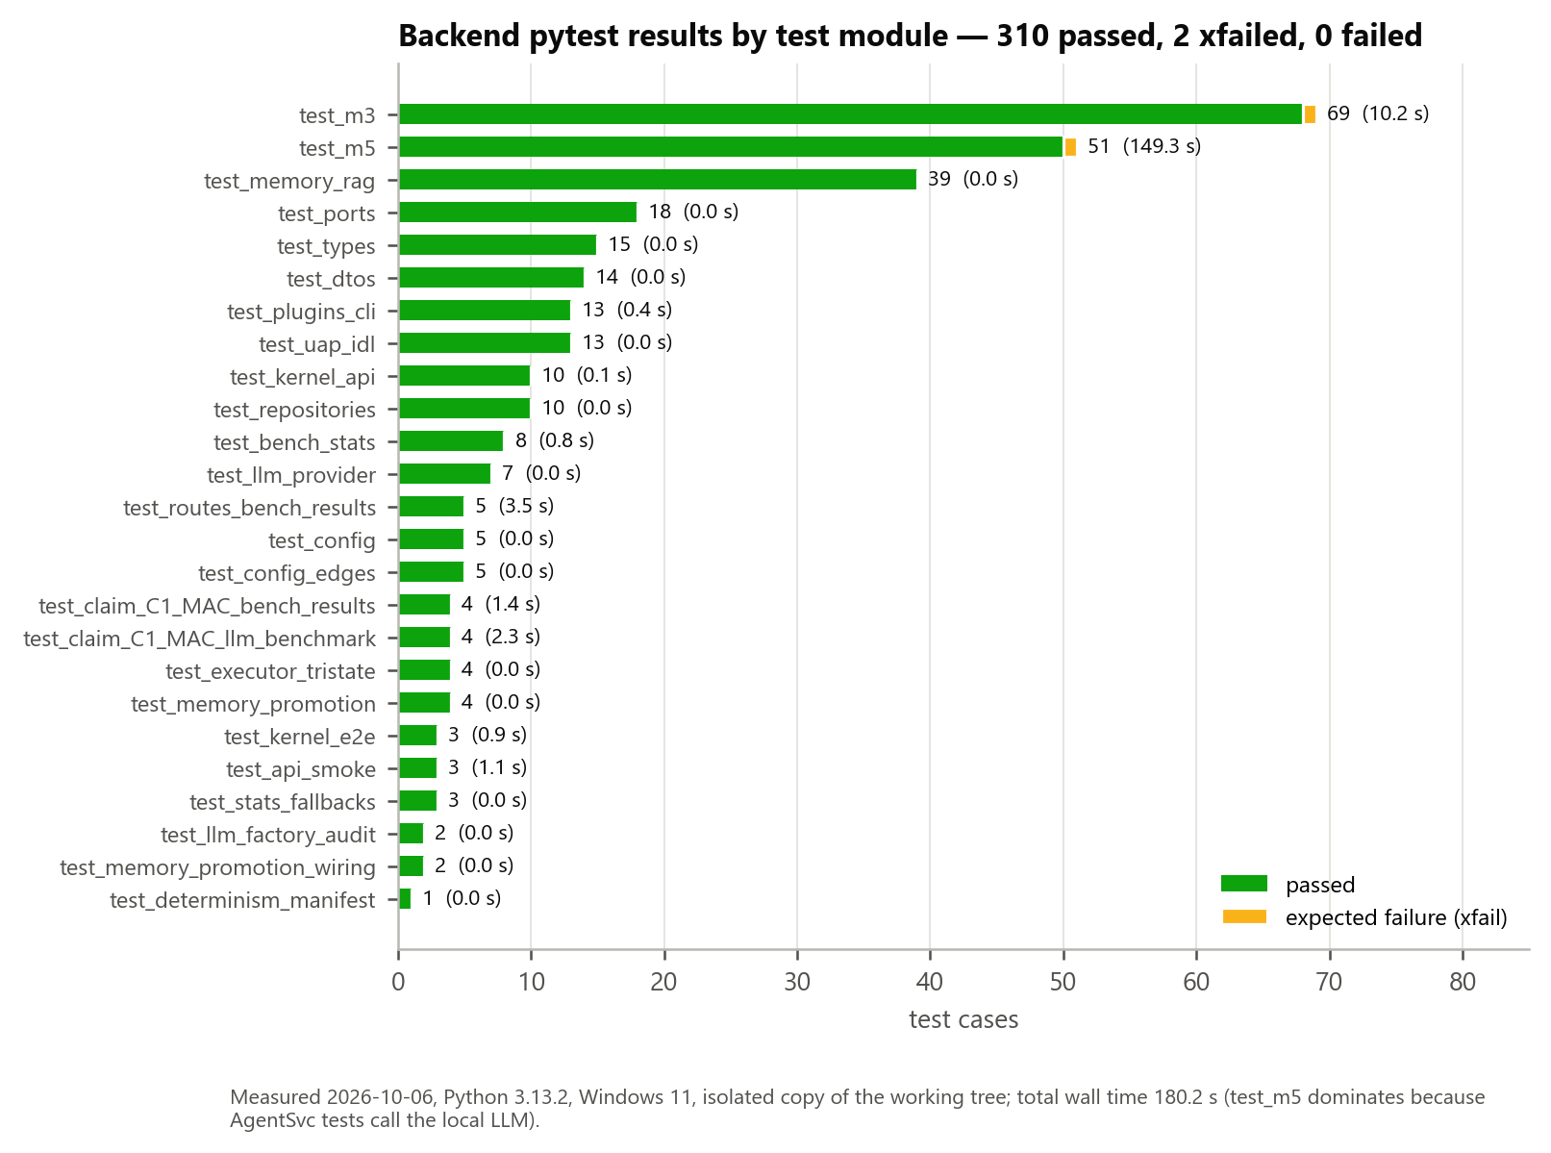
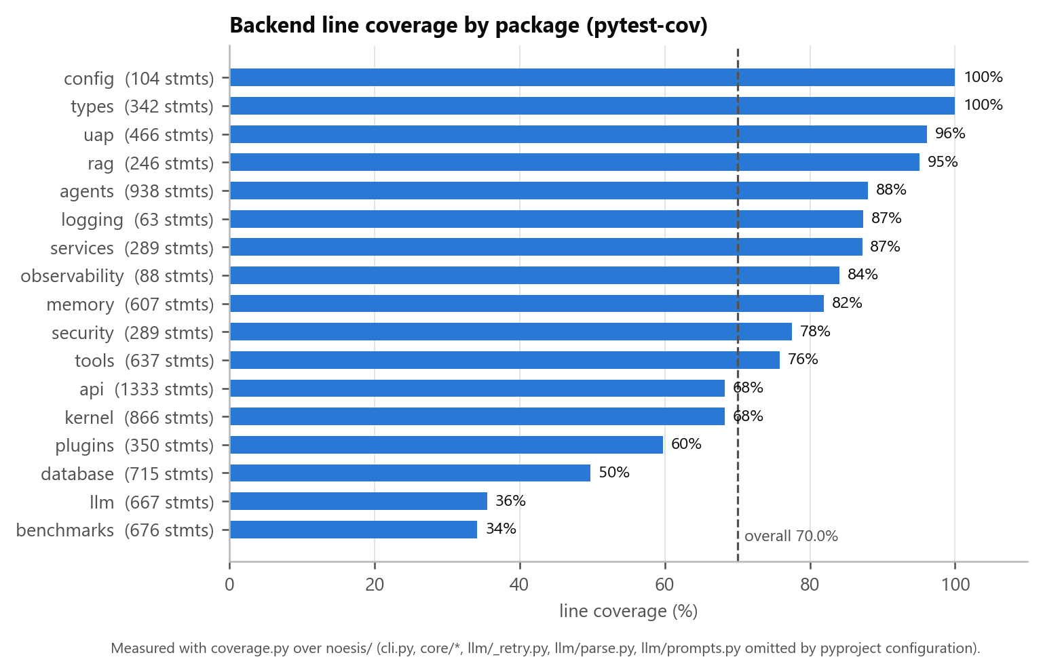
Results — Functional Testing
Results
Measured on an isolated copy of the working tree (Python 3.13.2, Node 20.18.1)
310/312
70.0 %
103/105
0 / 0
58
backend tests passed (2 xfail)
line coverage
frontend tests passed
tsc errors / ESLint issues
API scenarios exercised
NOESIS · Major Project End-Term Report · Dhruv Shah, Manan Nasa
18
Notes:
All backend tests pass; two xfails are deliberate; two frontend failures follow an uncommitted http.ts change.

Slide 19
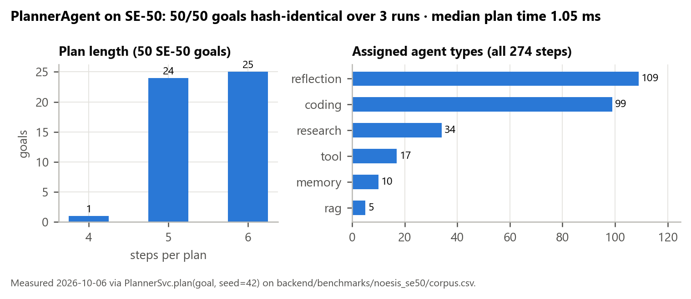
Results — Security & Determinism
Results
Scenario (measured) | Result
No capability token | 403 C1_DENY_MISSING_CAP
Forged HMAC secret | 403 C1_DENY_MAC
Expired token | 403 C1_DENY_EXPIRED
Capability not on token | 403 C1_DENY_MISSING_CAP
Deny mask llm.* | 403 C1_DENY_MASK
Kernel: 0 caps → TOOL_INVOKE | denied
Roster: 12 agents, empty caps | 12/12 denied
Sandbox: import os / open() | blocked
Files: ../../etc/passwd | refused (exit 13)
6th login in 60 s | 429
GET /v1/conversations, no token | 200 ⚠ open
Determinism (measured)
50/50 SE-50 goals → one SHA-256 over 3 runs
Median plan time 1.05 ms
5 seeds → 5 distinct plans
Promotion chain tail identical in 5/5 repeats
NOESIS · Major Project End-Term Report · Dhruv Shah, Manan Nasa
19
Notes:
Every deny scenario rejected with a specific code; planner is bit-identical; negative finding: resource routes are open.

Slide 20
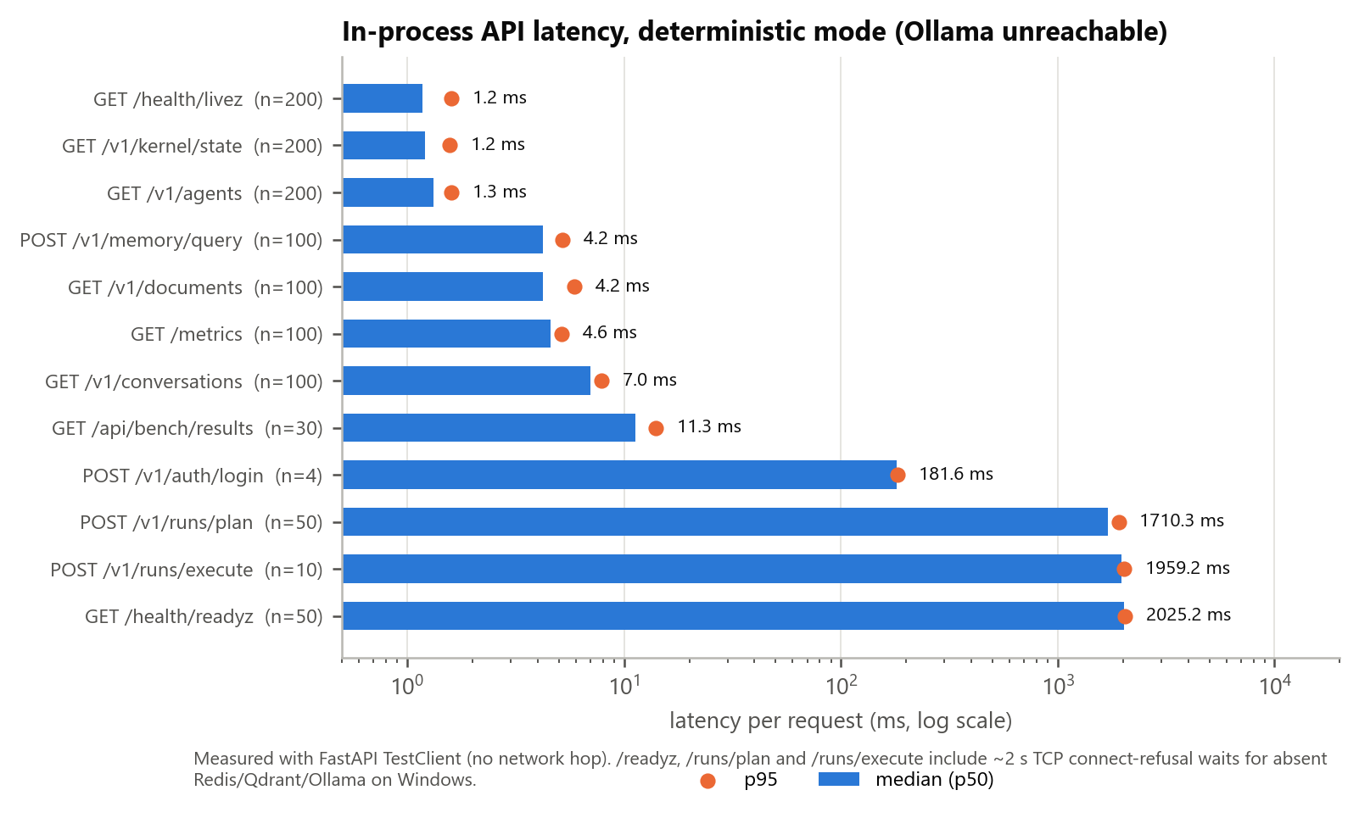
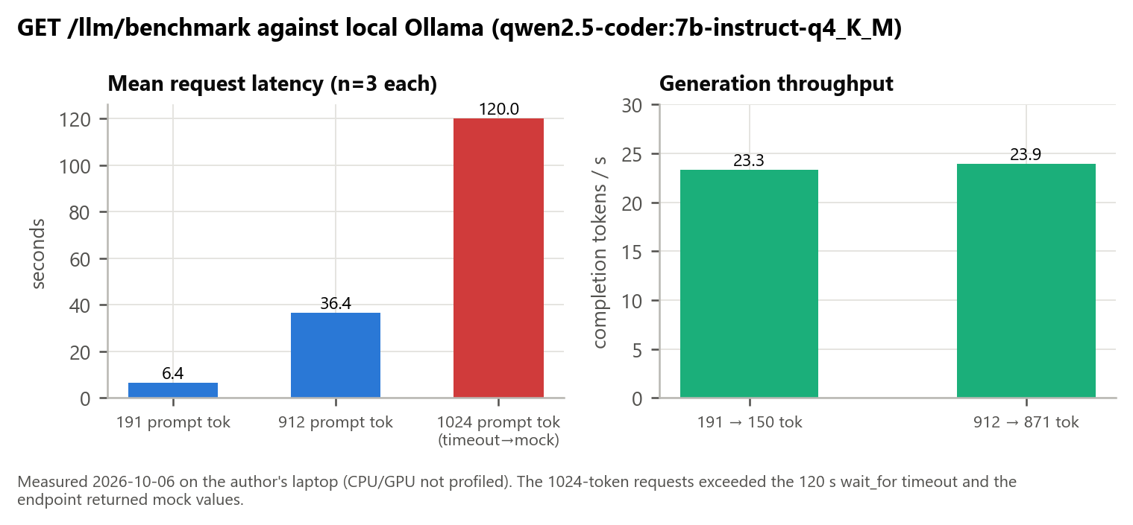
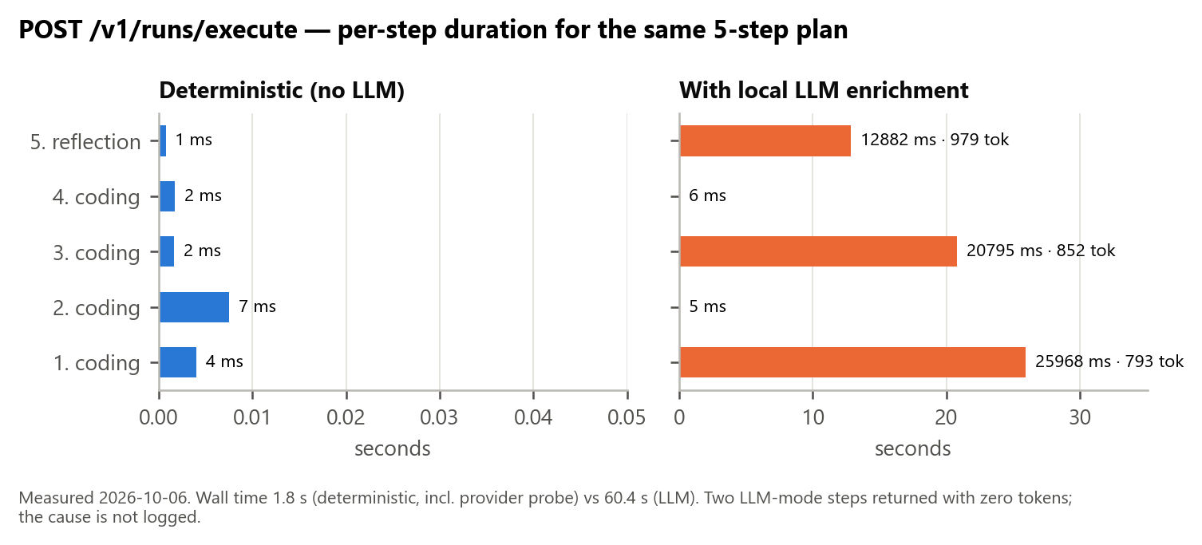
Results — Performance
Results
Read endpoints 1–11 ms (p50) · login ≈ 180 ms (password hashing) · 5-step run 1.96 s deterministic vs 60.4 s with qwen2.5-coder 7B · local LLM ≈ 23 tok/s
NOESIS · Major Project End-Term Report · Dhruv Shah, Manan Nasa
20
Notes:
In-process latencies; plan/execute dominated by per-request Ollama probe; local 7B ≈ 23 tok/s; 1024-token prompts hit the 120 s timeout.

Slide 21
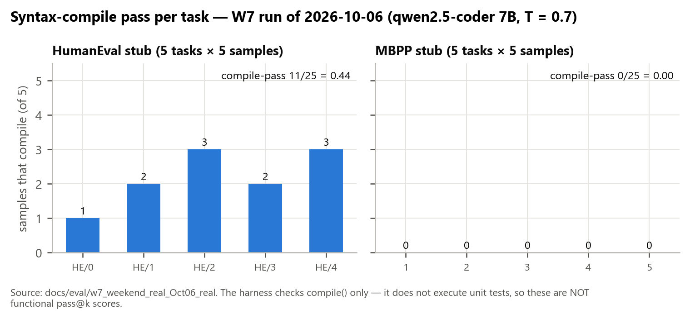
Results — Benchmark Harness
Results
W7 run of 6 Oct 2026 — reported artefacts, re-analysed: what the numbers do and do not mean
Benchmark | Result | Meaning
SE-50 (5 tasks × 3) | 15/15 SIGNOFF | Pipeline integrity; criteria synthesised as met
HumanEval stub (5 × 5) | 11/25 compile (0.44) | Syntax only — no tests executed
MBPP stub (5 × 5) | 0/25 compile | Samples did not compile
GPT-4o / Claude / Gemini | no artefacts | README figures not reproducible
Honest takeaway
The harness, statistics (pass@k, bootstrap, Wilson, McNemar) and corpus exist and run end-to-end with a local model; meaningful task-quality claims require functional test execution and full corpora — future work.
NOESIS · Major Project End-Term Report · Dhruv Shah, Manan Nasa
21
Notes:
Be explicit: compile-only checks and synthesised sign-off; README hosted-model numbers have no artefacts.

Slide 22
Testing — Strategy & Traceability
Results
Level | Tooling | Result
Unit | pytest, pytest-asyncio | 310 pass · 2 xfail
Integration (lifespan) | TestClient | 3/3
Security claim suites | pytest markers C1/MAC | 8/8
Frontend | Vitest + Testing Library | 103/105
Static | tsc · ESLint | 0 · 0/0
System / audit | 58 HTTP scenarios + screenshots | documented
Accessibility | axe-core script | not run
Requirements traceability (65 FRs)
43 — Implemented
7 — Partially implemented
7 — Implemented as library (not wired to API)
6 — Stub / simulated
2 — Planned (not implemented)
Each FR → module → test case → status (SRS §17.2)
14 acceptance test cases executed; 3 fail by design of current code
NOESIS · Major Project End-Term Report · Dhruv Shah, Manan Nasa
22
Notes:
Unit → API → claim suites → frontend → static gates → audit scenarios; every FR traces to code and tests in the SRS RTM.

Slide 23
Challenges
Conclusion
Contract drift
Run identity
Determinism leaks
Backend envelopes vs frontend array checks silently turned live pages into mock pages.
run_id stored only in JSON metadata; executions-by-run endpoint returns empty.
Python hash() randomisation and wall-clock time had to be removed from plan identity.
Slow local inference
Windows TCP refusal
Evidence vs claims
≈ 23 tok/s; 1 024-token prompts exceed the 120 s timeout.
~2 s per probe to absent services dominated plan/execute latency.
README numbers (tests, routes, benchmarks) had to be reconciled with the code.
NOESIS · Major Project End-Term Report · Dhruv Shah, Manan Nasa
23
Notes:
Technical surprises found while building and auditing.

Slide 24
Limitations
Conclusion
L1
Agents are rule-based; the LLM only adds rationale
L2
Resource routes have no authentication/authorisation
L3
Document upload & RAG agent simulated (BM25 library not wired)
L4
Memory promotion not driven by live runs; persistence not wired
L5
Six dashboard pages show placeholder data
L6
Benchmarks: compile-only and synthesised sign-off
L7
Single-process state; containers & CI not verified here
L8
Two frontend tests fail on the working tree
NOESIS · Major Project End-Term Report · Dhruv Shah, Manan Nasa
24
Notes:
Examiners value honesty: list what is not done.

Slide 25
Future Scope
Conclusion
Secure the API
Smarter agents
Real retrieval & memory
require_auth + ownership on all /v1 routes; reject default HMAC secret; SSRF filter; process sandbox
LLM-backed agents emitting the same typed reports (structured output) with deterministic fallback
Wire BM25/RRF + embeddings/Qdrant into upload and RAGAgent; drive promotion from recall; persist tiers
Live dashboard
Rigorous evaluation
Scale & edge
Unwrap envelopes; stream step progress (SSE); run_id column
Functional pass@k on full HumanEval/MBPP; SWE-bench Lite; paired McNemar comparisons
Externalise state; verified containers; characterise Jetson-class hardware
NOESIS · Major Project End-Term Report · Dhruv Shah, Manan Nasa
25
Notes:
All items proposed; each builds on existing code.

Slide 26
Conclusion
Conclusion
Justification of objectives
Objective | Status | Evidence
O1 Agent microkernel | Achieved | Kernel tests, 9 scenarios, 12-agent roster
O2 Deterministic planning | Achieved | 50/50 goals, ~1 ms/plan
O3 Least privilege | Partial | Agents/tools/gate enforced; resource routes open
O4 Tiered memory + provenance | Component | Controlled scenario, 5/5 identical chains
O5 Optional LLM | Achieved | Fallback; 23–24 tok/s measured
O6 API + dashboard | Partial | 42 ops, live conversations, 6 placeholder pages
O7 Evaluation harness | Partial | Runs end-to-end; compile-only
NOESIS is a reproducible, auditable, permission-checked kernel substrate for agent workflows. Its agent intelligence — not its kernel — is the main subject of future work.
NOESIS · Major Project End-Term Report · Dhruv Shah, Manan Nasa
26
Notes:
Summarise contributions and objective status; close with the positioning statement.

Slide 27
References
References
Selected; full list (47 entries) in the SRS and report
[9] S. Yao, J. Zhao, D. Yu, N. Du, I. Shafran, K. Narasimhan, and Y. Cao, "ReAct: Synergizing reasoning and acting in language models," in Proc. Int. Conf. Learning Representations (ICLR), 2023, arXiv:2210.03629.
[13] Q. Wu et al., "AutoGen: Enabling next-gen LLM applications via multi-agent conversation," arXiv:2308.08155, 2023.
[14] S. Hong et al., "MetaGPT: Meta programming for a multi-agent collaborative framework," in Proc. Int. Conf. Learning Representations (ICLR), 2024, arXiv:2308.00352.
[7] C. Packer, S. Wooders, K. Lin, V. Fang, S. G. Patil, I. Stoica, and J. E. Gonzalez, "MemGPT: Towards LLMs as operating systems," arXiv:2310.08560, 2023.
[8] K. Mei, Z. Li, S. Xu, R. Ye, Y. Ge, and Y. Zhang, "AIOS: LLM agent operating system," arXiv:2403.16971, 2024.
[2] J. B. Dennis and E. C. Van Horn, "Programming semantics for multiprogrammed computations," Communications of the ACM, vol. 9, no. 3, pp. 143–155, 1966, doi: 10.1145/365230.365252.
[3] J. H. Saltzer and M. D. Schroeder, "The protection of information in computer systems," Proceedings of the IEEE, vol. 63, no. 9, pp. 1278–1308, 1975, doi: 10.1109/PROC.1975.9939.
[4] M. S. Miller, K.-P. Yee, and J. Shapiro, "Capability myths demolished," Systems Research Laboratory, Johns Hopkins University, Tech. Rep. SRL2003-02, 2003.
[1] R. C. Atkinson and R. M. Shiffrin, "Human memory: A proposed system and its control processes," in The Psychology of Learning and Motivation, vol. 2, K. W. Spence and J. T. Spence, Eds. New York: Academic Press, 1968, pp. 89–195, doi: 10.1016/S0079-7421(08)60422-3.
[20] S. Robertson and H. Zaragoza, "The probabilistic relevance framework: BM25 and beyond," Foundations and Trends in Information Retrieval, vol. 3, no. 4, pp. 333–389, 2009, doi: 10.1561/1500000019.
[21] G. V. Cormack, C. L. A. Clarke, and S. Büttcher, "Reciprocal rank fusion outperforms Condorcet and individual rank learning methods," in Proc. 32nd Int. ACM SIGIR Conf., 2009, pp. 758–759, doi: 10.1145/1571941.1572114.
[23] M. Chen et al., "Evaluating large language models trained on code," arXiv:2107.03374, 2021.
[24] J. Austin et al., "Program synthesis with large language models," arXiv:2108.07732, 2021.
[26] B. Hui et al., "Qwen2.5-Coder technical report," arXiv:2409.12186, 2024.
[27] K. Greshake, S. Abdelnabi, S. Mishra, C. Endres, T. Holz, and M. Fritz, "Not what you've signed up for: Compromising real-world LLM-integrated applications with indirect prompt injection," in Proc. 16th ACM Workshop on Artificial Intelligence and Security (AISec), 2023, arXiv:2302.12173.
NOESIS · Major Project End-Term Report · Dhruv Shah, Manan Nasa
27
Notes:
Point to the full reference list.

Slide 28
Thank You
Questions?
Documentation package: SRS v1.0 · Major Project Report · this deck · evidence (tests, measurements, screenshots)
Notes:
Invite questions. Have the SRS appendix F (claims vs implementation) and the evidence folder ready.

