Slide 1
Sharda Dry Herbs – Multi-Page Responsive Website
Sharda Dry Herbs:
Multi-Page Responsive Product Website
Prepared By: DHRUV SHARDA
Roll no. : 2415000544
#Mini Hack Project

Slide 2
Introduction
About Sharda Dry Herbs
Sharda Dry Herbs is a website designed to showcase premium-quality natural herbs and herbal products. It provides users with product information and an easy way to contact the company.
Project Objective
Design a responsive multi-page website.
Display herbal products professionally.
Improve user experience with a simple interface.
Practice HTML, CSS, and responsive web design.

Slide 3
Technologies Used
Technologies:
HTML5
Website Structure
CSS3
Styling and Layout
Flexbox
Responsive Navigation & Sections
Responsive Design
Mobile-Friendly Layout
Git & GitHub
Version Control and Project Management

Slide 4
Website Structure
Pages Created
🏠 Home (index.html)
Hero Section
About Preview
Featured Products
🌿 About (about.html)
Company Introduction
Mission
Why Choose Us
📦 Products (Product.html)
Product Cards
Product Descriptions
Pricing Information
📞 Contact (Contact.html)
Contact Form
Email & Phone Details

Slide 5
Website Features
Main Features:
Sticky Navigation Bar
Company Logo
Hero Section
About Us Section
Product Cards
Responsive Layout
Contact Form
Footer
Simple & User-Friendly Interface

Slide 6
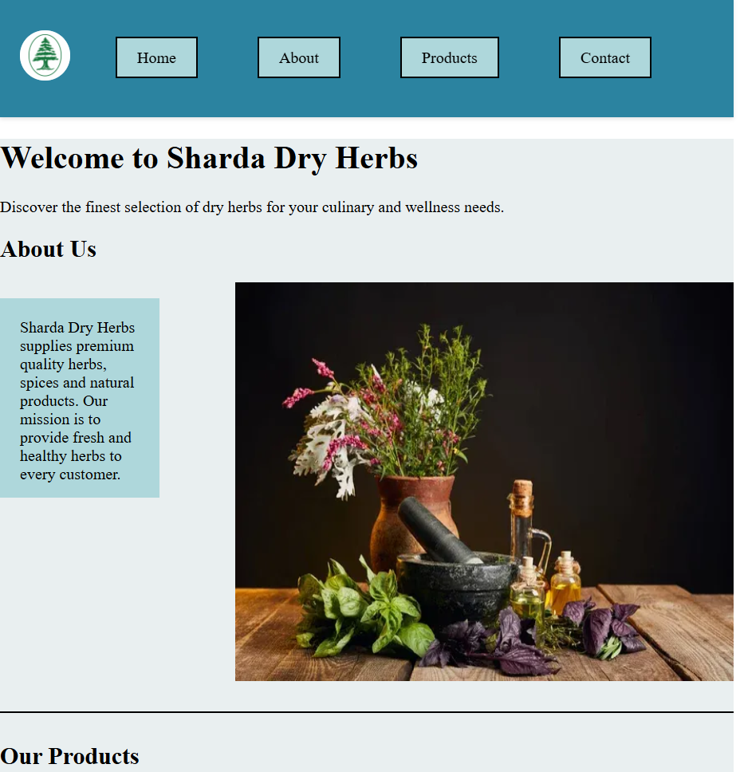
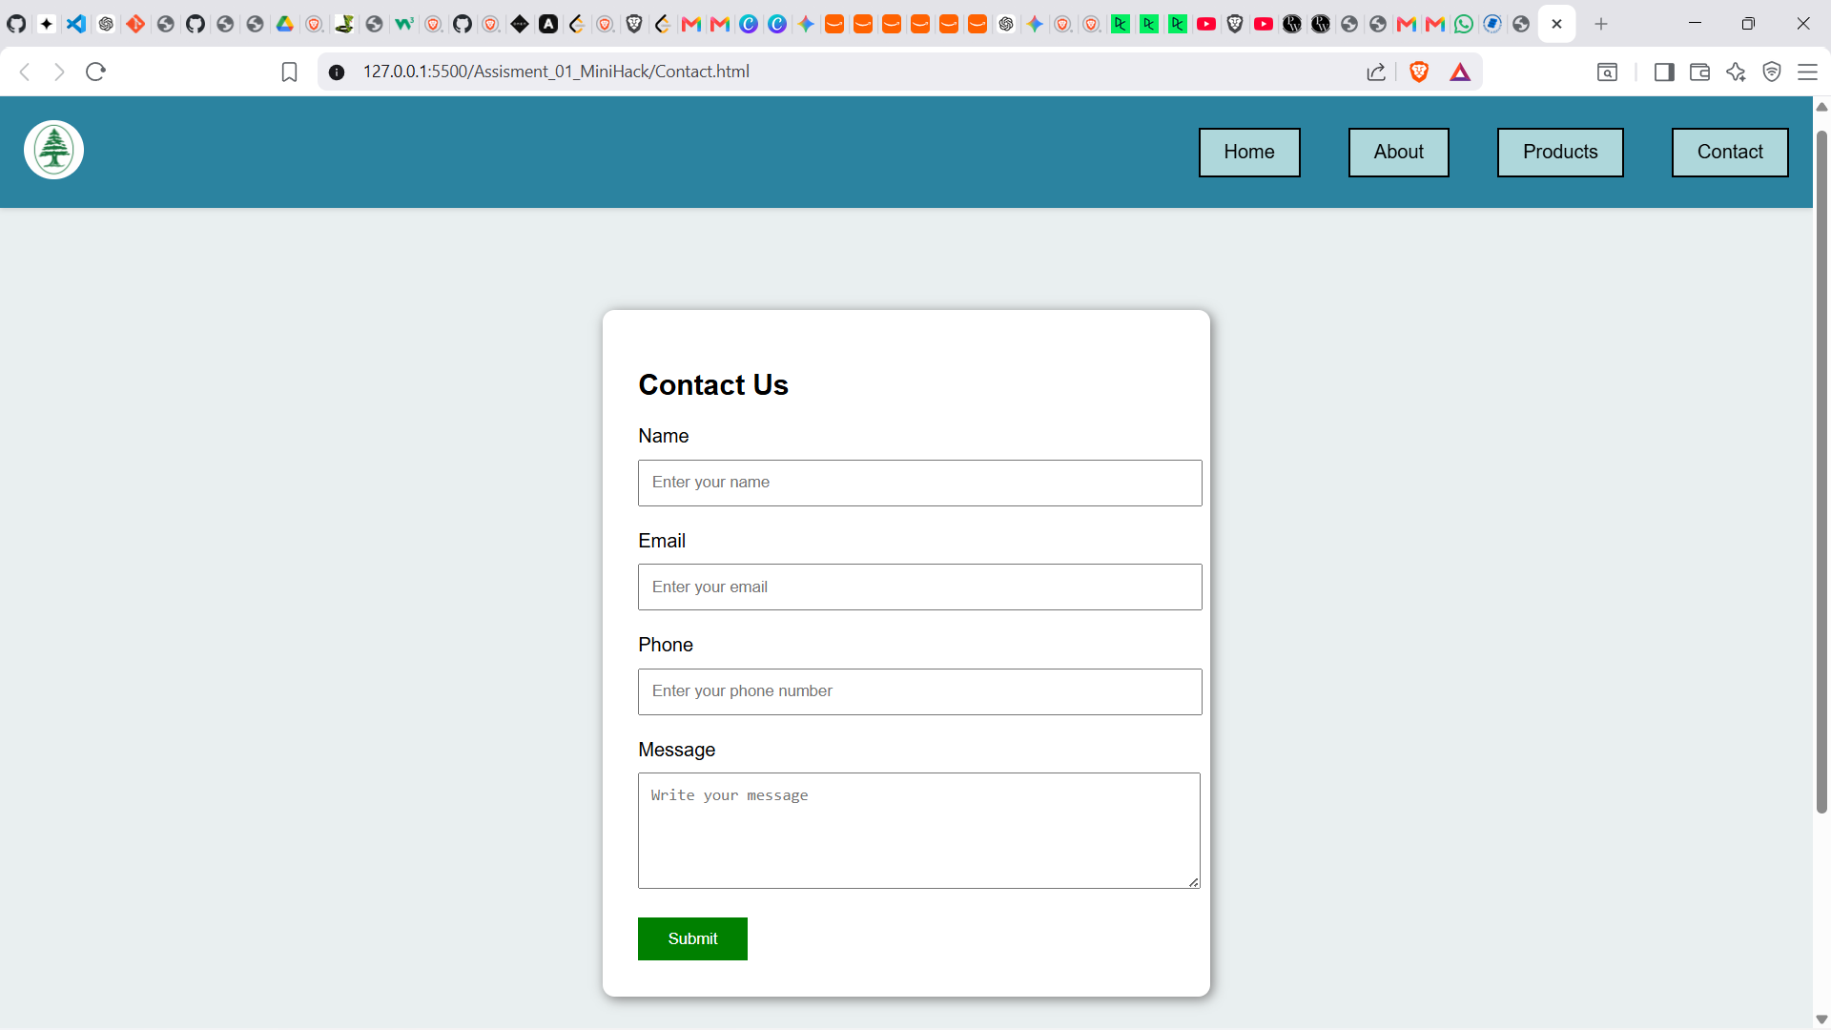
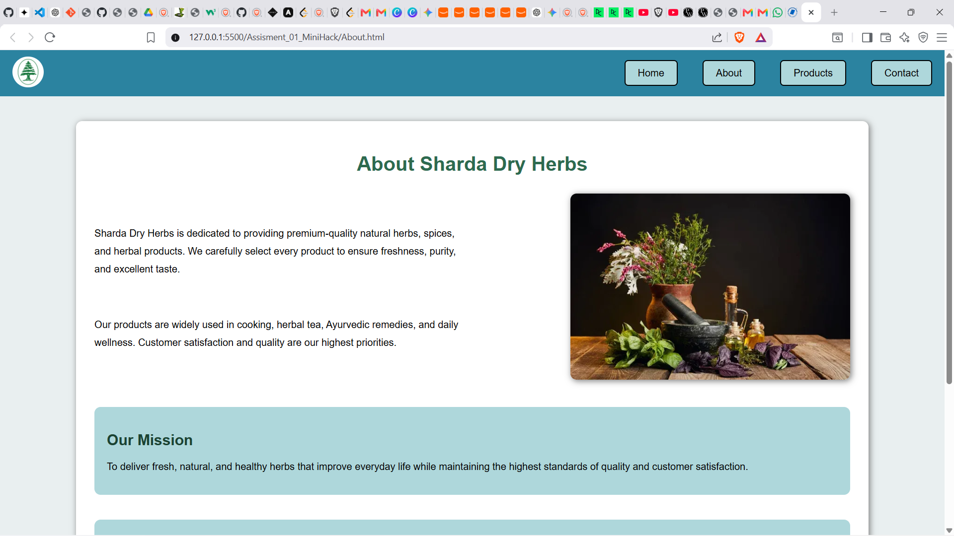
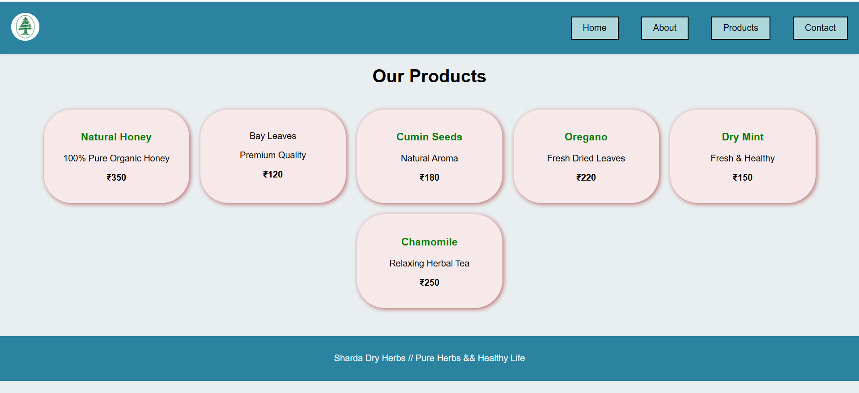
Website Screenshots
Home Page
Contact Page
About page
Products Page

Slide 7
Challenges & Learning
Challenges Faced
Designing a responsive layout
Aligning images and text
Creating navigation between pages
Organizing CSS effectively
Learning Outcomes
HTML page structure
CSS styling techniques
Flexbox layout
Multi-page website creation
Responsive design basics
Better understanding of project organization

Slide 8
Conclusion
Conclusion
The project successfully demonstrates a responsive multi-page herbal products website using HTML and CSS.
Future Improvements
Add JavaScript functionality
Product Search
Shopping Cart
Online Ordering
Customer Login
Database Integration
Payment Gateway
Thank You!!

