Slide 1



Name of Project
Visualizing Carbon Footprints Across Sectors Using Power BI
-By Dhruv Singh

Slide 2

Learning Objectives
Understand the concept and impact of carbon footprints across various sectors.
Learn how to prepare, clean, and transform environmental data for analysis.
Develop interactive and insightful dashboards using Power BI.
Visualize trends and patterns in carbon emissions over time.
Derive key insights to support data-driven decision-making on sustainability.
GOAL
Source :
www.freepik.com/

Slide 3
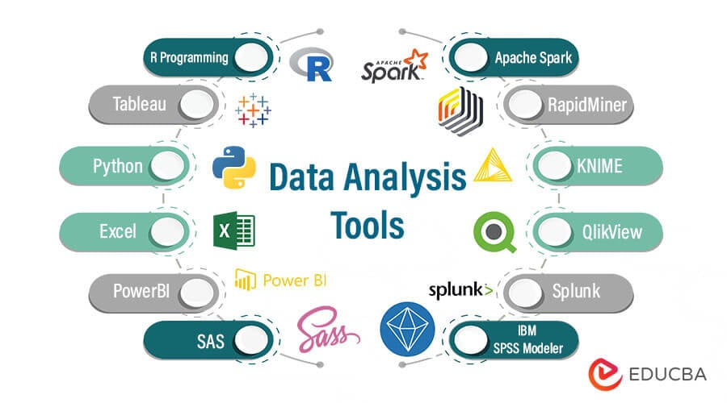
Tools and Technology used
Power BI For data visualization and interactive dashboard creation.
DAX (Data Analysis Expressions) To create custom table, calculated columns, and measures in Power BI.
Power Query Editor For advanced data shaping and modeling within Power BI.
Data Source: CSV File / Dataset Containing carbon footprint data across multiple sectors, years and country.
Collaboration Tools:
-Microsoft Teams or SharePoint for team collaboration and sharing insights.
-Power BI Service for publishing and sharing reports with stakeholders

Slide 4
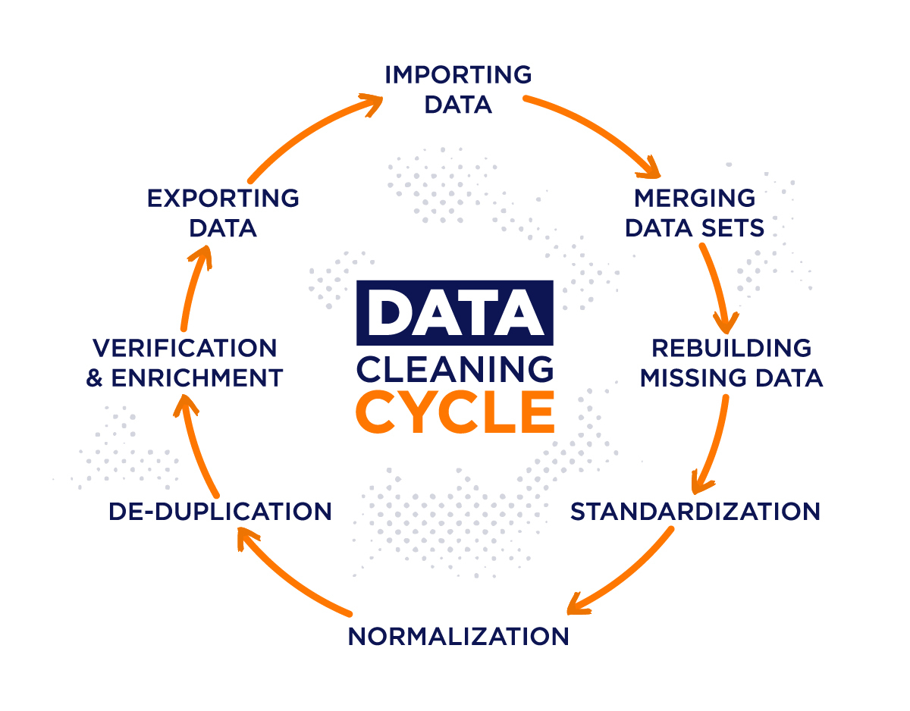
Methodology
Data Collection 📥
-Sourced carbon footprint dataset with sector-wise and year-wise data.
Data Cleaning & Transformation 🧹
-Handled missing values, standardized formats, and structured the data using Power Query.
Data Modeling 📐
-Created relationships, hierarchies, and calculated columns/measures using DAX in Power BI.
Visualization 📈
-Designed interactive visuals such as:
Bar & Line Charts
Donut Charts
Tree Maps
Slicers for filters
KPI Cards / Key Metrics Panel
Gauge
Insights Generation 💡
-Analyzed trends, sector comparisons, and year-wise variations to derive actionable insights.

Slide 5

Problem Statement:
The available dataset on sector-wise carbon footprints lacked proper structure and clarity, making it challenging to perform meaningful analysis.
In the absence of a comprehensive visualization, it was difficult to identify key contributors to carbon emissions and observe trends over time.
So how to solve this ?

Slide 6
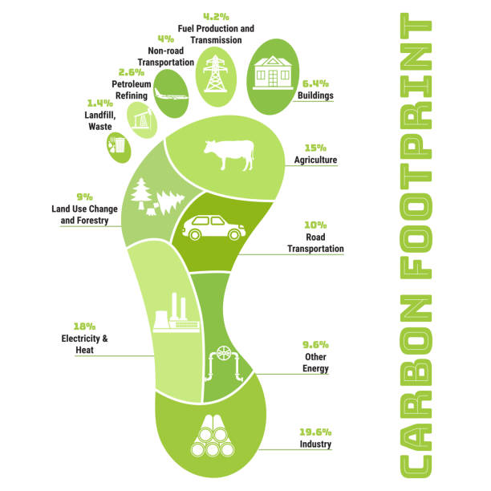
Solution:
To address the problem, the dataset was first cleaned and transformed using Power Query Editor.
- Handle all the missing values, and transform the date structure into date format.
Data modeling was performed in Power BI using DAX to create relationships and calculations.
-using the DAX, we have made the particular separate filtered table and new measures to find the single value like
(Sum, Average, Min, Max, Rank).
An interactive dashboard was developed to visualize sector-wise emissions, yearly trends, and key metrics.
- To visualize the data, we used slicers, Bar charts, Line charts, Donut charts, Gauge, KPI card, Multi Row Card, Table, Matrix.
This enabled easy interpretation and actionable insights for better understanding of carbon footprints across various sectors.
- This made us to get outcome by providing summary of the whole data, and

Slide 7
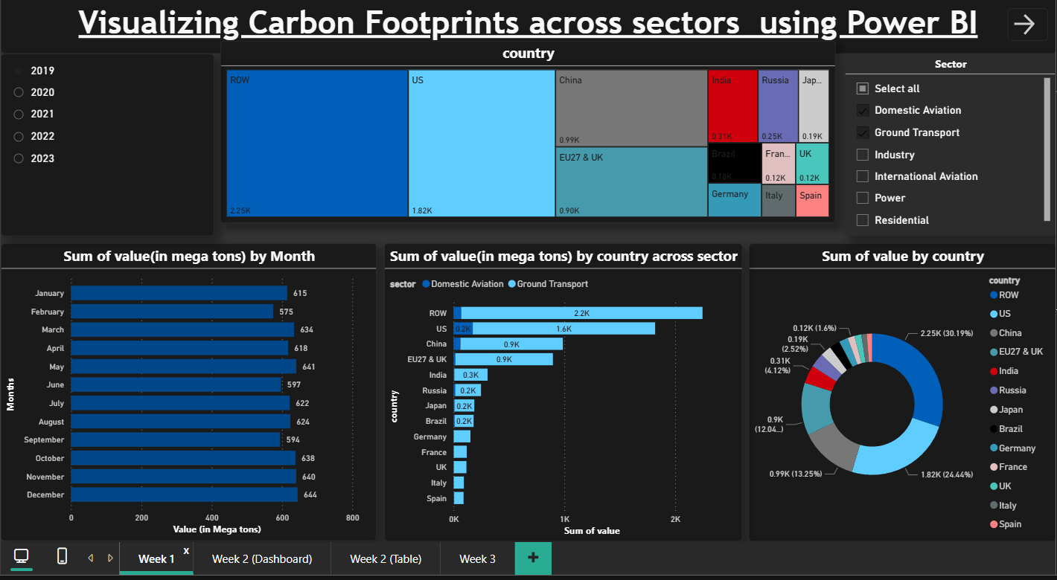
Screenshot of Output:
Week 1 (Dashboard)

Slide 8
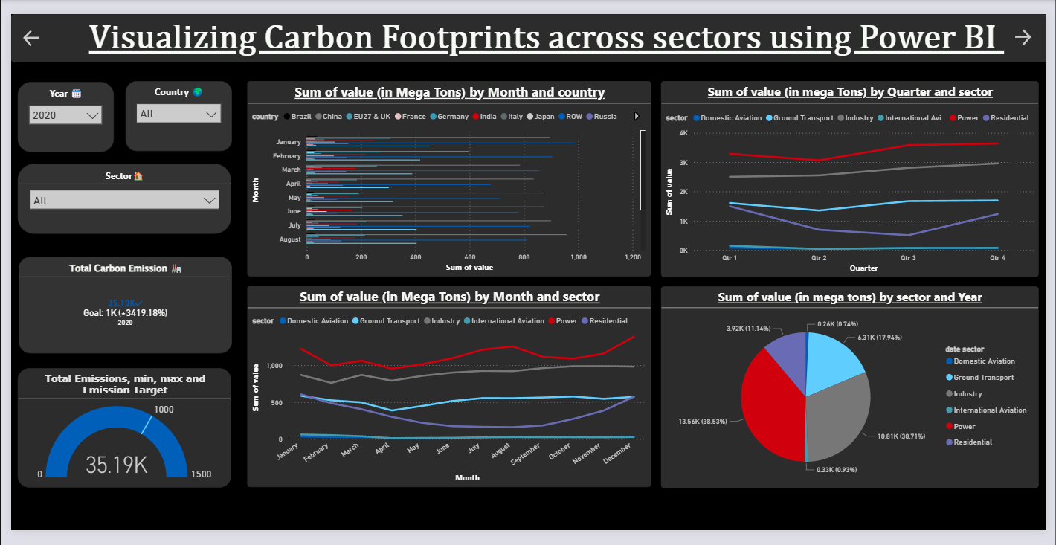
Screenshot of Output:
Week 2 (Dashboard)
Visualizing Total Carbon emission, Sum of carbon emission by month & country, Quarter & sector, month & sector, sector & year

Slide 9
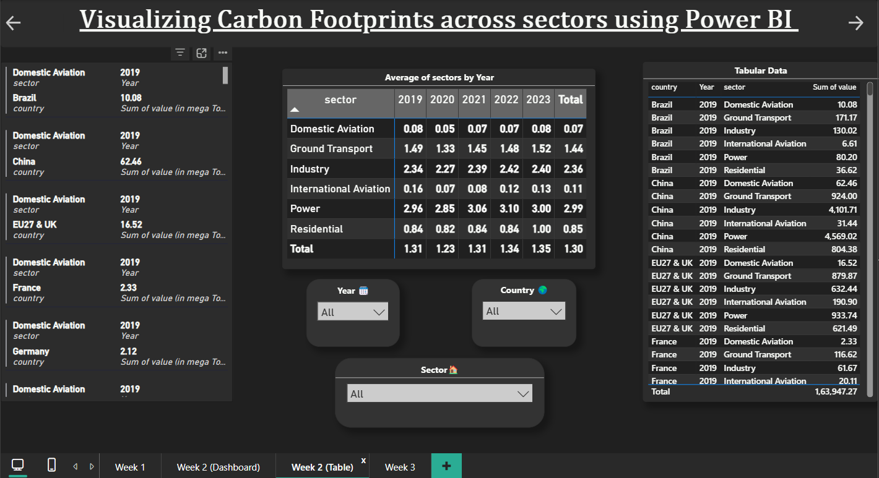
Screenshot of Output:
Week 2 (Table)

Slide 10
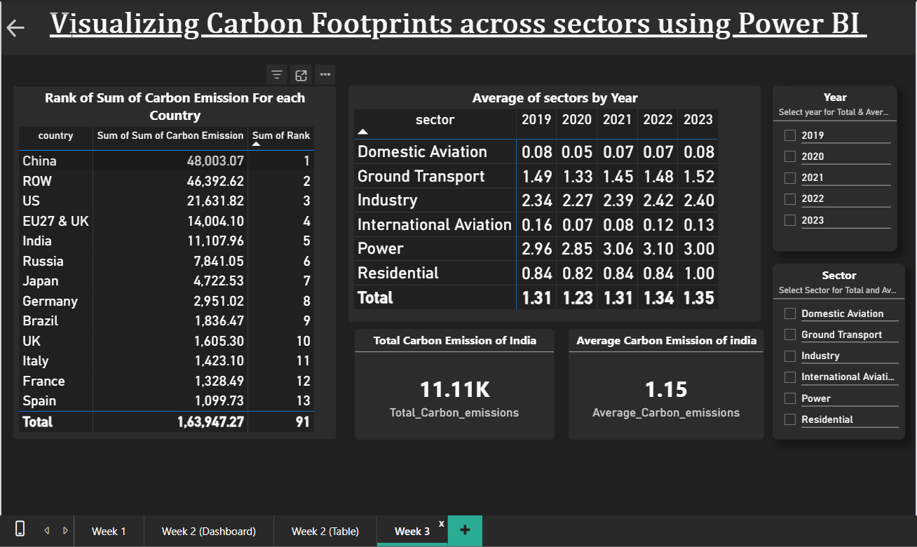
Screenshot of Output:
Week 3 (DAX)

Slide 11
Conclusion:
Through this project, I gained valuable hands-on experience in analyzing real-world environmental data using Power BI. The process involved cleaning and transforming unstructured data, modeling it efficiently, and creating an interactive dashboard to visualize sector-wise carbon emissions.
This helped in identifying major contributors to carbon footprints and understanding year-wise emission trends in a meaningful way. The visualizations not only made the data more accessible but also supported data-driven thinking for sustainability.
Overall, the project significantly enhanced my technical skills in Power BI, and data handling, while also improving my ability to derive insights from complex datasets and help to enhanced my Data Analytics skills.

Slide 12
Github Repository Link :-
https://github.com/dhruvsingh218?tab=repositories

