Slide 1
Data analytics – project 2
Members:
Yash Rathod
Dhruv Sojitra
Guided by: Prof. Ameera Al-Karkhi
Date: 01 Dec 2022

Slide 2
Introduction
Today's world is emerging with the advancements in Internet Technologies, which has empowered the human race with information at their fingertips. This may have caused an effect in operations of Libraries in Ontario and around the world. This analysis is intended to study the library data from Ontario's public libraries: (https://data.ontario.ca/dataset/ontario-public-library-statistics) and observe the effects/trends in Library Operations and suggest ideas for the libraries of Ontario to SUCCEED.

Slide 3
PRIMARY GOALS
The objectives of this project is to propose such solutions that the libraries of Ontario attain SUCCESS. By SUCCESS we mean the following terms:
1. Increase Revenue of the libraries
2. Increase Customer Base for the libraries, i.e., Increase outreach

Slide 4
Data Selection
Following are the data columns considered for the analysis
1. Library Name
2. Library Number
3. City
4. No of Cardholders
5. Year
6. Total Revenue
7. In-person Visits
8. Social Media Visits

Slide 5
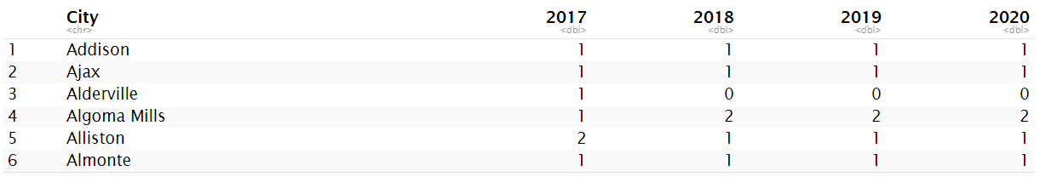
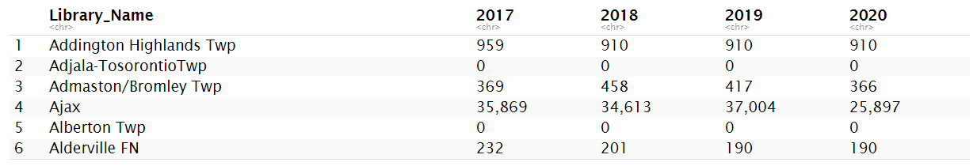
Number of Libraries in each City
Number of card holders per year for each library.

Slide 6
Research Question
Are the number of Social Media Visits and In Person Visits related ? If they are related do they influence Revenue?

Slide 7
Benefits of analysis
By doing this analysis we will be able to know if libraries work more on digital marketing and growing their presence on social media will influence their success or not.

Slide 8
Problems faced
The dataset for 2020 do not have the column Social Media Visits so we are excluding that dataset and focus on datasets of year 2017, 2018 and 2019.

Slide 9
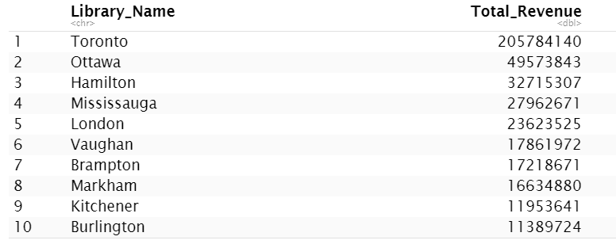
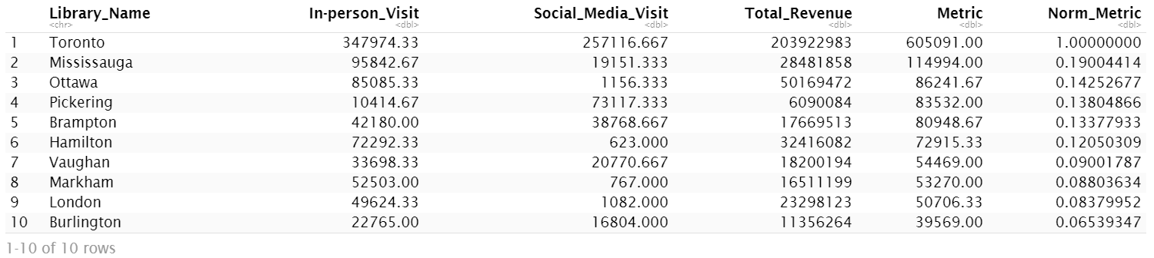
Insights
Top performing Libraries according to Revenue
Number of In Person Visits and Social Media Visits

Slide 10
Correlation : 0.8761
The Pearson Coefficient is 0.8761 between In Person Visits and Social Media Visits which indicates a fairly strong positive correlationship as the value is >0.5 and closer to 1.

Slide 11
Generated metric
Metric = Normalize( In-person Visits + Social Media Visits )
zi = (xi – min(x)) / (max(x) – min(x))
where:
zi: The ith normalized value in the dataset
xi: The ith value in the dataset
min(x): The minimum value in the dataset
max(x): The maximum value in the dataset

Slide 12
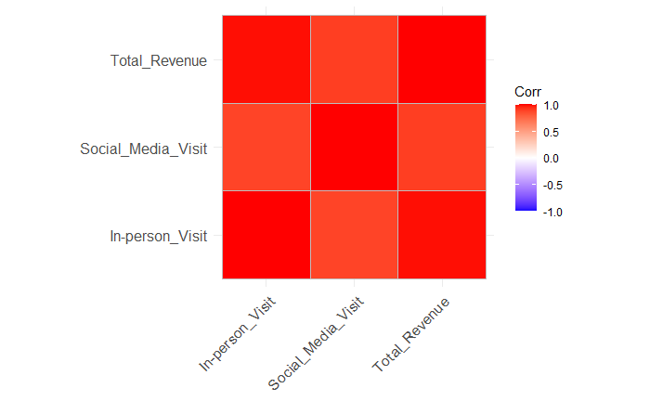
Correlation : 0.9826
The Pearson Coefficient is 0.9826 between Metric and Revenue which indicates a fairly strong positive correlationship as the value is >0.5 and closer to 1.

Slide 13
Suggestion
Libraries which have a good presence in social media, influences the in person visits and in turn generate more Revenue. Therefore, we can encourage other non performing libraries to get more social media presence to increase in person visits.

Slide 14
THANK YOU

