Slide 1
UV-Analysis

Slide 2
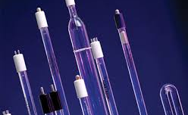
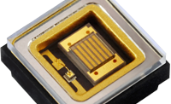
A Comparison (UV-LED & Cold Cathode UV-Hg Lamp)
UV-Led are a new invention to the market. They are a safer, more reliable, and advanced alternative over traditional UV-Lamps.
The factor restricting its wide spread use is high cost and low irradiance. This makes it unsuitable for sanitation over large distances.
A UV LED design with UV output comparable to Cold Cathode (CC) lamps would have cost $10,000.
Thus we have chosen CC Lamp whose life is not affected by frequent power cycles while having a respectable life and manageable costs.
UV LEDs and CCLs have comparable efficiency!

Slide 3


Model Used to Simulate
ϕ∗∂A4∗π∗r2
The lamp is assumed to be a combination of multiple point sources
Each point source irradiates light around sphere.
Thus, at an infinitesimally small area $∂A$, the radiant power received is $\frac{ϕ∗∂A}{4∗π∗r^{2}}$. Here r is the radius of the sphere.
We calculate the irradiance at the cylindrical surface by dividing this radian power received (point 2) with the area projected by $∂A$ on the cylindrical surface $∂S$.
Irradiance at a cylinder R meter away from the point source is therefore given by:
$$E=\frac{ϕ∗\cos^{2}{θ}}{4∗π∗R^{2}}$$

Slide 4
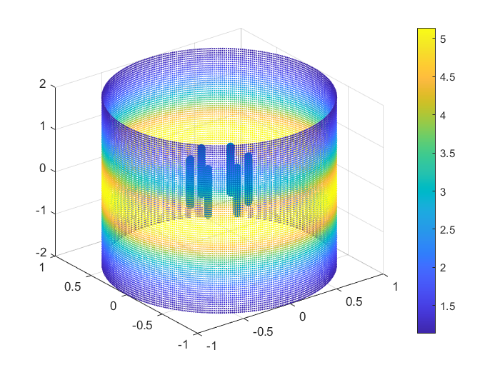
Simulation
A MATLAB program was coded to carry out this calculation and provide a visual output of the irradiation pattern.
After multiple iterations, a design with 6 lamps was chosen.
The adjoining figure shows the irradiation (colour) received at various locations on the cylindrical surface.
This program was built based on theoretical concepts of optics and provides a more realistic model to calculate irradiance values!

Slide 5
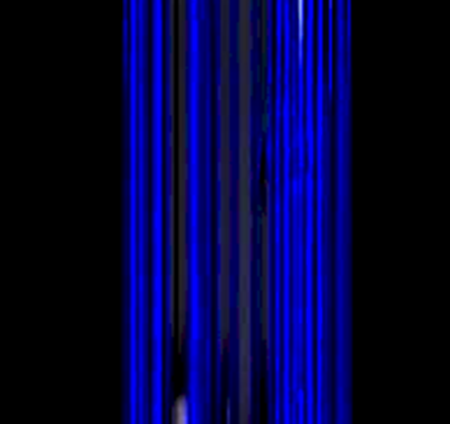

Design Specifications
STER-L-RAY’s CC48T5L UV lamp chosen
6 UV lamps of 11.2 Watt UV output arranged uniformly in a circle
UV dose of 85 $μ$Watt/cm² at 2 m away and 1.5m above
Disinfection Time (per 2m node): 294 seconds
360-degree coverage
UV wavelength 254 NM
UV lights mounted on the robot glows after ensuring there is no presence of human

Slide 6
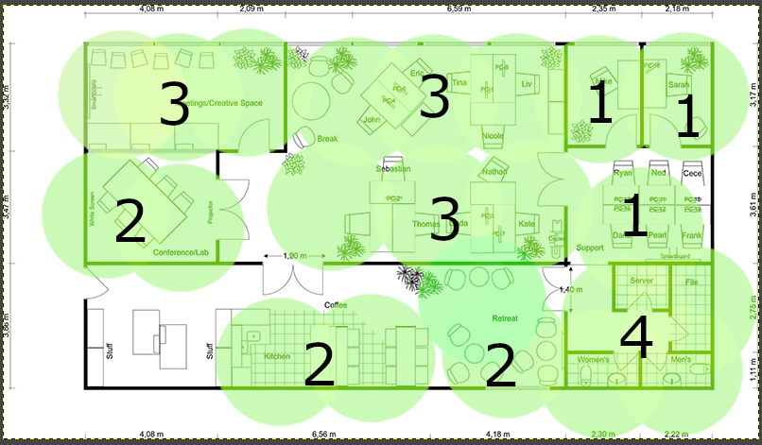
Waypoint depiction and power estimation
An approximate verification of our calculations was done.
•Total number of sanitation points needed 22

Slide 7
Irradiation time
Time taken to deliver a dose of 25 mJ was considered
Irradiation value calculated using MATLAB model
Irradiance value taken at a point 1.5 meters above the center point of UV lamp
Power (Watt) | Circle Rad (m) | Irradiance uWatt/cm2 | Time (Seconds) | Energy (Watt Hr)
255 | 1 | 169 | 147.93 | 10.48
 | 2 | 85 | 294.12 | 20.83
 | 3 | 48 | 520.83 | 36.89

Slide 8
Energy Requirement
Amount of energy required was calculated by appropriately locating nodes in floor plans
Various types of rooms with various dimensions were analyzed
The average energy required per square meter was calculated
# | Room Type | Dimensions (meter) | Area (sq mr) | # of 1m Circle | # of 2m Circle | Total Energy (Watt Hr) | TE per sqm
1 | Office | 4 by 4 | 16 | 4 | 1 | 62.75 | 3.92
2 | Office | 3 by 4 | 12 | 2 | 1 | 41.79 | 3.48
3 | Lab | 6.1 by 5.8 | 35.38 | 0 | 5 | 104.17 | 2.94
4 | Operating Room | 7.1 by 8.7 | 61.77 | 0 | 9 | 187.50 | 3.04
 | Floor plan of a building | 17 by 11 | 184 | 0 | 22 | 458.33 | 2.49
 |  |  |  |  | Average | 170.91 | 3.17

Slide 9
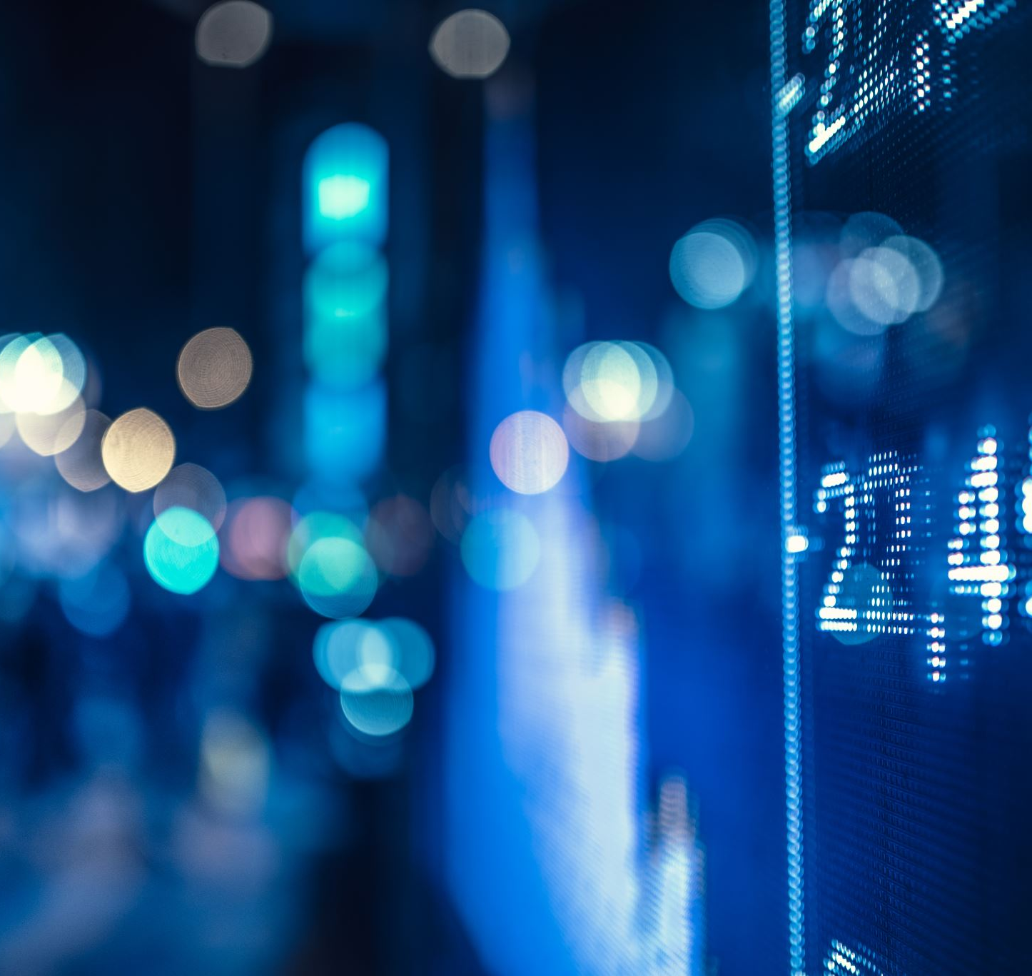
Battery Capacity
From the analysis, it was established that the robot will consume about 3 Watt hr of energy per sqm of area sanitised
Therefore it will take 600 Watt hr of energy (UV light only) to cover 10 rooms with a total area of 200 sqm. This shall allow the robot to irradiate UV lights for a total of 140 minutes
Based on these calculations a battery of ~ 1.3 KWatt hr capacity is suitable for the robot.
Additional energy budgeted for locomotion, computation and some headroom
We are in contact with vendors for suitable batteries that can be used by us in this project.

