Slide 1
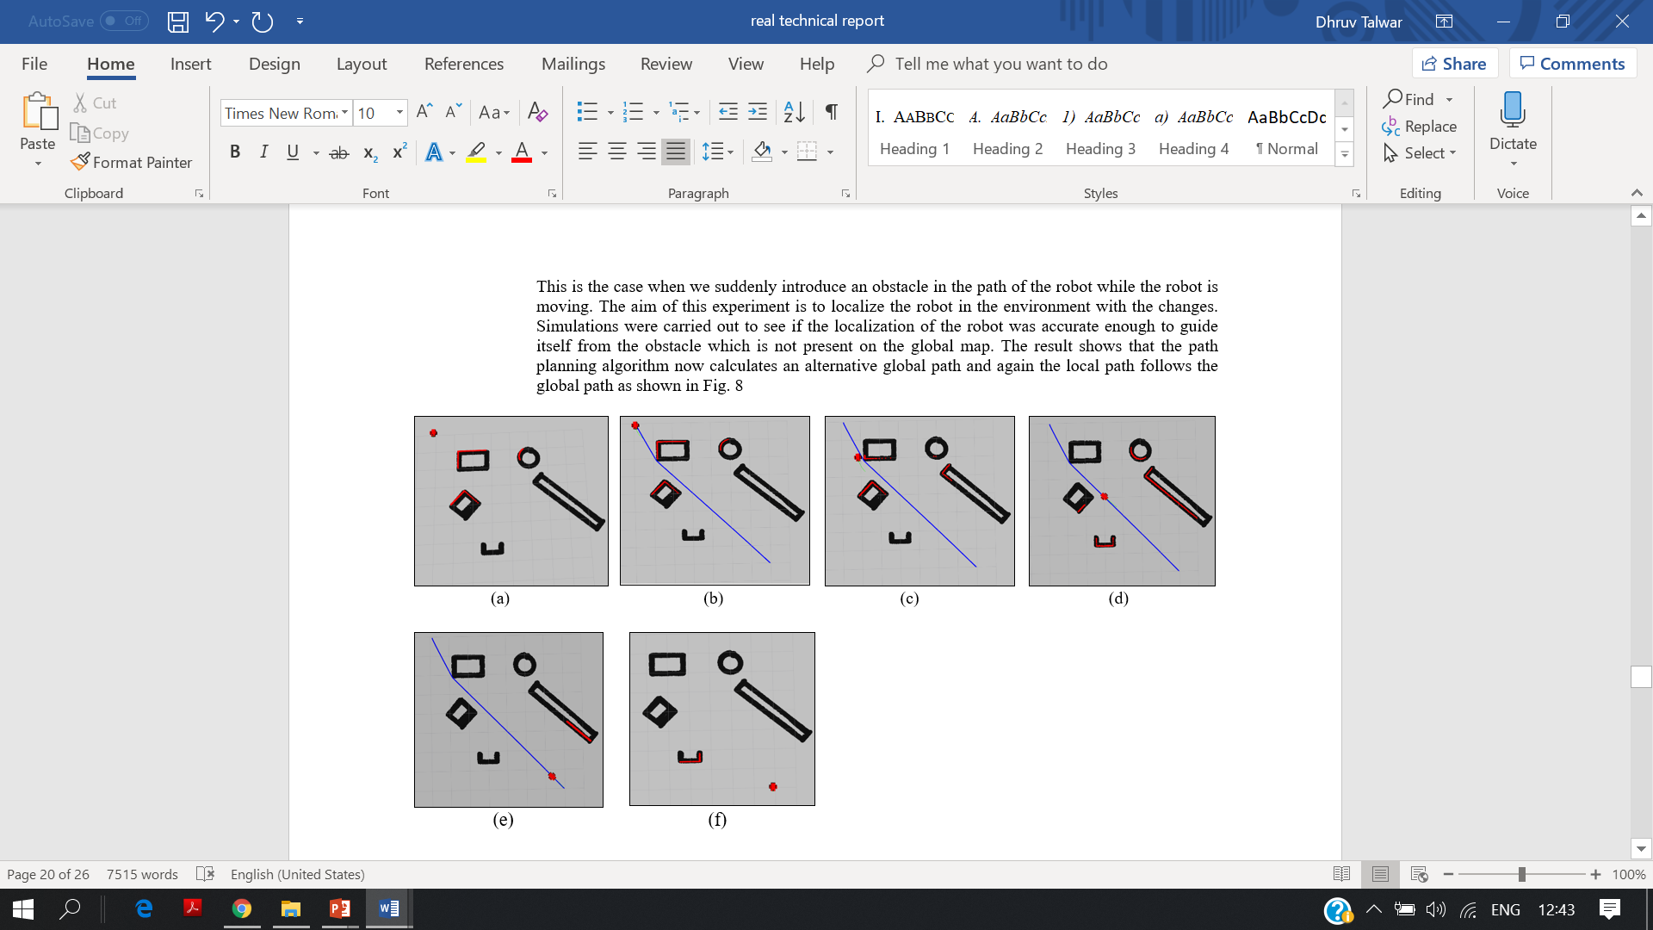
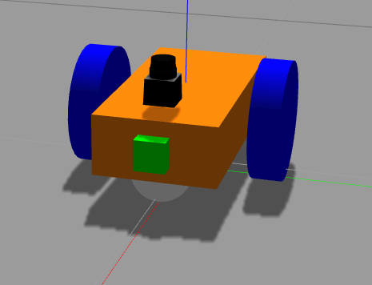
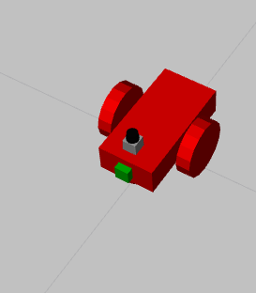
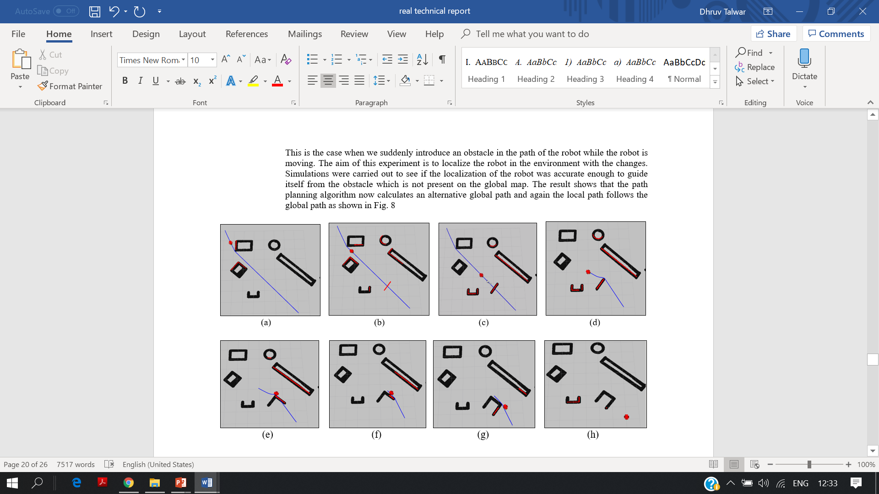
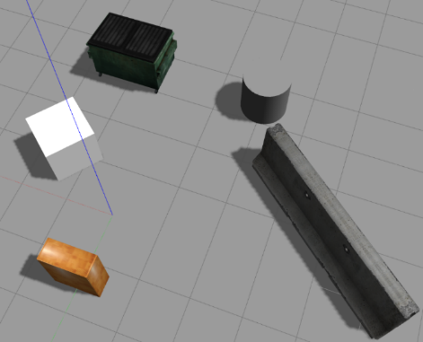
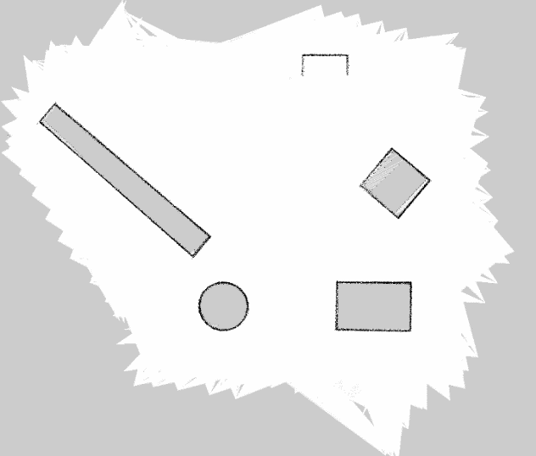
Particle Filter-based Localization of a Mobile Robot by Using a Single Lidar Sensor under SLAM in ROS Environment
Dhruv Talwar¹ and Seul Jung²
¹Department of Mechanical Engineering, IIT, Delhi, India
²Intelligent Systems and Emotional Engineering Lab,
Department of Mechatronics Engineering,
Chungnam National University, Daejeon, Korea
INTRODUCTION
PATH PLANNING – ROS NAVIGATION STACK
One of the most popular issues in autonomous mobile robots are mapping, localizing and autonomous navigation. For this a two wheel Adaptive Monte Carlo Localization (AMCL) as particle filters method is presented to show how effectively it localizes the mobile robot in an indoor environment. This poster presents our work of navigating a 2 wheel differential drive robot autonomously using just a single 2D lidar, in both a static as well as a dynamic environment. The simulation results demonstrated that the particles in the filter quickly converge on the pose and the robot was successfully able to follow the path to reach its goal position. In both the situations our robot was able to reach the final destination point without hitting or colliding with any obstacle.
The ROS navigation stack generates the global and local path for the robot to follow. The robot will be able to follow and reach the goal only if its localization in the map is accurate.
For the Global path, the ROS navigation package uses the Dijkstra's algorithm It is made according to the static map that we have. The global cost map does not get updated with the real time. It avoids the spaces that has an obstacle in the map.
The local planner breaks the long global path into smaller achievable targets or waypoints for the bot to follow. The Local cost map considers dynamic obstacles while generating a small local path. The Local Cost map is directly updated by the sensor which is feeding in the data. The Local path planner follows the DWA Dynamic Window Approach.
There are 4 configuration files for the package which helps in the generation of path. We can change the parameters of each file to get a desired path.
SETTING UP ROBOT IN ROS
First, we developed a URDF file of a two wheel differential drive model in Gazebo. And also added the lidar sensor available as a gazebo-ros plugin to the robot.
The Unified Robot Description Format (URDF) is an XML file format used in ROS to describe all elements of a robot. The URDF file of the Mobile robot contains the kinematic and dynamic properties of each link. It contains information related to the dimensions, orientation, co-ordinates of origin, moments of inertia, collision properties, coefficients of friction and weights of each link of the robot. It also contains the orientation of the axes and the type of each joint. Apart from this, it also has information about the transmissions and actuators of each joint as well as the gazebo-ros-control plugin used for initializing the controllers for the differential drive.
We developed a Gazebo launch file, which provides a way to spawn the robot model in Gazebo. It helps start multiple nodes and the packages which contain the nodes. It also contains other initialization parameters, including a reference to the URDF file. We could also see the robot model in a visual simulator which is the Rviz
RESULTS
We simulated the path of the robot for 2 different scenarios: In which the environment is static and the other in which the environment is dynamic
CASE I: Static environment
When the whole map is stationary, there is no movement of obstacles. In this case the global path that is formed will not change and the local path will follow the global path quite closely.
Figure 1- Robot in Gazebo
Figure 2- Robot in Rviz
Figure 5- Static environment
MAPPING USING LIDAR SENSOR
CASE II: Dynamic environment
This is the case when we suddenly introduce an obstacle in the path of the robot while the robot is moving. The aim of this experiment is to localize the robot in the environment with the changes. The result shows that the path planning algorithm now calculates an alternative global path and again the local path follows the global path as shown in Fig. 6
The next step involved developing a ROS control package to use the Lidar sensor to make a map of the surrounding environment. The lidar used was a Hokuyo URG-04LX-UG01. We used the Gmapping algorithm to make a 2D occupancy grid of the area. The Gmapping technique is based on the Iterative Closest Point method. The areas where the probability of finding an obstacle ~ 1, the area looks black similarly is the probability of the obstacle not present is ~0 it is marked as white. And thus we can get a 2D map of our surroundings.
As the robot is trans versed through the environment, the lidar sensor sends the 2D point cloud through the Gmapping launch file in the package, and we can see a map being created in the Rviz simulator. We then changed many parameters in the Gmapping lunch file to get a well defined map.
Figure 6- Dynamic environment
Figure 3- Environment in Gazebo
Figure 4- Map of the Gazebo Environment
CONCLUSIONS
LOCALIZATION USING AMCL
Adaptive Monte Carlo Localization is a very effective solution for localizing the robot in a given environment. The robot was successfully localized in the ROS Gazebo and Rviz environment. The results clearly show that the particle filter were successfully able to converge quickly and were able to give the exact pose and orientation of the mobile robot.
Because of the effective implementation of AMCL the robot was able to reach a goal in the map within a specific time interval.
Moreover, the robot was able to navigate in the map while performing AMCL algorithm in real time, thus the robot was able to localize itself and find a way around the obstacle even with changes in the static map. This algorithm along with all the ROS packages demonstrates that it is very much viable to realize autonomous navigation on mobile robots using the available sources.
After creating a map of the environment, we developed a ROS package to control the robot in the given map. We implemented Adaptive Monte Carlo Localization technique to localize the robot in the map. The algorithm estimates the position and orientation of a robot as it moves and senses the environment. The algorithm uses a particle filter to represent the distribution of likely states, with each particle representing a possible state, i.e., a hypothesis of where the robot is.
Whenever the robot moves, it shifts the particles to predict its new state after the movement. Whenever the robot senses something, the particles are resampled based on recursive Bayesian estimation, i.e., how well the actual sensed data correlate with the predicted state. Ultimately, the particles should converge towards the actual position of the robot.
The AMCL package has parameters related to the following subheading particle filter, laser scanner and the odometry. By Tuning the AMCL parameters we can define how well we can localize our robot.
ACKNOWLEDGMENT
We thank that this work was partially supported by Indo-Korea JNC program of National Research Foundation of Korea (NRF-2017K1A3A1A68072072).

