Slide 1
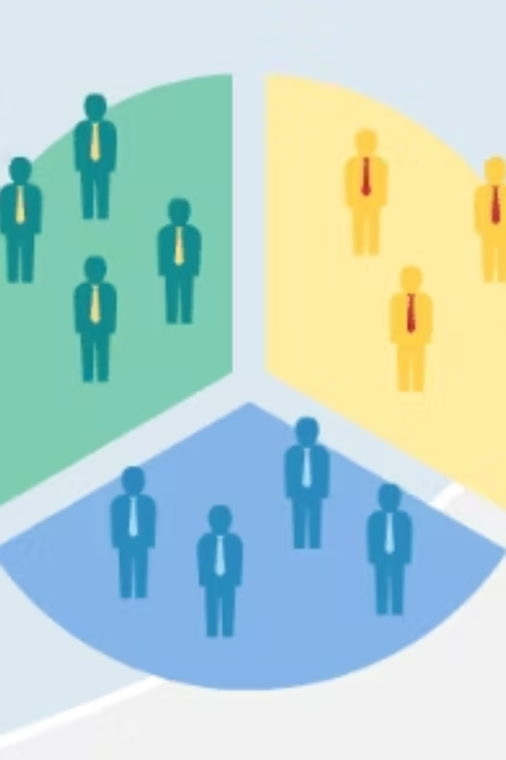
Customer Segmentation & Churn Prediction
Data-Driven Retail Analytics for Customer Retention
Term Project for
CS4403 - Data Mining
Dhruv Thumar #3753860
Notes:
"Good day everyone. I'm presenting a data mining project that is about customer segmentation with predictive modeling to solve a real business problem: customer churn. This project goes beyond basic RFM analysis to include machine learning for actionable insights .Every customer has a story told through their data; today, I’ll show you how we used RFM analysis and machine learning to decode those stories and protect our most valuable retail relationships using pro-active not reactive strategy.

Slide 2
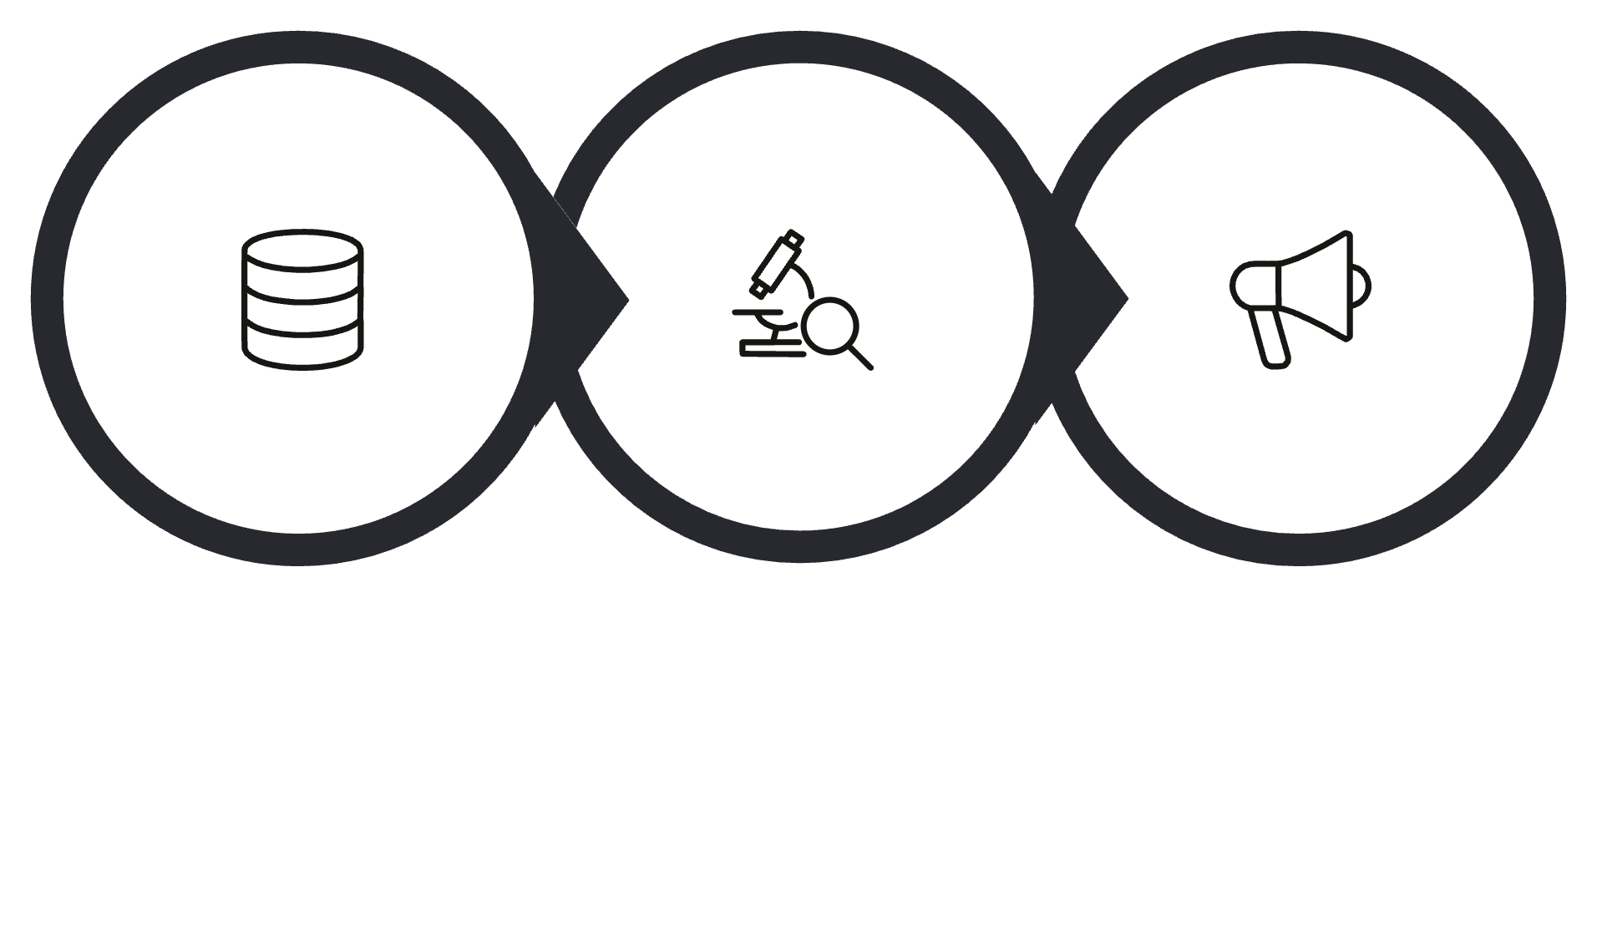
The Problem & Approach
The Challenge
Solution
3,863 retail customers with 43.3% churn rate - unable to predict departures before they happen. Marketing dollars wasted on uniform strategies without targeting.
Segment customers using RFM analysis (Recency, Frequency, Monetary Value)
Build predictive model for churn
Provide targeted retention strategies for each segment
How do we retain our best customers?
Data
Analysis
Action
Notes:
I started with customer purchase data, calculated RFM metrics for each customer, then used K-Means clustering to find 4 distinct segments. Then built a machine learning model that predicts churn- This lets us focus on retention efforts where they matter most.

Slide 3
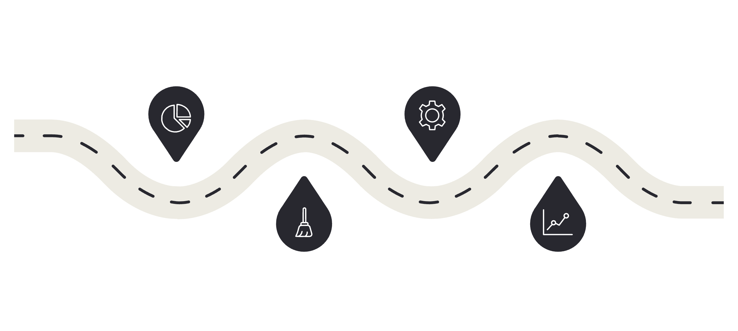
Technical Approach & Challenges
Dataset
Online Retail Dataset from UCI Machine Learning Repository (also available on Kaggle). Contains 541,909 transaction records from a UK-based online retailer, covering transactions from 01/12/2010 to 09/12/2011.
Implementation Steps
Challenges Overcome
EDA: Explored distributions, identified outliers, visualized RFM patterns
Data Cleaning: Removed 27% anomalies from 541910 records(cancellations, zero-price items, missing IDs)
Feature Engineering: Calculated RFM metrics, handled outliers with IQR method
Modeling: K-Means clustering (k=4), Random Forest tuning, model comparison
Duplicate clusters: Added monetary threshold (>£2000) to differentiate Elite vs Champions
Model overfitting: Excluded recency from prediction to avoid data leakage
Imbalanced data: Used class weighting and stratified sampling
EDA
Modeling
Explore distributions and outliers
Build and validate predictive models
Cleaning
Results
Remove anomalies and bad records
Evaluate performance and insights
Notes:
The technical work involved thorough data exploration to understand the patterns, then rigorous cleaning to ensure quality. I faced challenges like duplicate segment names and model leakage, but solved them through careful feature engineering and validation. This foundation enabled the predictive modeling that drives the business insights."

Slide 4
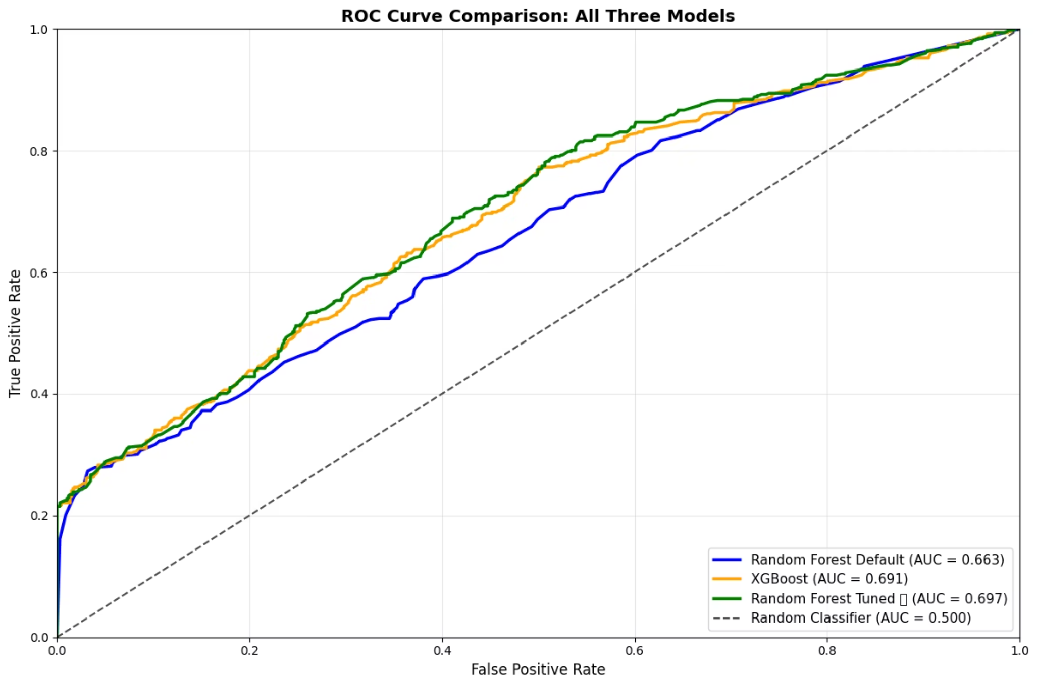
Model Results Comparison
Model
AUC-ROC
Precision
Recall
F1-Score
RF Default
0.663
0.54
0.54
0.54
XGBoost
0.691
0.57
0.59
0.58
Tuned Random Forest ⭐ BEST
0.697
0.56
0.70
0.62
Key Differences
RF: 5% better AUC than default (0.697 vs 0.663)
XGBoost: Good balance but lower recall (59% vs 70%)
Tuned RF: Best at identifying churners (70% recall = catches 7/10)
Why Tuned RF Won
Hyperparameter optimization (n_estimators=50, max_depth=5)
Better handling of imbalanced data
Superior recall for retention use case
Notes:
I compared three machine learning models to find the best churn predictor. The default Random Forest was decent but the tuned version performed significantly better. XGBoost was competitive but the tuned Random Forest had the highest recall - meaning it was best at identifying customers who would actually churn. This is critical for retention because we'd rather catch more potential churners than miss them.

Slide 5
What We Found
Customer Segments Identified
Segment
Size
Status
Risk
Characteristics
At-Risk
386 (10%)
Urgent
100%
Low R, Low F, Low M
Elite
494 (13%)
Protect
46%
Low R, High F, High M (>£2k)
Champions
959 (25%)
Protect
45%
Low R, High F, High M (≤£2k)
Promising
2,024 (52%)
Nurture
31%
Low R, Low F, Low M (new buyers)
70%
80x
Model Performance
Feature Importance
AUC-ROC score - catches churners effectively
Spending behavior matters 80x more than frequency
Notes:
I identified 4 segments each with very different characteristics. The At-Risk segment needs immediate intervention - they’re maybe high-value customers who haven't engaged in months. Elite and Champions represent our bread and butter - 38% of customers but much higher value. Promising customers are newer - we need to convert them into repeat buyers.

Slide 6
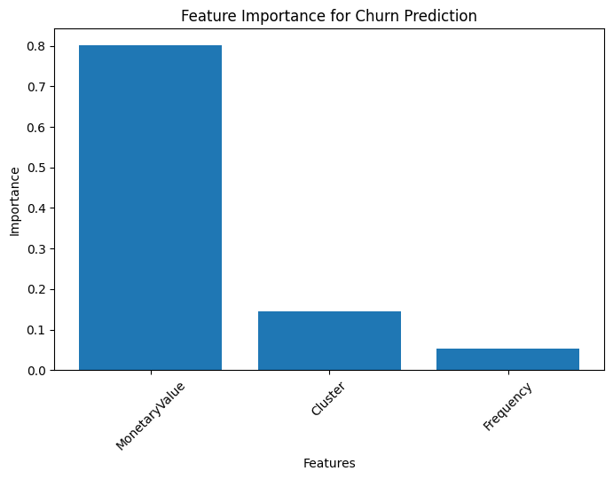
Churn Prediction Model Performance
Key Insights
Best Model: Tuned Random Forest
Performance: 70% AUC-ROC
Key Driver: Monetary value
Feature Engineering: RFM metrics
Notes:
Our model is 70% effective at identifying who will churn, which means if we focus retention efforts on flagged high-risk customers, we'll catch most of them before they leave." "We achieved 70% recall with our tuned Random Forest, which is the optimal balance. We catch most churners without wasting resources on false positives. Going to 100% recall would require flagging almost everyone as at-risk, making the model useless for practical business decisions.

Slide 7



Business Recommendations
At-Risk (Urgent)
Win-back campaigns with personalized offers. "We miss you!"
Elite & Champions (Protect)
VIP rewards programs. Exclusive early access to products
Promising (Nurture)
Incentives for second purchase.
Notes:
The beauty of this analysis is it gives me exactly who to target and why. I’m not mass-marketing to everyone – I’m being surgical about where to spend retention dollars. The At-Risk segment alone has 386 customers. If we can retain just 30% of them instead of losing all 100%, that significantly improves our bottom line compared to acquisition costs.

Slide 8

Conclusion
01
Segmented 3,863 customers into 4 actionable groups
02
Built 70% effective churn prediction model
03
Created roadmap for targeted retention
04
Enabled proactive - not reactive - customer management
Thank you
Notes:
For this project, Data mining isn't just about finding patterns; it's about ensuring that every marketing dollar is an investment in a customer who wants to stay. Thank you.

