Slide 1

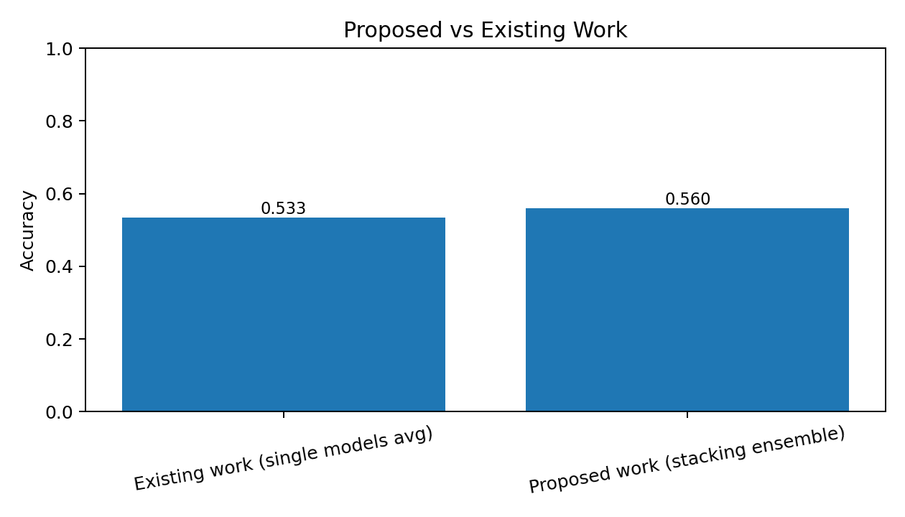
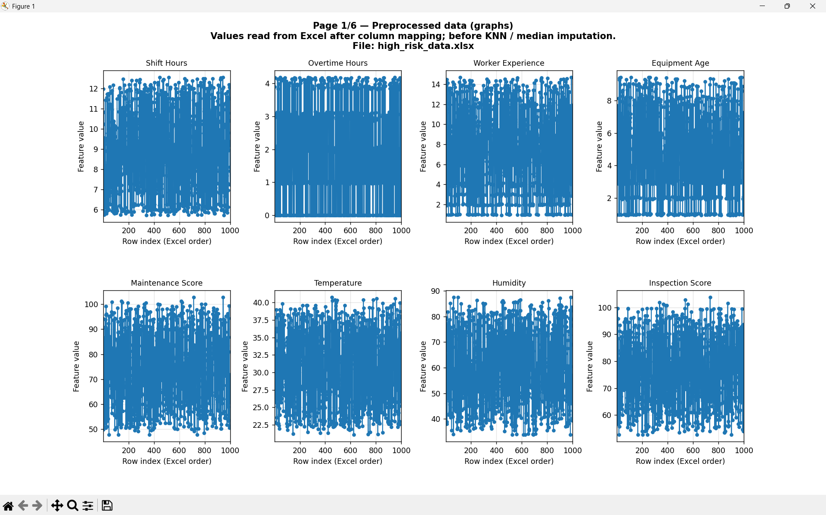
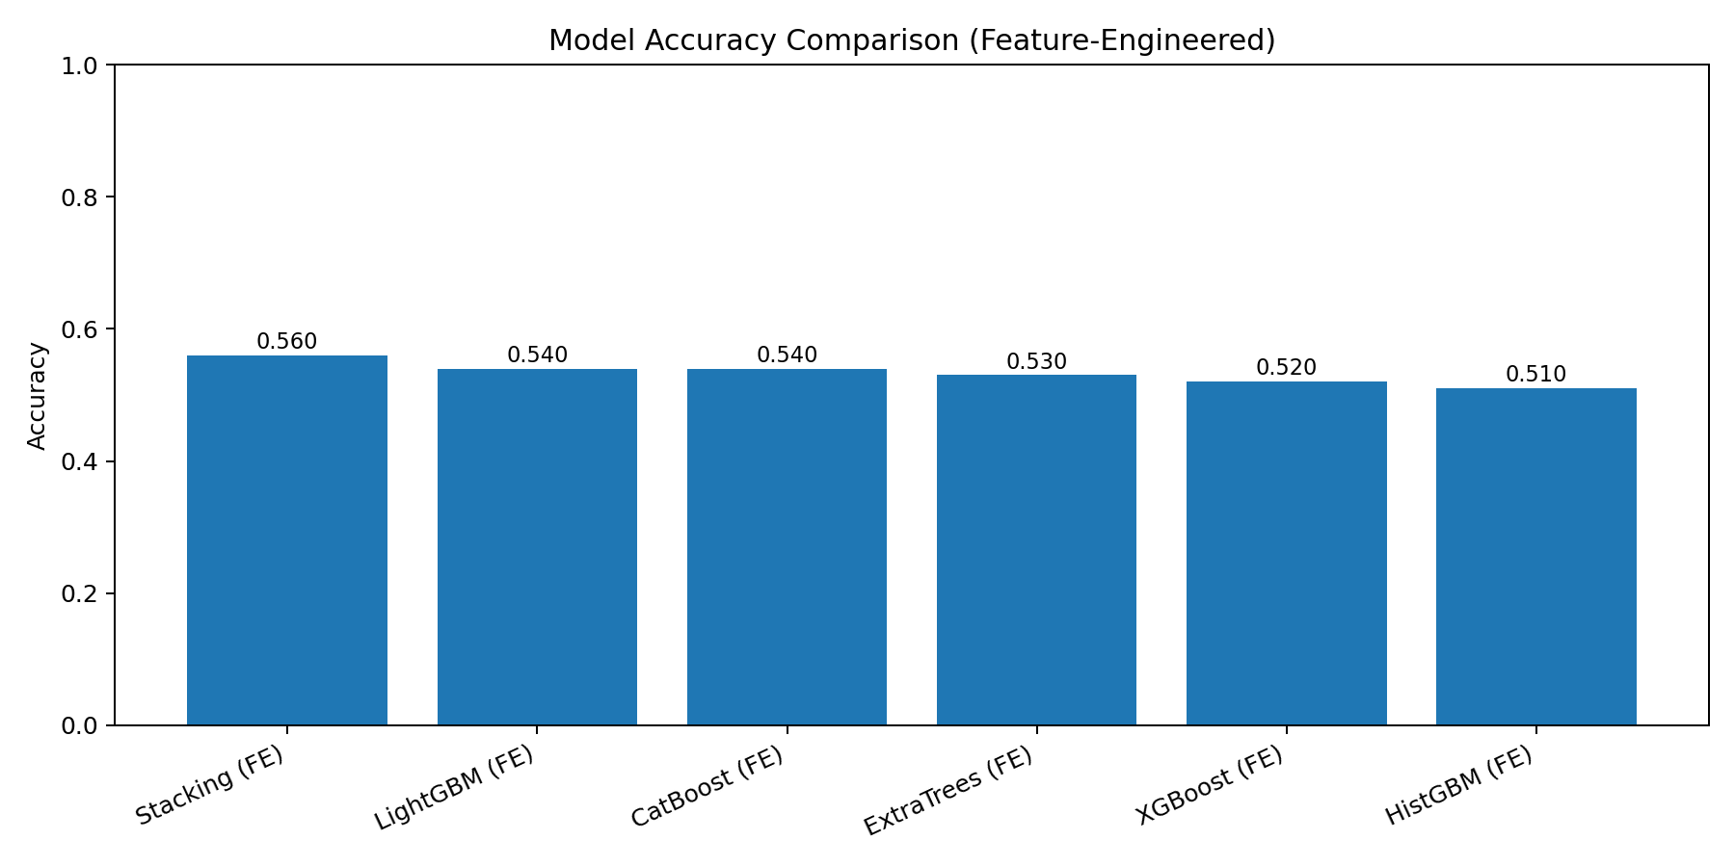
AccidentZero AI: Intelligent Safety Risk Monitoring
Student Name (Reg. No.): __________________
Guide Name: __________________
School Name: __________________
GitHub link: Add your repository URL here
INTRODUCTION
Industrial accidents are caused by interacting human, equipment, and environment factors. This project builds a machine learning safety intelligence system to predict accident risk before incidents occur.
Objectives
- Build an end-to-end safety risk prediction pipeline.
- Compare multiple ML models and ensemble methods.
- Provide interpretable risk score and risk level outputs.
- Support API and dashboard-based operational usage.
SCOPE of the project
- Works on CSV/Excel safety datasets.
- Supports batch and real-time prediction.
- Extensible for IoT integration and explainability modules.
Methodology
1) Data loading and validation
2) Preprocessing: missing value handling, encoding, scaling
3) Feature engineering: fatigue_index, equipment_risk, weather_severity
4) Model training: XGBoost, LightGBM, CatBoost, HistGBM, ExtraTrees, Stacking
5) Risk inference: ensemble_probability -> risk_score -> risk_level
Dataset
- File: data/safety_data.csv
- 500 rows, 9 core columns + engineered features
Working code
- main.py, models/train_models.py, evaluation/evaluate_models.py, api/app.py
Input/Output Example
- Input: shift_hours, overtime_hours, experience, equipment_age, temperature, humidity, inspection_score
- Output: ensemble_probability, risk_score, risk_level
Results and discussion
- Best model accuracy (current run): 0.56 (Stacking Ensemble).
- Existing single-model average accuracy: 0.5333.
- Proposed ensemble improves robustness and prediction consistency.
Conclusion
AccidentZero AI successfully predicts safety risk and can support proactive industrial decision making.
Future enhancement
- Add SHAP explainability and drift monitoring.
- Integrate streaming IoT safety signals.
References
1. Chen & Guestrin, XGBoost (KDD 2016)
2. Ke et al., LightGBM (NeurIPS 2017)
3. Prokhorenkova et al., CatBoost (NeurIPS 2018)
Figure: Proposed vs existing work
Figure: Model accuracy comparison

Slide 2
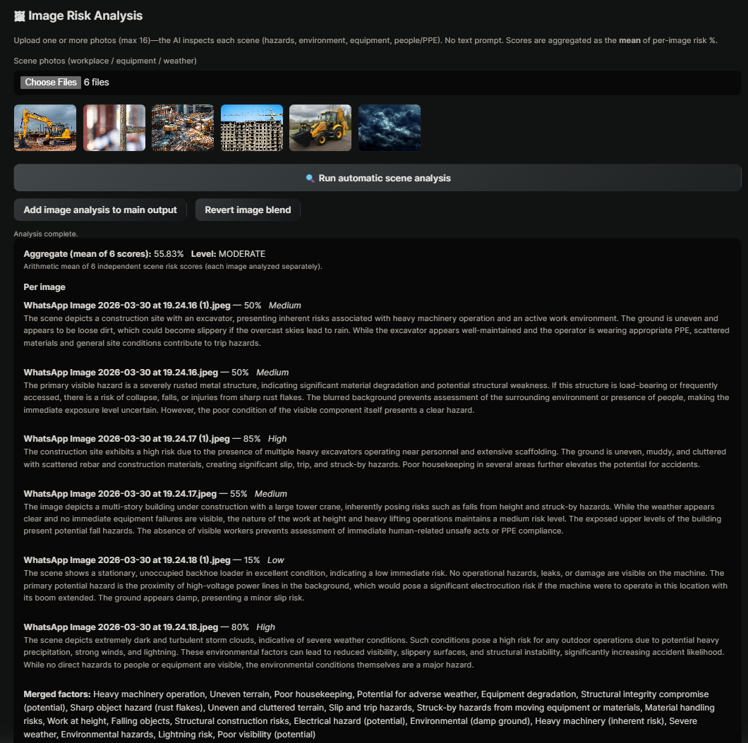

AccidentZero AI: EDA and Visual Analysis Summary
Student Name (Reg. No.): __________________
Guide Name: __________________
School Name: __________________
INTRODUCTION
This slide presents visual EDA outputs from the safety dataset and generated analysis charts.
Highlights
- Distribution trends captured for key risk variables.
- Comparative model performance and risk behavior observed.
- Visual outputs validate pattern consistency used by ML models.
Methodology (EDA)
- Bar, line, histogram, scatter and correlation visualizations were generated.
- Comparative fused charts were used to analyze variable interactions.
All methods/model implementations
- Classical ML + ensemble pipeline implemented in project code.
- Batch prediction outputs verified through generated CSV artifacts.
Results and discussion
- The visual analysis supports the predictive modeling conclusions.
- Combined charts help interpret feature influence and risk movement.
Conclusion
EDA findings align with model evaluation and justify ensemble usage.
References
Project codebase, generated experiment artifacts, and model evaluation outputs.
Datasets
Data Exploration
Deep Net
Figure: EDA/analysis visualization 2
TB affected or not
Machine Learning Algorithm
Feature Extraction
Figure: EDA/analysis visualization 1

