Slide 1

PROJECT TITLE HERE
Student Name (Reg. No.)
Guide Name
School Name
Github link:
INTRODUCTION
Provide the introduction of the project here.
Mention the motivation for the project
Objectives
Provide the objectives of the project as bulleted points here.
SCOPE of the project
Provide the scope of the project as bulleted points here.
methodology
Discuss the method proposed/employed briefly here
Architecture
Have the system architecture diagram/process block diagram here.
Briefly describe the diagram here.
Results and discussion
Provide the tables or charts showing the results of your experiments briefly discuss the results immediately below every chart/table
Conclusion
Provide a clear and crispy conclusion here
References
One or two important references here
caption here.
caption here.

Slide 2
Tuberclosis detection using machine learning algorithm
XXXXX (Reg. No.)
YYYYY
School of Computer Science and Engineering
INTRODUCTION
In today’s world TB is a fatal disease. The whole world is affected by TB and a huge number of people die to this deadly disease. The following facts motivates the initiation of the project.
Tuberculosis (TB) is one of the top 10 causes of death worldwide.
In 2017, 10 million people fell ill with TB where 1.6 million died from the disease.
In 2017, an estimated 1 million children became ill with TB and 230 000 children died of TB.
In order to detect the body cells which are affected by tuberculosis bacteria, image processing as well as machine learning algorithms viz random forest, KNN, SVM etc. are used. This poster presents a comparison study of machine learning algorithms in detecting tuberculosis bacteria affected body cells in images.
Objectives
Identify the publically available datasets such as microscopic bacteria images, chest x-ray radiogram, fluorescent image for analysis
Apply image processing techniques for preprocessing and extracting representative features
Analyze the performance of machine learning algorithms based on accuracy, specificity, sensitivity
SCOPE of the project
The scope of this project is that it can aid the healthcare professionals with faster and accurate detection of tuberculosis.
Methodology
Preprocessing
In preprocessing technique segmentation, filtration method named wiener filter is used.
Under segmentation, mainly graph-cut segmentation is used.
Feature Extraction
A modified LHTGF technique is used for extracting features
Modified LHTGF: LBP, HOG, Tamura Feature Extraction and Gabor Filter
Architecture
Used 2 datasets oft otal 800 images
Montgomery Country:
58 with manifestation of tuberculosis
80 with normal cases
China Set:
326 with normal cases
336 with manifestation of tuberculosis
Resnet is employed to extract features and Machine learning algorithms such as SVM, KNN and Random Forest are experimented to compare the classification accuracy.
Results and discussion
Provide the tables or charts showing the results of your experiments briefly discuss the results immediately below every chart/table
Conclusion
Provide a clear and crispy summary of your results here
References
One or two important references here
Datasets
Data Exploration
Deep Net
caption here.
TB affected or not
Machine Learning Algorithm
Feature Extraction
caption here.

Slide 3
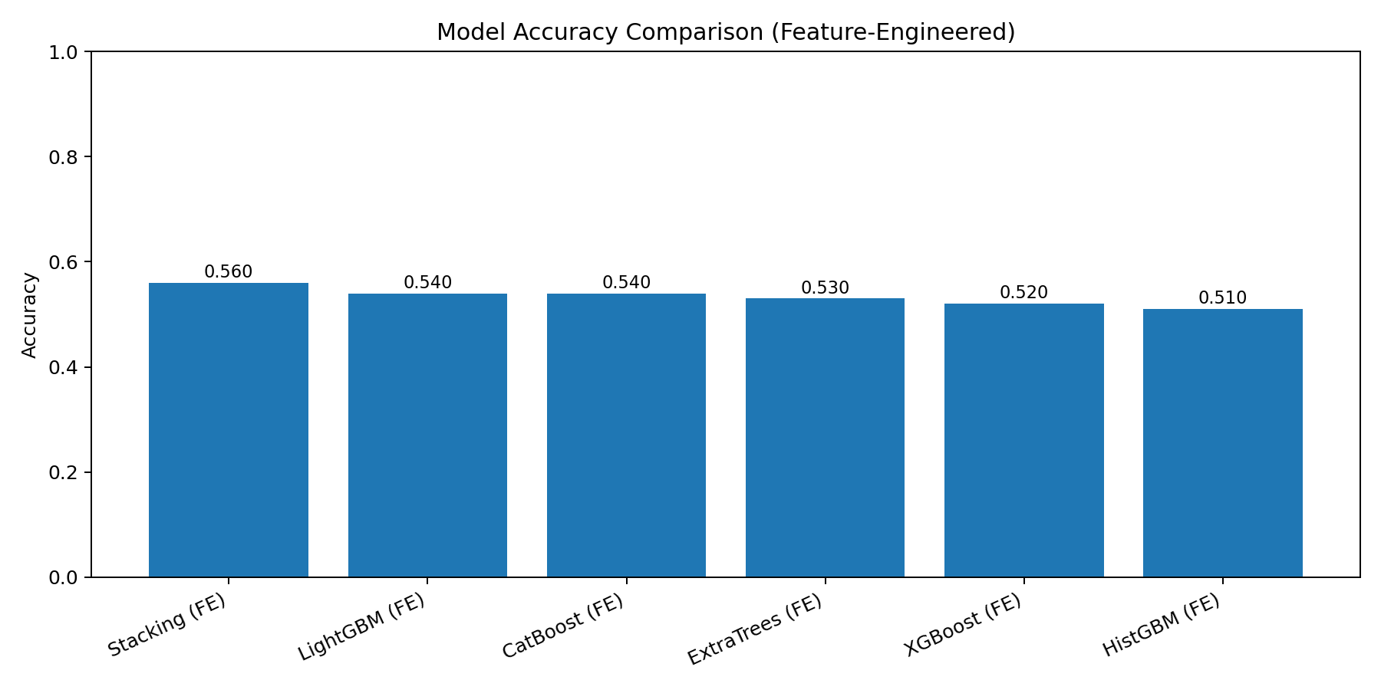
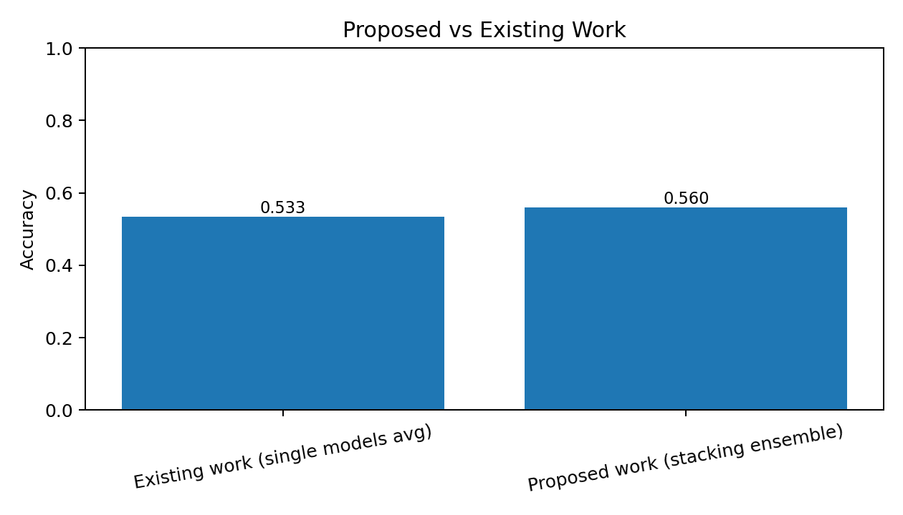
AccidentZero AI - Project Poster Summary
Problem: Predict industrial accident risk from safety parameters.
Dataset: safety_data.csv (500 rows, 9 core columns + engineered features).
Methods: XGBoost, LightGBM, CatBoost, HistGBM, ExtraTrees, Stacking Ensemble.
Best model accuracy: 0.560
Output: ensemble_probability, risk_score, risk_level.
Future work: SHAP explainability + real-time IoT streaming.

