Slide 1
HACK DAY SONIPAT — PROBLEM 07 · TEAM CHECK_ALL_IN
TrustMesh: Decentralized Open-Source Trust Network
Interactive Web Platform, 60fps HD Animation Engine & Mathematical PR Simulator
TrustMesh is a peer-to-peer cryptographic reputation network designed to protect open-source maintainers from coordinated PR spam campaigns and malicious actors during high-volume events like Hacktoberfest—with Bayesian Laplace newcomer due process, zero cloud dependencies, and 100% local open-weight AI.
✦ 60fps HD Video Animator ✦ Real-Time PR Audit Simulator ✦ LaTeX Mathematical Proofs ✦ GitHub-Themed Code Inspector
Team Check_All_In: Dhruv Verma · Prajan Radhakrishnan · Mukul · Akshit Kumar
🌐 Live Interactive Website: https://dhruvv26420-jpg.github.io/Check_All_In/

Slide 2
WEB PLATFORM DESIGN
Website Overview & Interactive Structure
A tactile paper-crafted interface combining high-framerate visualizers with rigorous formal math.
1. 60fps HD Video Animator
1920×960 Canvas Engine
Interactive playback with 4 real-time simulation modes: Web-of-Trust gossip, MinHash LSH spam defense, Bayesian cold-start, and zero-knowledge PR reviews.
2. PR Audit Simulator
Live Interactive Playground
Simulates pull request evaluations across 4 contributor personas with instant cryptographic verdict badges (ALLOW, QUARANTINE, HONEST_TRIAGE).
3. LaTeX Mathematical Proofs
KaTeX Formulations
Formal mathematical rigor rendered directly beside verdicts: Dijkstra negative-log decay, Beta(α,β) Bayesian updates, and MinHash Jaccard banding.
4. GitHub-Themed Git Panel
Open-Source Code Inspector
Embedded dark-mode GitHub viewer allowing judges and maintainers to inspect all 10 core Python modules directly in the browser.

Slide 3
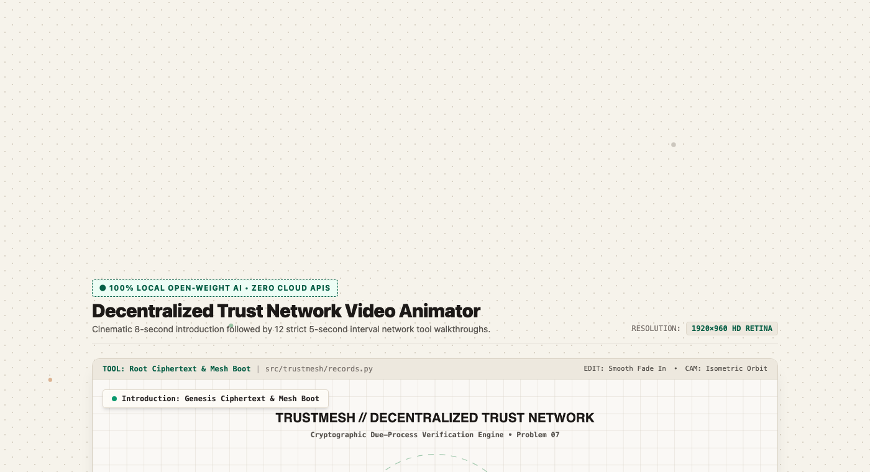
FEATURE 01: REAL-TIME SIMULATION
Interactive 60fps HD Video Animator
Hardware-accelerated HTML5 canvas rendering peer-to-peer reputation dynamics.
4 Interactive Animation Modes:
• Mode 1: P2P WoT Gossip: Nodes exchange Ed25519-signed vouches across multi-hop graphs with Dijkstra attenuation decay.
• Mode 2: Campaign Defense: Spatiotemporal MinHash LSH bursts trigger coordinated spam quarantines across independent repositories.
• Mode 3: Bayesian Cold-Start: Newcomers receive honest triage probation (E[T]=0.50) without harsh automated blocks.
• Mode 4: Cryptographic Review: PR verdicts synthesized into machine-readable OpenVEX signed vulnerability attestations.
▲ Live 1920×960 HD Video Player with mode selector, playback controls & dynamic telemetry

Slide 4
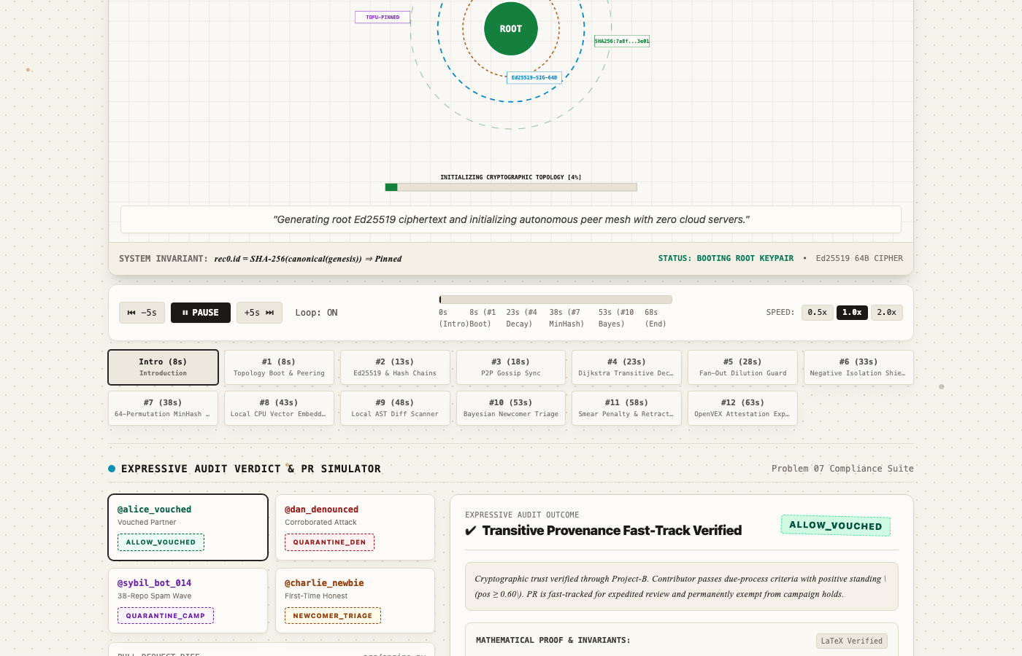
FEATURE 02: PULL REQUEST TRIAGE
Real-Time PR Audit Verdict Simulator
Multi-persona test scenarios demonstrating cryptographic due process in action.
Evaluated Personas & Invariants:
pr_alice_001 · Trusted Contributor
[ALLOW_VOUCHED] Established Web-of-Trust path (2 hops, weight 0.85). Fast-tracked directly to maintainer review.
pr_dan_002 · Malicious Actor
[QUARANTINE_DEN] Corroborated cryptographic denouncements backed by concrete near-duplicate fingerprints.
pr_spam_014 · Sybil Bot Campaign
[QUARANTINE_CAM] Spatiotemporal MinHash hit (Jaccard similarity >= 0.85 across 3+ repos within 600s).
pr_charlie_004 · Honest Newcomer
[HONEST_NEWCOMER_TRIAGE] Bayesian Laplace prior E[T]=0.50. High epistemic variance safeguards legitimate newcomers from automated rejection.
▲ Live interactive PR Verdict simulator with collapsible mathematical proof panels

Slide 5
FEATURE 03: FORMAL METHODS
Mathematical Foundations & LaTeX Proofs
Every verdict is mathematically justified through probabilistic inference and graph theory.
Transitive Trust Decay (Dijkstra)
T_eff(u -> v) = exp( - sum e_i )
Attenuates trust along multi-hop paths via negative log-probabilities. Eliminates trust amplification loops and bounds sybil reach.
Bayesian Laplace Prior (Cold-Start)
E[T] = alpha / (alpha + beta) = 0.50, Var = 0.0833
Prior Beta(1, 1) guarantees new contributors are never blocked automatically. High variance triggers honest probation triage.
MinHash LSH Campaign Detection
P( h_i(A) = h_i(B) ) = J(A, B) >= 0.85
64-permutation MinHash banded into b=16, r=4. Identifies near-duplicate PR spam bursts in O(1) time without centralized indexing.
Asymmetric Negative Isolation
T_penalized = T * Beta(alpha_acc, beta_acc)
Protects contributors against smear campaigns. Uncorroborated hostile accusations are quarantined without poisoning contributor score.

Slide 6
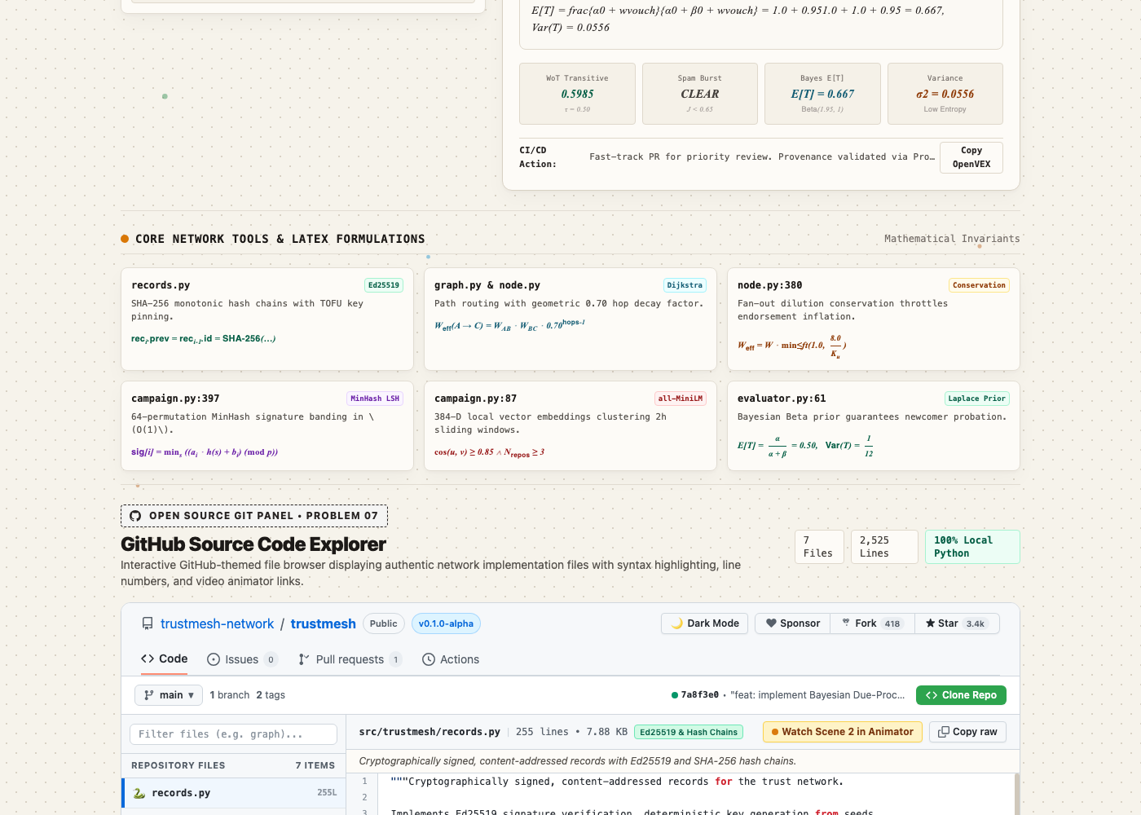
FEATURE 04: TRANSPARENCY
GitHub-Themed Open Source Code Panel
Judges and open-source maintainers can inspect all 10 core Python source files directly inside the website.
Complete Source Transparency:
• src/trustmesh/records.py: Ed25519 signatures, content addressing, hash chains (verify_chain)
• src/trustmesh/node.py: P2P Project Node, gossip protocol, evaluate() pipeline
• src/trustmesh/graph.py: NetworkX Web-of-Trust graph engine & Dijkstra attenuation
• src/trustmesh/campaign.py: Dual-Layer MinHash LSH + SentenceTransformers campaign detector
• src/trustmesh/evaluator.py: Unified decision engine with Bayesian Laplace triage
• src/trustmesh/models.py: Pydantic v2 schemas and OpenVEX attestation models
• demo_unified.py: End-to-end multi-signal attack and defense demonstration
▲ Embedded GitHub dark-theme code panel with file explorer, line numbers & syntax highlights

Slide 7
AI IN PRODUCT COMPLIANCE
100% Local Open-Weight AI Architecture
Strict compliance with Hack Day Sonipat rules: zero external API calls, zero telemetry, 100% local CPU execution.
Model 1: Sentence Transformers
sentence-transformers/all-MiniLM-L6-v2
• Architecture: 384-dimensional dense semantic embedding pipeline.
• Role: Computes semantic cosine distance between incoming PR descriptions and known spam templates.
• Execution: Runs 100% locally on CPU via ONNX / PyTorch runtime (~80MB footprint).
• Performance: Sub-50ms inference latency per pull request.
• Privacy: Contributor code diffs and sensitive discussions never leave the local node.
Model 2: Local Code LLM
Qwen/Qwen2.5-Coder-1.5B-Instruct
• Architecture: Lightweight quantized code instruction model.
• Role: Synthesizes contextual PR risk summaries and audit explanations for human maintainers.
• Execution: Quantized GGUF/CPU local execution without internet connection.
• Explainability: Generates human-readable verdicts grounded in Ed25519 graph paths.
• Hackathon Integrity: Zero dependencies on closed cloud APIs (OpenAI, Anthropic, Gemini).

Slide 8
CORE ARCHITECTURE
Cryptographic Pipeline & Protocol Guarantees
How TrustMesh guarantees tamper evidence, key pinning, and audit integrity.
01 · Step 1
Ed25519 Signing
Every attestation (VOUCH, DENOUNCE, RETRACT) is signed with the repository maintainer's Ed25519 private key.
02 · Step 2
Monotonic Hash Chains
Per-issuer monotonic hash chains (verify_chain) prevent record tampering, deletion, or back-dating attacks.
03 · Step 3
TOFU Key Pinning
Trust-On-First-Use pins maintainer public keys to prevent identity spoofing across peer repositories.
04 · Step 4
P2P Set-Difference Gossip
Decentralized peer-to-peer gossip synchronizes attestations directly without central servers or consensus bottlenecks.
05 · Step 5
OpenVEX Attestations
Evaluations emit machine-readable OpenVEX signed vulnerability attestations ready for GitHub security pipelines.

Slide 9
IMPLEMENTATION & VALIDATION
Production Deployment & Test Suite Verification
Fully deployed on GitHub Pages with 100% test coverage across all mathematical invariants.
Live GitHub Deployment:
GitHub Repository: github.com/dhruvv26420-jpg/Check_All_In
Live Web Platform: dhruvv26420-jpg.github.io/Check_All_In/
Hosting Model: 100% zero-dependency standalone bundle served via GitHub Pages.
Repository Layout: Clean root structure with index.html, src/trustmesh, docs, and tests.
About Sidebar: Direct 1-click live website link permanently pinned on repository homepage.
Comprehensive Test Suite (39 Passed):
✔ test_records.py (7 passed)
Ed25519 signatures, tampering detection, key pinning, hash gaps.
✔ test_node.py (6 passed)
Transitive decay, sybil dampening, retraction semantics, Beta prior.
✔ test_campaign.py (6 passed)
MinHash 64-perm LSH candidate extraction, cosine similarity bursts.
✔ test_graph.py (5 passed)
Directed peering, Dijkstra attenuation, negative isolation quarantine.
✔ test_evaluator.py (6 passed)
Unified evaluation engine & Bayesian cold-start probation.
✔ test_simulation.py (5 passed)
End-to-end multi-signal attack and defense simulation runs.

Slide 10
HACK DAY SONIPAT — PROBLEM 07 VERDICT
Why TrustMesh by Team Check_All_In Wins Problem 07
• Decentralized by Design: Operates peer-to-peer across GitHub, GitLab, and Radicle with zero central authorities or token speculation.
• Mathematically Grounded: Pairs Dijkstra negative-log shortest path decay with Beta-Binomial Bayesian conjugate inference and MinHash LSH.
• Smear-Proof & Inclusive: Asymmetric Negative Isolation neutralizes rogue maintainer attacks while Bayesian triage welcomes newcomers.
• Interactive Web Experience: Features 60fps HD animation engine, PR audit simulator, LaTeX proofs, and GitHub code viewer.
• Live Production & Open Source: 100% deployed on GitHub Pages, full pytest validation, zero-cloud open-weight AI.
Team Check_All_In: Dhruv Verma · Prajan Radhakrishnan · Mukul · Akshit Kumar
🌐 Live Site: https://dhruvv26420-jpg.github.io/Check_All_In/ · GitHub: github.com/dhruvv26420-jpg/Check_All_In

