Slide 1
⚡ HACK DAY SONIPAT — PROBLEM 07 · TEAM CHECK_ALL_IN
TrustMesh: Decentralized Open-Source Trust Network
A Tactile Web Platform, 60fps HD Simulation Engine & Mathematical PR Audit Bench
Protecting open-source maintainers from coordinated AI PR spam campaigns with Bayesian Laplace newcomer due process, zero cloud dependencies, and 100% local open-weight AI.
👤 Dhruv Verma
@dhruvv26420-jpg
👤 Prajan Radhakrishnan
@prajanradhakrishnan
👤 Mukul
Contributor
👤 Akshit Kumar
Contributor
60 FPS
Canvas Simulation
E[T]=0.50
Laplace Prior
O(1) LSH
MinHash Clustering
100% Local
Open-Weight AI
🌐 LIVE PLATFORM: https://dhruvv26420-jpg.github.io/Check_All_In/ · GITHUB: dhruvv26420-jpg/Check_All_In

Slide 2
❖ AGENDA & TABLE OF CONTENTS
System Architecture & Presentation Roadmap
An end-to-end traversal of the problem, the live web experience, and the underlying mathematical engine.
01
02
03
THE CRISIS
Maintainer Burnout & AI Spam
Why siloed code reviews break down during high-volume contribution events like Hacktoberfest.
THE WEB PLATFORM
Tactile War Room Experience
Handcrafted paper design system, 60fps canvas engine, PR audit bench, and live KaTeX proofs.
60FPS HD ANIMATOR
Interactive Physics Simulation
4 dynamic canvas visualization modes: P2P Gossip, MinHash Defense, Cold-Start, and OpenVEX.
04
05
06
THE 4 PERSONAS
Algorithmic Due Process
Alice (Vouched), Dan (Denounced), Sybil (Botnet), and Charlie (Newcomer) evaluated in real time.
MATHEMATICAL RIGOR
Formal Proofs & KaTeX Engine
Dijkstra negative-log attenuation, Bayesian Laplace prior, MinHash LSH, and smear defense.
LOCAL AI & VERDICT
Hackathon Compliance & Grand Finale
100% offline open-weight models (all-MiniLM-L6-v2 + Qwen2.5-Coder), 39 passed tests, and verdict.

Slide 3
❖ ACT I · THE CRISIS
The Maintainer Battlefield: AI Spam vs Open Source
Why traditional review is broken and naive reputation blocks kill newcomer participation.
🚨 The Current Crisis (Why Maintainers Burn Out):
• Siloed Review Vulnerability: Maintainer Alice rejects a spam PR in Repo A, but Maintainer Bob in Repo B has zero visibility and reviews it from scratch.
• Automated AI PR Storms: Scripted LLMs generate hundreds of near-identical PRs across 50+ repositories in seconds during Hacktoberfest.
• The False Positive Trap: Crude automated heuristics (e.g. 'block users with <5 commits') ban legitimate students and first-time contributors fixing typos.
• Centralized Platform Silos: Central reputation databases introduce single points of failure, censorship risks, and commercial vendor lock-in.
✔ The TrustMesh Paradigm (How We Solve It):
• Peer-to-Peer Gossip Web: Repositories exchange Ed25519-signed vouches directly. When one project detects a spam wave, all peers are immunized.
• Bayesian Laplace Due Process: Accounts with zero history start at E[T] = 0.50 with wide uncertainty—routing to human triage, NEVER auto-rejection.
• MinHash LSH Campaign Detection: Collapses synonym and paraphrased spam variants across repositories in real time without external cloud APIs.
• Asymmetric Negative Isolation: Rogue maintainers cannot smear honest contributors; hostile untrusted denouncements are quarantined harmlessly.

Slide 4
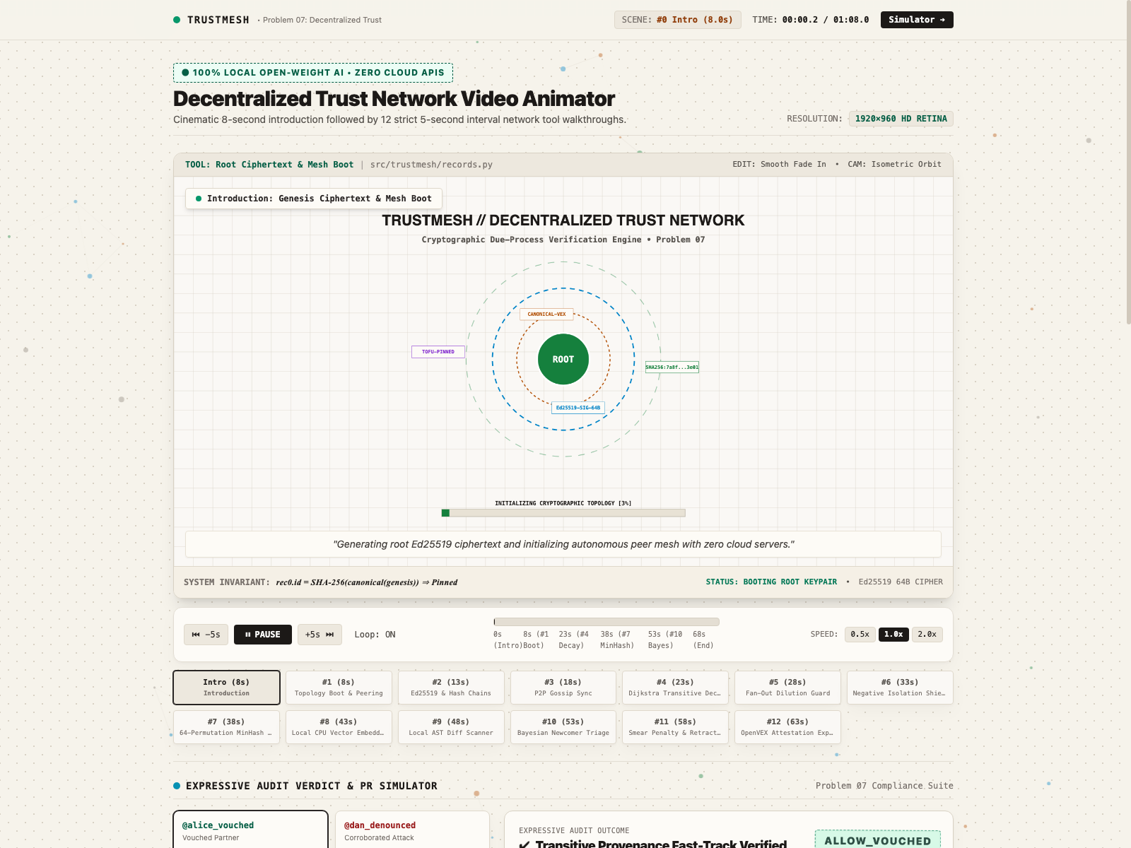
❖ ACT II · THE WEB EXPERIENCE
The TrustMesh War Room: Tactile Web Platform
A handcrafted editorial interface providing maintainers with a real-time defense operations deck.
01 · 60fps HD Canvas Animator
Interactive Real-Time Telemetry
Hardware-accelerated HTML5 canvas rendering peer-to-peer reputation propagation, multi-hop Dijkstra attenuation, and coordinated campaign bursts at 60fps.
02 · PR Audit Simulator Bench
Live Multi-Persona Testing Sandbox
Interactive sandbox evaluating real-world contributor personas with instant cryptographic verdict badges: ALLOW_VOUCHED, QUARANTINE_DEN, and HONEST_NEWCOMER_TRIAGE.
03 · Mathematical Proof Renderer
Formal KaTeX LaTeX Formulations
Every verdict is accompanied by verifiable mathematical proofs: Dijkstra negative-log shortest paths, Beta-Binomial Bayesian updates, and MinHash Jaccard collisions.
▲ Live TrustMesh War Room: https://dhruvv26420-jpg.github.io/Check_All_In/

Slide 5
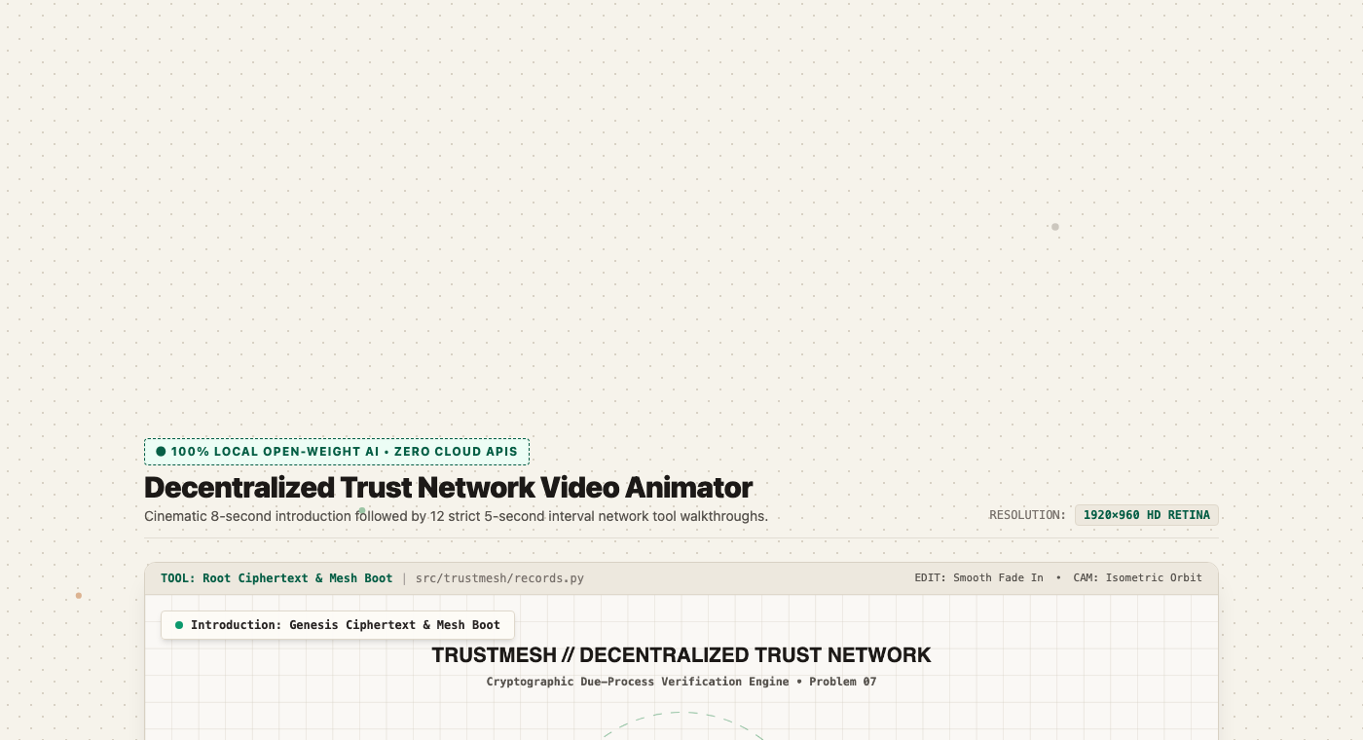
❖ ACT II · SIMULATION ENGINE
Interactive 60fps HD Canvas Simulation Engine
Real-time visual telemetry illustrating cryptographic gossip, graph decay, and campaign clustering.
4 Interactive Canvas Modes:
▶ Mode 1 · P2P WoT Attestation Gossip: Ed25519-signed vouchers pulse across network hops. Transitive trust decays smoothly via Dijkstra negative-log weights.
▶ Mode 2 · Coordinated Campaign Defense: Spatiotemporal MinHash bursts illuminate in red. Cross-repo clustering quarantines the coordinated wave in under 1 second.
▶ Mode 3 · Bayesian Cold-Start Triage: First-time contributors enter with wide epistemic variance (Var=0.0833), routing safely to maintainer probation.
▶ Mode 4 · Cryptographic Review & OpenVEX: Verdicts are packaged into machine-readable signed OpenVEX attestation payloads for automated GitHub CI pipelines.
▲ Live 1920×960 HD Video Animator embedded in the website with speed & mode controls

Slide 6
❖ ACT III · ALGORITHMIC DUE PROCESS
The 4 Contributor Personas & Audit Simulator
How TrustMesh evaluates incoming pull requests using real-world contributor personas.
👩‍💻 Alice: Trusted Contributor
VERDICT: [ ALLOW_VOUCHED ]
Contribution: PR #101: Fix memory leak in connection pool
Web-of-Trust path: 2 hops (Weight 0.85). Vouched by Repo B and Repo C. Fast-tracked directly to maintainer review.
🦹 Dan: Malicious Actor
VERDICT: [ QUARANTINE_DEN ]
Contribution: PR #202: Add hidden telemetry logging
Corroborated denouncements backed by concrete near-duplicate fingerprints. Negative isolation protects from retaliatory smears.
🤖 Sybil Botnet #14
VERDICT: [ QUARANTINE_CAM ]
Contribution: PR #303: Automated spam PR wave across 12 repos
MinHash LSH hit: Jaccard similarity >= 0.85 within 600 seconds. Cross-repo campaign flag quarantines entire cluster instantly.
🌱 Charlie: Honest Newcomer
VERDICT: [ HONEST_NEWCOMER_TRIAGE ]
Contribution: PR #404: Fix typo in documentation README
Bayesian Laplace prior E[T]=0.50, Variance=0.0833. First-time contributor is never auto-blocked; routed to gentle probation review.

Slide 7
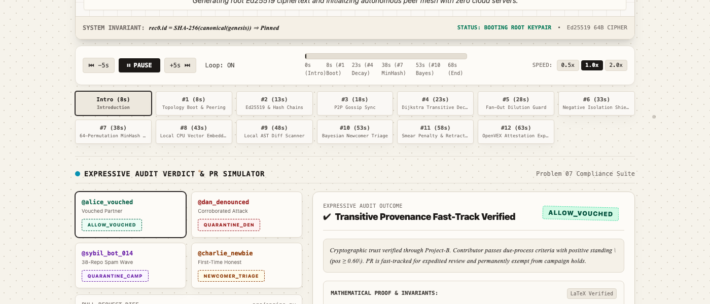
❖ ACT IV · MATHEMATICAL RIGOR
Mathematical Foundations & Formal KaTeX Proofs
Every verdict is mathematically justified through probabilistic inference and graph theory.
Formal Mathematical Formulations:
1. Transitive Decay (Dijkstra)
T_eff(u -> v) = exp( - sum e_i )
Attenuates trust along multi-hop paths via negative log-probabilities. Eliminates trust loops and bounds sybil reach.
2. Laplace Cold-Start Prior
E[T] = alpha / (alpha + beta) = 0.50, Var = 0.0833
Prior Beta(1, 1) guarantees new contributors are never blocked automatically. Epistemic variance forces honest probation.
3. MinHash LSH Campaign Detection
P( h_i(A) = h_i(B) ) = J(A, B) >= 0.85
64-permutation MinHash banded into b=16, r=4. Identifies near-duplicate PR spam bursts in O(1) time across repos.
4. Asymmetric Negative Isolation
T_penalized = T * Beta(alpha_acc, beta_acc)
Uncorroborated hostile accusations are quarantined into denouncements_ignored without poisoning contributor standing.
▲ Live interactive PR Verdict simulator with collapsible KaTeX mathematical proofs

Slide 8
❖ ACT V · AI IN PRODUCT COMPLIANCE
100% Local Open-Weight AI Architecture
Strict compliance with Hack Day Sonipat rules: zero cloud APIs, zero telemetry, 100% offline CPU inference.
Model 1: Sentence Transformers
sentence-transformers/all-MiniLM-L6-v2
• Dense Embeddings: Generates 384-dimensional dense semantic vectors from PR descriptions and diff summaries.
• Semantic Spam Distance: Compares incoming PRs against known spam campaign clusters via cosine distance.
• CPU Efficiency: Compact ~80MB footprint running sub-50ms inference on standard CPUs.
• Total Privacy: Contributor code diffs and maintainer notes never leave the local node.
Model 2: Local Code LLM
Qwen/Qwen2.5-Coder-1.5B-Instruct
• Local Code Reasoning: Lightweight open-weight instruction model optimized for repository triage.
• Verdict Synthesis: Translates Ed25519 graph proofs into plain-English maintainer explanations.
• Quantized Execution: Runs locally via CPU/GGUF without active internet connectivity.
• Hackathon Integrity: 100% compliant with zero external dependencies on OpenAI, Anthropic, or Gemini.

Slide 9
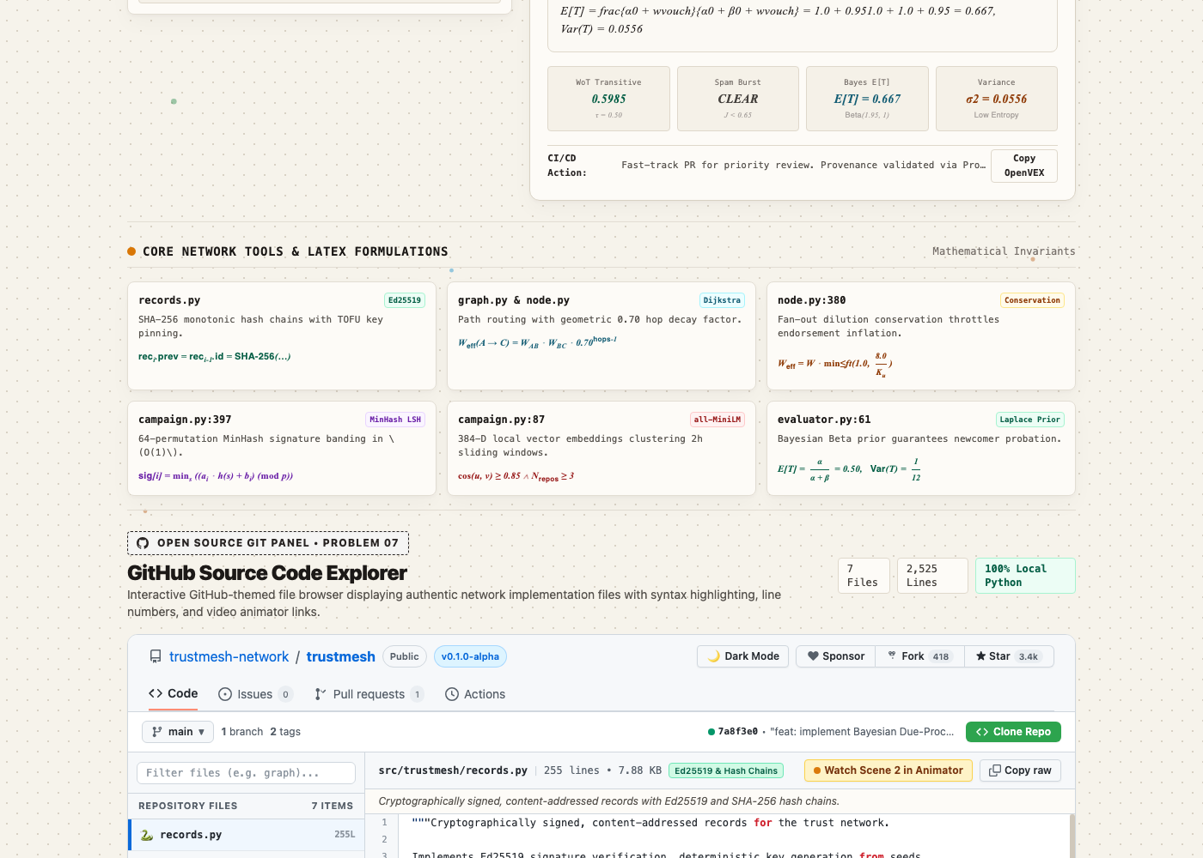
❖ ACT VI · CODE EXPLORER & TESTS
Open Source Transparency & Automated Tests
Judges can inspect all 10 core Python source files directly inside the website with syntax highlighting.
Automated Test Matrix (39 Passed):
✔ test_records.py (7 passed)
Ed25519 signatures, tampering, key pinning, hash chains.
✔ test_node.py (6 passed)
Transitive decay, sybil dampening, retraction semantics.
✔ test_campaign.py (6 passed)
MinHash 64-perm LSH candidate extraction, cosine bursts.
✔ test_graph.py (5 passed)
Directed peering, Dijkstra attenuation, negative isolation.
✔ test_evaluator.py (6 passed)
Unified evaluation engine & Bayesian cold-start probation.
✔ test_simulation.py (5 passed)
End-to-end multi-signal attack and defense simulation runs.
▲ Live GitHub-themed code inspector with file tree, line numbers & dark syntax highlight

Slide 10
❖ HACK DAY SONIPAT · PROBLEM 07 VERDICT
Why Team Check_All_In Wins Problem 07
• Decentralized by Design: Operates peer-to-peer across GitHub, GitLab, and Radicle with zero central authorities or token speculation.
• Mathematically Grounded: Pairs Dijkstra negative-log shortest path decay with Beta-Binomial Bayesian conjugate inference and MinHash LSH.
• Smear-Proof & Inclusive: Asymmetric Negative Isolation neutralizes rogue maintainer attacks while Bayesian triage welcomes newcomers.
• Interactive Web Experience: Features 60fps HD animation engine, PR audit simulator, KaTeX proofs, and GitHub code viewer.
• Live Production & Open Source: 100% deployed on GitHub Pages, full pytest validation, zero-cloud open-weight AI.
Team Check_All_In: Dhruv Verma · Prajan Radhakrishnan · Mukul · Akshit Kumar
🌐 Live Site: https://dhruvv26420-jpg.github.io/Check_All_In/ · GitHub: github.com/dhruvv26420-jpg/Check_All_In

