Slide 1
IETF 113 SCIM Profile for Security Events
March 23, 2022
Phil Hunt, Independent Identity Inc
Nancy Cam-Winget, Cisco Systems

Slide 2
Agenda
Security Event Tokens?
Origin and usage
Shared Signals
Use Cases
Domain Replication
Cross-domain Co-ordination
Signals
Misc
Delivery Streams
Bus vs. Pont-to-Point SET
Events
Discussion
Scope of spec
Next steps
2

Slide 3
Origin of Security Event Token
Originated within the SCIM WG
A mechanism to send back-channel messages "triggers"
In 2015, several groups (SCIM, OAuth, OpenID) considering JWT.
The SCIM WG proposed a common standard form which became SET under the newly formed SECEVENTs group.
Unfortunately, the SCIM WG was "paused" while this happened as major deliverable deemed complete*
Profiles the use of JWT for passing Security Events
Signable, securable, transportable in many ways
What is an "Event"?
A statement about something that occurred about a subject
Interpreted by the receiver for independent action*
This specification profiles SET for SCIM scenarios

Slide 4
Specifications
RFC8417 – Security Event Token
Delivery
Support for transfer and acknowledgement
Defines publishers and receivers
Limited SET recovery due to perceived stream scale (OIDC)
Publisher not obliged to retain after ack
Receiver implements own recovery once transferred*
Delivery Methods
RFC8935 – HTTP Push Delivery
RFC8936 – HTTP Polling Delivery
Includes support for "long-polling" to enable real-time
Costly when a publisher has 1k+ streams

Slide 5
Related: Shared Signals Events
SSE is a framework that defines an API to enable:
https://openid.net/wg/sse/
RFC8935/8936 delivery streams plus
Secure management of the streams (feeds)
Streams carry events using RFC 8417 (Security Event Token)
Events use Identifiers specified in draft-ietf-secevent-subject-identifiers
2 events schemas defined: CAEP and RISC
RISC Events
Account Credential Change Required
Credential Compromised
Account Purged/Disabled/Enabled
Identifier Changed/Recycled
Recovery Activated/Information Changed
CAEP Events
Credential Change
Session Revoked
Token Claims Change
Device Compliance Change
Assurance Level Change

Slide 6



Example Flow
CAEP/RISC
interactions
Policy Service (e.g. Okta or Duo)
Relying Party (e.g.
Salesforce
or Aruba)
2
3
Service Request: request service from a relying party
Context Update: Relying party can provide any change notifications
Policy Update: a subscriber to CAEP/RISC events can re-evaluate policy
Remediative Action: Relying party can enforce an action based on the policy update
4 1
Devices /
Apps
Reference implementation: https://sharedsignals.guide/

Slide 7
Major SCIM Use Case
Domain Based Replication
Common Schema and Resources
Single administrative domain
Many nodes to synchronize
May be multi SCIM implementations
Acts as a common User repository or directory
Messages convey transactions
Co-ordinated Provisioning
Differing Schema and Resources
May be multi-admin domain
Point-to-point cross-domain link
Often has differing implementations
May be related to cross-domain workflows and entitlements
Messages convey "triggers"

Slide 8
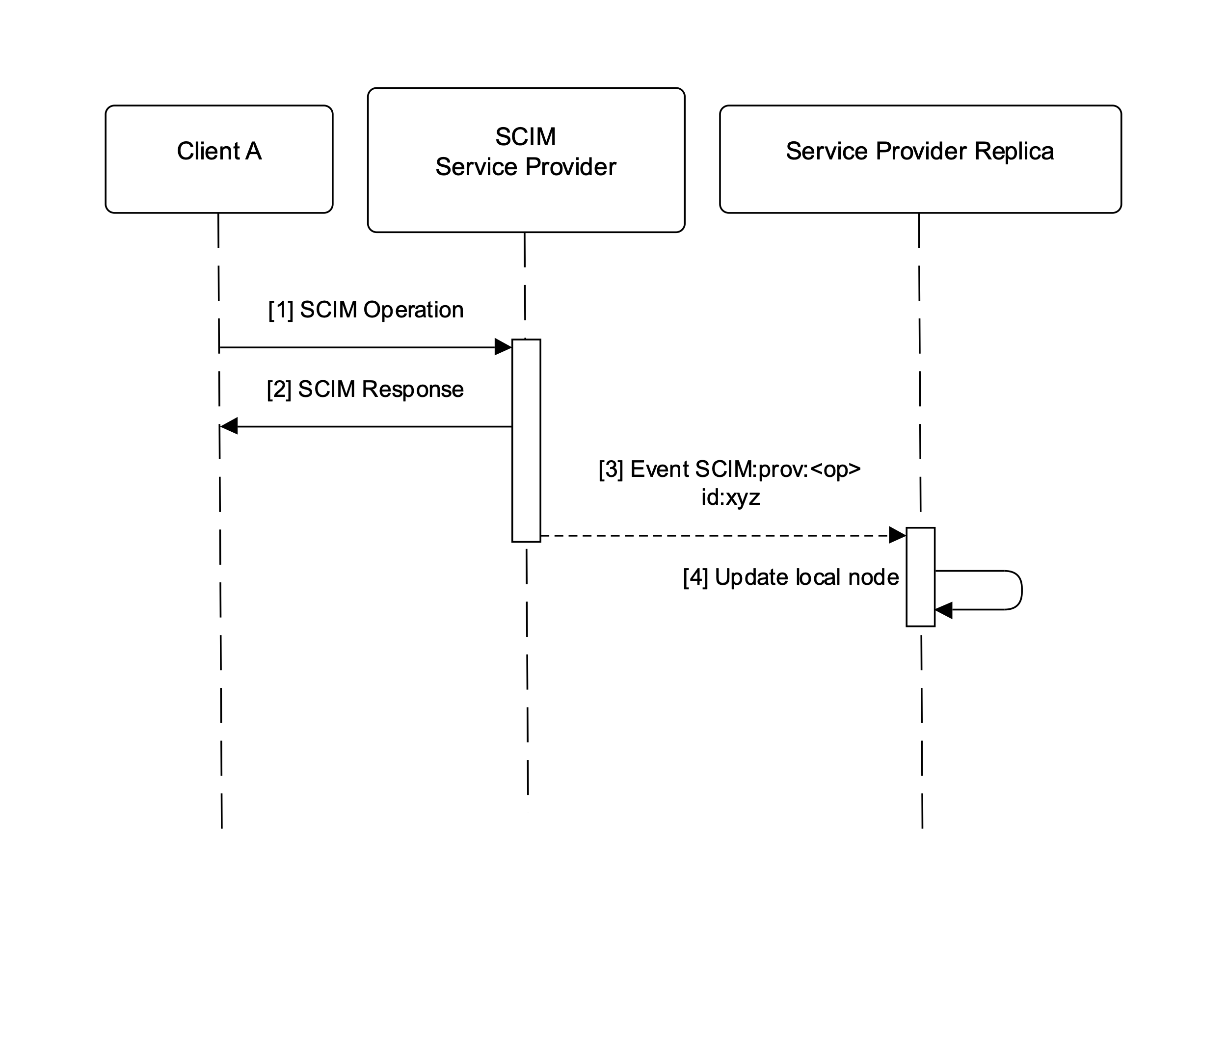
Sequence for Domain Based Replication

Slide 9
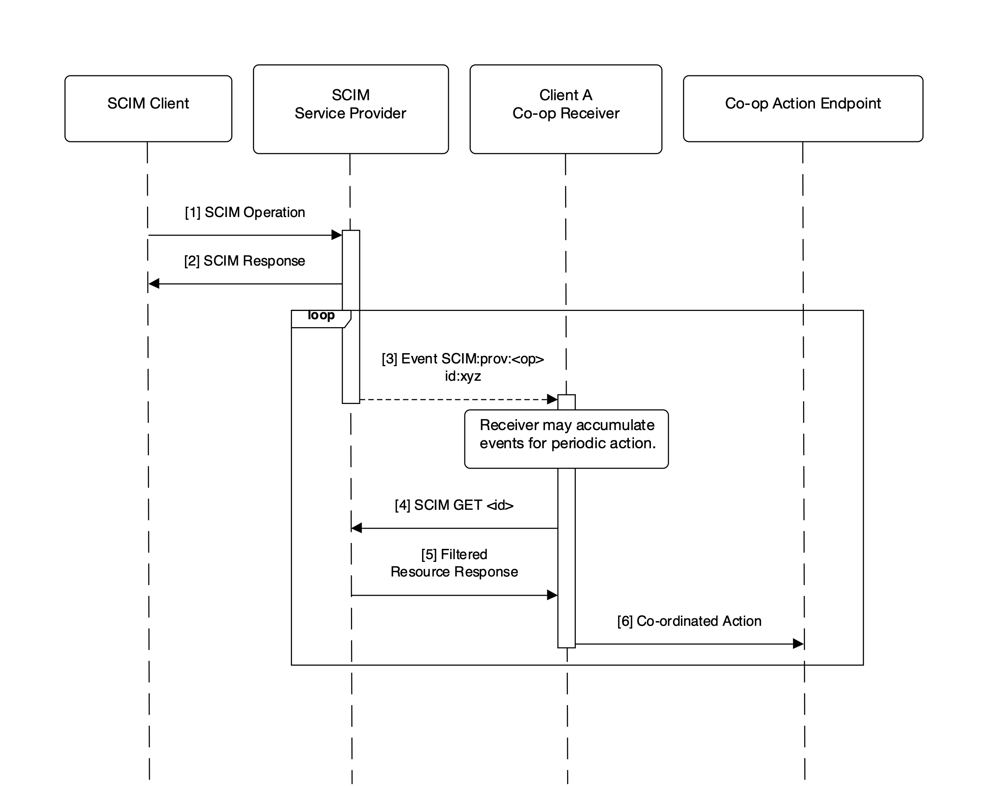
Co-ordinated Provisioning

Slide 10
Use Cases…
Security Signals
Receiver MAY be an IDP, or Security AI System
Related to the Shared Signals WG
Certain SCIM change events are of interest:
Password change / reset
Authentication factor changes
User account status changes (activation, suspension etc)
Password validation failure count

Slide 11
Use Cases…
Miscellaneous
Feed control confirmations (subject add/remove)
RFC7240 HTTP Respond Async Request
Anticipated due to some workflow or long-running operations
Useful if SCIM API implementation needs to be async
E.g. performance needed for high-update rate

Slide 12
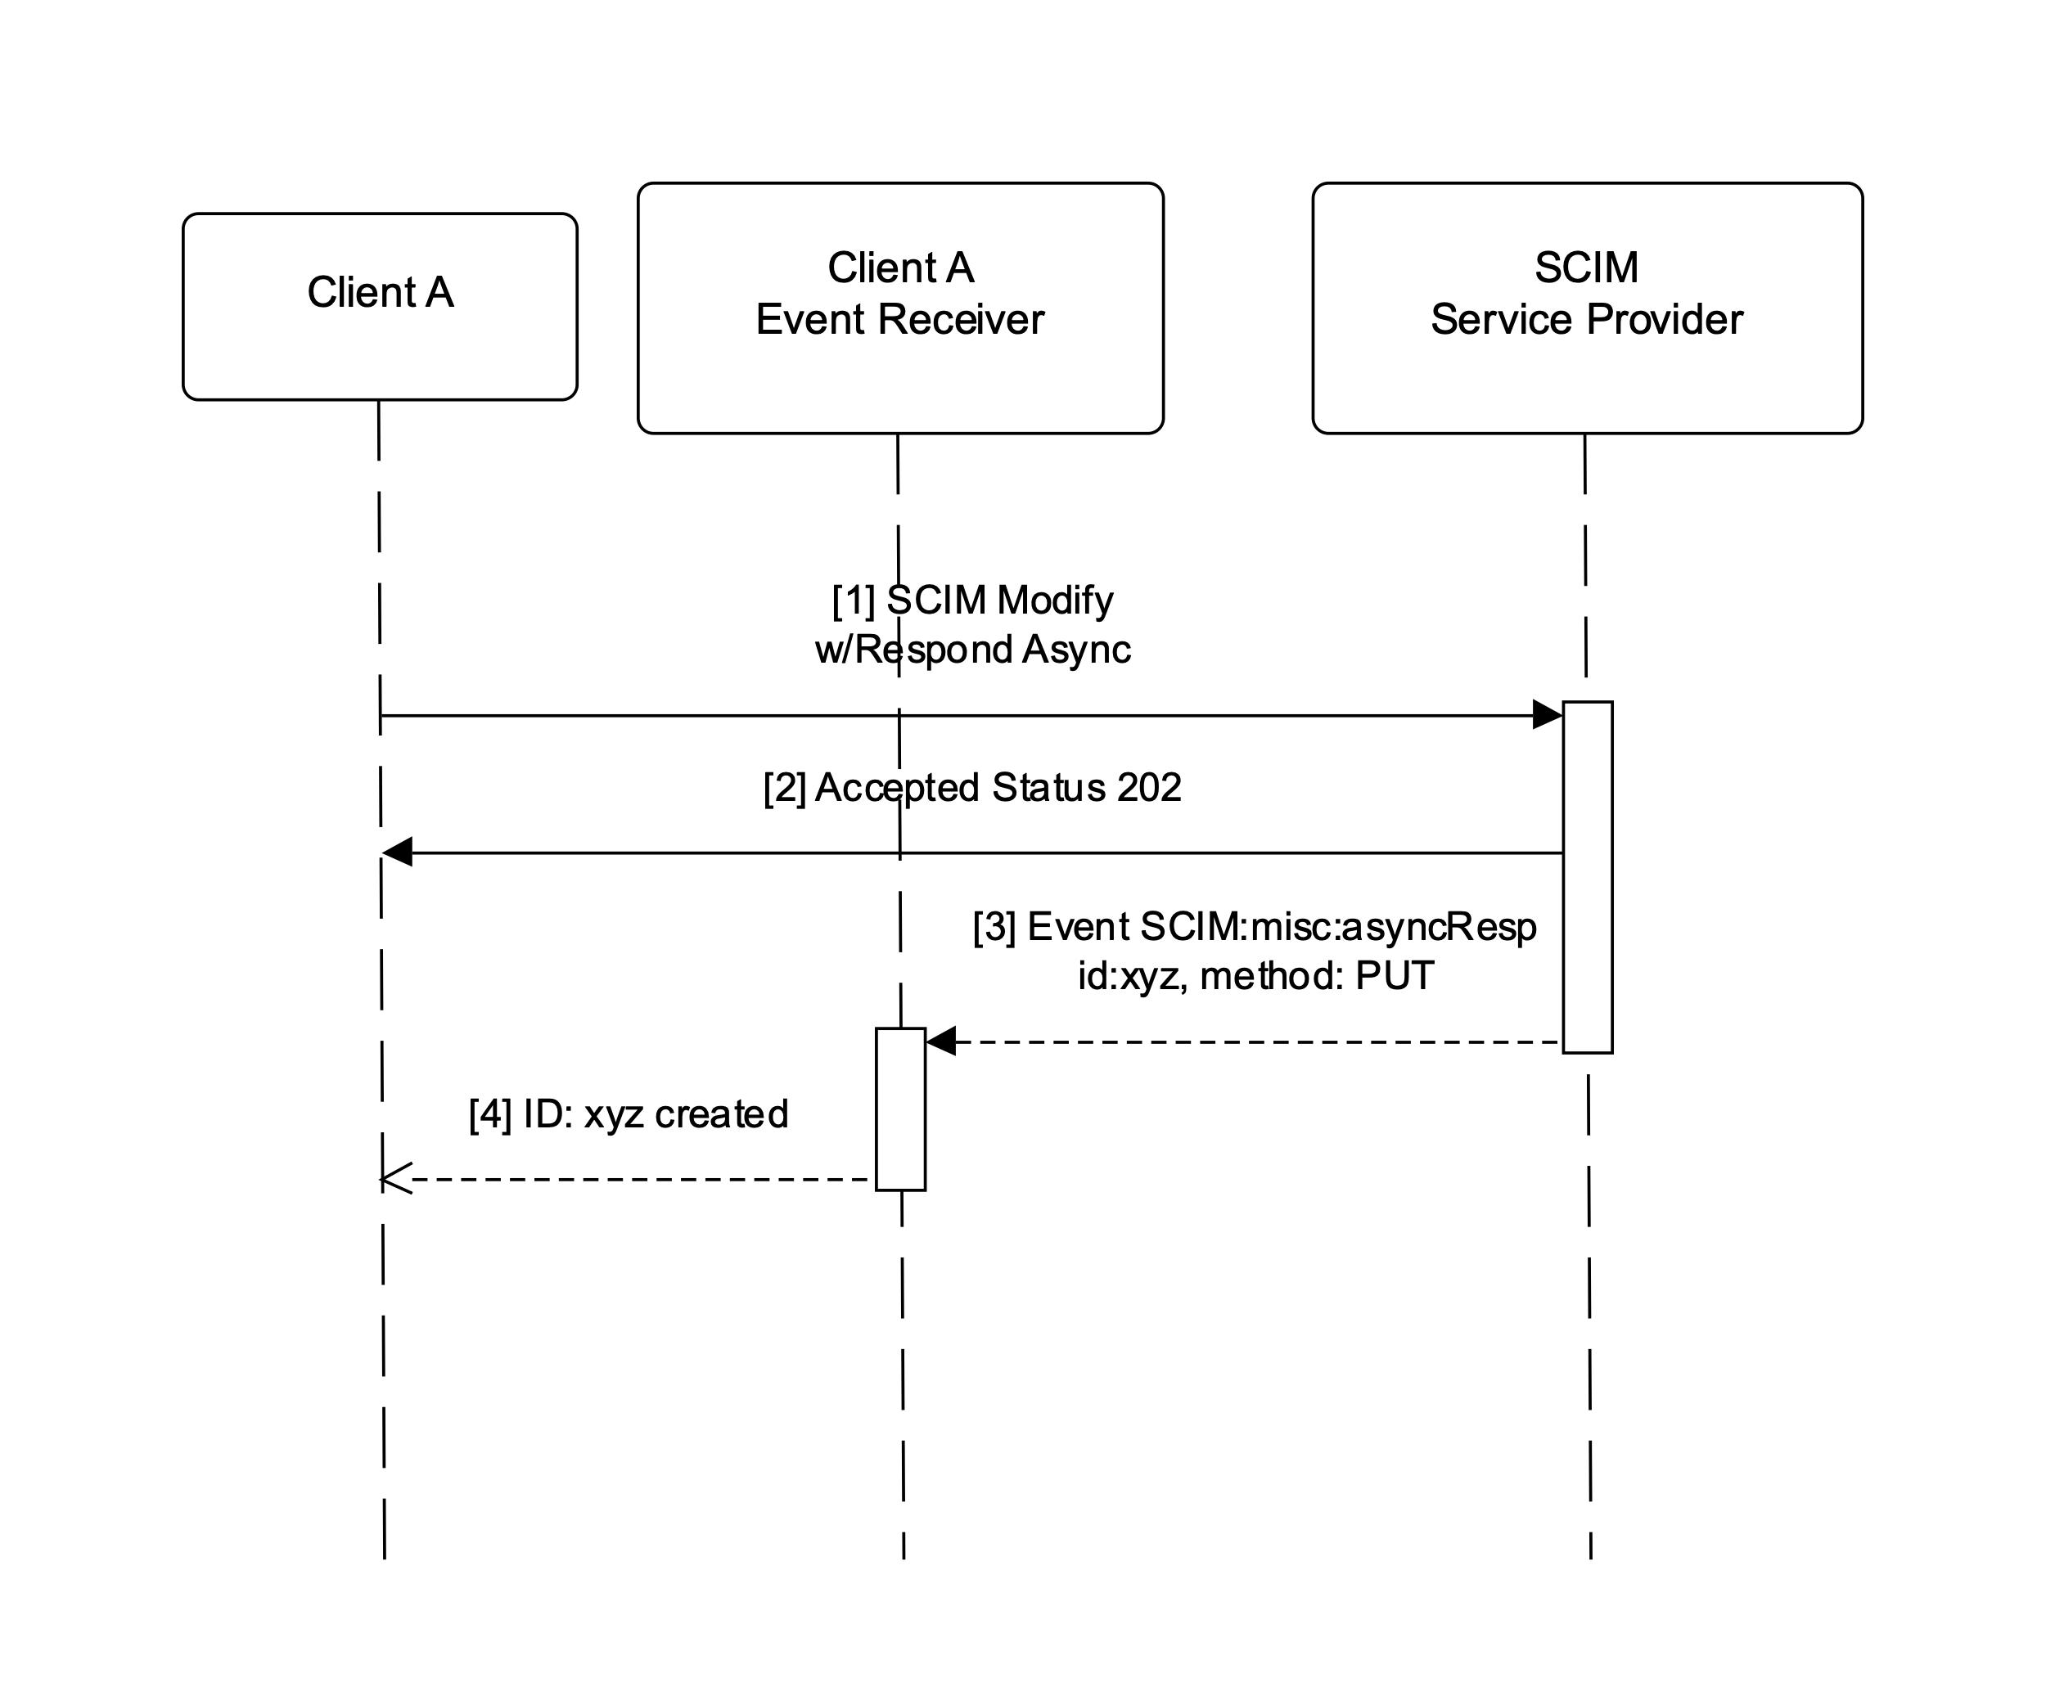
HTTP Async Request Flow

Slide 13
SCIM Event
Defines common attributes
SET Event Claims
toe – "time of event" (may be earlier than SET iat)
txn – transaction identifier
events – a claim carrying one or more events about a txn
Sub, iss, iat, jti, aud, sub, exp also have profiling
Scim Events Claims
sub* – to contain the URL of the SCIM Resource impacted
A set of event URIs for (Create, Put, Patch, Delete, etc)
Sub-claims: id, externalId, data, attributes

Slide 14
Subject/Identifiers
CAEP/RISC use a more complex subject identifiers supporting more complex semantics
E.g. in OIDC, a SET issued by an OIDC client refers to a "sub" which only has meaning to the OP. Normally "iss" disambiguates, but the SET would have "iss" set to the Client!
SCIM Profile uses SCIM "id" and "externalId" as the agreement on how to identify a SET subject.
Subject Identifiers draft is still in last call after several years
It's a tough nut to crack
SCIM should have a cross-domain relationship where "id" is understood.
common understanding of identifiers

Slide 15
Events
{ "jti": "4d3559ec67504aaba65d40b0363faad8", "iat": 1458496404, "iss":"https://scim.example.com", "aud":[ "https://scim.example.com/Feeds/98d52461fa5bbc879593b7754", "https://scim.example.com/Feeds/5d7604516b1d08641d7676ee7" ], "sub": "/Users/44f6142df96bd6ab61e7521d9", "events":{ "urn:ietf:params:event:SCIM:prov:create":{ "id":"44f6142df96bd6ab61e7521d9", "externalId":"jdoe", "data":{ "schemas":[ "urn:ietf:params:scim:schemas:core:2.0:User"], "emails":[ {"type":"work","value":"jdoe@example.com"} ], "userName":"jdoe", "name":{ "givenName":"John", "familyName":"Doe" } } } } }
Create Event for Domain Based Replication

Slide 16
Defined Events
Feed Mgmt
Add and Remove Subject to a Feed
SCIM API Events
Create, Put, Patch, Delete
Activate, Deactivate
Signals
AuthMethod, pwdReset
Misc
AsyncResp

Slide 17
Delivery
SCIM Event Profile does not define delivery streams (nor how to manage it)
Two common stream patterns expected
SECEvents defines SET Push and Poll for Point-to-point
Shared Signals Framework builds management and other features into SECEVENTs mechanisms
See: https://sharedsignals.guide
Lots of message bus systems out there (e.g. Kafka)
Difficult to force a single choice
Buses useful in they may contain historical record and recovery mechanisms
Much easier to do connection management at scale
Bi-directional flows possible

Slide 18
Out-of-scope
How receivers should act
This does not impact over-the-wire interop
In the security world, this impacts demarcation, proprietary, and confidentiality boundaries
An event is just a statement of fact not a command
Delivery mechanism defined by shared signals and bus systems
No need to re-invent a SCIM specific protocol?

Slide 19
Questions for WG
Currently sub provides a convenient callback URL
Do we need it?
Feed Management
Should we use SSE equivalents?
Note that SCIM has a simple subject identifier agreement
Is Async Request Response Useful?
Other events? (e.g. signals)
Other concerns?

Slide 20
Thank You!

