Slide 1


The Last-Level Branch Predictor
David Schall^{1*}, Andreas Sandberg², Boris Grot¹
University of Edinburgh¹, Arm Ltd²
Nov. 4, 2024
*Now at TU Munich

Slide 2
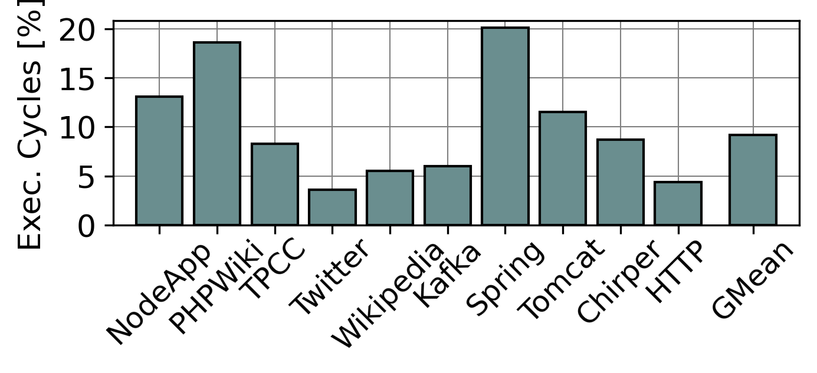
Branch Prediction
Essential for modern CPU’s
Unlocks more aggressive processor designs [Intel’19]
Key limiter for performance
Mispredictions waste
tens of cycles and hundreds of instructions
9.2% of execution cycles on Intel Sapphire Rapids
15.4% of executing cycles in Googles data centres [Google’19]
Execution cycles wasted due to branch misprediction
Wasted cycles [%]
Branch mispredictions are a key bottleneck for modern processors

Slide 3
State-of-the-art in Branch Prediction
Next branch
Global Branch History
TAGE (TAgged GEometric history length)
Partial pattern-matching with global history
Multiple tables for different lengths of histories
Upon misprediction, allocates a pattern with a longer history
Implemented in many commercial CPU’s
Arm, IBM, Qualcomm,…
…
0
0
1
0
0
1
0
?
0
1
0
0
1
0
1
1
1
0
1
0
0
1
0
0
1
0
0
1
1
0
0
0
0
1
0
0
1
0
1
1
1
0
1
0
0
1
0
0
1
0
0
1
0
Short History
Long History
PC
H1
PC
H2
PC
Hn
…
Predictor Pattern
prediction
prediction
How does TAGE perform on modern server workloads?

Slide 4
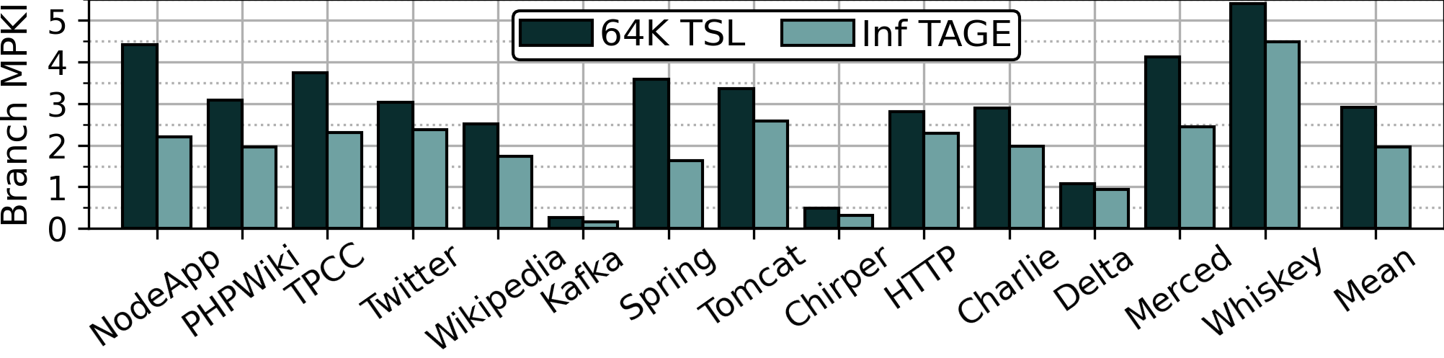
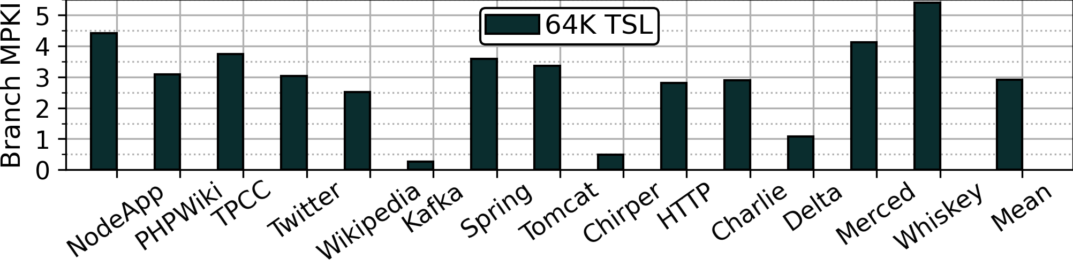
TAGE in the Limit
Lower is better
Baseline 64KiB TAGE-SC-L (TSL) (state-of-the-art)
High number of mispredictions (avg. 2.9 MPKI, max. 6.4 MPKI)
→ Flush every ~300 instructions
Compare Intel Sapphire Rapids ROB: 512-entries
TAGE with unlimited capacity (Inf TAGE)
Reduces mispredictions by 32%
A larger TAGE significantly reduces mispredictions

Slide 5
Understanding the Branch Working Set
Studied the execution of 13 server workloads
Analyzed mispredictions & useful patterns for individual branch instructions
Two key insights:
Mispredictions are skewed
Hard-to-predict (H2P) (<1% of all branches)…
…responsible for >40% of all mispredictions
…offer >1/3 of the opportunity with more capacity
All Branches
All Mispredictions
H2P
(Hard-to-predict)
H2P
(Hard-to-predict)
H2P

Slide 6
Understanding the Branch Working Set
Studied the execution of 13 server workloads.
Analyzed mispredictions & useful patterns for individual branch instructions
Two key insights:
Mispredictions are skewed
Hard-to-predict (H2P) (<1% of all branches)…
…responsible for >40% of all mispredictions
…offer >1/3 of the opportunity with more capacity
Branch working set is skewed
Most branches consume only few patterns
Combined patterns of tens of thousands of simple branches
H2P branches 100-1000s of patterns per branch
Takeaways:
Need to address both simple and hard-to-predict branches
Multiple KBs per H2P branch are needed
prediction

Slide 7

Jacking up the Branch Predictor
Option 1: Up-scaling TAGE tables
Increases table access latencies
→ Offsets accuracy gains [HPCA’03]
Practical limits to increase the tables
prediction
Up-scaling TAGE tables is counterproductive

Slide 8


Jacking up the Branch Predictor
Option 2: Hierarchical TAGE
Branch Predictor hashes PC with branch history
which creates two problems:
Many patterns per branch possible
Simple branches: Few patterns
H2P branches: 100-1000s patterns
Impossible to move multiple kilo-bytes per branch
Breaks locality
Patterns cannot be associated with its branch PC
Impedes prefetching
PC = ?
PC = ?
prediction
No conventional technique to build hierarchical branch predictors!

Slide 9
Towards a Hierarchical Branch Predictor
Approach:
Identify the subset of patterns needed for the upcoming branch execution
Prefetch just those patterns
Challenge:
Localize patterns for an upcoming branch execution
prediction

Slide 10
Introducing Contexts
Observations:
H2P branches have patterns with long history
Span multiped code regions (e.g. function calls)
Sequence of unconditional branches identify global program state → program context (aka. call chain)
Call_{A}
fnA
Global History
Call_{B}
fnB
…
…
fnA
fnB
fnC
Call_{C}
1
1
0
1
1
1
1
0
1
1
1
0
1
0
0
1
1
0
1
0
0
1
1
0
0
0
0
1
0
0
1
0
1
1
1
0
1
0
0
1
0
0
1
0
?
fnC
Long history pattern
H2P branch
H2P
Call_{A}
Call_{B}
Call_{C}
Program Context

Slide 11
Introducing Contexts
Hypothesis:
Branch behaviour can be captured per context
Sequence of preceding unconditional branches identify context
→ Context locality
Context ABC
Context DEF
fnA
fnD
fnB
fnE
Pattern 1
1
1
0
1
1
1
0
1
0
0
1
1
0
1
0
0
1
1
0
0
0
0
1
0
0
1
0
1
1
1
0
1
0
0
1
0
0
1
0
fnC
fnF
Context ABC
Pattern 2
1
0
1
0
0
1
0
1
0
0
1
1
0
0
1
1
1
0
0
0
1
1
1
0
0
1
0
1
1
1
0
1
0
0
1
1
0
1
0
H2P
Pattern 3
0
1
0
1
1
1
0
1
1
0
1
1
0
1
0
1
1
1
1
1
0
0
0
0
1
1
0
1
1
1
1
1
1
0
0
0
1
1
0
Pattern 4
1
1
0
1
0
1
0
1
0
0
1
1
0
0
0
1
1
0
0
0
0
1
0
1
0
1
0
1
1
1
0
1
0
0
1
0
0
1
0
Context DEF
Pattern 5
1
1
0
0
0
0
0
1
0
0
1
1
0
1
0
1
0
0
0
0
1
1
1
0
0
1
0
1
1
1
0
1
0
0
0
0
0
1
0

Slide 12
Introducing Contexts
Context GABC
Context IDEF
Context HDEF
Hypothesis:
Branch behaviour can be captured per context
Sequence of preceding unconditional branches identify context
→ Context locality
The larger the context depth the fewer patterns per context
fnH
fnI
fnG
fnA
fnD
fnB
fnE
Pattern 1
1
1
0
1
1
1
0
1
0
0
1
1
0
1
0
0
1
1
0
0
0
0
1
0
0
1
0
1
1
1
0
1
0
0
1
0
0
1
0
fnC
fnF
Context GABC
Pattern 3
0
1
0
1
1
1
0
1
1
0
1
1
0
1
0
1
1
1
1
1
0
0
0
0
1
1
0
1
1
1
1
1
1
0
0
0
1
1
0
Context IDEF
H2P
Pattern 2
1
0
1
0
0
1
0
1
0
0
1
1
0
0
1
1
1
0
0
0
1
1
1
0
0
1
0
1
1
1
0
1
0
0
1
1
0
1
0
Pattern 4
1
1
0
1
0
1
0
1
0
0
1
1
0
0
0
1
1
0
0
0
0
1
0
1
0
1
0
1
1
1
0
1
0
0
1
0
0
1
0
Context HDEF
Pattern 5
1
1
0
0
0
0
0
1
0
0
1
1
0
1
0
1
0
0
0
0
1
1
1
0
0
1
0
1
1
1
0
1
0
0
0
0
0
1
0

Slide 13
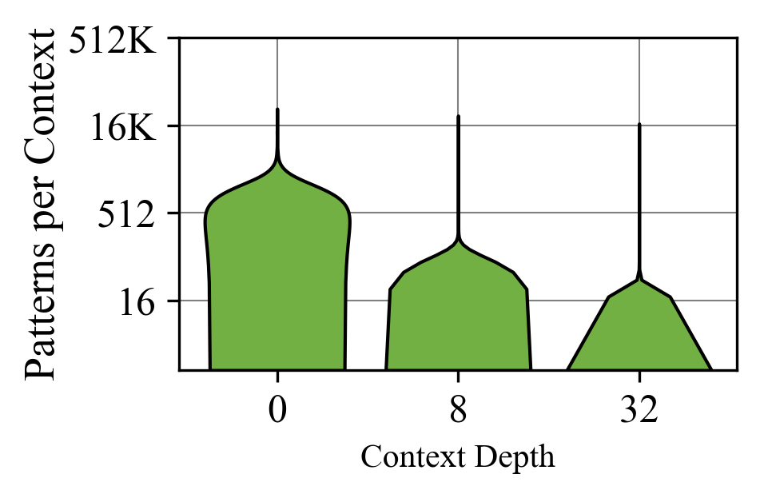
Confirming Contexts
Method:
Create context by hashing uncond. branch instructions
Aka. Hash of the call chain
Count useful patterns per context
Increase context depth (number of branches hashed)
Finding:
The more unconditional branches are hashed to form the context,…
…the fewer patterns per context are needed to predict a branch
Contexts localize a small subset of patterns useful to predict a branch

Slide 14
The Last-Level Branch Predictor (LLBP)
Context-sensitive branch predictor storage augmenting TAGE
LLBP: Stores patterns organized per context (Pattern Set)
Pattern Buffer: Makes predictions from current active pattern set
Context directory: Identifies and prefetches pattern sets for upcoming contexts
Core Front-end
Context
ID
Pattern Buffer
TAGE
Context Directory
prediction
LLBP .
(Pattern Store)
…
Pattern Set
LLBP
(Pattern Store)

Slide 15
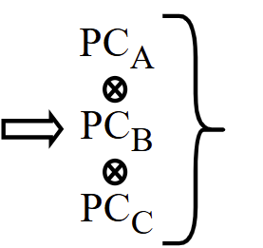
The Last-Level Branch Predictor (LLBP)
Context-sensitive branch predictor storage augmenting TAGE
Prediction:
Create Context ID upon executing uncond. branch
Context directory hit triggers prefetch
Pattern buffer make predictions from current active context
Associate current context with future context to overcome LLBP access latency
Core Front-end
Context
ID
Pattern Buffer
TAGE
Context Directory
prediction
Call_{A}
fnA
Call_{B}
LLBP .
(Pattern Store)
fnB
Context
ID
…
Call_{C}
fnC
H2P
LLBP
(Pattern Store)

Slide 16
The Last-Level Branch Predictor (LLBP)
Context-sensitive branch predictor storage augmenting TAGE
Training:
Upon misprediction a new pattern is allocated in TAGE and LLBP (same pattern)
Create new pattern set if none exists for current context
As patterns get replaced in TAGE, LLBP still preserves them due to larger capacity
Core Front-end
Context
ID
Pattern Buffer
TAGE
Context Directory
prediction
LLBP .
(Pattern Store)
Context-based organization enables hierarchical branch predictor designs
LLBP
(Pattern Store)

Slide 17
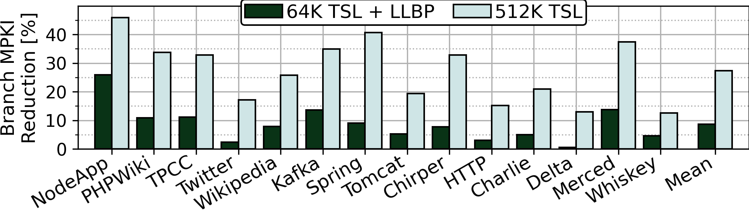
Results
Higher is better
LLBP:
Reduces mispredictions by 8.9% over 64 KB TAGE-SC-L
Achieves ~33% of ideal TAGE with similar storage budged (512KB)
Unlocks new innovations in branch predictor designs

Slide 18
Takeaways
Branch predictions remains a key performance limiter for modern CPU’s
>9% of execution cycles are wasted due to branch mispredictions
Analysis shows significant opportunity with larger predictor structures
Additional latency impedes larger predictor structures
No conventional technique to build hierarchical branch predictors
Introduce context locality
Localize a small subset of patterns for given branch execution
Enables hierarchical branch predictor designs
LLBP: Context-based, hierarchical branch predictor organization
Improves branch prediction accuracy by 8.9%

Slide 19
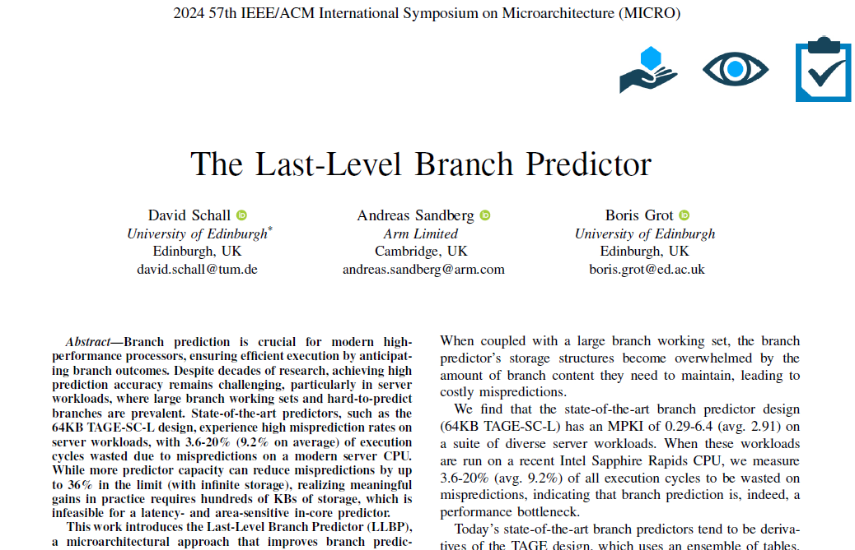
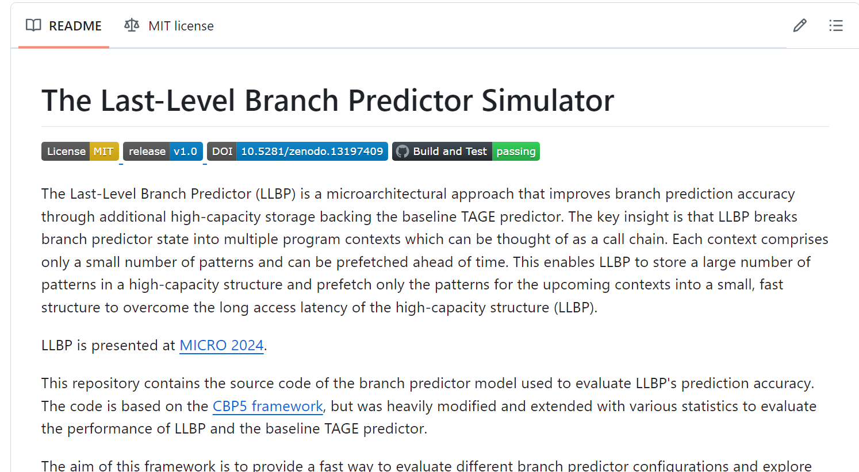

Thank you!
Extensive characterization
Design details
Sensitivity studies
LLBP implementation
https://github.com/dhschall/LLBP/

