Slide 1


The Last-Level Branch Predictor Revisited
David Schall¹, Mária Ďuračková², Boris Grot²
Technical University of Munich¹, University of Edinburgh²
Feb. 3, 2026

Slide 2
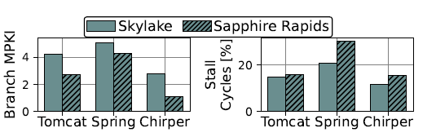
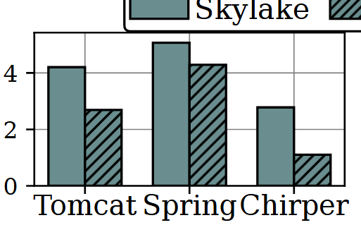
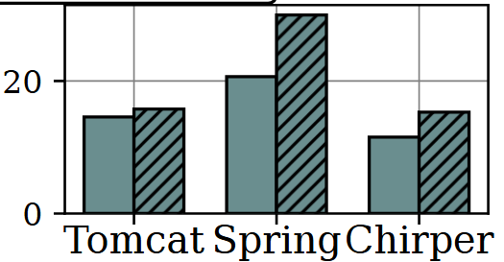
Branch Prediction
Essential for modern CPUs
Mispredictions waste
tens of cycles and hundreds of instructions
15.4% of executing cycles in Google’s data centres [Google’19]
Unlocks aggressive processor designs
Aggressive pipelines shift bottleneck to the branch predictor [Intel’19]
Skylake (2015) → Sapphire Rapids (2025)
Massive pipeline upscale: Width: 5→8 (1.6x), ROB 224→512 (2.3x)
Significant reduction in mispredictions → ~35%
But fraction of branch-related stalls increased → ~5%
Branch MPKI
Lower is better
Wasted cycles [%]
Branch mispredictions are a key performance killer

Slide 3
The TAGE Branch Predictor
Next branch
Global Branch History
TAGE (TAgged GEometric history length)
Partial pattern-matching with global history
Stores patterns (Hash of PC + history) in matching tables
Multiple tables for different lengths of histories
Upon misprediction, allocates a pattern with a longer history
TAGE-SC-L state-of-the-art since >10 years
TAGE + perceptron + loop predictor
Implemented in many commercial CPU’s
Arm, IBM, Qualcomm,…
…
0
0
1
0
0
1
0
?
0
1
0
0
1
0
1
1
1
0
1
0
0
1
0
0
1
0
0
1
1
0
0
0
0
1
0
0
1
0
1
1
1
0
1
0
0
1
0
0
1
0
0
1
0
Short History
Long History
PC
H1
PC
H2
PC
Hn
…
Prediction pattern
tag
ctr
u
Hash(PC, GHR)
Prediction counter
prediction
Useful bit
prediction
What are the challenges with TAGE?

Slide 4
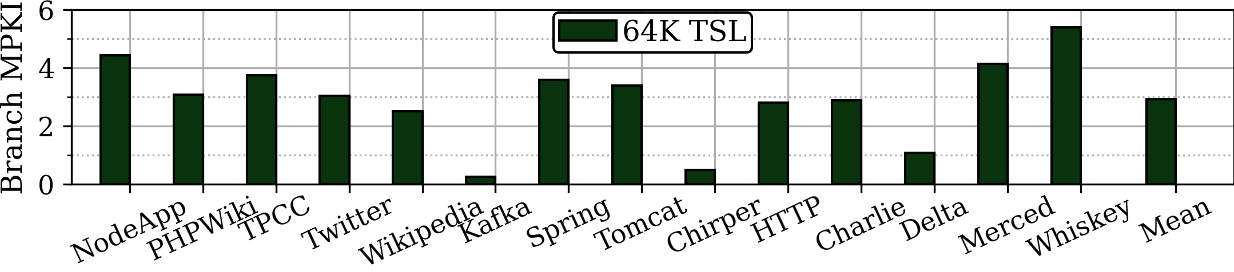
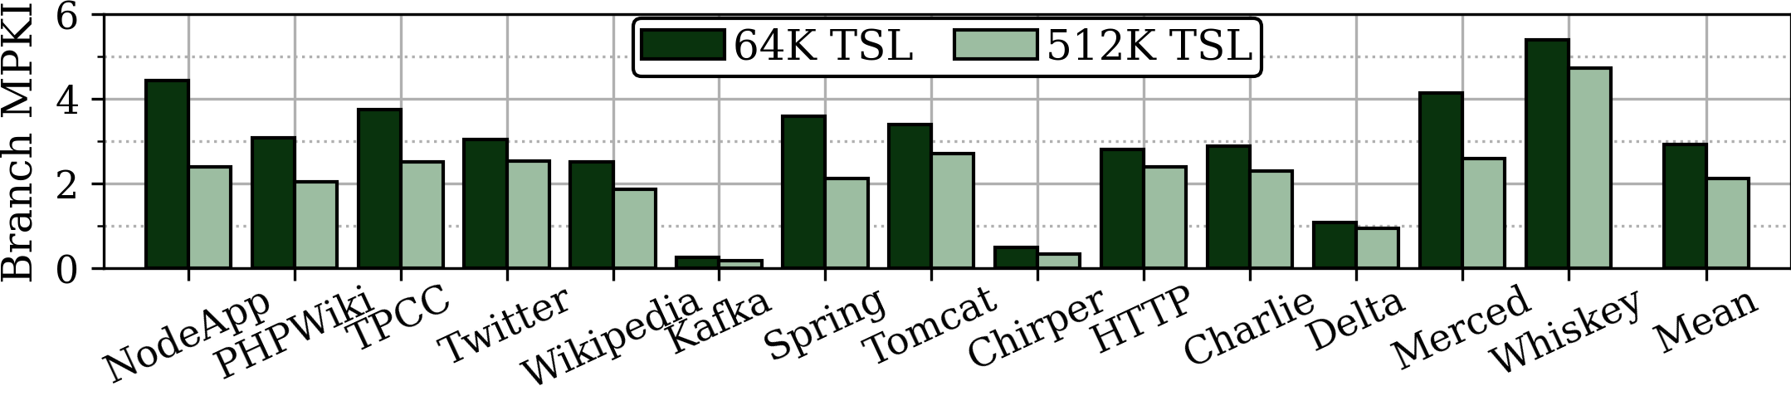
The Capacity-Latency Trade-off
Branch predictor is in the critical fetch path → must be accurate & fast
Lower is better
impractical
Larger predictors improve accuracy
More capacity allows storing more patterns
→ Captures more correlations
64K TAGE-SC-L → 512K TSL (8x capacity)
→ Reduces mispredictions by 27% 🙂
Larger predictors hit physical limits
High prediction latency
High energy consumption
→ Offsets accuracy gains!
☹️
How to increase predictor capacity without additional latency?

Slide 5
The Last-Level Branch Predictor (LLBP) [MICRO ‘24]
Context-sensitive branch predictor storage augmenting TAGE
Approach: Hierarchical branch predictor
Pattern Store: large but slow capacity structure to store patterns
Pattern Buffer: small and fast structure to make predictions
Prefetch required patterns into pattern buffer for upcoming predictions
Core Front-end
Context
ID
Pattern Buffer
TAGE
Context Directory
prediction
LLBP .
(Pattern Store)
???
…
How to know which patterns are needed ahead of time?

Slide 6
Enabling Hierarchical Branch Predictors via Contexts
Observations:
Branches can have many patterns with long history (hundreds of branches)
Span multiple code regions (e.g. function calls)
Sequence of unconditional branches identifies global program state
→ program context (aka. call chain)
Call_{A}
fnA
Call_{B}
fnB
Call_{C}
Global History
fnC
…
…
fnA
fnB
fnC
0
1
1
1
1
1
0
0
1
1
1
br
1
1
1
0
1
0
0
1
1
0
0
0
0
1
0
0
1
0
1
1
1
0
1
0
0
1
0
0
1
0
?
Pattern 1
Call_{A}
Call_{B}
Call_{C}
branch
Program Context → ABC

Slide 7
Enabling Hierarchical Branch Predictors via Contexts
Observations:
Branches can have many patterns with long history (hundreds of branches)
Span multiple code regions (e.g. function calls)
Sequence of unconditional branches identifies global program state
→ program context (aka. call chain)
Call_{D}
Call_{A}
fnA
fnD
Call_{B}
fnB
Call_{C}
Global History
fnC
…
…
fnA
fnB
fnC
0
1
1
1
1
1
0
0
0
1
1
0
1
0
0
1
1
0
0
0
0
1
0
0
1
0
1
1
1
0
1
0
0
1
0
0
1
0
?
br
Pattern 1
fnD
fnB
fnC
0
0
1
1
1
1
0
0
1
1
0
1
0
0
1
0
0
1
0
1
1
1
0
1
0
0
1
0
0
1
0
?
branch
Pattern 2
Call_{D}
Call_{B}
Call_{C}
Program Context → DBC
Contexts can identify required patterns ahead of time

Slide 8
Enabling Hierarchical Branch Predictors via Contexts
LLBP Mechanism:
Group patterns per context into pattern sets
Form context ID by hashing uncond. branches
Call_{D}
Call_{A}
fnA
fnD
Call_{B}
fnB
Call_{C}
fnC
DBC
ABC
01010001
br
01011101
ABC
DBC

Slide 9
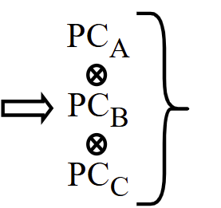
Enabling Hierarchical Branch Predictors via Contexts
LLBP Mechanism:
Group patterns per context into pattern sets
Form context ID by hashing uncond. branches
Use context ID to prefetch pattern sets
Core Front-end
Context
ID
Pattern Buffer
TAGE
Context Directory
Call_{A}
fnA
Call_{B}
prediction
Call_{C}
fnB
Context
ID
LLBP .
(Pattern Store)
fnC
ABC
DBC
br
How effective is LLBP?

Slide 10
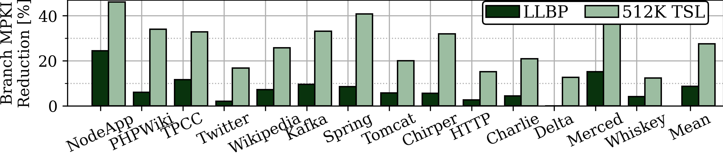
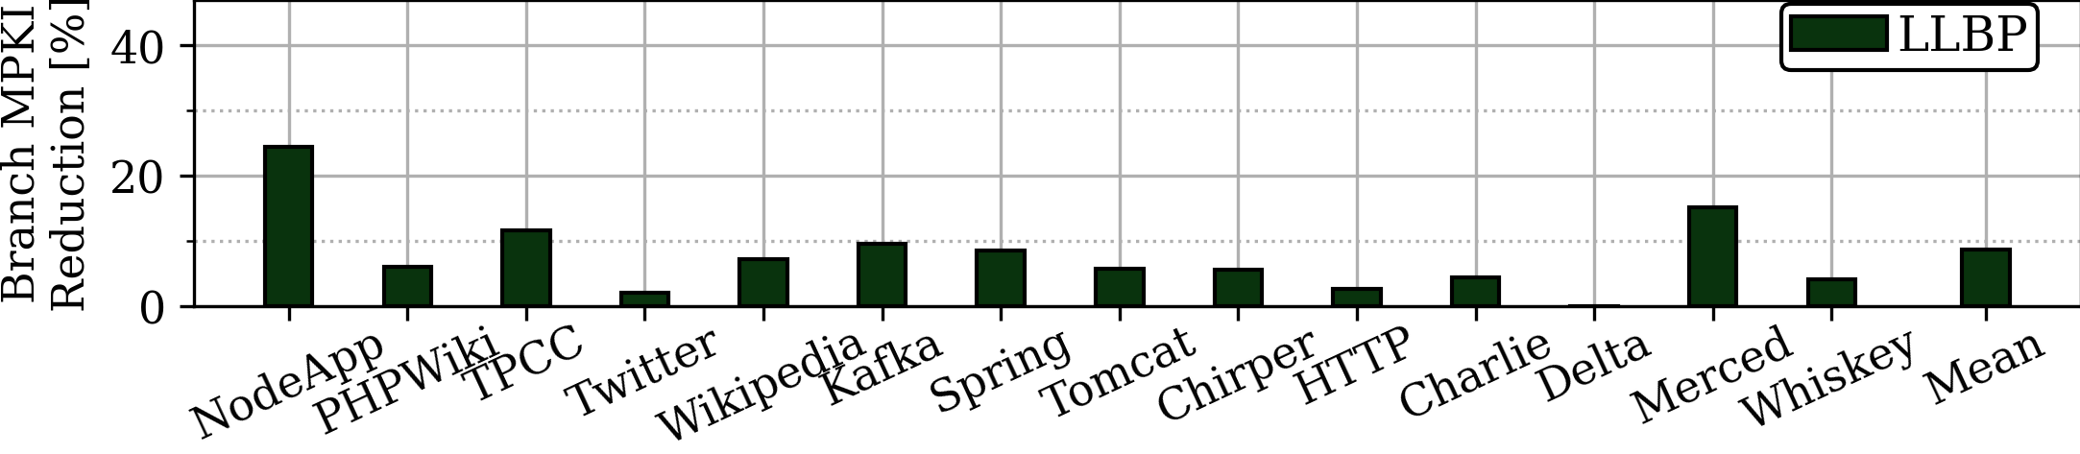
LLBP Effectiveness
Higher is better
Compare 512K LLBP with 512K TSL
LLBP reduces mispredictions by 8.8% over 64K TSL
Only 1/3 of the reduction of a similarly sized (but impractical) TAGE-SC-L (512K TSL)
What affects LLBPs’ effectiveness and can it be improved?

Slide 11
Outline
To understand & address LLBP’s limitations we:
Performed root-cause analysis of LLBP’s inefficiencies
→ Identified two main compounding negative effects
Developed mechanism to overcome both limitations
→ Unified and light-weight solution

Slide 12
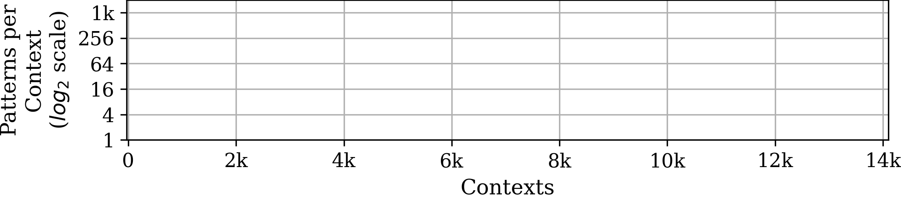
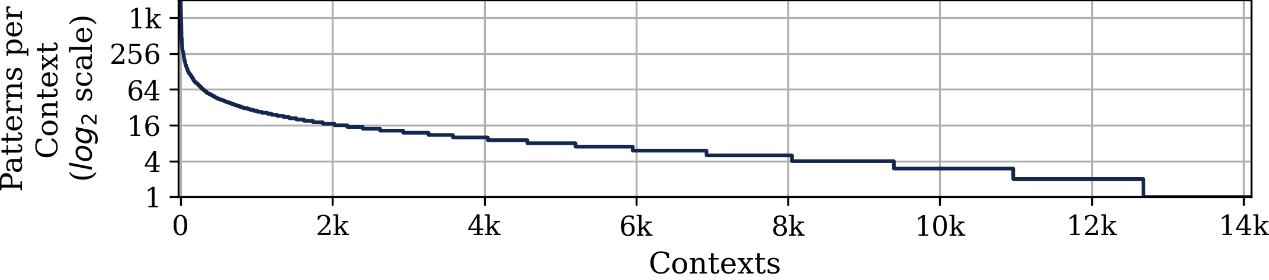
Understanding LLBP’s Bottlenecks
overutilized
underutilized
LLBP storage
16 x 14k
Problem 1: Skewed pattern set utilization
LLBP organization: 14k pattern sets, each with up to 16 patterns
Most pattern sets are underutilized
85% of the sets have less than 16 useful patterns
Some pattern sets are heavily overutilized
15% of the sets require more than 16 patterns, and a few up to 1k
LLBP’s fixed-size pattern sets result in wasted capacity and lost coverage

Slide 13
Understanding LLBP’s Bottlenecks
Call_{A}
Problem 2: Pattern duplication due to contextualization
LLBP uses a fixed context depth
Number of unconditional branches to create the context ID
Context too deep for patterns with short history
The same pattern must be replicated in multiple pattern sets
Wastes capacity and increases training time
fnA
fnD
Call_{B}
Context Depth (3 UBs)
fnB
Call_{C}
fnC
Context Depth (3 UBs)
0001
br
0001
fnA
fnB
fnC
1
1
1
1
?
1
1
1
1
0
0
1
1
0
1
0
0
1
0
0
1
0
1
1
1
0
1
0
0
0
0
1
fnD
Pattern History Length (4 Branches)
ABC
DBC
Deep context depth requires duplication of short history patterns

Slide 14
Addressing LLBPs Inefficiency
Key Problems:
Skewed pattern set utilization
Pattern duplication due to contextualization
Naïve Approach: Change LLBP organization
E.g., multiple types of pattern sets, chaining if overflow,…
However:
Implementation challenges, multiple LLBP lookups, or higher bandwidth
Doesn‘t solve pattern duplication
How can we overcome both limitations without changing the pattern set organization?

Slide 15

Addressing LLBPs Inefficiency
Key Problems:
Skewed pattern set utilization
Pattern duplication due to contextualization
Our Idea: Dynamic context depth
Use shallow context depth by default
Coarse-grained contextualization
Increase utilization of underutilized sets
Reduces pattern duplication
Increase depth when pattern set becomes full
Fine-grained contextualization
Splits overutilized pattern sets into multiple sets
Call_{A}
fnA
fnD
Call_{B}
fnB
Call_{C}
Context Depth (1 UB)
Context Depth (3 UBs)
fnC
0001
br
0101
10011
ABC
C
0011
DBC
0101
1101
One solution to overcome both limitations

Slide 16
LLBP-X
Dynamic context depth adoption
Context tracking table (CTT) monitors highly contended pattern sets
Upon exceeding a threshold, CTT switches to use a deep context
Effectively spreads patterns across more pattern sets
NO change to LLBPs’ storage organization needed
Unified solution for both limitations
CTT increases LLBPs’ storage and energy by less than 2%
Core Front-end
Shallow
CID
Deep
CID
CTT
Pattern Buffer
TAGE
Context Directory
prediction
LLBP .
(Pattern Store)
…
LLBP-X is a simple and lightweight enhancement to LLBP

Slide 17
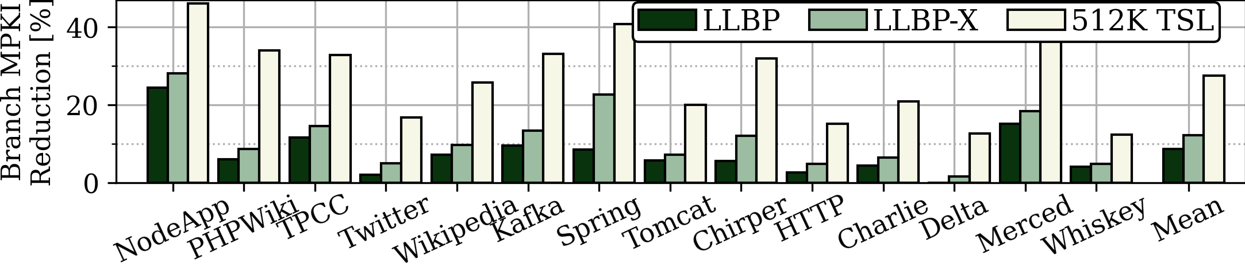
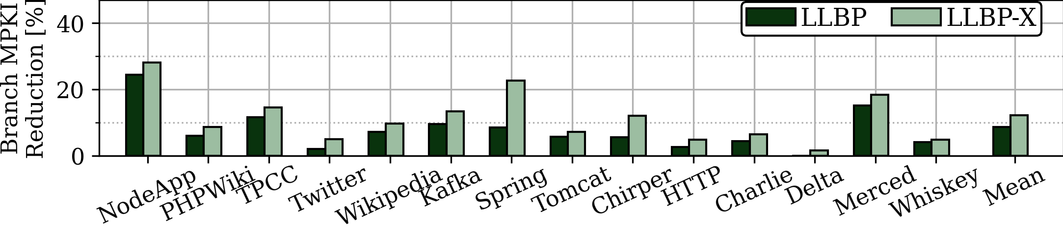
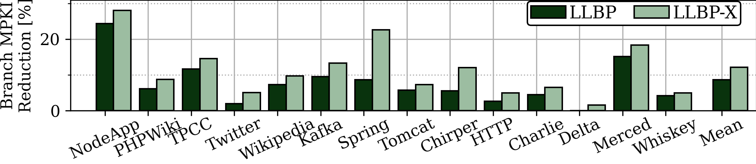
Results
Higher is better
LLBP-X’s lightweight adaptation mechanism significantly improves efficiency
12.1% misprediction reduction over 64K TSL
27% more effective than LLBP
With less than 2% storage and energy overhead over LLBP
Achieves 45% of the accuracy increase compared to ideal 512K TSL
LLBP-X is simple and effective

Slide 18
Takeaways
Branch predictions remains a key performance limiter for modern CPU’s
Larger predictors significantly reduce mispredictions
But predictor latency impedes larger predictors
LLBP addresses the capacity-latency trade-off with hierarchical design
However, falls far behind equally sized (but impractical) 512K TSL
Detailed root-cause analysis revealed key inefficiencies of LLBP
Skewed pattern sets utilization
Pattern duplication due to contextualization
LLBP-X: Dynamic context depth adaptation
Simple and lightweight enhancement of original design
Improves effectiveness of LLBP by 27%

Slide 19
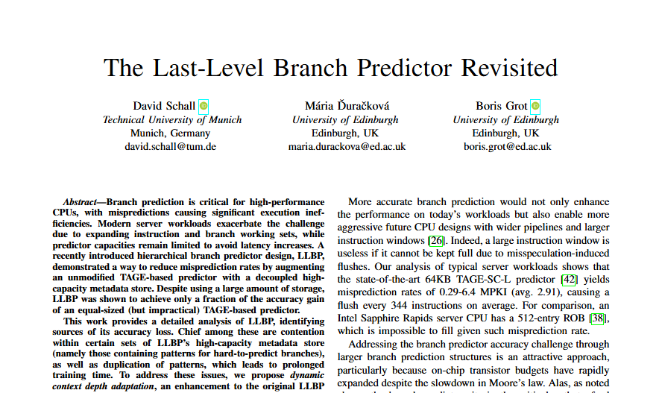
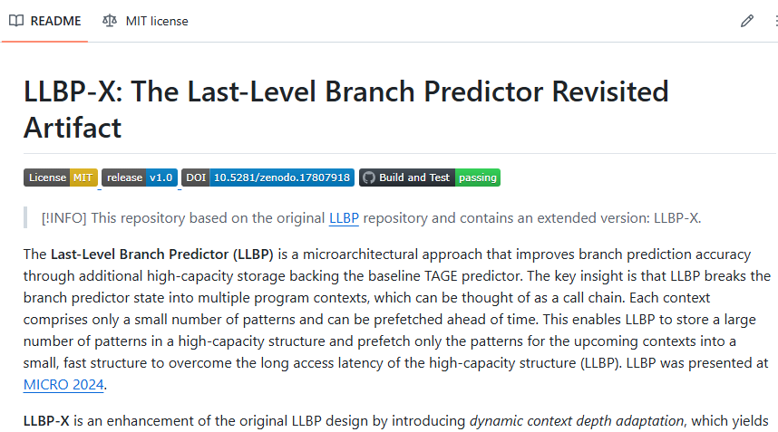
Thank you!
Extensive characterization
Design details
Sensitivity studies
LLBP-X implementation
(CBP & gem5)
https://github.com/dhschall/LLBP-X/

