Slide 1




vSwarm-µ: Microarchitectural Research for Serverless
David Schall
University of Edinburgh
Jun 18, 2022
ISCA’22: gem5 tutorial
Notes:
Hello, Im David and what I want to present to you today is a Framework, that allow microarchitectual research for serverless. Ok so now there are two questions, first of all what is serverless and secondly why do we need this framework.

Slide 2

Cloud Applications: from Monoliths to Serverless
Monolithic app
Microservices
Serverless
<f1>
Online Shop
<f2>
<f3>
<f5>
<f4>
<f6>
<f7>
<f8>
<f9>
Conventional cloud deployments:
Virtual machines that stay up for long periods of time
User is billed even when the service is idle
Serverless cloud deployments:
Functions are invoked on-demand
No invocations → no cost
> 50% of cloud customers use serverless [Datadog 2022]
Serverless is big … and growing!
Notes:
*** NEW:
Ok lets go step by step and start by briefly overviewing how complex services are deployed in the cloud. Traditionally, a service would be packaged up as a beefy virtual machine image that would run on a cloud server. The only way to scale the service was to run more instances of the entire VM. Microservices improved on the situation by breaking down the complex service into a set of blocks each of which can be scaled independently. However, for both monolithic and microservice-based deployments, whenever the service is idle, the cloud customer must still pay for the active virtual machines.
Enter serverless, a radically different cloud execution model. In serverless, applications are decomposed into collections of stateless functions that are invoked on-demand. When there are no invocations, nothing runs and the cloud customer doesn’t pay. Moreover, launching or shutting down serverless functions in response to load is done automatically by the provider, making this execution model perfectly elastic both in terms of scalability and cost. Cloud customer love this, and – not surprisingly - adoption of serverless has been skyrocketing. A recent study reports that over half of all cloud customers use serverless.
*** OLD:
The term serverless popped up a few years ago in cloud applications. Typically if we think about cloud applications we think about fat virtual machine which comprises our application and constantly run on a reserved hardware instance in the cloud. Microservices disaggregates an application into different modules each implemented in its own image. The main drawback of this approach is that those images always cost money and resources even when they are idle.
Now in the serverless approach we don’t have virtual machine images. Instead we have tiny little functions which get executed only on demand. This means that when there is no demand there is also no cost. Which is great! And with this feature its not surprising, that serverless has emerged to be quite big nowadays. The biggest cloud provider just reported, that more than 50% of their customers already use one of their serverless technology.
So lets get a bit more background how serverless works.

Slide 3
Serverless Basics
Datacenter application organized as a collection of stateless functions
Functions invoked on-demand
via triggers (e.g., user click) or by another function
Functions are stateless: facilitates on-demand scaling down to zero
Zero is not possible for monoliths & microservices
Developers: pay only per invocation (CPU + memory), not idle time
Key difference from monoliths & microservices!
Financial incentive to reduce function footprint
Cloud providers: high density and utilization at the server level
<f1>
<f2>
<f3>
<f5>
<f5>
<f4>
<f6>
<f4>
<f4>
<f7>
<f8>
<f9>
<f7>
Workloads are changing
Notes:
In the serverless programming model you implement your application as a collection of stateless functions. The functions are invoked on demand via a trigger events and the functions are stateless which is nice because it enables this rapid on-demand scaling down to zero.
The developer pays only per invokation -- that is, the time that the CPU was busy running the function.
Also this scaling down to zero is great for the cloud providers because they don’t need to provide expensive hardware for idle spinning nodes.
Ok but this is now quite different then what we had before

Slide 4

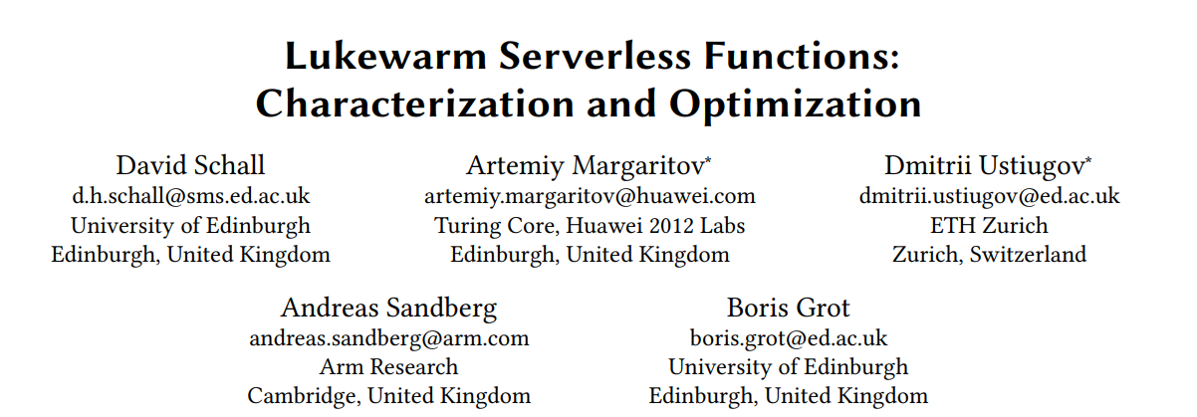
Serverless on a Server
Serverless represents a new class of workloads
Unique characteristics and challenges
Short function execution times: a few ms or less
Small memory footprint
Sporadically invoked (seconds or minutes)
Serverless runs on CPUs designed for conventional workloads
Problematic: Inefficient (lukewarm) execution
Session 9A: Lukewarm Serverless Functions: Characterization and Optimization
High demand of microarchitectural support for emerging workloads
gem5 is designed to study conventional workloads
Limited support for serverless software stack in the reference setup
Workload highly depend on server-client communication
Incomplete and misleading simulation results
What are the limitations of gem5?
Notes:
The thing is that serverless workloads nowadays runs on CPUs designed for conventional workloads. And that this has implications on the effictinty we found in our recent work Ill present next week at the main conference.
And what we found was that the cpu is wasting a lot of cycles while executing these workloads and there is a high demand to add uarch support for these kind of workloads.
The good news is that we have a great tool with that we can evaluate new design indeas. gem5
The bad news is that gem5 is designed to study conventional workloads which makes completely sence as we wanted to design CPUs for conventional workload.
But this implies that gem5 has limited support in its reference setup to study serverless workloads with their unique characteristics which result in incomplete data and may mislead research.
Ok lets understand what those limitations are

Slide 5


1. Challenge of Serverless Host Simulations
Conventional workloads
Serverless workloads
Full Application
Simulated
Full Application
System
User
System
User
Execution timeline
Execution timeline
Simulation timeline
Simulation timeline
Long running applications
Challenge: Infeasible simulation times
Cannot simulate full application in cycle accurate mode.
Solution: Focus on application (what matters)
Simplified software stack in favour of simulation speed
System stack components are negligible
Good support from gem5
SimPoints, regions of interest, snapshots,…
Short execution times of serverless functions
Function can be simulated in full
Significant fraction of execution spent in system stack
Key layers are not supported by gem5 out of the box
Isolation: Containerization, virtualization
Key layers in the communication stack are simplified
gem5 must support the full system stack
Notes:
So what you can see here is what we typically have. A conventional workload running for a long period of time.
And exactly this is also the problem for conventional workloads that the long execution times make it impossible to simulate them in full in cycle accurate mode.
What we do In order achievable feasible simulation times is we focuse on the part that matters and simulate only representative parts of the full application.
Also for example what we do is we cut most parts of the system stack. I.e. for spec benchmarks the OS has negligible impact on the CPU performance.
As this is a long existing problem it is well explored and we have good mechanisms like simpoints, regions of interest or snapshots and gem5 has good support for it.
Now for serverless the picture is completely different because here we have very short execution time. Now the good news is that this means we can simulate the function in full ☺ The bad news is that a significant part of the overall execution time is spend in exactly that system stack we just simplified.
Key layers are not supported byout of the box gem5 does not support key layers of the serverless stack like containerization or isolation.
So what we need is

Slide 6



Enabling Serverless on gem5
Serverless function consist of:
Function code
Dependent libraries
Remote Procedure Call (RPC) communication framework
Everything packaged as container image.
vSwarm-u: Serverless stack for gem5
Kernel compatible with gem5 and containerization
Modules necessary: cgroups, overlays, bridge and net filtering,…
gem5 cannot load modules dynamically → need to be compiled.
Modern OS with container engine installed
Publicly available https://github.com/ease-lab/vSwarm-u
Bonus: vSwarm: Serverless benchmark suite
20 ready to use containerized functions that run on gem5.
Publicly available https://github.com/ease-lab/vSwarm
Serverless software stack
Container
Function
Client
Libraries
RPC stub
RPC server
Container Engine
Host OS / Kernel
Hardware
vSwarm-u allows simulation of containers with gem5
Notes:
We have a precompiled linux kernel v5.4 and also

Slide 7
2. Challenge of Serverless Host Simulations
Conventional workloads
Serverless workloads
Client
Server
Core
Core
Core n
App
Core
f
client
I-$
D-$
I-$
D-$
I-$
D-$
LLC
Memory Subsystem
LLC
Memory
NIC
Memory
NIC
Ethernet
Long execution times:
Modelling only core components is sufficient
CPU core and memory subsystem
Long execution times eliminate side effects of simplified test environment.
Simple script for starting the application is sufficient
Taking the mean is representative
Short execution times:
Communication is significant of execution time
affected by many components
Other cores, network,…
Require sophisticated test environment
Isolation between client and server node
Precise trigger points for taking measurements
Representative infrastructure for detailed evaluation is required

Slide 8
Requirements on Test Infrastructure
Before measurement:
OS booting
Start function container
Establish connection
Functional warming
I.e. for warming JIT engine in NodeJS code.
Mechanism: m5.switchCpus(from, to)
Use kvm core for booting, container start and warming
Detailed core for measurement
Use checkpoints after functional warming
m5.checkpoint(path/to/checkpoint)
Use m5 binary tool to control gem5
KVM
Detailed
Client
OS Booting
f
f
f
Server
Start container
Functional warming
## Spin up Container
docker run -d --name func-container -p 50051:50051 $IMAGE_NAME
## Pause simulation and switch CPU
m5 exit ## Use ‘m5 fail <code>’ to also send a code to gem5
Checkpoint
KVM accelerates, m5 controls booting and warming

Slide 9
Requirements on Test Infrastructure
During measurement
Want to simulate several invocations, different inputs
Precise trigger points are required
Client side: Instrumented go client
m5ops
Server side: Instrumented Scheduler
Attach FuncEvent to the symbol table
Use ThreadInfo to get previous and next pid
Kernel need to be build for it.
React on certain scheduling events
f
m5.WorkBegin(n, 0) // 21: Send Request client.Request(pkt) // Invoke function (nth invocation)
m5.WorkEnd(n, 0) // 22: Received Response
Request
Response
Client
f
Server
Workitem
Function is scheduled
if (prev_pid == 0) ppSwitchIdleActive->notify(true);
…
exitSimLoop(<Exit message>,0, curTick(),0);
vSwarm-u offers the test infrastructure for serverless

Slide 10
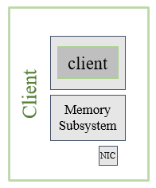
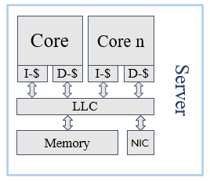
vSwarm-u Roadmap
What is available already
Support for containerized workloads
Ready to use standalone kernels from vSwarm
20 Functions, three runtimes
Server-client test infrastructure
One and two machines setups with several cores
Trigger point for client side (server side will be rolled out soon)
Actively used for research
ISCA’22 Session 9A: Lukewarm Serverless Functions: Characterization and Optimization
What we plan to do
Support for Knative in gem5
Container orchestrator with autoscaling.
Support distributed workloads
Support for Arm Instruction set
Virtualization
Arm already supports virtualization
f
f
f
Network
f
f
Call for contribution

Slide 11
Takeaways
Serverless functions present new challenges for modern CPUs
Unique workload characteristics have limited support in conventional microarchitecture.
Urgent need for more research in hardware for serverless
Unique workload characteristics have new requirements on research platforms
Short execution time require to model the full system / software stack
Simplifications in the software stack and test setup result incomplete results
vSwarm-u: Framework for microarchitectural research of serverless workloads.
Modern software stack to simulate containerized workloads with gem5
Robust test infrastructure to do detailed evaluation
Enabled Microarchitectural research for serverless

Slide 12

Thank you! Questions?
Start Microarchitectural Research for Serverless:
https://github.com/ease-lab/vSwarm-u

