Slide 1
Beyond Accuracy: Evaluating the Reasoning Behavior of
Large Language Models - A Survey
Short Story Review
By: Dhruval Shah

Slide 2
Introduction
Exploring beyond task accuracy, this survey investigates if Large Language Models (LLMs) can reason like humans, highlighting the gap in our understanding of LLMs' reasoning processes and the over reliance on shallow patterns over deeper insights

Slide 3
Understanding Reasoning
Reasoning, both in humans and AI, is the process of deriving conclusions from premises given. While humans use implicit reasoning in everyday decisions, LLMs' reasoning is analyzed based on their response to specific tasks they were already trained on, focusing on their actions and the mechanisms they employ.

Slide 4
Categorizing Reasoning Tasks
This survey categorizes reasoning tasks into two types: Core and Integrated. Core Reasoning Tasks test LLMs on fundamental reasoning skills—logical, mathematical, and causal. Integrated tasks combine multiple core skills, but the focus here in this survey paper is solely on core tasks

Slide 5
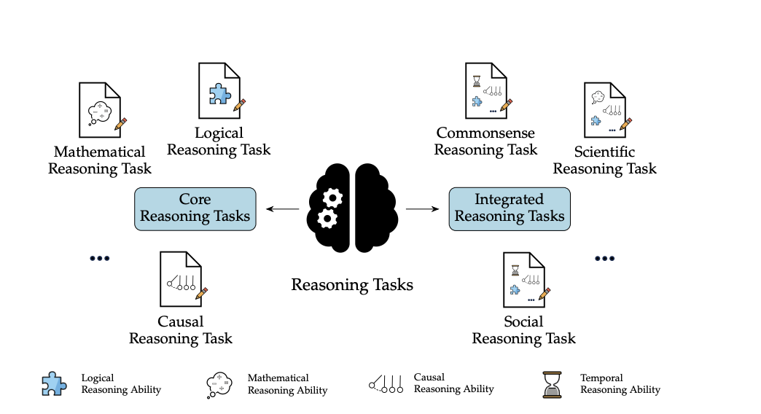

Slide 6
Logical Reasoning
LLMs show varied success in logical reasoning, capable of engaging in deductive, inductive, and abductive reasoning. However, they often rely on identifying patterns, leading to challenges when faced with novel or complex scenarios outside their training.

Slide 7
Mathematical Reasoning
In mathematical reasoning, LLMs excel in familiar problems but struggle when presented with slightly altered problem statements. This indicates a reliance on memorization over genuine understanding, highlighting a key limitation in their reasoning capabilities.

Slide 8
Causal Reasoning
Causal reasoning in LLMs is tested through their ability to understand cause-and-effect relationships. LLMs can mimic this reasoning for scenarios they've been trained on but struggle with novel tasks, showing limitations in their ability to truly 'understand' causality.

Slide 9
Evaluation Methodologies Overview
The survey introduces four methodologies for evaluating LLMs' reasoning: Conclusion-based, Rationale-based, Interactive, and Mechanistic evaluations, each offering unique insights into the reasoning behavior of LLMs.

Slide 10
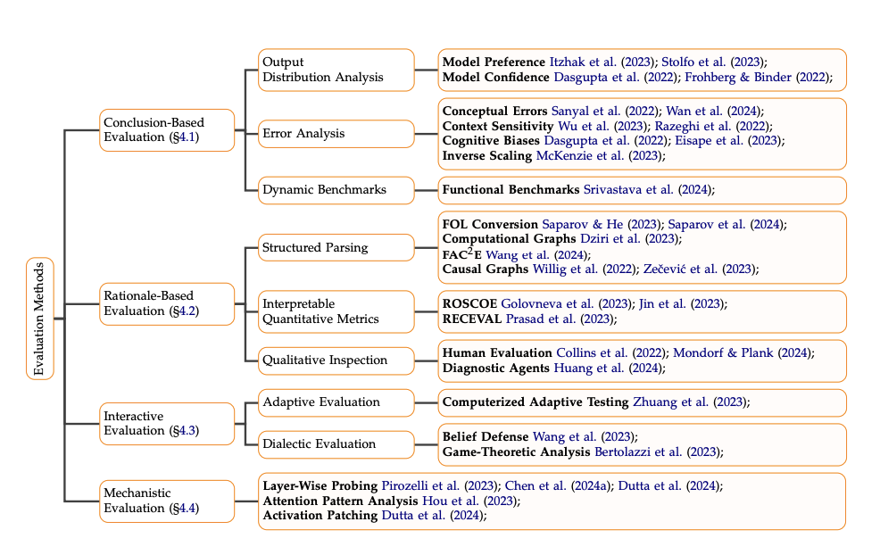

Slide 11
Conclusion-Based Evaluation
This methodology assesses LLMs based on the accuracy and relevance of their conclusions, using error analysis to identify patterns in mistakes, thus testing the models' adaptability and generalization capabilities.

Slide 12
Rationale-Based Evaluation
Rationale-based evaluation delves into the 'thought process' of LLMs, analyzing the logical steps they take to reach conclusions. It assesses the coherence, validity, and consistency of their rationales, aiming to understand if LLMs mimic human thought processes.

Slide 13
Interactive Evaluation
Interactive evaluation involves engaging LLMs in dynamic dialogues, mimicking human learning environments. It tests the models' ability to adapt their reasoning in light of new information, assessing their conversational reasoning skills

Slide 14
Mechanistic Evaluation
This method aims to understand the internal workings of LLMs during reasoning, analyzing models' attention patterns, layer functions, and activation flows to uncover the computational bases of their reasoning behavior.

Slide 15
Key Insights
LLMs demonstrate an impressive yet limited ability to mimic human reasoning, heavily relying on pattern recognition. The survey highlights the need for more nuanced evaluation methods to fully capture the complexity of LLM reasoning processes.

Slide 16
Future Research Directions
The survey calls for research focused on enhancing LLMs' generalization capabilities and developing sophisticated evaluation methodologies that go beyond traditional task performance metrics, aiming to bridge the gap between human and AI reasoning.

Slide 17
The Journey Ahead
Understanding LLMs' reasoning abilities is an ongoing journey, with the ultimate goal of developing models that not only compute but truly comprehend and reason, mirroring the depth of human thought

Slide 18
Closing Thoughts
This survey underscores the importance of advancing our understanding and evaluation of LLMs' reasoning abilities, paving the way for future AI systems that are more aligned with human-like reasoning.

Slide 19
THANK YOU

