Slide 1
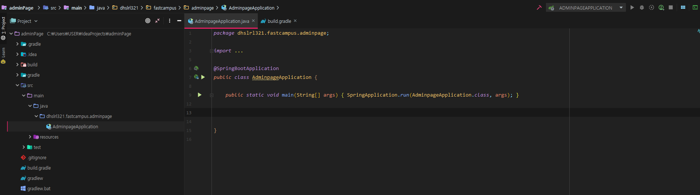

Slide 2
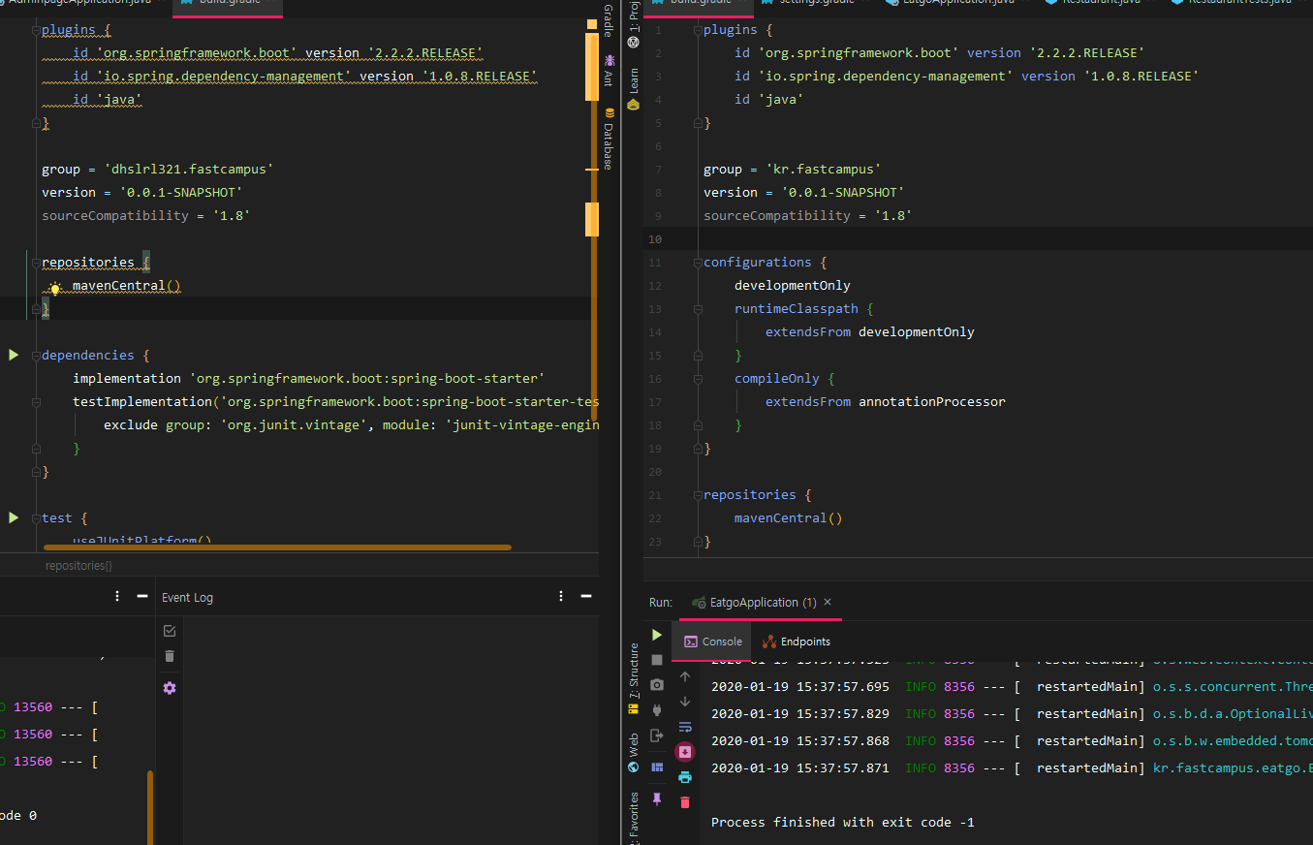

Slide 3
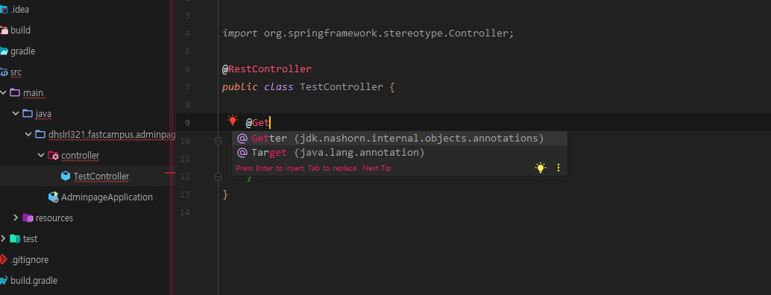

Slide 4
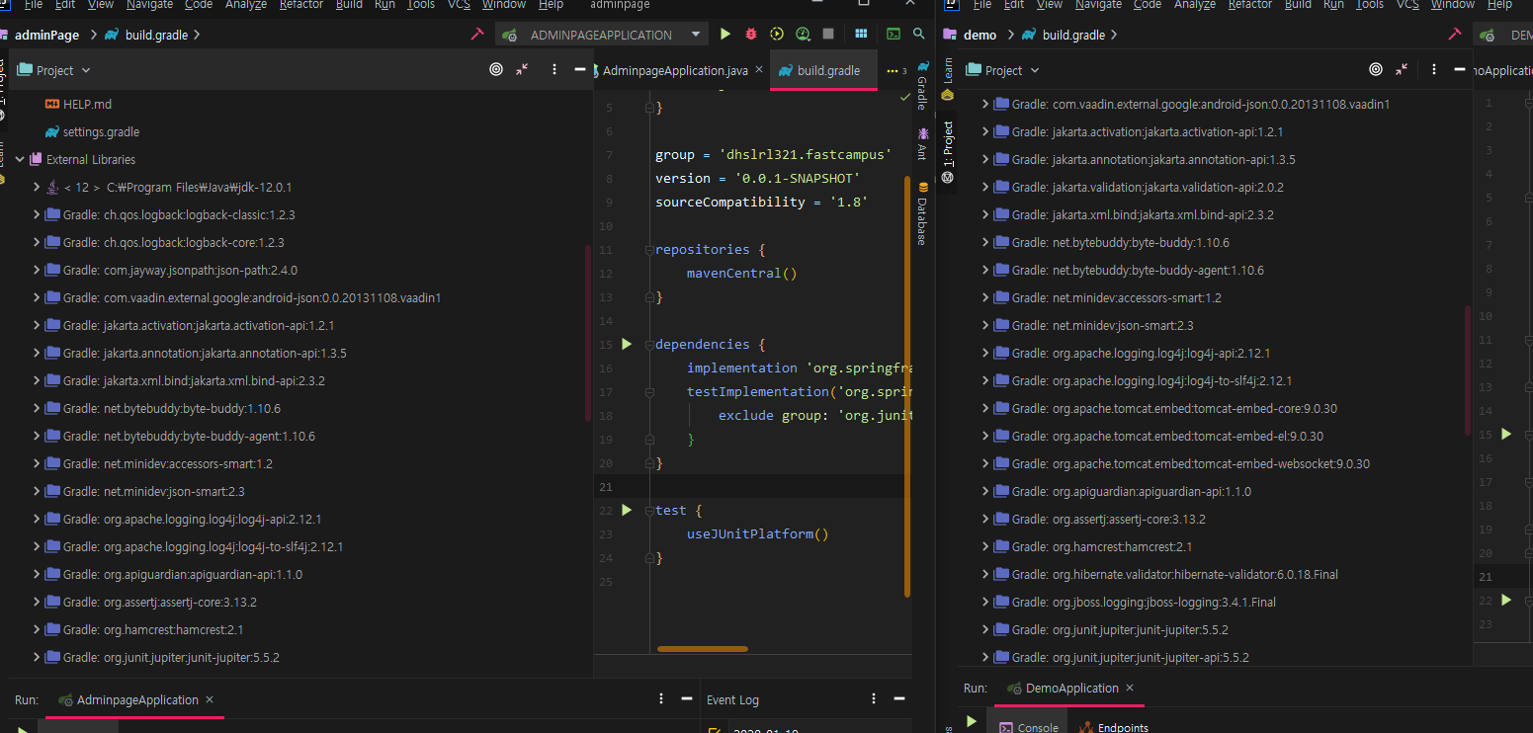

Slide 5
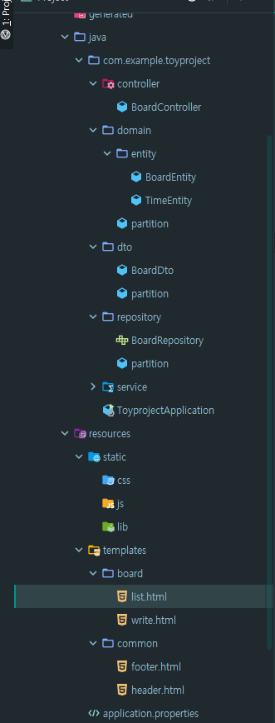
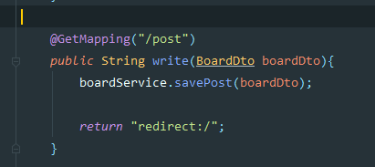
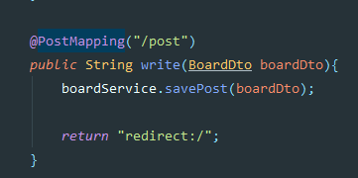

Slide 6
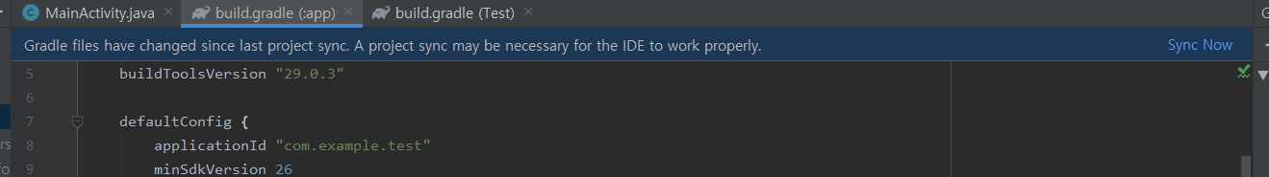
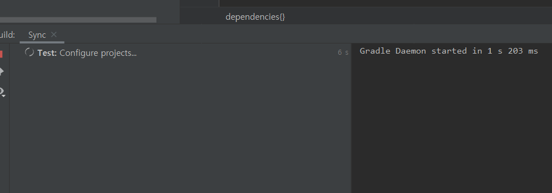



Slide 7
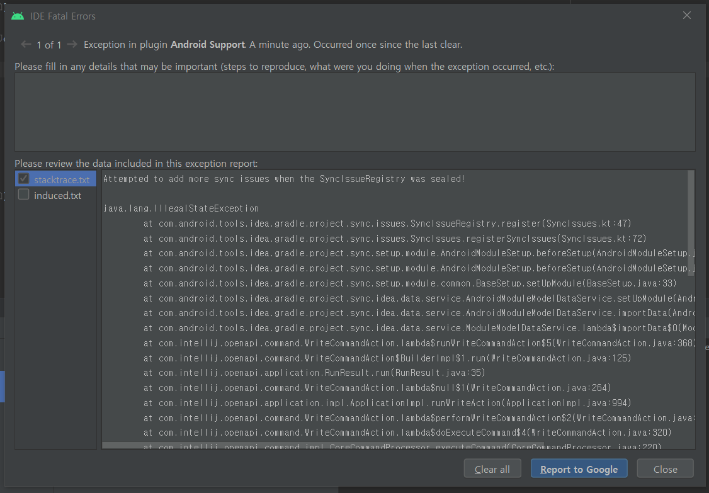

Slide 8
Attempted to add more sync issues when the SyncIssueRegistry was sealed!
java.lang.IllegalStateException
at com.android.tools.idea.gradle.project.sync.issues.SyncIssueRegistry.register(SyncIssues.kt:47)
at com.android.tools.idea.gradle.project.sync.issues.SyncIssues.registerSyncIssues(SyncIssues.kt:72)
at com.android.tools.idea.gradle.project.sync.setup.module.AndroidModuleSetup.beforeSetup(AndroidModuleSetup.java:43)
at com.android.tools.idea.gradle.project.sync.setup.module.AndroidModuleSetup.beforeSetup(AndroidModuleSetup.java:28)
at com.android.tools.idea.gradle.project.sync.setup.module.common.BaseSetup.setUpModule(BaseSetup.java:33)
at com.android.tools.idea.gradle.project.sync.idea.data.service.AndroidModuleModelDataService.setUpModule(AndroidModuleModelDataService.java:91)
at com.android.tools.idea.gradle.project.sync.idea.data.service.AndroidModuleModelDataService.importData(AndroidModuleModelDataService.java:77)
at com.android.tools.idea.gradle.project.sync.idea.data.service.ModuleModelDataService.lambda$importData$0(ModuleModelDataService.java:79)
at com.intellij.openapi.command.WriteCommandAction.lambda$runWriteCommandAction$5(WriteCommandAction.java:368)
at com.intellij.openapi.command.WriteCommandAction$BuilderImpl$1.run(WriteCommandAction.java:125)
at com.intellij.openapi.application.RunResult.run(RunResult.java:35)
at com.intellij.openapi.command.WriteCommandAction.lambda$null$1(WriteCommandAction.java:264)

