Slide 1
Ethics for Digital Projects and Research
Alexis Grant
University of Illinois at Chicago
@missalexisgrant
Based on content created by Kelsey Chatlosh
[See: README.MD]

Slide 2
Getting Started
Be ready to talk!
Be critical (of yourself and others)
Prepare for change

Slide 3
Roadmap
By the end of this workshop, participants will:
Understand ethical practices to satisfy institutional needs (IRB) when working with "human subjects"
Learn specific ethical questions and levels of impact to consider when doing various forms of digital research and using digital tools, including: (1) direct impacts on people through data collection; (2) the politics of knowledge production and categorization; and (3) social, political, and economic impacts of projects or research
Critically consider questions of accessibility and openness, for people of varying (dis)abilities, and depending on people's language fluencies, access to technology and speedy internet, and geo-political location in the world
Engage with alternative approaches and case examples
Envision the ethics of their own projects and methodologies
[See: introduction.md]

Slide 4
What are ethics? What do we mean by digital projects and research?
[See: introduction.md]

Slide 5
“situated ethics”
Our understanding of and commitment to ethics are linked to our own experiences, positionalities, political orientations, and contexts
[See: introduction.md]

Slide 6
Ethics from the standpoint of the institution

Slide 7
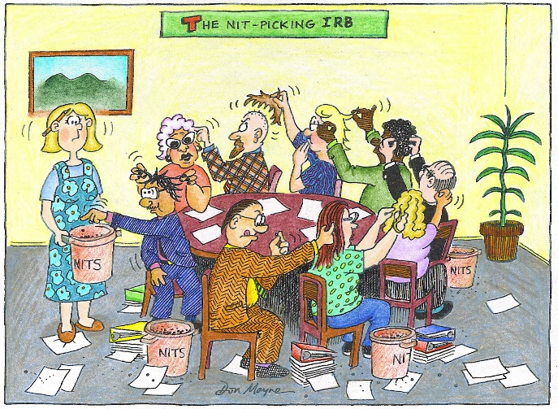
Source: https://intentionalmuseum.files.wordpress.com/2014/03/1609_color_nit-picking_irb.jpg
[See: institutional.md]

Slide 8
The Belmont Report
The National Commission for the Protection of Human Subjects of Biomedical and Behavioral Research, created as a result of the National Research Act of 1974, published the Belmont Report in 1979. Following the outrage to unethical practice such as the Tuskegee Syphilis Study.
[See: belmont.md]

Slide 9
The Belmont Report
3 core principles
3 key concerns
Respect for persons
Beneficence
Justice
Informed consent
Assessment of risks and benefits
Selection of subjects
[See: belmont.md]

Slide 10
Every university or research institution must, legally, have its own or an affiliated Institutional Review Board (IRB).
[See: irb.md]

Slide 11
IRB
Usually, IRB review is required when research is…
Conducted at this organization;
Conducted by or under the direction of any employee or agent of this organization (including students) in connection with his or her organization responsibilities;
Conducted by or under the direction of any employee or agent (including students) of this organization using any property or facility of this organization; or
Involving the use of this organization's non-public information to identify, contact, or study human subjects.
[See: irb.md]

Slide 12
Pair up and discuss…
In 1 minute each, what is the purpose of your project—what does it aim to do?
In 1 minute each, what is the design of your project—how will you do this?
In relation to each of your projects' purpose and design, what might be some ethical concerns that fall beyond questions of legality or the purview of the IRB?
Share as a class.
[See: beyond.md]
Notes:
Think about a digital project or research you are or will be working on. Pair up with another person near you and discuss

Slide 13
Ethics beyond compliance
An “impact approach” (Markham 2016)
[See: levelsimpact.md]

Slide 14
Overview
Drawing from Markham (2016), we will focus on three levels of impact:
Direct impacts on people
Ramifications of (re)producing categories
Social, political and economic effects
[See: levelsimpact.md]

Slide 15
Overview
Additionally, we will consider the range of impact, or the range of accessibility to your work:
to marginalized populations and communities
to people with disabilities,
to people in different countries or who speak different languages, and
in terms of cost and proprietary accessibility.
[See: levelsimpact.md]

Slide 16
Direct Impacts on People
(level of impact 1)

Slide 17
Direct Impacts on People
“how our methods of data collection impact humans, directly” (Markham 2016)
[See: impact1.md]

Slide 18
What counts as "human"? What data should be off limits?
[See: impact1.md]

Slide 19
Commonly blurred definitions
“human subjects”
public vs. private
data(text) vs. persons
(Source: AOIR 2012 report)
[See: impact1.md]

Slide 20
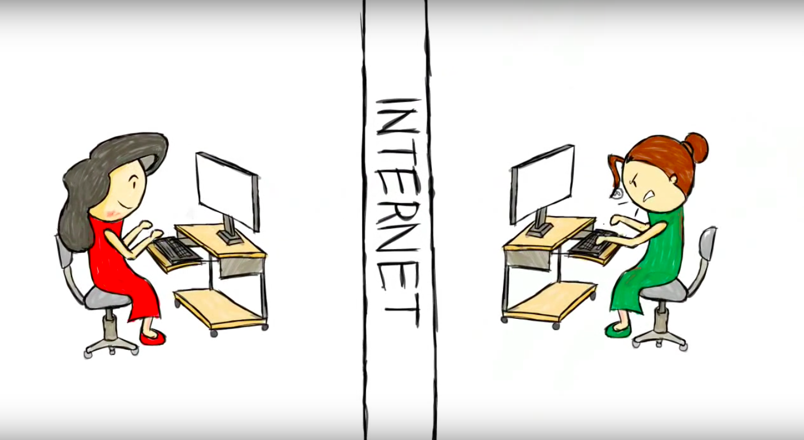
The Distance Principle
[Image source: A still image from "A real person, a lot like you" by Derek Sivers, shared with his permission]
[See: impact1.md]

Slide 21
“Public Data”
Do we really have privacy?
Research vs. spying
What public data is ethical to use?
How might we share data?
[See: impact1cont.md]

Slide 22
The Question of Personhood
[See: impact1cont.md]

Slide 23
Considerations of Representation
[See: impact1cont.md]

Slide 24
Activity
Review Joshua Tabak and Vivian Zayas's academic article [tinyurl.com/tabakzayas] and their summary of it for the New York Times [tinyurl.com/gaydarscience], and discuss:
What kinds of “human subjects” are involved in this study?
Is a social media photo of oneself an extension of the self?
Does their methodology raise any ethical concerns? Discuss with your table, then share as a group. Further reading: Patrick Sweeney, "Images of Faces Gleaned from Social Media in Social Psychological Research on Sexual Orientation," 2017 [tinyurl.com/sweeneyimages]
[See: impact1cont.md]

Slide 25
Politics of Knowledge Production and Categorization
The ramifications of (re)producing categories
(level of impact 2)
[See: impact2.md]

Slide 26
“how our methods of organizing data, analytical interpretations, or findings as shared datasets are being used—or might be used—to build definitional categories or to profile particular groups” (Markham 2016)
[See: impact2.md]

Slide 27
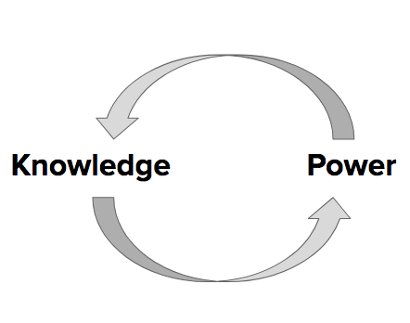
[See: impact2.md]

Slide 28
Discuss as a group…
How are knowledge and power mutually constituted, according to the theorizations of Gramsci, Hall, Foucault, Freire, or others, perhaps from your own discipline?
How might we apply the concepts below when thinking through ethics for digital research and projects?
How do my assumptions and biases impact my research approach?
[See: impact2.md]

Slide 29
How do digital tools and projects categorize or rely on categorizations?
[See: impact2.md]

Slide 30
What are some ramifications of (re)producing categories?
[See: impact2cont.md]

Slide 31
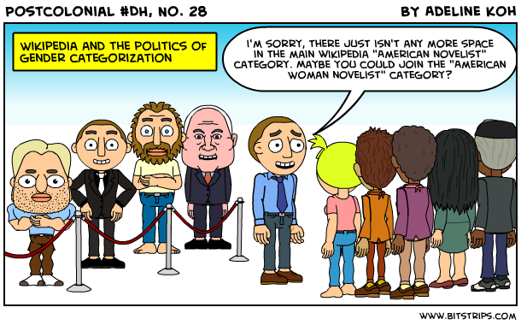
[Image source: A comic by Adeline Koh from #DHPoco: Postcolonial Digital Humanities, shared here with her permission.]
[See: impact2cont.md]

Slide 32
bias in
bias out
[See: impact2cont.md]

Slide 33
Can categorical hierarchies and existing bias be resisted through digital projects? If so, how?
[See: impact2cont.md]

Slide 34
Activity
Let's analyze and discuss a case study. Check out the Interference Archive (IA) website [interferencearchive.org], read this brief article [tinyurl.com/joynerhidden] and discuss:
What kinds of materials does IA host and do they have rights to it?
In reference to the article, how does IA see itself as “resisting the hierarchy” (Joyner 2016)?
What levels of impact does IA aim to take into account?
Discuss with your table, then share as a group.
[See: impact2cont.md]

Slide 35
Social, Political, and Economic Impacts
(Level of impact 3)
[See: impact3.md]

Slide 36
Whose labor and what materials are used to make the digital tools we use? How should we attribute others' labor? How can we be held accountable?
[See: impact3.md]

Slide 37
How may digital projects or research be used to justify or facilitate potentially harmful control or surveillance?
[See: impact3.md]

Slide 38
How may digital projects or research influence social or political discourse? Modes of profit?
[See: impact3.md]

Slide 39

All projects and research have impacts.
[Image source: Image source: Sergiu Bacioiu from Romania, "Ripple effect on water," Wikimedia, Creative Commons Attribution 2.0 Generic license.]
[See: impact3.md]

Slide 40
Pair up and discuss…
Whose labor and what materials do you rely upon to do your work?
Could your research or project be used to justify or facilitate potentially harmful control or surveillance?
How could your work cause changes to or justify social, economic or political discourses?
Will your work be used for profit, for who?
Share as a class.
[See: impact3.md]
Notes:
Will your work be used for profit, for who?

Slide 41
Range of Impact
Accessibility in your work
[See: range.md]

Slide 42
What is universal design? What is accessibility?
[See: range.md]

Slide 43
Accessibility to marginalized populations and communities
[See: range.md]

Slide 44
Accessibility to people with disabilities
[See: range.md]

Slide 45
International accessibility and language access
[See: range.md]

Slide 46
Openness and accessibility
[See: range.md]

Slide 47
Other kinds of accessibility?
[See: range.md]

Slide 48
When might researchers or makers not want to make their work or data fully open and accessible?
[See: range.md]

Slide 49
When might researchers or makers decide not to even record data or media, or to delete it?
[See: range.md]

Slide 50
Pair up and discuss…
Who will be able to access your research or project?
Where and through what media will it be accessible?
Will it cost money to access?
Will it be accessible in different languages?
Will it be accessible to people with visual, hearing, mobility, or other physical, sensory, or cognitive disabilities?
Share as a class.
[See: range.md]
Notes:
Will your work be used for profit, for who?

Slide 51
See additional case examples, a glossary of key terms and concepts, and a resources page on the DHRI ethics curriculum on GitHub
[See: cases.md, glossary.md, and resources.md]

Slide 52
Debrief
By the end of this workshop, participants have:
Reviewed ethical practices to satisfy institutional needs (IRB) when working with "human subjects.”
Learned specific ethical questions and levels of impact to consider when doing various forms of digital research and using digital tools.
Engaged with alternative approaches and case examples.
Envisioned the ethics of their own projects and methodologies.
[See: review.md]

Slide 53
Next Steps
Determine institutional requirements
Explore ethics beyond compliance
Reassess your research methodology
[See: review.md]

