Slide 1
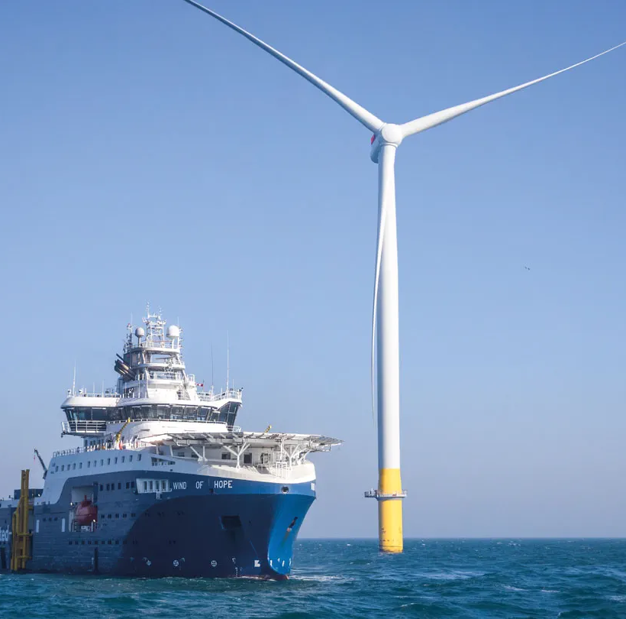
Wind Power
Plants
How a wind turbine
generates electricity
Yangzi Liu
Haitian Dai
Notes:
Presenter A 00:00–00:30
Good afternoon, everyone. Today we are going to explain how a wind power plant works. We will start with the turbine, then follow the electricity to the grid. I will cover the equipment and the main performance measures. My partner will explain grid support, environmental impacts, and a real offshore wind farm.
中文提示：用正常语速介绍主题与分工。不要在开场把后面所有知识点都念一遍。
R1: U.S. Department of Energy. How Do Wind Turbines Work?
https://www.energy.gov/cmei/systems/how-do-wind-turbines-work
Image source: https://cdn.orsted.com/-/media/www/images/corp/uk/expert-take/hornsea-2/56a-wind-of-hope-a2l.jpg?extension=webp&hash=E11C89B3CC7A6AAEE52EC3E9AC23F08A&mh=1440&mw=1440&rev=1b15ecc03bf34e4b83a154639c54c8c7

Slide 2
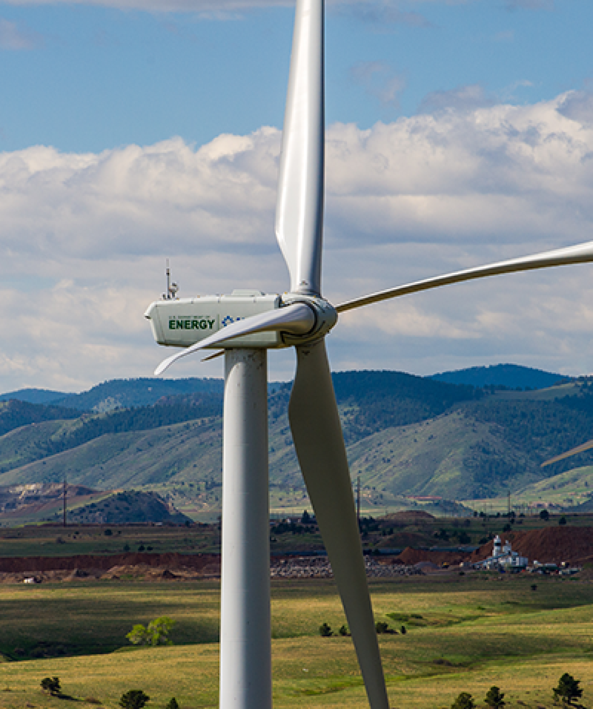
Wind as an energy source
Moving air carries kinetic energy.
The available energy changes with wind speed.
Image: U.S. Department of Energy
02
Notes:
Presenter A 00:30–01:15
The energy comes from moving air. We can see a rotor placed high above the ground, where it can intercept that air flow. The turbine does not burn a fuel to generate electricity. But it also cannot choose when the wind will blow. Even at a good site, wind speed changes during the day and across the seasons. That is why a turbine's rated power alone cannot tell us how much electricity it will produce. We need to understand both the machine and the wind at its location.
中文提示：指着照片中的转子和塔架，解释能源来自空气运动。最后一句引出后面的功率与容量因子，不展开环境影响。
R1: U.S. Department of Energy. How Do Wind Turbines Work?
https://www.energy.gov/cmei/systems/how-do-wind-turbines-work
Image source: https://www.energy.gov/sites/default/files/styles/full_article_width/public/2019/08/f66/25897_CROPPED.png?itok=IgKTfBNx

Slide 3
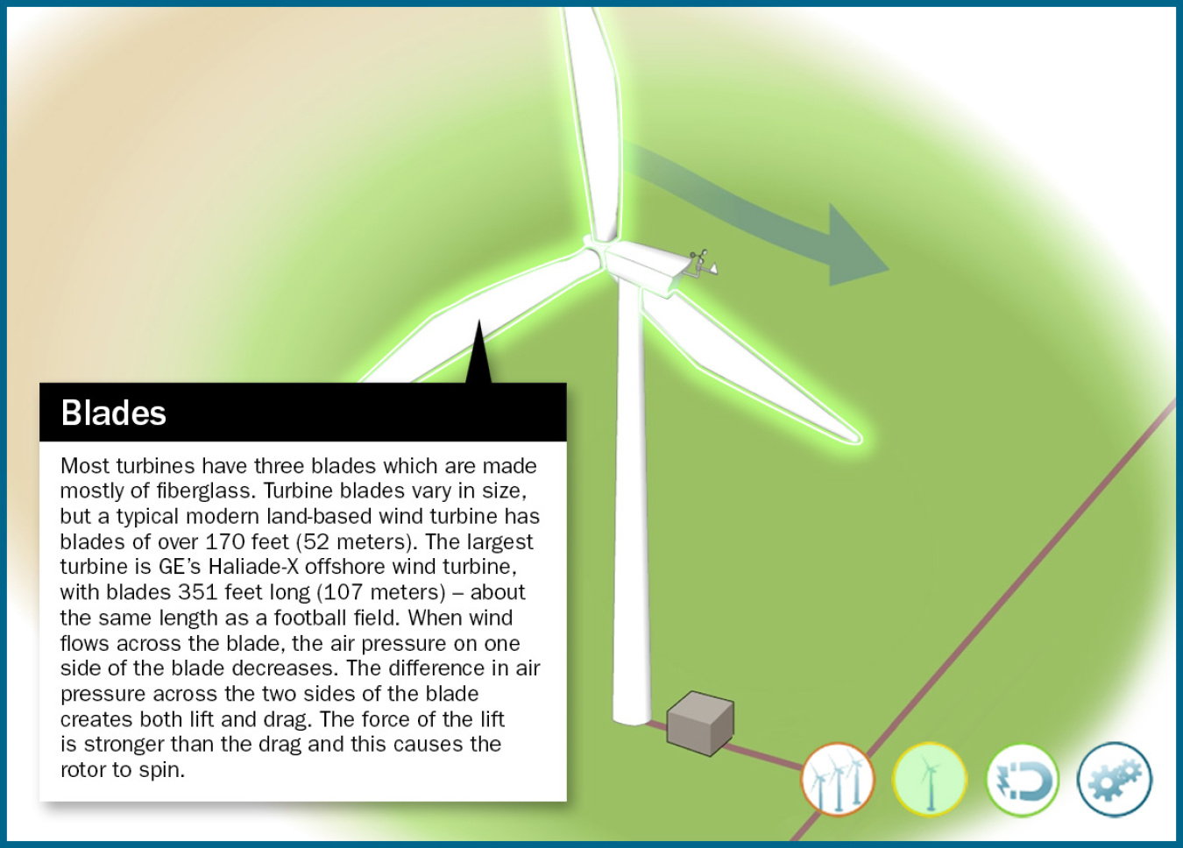
How blades turn the rotor
Each blade has an airfoil profile.
The tangential force produces rotor torque.
Image: U.S. Department of Energy
03
Notes:
Presenter A 01:15–02:15
Modern wind turbine blades work in a similar way to airplane wings. If we look at the cross-section, we can see that it has a special shape called an airfoil.
When the wind flows around the blade, it creates lift and drag. Part of this force helps the blade rotate, creating torque and turning the rotor.
Here, we can see that the blades are connected to the hub. They rotate together and transfer mechanical power to the turbine.
So, the important thing is that the wind doesn't just push the blades directly. Instead, the aerodynamic force helps the rotor spin.
Then, the generator uses this rotation to produce electricity. We will talk about that on the next slide.
中文提示：指叶片、轮毂，按“气流产生气动力，切向分量产生转矩”解释。插图只说明转子位置，不是升力矢量图。
R1: U.S. Department of Energy. How Do Wind Turbines Work?
https://www.energy.gov/cmei/systems/how-do-wind-turbines-work
R3: Burton et al. (2011). Wind Energy Handbook, 2nd edition
https://doi.org/10.1002/9781119992714
Image source: https://www.energy.gov/sites/default/files/styles/full_article_width/public/2021-07/wind-turbine-blades.jpg?itok=THlqet8U

Slide 4
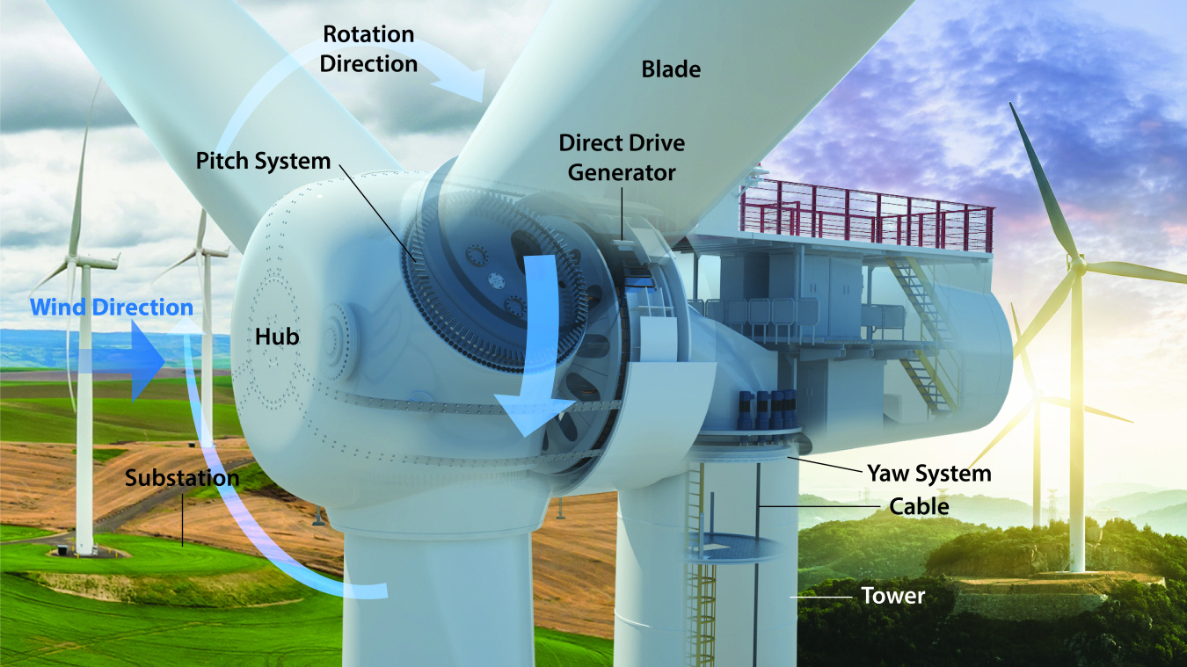
The generator inside the nacelle
Direct drive: the rotor turns the generator directly.
A geared design adds a gearbox between them.
Direct-drive illustration: Josh Bauer / NLR, via U.S. DOE
04
Notes:
Presenter A 02:15–03:20
The part behind the rotor is called the nacelle. In this picture, we can see a direct-drive design. This means the rotor is connected directly to the generator, so there is no gearbox.
The generator changes mechanical energy into electrical energy using electromagnetic action.
Another design uses a gearbox between the rotor and the generator. The gearbox increases the rotational speed, so it can use a different type of generator.
Both designs can generate electricity, but their structures and maintenance needs are different.
The tower supports the nacelle and lifts the rotor higher to catch the wind, while the foundation supports the whole structure.
So, the main thing to remember here is where the generator is located and how the rotor drives it.
中文提示：图是直驱结构，先指 Direct Drive Generator，再说明有齿轮箱机型是另一种设计。不要把图讲成所有风机统一结构。
R1: U.S. Department of Energy. How Do Wind Turbines Work?
https://www.energy.gov/cmei/systems/how-do-wind-turbines-work
R2: U.S. Department of Energy. Explore a Wind Turbine
https://www.energy.gov/cmei/systems/explore-wind-turbine-text-version
R10: U.S. Department of Energy. What Is Wind Energy?
https://www.energy.gov/cmei/systems/windexchange/what-wind-energy
Image source: https://www.energy.gov/sites/default/files/styles/full_article_width/public/2025-09/123838_Wind%20Turbine%20Cutaway_wText_4_4.jpg?itok=b3JPY3iH

Slide 5
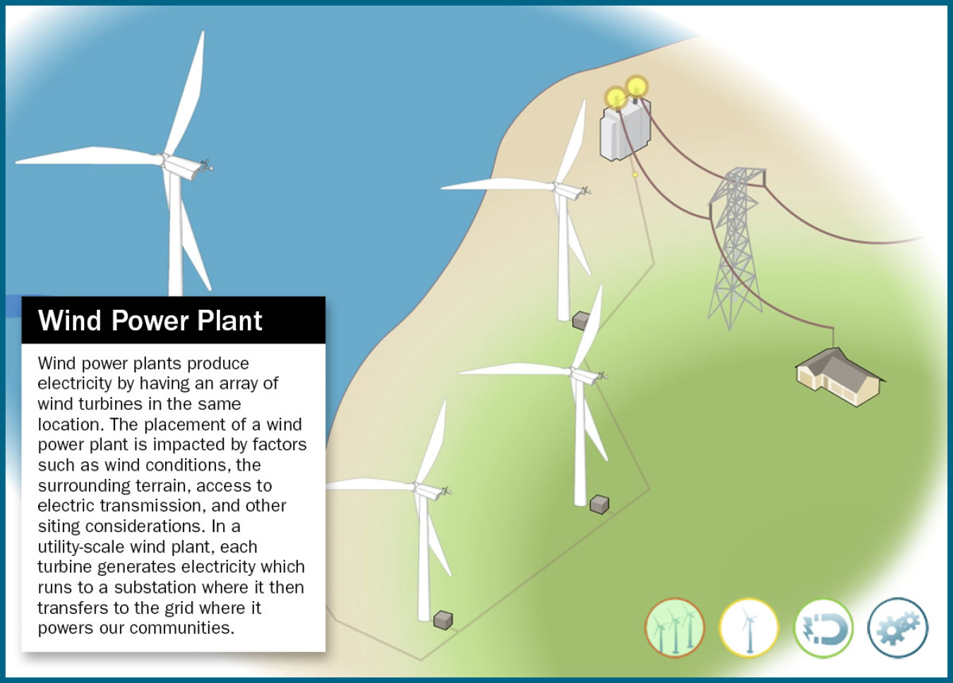
Collecting electricity from a wind farm
Each turbine feeds a collection network.
The substation combines output and raises voltage.
Image: U.S. Department of Energy
05
Notes:
Presenter A 03:20–04:20
One wind turbine is one generating unit. A wind farm connects many turbines together through a collection network.
In this picture, we can follow the cables from the turbines to the substation. The electricity from all the turbines comes together there. Then, transformers increase the voltage so the electricity can connect to the power grid.
Why do we need higher voltage? Because for the same amount of power, higher voltage means lower current. This helps reduce power losses during transmission.
A wind farm also needs other equipment, such as protection devices, meters, switches, and communication systems.
So, the main idea is that the collection network connects many individual turbines and sends their electricity to the grid through one shared connection.
Offshore wind farms work in a similar way, but their cables need to withstand the marine environment.
中文提示：指图中的电缆、变电站与输电线路。讲清集电系统如何连接多台风机，不再复述机舱内部组成。
R2: U.S. Department of Energy. Explore a Wind Turbine
https://www.energy.gov/cmei/systems/explore-wind-turbine-text-version
R3: Burton et al. (2011). Wind Energy Handbook, 2nd edition
https://doi.org/10.1002/9781119992714
Image source: https://www.energy.gov/sites/default/files/styles/full_article_width/public/2021-07/wind-power-plant-main.jpg?itok=Sj3TZlTp

Slide 6
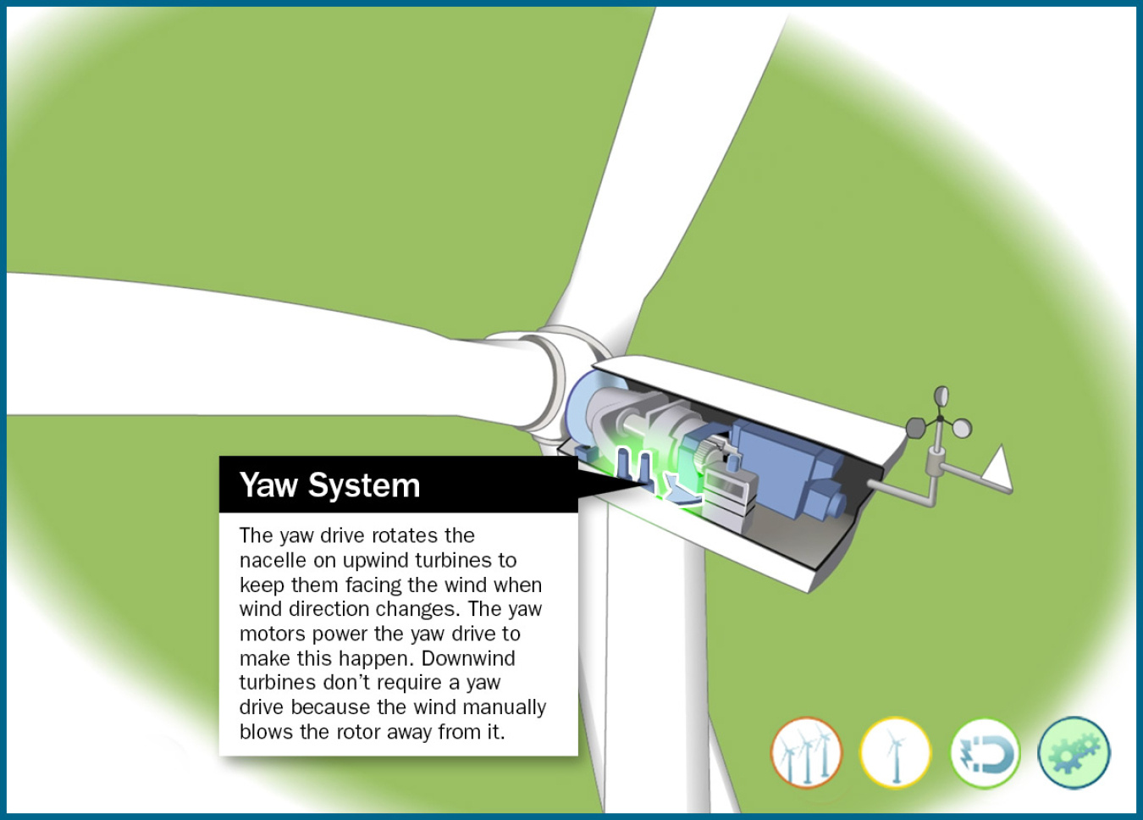
Yaw control
Yaw rotates the whole nacelle.
It keeps an upwind rotor facing the wind.
Image: U.S. Department of Energy
06
Notes:
Presenter A 04:20–05:05
Wind direction can change, so yaw control helps the turbine face the wind.
A wind vane measures the wind direction, and yaw motors turn the nacelle at the top of the tower.
As we can see, the whole nacelle turns with the rotor. This helps the turbine capture more wind energy and reduces uneven loading.
So, yaw control turns the whole nacelle, not the individual blades.
中文提示：指机舱与塔顶之间的偏航机构。用“整台机舱转向”解释，避免把偏航与变桨混为一谈。
R2: U.S. Department of Energy. Explore a Wind Turbine
https://www.energy.gov/cmei/systems/explore-wind-turbine-text-version
Image source: https://www.energy.gov/sites/default/files/styles/full_article_width/public/2021-07/land-based--turbine-yaw-system.jpg?itok=iDJer7-0

Slide 7
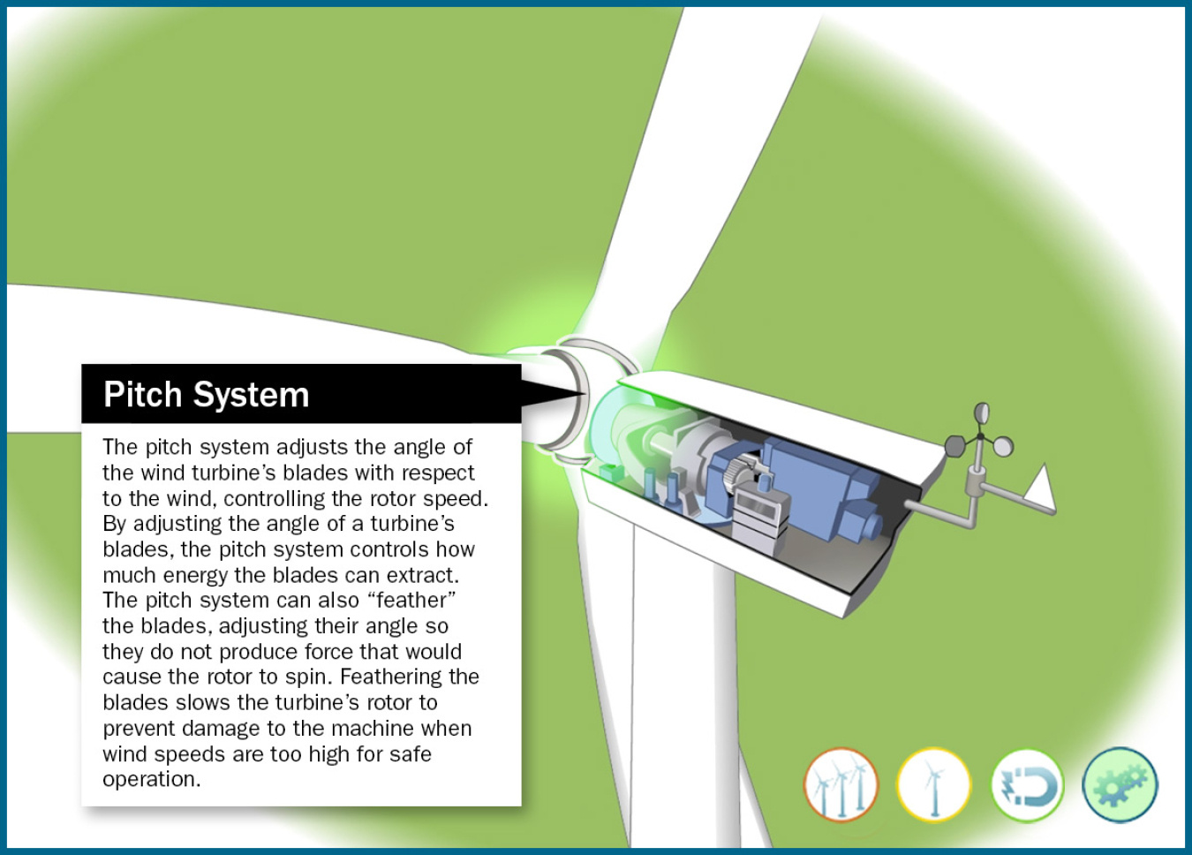
Pitch control
Pitch rotates each blade about its own axis.
It limits power and loads in strong winds.
Image: U.S. Department of Energy
07
Notes:
Presenter A 05:05–05:55
Pitch control changes the angle of each blade where it connects to the hub. This changes the aerodynamic force on the blade.
When the wind is strong, the controller adjusts the blade angle to keep power and loads within safe limits.
If the turbine needs to stop, the blades turn to a feathered position to reduce the force from the wind.
So, more wind does not always mean more electricity. The main point here is that pitch control adjusts the blade angle to control power and keep the turbine safe.
中文提示：指叶根，说明变桨改变叶片绕自身长轴的角度。重点解释额定功率以上的限功率与保护作用。
R2: U.S. Department of Energy. Explore a Wind Turbine
https://www.energy.gov/cmei/systems/explore-wind-turbine-text-version
R3: Burton et al. (2011). Wind Energy Handbook, 2nd edition
https://doi.org/10.1002/9781119992714
Image source: https://www.energy.gov/sites/default/files/styles/full_article_width/public/2021-07/land-based--turbine-pitch-system.jpg?itok=Fef4z2cQ

Slide 8
Wind speed and available power
Pwind = ½ρAv³
Same air density
Same rotor swept area
8 m/s is the baseline
Available wind power under fixed assumptions. Electrical output also depends on Cp, losses and control.
08
Notes:
Presenter A 05:55–07:00
This equation shows why wind speed is so important. Wind power depends on air density, rotor area, and wind speed cubed.
The key point is the cubic relationship. If wind speed increases from 8 to 10 meters per second, the available wind power becomes about 1.95 times higher. At 12 meters per second, it becomes about 3.38 times higher.
However, a real turbine cannot always produce more power as wind speed increases, because the controller limits its output to the rated power.
中文提示：先讲 v³，再指三个柱子。强调图表示来流可用功率比，不是某台风机的实测功率曲线。
R3: Burton et al. (2011). Wind Energy Handbook, 2nd edition
https://doi.org/10.1002/9781119992714

Slide 9
A wind-power calculation
Pe ≈ ½ρAv³ × Cp × η
Assumed inputs
Calculated power
D = 120 m v = 8 m/s
ρ = 1.225 kg/m³
Cp = 0.45 η = 0.94
A = π × 60² ≈ 11,310 m²
Incoming wind 3.55 MW
Rotor 1.60 MW
Electrical output 1.50 MW
Teaching example with assumed inputs. Values rounded.
09
Notes:
Presenter A 07:00–08:05
Let's look at a simple example. Assume the rotor diameter is 120 meters, the wind speed is 8 meters per second, and the air density is 1.225 kilograms per cubic meter.
Using the equation, the power in the wind is about 3.55 megawatts. With a power coefficient of 0.45, the rotor captures about 1.6 megawatts.
After accounting for 94% efficiency, the electrical output is about 1.5 megawatts.
This is just an example calculation, not actual measured data.
中文提示：按来流 3.55 MW、转子 1.60 MW、电气输出 1.50 MW 依次指读。尺寸、风速、Cp、η 都是假设值。
R3: Burton et al. (2011). Wind Energy Handbook, 2nd edition
https://doi.org/10.1002/9781119992714

Slide 10
The power coefficient Cp
Cp = rotor power / available wind power
59.3%
Air must still flow out
behind the rotor.
Ideal Betz limit
Downstream mechanical and electrical
losses are accounted for separately by η.
Cp ≤ 16/27 in the ideal actuator-disk model
10
Notes:
Presenter A 08:05–08:55
The power coefficient, or Cp, tells us how much wind power the rotor converts into mechanical power.
But why is there a limit? Because air still needs to flow through and leave the rotor. In theory, the maximum Cp is about 59.3%, according to the Betz limit.
In real turbines, aerodynamic losses and equipment losses reduce the final output even more.
So, Cp represents how much power the rotor captures, while efficiency, or eta, represents how well the remaining system converts that power into electricity.
中文提示：口播把 Cp 读作 C p。说明 Betz 上限是理想模型里的气动捕获上限，不能把它直接当整机电气效率。
R3: Burton et al. (2011). Wind Energy Handbook, 2nd edition
https://doi.org/10.1002/9781119992714

Slide 11
Capacity factor and annual energy
Capacity factor
Actual energy / (rated power × time)
3 MW × 8,760 h × 0.35
≈ 9.20 GWh per year
Assumed 35% capacity factor in a non-leap year. Capacity factor measures output over time.
11
Notes:
Presenter A 08:55–10:00
Capacity factor tells us how much energy a turbine produces over time compared with its maximum possible output.
For example, a 3-megawatt turbine with a 35% annual capacity factor produces about 9.2 gigawatt-hours of electricity per year.
The 35% does not mean the turbine is only 35% efficient. It depends on wind conditions, maintenance, and other losses.
That’s all for the turbine and performance section. Now, I’ll hand over to my partner to explain the grid connection.
中文提示：按分子和分母解释容量因子。算例用非闰年的 8,760 小时。结尾完成 A 到 B 的交接。
R3: Burton et al. (2011). Wind Energy Handbook, 2nd edition
https://doi.org/10.1002/9781119992714

Slide 12
How wind farms support the grid
Active power helps support frequency.
Reactive power helps support voltage.
Extra active power needs available energy; reactive support stays within converter limits.
12
Notes:
Presenter B 10:00–11:00
Thank you. I'll start with a quick look at grid support. Wind farms can help in two ways: active power mainly helps with frequency, and reactive power helps with voltage. The controls have to stay within the equipment's limits.
The chart gives a simple example of active-power headroom. Two megawatts are available from the wind, but the turbine is producing one point six. That leaves zero point four megawatts it can add if needed, while the wind allows it.
So, wind can support the grid, but extra output needs an available energy source. Now let's turn to its environmental impacts.
中文提示：约1分钟。只讲有功/频率、无功/电压，以及图中的2.0、1.6和0.4 MW。指图解释预留0.4 MW的含义；不展开转子动能恢复、励磁或AVR模型。详细电压控制保留在隐藏第23页。
R3: Burton et al. (2011). Wind Energy Handbook, 2nd edition
https://doi.org/10.1002/9781119992714
R8: NREL (2014). Active Power Controls from Wind Power, NREL/TP-5D00-60574
https://www1.eere.energy.gov/wind/pdfs/60574.pdf
C3: Mehrjerdi. Course slides, Frequency Control, PDF pp. 12–13 and 24–29
Illustrative headroom example: 2.0 MW available, 1.6 MW scheduled, 0.4 MW held back.
R3: Burton et al. (2011). Wind Energy Handbook, 2nd edition
https://doi.org/10.1002/9781119992714
C2: Mehrjerdi. Course slides, Voltage Control, PDF pp. 17–21 and 33
Image source: https://www.energy.gov/sites/default/files/styles/full_article_width/public/2021-07/wind-power-plant-transformer.jpg?itok=dQGGgljg

Slide 13
Life-cycle carbon emissions
Life-cycle emissions, g CO₂-eq/kWh
IPCC 2014 literature medians. Includes upstream and construction emissions.
The values describe a synthesis of studies, not measurements from every plant.
13
Notes:
Presenter B 11:00–12:35
Wind is often described as a low-carbon energy source. That's because turbines don't burn fuel while they generate electricity. But we still need to make the steel and concrete, build the plant, and maintain the equipment. These activities also cause emissions.
That's why this chart looks at the whole life cycle. It uses median figures from the IPCC's 2014 assessment. For onshore wind, the figure is about eleven grams of carbon-dioxide equivalent per kilowatt-hour. For gas combined cycle, it's four hundred and ninety. For pulverized coal, it's eight hundred and twenty. All three use the same unit.
Take a moment to compare the bars. Wind's figure is much lower, although it isn't zero. These are middle values from earlier studies, not measurements of every plant or current-year averages. They help us compare the scale of emissions, rather than predict an exact figure for every project.
Carbon is one part of the environmental picture. We also need to consider what happens around the wind farm itself.
中文提示：约1分35秒。指三根柱子，先说明共同单位，再讲11、490、820。给听众几秒比较柱高。明确数据为IPCC 2014文献中位数，不是实时排放。结尾自然转到选址与周边影响。
R5: IPCC (2014). Annex III, Table A.III.2
https://www.ipcc.ch/site/assets/uploads/2018/02/ipcc_wg3_ar5_annex-iii.pdf

Slide 14
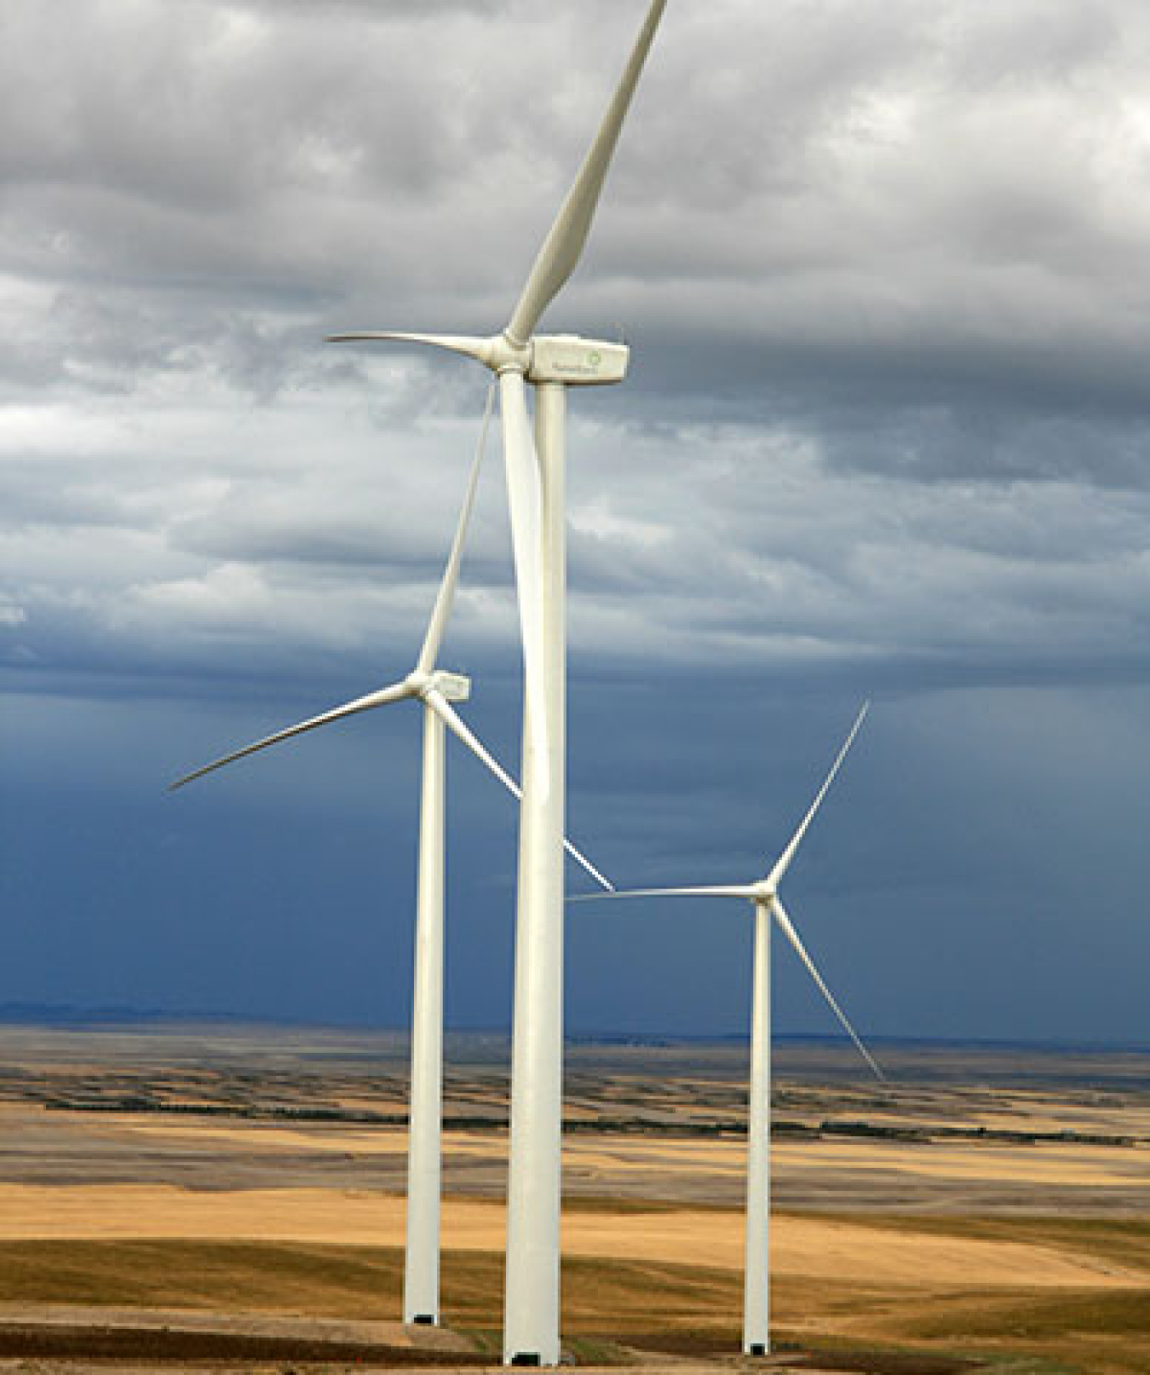
Siting and local impacts
Bird and bat activity can affect where turbines go.
Noise and visual effects matter to nearby residents.
Land between turbines can remain in use.
Image: U.S. Department of Energy
14
Notes:
Presenter B 12:35–14:05
So, where should we build a wind farm? We need to consider birds, bats, their habitats and nearby residents, as well as carbon emissions.
Surveys help identify sensitive areas before construction. Monitoring then helps operators decide whether the turbines need to run differently. For example, temporarily reducing output or stopping turbines at certain times may lower the risk to wildlife. That's one use of curtailment. Noise and the way turbines look also need to be discussed with local communities.
Now look at the spaces between the turbines in this photo. The whole project area isn't all covered by concrete. Foundations and access roads directly occupy only part of the site. Depending on local conditions, farming or other activities can continue between turbines.
So there are two useful things to check: whether the site is suitable for people and wildlife, and how much land the actual infrastructure occupies. Careful siting helps the project deliver its benefits while managing these local impacts.
中文提示：约1分30秒。沿照片指风机基础、道路和机组间的空地，说明直接占地与风场总范围不同。用简单例子讲生态监测和有针对性的限电，避免增加没有来源的鸟类死亡率或噪声数字。
R7: Denholm et al. (2009). Land-Use Requirements of Modern Wind Power Plants, NREL/TP-6A2-45834
https://www.nrel.gov/docs/fy09osti/45834.pdf
R10: U.S. Department of Energy. What Is Wind Energy?
https://www.energy.gov/cmei/systems/windexchange/what-wind-energy
Image source: https://www.energy.gov/sites/default/files/styles/full_article_width/public/2019/08/f65/photo-utility-scale-16082-035a6f4113cac1389bcd8841b09aae02510b2a443b902ae64f7ff8162ba5ea30.jpg?itok=F7ecuByb

Slide 15
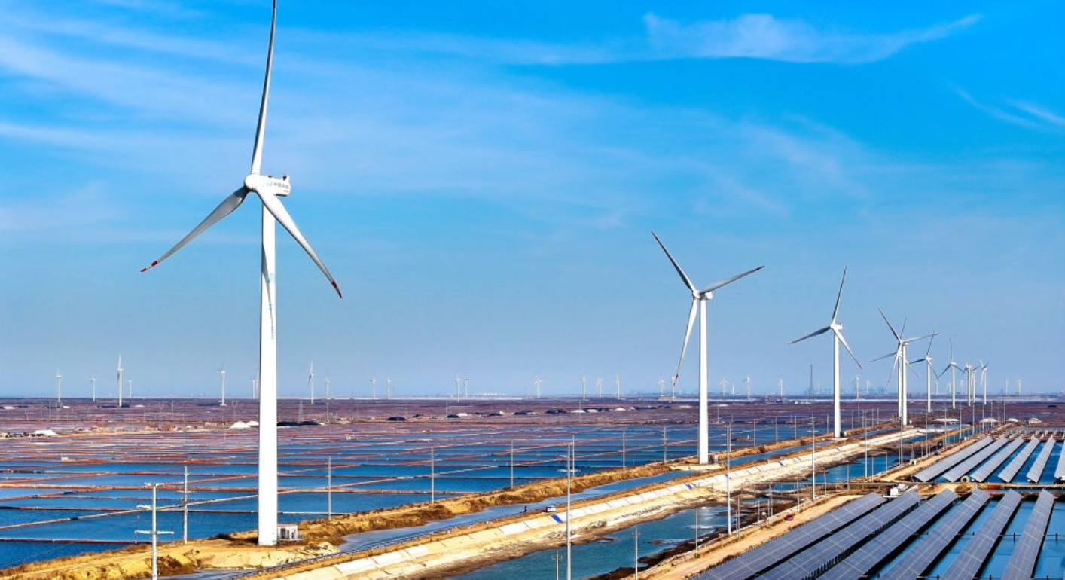
Global wind power and China
1,133 GW
China has the largest national market.
The US and Europe also have large wind fleets.
Global wind capacity
End of 2024
China: location | Main issue
North / west onshore | Wind resources can be far from demand.
Eastern demand centres | Transmission connects wind farms to consumers.
Coastal offshore | Closer to demand; marine work adds complexity.
End-2024 capacity: IRENA 2025. GW measures rated power, not annual energy.
15
Notes:
Presenter B 14:05–15:50
Let's look at where wind power is being used. IRENA's 2025 report gives about one thousand one hundred and thirty-three gigawatts of installed wind capacity worldwide at the end of 2024. That's roughly one point one three terawatts. China has the largest national installed-capacity market, and the United States and Europe also have large fleets.
The table shows why location matters in China. Strong onshore resources are often in the north and west, while major demand centres are elsewhere, including the east. Good wind therefore needs transmission lines to reach consumers. If the grid can't take all the available output, the wind farm may have to reduce production.
Coastal offshore projects offer another option near coastal demand, although marine construction and maintenance bring extra challenges. So deployment depends on both the wind resource and the ability to deliver its electricity.
One final point about the big number: gigawatts measure rated capacity. To describe electricity generated over a year, we'd need an energy unit, such as terawatt-hours.
中文提示：约1分45秒。先读全球1,133 GW及2024年底口径，再按表格三行解释中国的资源、需求与沿海海上开发。原中国区域对照表保留在隐藏第24页。保留“装机容量不等于年发电量”，不再为全球、中国分别切换一页。
R4: IRENA (2025). Renewable Capacity Statistics 2025
https://www.irena.org/Publications/2025/Mar/Renewable-capacity-statistics-2025
R3: Burton et al. (2011). Wind Energy Handbook, 2nd edition
https://doi.org/10.1002/9781119992714
R9: IEA (2025). World Energy Investment 2025, China
https://www.iea.org/reports/world-energy-investment-2025/china

Slide 16
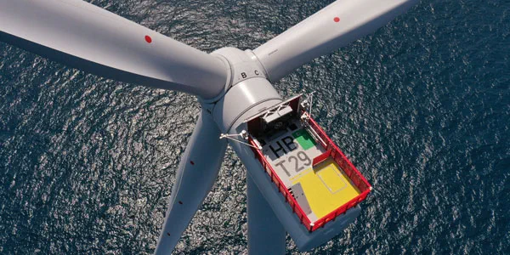
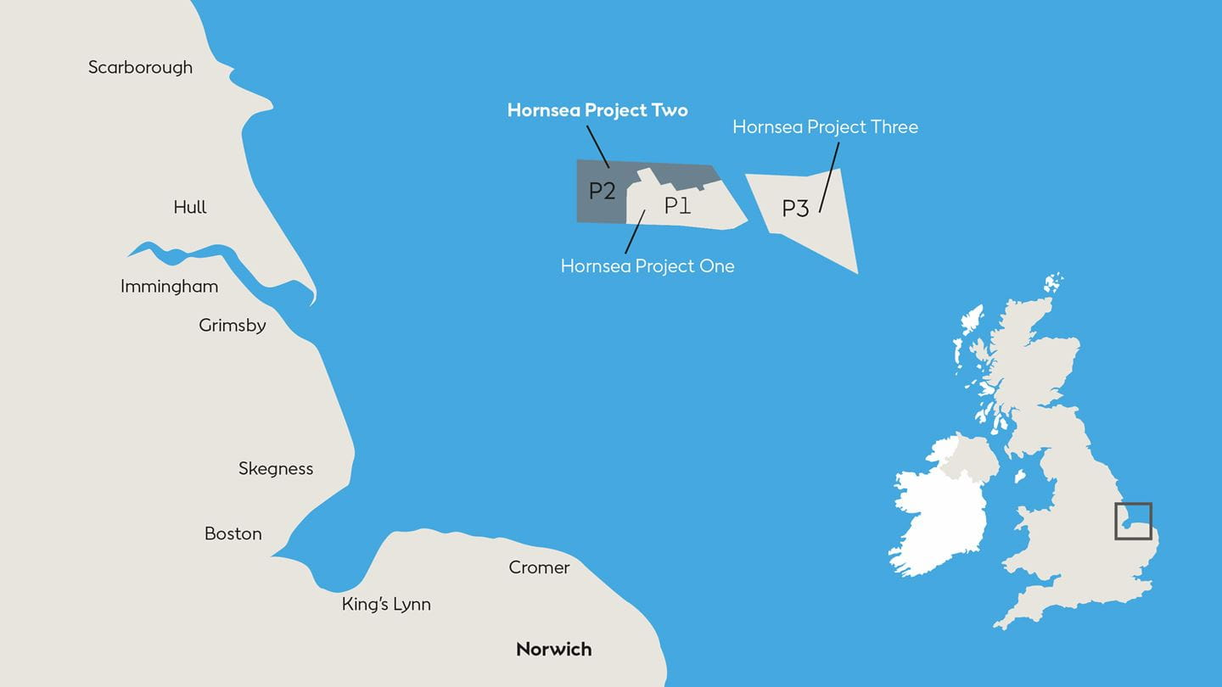
Hornsea 2 offshore wind farm
Photo and location map: Ørsted
165 turbines × 8 MW
1,320 MW rated capacity
Fully operational in August 2022
16
Notes:
Presenter B 15:50–17:50
Now let's bring these ideas together with a real project: Hornsea Two. It's in the North Sea, off the UK coast, and it became fully operational in August 2022.
Start with the photo. It shows the turbine in its marine setting. Then look at the official map on the right. The shaded P2 area is Hornsea Two; P1 and P3 are neighbouring projects. This helps us place the wind farm in relation to the coast.
The project has one hundred and sixty-five turbines, each rated at eight megawatts. Multiply those numbers and we get one thousand three hundred and twenty megawatts, or about one point three gigawatts.
But a wind farm needs more than turbines. Their electricity has to pass through a collection network and substations, then travel through export cables to the onshore grid. Maintenance also needs vessels and suitable weather conditions. So the offshore setting affects how the plant is built, connected and maintained.
This example links the two halves of our presentation. Each turbine converts wind into electricity, and the shared electrical system delivers that output to the grid. Just remember that one point three gigawatts is the rated capacity. Actual output changes with the wind, and annual generation also depends on availability and losses.
中文提示：约2分钟。先指照片，再在官方位置图中找到P2；不要把P1/P3混为本项目。讲165×8 MW后，用手势说明机组、集电网、变电站、海缆、陆上电网的路径。图片、官方地图和原出处均保留；不给出未经核对的距离或年发电量。
R6: Ørsted. Hornsea 2 Offshore Wind Farm
https://orsted.co.uk/energy-solutions/offshore-wind/our-wind-farms/hornsea2
Image source: https://cdn.orsted.com/-/media/2022-activity-maps/hornsea2sgre84mwturbine.jpg?extension=webp&hash=4705F719FDF91946E70B400FC62C43AF&mh=1440&mw=1440&rev=23e97ca3f9c94109ae7b9b7db4b2cb72
Location map: https://cdn.orsted.com/-/media/www/images/corp/uk/hornsea-project-two/how2_map.jpg?hash=27FCE6711EB4F75CA5A0FBABB36ADF83&mh=1440&mw=1440&rev=4133b672a21c4c60a38199c6039f52d2

Slide 17
Wind in the generation mix
Technology | Supply characteristic | Main constraint
Wind | Low-carbon energy, no fuel purchase | Output follows the wind resource
Gas | Output adjustable within limits | Fuel supply, cost and emissions
Solar PV | Modular, low-carbon energy | Daylight and weather
Reservoir hydro | Flexible when water is available | Sites, water and ecology
During low wind, the system can use gas, hydro, storage or imports.
17
Notes:
Presenter B 17:50–19:30
How does wind fit alongside other power plants? Let's work through this table. Wind gives us low-carbon electricity without buying fuel, but its available output changes with the wind.
Gas plants can adjust their output within operating limits. That can be useful when wind output falls, although gas needs fuel and produces emissions. Solar PV provides low-carbon electricity too, but it depends on daylight and weather. Reservoir hydro can adjust output when water and operating conditions allow, but suitable sites, water availability and environmental impacts limit its use.
Each technology therefore makes a different contribution. During a low-wind period, operators may use available gas generation, reservoir hydro, stored energy or imports. They can also shift some electricity demand where possible. The exact combination depends on the power system and what is available at that time.
The grid has to meet demand every hour, not just produce enough energy over a year. Wind can supply valuable energy, while the rest of the system helps manage its changing output. That's why planning the mix matters.
中文提示：约1分40秒。按表格逐行比较，每行只说一个优势和主要限制。用“低风速时系统如何补足供电”的简单例子串联；保持储能、进口等为可选手段，不说每个风场都必须配置电池。水电特指水库式。
R1: U.S. Department of Energy. How Do Wind Turbines Work?
https://www.energy.gov/cmei/systems/how-do-wind-turbines-work
R3: Burton et al. (2011). Wind Energy Handbook, 2nd edition
https://doi.org/10.1002/9781119992714
R5: IPCC (2014). Annex III, Table A.III.2
https://www.ipcc.ch/site/assets/uploads/2018/02/ipcc_wg3_ar5_annex-iii.pdf

Slide 18
Summary
Wind is a renewable source of low-carbon electricity.
Actual generation depends on the wind and turbine performance.
Careful siting and grid integration support reliable delivery.
18
Notes:
Presenter B 19:30–19:50
To sum up, wind provides low-carbon electricity from a renewable resource. Actual generation depends on the wind and turbine performance. Good siting and grid integration help us use that electricity reliably.
中文提示：约20秒。依次总结低碳可再生能源、实际发电表现、选址与电网整合三个要点。本页只做总结；说完换到第19页致谢。
R3: Burton et al. (2011). Wind Energy Handbook, 2nd edition
https://doi.org/10.1002/9781119992714

Slide 19
THANK YOU
Questions?
19
Notes:
Presenter B 19:50–20:00
Thank you for listening. We're happy to take your questions.
中文提示：约10秒。看向听众，感谢聆听并邀请提问；致谢后保留本页。第20–22页参考文献和第23–24页备份均隐藏，需要时手动打开。

Slide 20
References for turbine technology
R1
U.S. Department of Energy. How Do Wind Turbines Work?
https://www.energy.gov/cmei/systems/how-do-wind-turbines-work
R2
U.S. Department of Energy. Explore a Wind Turbine
https://www.energy.gov/cmei/systems/explore-wind-turbine-text-version
R3
Burton et al. (2011). Wind Energy Handbook, 2nd edition
https://doi.org/10.1002/9781119992714
R10
U.S. Department of Energy. What Is Wind Energy?
https://www.energy.gov/cmei/systems/windexchange/what-wind-energy
20
Notes:
Reference or discussion slide
R1: U.S. Department of Energy. How Do Wind Turbines Work?
https://www.energy.gov/cmei/systems/how-do-wind-turbines-work
R2: U.S. Department of Energy. Explore a Wind Turbine
https://www.energy.gov/cmei/systems/explore-wind-turbine-text-version
R3: Burton et al. (2011). Wind Energy Handbook, 2nd edition
https://doi.org/10.1002/9781119992714
R10: U.S. Department of Energy. What Is Wind Energy?
https://www.energy.gov/cmei/systems/windexchange/what-wind-energy

Slide 21
References for deployment and impacts
R4
IRENA (2025). Renewable Capacity Statistics 2025
https://www.irena.org/Publications/2025/Mar/Renewable-capacity-statistics-2025
R5
IPCC (2014). Annex III, Table A.III.2
https://www.ipcc.ch/site/assets/uploads/2018/02/ipcc_wg3_ar5_annex-iii.pdf
R6
Ørsted. Hornsea 2 Offshore Wind Farm
https://orsted.co.uk/energy-solutions/offshore-wind/our-wind-farms/hornsea2
R7
Denholm et al. (2009). Land-Use Requirements of Modern Wind Power Plants, NREL/TP-6A2-45834
https://www.nrel.gov/docs/fy09osti/45834.pdf
R9
IEA (2025). World Energy Investment 2025, China
https://www.iea.org/reports/world-energy-investment-2025/china
21
Notes:
Reference or discussion slide
R4: IRENA (2025). Renewable Capacity Statistics 2025
https://www.irena.org/Publications/2025/Mar/Renewable-capacity-statistics-2025
R5: IPCC (2014). Annex III, Table A.III.2
https://www.ipcc.ch/site/assets/uploads/2018/02/ipcc_wg3_ar5_annex-iii.pdf
R6: Ørsted. Hornsea 2 Offshore Wind Farm
https://orsted.co.uk/energy-solutions/offshore-wind/our-wind-farms/hornsea2
R7: Denholm et al. (2009). Land-Use Requirements of Modern Wind Power Plants, NREL/TP-6A2-45834
https://www.nrel.gov/docs/fy09osti/45834.pdf
R9: IEA (2025). World Energy Investment 2025, China
https://www.iea.org/reports/world-energy-investment-2025/china

Slide 22
References for grid support
R8
NREL (2014). Active Power Controls from Wind Power, NREL/TP-5D00-60574
https://www1.eere.energy.gov/wind/pdfs/60574.pdf
C1
Mehrjerdi. Course slides, Introduction, PDF pp. 17–19 and 27
C2
Mehrjerdi. Course slides, Voltage Control, PDF pp. 17–21 and 33
C3
Mehrjerdi. Course slides, Frequency Control, PDF pp. 12–13 and 24–29
22
Notes:
Reference or discussion slide
R8: NREL (2014). Active Power Controls from Wind Power, NREL/TP-5D00-60574
https://www1.eere.energy.gov/wind/pdfs/60574.pdf
C1: Mehrjerdi. Course slides, Introduction, PDF pp. 17–19 and 27
C2: Mehrjerdi. Course slides, Voltage Control, PDF pp. 17–21 and 33
C3: Mehrjerdi. Course slides, Frequency Control, PDF pp. 12–13 and 24–29

Slide 23
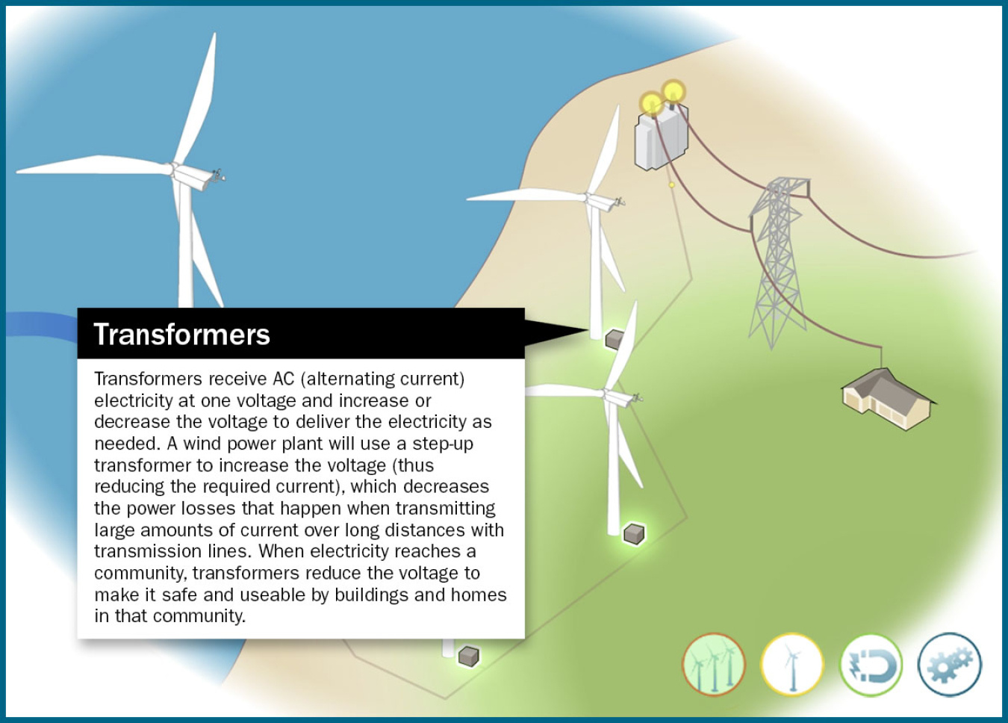
Voltage support from reactive power
The converter controls reactive current.
Plant control coordinates support at the grid connection.
Image: U.S. Department of Energy
23
Notes:
Hidden backup — outside the 20-minute presentation
Voltage support involves reactive power. In our full-converter example, power electronics control the current supplied to the grid, including its reactive component. Plant-level control coordinates the turbines so that the shared grid connection follows a voltage or reactive-power target. The converter has current and thermal limits, so the available reactive support is bounded. Active and reactive power requirements also have to fit within the equipment's capability. This connects with the voltage-control topic in our course, but the equipment differs. A conventional synchronous generator's automatic voltage regulator acts on excitation. A full-converter turbine uses converter control. The illustration shows the plant's electrical connection, not a detailed control circuit. The useful distinction is that active-power support and reactive-power support have different jobs and different limits.
中文提示：重点讲变流器无功电流与风场协调。配图用于指出并网位置，不当作控制回路图。同步机 AVR 的详细比较留在备份页。
R3: Burton et al. (2011). Wind Energy Handbook, 2nd edition
https://doi.org/10.1002/9781119992714
C2: Mehrjerdi. Course slides, Voltage Control, PDF pp. 17–21 and 33
Image source: https://www.energy.gov/sites/default/files/styles/full_article_width/public/2021-07/wind-power-plant-transformer.jpg?itok=dQGGgljg

Slide 24
China’s resource and demand locations
Location | Resource and delivery
Northern and western onshore sites | Strong resources can be far from major demand centres.
Eastern demand centres | Transmission must carry energy to consumers.
Coastal offshore sites | Closer to coastal demand, with marine engineering needs.
Limited transmission can force a wind farm to reduce output.
24
Notes:
Hidden backup — outside the 20-minute presentation
China gives us a useful example of why the grid location matters. Many strong onshore resources are in northern and western areas, while major demand centres are elsewhere, including the east. A wind farm can therefore have a good wind resource but still need long-distance transmission to reach consumers. If the network cannot accept all the available output, some generation may be curtailed. Forecasting helps operators prepare for changes, while transmission and system flexibility help them use the energy. Coastal offshore development offers a different location option, though marine engineering brings its own challenges. For this regional example, the main lesson is the distance between a useful resource and the demand it needs to serve.
中文提示：用左右两栏说明资源所在地与负荷中心的关系。英国海缆照片不拿来冒充中国工程；本页用可编辑对照表。
R3: Burton et al. (2011). Wind Energy Handbook, 2nd edition
https://doi.org/10.1002/9781119992714
R9: IEA (2025). World Energy Investment 2025, China
https://www.iea.org/reports/world-energy-investment-2025/china

